Slide 1
Exploring the size of atomic nuclei at the limits of existence with laser spectroscopy
Shane Wilkins
wilkins@frib.msu.edu
Workshop on NREC 2026
Stony Brook University, 15th April 2026

Slide 2
Part I – Laser spectroscopy for nuclear science

Slide 3
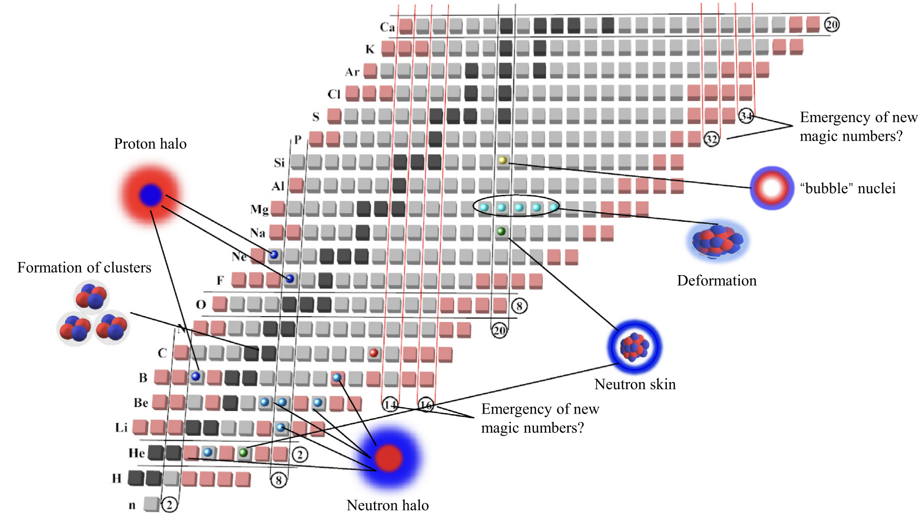
Open questions in nuclear science
Studies of the size of atomic nuclei with laser spectroscopy are enabling advances in our understanding of some of the major open questions in nuclear science.
How do quarks and gluons make up protons, neutrons, and ultimately, atomic nuclei?
How do the rich patterns observed in the structure and reactions of nuclei emerge from the interactions between neutrons and protons?
X. F. Yang, S. J. Wang, S. G Wilkins, R. F Garcia Ruiz., Prog. Part. Nucl. Phys. 129, 104005 (2023)

Slide 4
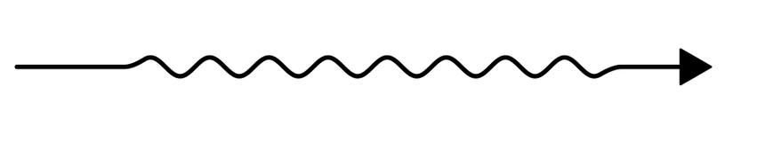
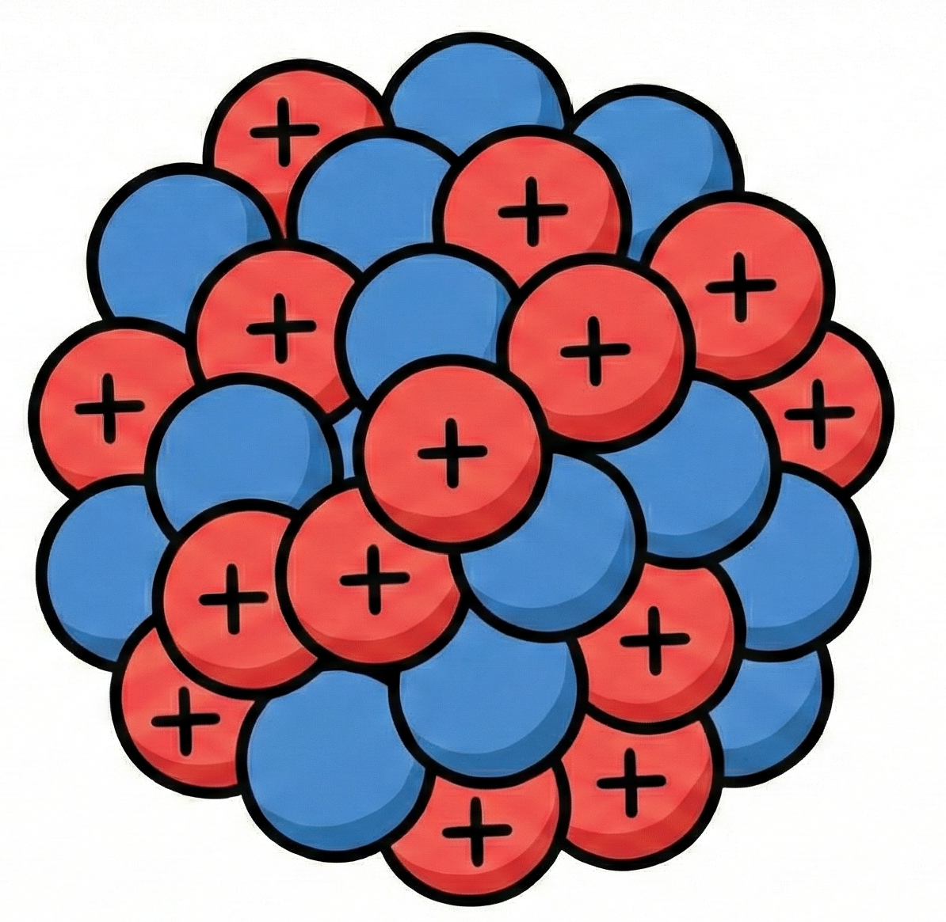

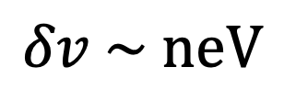
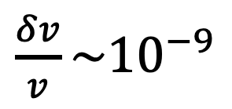
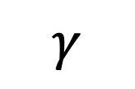

Laser spectroscopy of atomic nuclei
Laser spectroscopy investigates the atomic nucleus through its influence upon electrons which are bound to it in atoms and molecules.
$$γ$$
$$e^{−}$$
$$e^{−}$$
$\frac{δv}{v}\sim {10}^{−9}$
$$δv \sim neV$$

Slide 5
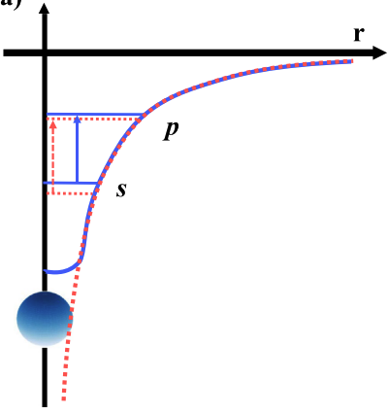
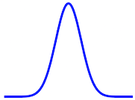

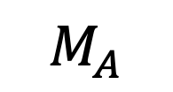
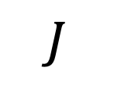
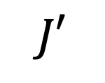
Isotope shifts and nuclear charge radii
Differences in overlap between the nucleus and its bound atomic electrons causes shifts in transition frequencies between different isotopes of the same element.
$$J′$$
$$J$$
$$M_{A}$$
$$v$$
X. F. Yang, S. J. Wang, S. G Wilkins, R. F Garcia Ruiz., Prog. Part. Nucl. Phys. 129, 104005 (2023)

Slide 6
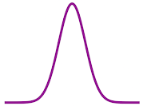
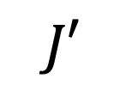
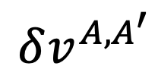
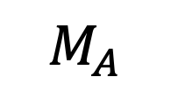

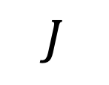

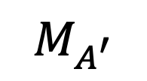
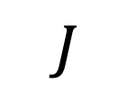

Isotope shifts and nuclear charge radii
These isotopic changes in transition frequency are related to the changes in nuclear charge radii.
$$J′$$
$$J′$$
$$δv^{A,A^{′}}$$
$$I=0$$
$$I=0$$
$$J$$
$$J$$
$$M_{A}$$
$$M_{A^{′}}$$
$$v$$

Slide 7
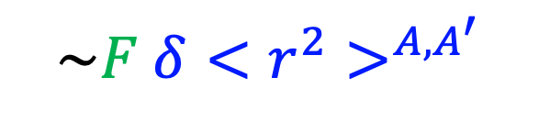
Isotope shifts and nuclear charge radii
These isotopic changes in transition frequency are related to the changes in nuclear charge radii.
$$J′$$
Atomic
Nuclear
$$J′$$
$$\sim F δ{<r^{2}>}^{A,A^{′}}$$
$$I=0$$
$$I=0$$
$$J$$
$$J$$
$$M_{A}$$
$$M_{A^{′}}$$
$$v$$

Slide 8
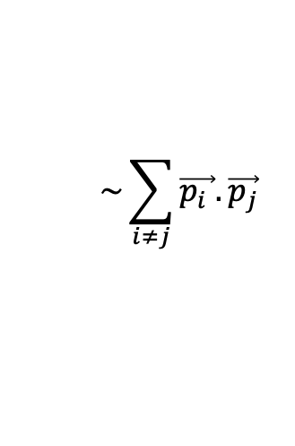

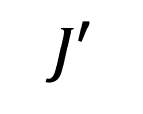


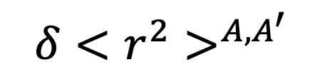
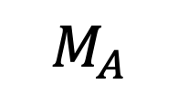
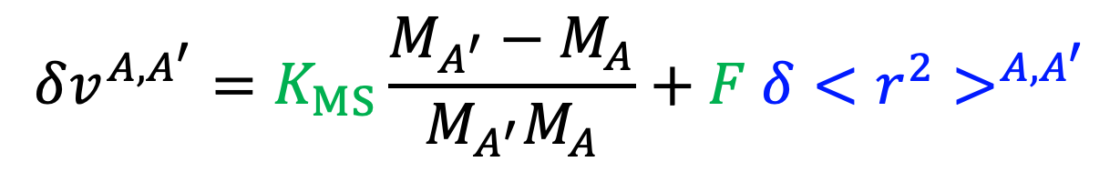
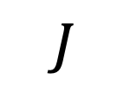

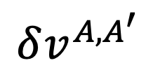
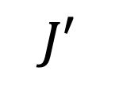
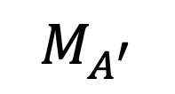
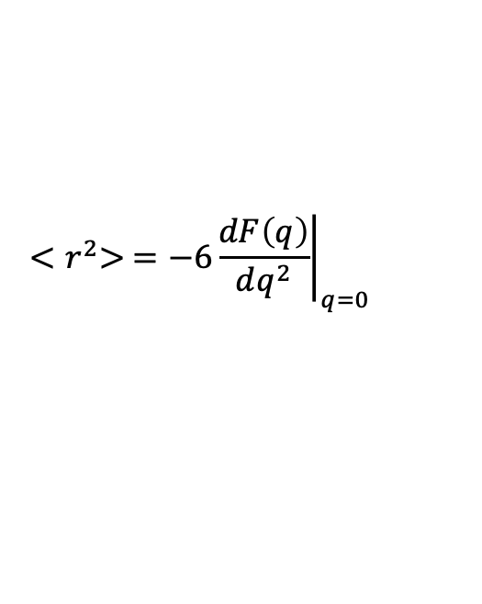
Isotope shifts and nuclear charge radii
The isotope shift has two components: the mass shift and field shift, and can be separated into terms which depend upon atomic and nuclear properties.
Atomic
Nuclear
$$J′$$
$$δv^{A,A^{′}}$$
$$δv^{A,A^{′}}=K_{MS}\frac{M_{A^{′}}−M_{A}}{M_{A^{′}}M_{A}}+F δ{<r^{2}>}^{A,A^{′}}$$
$$J′$$
Mass shift
RMS charge radius
Field shift
$$K_{NMS}+K_{SMS}$$
$$\sim \sum_{i≠j}{\vec{p_{i} }.\vec{p_{j}}}$$
$$\sim {\left|ψ\left(0\right)\right|}^{2}$$
$${<r}^{2}> =−6{\left.\frac{dF\left(q\right)}{dq^{2}}\right|}_{q=0}$$
$$J$$
$$J$$
$$δ{<r^{2}>}^{A,A^{′}}$$
$$r_{ch}$$
$$M_{A}$$
$$M_{A^{′}}$$
$$→$$

Slide 9
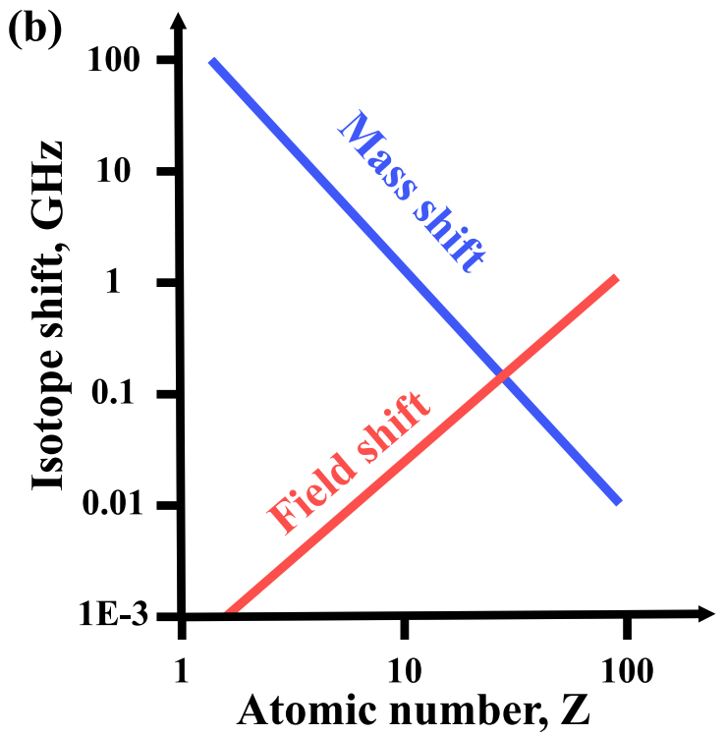
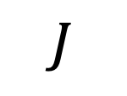
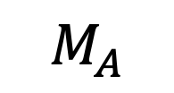
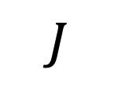
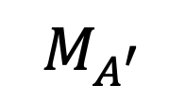
Isotope shifts and nuclear charge radii
The magnitude of the mass and field shift varies over the periodic table, imposing different challenges across the nuclear chart.
$$J′$$
$$δv^{A,A^{′}}$$
$$J′$$
See Dr. Kristian König’s talk directly after this one!
$$J$$
$$J$$
$$M_{A}$$
$$M_{A^{′}}$$
X. F. Yang, S. J. Wang, S. G Wilkins, R. F Garcia Ruiz., Prog. Part. Nucl. Phys. 129, 104005 (2023)

Slide 10




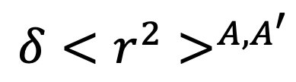

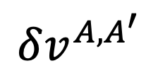

Isotope shifts and nuclear charge radii
The atomic mass- and field-shift factors can be determined experimentally or calculated with atomic theory.
$$δv^{A,A^{′}}=K_{MS}\frac{M_{A^{′}}−M_{A}}{M_{A^{′}}M_{A}}+F δ{<r^{2}>}^{A,A^{′}}$$
$$A,A^{′′′}$$
$$δv^{A,A^{′}}$$
$$A,A^{′′}$$
$$F$$
$$K_{MS}$$
$$A,A^{′}$$
$$δ{<r^{2}>}^{A,A^{′}}$$

Slide 11
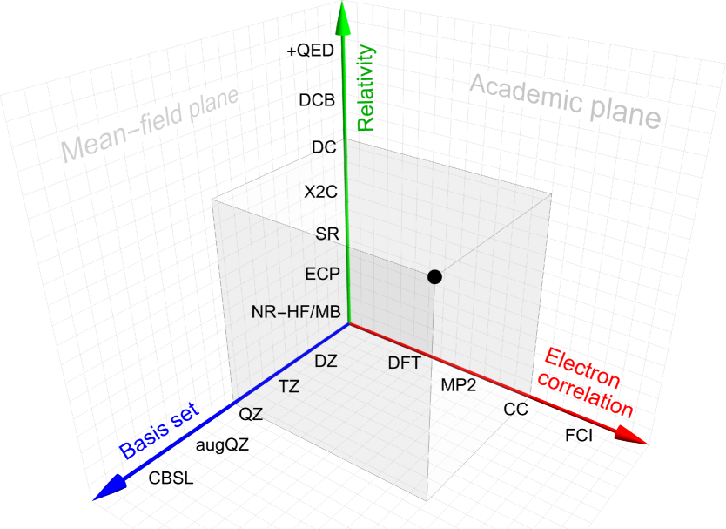
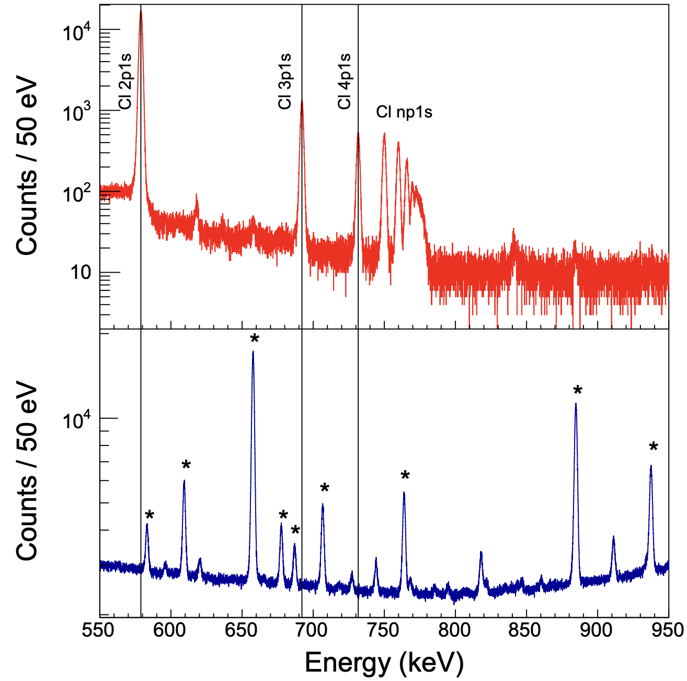
Experiment-theory collaboration
The field of laser spectroscopy of short-lived nuclei greatly benefits from close collaboration with theorists and other experimentalists.
L. Pašteka et al. Prog. Part. Nucl. Phys. 146, 104200 (2025), K. A. Beyer et al., arXiv 2506.08804 (2025)

Slide 12
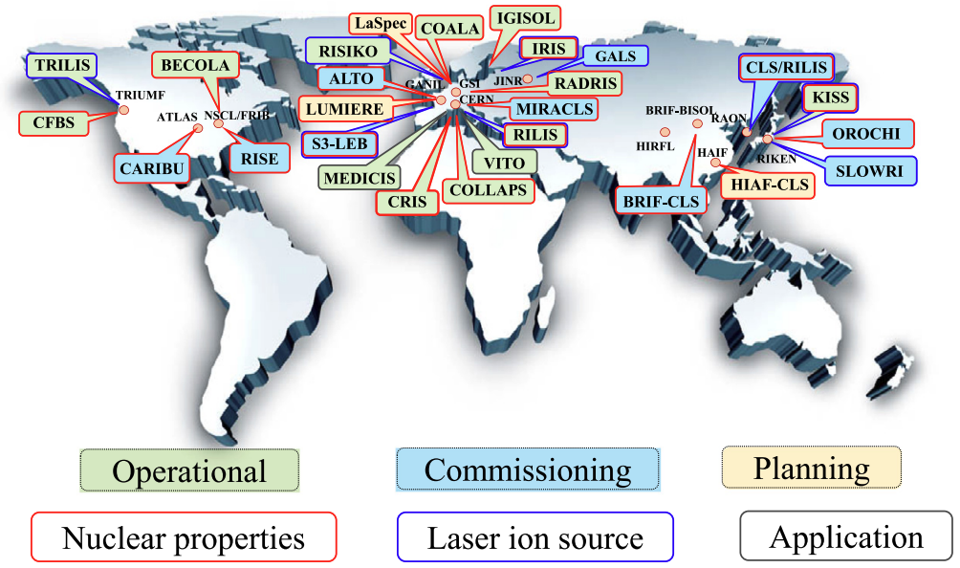
Laser spectroscopy of short-lived nuclei
Studying the size and structure of short-lived nuclei with laser spectroscopy is a global effort.
X. F. Yang, S. J. Wang, S. G Wilkins, R. F Garcia Ruiz., Prog. Part. Nucl. Phys. 129, 104005 (2023)

Slide 13
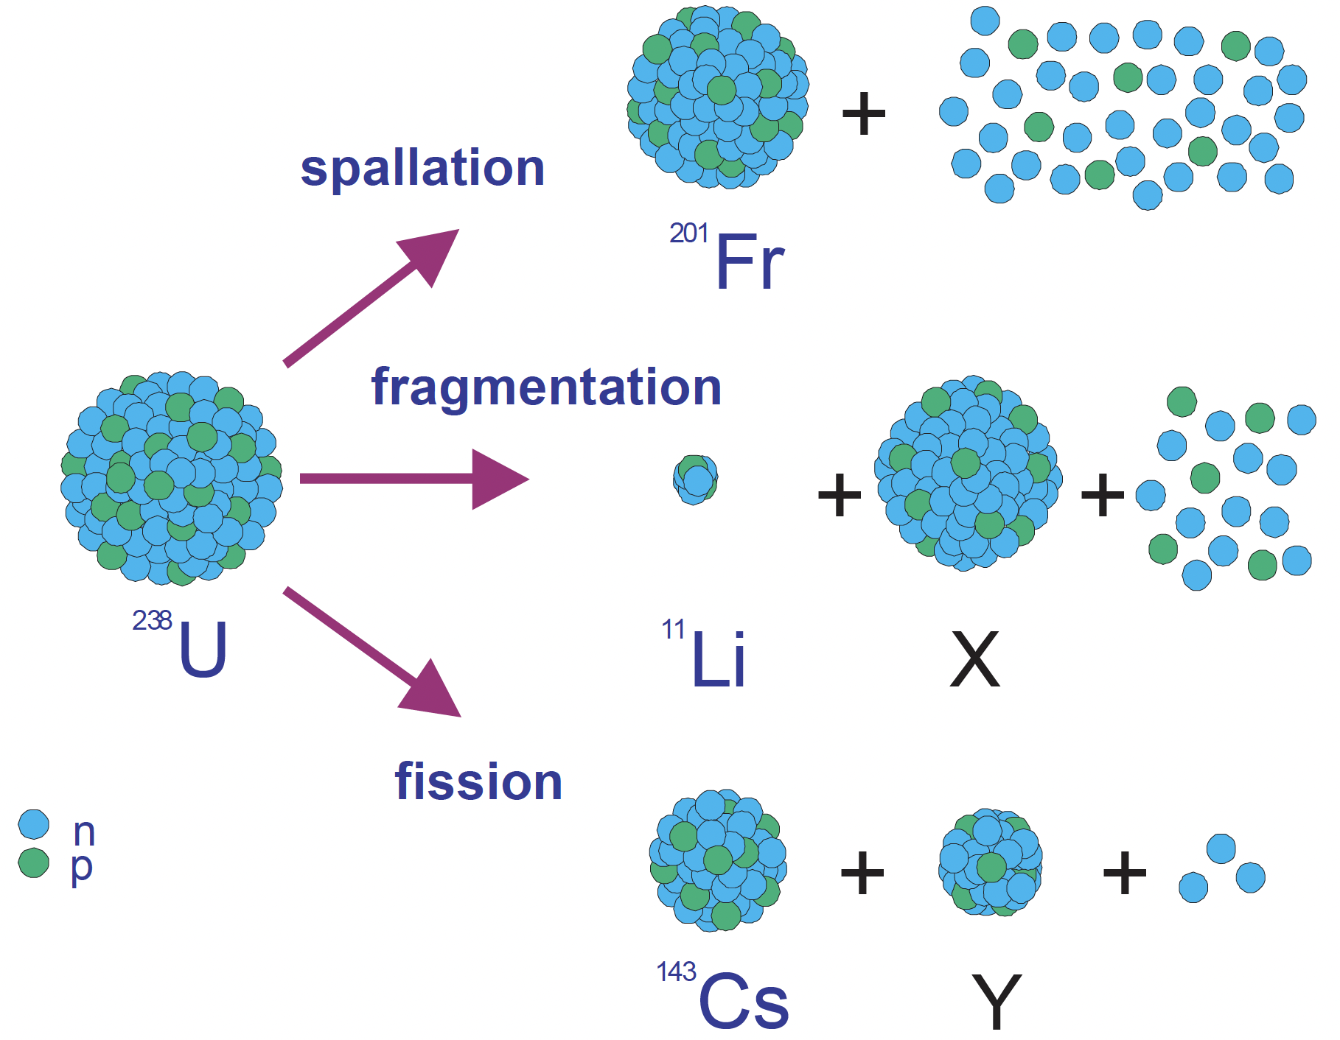
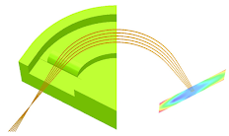
Laser spectroscopy of short-lived nuclei
Short-lived nuclei are produced through a variety of approaches utilizing energetic nuclear reactions at specialized accelerator facilities.
Separation
Study
Production
Requirements
High selectivity (>10⁶)
Fast (< 1s half lives)
High efficiency (< 100 s⁻¹ production rate)
High precision (~100 MHz)
M. Lindroos, CERN-AB-2004-086 (2004)

Slide 14
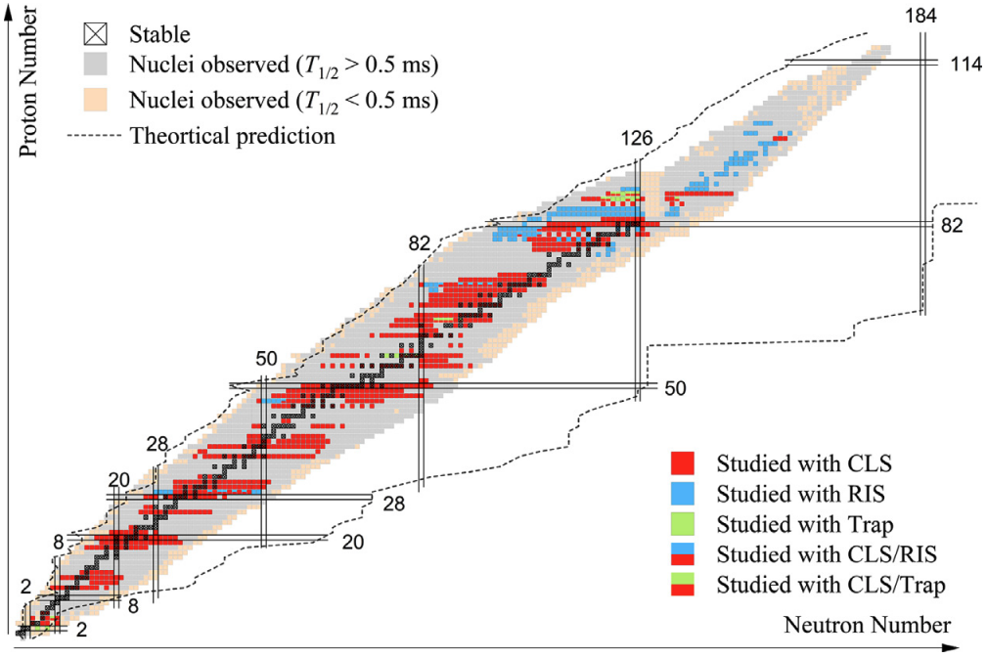
Laser spectroscopy of short-lived nuclei
Laser spectroscopy techniques have investigated around one third of the roughly 3,000 atomic nuclei that have been discovered so far.
X. F. Yang, S. J. Wang, S. G Wilkins, R. F Garcia Ruiz., Prog. Part. Nucl. Phys. 129, 104005 (2023)

Slide 15
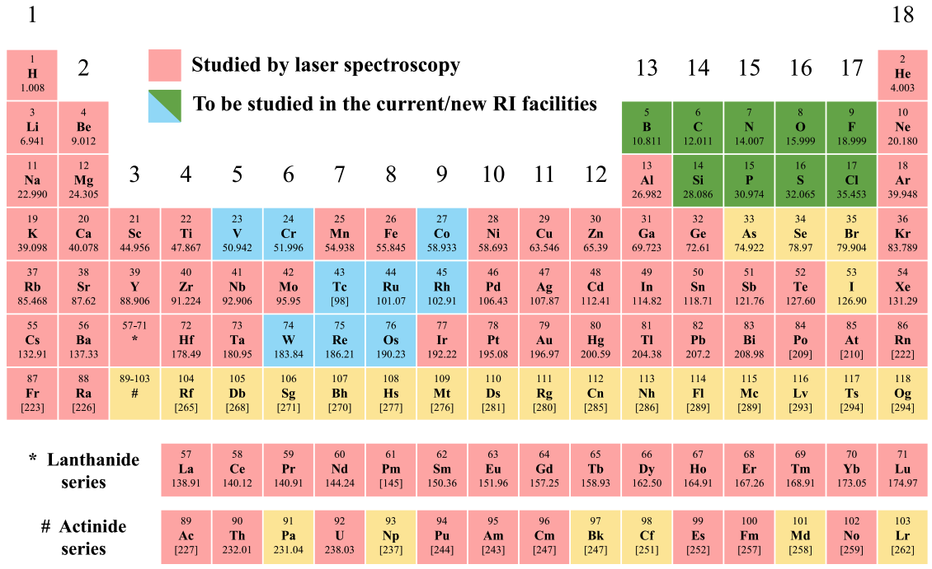
Laser spectroscopy of short-lived nuclei
Certain regions of the nuclear chart have been challenging to study that are becoming accessible with new facilities and technical developments.
X. F. Yang, S. J. Wang, S. G Wilkins, R. F Garcia Ruiz., Prog. Part. Nucl. Phys. 129, 104005 (2023)

Slide 16
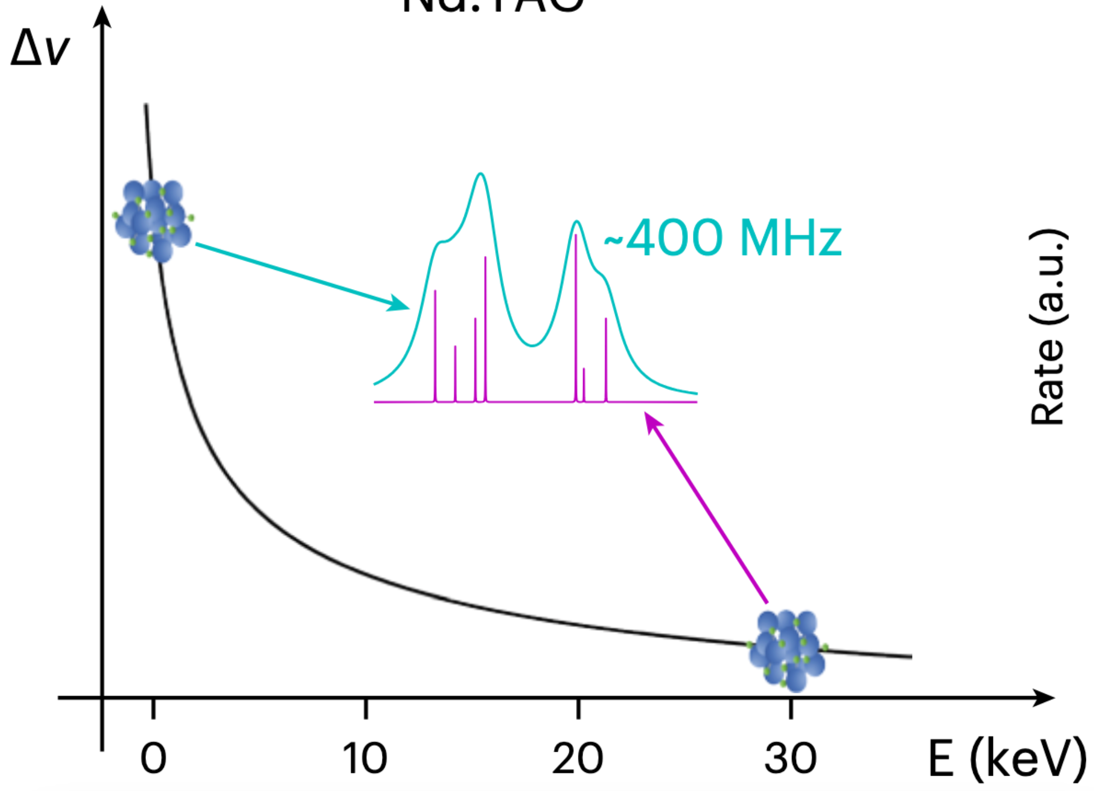
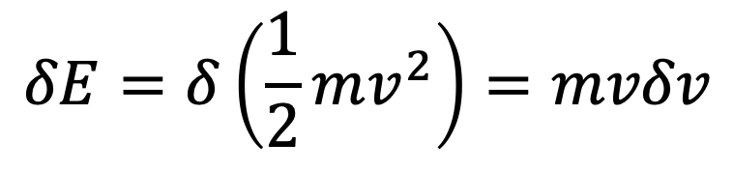
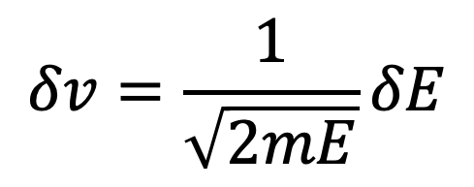
High-precision collinear laser spectroscopy
Collinear geometry boosts resolution by performing laser spectroscopy on an accelerated beam.
$$δE=δ\left(\frac{1}{2}mv^{2}\right)=mvδv$$
$$δv=\frac{1}{\sqrt{2mE}}δE$$
S. M. Udrescu, S. G Wilkins et al., Nature Phys. 20, 202-207 (2024)

Slide 17
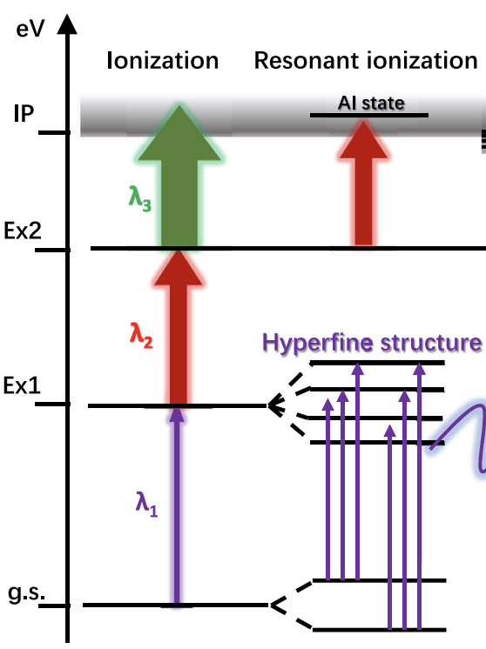
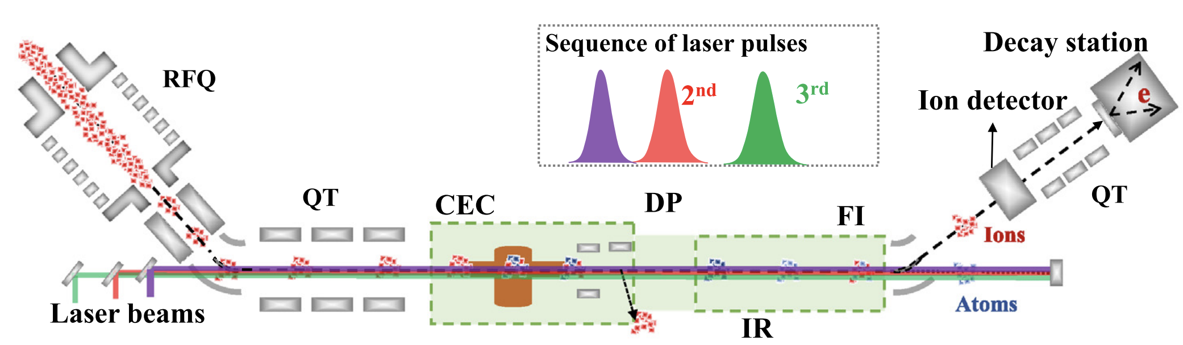
Collinear resonance ionization spectroscopy
By performing laser spectroscopy on a bunched beam in a collinear geometry, high-resolution measurements of the structure of atoms containing radioactive nuclei can be obtained.
v
v
X. F. Yang, S. J. Wang, S. G Wilkins, R. F Garcia Ruiz., Prog. Part. Nucl. Phys. 129, 104005 (2023)

Slide 18
Collinear resonance ionization spectroscopy
By performing laser spectroscopy on a bunched beam in a collinear geometry, high-resolution measurements of the structure of atoms containing radioactive nuclei can be obtained.
X. F. Yang, S. J. Wang, S. G Wilkins, R. F Garcia Ruiz., Prog. Part. Nucl. Phys. 129, 104005 (2023)

Slide 19
Part II – Progress of laser spectroscopy at FRIB

Slide 20
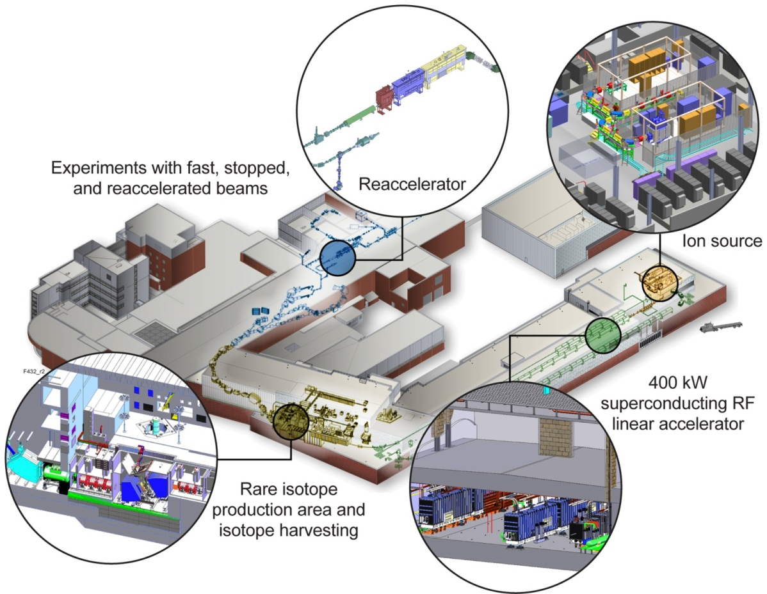
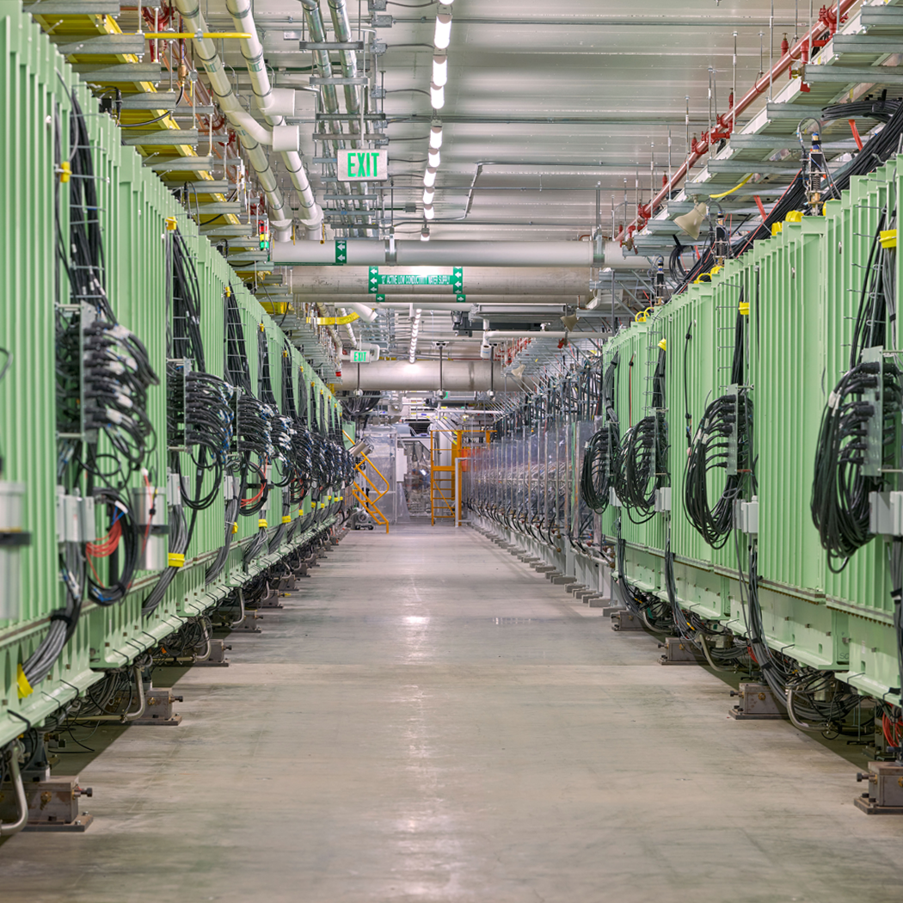
Facility for Rare Isotope Beams
FRIB is a DOE-SC User Facility providing rare isotope beams for scientific users across a range of fields

Slide 21

Facility for Rare Isotope Beams
FRIB is a DOE-SC User Facility providing rare isotope beams for scientific users across a range of fields.

Slide 22


The Resonance Ionization Spectroscopy Experiment (RISE)
RISE is a new experimental setup at FRIB, extending the existing BECOLA facility to enable higher-sensitivity resonance ionization studies.
A. J. Brinson, B. J. Rickey et al., Phys. Rev. Res. 8, 013276 (2026)

Slide 23




Nuclear structure at the proton dripline
As neutrons are removed from isotopes of a given element, the strength of the electromagnetic force increases relative to the strong force, giving rise to distinct phenomena.
+
+
+
+
+
+
+
+
+
+
+
+
+
+
+
+
M. Pfützner et al., Nuclei Near and at the Proton Dripline (2023).

Slide 24


Structural evolution of neutron-deficient aluminum
Reaction studies and ab initio theory of neutron-deficient aluminum isotopes show an increased reaction cross section towards the dripline, possibly suggesting an increase in the nuclear size.
Cai et al., Phys. Rev. C 65, 024610 (2002)

Slide 25
Aluminum charge radii at the limits of existence
Measurements of the size of aluminum isotopes performed all the way to the proton dripline!
Figure removed from online copy of slides
A. Brinson, B. Rickey et al., In preparation (2026)

Slide 26

Exploring the nuclear landscape at FRIB with BECOLA-RISE
Resonance Ionization Spectroscopy Experiment (RISE) at BECOLA is investigating the emergence of nuclear phenomena across the nuclear chart at FRIB.
Figure removed from online copy of slides
^{52,53}Ni
²²⁻²⁵Al
^{31,33-36,38}Si
¹⁹⁻²²O
- New BECOLA-RISE measurements
Evolution of the size of neutron-rich silicon isotopes measured to N=24 including ’bubble’ nucleus ³⁴Si.
- Approved beam time

Slide 27


Exploring the nuclear landscape at FRIB with BECOLA-RISE
Resonance Ionization Spectroscopy Experiment (RISE) at BECOLA is investigating the emergence of nuclear phenomena across the nuclear chart at FRIB.
- New BECOLA-RISE measurements
Preliminary
- Approved beam time
²²³⁻²³²Th
Preparations underway to answer ‘Which thorium isotopes are octupole deformed?’.
^{200,201,203m}Fr

Slide 28
Part III – Highlights from other facilities

Slide 29

Laser spectroscopy of the heaviest elements
Investigation of the heaviest elements (Z ~ 100) is especially challenges due to vanishing production rates being compounded by lack of available atomic data.
M. Block, M. Laatiaoui, S. Raeder., Prog. Part. Nucl. Phys. 116, 103834 (2021)

Slide 30

Laser spectroscopy of the heaviest elements
Using a combination of fusion-evaporation reactions an reactor breeding, an extended isotope shift measurement campaign was performed at GSI and Mainz.
J. Warbinek et al., Nature 634, 1075-1079 (2024)

Slide 31

Laser spectroscopy of the heaviest elements
The charge radii of lighter elements exhibit strong shell effects at certain nucleon numbers.
X. F. Yang, S. J. Wang, S. G Wilkins, R. F Garcia Ruiz., Prog. Part. Nucl. Phys. 129, 104005 (2023)

Slide 32

Laser spectroscopy of the heaviest elements
The charge radii of nobelium and fermium isotopes increase smoothly, indicating a transition to a regime of reduced shell effects with bulk behaviour increasing in nuclear mass.
J. Warbinek et al., Nature 634, 1075-1079 (2024)

Slide 33

Laser spectroscopy of the heaviest elements
The charge radii of nobelium and fermium isotopes increase smoothly, indicating a transition to a regime of reduced shell effects with bulk behaviour increasing in nuclear mass.
J. Warbinek et al., Nature 634, 1075-1079 (2024)

Slide 34
Conclusion
Laser spectroscopy measurements of short-lived nuclei enable precision insights into the how the size of atomic nuclei evolves towards extreme proton-to-neutron ratios.
The Resonance Ionization Spectroscopy Experiment at FRIB performed its first experiment investigating the evolution of the size of aluminum nuclei all the way to limits of existence.
Other facilities continue to produce striking results which challenge our understanding of nuclear structure.

Slide 35








Acknowledgements
A. J. Brinson, R. F. Garcia Ruiz, J. Karthein, S. Moroch, J. M. Munoz Arias, F. C. Pastrana Cruz, S. M. Udrescu, A.R. Vernon.
S. Campbell, A. Dockery, H. Erington, C. Ireland, F. Maier, K. Minamisono, M. Moenter, A. Ortiz-Cortes, S. Pineda, H. Sims, R. Ringle.
J. Allmond, M. Febbraro, T. Gray, T. King, C. Rasco.
K. König. P. Mϋller, W. Nörtershäuser, J. Palmes, L. Renth, D. Rossi.
J. Lantis, B. Maaß, P. Mϋller
C. Jones, S. Papa, R. Yadav

