Slide 1
radbase: Tools for a Modern Evaluation of Nuclear Charge Radii
Hunter Staiger, István Angeli, Endre Takacs
Notes:
HS 3rd year

Slide 2
Overview
IAEA Working Group White Paper Summary
Objectives for Next Compilation and Evaluation
radbase: Correlations
radbase: Network Approach to Data Storage
Timeline
Highly Charged Ions Talk
Friday 2:30 P.M.

Slide 3
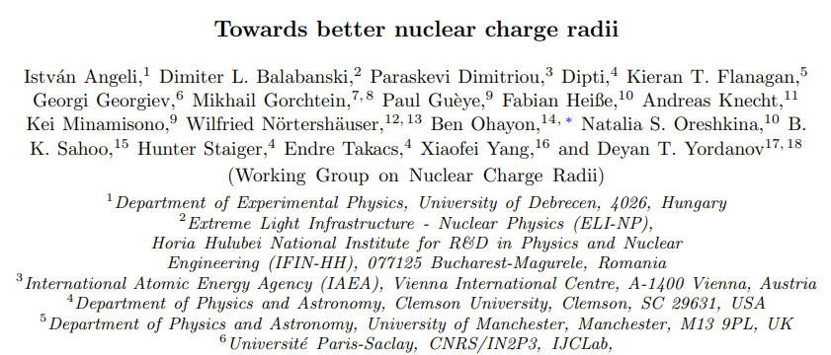
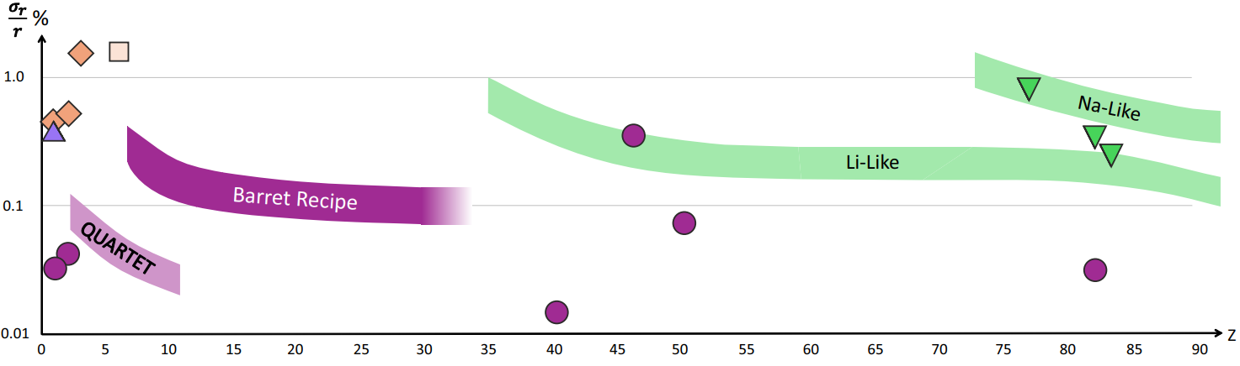
White Paper: Towards Better Nuclear Charge Radii
arXiv:2604.08985
arXiv:2604.08985
Posted on arXiv: 2604.08985:
Current status of different techniques.
Recommended data to include in publications.
Broad framework for next evaluation.
Follow-up of 2025 IAEA Technical Meeting
Corresponding author:
bohayon@technion.ac.il

Slide 4
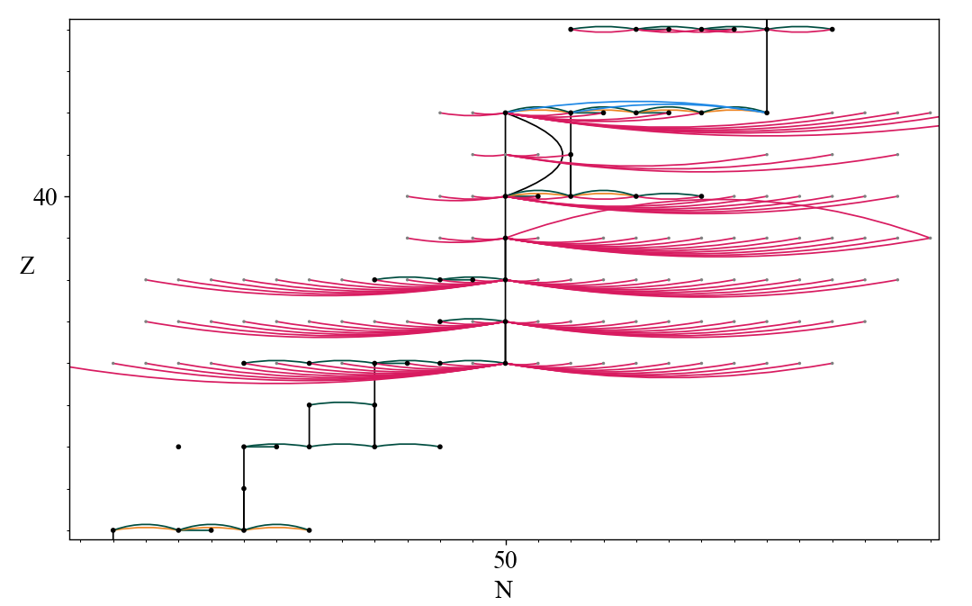
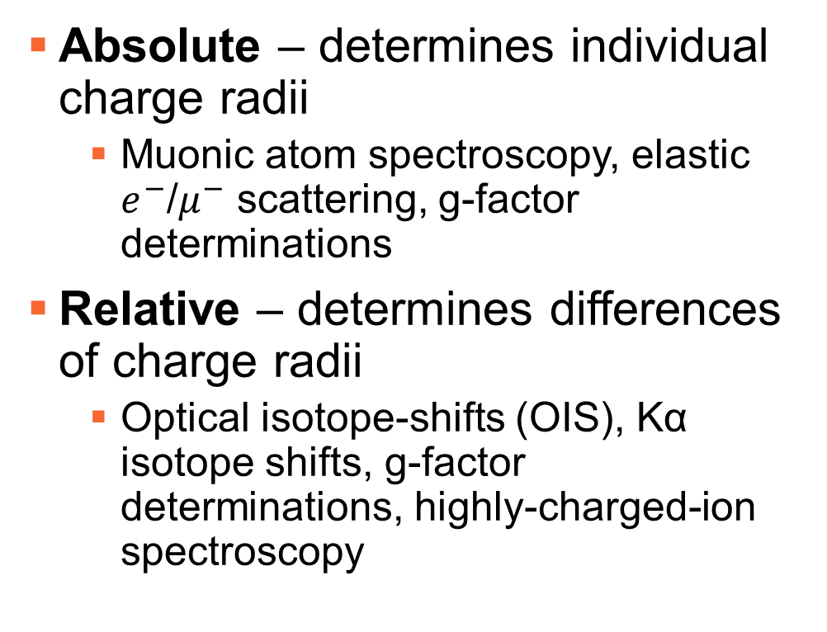
How Do We Measure Nuclear Charge Radii?
Absolute – determines individual charge radii
Muonic atom spectroscopy, elastic $e^{−}$/$μ^{−}$ scattering, g-factor determinations
Relative – determines differences of charge radii
Optical isotope-shifts (OIS), Kα isotope shifts, g-factor determinations, highly-charged-ion spectroscopy
Data used in Angeli and Marinova ADNDT 99 69 (2013)

Slide 5
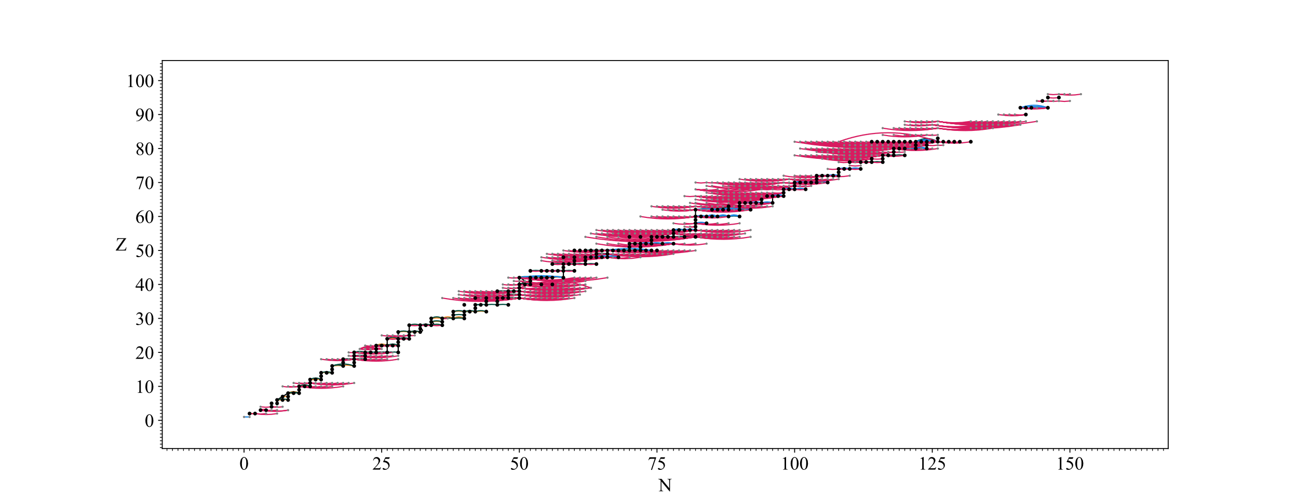
Nuclear Radius Data
Data used in Angeli and Marinova ADNDT 99 69 (2013)

Slide 6
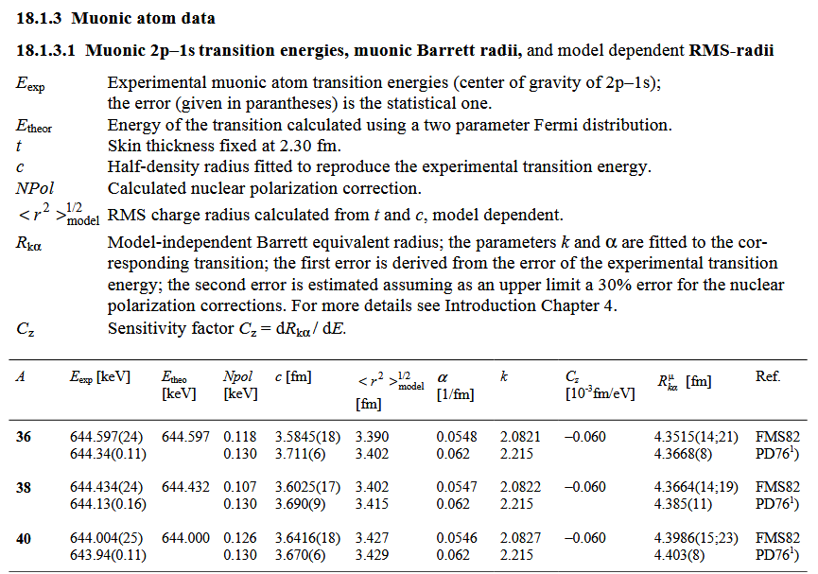
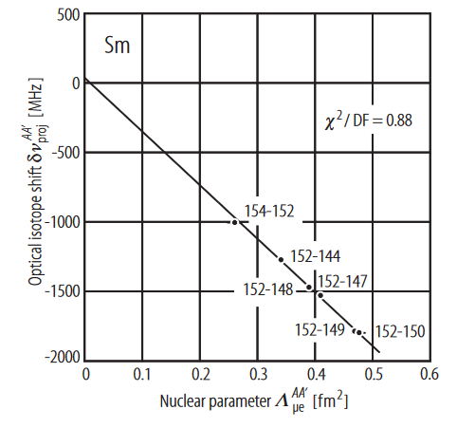
Previous Comprehensive Evaluations
Fricke and Heilig, 2004
Comprehensive compilation
King Plot focused analysis

Slide 7
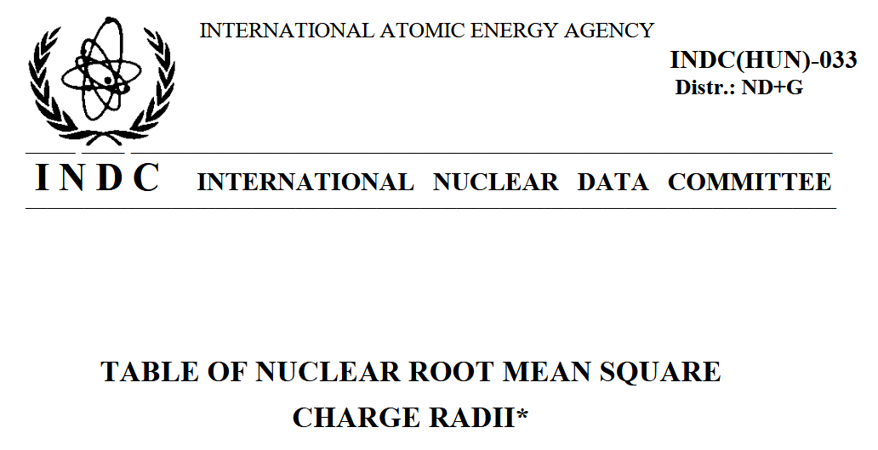
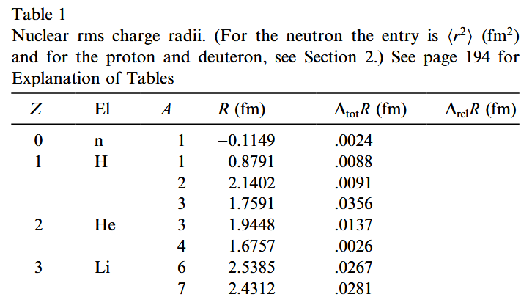
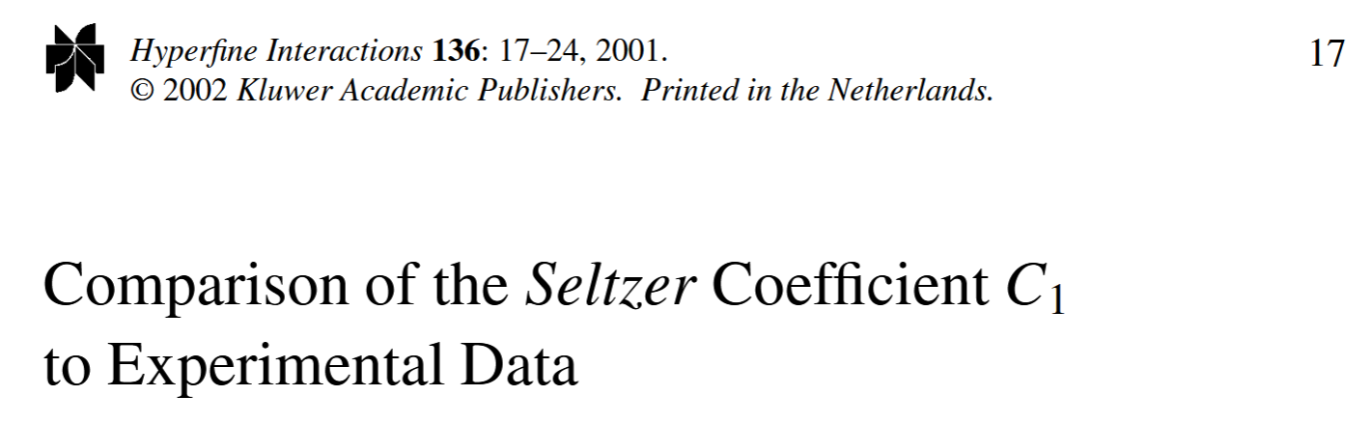
Previous Comprehensive Evaluations
Angeli 2004
Radius data and techniques found in previous works:
Weighted least squares fit
Internal and external uncertainties considered

Slide 8
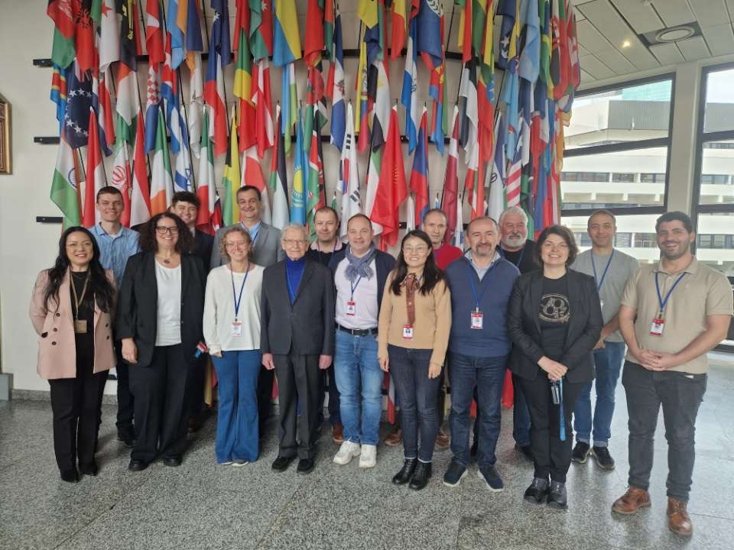
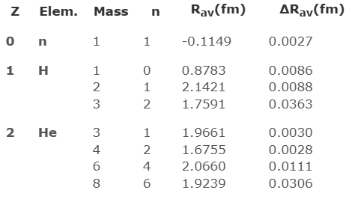
Previous Comprehensive Evaluations
Angeli and Marinova 2013
IAEA Working Group on Nuclear Charge Radii
Angeli04 + Nadjakov94
Current IAEA NDS recommendation

Slide 9
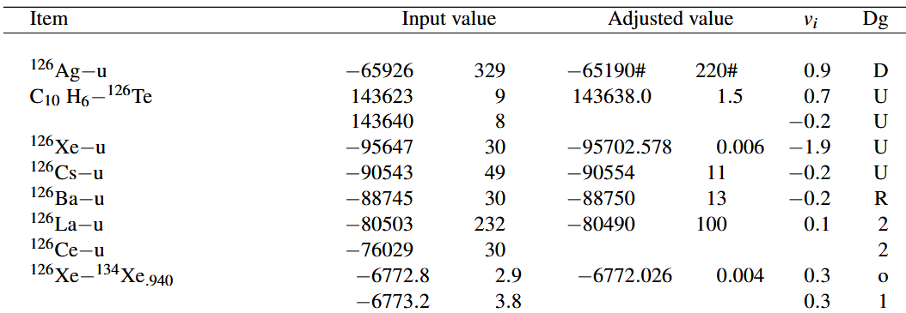
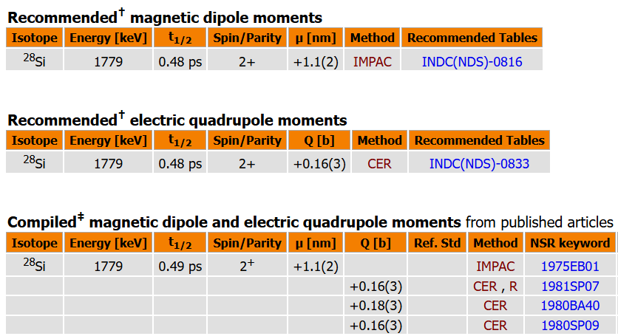
Long Term Objectives - Compilation
Compilation of Charge Radius Data
Includes experimental and theoretical inputs required to reconstruct radii.
Relies on original data, not secondary sources
Updated frequently (once a month)
Accessible via web-interface
Image Credit: W. J. Huang et al. Chinese Physics C 45 03002 (2021)
Image Credit: IAEA NDS Nuclear Electromagnetic Moments Database

Slide 10
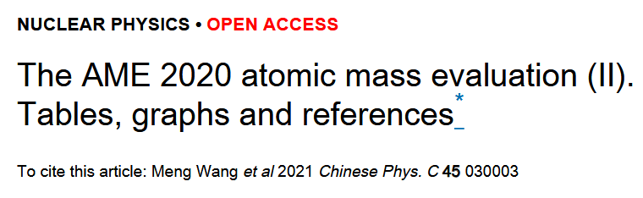
Long Term Objectives - Evaluation
Comprehensive Critical Evaluation
Constructed by experts from different techniques
Correlations between charge radii considered
Analysis decisions fully transparent
Output covariance matrix provided
Image Credit: IAEA NDS Nuclear Electromagnetic Moments Database

Slide 11
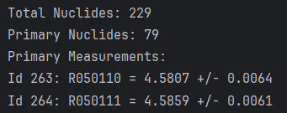
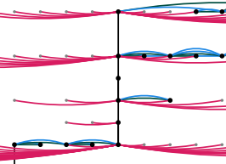

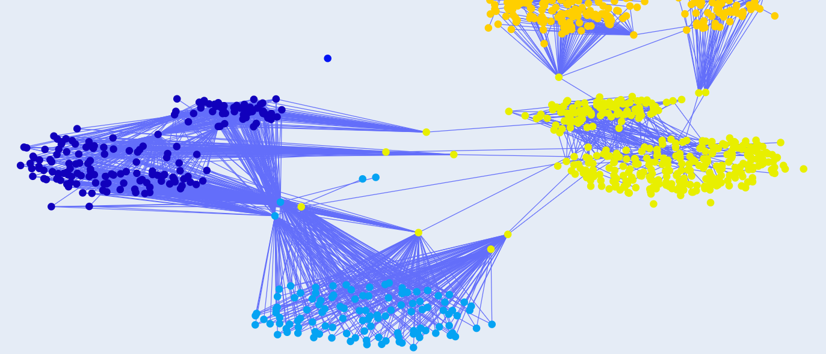
radbase – Backend for Evaluation/Compilation
Goals:
Storage of data in consistent, computer readable format
Correlation propagation
Search and visualization of data

Slide 12
Definitions
Input Data: experimental and theoretical information needed to obtain radii
Output Data: charge radii or intermediate quantities obtained from inputs.
Conversion: the process of converting inputs to charge radius data

Slide 13
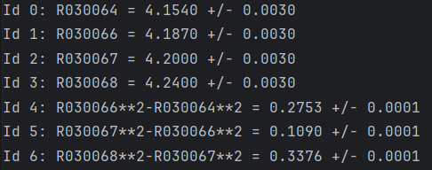
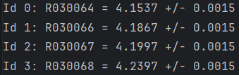
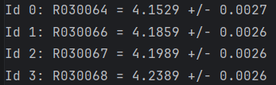


Statistical Correlations
Largest change to next evaluation: inclusion of statistical correlations between charge radius data.
Correlations shift recommended radii values, uncertainties, and covariances.
Particularly impactful when absolute and relative radius information is combined.
Absolutes are independent ($ρ=0)$
Absolutes are correlated ($ρ=0.7)$

Slide 14
Statistical Correlations
To include correlations between charge radii you need to:
Determine correlations between input data
Propagate these correlations to the charge radii
Optimize recommended radii, considering correlations
Generally, difficulty decreases as you go from 1 to 3.

Slide 15
1.) Input Data Correlation – Sources
Sources of correlation:
Experimental – sometimes reported, can often be estimated.
Theoretical – almost never reported, likely the largest source of correlation between charge radius data
Shared Data / Interpolation – most transparent, can be determined by evaluators.

Slide 16
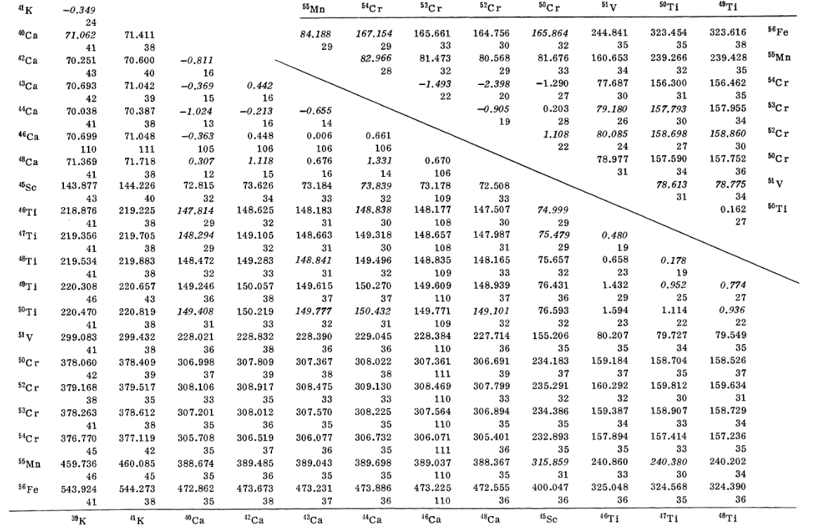
1.) Input Data Correlations – Exp. Sources
Listed experimental correlation information is local (only for a few nuclides).
Complete correlation information is sometimes available.
Can be estimated with understanding of technique.
Wohlfahrt et. al. PRC (23) 1, 1981

Slide 17
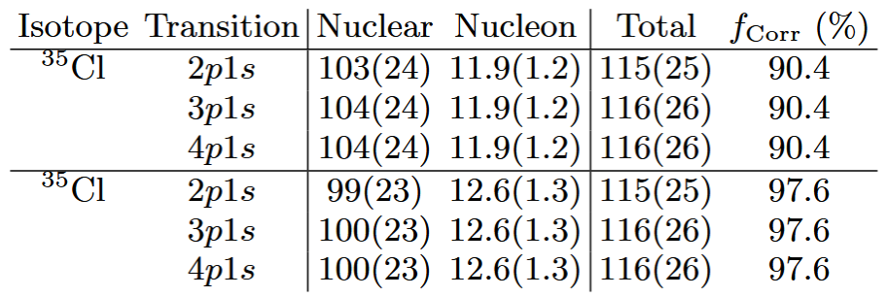
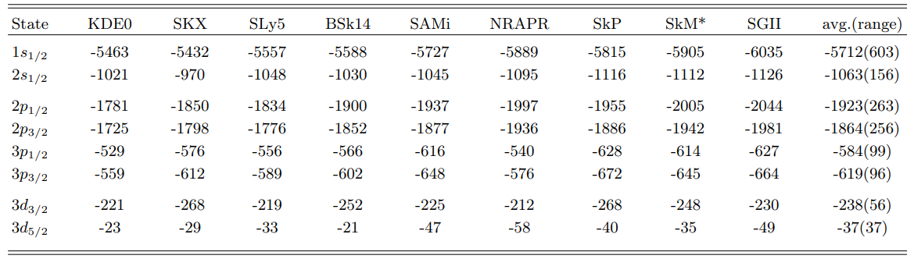
1.) Input Data Correlations – Theory Sources
Positive examples from muonic atom spectroscopy theory
Enough information to reconstruct local correlations.
37
Cl35-Cl37 Beyer et al., arXiv:2506.08804
More work to do!
Currently building radbase to prepare for better correlations.
Pb208 NP - Sun et al., PRL (135) 163002 2025

Slide 18
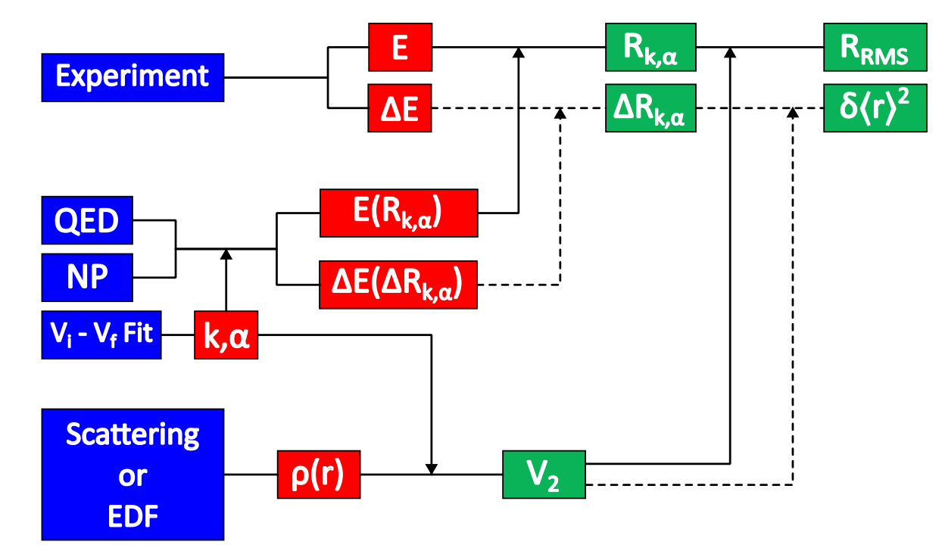
Network View of Radius Data
Radii depend on quantities which depend on quantities which …
Abstractly, this can be represented by a directed graph – quantities are nodes, dependencies are directed edges.
Image Credit: Beyer et al., arXiv:2506.08804

Slide 19


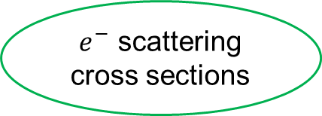
Network View of Radius Data
Allows radii to be traced back to source information.
Reanalysis can be included alongside original data.
Legend
Original muonic atom data
Muonic atom reanalysis
Elastic electron scattering
Charge Radius
Charge Radius
$V_{2}^{e}$ factor
NP corrections
Charge Distribution
$μ$ Energies
Barrett Radius
$e^{−}$ scattering cross sections
NP corrections

Slide 20
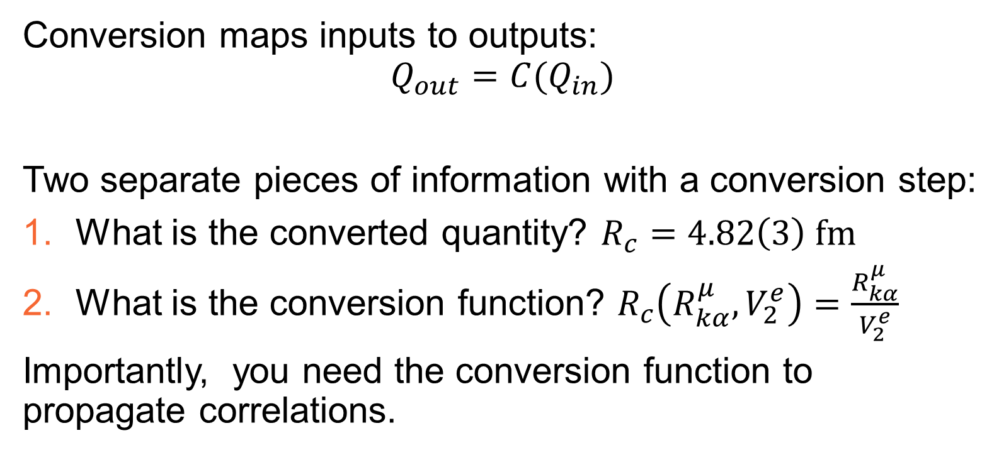
Functions vs. Quantities
Conversion maps inputs to outputs:
$$Q_{out}=C(Q_{in})$$
Two separate pieces of information with a conversion step:
What is the converted quantity? $R_{c}=4.82\left(3\right) fm$
What is the conversion function? $R_{c}\left(R_{kα}^{μ}, V_{2}^{e}\right)=\frac{R_{kα}^{μ}}{V_{2}^{e}}$
Importantly, you need the conversion function to propagate correlations.

Slide 21

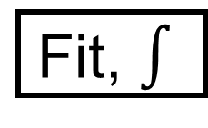



Conversion Functions – Network View
Charge Radius
Charge Radius
$V_{2}^{e}$ factor
Charge Distribution
/
$$∫$$
NP corrections
Barrett Radius
Fit, $∫$
Fit
$μ$ Energies
$$R_{kα}$$
$e^{−}$ scattering cross sections
NP corrections

Slide 22
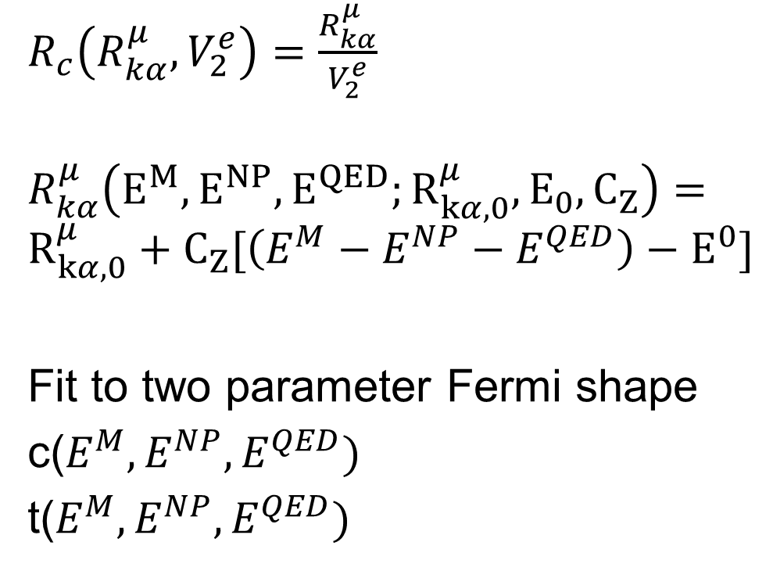
Conversion Functions
Some steps provide the function, while others do not.
Transparent (Differentiable) vs. Opaque (Not Differentiable)
Can that step be evaluated with new inputs?
$R_{c}\left(R_{kα}^{μ}, V_{2}^{e}\right)=\frac{R_{kα}^{μ}}{V_{2}^{e}}$
$$R_{kα}^{μ}\left(E^{M}, E^{NP}, E^{QED};R_{kα,0}^{μ}, E_{0}, C_{Z}\right)=$$
$$R_{kα,0}^{μ}+C_{Z}[\left(E^{M}−E^{NP}−E^{QED}\right)−E^{0}]$$
Fit to two parameter Fermi shape
c($E^{M}, E^{NP}, E^{QED})$
t($E^{M}, E^{NP}, E^{QED})$

Slide 23
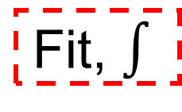
Conversion Functions – Network View
Charge Radius
Legend
Derivatives Available
Derivatives Unavailable
Charge Radius
$V_{2}^{e}$ factor
Charge Distribution
/
$$∫$$
NP corrections
Barrett Radius
Fit, $∫$
Fit
$μ$ Energies
$$R_{kα}$$
$e^{−}$ scattering cross sections
NP corrections

Slide 24


Conversion Functions – Ranking
Best to worst case:
Conversion function is provided!
Or an approximation (fit Jacobian, polynomial)
No function, but correlations are explicitly given
No function and no correlation information
Charge Distribution
$$\frac{∂c}{∂E}$$
Fit
$μ$ Energies
NP corrections

Slide 25
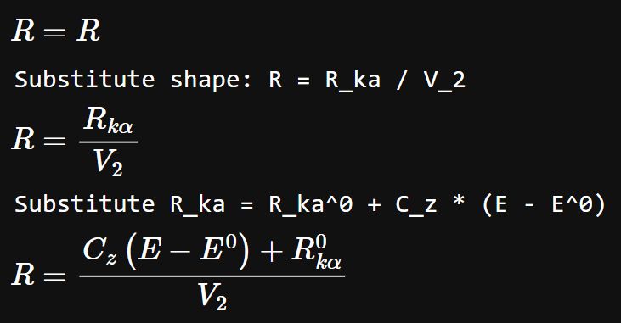
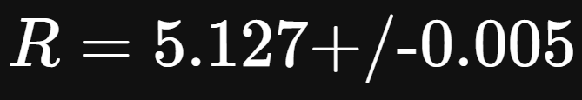
2.) Propagating Correlations – Implementation
sympy allows for symbolic manipulation
uncertainties (or sympy) to numerically propagate covariances
from uncertainties import ufloat
uR_ka0, uE = ufloat(5.614, 0.001), ufloat(5126, 0.01)
uV_2 = ufloat(1.095, 0.001)
rad = lambdify([C_z, R_ka0, E, E0, V_2],
rad,
modules='numpy')(1e-2, uR_ka0, uE, uE.n, uV_2)

Slide 26
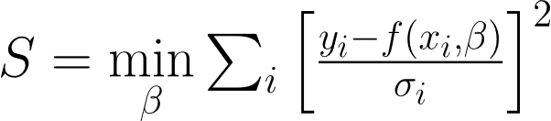
3.) Optimization with Correlated Data
Generalized least squares propagates correlations from radius data
Implemented in radbase alongside optimizations from graph analysis.
Uncorrelated – Weighted Least Squares
Correlated Errors – Generalized Least Squares

Slide 27
Potential Pitfalls – Correlated Variables
Numerical errors from highly correlated variables:
Ex: Radii from optical isotope shift where atomic theory is dominant uncertainty.
Inversion of covariance matrix becomes unstable.
Potential solution: Take CODATA approach, have free parameters besides radii.
Decision to just use radii vs. parameters included in conversion process.

Slide 28
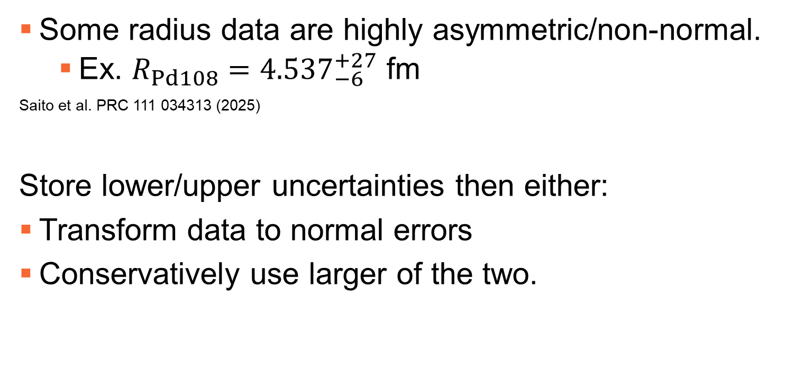
Potential Pitfalls – Non-Gaussian Errors.
Some radius data are highly asymmetric/non-normal.
Ex. $R_{Pd108}={4.537}_{−6}^{+27}$ fm
Saito et al. PRC 111 034313 (2025)
Store lower/upper uncertainties then either:
Transform data to normal errors
Conservatively use larger of the two.

Slide 29
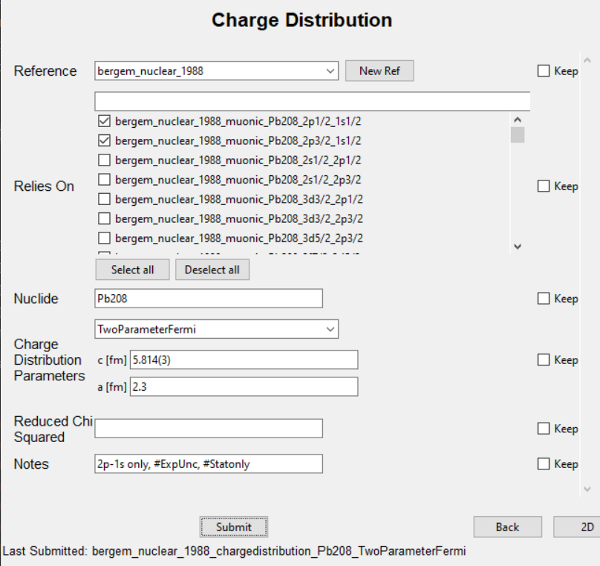
Data Collection Progress
January 2026, I created a data entry user interface to standardize the entered data.
Each data type has a template that can dynamically generate its data entry interface.
Data can be entered programmatically using these templates as well.

Slide 30
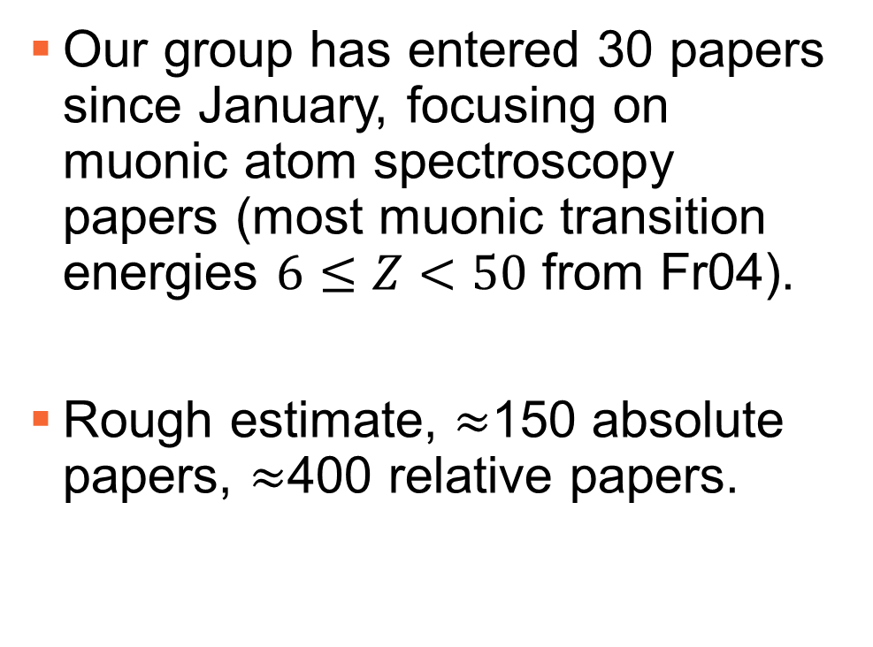
Data Collection Progress
Our group has entered 30 papers since January, focusing on muonic atom spectroscopy papers (most muonic transition energies $6≤Z<50$ from Fr04).
Rough estimate, $≈$150 absolute papers, $≈$400 relative papers.
Network of Data near Wohlfahrt PRC 23 533 (1981)

Slide 31
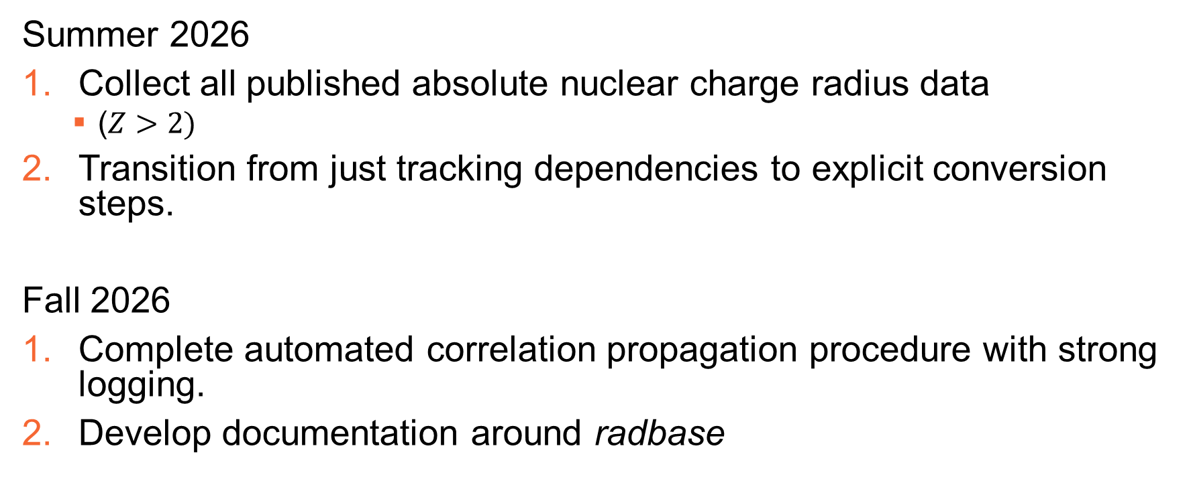
Timeline - 2026
Summer 2026
Collect all published absolute nuclear charge radius data
($Z>2)$
Transition from just tracking dependencies to explicit conversion steps.
Fall 2026
Complete automated correlation propagation procedure with strong logging.
Develop documentation around radbase

Slide 32
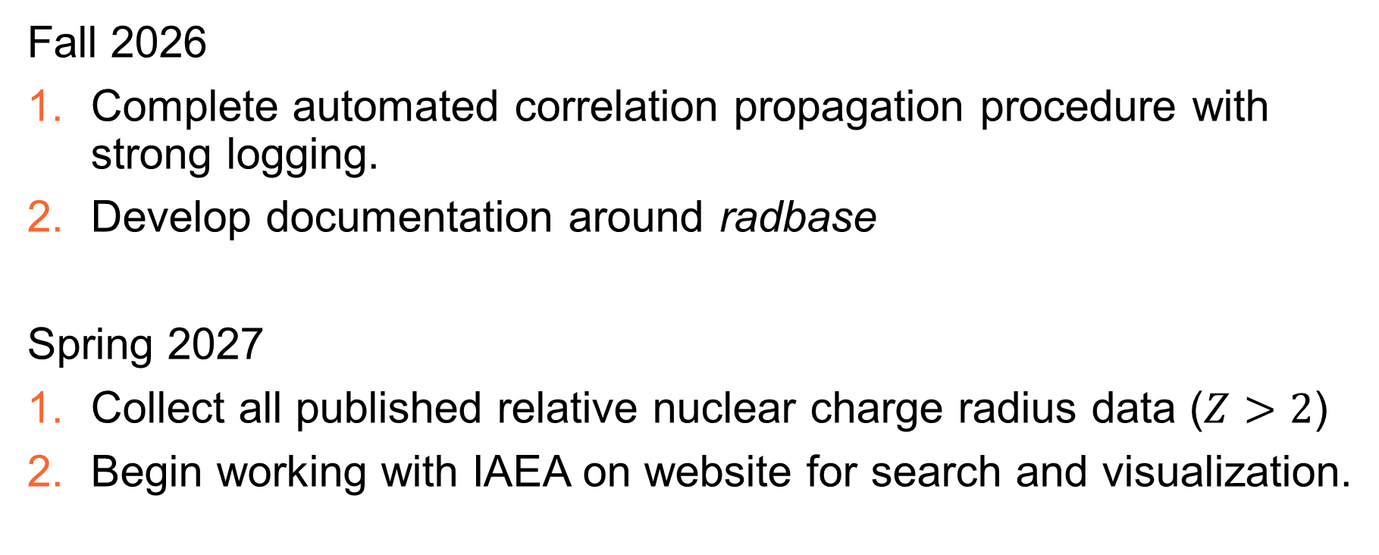
Timeline - 2027
Fall 2026
Complete automated correlation propagation procedure with strong logging.
Develop documentation around radbase
Spring 2027
Collect all published relative nuclear charge radius data ($Z>2$)
Begin working with IAEA on website for search and visualization.

Slide 33
Is radbase useful to you today?

Slide 34
No

Slide 35
Will radbase be useful to you 6 months from now?

Slide 36
Yes

Slide 37
Conclusions
Moving towards new comprehensive compilation and evaluation
Data compilation and standardization
Inclusion of correlations between inputs

Slide 38

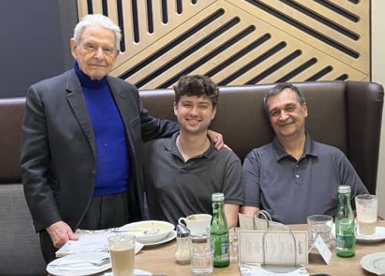

Thank you! Questions?
Contact: hstaige@clemson.edu
NIST Grant Award Number 70NANB20H87
National Science Foundation Award Number 2309273

Slide 39
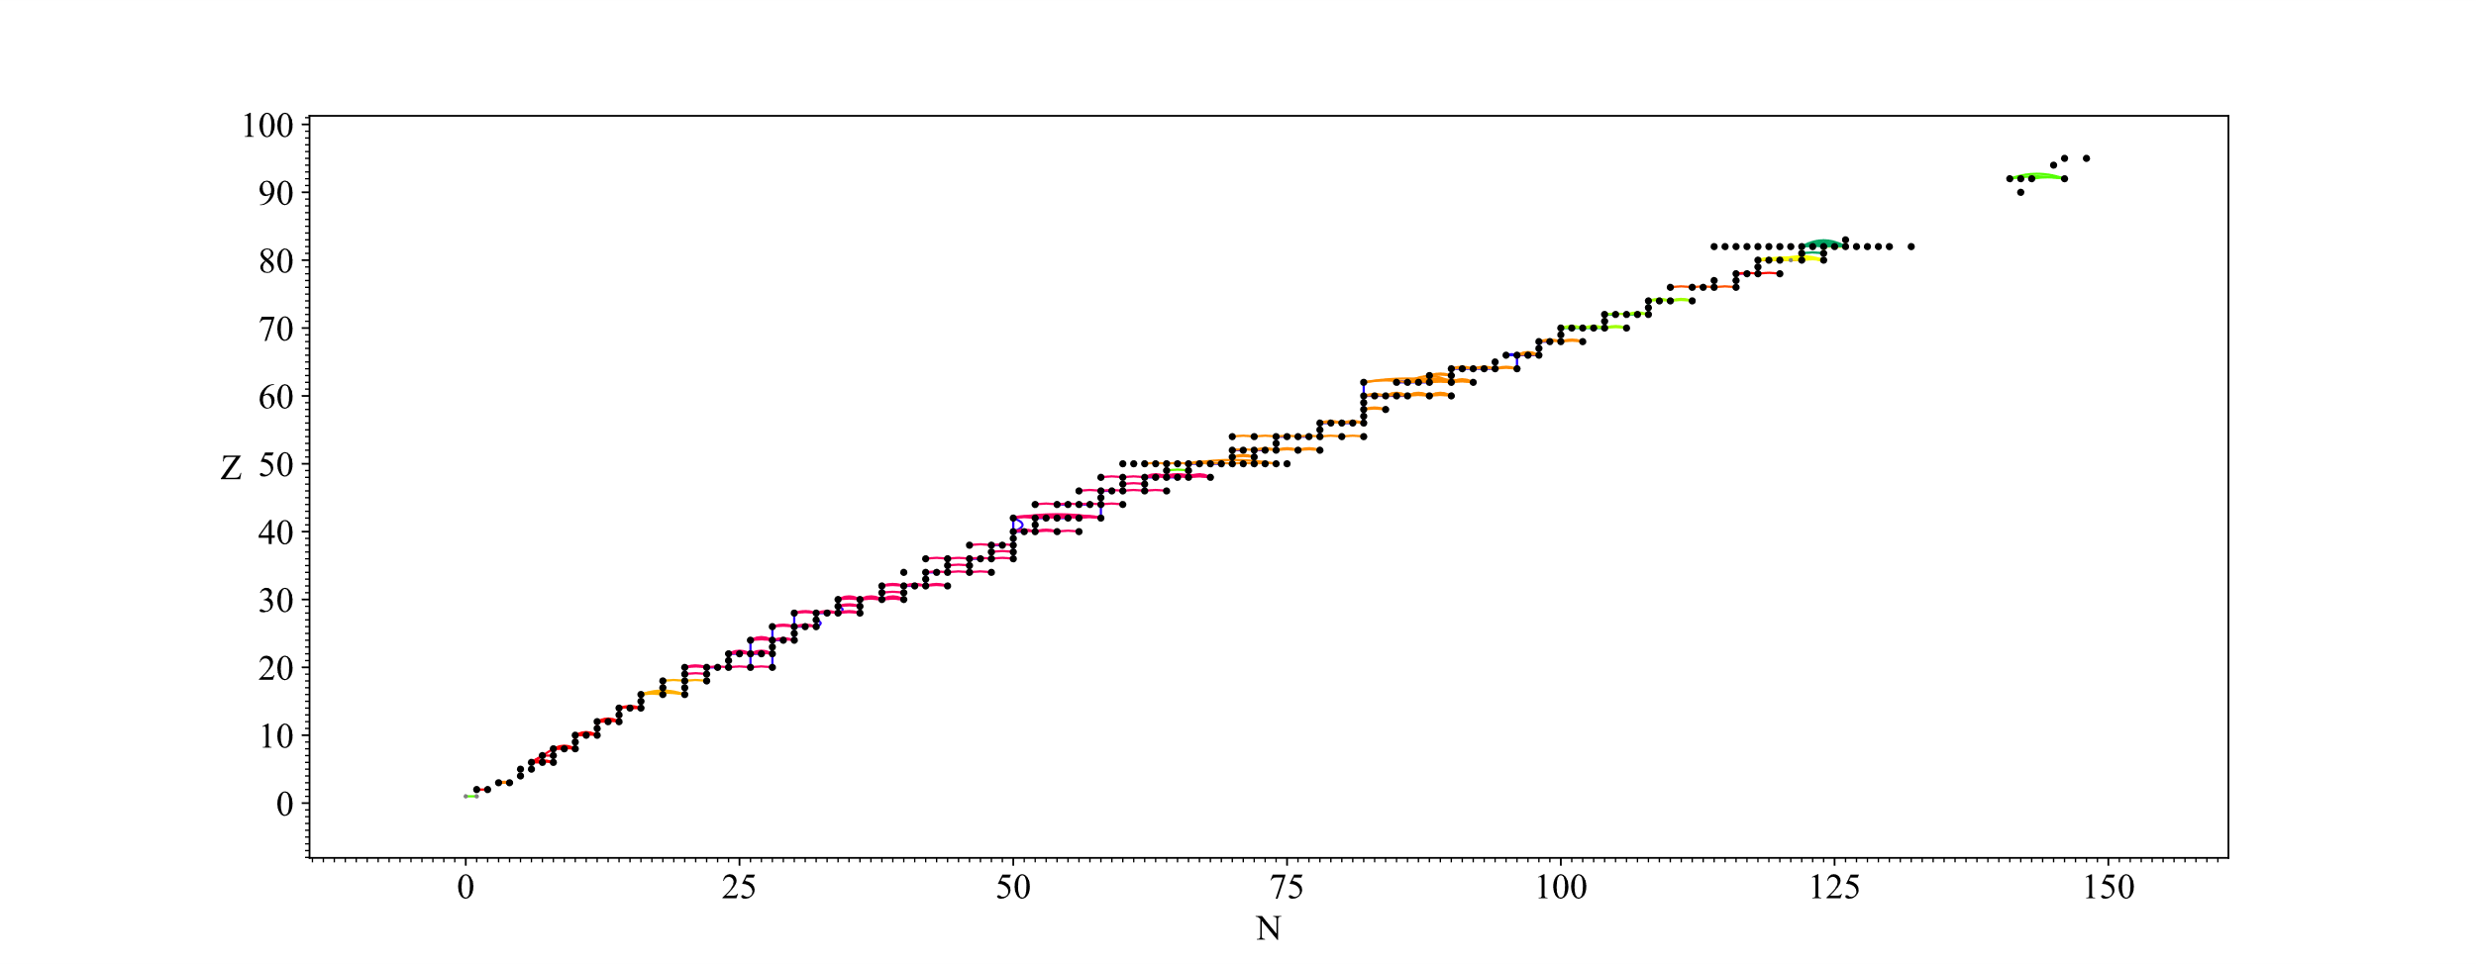
Objective 1: Grouping / Graph Exploration
Users should be able to group data quickly and flexibly!

Slide 40
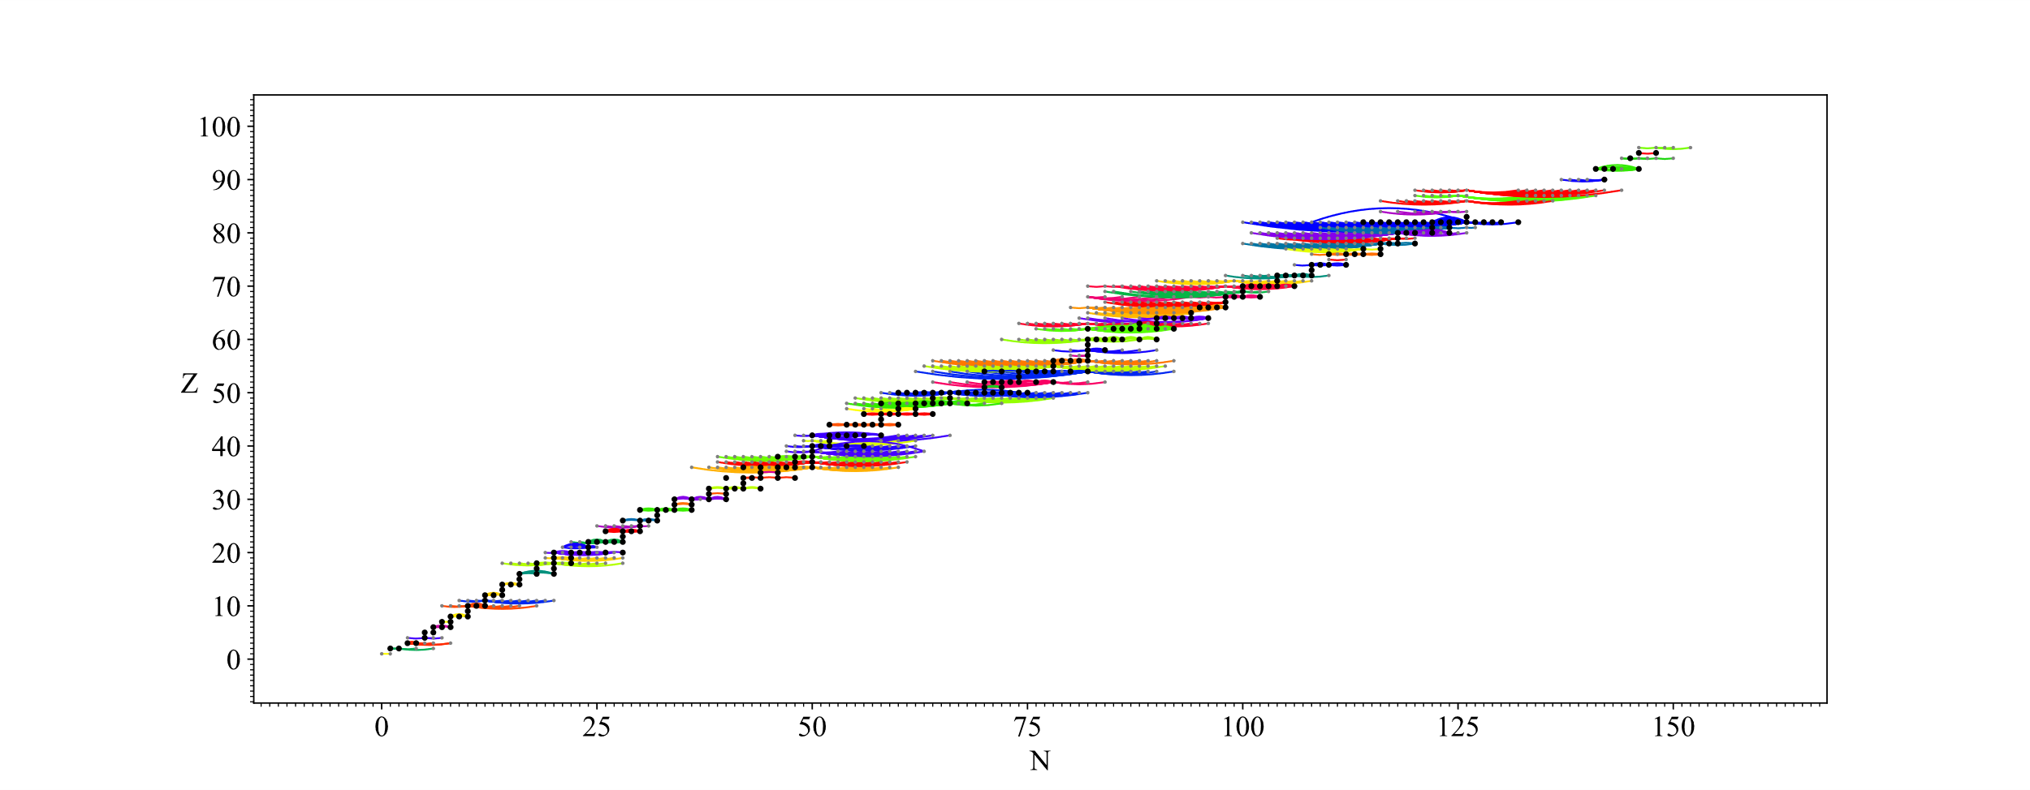
Objective 1: Grouping / Graph Exploration
Whether that be by element:

Slide 41
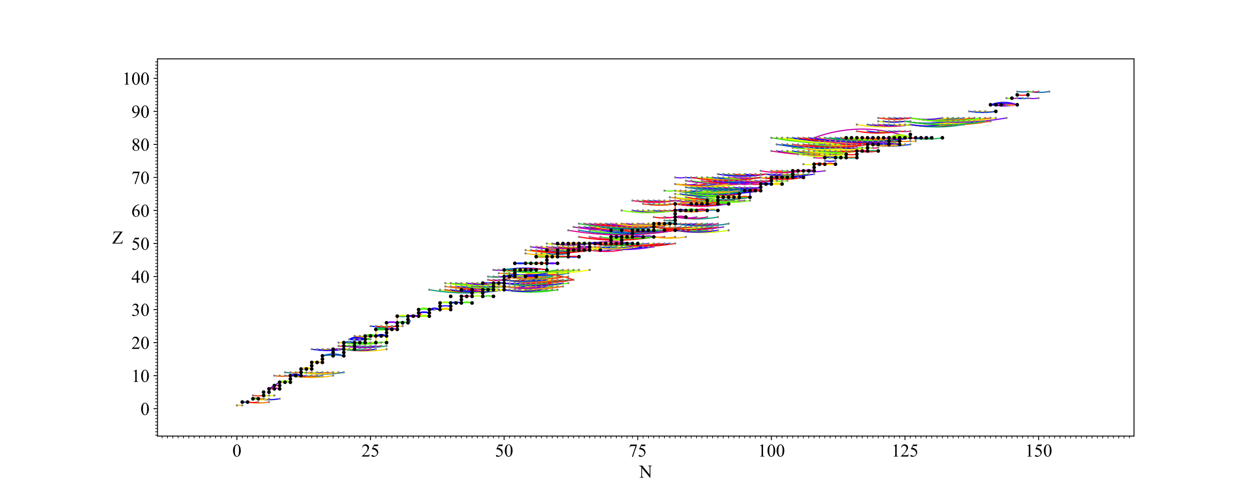
Objective 1: Grouping / Graph Exploration
Or by measured quantity:

Slide 42
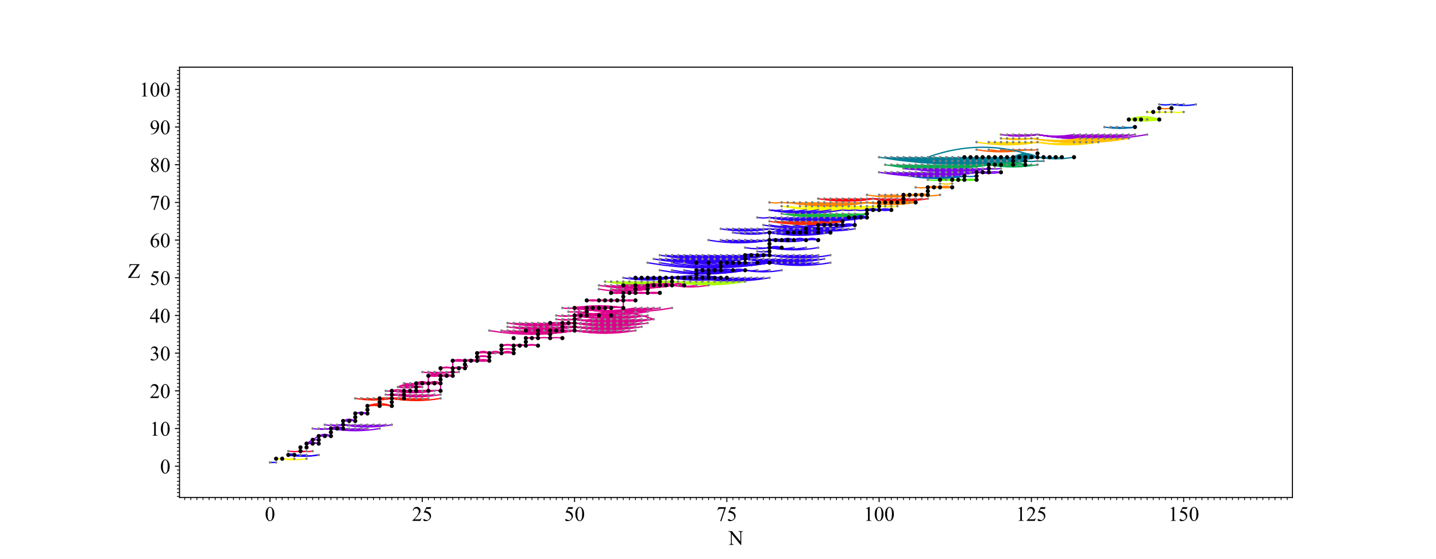
Objective 1: Grouping / Graph Exploration
Or by group in the network:

Slide 43


Correlation from Conversion: OIS
Where:
F_i: Transition specific electronic factor
M_i: Transition specific mass factor – includes normal and specific mass shifts
C_i: The Seltzer coefficients

Slide 44
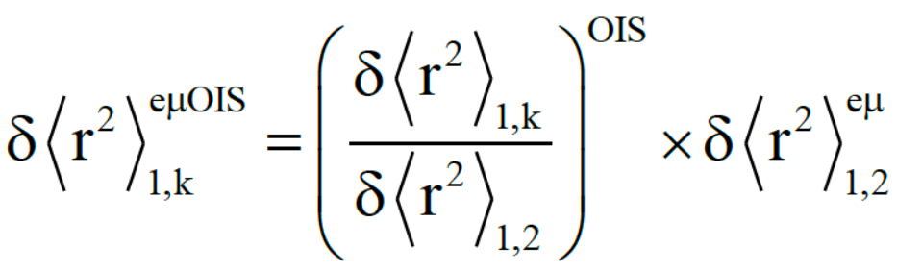
Correlations from Conversion: OIS
Angeli 2004 / 2013 used a correction factor determined from comparing OIS radii differences to electronic and muonic radii differences.

Slide 45
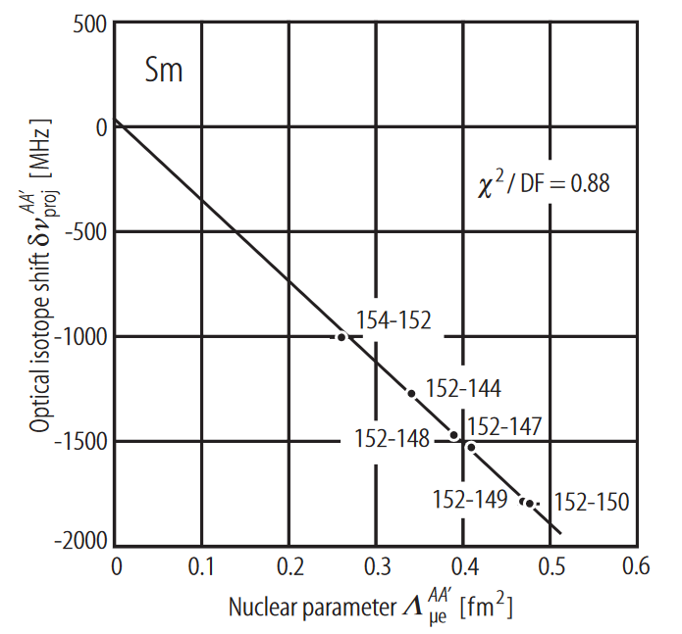
Correlations from Conversion: OIS
King plot was used in Fricke 2004 – directly fit parameters of OIS equation.
Notes:
Calculation Independence!

Slide 46
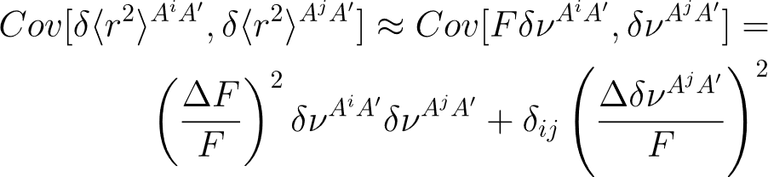
Correlations from Conversion: OIS
Covariance matrix elements:
Notes:
Correct this equation

Slide 47
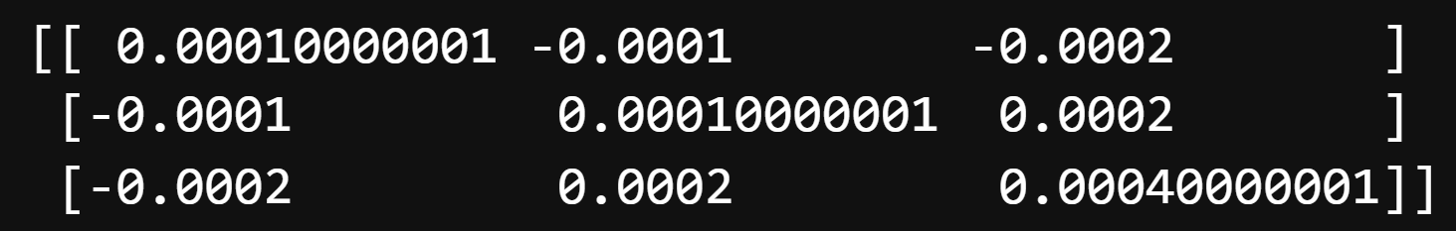

Correlations from Conversion: OIS
Notes:
Delta F = 10%, makes sense!

Slide 48


Correlations from Conversion: OIS
Standard weighted least-squares, vary F
Generalized least-squares, all radii are parameters
Notes:
Lower uncertainties are from the uncertainty on F limiting possible radii combinations.

