Slide 1



Non-Perturbative QCD Insights:
Meson Form Factors and Charge Radii
Adnan Bashir
Department of Integrated Sciences
University of Huelva, Huelva, Spain
Institute of Physics and Mathematics
University of Michoacán, Morelia, Michoacán, Mexico
Nuclear Radius Extraction Collaboration (NREC 2026)
Stony Brook University, New York, April 13-17, 2026

Slide 2
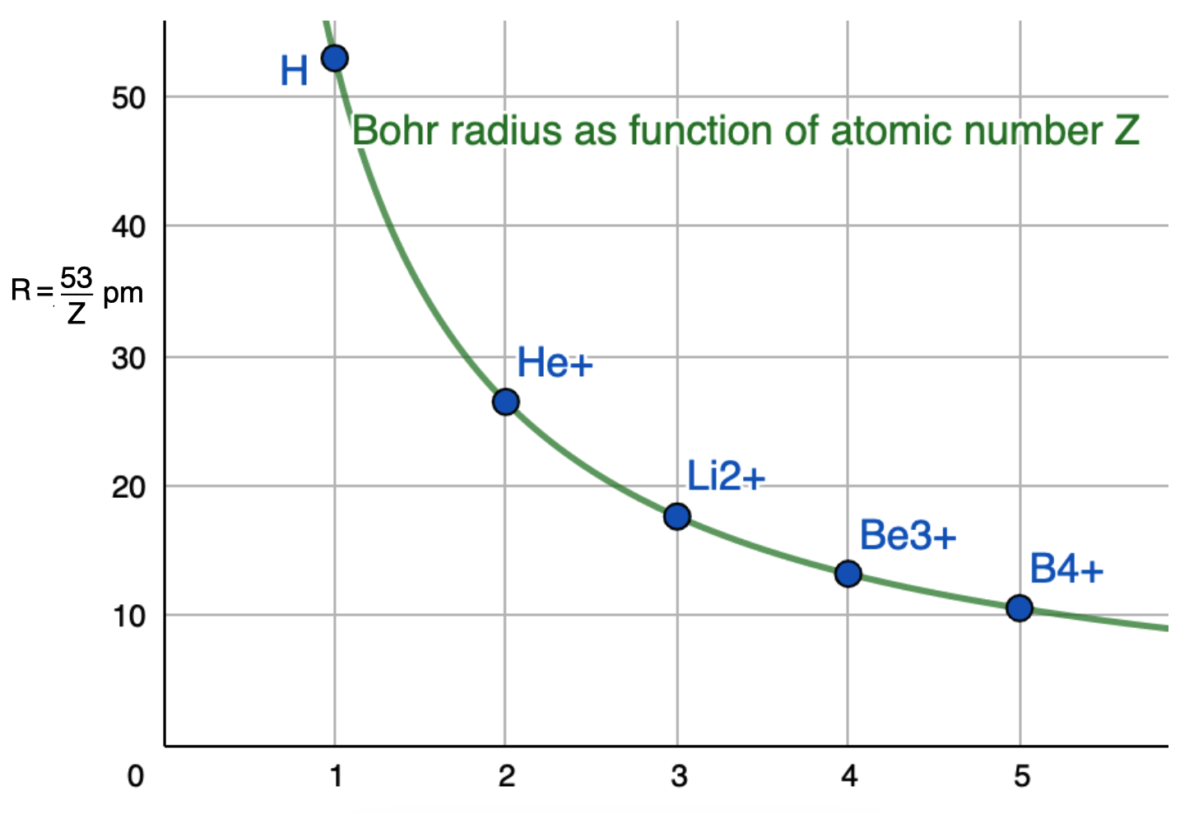
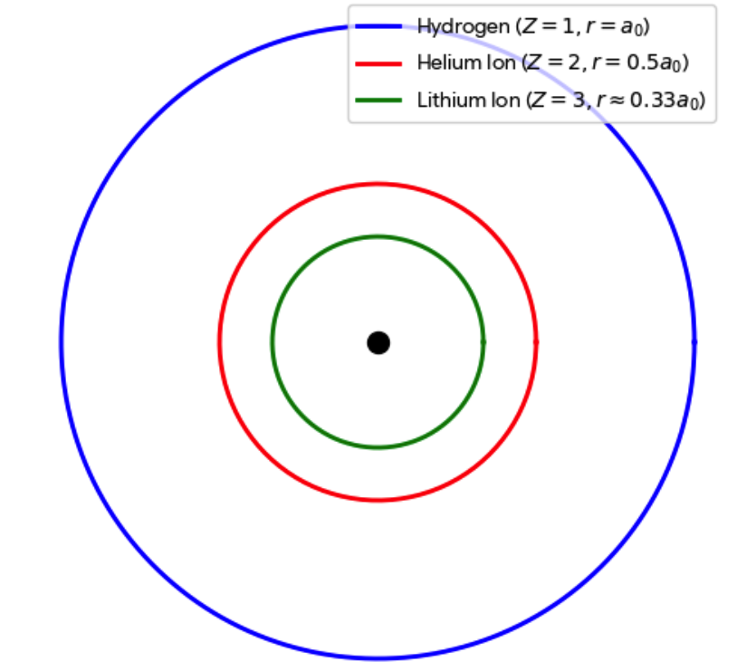
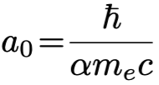

Bohr radii of Hydrogen-like atoms
The Bohr radius depends depend only on constants, whose better determination improves its accuracy.
Electrodynamics
The Bohr radius feeds into many observables such as precision spectroscopy, Lamb shift, hyperfine structure, atomic polarizability, providing insights into quantum electrodynamics.
These observables have implications for nuclear radius extraction (proton, deuteron, light and heavy nuclei), proton radius puzzle and muonic atom spectroscopy.

Slide 3
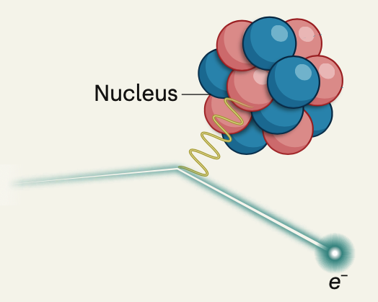
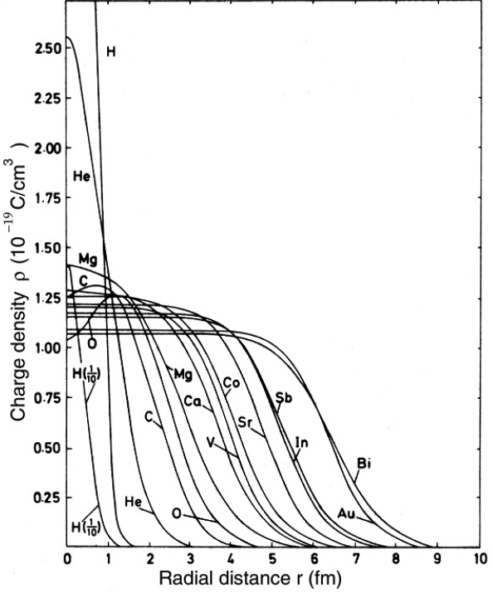
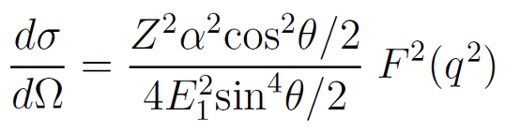
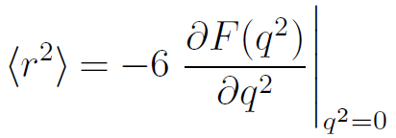
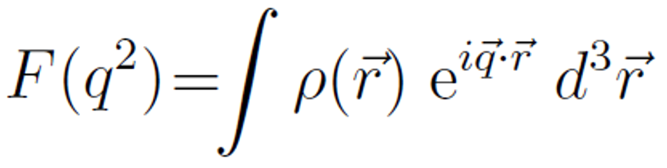
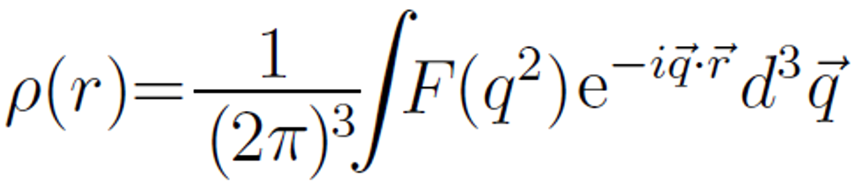
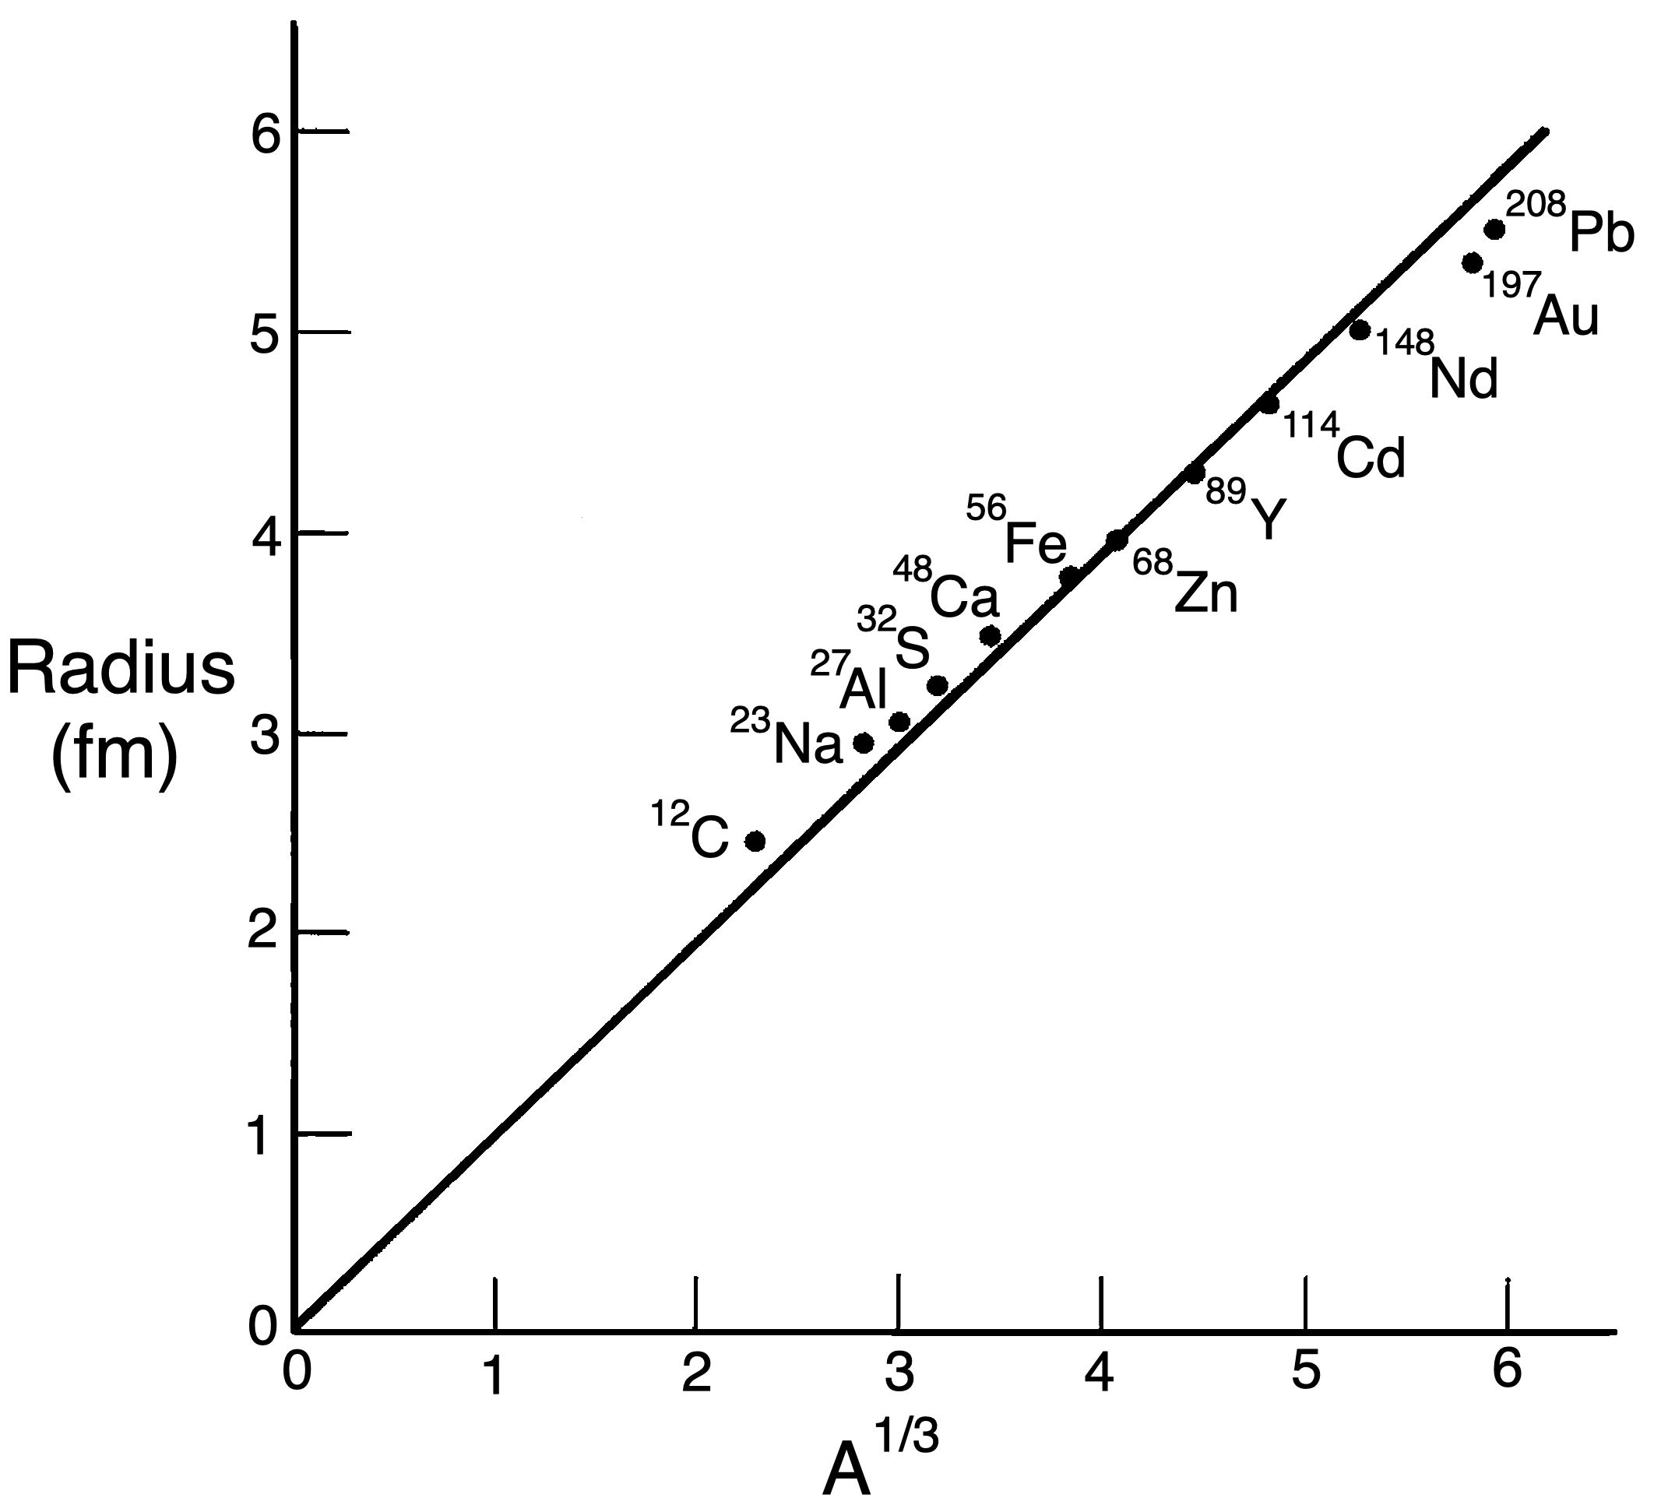

Nuclear charge distribution and radii
Hofstadter, et. al., Phys. Rev. 91, 422 (1953)
Hofstadter, Rev. Mod. Phys. 28, 214 (1956)
(100-200) MeV
QCD footprints
Short range interaction,
large infrared coupling, quark-gluon dressing, dynamical chiral
symmetry breaking,
quark-gluon interaction vertex and perhaps confinement.

Slide 4
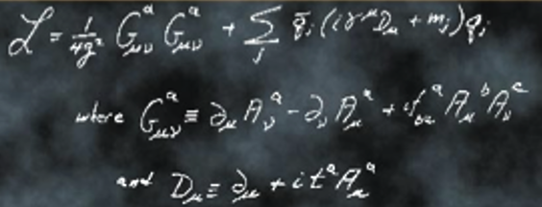

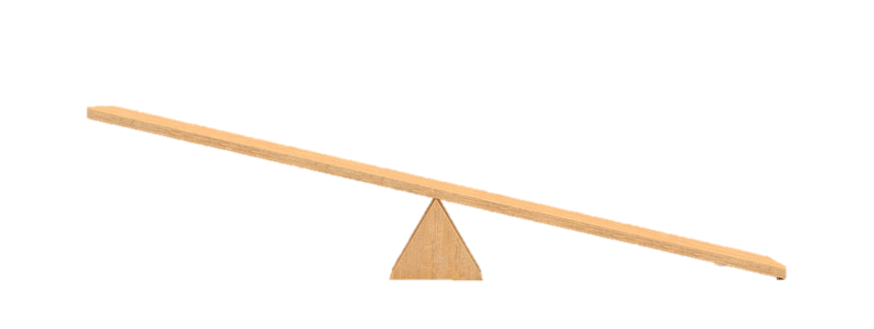




QCD: emergent phenomena and challenges
QCD is characterized by two emergent phenomena:
confinement and emergent hadron mass.
Quarks and gluons do not reach detectors.
Formation of color-singlet bound states: “Hadrons”
mesons, baryons, tetraquarks, molecules
Emergence of hadron masses from QCD dynamics
$\sim 2\%$ of $M_{p}$
$\sim 98\%$ of $M_{p}$ strong QCD
$m_{u,d}≈5−10$ MeV
$M_{p,n}≈940$ MeV

Slide 5
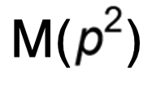
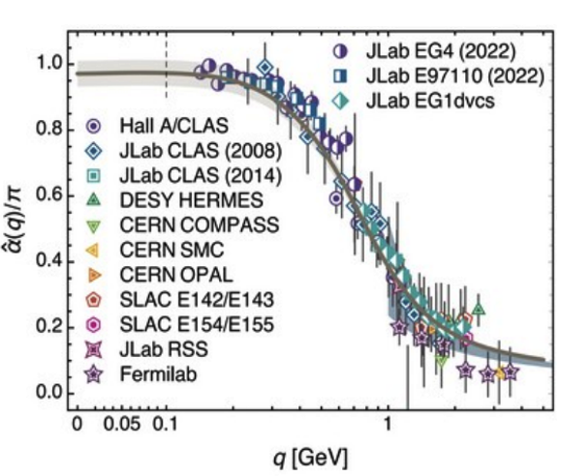
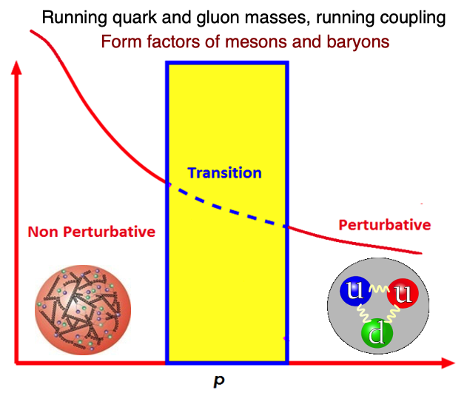
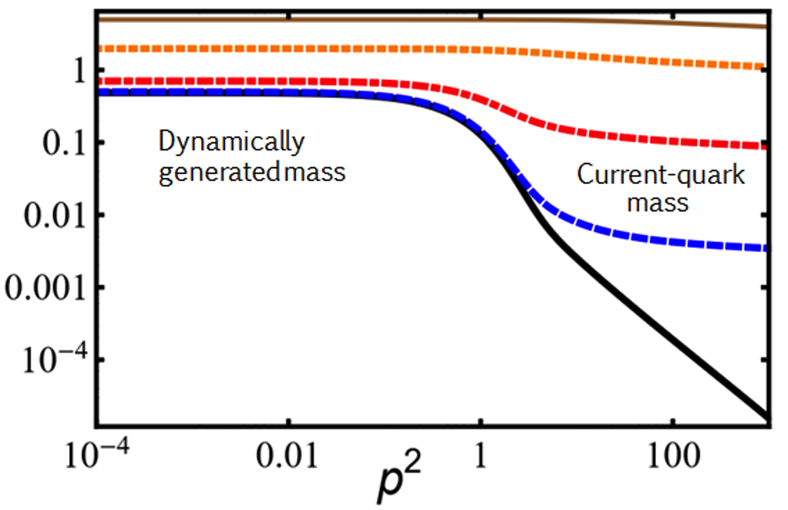
QCD: emergent phenomena and challenges
Origins of confinement and dynamical mass generation can perhaps be traced back to the Green functions of quarks and gluons.
These emergent phenomena of QCD, non-existent in perturbation theory are naturally linked to the infrared enhancement of the strong running coupling.
The effects of of the pattern of dynamical mass generation are traceable in the Q² evolution of the 𝜋 and K electromagnetic form factors explored and planned in the JLab and the EIC.

Slide 6
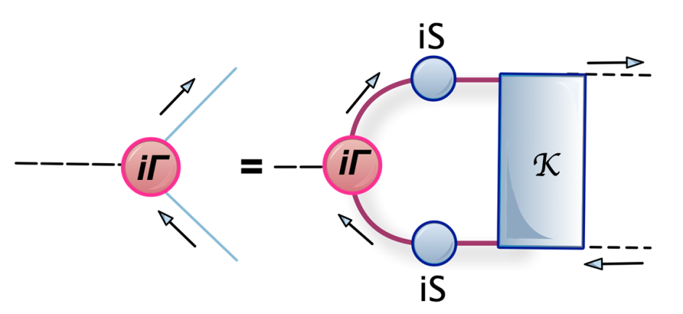
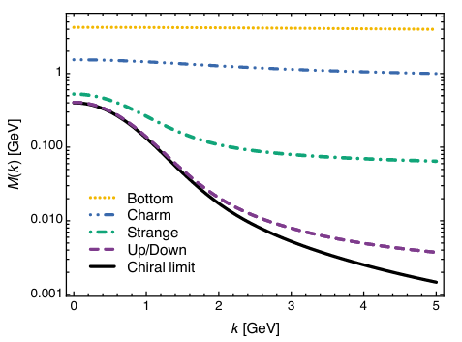
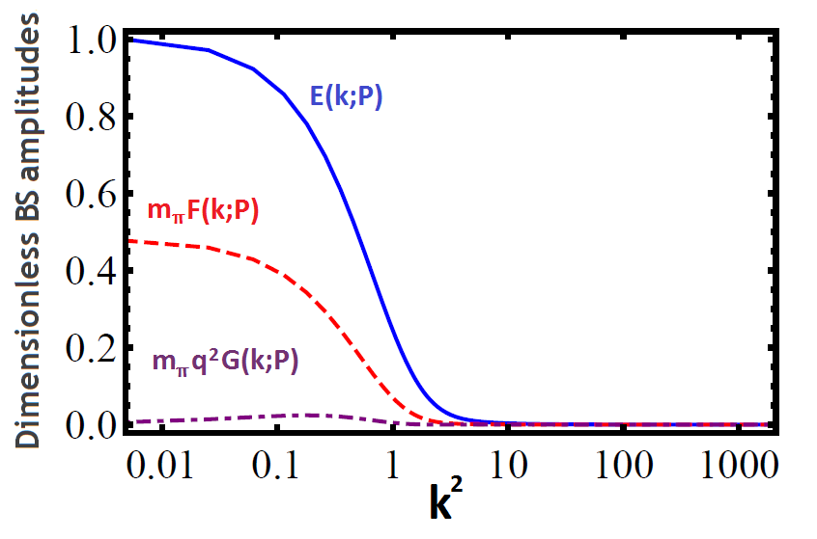
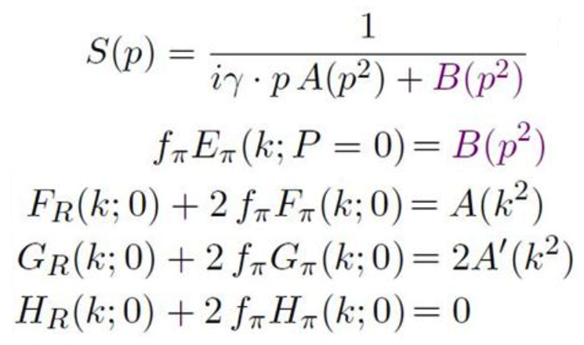
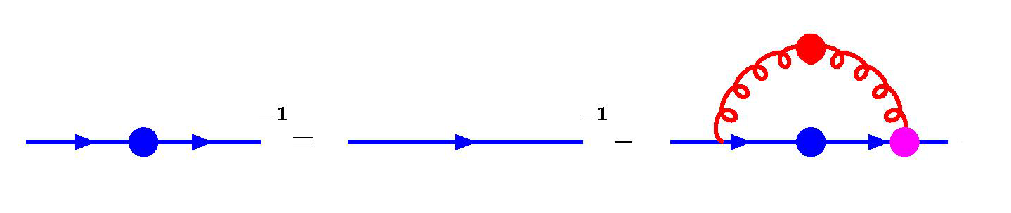
𝜋 and K: bound states and NGSW bosons
Pions are simultaneously bound states of quark-anti-quark and the Nambu-Goldstone-Salam-Weinberg bosons associated with dynamical chiral symmetry breaking.

Slide 7
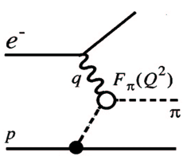
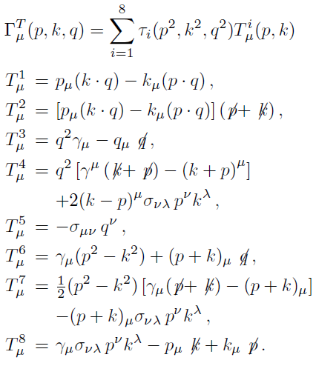
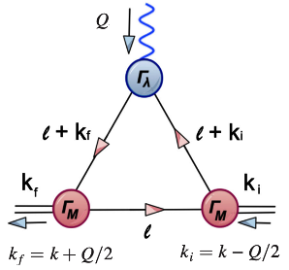
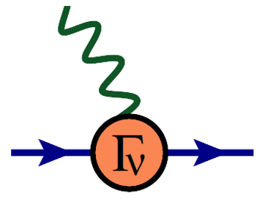
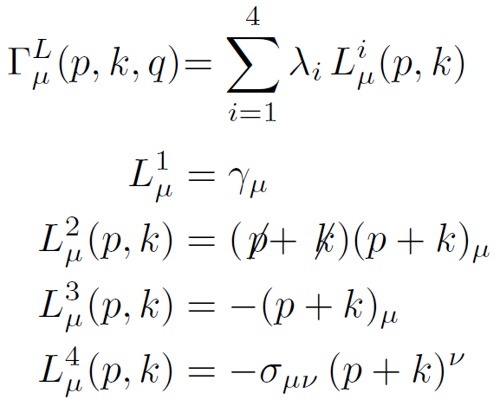
𝜋 and K: probing quarks with photons
In studying the electromagnetic form factors, it is the photon which probes the dressed quarks inside the bound states, highlighting the importance of the quark-photon vertex.
Gauge covariance
(WTI,TTI, LKFT),
Singularities,
perturbation theory,
Multiplicative
renormalizability
AB, R. Bermudez, L. Chang, C.D. Roberts
Phys. Rev. C85, 045205 (2012)
M. Atif, K. Raya, F. Akram, AB, B. Masud,
Phys. Rev. D103 (2021) 5, 054036.
A. Ashraf, J. Aslam, F. Akram, AB,
Phys. Rev. D111 (2025) 3, 034043.

Slide 8
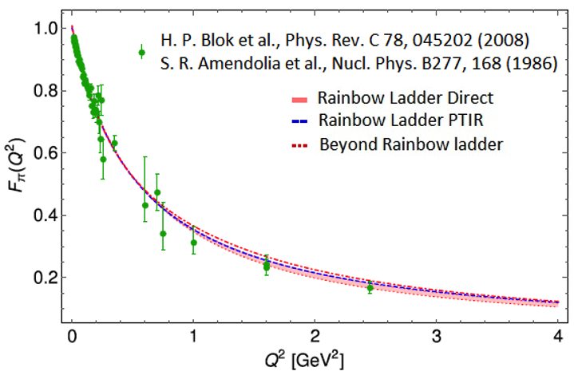
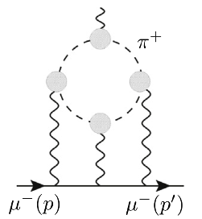
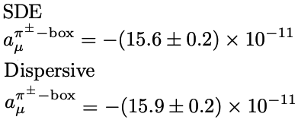

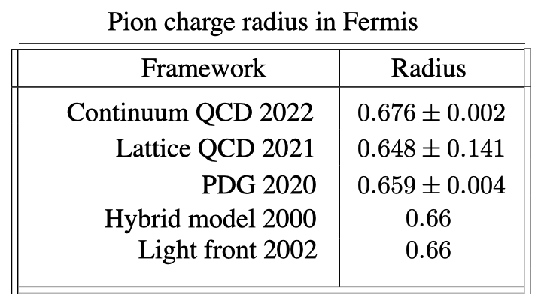
𝜋 form factor and charge radius
Hlbl scattering contribution to the muon anomalous magnetic moment
Dispersive: G. Colangelo, M. Hoferichter, M. Procura, P. Stoffer,
JHEP, 04, 161, (2017).
Pion charge radius - Fermis
Continuum QCD:
A. Miramontes, AB, K. Raya, P. Roig, Phys. Rev. D105 7, 074013 (2022).
Lattice QCD: X. Gao et. al., Phys. Rev. D104, 114515 (2021).
PDG 2020: P. A. Zyla et al. (PDG), PTEP 2020, 083C01 (2020).
Hybrid Model: R. J. Lombard, J. Mares, Phys. Lett. B472, 150 (2000).
Light Front: C.-W. Hwang, Eur. Phys. J. C23, 585 (2002).

Slide 9
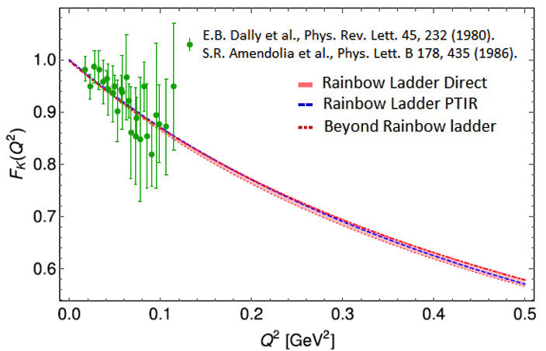
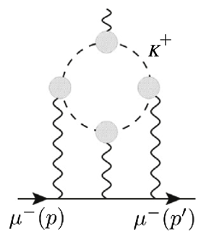
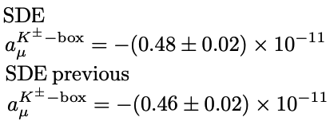

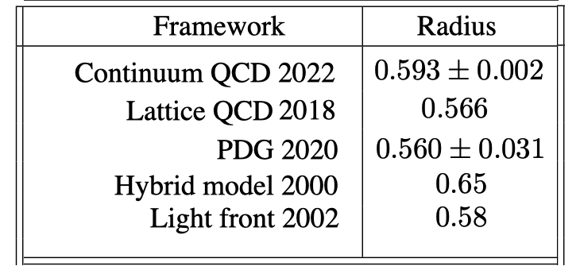
K form factor and charge radius
Hlbl scattering contribution to the muon anomalous magnetic moment
SDE previous: G. Eichmann, C. S. Fischer, R. Williams. Phys. Rev. D101 5, 054015 (2020).
Kaon charge radius - Fermis
Continuum QCD:
A. Miramontes, AB, K. Raya, P. Roig, Phys. Rev. D105 7, 074013 (2022).
Lattice QCD: C. T. H. Davies, et. al., (HPQCD), PoS LATTICE2018, 298 (2018).
PDG 2020: P. A. Zyla et al. (PDG), PTEP 2020, 083C01 (2020).
Hybrid Model: R. J. Lombard, J. Mares, Phys. Lett. B472, 150 (2000).
Light Front: C.-W. Hwang, Eur. Phys. J. C23, 585 (2002).

Slide 10
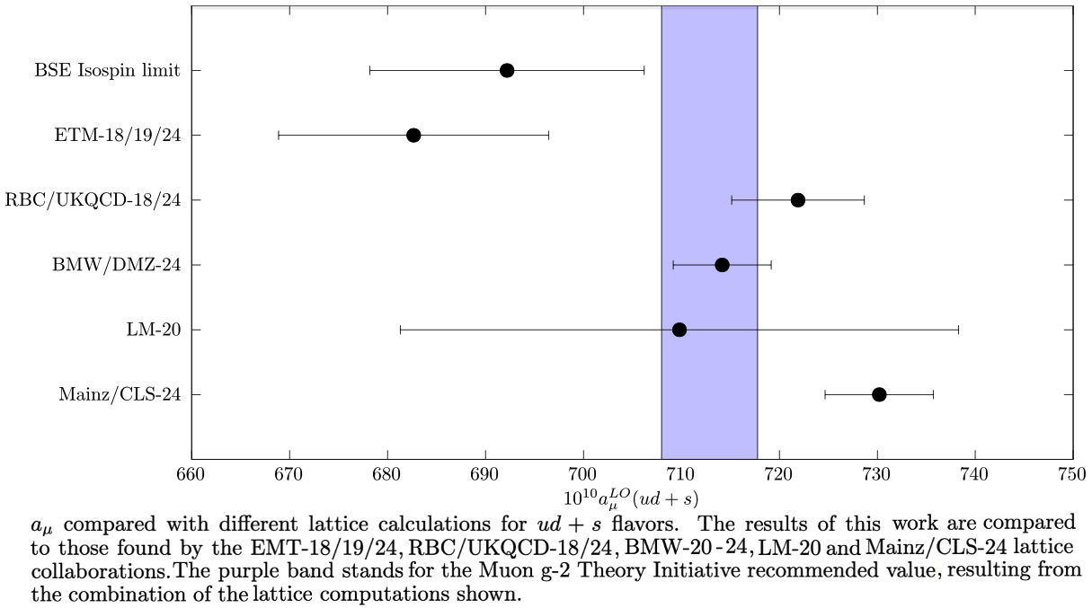
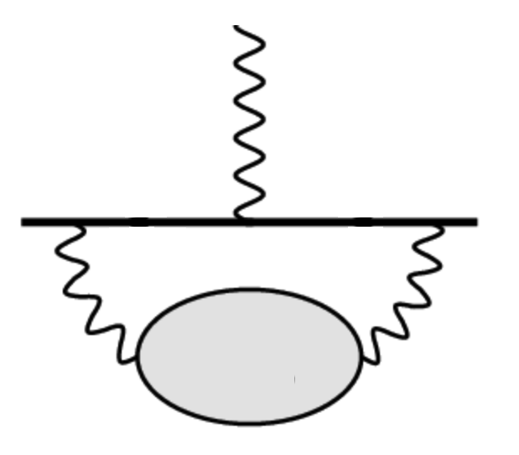

SDE - Hadronic Vacuum Polarization
In progress
Continuum QCD:
A. Miramontes,
AB, et. al.
in progress

Slide 11
Truncating Schwinger-Dyson equations
Sophisticated Truncations
Numerically Demanding
“QCD Predictions”
QCD Green Functions
Mesons – Static, FFs, PDAs, PDFs
Schwinger-Dyson Equations
Most Observables
Mesons, Baryons
Moderate Simplicity
QCD-like Predictions
Contact Interaction
QCD-Inspired & Data Driven
Algebraic Models
Simple Implementation
Insightful - Mindful
LFWFs, GPDs, TMDs,
PDFs, FFs, Mesons, Baryons

Slide 12
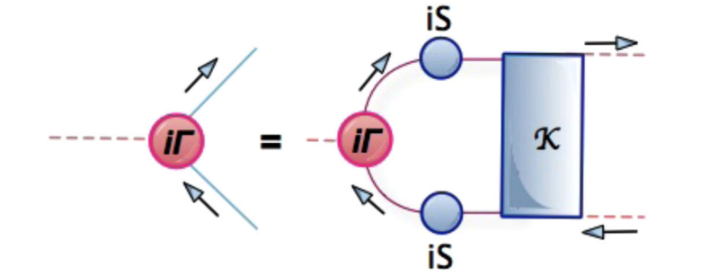
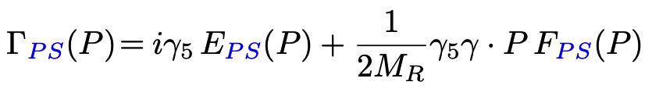
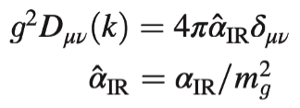

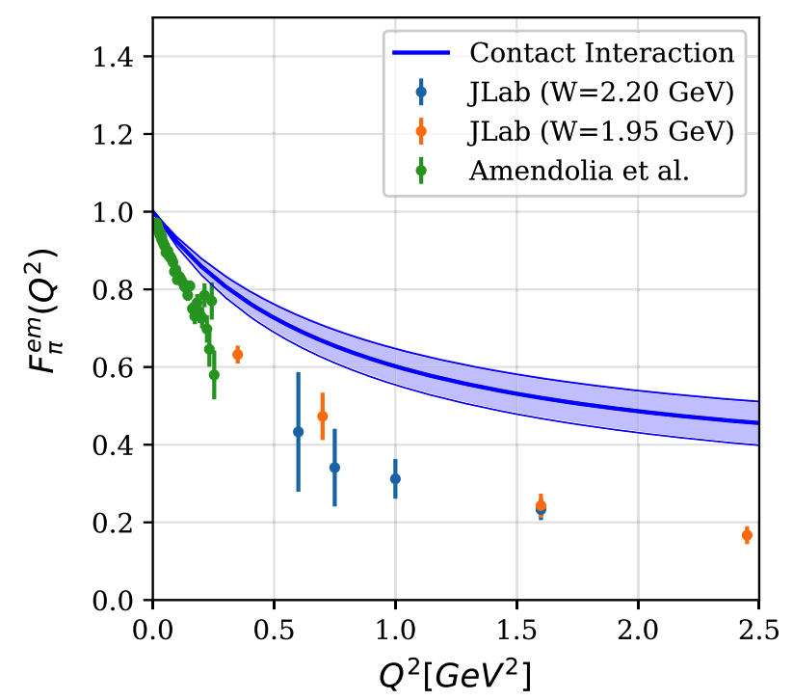


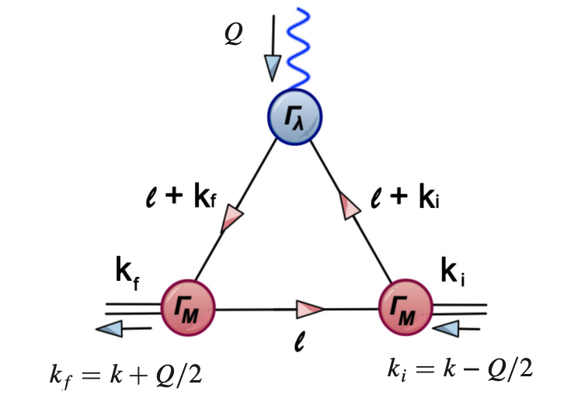
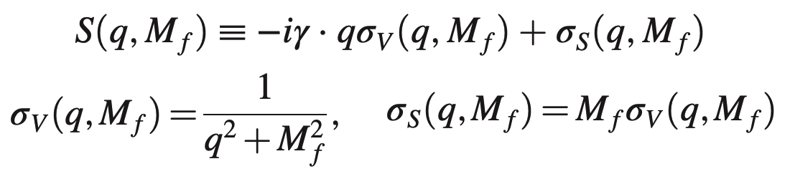
The contact interaction (CI)
The SDE for the quark propagator of flavor f:
Bethe-Salpeter
equation:
It is known that a mass scale is generated
for the gluon in the infrared.
Bethe-Salpeter amplitude
Pion form factor
L.X. Gutierrez, AB, et. al., Phys. Rev. C81 (2010) 065202

Slide 13
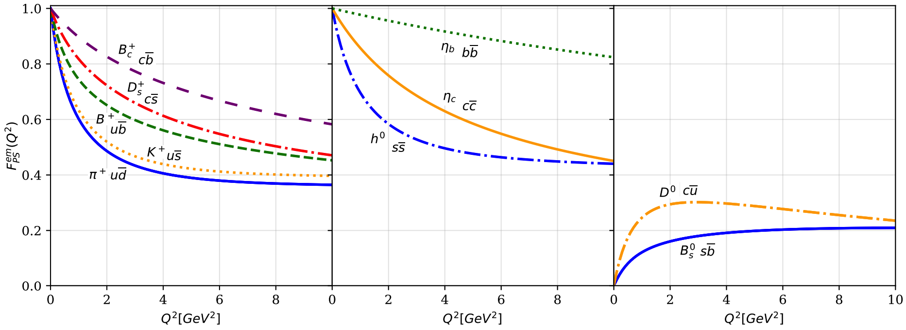
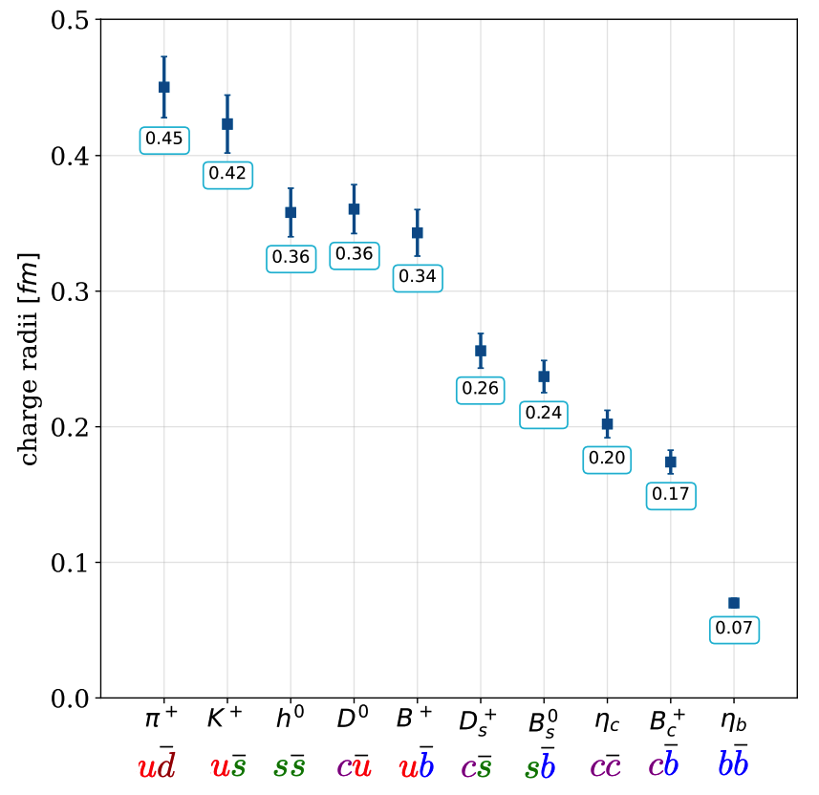
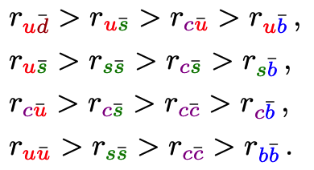
Pseudoscalar mesons in CI
Electromagnetic form factors of electrically charged and
neutral pseudo-scalar mesons in a Contact Interaction model.
Charge radii of pseudo-scalar mesons with a permissible variation
of the defining parameters.
Hierarchy of the charge radii of pseudo-scalar mesons:
R.J. Hernández, L.X. Gutiérrez, AB, M.A. Bedolla, I.M. Higuera, Phys. Rev. D 107 (2023) 5, 054002

Slide 14
Truncating Schwinger-Dyson equations
Sophisticated Truncations
Numerically Demanding
“QCD Predictions”
QCD Green Functions
Mesons – Static, FFs, PDAs, PDFs
Schwinger-Dyson Equations
Most Observables
Mesons, Baryons
Moderate Simplicity
QCD-like Predictions
Contact Interaction
QCD-Inspired & Data Driven
Algebraic Models
Simple Implementation
Insightful - Mindful
LFWFs, GPDs, TMDs,
PDFs, FFs, Mesons, Baryons

Slide 15
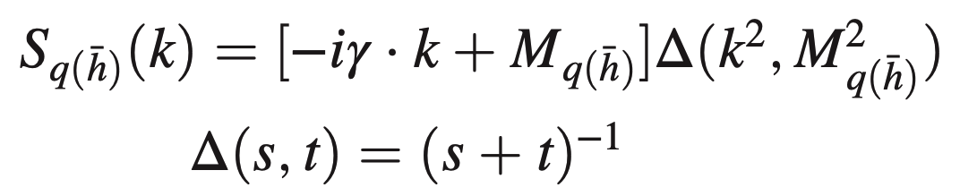
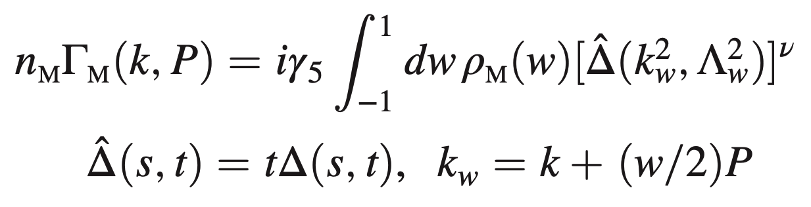

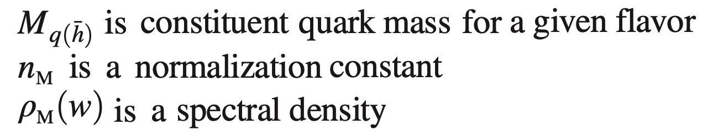

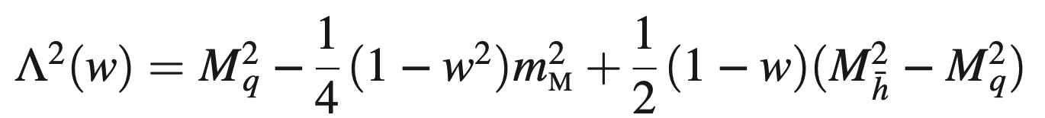
The Algebraic Model (AM)
It retains the constant term from original models, setting it to M_{q}.
There is a term linear in w with the coefficient (M_{h}² − M_{q}²). For same flavored quarks, it ceases to contribute by construction.
There is a quadratic term w² with coefficient m_{M}². The condition
It guarantees the positivity of
The quark propagator:
Bethe-Salpeter Amplitude:

Slide 16
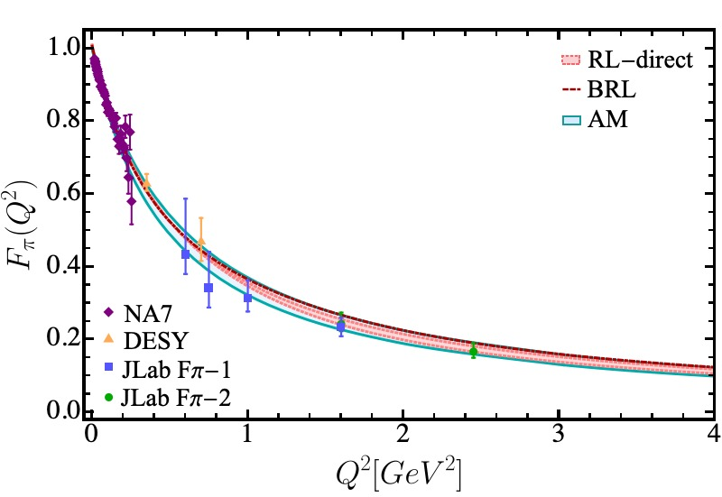

Form Factors and charge radii in algebraic model
Electromagnetic form factors and the charge radii are obtained via generalized parton distributions or the direct evaluation of the triangle diagram.
A. Miramontes, AB, K. Raya, P. Roig,
Phys. Rev. D 105 (2022) 7, 074013
I.M. Higuera, R.J. Hernández, K.Raya, A. Bashir,
Phys. Rev. D 110 (2024) 3, 034013

Slide 17


Form Factors and charge radii in algebraic model
We can test the efficacy of the Algebraic Model and evaluate the electromagnetic form factor to larger Q² range: 0-40 GeV².
I.M. Higuera, R.J. Hernández, K.Raya, AB, Phys. Rev. D 110 (2024) 3, 034013
H-T Ding, X. Gao, A.D. Hanlon, S. Mukherjee, P. Petreczky, Q, Shi, et. al., Phys. Rev Lett. 133 (2024) 18, 181902

Slide 18


Form Factors and charge radii in algebraic model
We can now compare the charge radii for different modelling of the Schwinger-Dyson and Bethe-Salpeter equations.
A. Miramontes, AB, K. Raya, P. Roig, Phys. Rev. D 105 (2022) 7, 074013
B. Almeida-Zamora, L. Albino, AB, J.J. Cobos-Martínez, J. Segovia,e-Print: 2602.10775 [hep-ph]

Slide 19
Summary and Outlook
Electromagnetic form factors and charge radii of pion and kaon, as well as their box diagram contributions to the g-2 of the muon were studied in QCD akin truncations of SDEs.
A. Miramontes, AB, K. Raya, P. Roig, Phys. Rev. D 105 (2022) 7, 074013
A similar study on the excited pion and kaon, and their charge radii has also been complete:
A.S. Miramontes, K. Raya, AB, P. Roig, G. Paredes, Chin. Phys. C49 (2025) 8. 083108
Through the contact interaction model, a detailed analysis of form factors and charge radii of pseudo-scalar, scalar, vector and axial-vector mesons can be found in:
R.J. Hernández-Pinto, L.X. Gutiérrez-Guerrero, AB, M.A. Bedolla, I.M. Higuera-Angulo, Phys. Rev. D 107 (2023) 5, 054002
R.J. Hernández-Pinto, L.X. Gutiérrez-Guerrero, M.A. Bedolla, AB, Phys. Rev. D 110 (2024) 11, 114015
R.J. Hernández-Pinto, L.X. Gutiérrez-Guerrero, M.A. Bedolla, AB, submitted to Phys. Rev. D
Algebraic model computations can be found in:
L. Albino, I.M. Higuera-Angulo, K. Raya, AB, Phys. Rev. D 106 (2022) 3, 034003
I.M. Higuera-Angulo, R.J. Hernández-Pinto, K. Raya, AB, Phys. Rev. D 110 (2024) 3, 034013
L. Albino, K. Raya, R.J. Hernández-Pinto, B. Almeida-Zamora, J. Segovia, A. Huet, AB, Phys. Rev. D 113 (2026) 3, 034019
B. Almeida-Zamora, L. Albino, AB, J.J. Cobos-Martínez, J. Segovia, e-Print: 2602.10775 [hep-ph]

Slide 20
Thank you for your attention

