Slide 1






Extracting nuclear charge radii systematics from spectroscopy of highly charged ions
Hunter Staiger, Abrar Faiyez, Steven Blundell, Dipti, Ronald Garcia-Ruiz, Nobuyuki Nakamura, Naoki Kimura, Daiji Kato, Witold Nazarewicz, Paul-Gerhard Reinhard, István Angeli, Endre Takacs

Slide 2
Summary
Nuclear charge radius surface
Highly charged ion (HCI) based charge radii measurements
Why HCIs?
Challenges: nuclear model dependence, interpretation of results
Investigating nuclear structure with charge radius trends
Conclusions and outlook

Slide 3
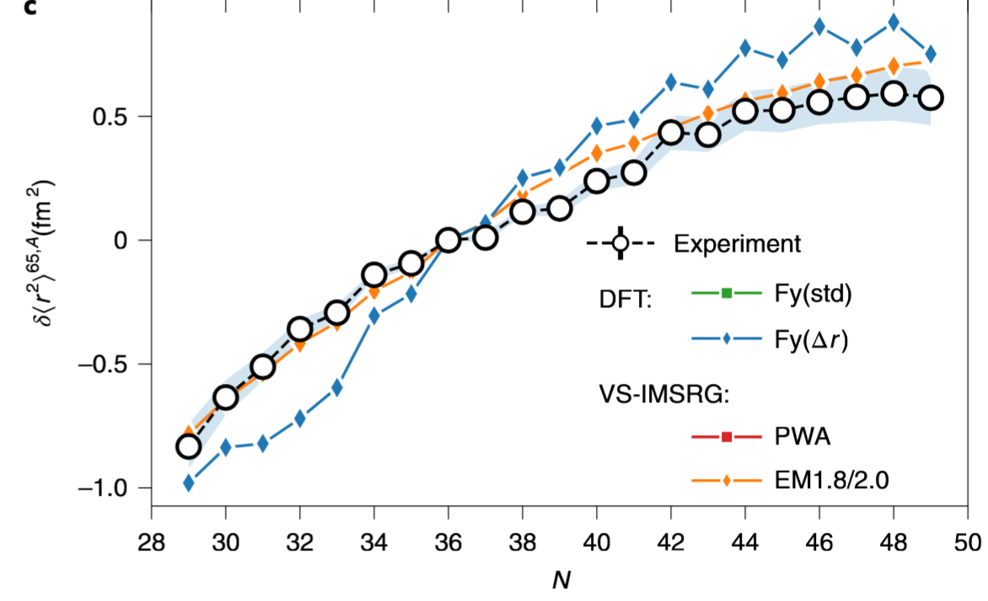
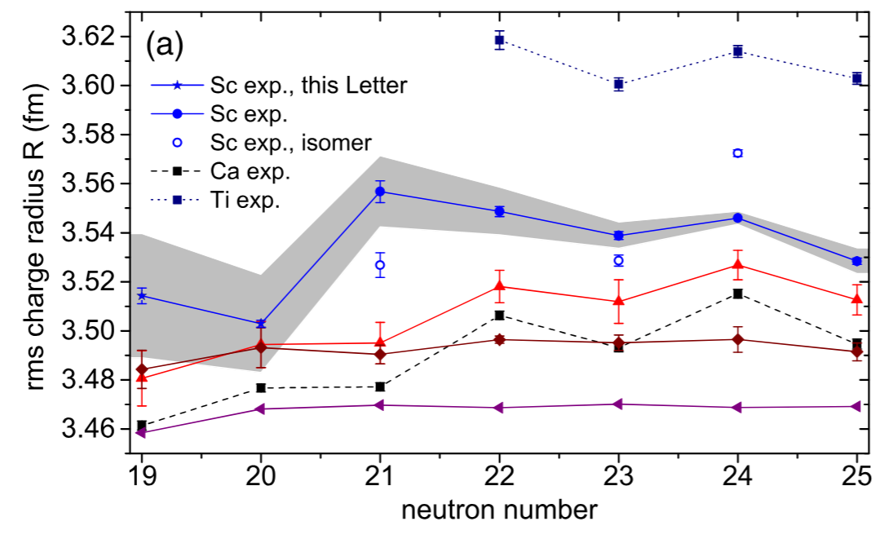
Isotopic Structure Studies
Odd-even staggering in Cu
R.P. de Groote Nat. Comm. 16, 620 (2020)
Experimental radius data guides + benchmarks nuclear structure theory.
Kink in Sc charge radii
K. König PRL 131, 102501 (2023)

Slide 4
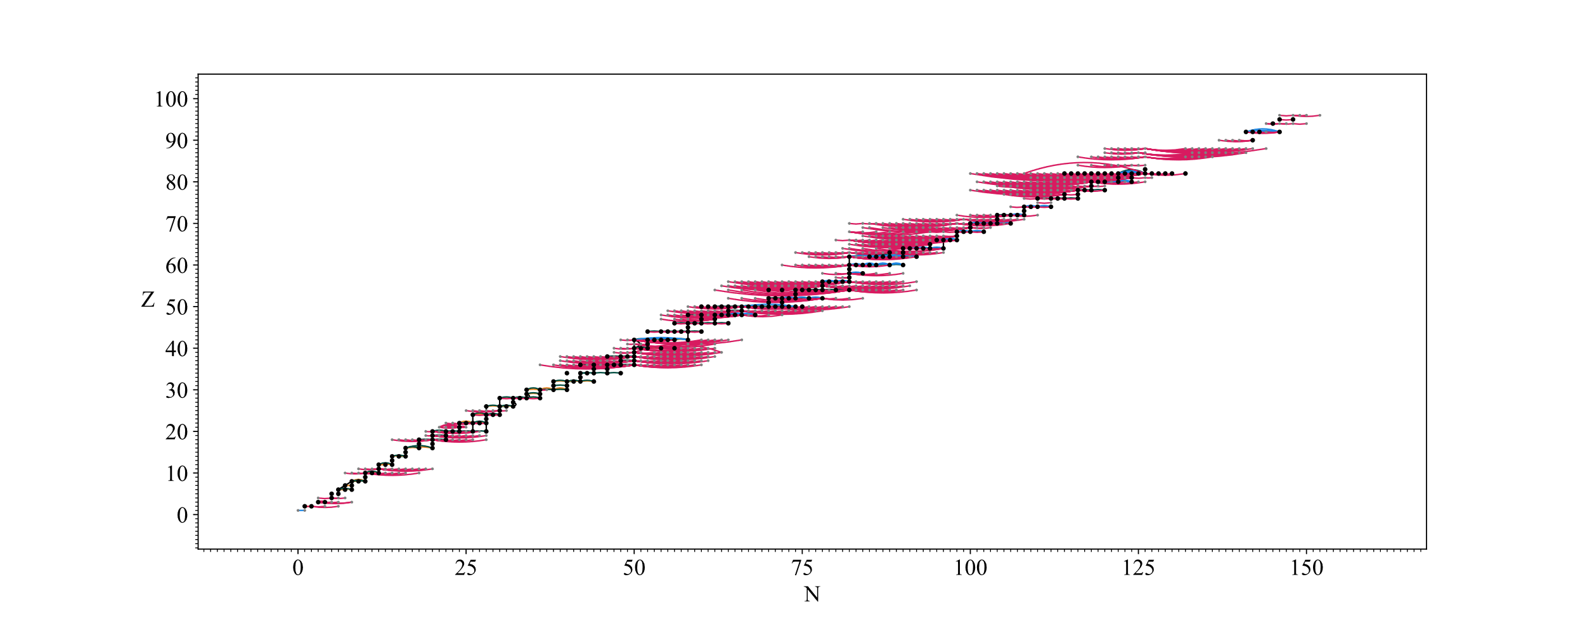
Nuclear Surface is 2 Dimensional

Slide 5
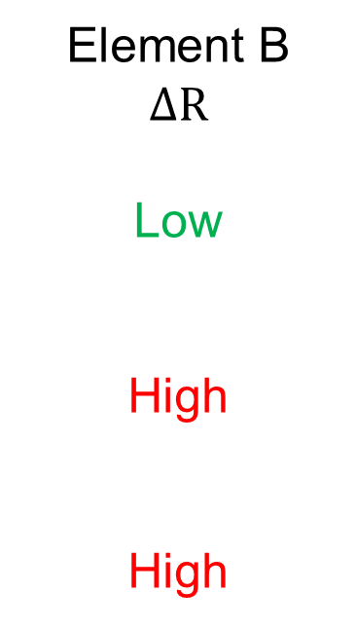

Use Cases of Inter-Element Measurements
Element A
$$ΔR$$
Low
Low
High
Element B
$$ΔR$$
Low
High
High
Testing consistency of absolute measurements
Lowering absolute nuclear charge radius uncertainties through connection.
Extract differential trends in nuclear charge radii

Slide 6
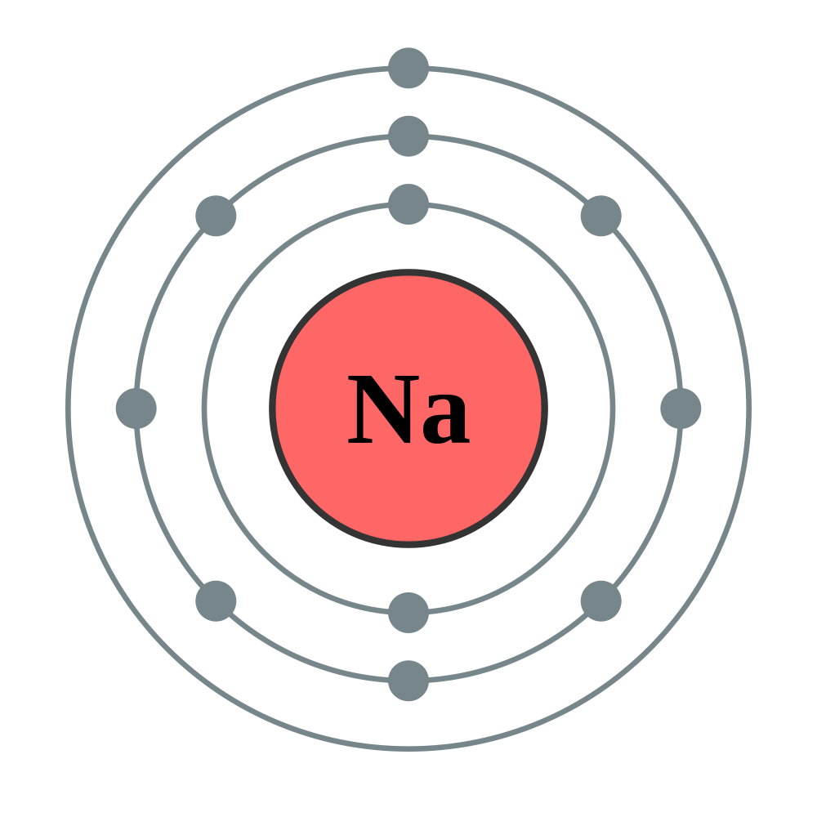


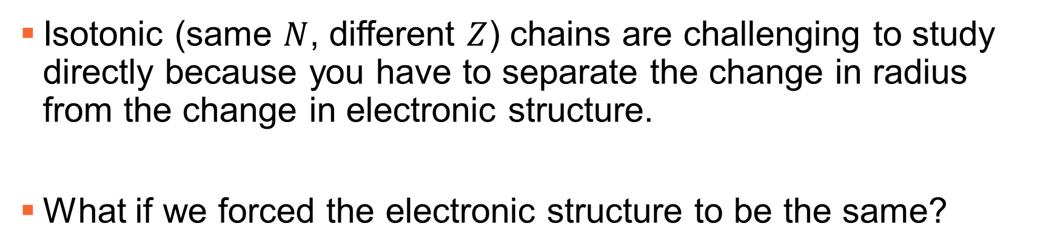
Challenge: How to Study Isotonic Chains
Isotonic (same $N$, different $Z$) chains are challenging to study directly because you have to separate the change in radius from the change in electronic structure.
What if we forced the electronic structure to be the same?

Slide 7


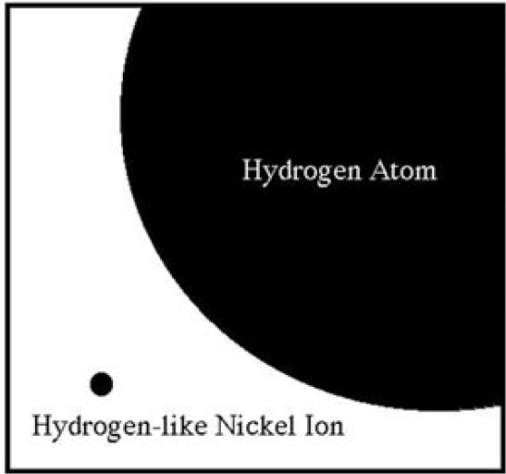


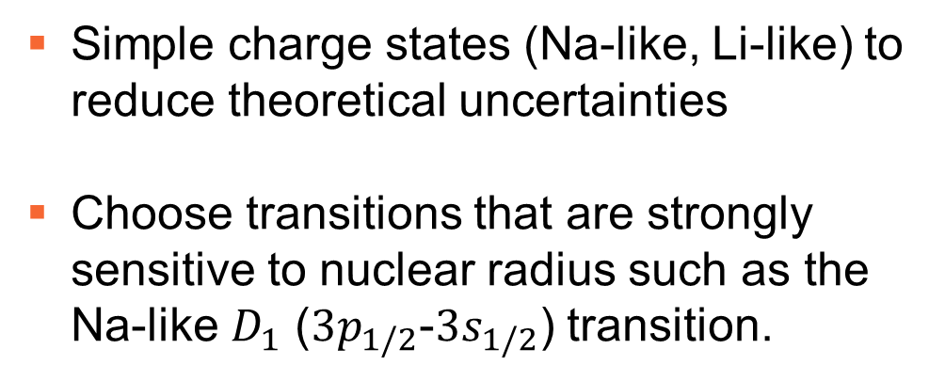
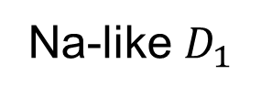
Highly Charged Ion (HCI) Radius Measurements
Simple charge states (Na-like, Li-like) to reduce theoretical uncertainties
Choose transitions that are strongly sensitive to nuclear radius such as the Na-like $D_{1}$ ($3p_{1/2}$-$3s_{1/2}$) transition.
Na-like $D_{1}$
J.D. Gillaspy J. Phys. B. 34, R93 (2001)

Slide 8

HCI Radius Measurements: Experiment
Creation and excitation of HCIs are done in an EBIT
Electron beam (E≈15 keV) repeatedly ionizes and radially traps ions
Drift tubes provide axial trapping
https://www.nist.gov/video/electron-beam-ion-trap

Slide 9
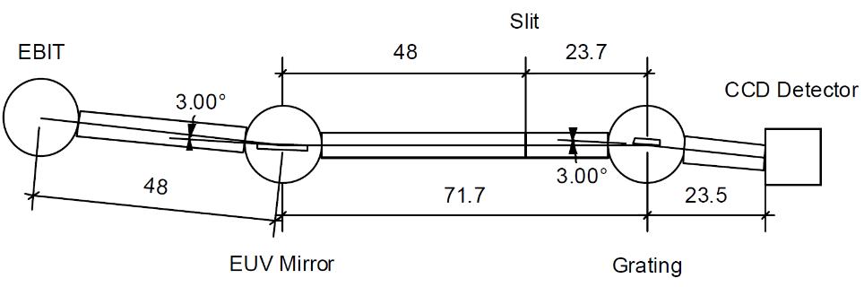
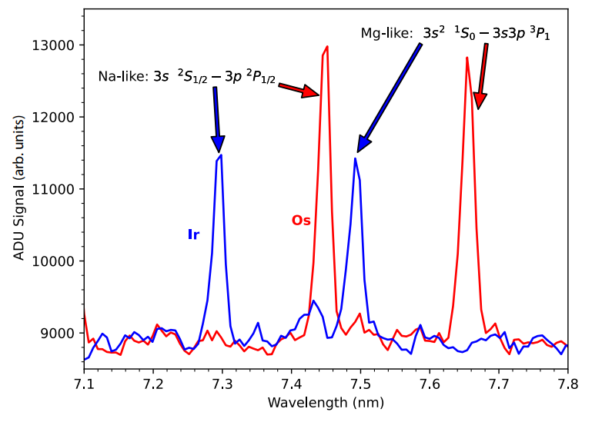


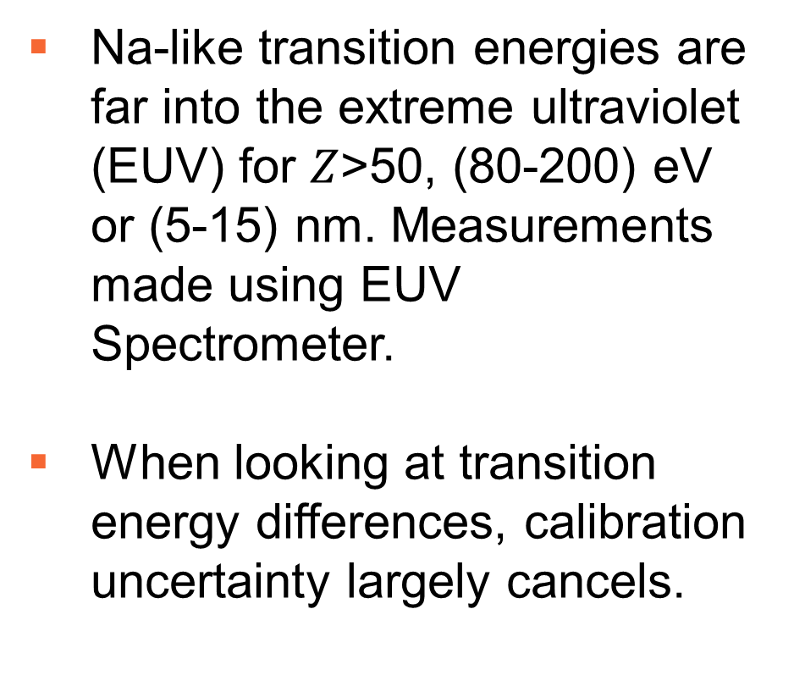
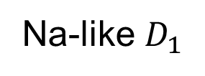
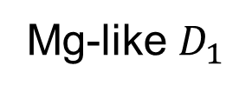
HCI radius measurements: experiment
Na-like transition energies are far into the extreme ultraviolet (EUV) for $Z$>50, (80-200) eV or (5-15) nm. Measurements made using EUV Spectrometer.
When looking at transition energy differences, calibration uncertainty largely cancels.
Mg-like $D_{1}$
Na-like $D_{1}$
DOI: 10.1103/PhysRevResearch.7.L012024

Slide 10
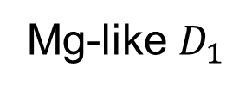
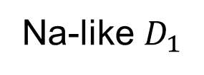
HCI Radius Measurements: Theory
Transition energies calculated using relativistic many body perturbation theory (RMBPT).
Recent result: Mg-like calculation using RMBPT + configuration interaction to handle strong n=3 state mixing.
Mg-like $D_{1}$
Na-like $D_{1}$

Slide 11
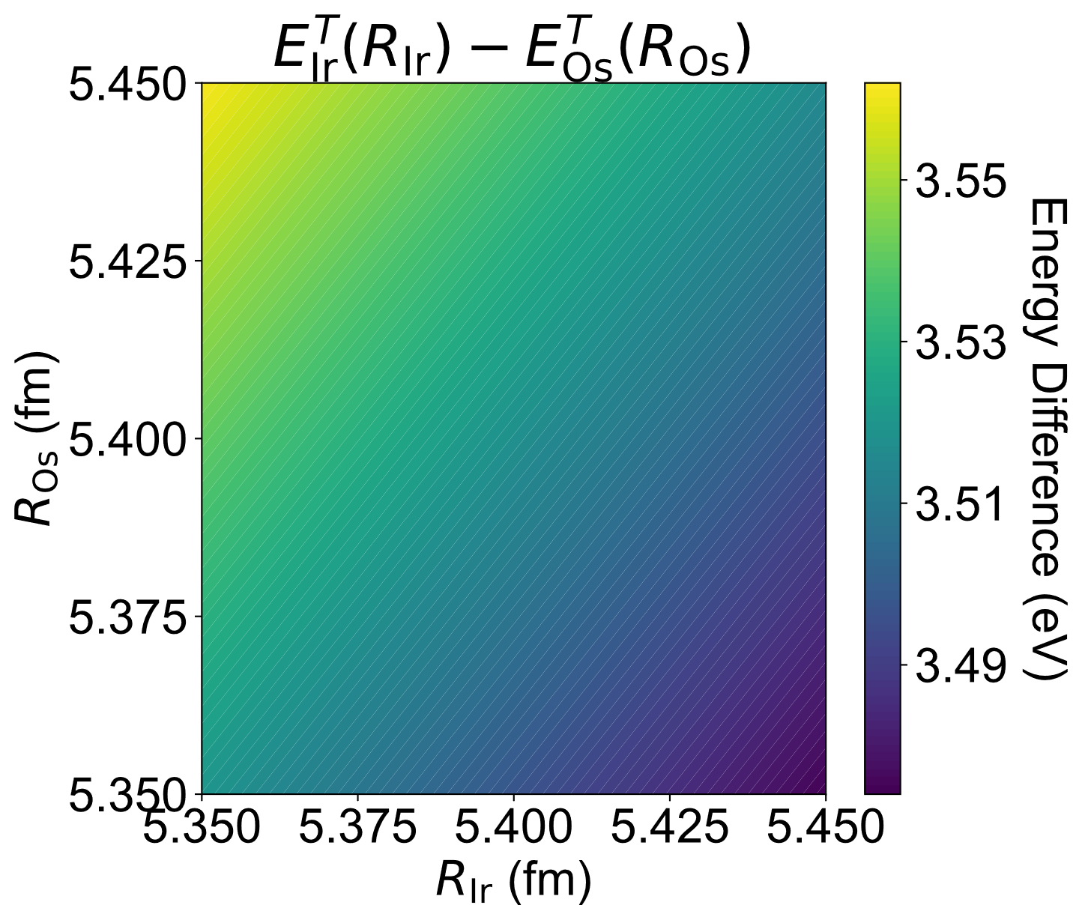
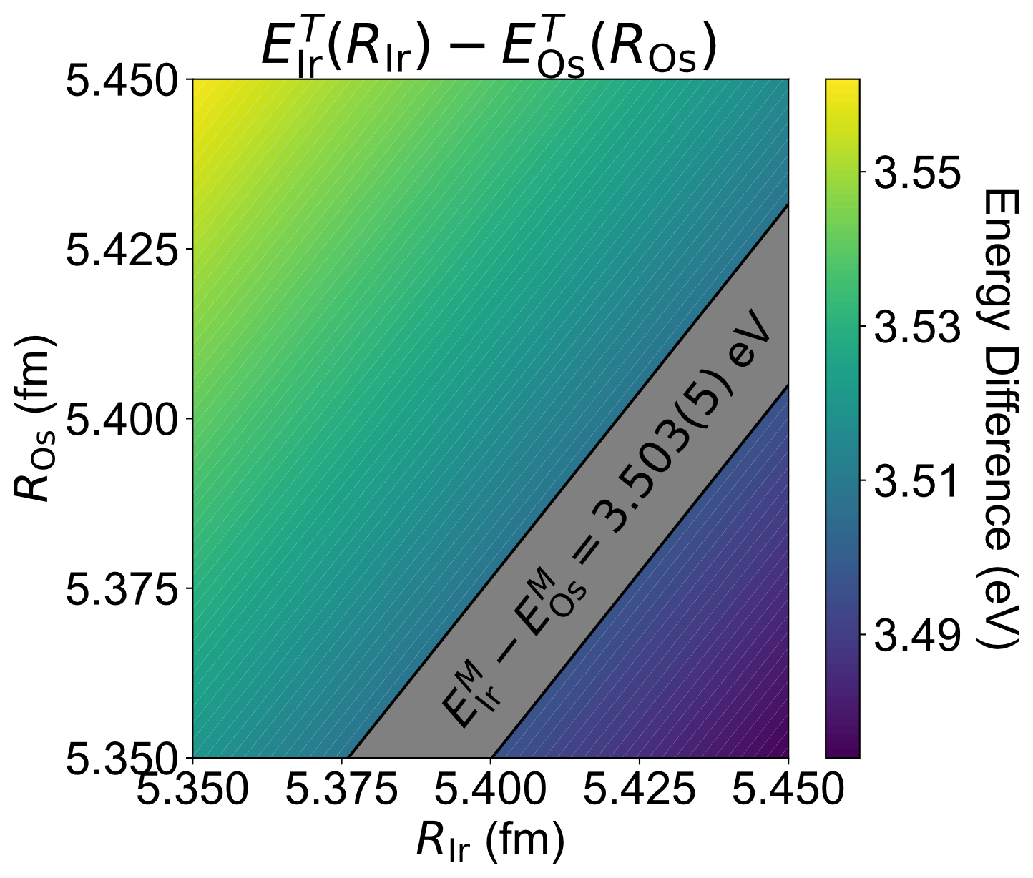
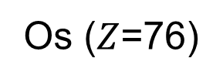
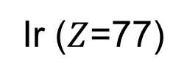
HCI Radius Measurements
Ir ($Z$=77)
Os ($Z$=76)

Slide 12
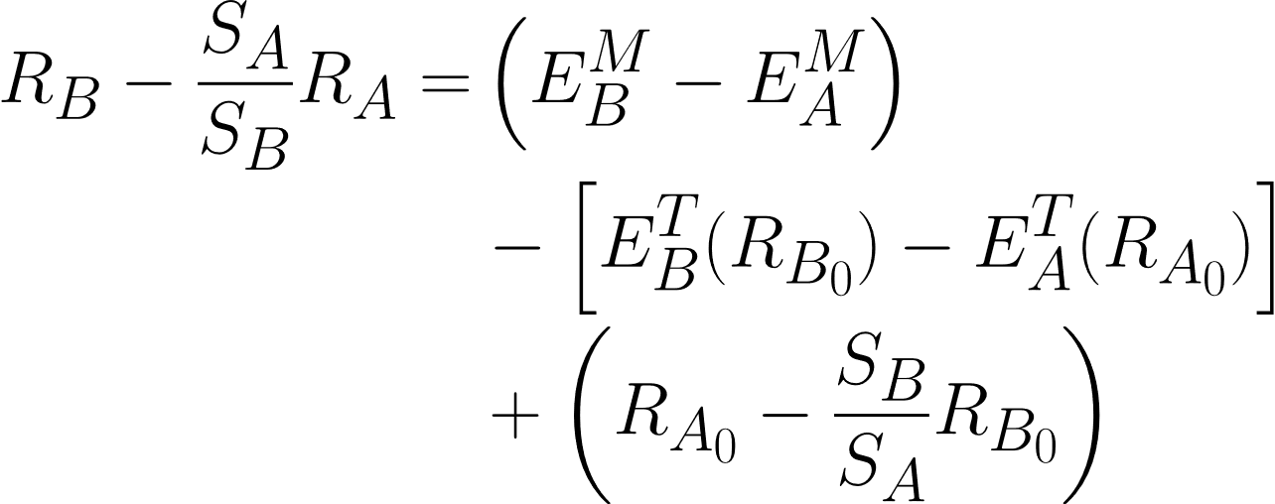

HCI radius measurements

Slide 13
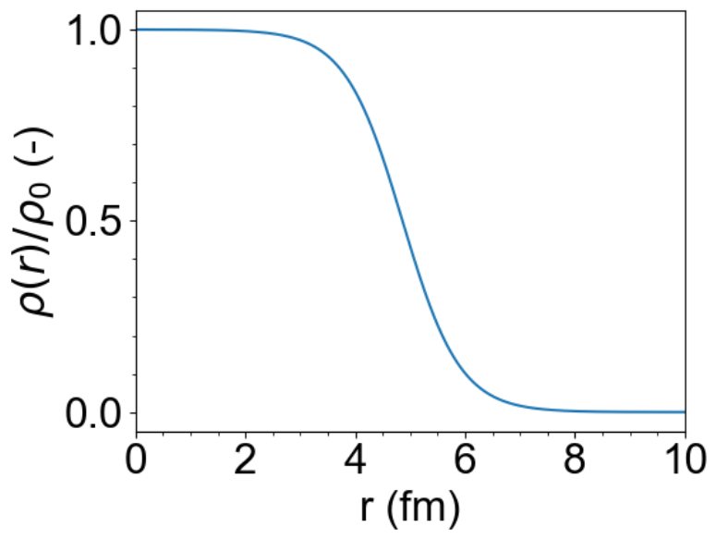
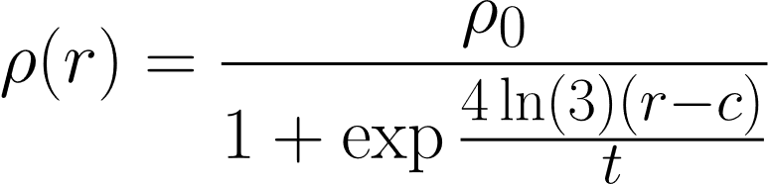
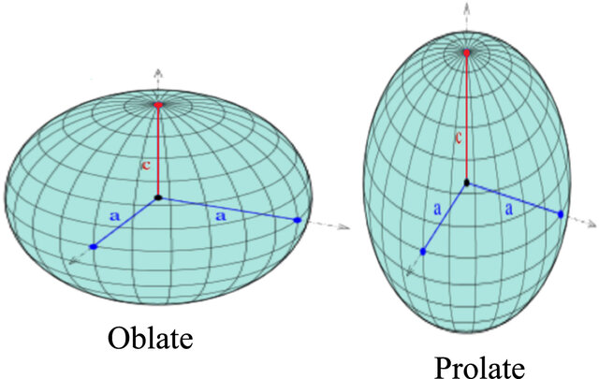
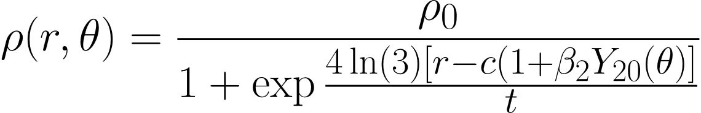
Nuclear model dependence
2-parameter Fermi distribution (spherical nuclei)
3-parameter Fermi distribution (deformed nuclei)
Image Credit: E. Yazdankish Phys. Scr. 98, 115309 (2023)

Slide 14
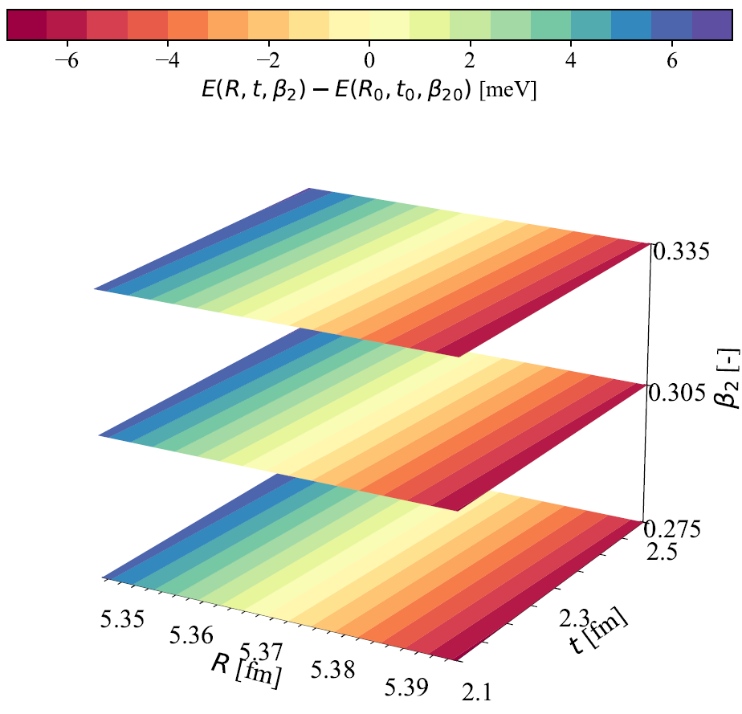
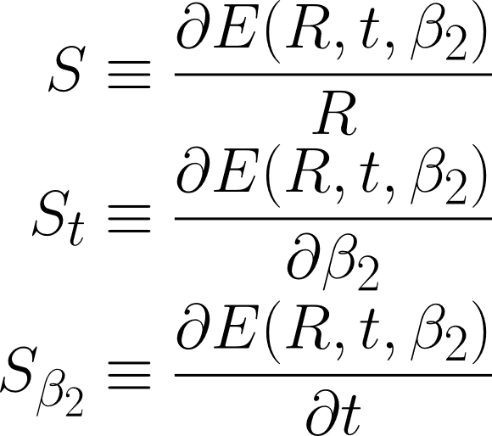

Nuclear model dependence
Mostly Model Independent

Slide 15
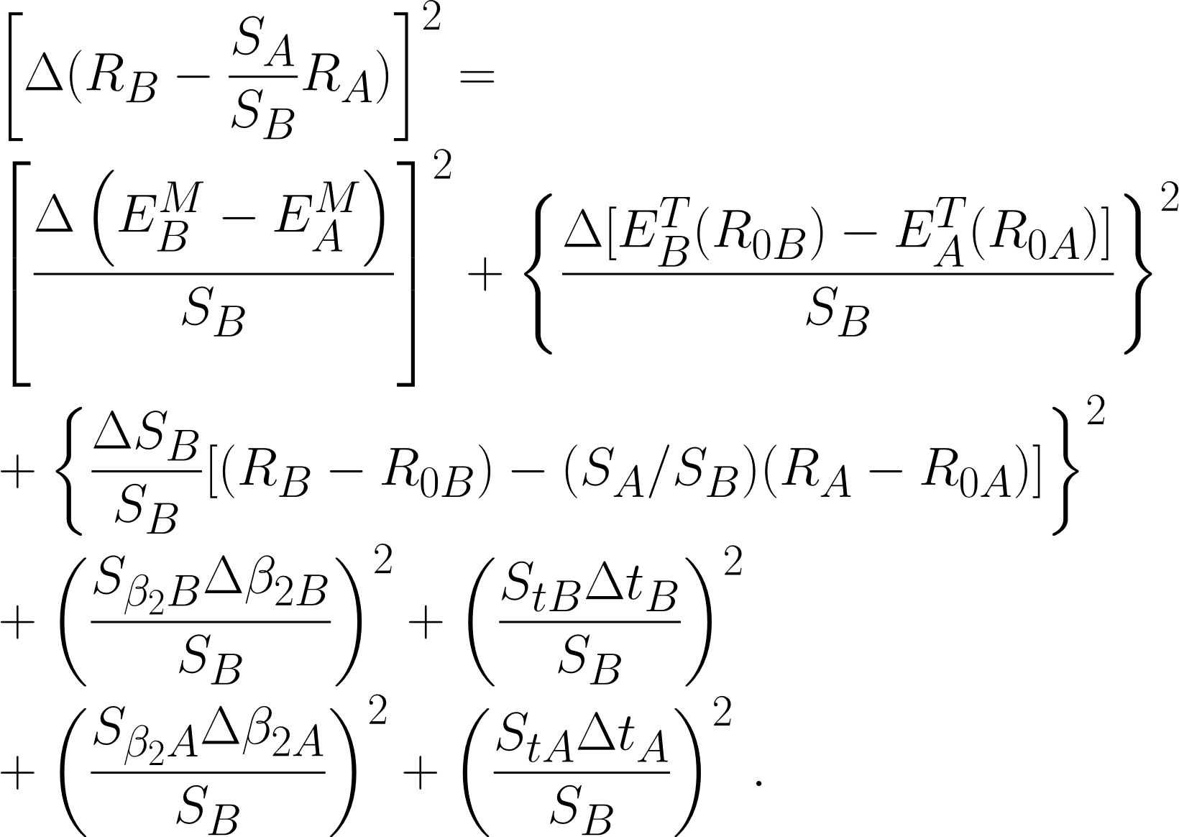
HCI radius measurements
Uncertainty in experimental and theoretical energy differences.
Uncertainty in radial sensitivity coefficient
Uncertainty in other nuclear parameters.

Slide 16
Previous HCI Radius Determinations
Xe136 – Xe124 radius difference from Na-like
R. Silwal PRA 98, 052502 (2018)
Xe136 – Xe124 radius difference from Na-like, Mg-like, Al-like
R. Silwal PRA 101, 062512 (2020)
Natural abundance Ir – Os radius difference from Na-like
A. Hosier PRR 7, L012024 (2025)
Reanalysis of Li-like Pb, Bi
V. Yerokhin PRA 113, 012804 (2026)

Slide 17
Puzzling Odd-Even Staggering (OES) of Rare Earth Nuclei

Slide 18
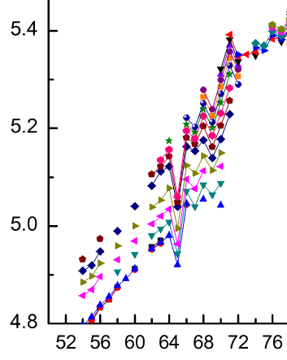
The Puzzle
Rare earth nuclei are highly deformed, causing an odd/even stagger in charge radii
Exception: Lu (Z=71)?
Color: # of Neutrons
Charge Radius (fm)
Image Credit: E. Yazdankish Phys. Scr. 98, 115309 (2023)
Angeli ADNDT 2013
Proton Number

Slide 19
Lu radius measurement
Ytterbium (Z=70) radii are known to 0.006 fm
Lutetium (Z=71) radii are known to 0.030 fm
Determine Lu-Yb scaled radius difference – lower radius uncertainty of Lu radii.

Slide 20
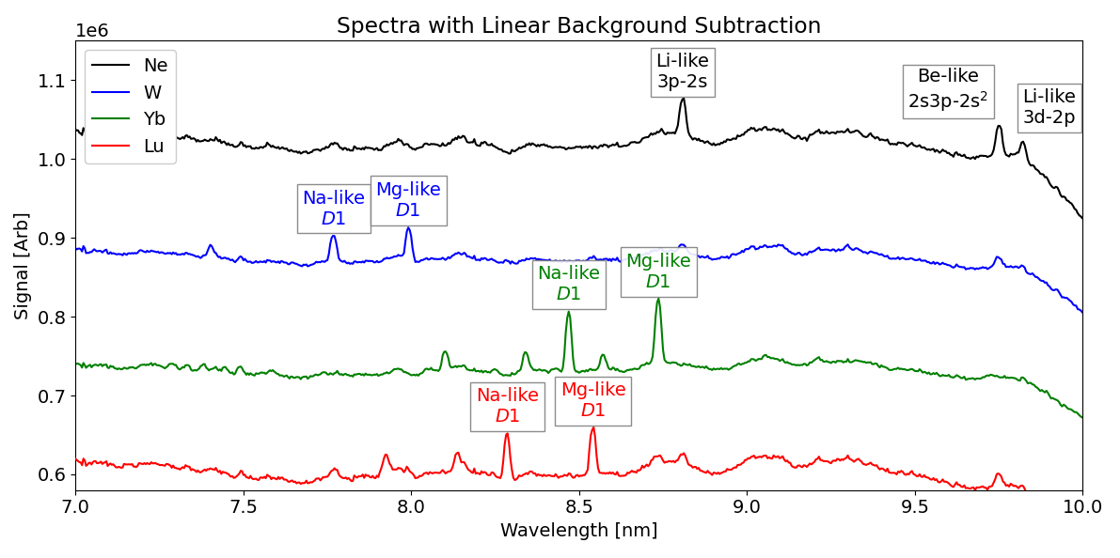
Lu-Yb: The Experiment
5 day run, injected Lu, Yb, W, and Ne into Tokyo EBIT with electron beam energy of 10 keV.
Use W and Ne spectra for calibration
Note: Inject Ne with W, Lu and Yb to get better signal!
Z=10
Z=74
Z=70
Z=71

Slide 21
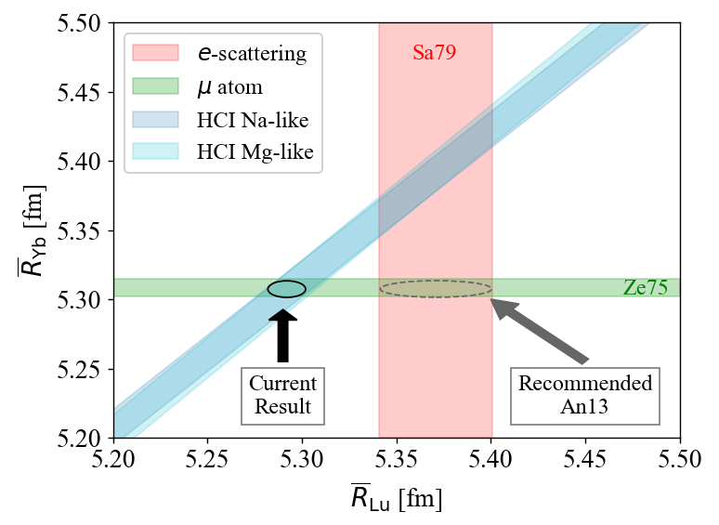
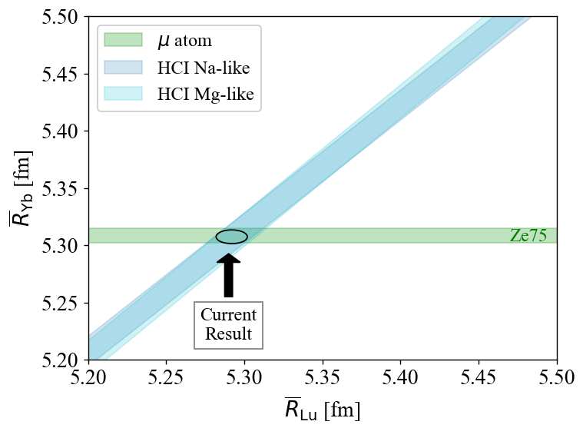
Lu-Yb: Radius Result
Our Lu-Yb difference (blue region) + previous muonic atom measurement (green region) gave a Lu radius of 5.291(11) fm, factor of 3 reduction in uncertainty!
Problem: Previous measurement of Lu radius was 5.37(3) fm?

Slide 22
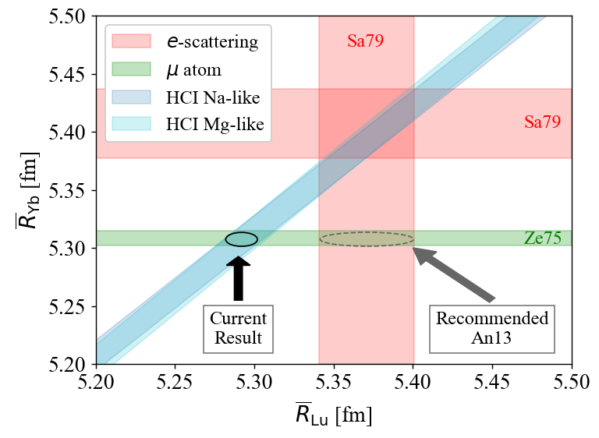
Lu-Yb: Radius Result
Interesting problem: that same e- scattering paper (Sa79) also measured Yb and got a different result than the muonic measurement!
Maybe the radii from Sa79 are systematically too high?
E. Takacs arXiv:2511.19395
H. Staiger arXiv:2511.20537

Slide 23
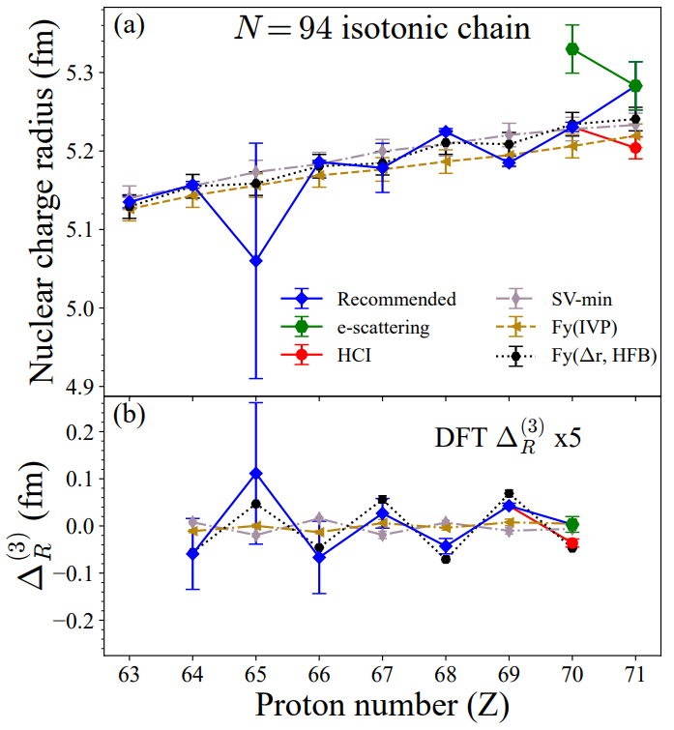
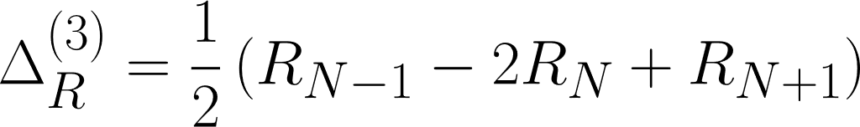
Theory predicts absolute charge radii quite well, all theoretical error bars overlap with experimental ones
However, theory predicts dramatically less stagger than seen in experiment, at least a factor of two or more.
E. Takacs arXiv:2511.19395
H. Staiger arXiv:2511.20537

Slide 24
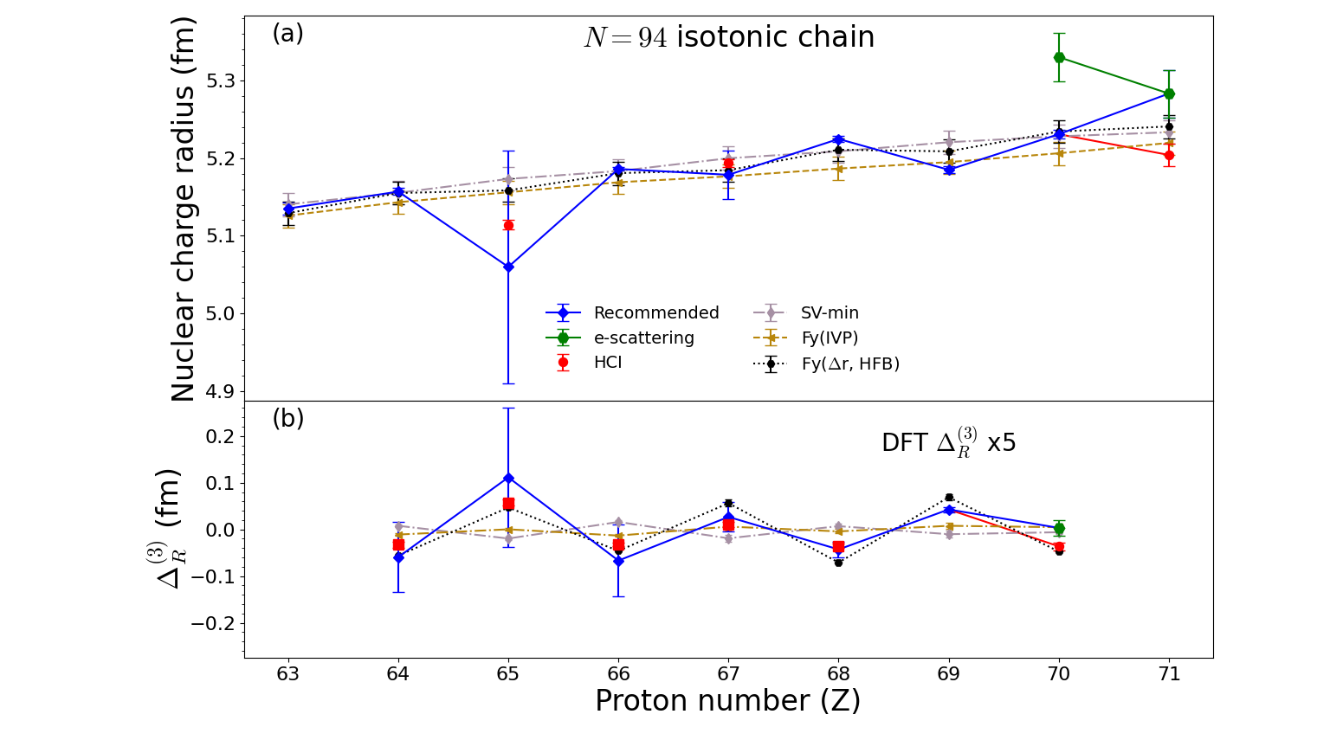
Preliminary

Slide 25
Outlook and Conclusions

Slide 26
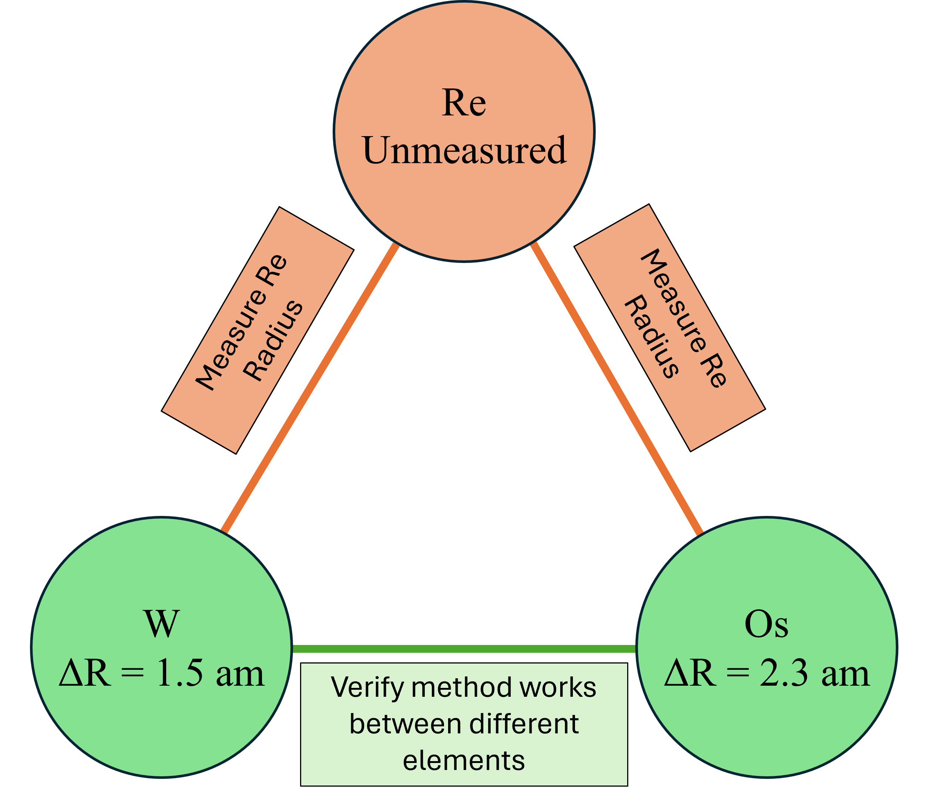
Planned Experiments
Isotopically pure W, Re, Os
Th229 – Th232 radius difference measurement
Injection using laser desorption near trapping region, similar to:
Ch. Schweiger Rev. Sci. Instrum. 90, 123201 (2019)
Developing injection scheme.
Unpublished
Consistency Check

Slide 27
Conclusions
Highly charged ions allow for unique inter-element studies of charge radius trends.
Further measurements of charge radii in the rare earth region are required to explain the tension with nuclear theory
Combining information from different techniques provides unique pathways to charge radius information.

Slide 28


Acknowledgements
This work was funded by a NIST Grant Award Number 70NANB20H87 and by a National Science Foundation Award Number 2309273

Slide 29
Backup Slides

Slide 30
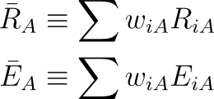
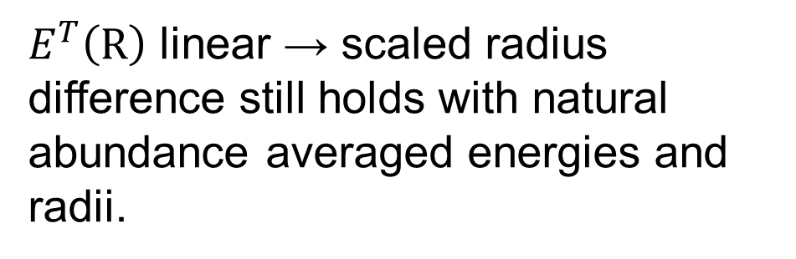
HCI Radius Measurements
$E^{T}\left(R\right)$ linear → scaled radius difference still holds with natural abundance averaged energies and radii.
$w_{iA}$ = Abundance of isotope $i$ of element $A$.

Slide 31


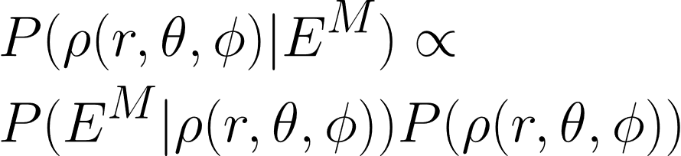
Nuclear Model Dependence
P(R|E^M): Posterior
P(E^M | R): Likelihood
P(R): Prior
Uniform prior -> Maximum likelihood
Likelihood is easy, but how do we place a prior over a function?

Slide 32
Nuclear Model Dependence
We know that the nuclear charge distribution:
Has total charge Z|e|
Is continuous and differentiable
Has finite extent (is zero beyond some cutoff radius)
Is mostly flat near the center (incompressibility)

Slide 33

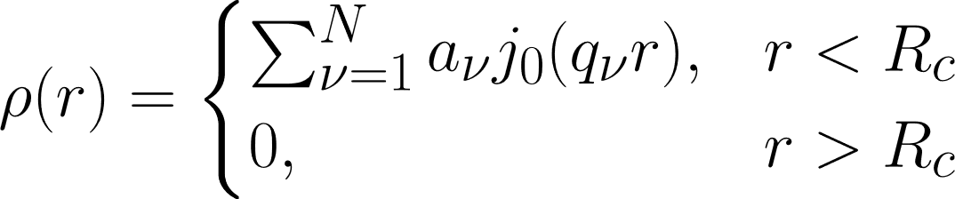
Nuclear Model Dependence: Basis Expansion
Elastic electron scattering measures scattering cross sections for various levels of momentum transfer, provides the most constraints on the shape of the charge distribution.
j0 = spherical Bessel function of zeroth order,
q_v = v pi / R_c,
R_c = cutoff radius

Slide 34
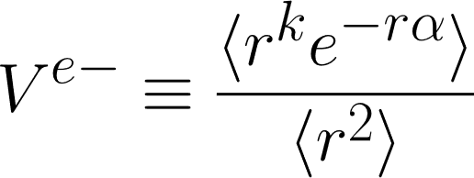

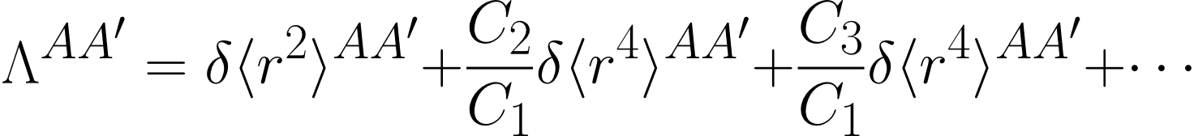
Nuclear Model Dependence: Method of Moments
Define energy as a strict function of some non-radius moment of charge distribution. Take ratio of that moment to the <r^2> moment from e- scattering/muonic data.
“Barrett Moment”
“Seltzer Moment”

Slide 35
HCI radius measurements

Slide 36
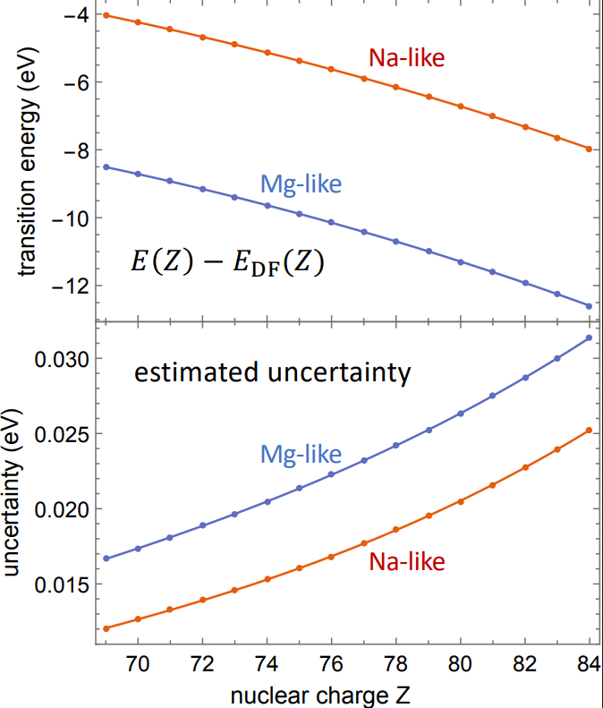
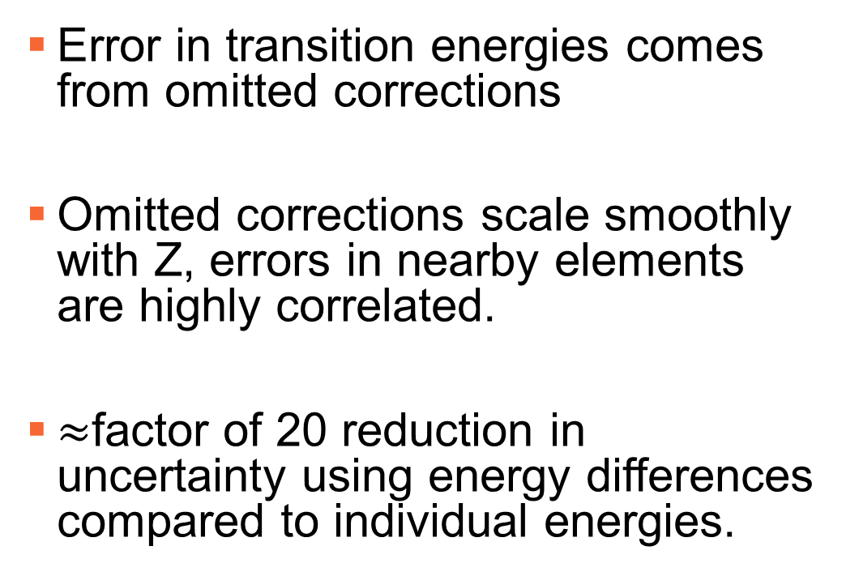
HCI Radius Measurements: Theory
Error in transition energies comes from omitted corrections
Omitted corrections scale smoothly with Z, errors in nearby elements are highly correlated.
$≈$factor of 20 reduction in uncertainty using energy differences compared to individual energies.

