Slide 1

Toward First-Principles Calculations of Nucleon Structure in
Full Light-Front QCD
Siqi Xu
With
Chandan Mondal, Xingbo Zhao, Yang Li, James P. Vary
LC2026, Stony Brook University, Jun 22 – 26, 2026

Slide 2
Outline
Major questions
A platform for light front QCD
Proton structure on light front: valence quarks, gluons and sea quarks

Slide 3
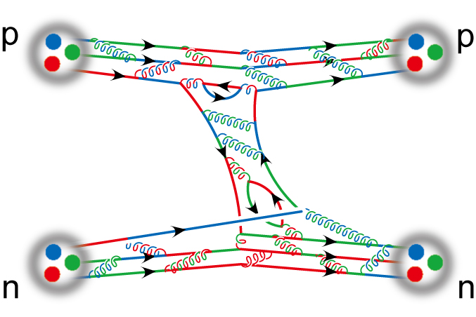
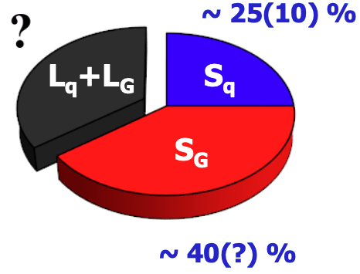
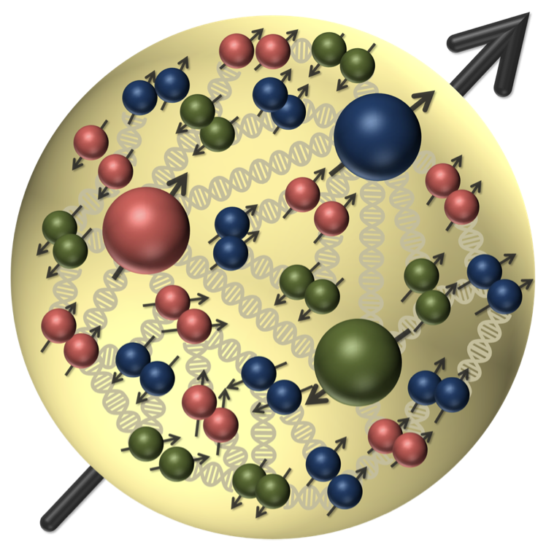


Major Questions in Nuclear Physics
Origin of mass
Spin puzzle
Nuclear force
Ortibal angular momentum
$$\vec{L}=\vec{r}×\vec{p}$$
Need to know 3D tomography of nucleon from QCD
?
$$ℒ_{QCD}=\left( {\overline{ψ}}_{q}(iD −m_{q})ψ_{q}\right)−\frac{1}{4}G_{μν}^{α}G_{α}^{μν}$$
/

Slide 4





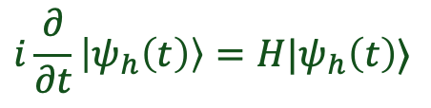
Non-Perturbative Approaches
Hadrons are the eigenstates of the QCD Hamiltonian
$$H|ψ_{h}〉=E_{h}|ψ_{h}〉$$
Lagrangian Formalism
Hamiltonian Formalism
Euclidean Space
Minkowski Space
Correlators: $\left\langle \hat{O}\right\rangle$
Wave Functions: $|ψ_{h}〉$
$$\left\langle \hat{O}\right\rangle =∫D_{ψ}\hat{O}e^{−S_{E}[ψ]}$$
$$H|ψ_{h}〉=E_{h}|ψ_{h}〉$$
$$i\frac{∂}{∂t}\left|ψ_{h}\left(t\right)\right\rangle =H|ψ_{h}\left(t\right)⟩$$
Approach: Lattice QCD, DS / BSE
Approach: DLCQ , BLFQ
Advantanges:
  Covariant, gauge-symmetry
Advantanges:
  Access to distributions, real-time
Hamiltonian and Lagrangian approaches are complementary to each others

Slide 5




Light-front Quantization
Equal time quantization
Light-front quantization
[Dirac, 1949]
Time variable
Quantization surface
Coordinate space
$$x^{1},x^{2},x^{3}$$
$${x^{−}=x}^{0}−x^{3},$$
$$x^{⊥}=x^{1,2}$$
Momentum Space
$$P^{0},\overset{⃑}{P}$$
$${P^{−}=P}^{0}−P^{3},$$
${P^{+}=P}^{0}+P^{3}$,$P^{⊥}=P^{1,2}$
Dispersion relation
Notes:
Light front was first proposed by Dirac, at 1949.
1. First, what is light-front. Different from equal time theory. We define light-front time as a linear combination of the regular time and one of the spatial coordinate, usually we choose z direction.
So our field quantized at this equal light-front time plane. Where in equal time quantization, they quantized at this equal time plane.
X minus is longitudinal coordinate. P minus is light front Hamiltonian. P plus is longitudinal momentum.
This is light front version of schordinger equation.
Please note that it is not just a coodernate transformation, it is a new theory in a different quantization.
Why go to light front? For we can get Frame Independent wavefunction. Which encods all the information of the bound state structure. It has simple vacuum structure. The theory is boost invariant. And there is no square root in Hamiltonian p minus.

Slide 6
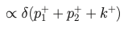



Main Advantage I
1. Simple vacuum
For on-shell particles, $k^{0}≥k^{3}$, so $k^{+}=k^{0}+k^{3}≥0$
$$p_{1}$$
$$k$$
$$p_{2}$$
For example, above diagram can exist in equal time field theory,
but cannot exist in light-front field theory.
Instead of the vacuum problem, Zero Mode problem arise

Slide 7
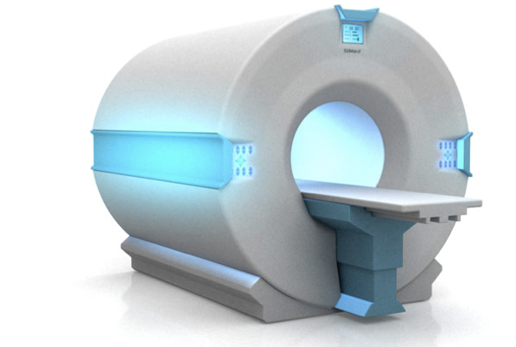

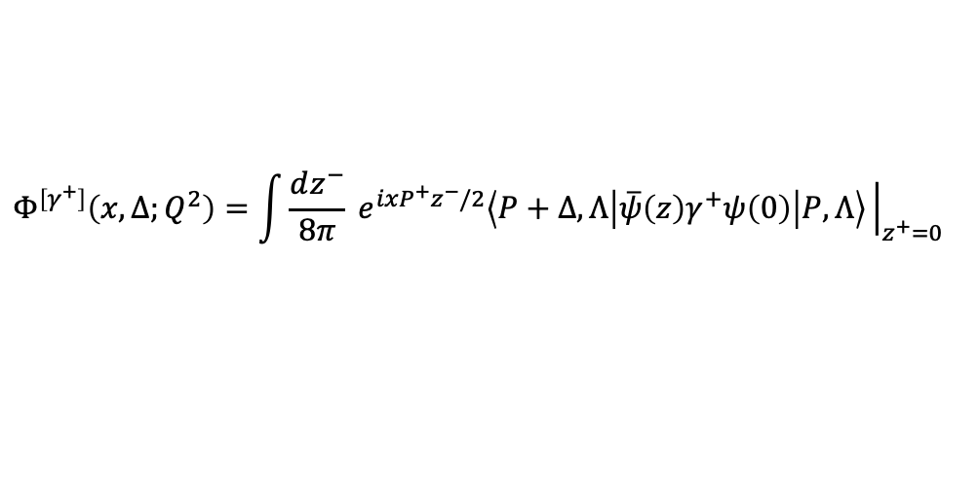
Main Advantage II
2. Frame-independence
Convenience for evaluating observables:
For example:
Generalized Parton Distribution Functions (GPDs)
Encode the information about three-dimensional spatial structure of hadrons
$$Φ^{\left[γ^{+}\right]}\left(x,Δ;Q^{2}\right)=\int{\frac{dz^{−}}{8π}} e^{ixP^{+}z^{−}/2}\left\langle P+Δ,Λ\left|\overline{ψ}\left(z\right)γ^{+}ψ\left(0\right)\right|P,Λ\right\rangle {\left.​\right|}_{z^{+}=0}$$

Slide 8
Basis Light-Front Quantization
Hamiltonian eigenvalue equation:
[Vary, et.al, 2010]
$P^{−}$: Light-Front Hamiltonian
$|\left.N\right\rangle$: Eigenstates
$P_{N}^{−}$: Eigenvalues for eigenstates
$$P^{−}\left|\left.N\right\rangle =P_{N}^{−}\right|\left.N\right\rangle$$
Basis setup:
  Fock sector expansion:
  $$\left|\left.N\right\rangle →\right|\left.qqq\right\rangle +\left|qqqu\overline{u}\right\rangle +\left|qqqd\overline{d}\right\rangle +\left|qqqs\overline{s}\right\rangle +\left|qqqu\overline{u}g\right\rangle +\left|qqqd\overline{d}g\right\rangle +\left|qqqs\overline{s}g\right\rangle +\left|qqqg\right\rangle +\left|qqqgg\right\rangle +\left|qqqggg\right\rangle$$
single particle basis:
$$\left|qqq\right\rangle =|n_{1},m_{1},n_{2},m_{2},n_{3},m_{3}⟩$$
$$⨂ |k_{1}^{+}, k_{2}^{+},k_{3}^{+}⟩$$
$$⨂|λ_{1},λ_{2},λ_{3},C⟩$$
2-d harmonic oscillator (2DHO)
Discretized longitudinal momentum
Helicity and color
$$\sum_{i}{(2n_{i}+\left|m_{i}\right|+1)}≤N_{max}$$
$$\sum_{i}{k_{i}^{+}}=K_{max}$$
$$m_{J}=\sum_{i}{(λ_{i}+m_{i})}$$
Gluon
Fermion
$$k=\frac{1}{2},\frac{3}{2},\frac{5}{2},\frac{7}{2} ……$$
$$k=1, 2, 3, 4, 5, 6 ……$$

Slide 9
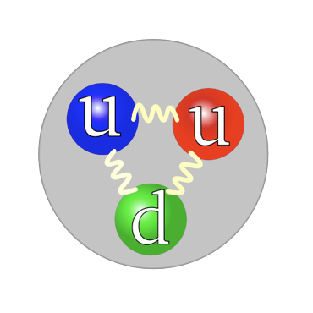
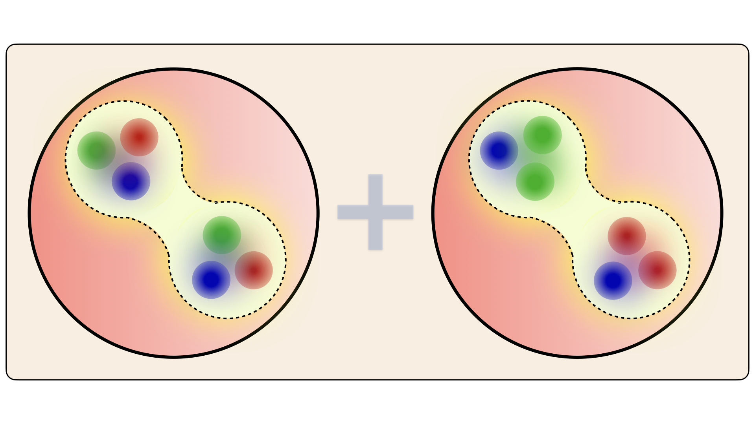






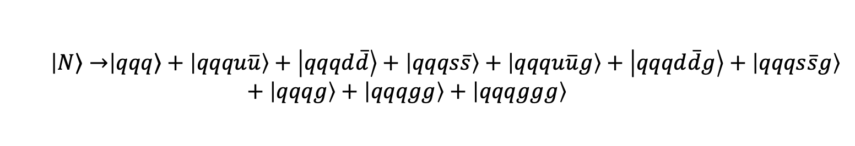
Color Structure
  $$\left|\left.N\right\rangle →\right|\left.qqq\right\rangle +\left|qqqu\overline{u}\right\rangle +\left|qqqd\overline{d}\right\rangle +\left|qqqs\overline{s}\right\rangle +\left|qqqu\overline{u}g\right\rangle +\left|qqqd\overline{d}g\right\rangle +\left|qqqs\overline{s}g\right\rangle +\left|qqqg\right\rangle +\left|qqqgg\right\rangle +\left|qqqggg\right\rangle$$
$\left|qqq\right\rangle$ ～ 1 color singlet state
$\left|qqq g\right\rangle$ ～ 2 color singlet states
$\left|qqq q\overline{q}\right\rangle \sim 3$ color singlet states
$\left|qqq gg\right\rangle \sim 6$ color singlet states
$\left|qqq q\overline{q}g\right\rangle \sim 8$ color singlet states
$\left|qqq ggg\right\rangle \sim 22$ color singlet states
Complicated color structure in higher Fock sectors

Slide 10

BLFQ Algorithm Flowchart
Basis
Preparation
Hamiltonian
Generation
Renormalization and Solution
Color singlet wave function
Observables: $O≡\left\langle N | \hat{O} | N\right\rangle$
Symmetry factor
Basis Enumeration
Light-Front Wave Functions
Color database
QCD Bound state
Hamiltonian Matrix
Diagonalize
Hamiltonian Matrix
Identical particle
information
Generating
mass counter term
Single quark/gluon
Hamiltonian Matrix
Singlet particle basis

Slide 11
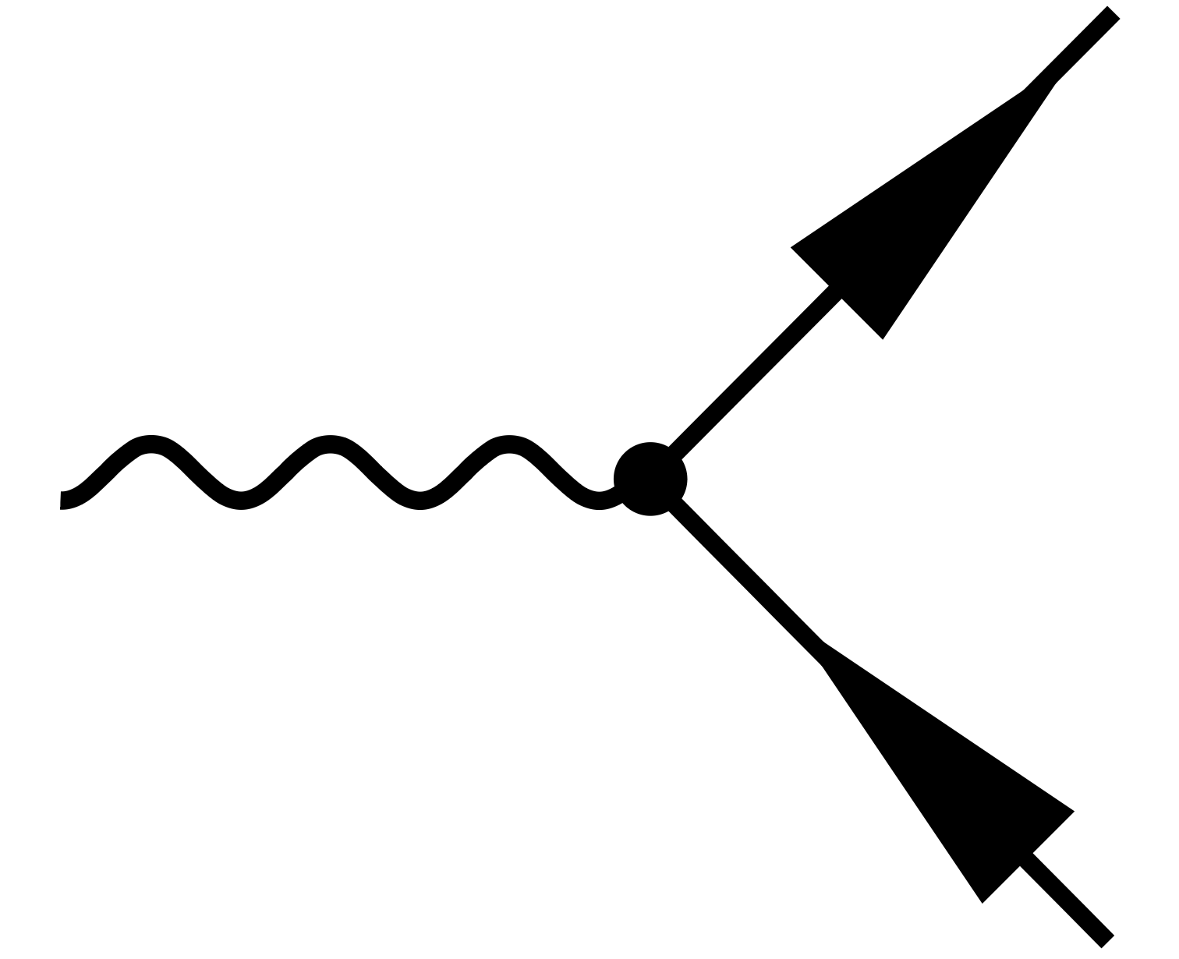

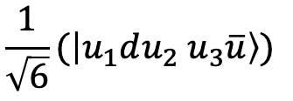


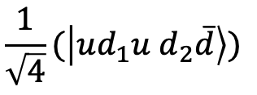
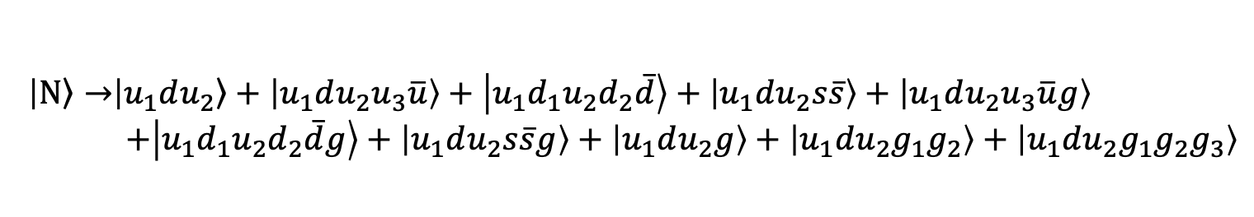
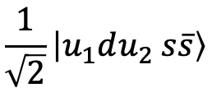

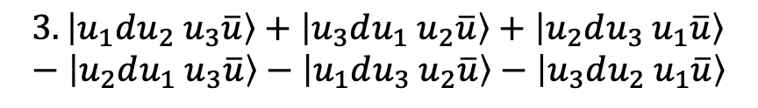

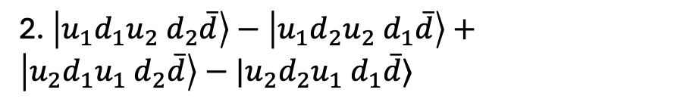
Identical Particle
Work in BLFQ Basis with already solving identical particle issue
$$\left|\left.N\right\rangle →\right|\left.u_{1}du_{2}\right\rangle +\left|u_{1}du_{2}u_{3}\overline{u}\right\rangle +\left|u_{1}d_{1}u_{2}d_{2}\overline{d}\right\rangle +\left|u_{1}du_{2}s\overline{s}\right\rangle +\left|u_{1}du_{2}u_{3}\overline{u}g\right\rangle$$
  $+\left|u_{1}d_{1}u_{2}d_{2}\overline{d}g\right\rangle +\left|u_{1}du_{2}s\overline{s}g\right\rangle +\left|u_{1}du_{2}g\right\rangle +\left|u_{1}du_{2}g_{1}g_{2}\right\rangle +\left|u_{1}du_{2}g_{1}g_{2}g_{3}\right\rangle$
Noncolor quantum number:
$$u_{1}≥u_{2}≥u_{3}$$
$$d_{1}≥d_{2}$$
$$g_{1}≥g_{2}≥g_{3}$$
Light front Hamiltonian with identical particle
1. $\left|u_{1}du_{2} s\overline{s}\right\rangle −\left|u_{2}du_{1} s\overline{s}\right\rangle$
2. $\left|u_{1}d_{1}u_{2} d_{2}\overline{d}\right\rangle −\left|u_{1}d_{2}u_{2} d_{1}\overline{d}\right\rangle +\left|u_{2}d_{1}u_{1} d_{2}\overline{d}\right\rangle −|u_{2}d_{2}u_{1} d_{1}\overline{d}⟩$
$$⟨udu g|$$
$$3.\left|u_{1}du_{2} u_{3}\overline{u}\right\rangle +\left|u_{3}du_{1} u_{2}\overline{u}\right\rangle +\left|u_{2}du_{3} u_{1}\overline{u}\right\rangle −\left|u_{2}du_{1} u_{3}\overline{u}\right\rangle −\left|u_{1}du_{3} u_{2}\overline{u}\right\rangle −\left|u_{3}du_{2} u_{1}\overline{u}\right\rangle$$
For same non color quantum number:
$$\frac{1}{\sqrt{2}}\left|u_{1}du_{2} s\overline{s}\right\rangle$$
$$\frac{1}{\sqrt{4}}(\left|ud_{1}u d_{2}\overline{d}\right\rangle )$$
$$\frac{1}{\sqrt{6}}(\left|u_{1}du_{2} u_{3}\overline{u}\right\rangle )$$

Slide 12
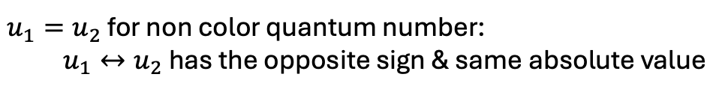
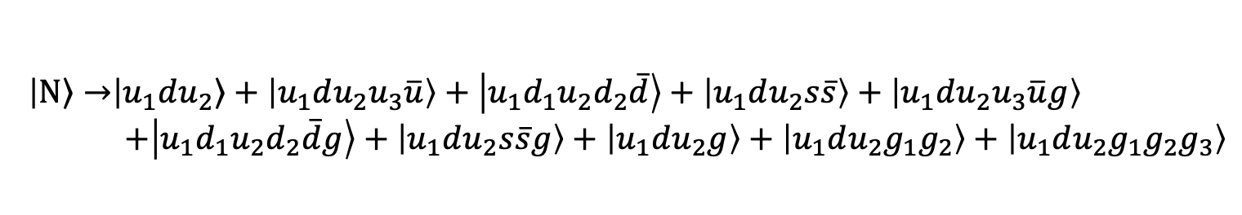
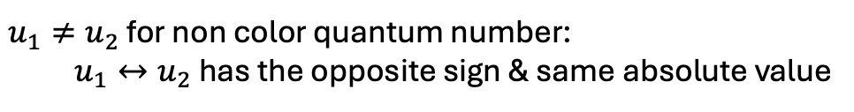
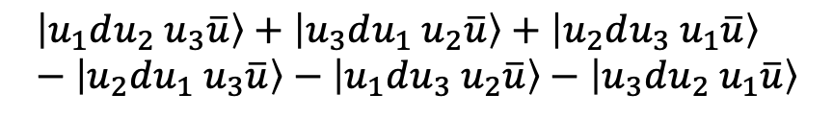

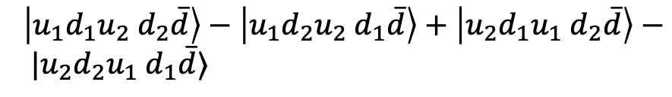


Hamiltonian Symmetry Check
Work in overcomplete Basis
$$\left|\left.N\right\rangle →\right|\left.u_{1}du_{2}\right\rangle +\left|u_{1}du_{2}u_{3}\overline{u}\right\rangle +\left|u_{1}d_{1}u_{2}d_{2}\overline{d}\right\rangle +\left|u_{1}du_{2}s\overline{s}\right\rangle +\left|u_{1}du_{2}u_{3}\overline{u}g\right\rangle$$
  $+\left|u_{1}d_{1}u_{2}d_{2}\overline{d}g\right\rangle +\left|u_{1}du_{2}s\overline{s}g\right\rangle +\left|u_{1}du_{2}g\right\rangle +\left|u_{1}du_{2}g_{1}g_{2}\right\rangle +\left|u_{1}du_{2}g_{1}g_{2}g_{3}\right\rangle$
Particle exchange term in light front Hamiltonian
$\left|u_{1}du_{2} s\overline{s}\right\rangle −\left|u_{2}du_{1} s\overline{s}\right\rangle$
$\left|u_{1}d_{1}u_{2} d_{2}\overline{d}\right\rangle −\left|u_{1}d_{2}u_{2} d_{1}\overline{d}\right\rangle +\left|u_{2}d_{1}u_{1} d_{2}\overline{d}\right\rangle − |u_{2}d_{2}u_{1} d_{1}\overline{d}⟩$
$$⟨udu g|$$
$$\left|u_{1}du_{2} u_{3}\overline{u}\right\rangle +\left|u_{3}du_{1} u_{2}\overline{u}\right\rangle +\left|u_{2}du_{3} u_{1}\overline{u}\right\rangle −\left|u_{2}du_{1} u_{3}\overline{u}\right\rangle −\left|u_{1}du_{3} u_{2}\overline{u}\right\rangle −\left|u_{3}du_{2} u_{1}\overline{u}\right\rangle$$
Exchange symmetries are reserved
$u_{1}≠u_{2}$ for non color quantum number:
  $u_{1}↔u_{2}$ has the opposite sign & same absolute value
$$\left\langle u_{1}du_{2}\right|b_{u1}^{+}b_{u2}^{+}b_{u1}b_{u2}\left|u_{1}du_{2}\right\rangle$$
$u_{1}=u_{2}$ for non color quantum number:
  $u_{1}↔u_{2}$ has the opposite sign & same absolute value
Especially, $u_{1}↔u_{2}$ for $u_{1}=u_{2}$ case work on the subspace of color singlet space.

Slide 13
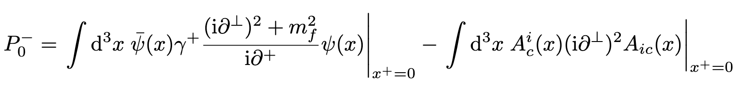
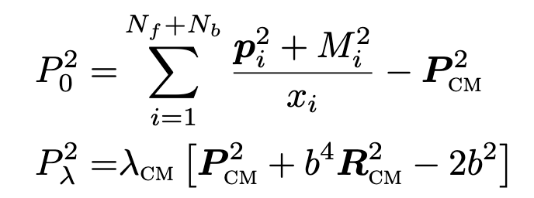
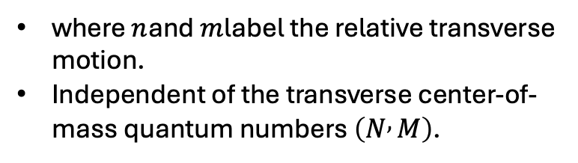


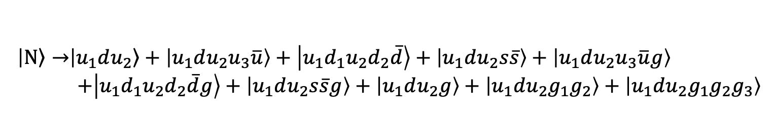




Center of Mass Motion Factorization
Work in BLFQ Basis with already solving identical particle issue
$$\left|\left.N\right\rangle →\right|\left.u_{1}du_{2}\right\rangle +\left|u_{1}du_{2}u_{3}\overline{u}\right\rangle +\left|u_{1}d_{1}u_{2}d_{2}\overline{d}\right\rangle +\left|u_{1}du_{2}s\overline{s}\right\rangle +\left|u_{1}du_{2}u_{3}\overline{u}g\right\rangle$$
  $+\left|u_{1}d_{1}u_{2}d_{2}\overline{d}g\right\rangle +\left|u_{1}du_{2}s\overline{s}g\right\rangle +\left|u_{1}du_{2}g\right\rangle +\left|u_{1}du_{2}g_{1}g_{2}\right\rangle +\left|u_{1}du_{2}g_{1}g_{2}g_{3}\right\rangle$
Non color quantum number:
$$u_{1}≥u_{2}≥u_{3}$$
$$d_{1}≥d_{2}$$
$$g_{1}≥g_{2}≥g_{3}$$
Central mass motion effect
$$P_{int}^{2} \sim f(g,k,n,m)$$
where $n$and $m$label the relative transverse motion.
Independent of the transverse center-of-mass quantum numbers $\left(N , M\right)$.
$$P_{kinetic}^{2}=P_{0}^{2}+P_{λ}^{2}$$
$$\left[P_{int}^{2} , P_{λ}^{2}\right]=0$$
Both the kinetic and interaction terms are evaluated in the sorted basis with the corresponding exchange contributions properly included.

Slide 14
Recent Progress
Build a general numerical platform to investigate the Hadron structure in light front frame
Solving the identical particle issue:
    remove spurious redundant states
    reduction of basis dimension
    ensure exchange symmetry of the system
Reserve center of mass motion factorization

Slide 15
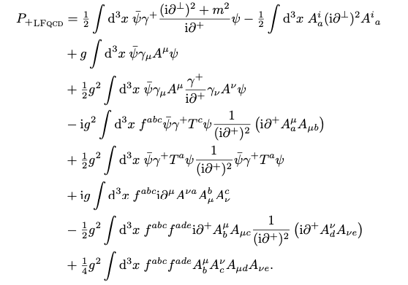
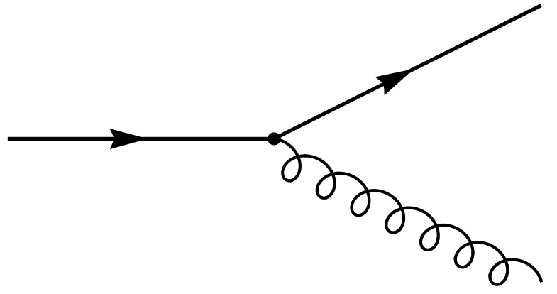
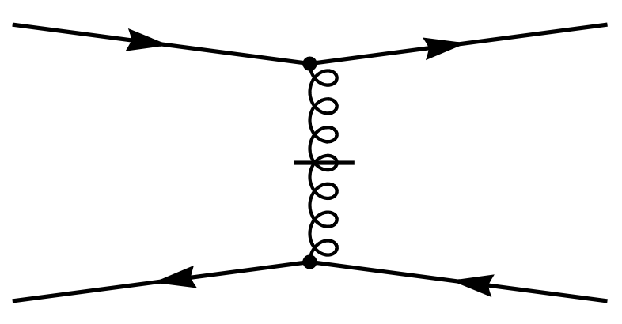
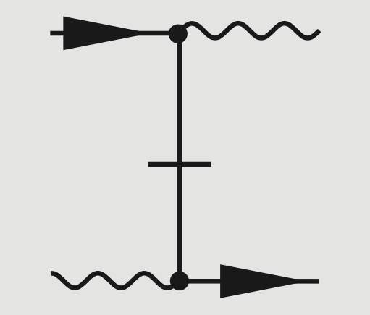
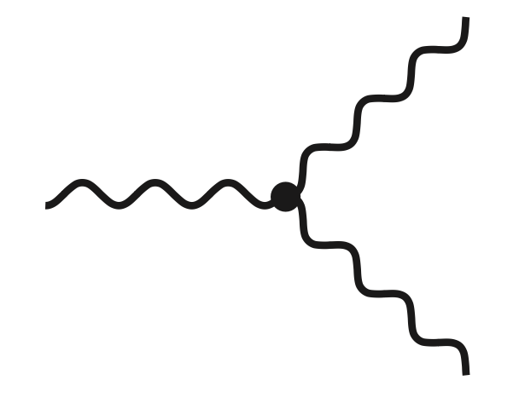
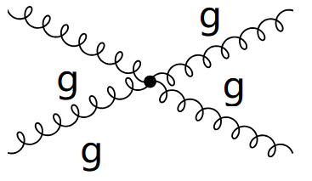



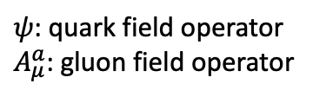



QCD Light-front Hamiltonian
[S. Brodsky, H-C Pauli, S. Pinsky, ‘97]
QCD light-front Hamiltonian from QCD Lagrangian:
$$ℒ_{QCD}=\overline{ψ}\left(iD−m\right)ψ−\frac{1}{4}G_{μν}^{α}G_{α}^{μν}$$
$$A^{+}=0$$
/
$${ P}_{QCD}^{−}=H_{K}+H_{I}$$
$$H_{K}=$$
$$H_{I}=$$
$ψ$: quark field operator
$A_{μ}^{a}$: gluon field operator
7 terms in $H_{I}$
Notes:
Add Fock sector

Slide 16
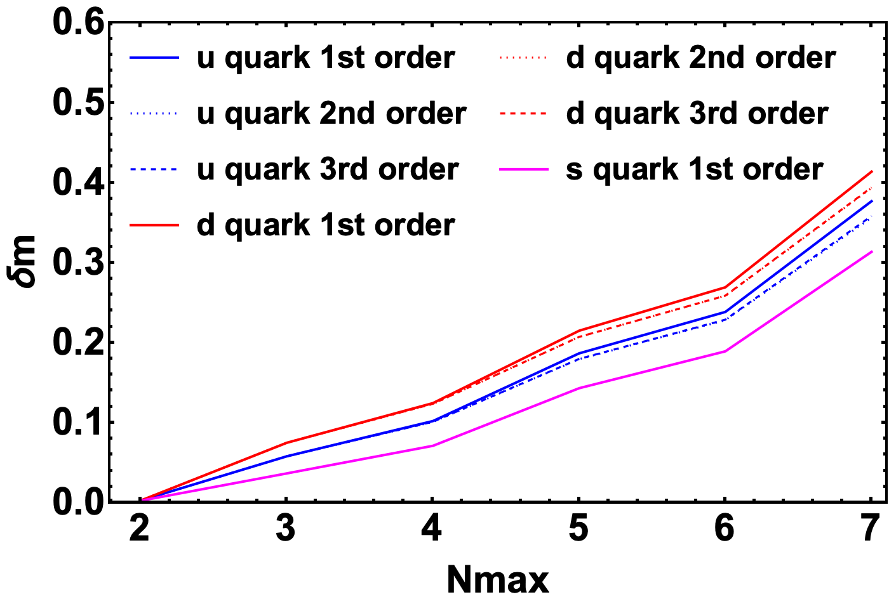
Fock Sector Dependent Renormalization
mass counterterm $δm_{i}^{q/g}$
      -- generated from the single particle system
$P^{−}$: Light-Front Hamiltonian
$|\left.q/g\right\rangle$: Eigenstates of quark & gluon
$M_{q/g}^{2}$: Quark & gluon mass
$$P^{−}P^{+}\left|\left.q/g\right\rangle =M_{q/g}^{2}\right|\left.q/g\right\rangle$$
$$i=1$$
$$i=2$$
$$i=3$$
For Quark:
$$\left|q\right\rangle =\left|q\right\rangle +\left|qg\right\rangle +\left|qq\overline{q}\right\rangle +\left|qgg\right\rangle +\left|qq\overline{q}g\right\rangle +\left|qggg\right\rangle$$
For Gluon:
$$\left|g\right\rangle =\left|g\right\rangle +\left|q\overline{q}\right\rangle +\left|gg\right\rangle +\left|q\overline{q}g\right\rangle +\left|ggg\right\rangle$$
Renormalization Condition:
$M_{q}=m_{q}$, $M_{g}=0$

Slide 17

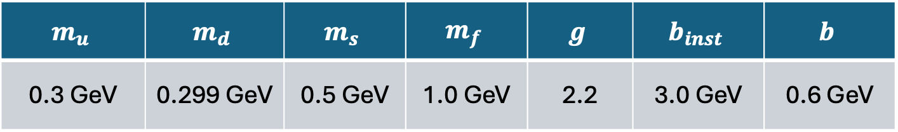
Input Parameters
Truncation Parameters: up to 6-parton Fock sectors with
$N_{max}=7$ & $K=6$
  $$\left|\left.N\right\rangle →\right|\left.qqq\right\rangle +\left|qqqu\overline{u}\right\rangle +\left|qqqd\overline{d}\right\rangle +\left|qqqs\overline{s}\right\rangle +\left|qqqu\overline{u}g\right\rangle$$
  $+\left|qqqd\overline{d}g\right\rangle +\left|qqqs\overline{s}g\right\rangle +\left|qqqg\right\rangle +\left|qqqgg\right\rangle +\left|qqqggg\right\rangle$
Input Parameters:
$$m_{u}$$ | $$m_{d}$$ | $$m_{s}$$ | $$m_{f}$$ | $$g$$ | $$b_{inst}$$ | $$b$$
0.3 GeV | 0.299 GeV | 0.5 GeV | 1.0 GeV | 2.2 | 3.0 GeV | 0.6 GeV
determined by fitting electromagnetic Form Factors and proton mass
separate quark mass in the quark-gluon vertex $m_{f}$ is needed
$$M_{p}=0.93 GeV$$
$$∝gb+…$$
Spin no flip
$$∝gm_{f}+…$$
Spin flip

Slide 18
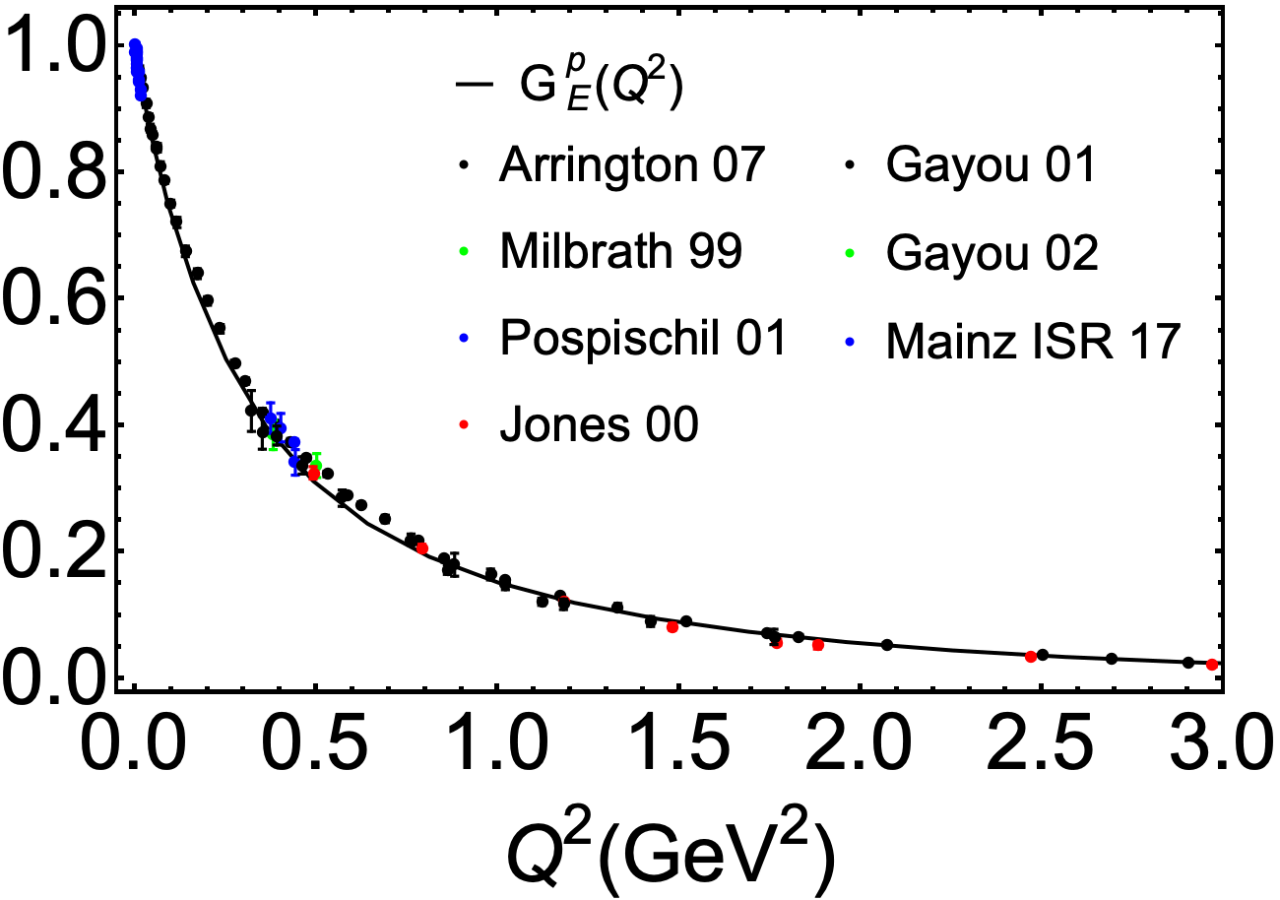
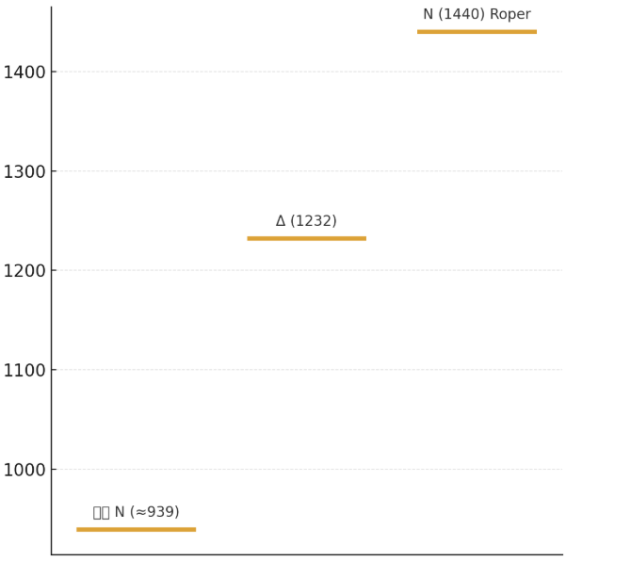
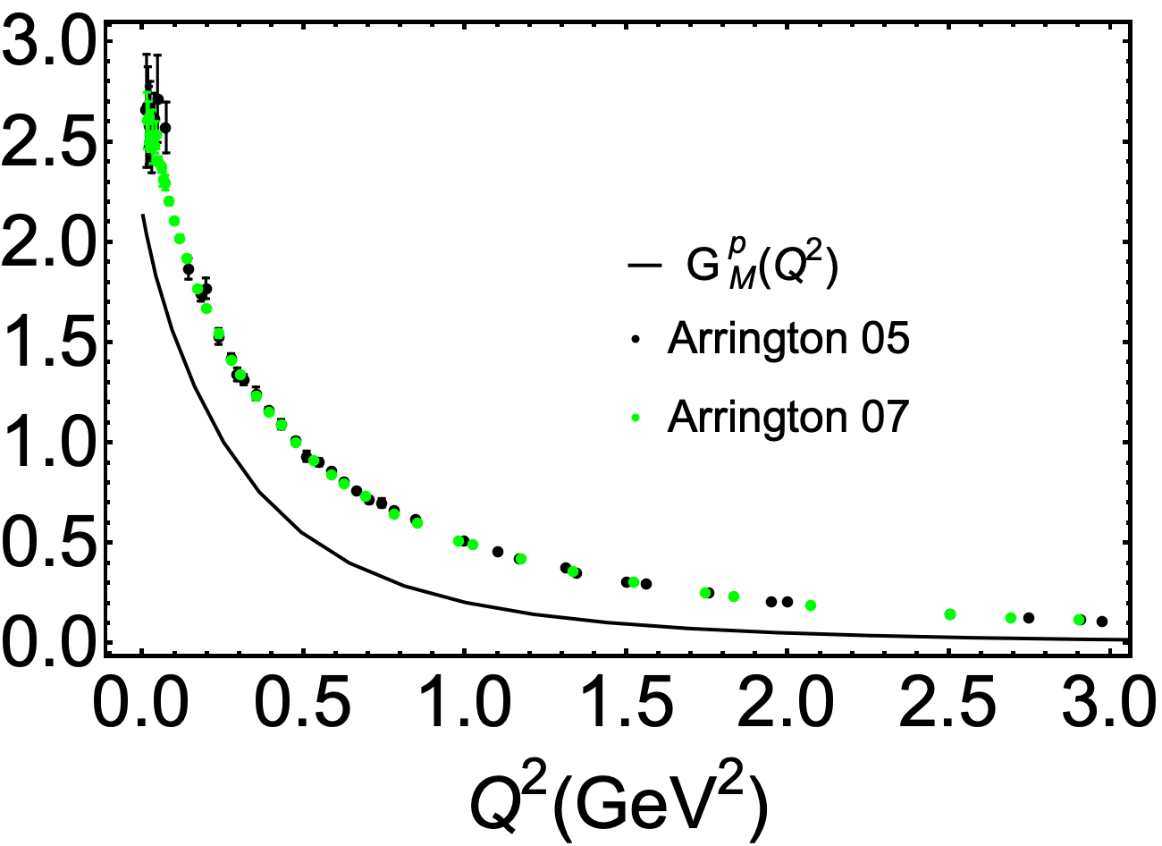
Electromagnetic FF & Mass Spectrum
Preliminary
$b_{inst}$, $b$, $m_{f}$,$g$,$m_{q}$
$$N (1440)$$
$$m_{1/2}−m_{3/2}\sim [10,50]MeV$$
$$\left\langle r_{c}\right\rangle =0.96fm$$
$$Δ (1232)$$
$$Σ (1192)$$
$$m_{J}=1/2$$
$$\left\langle r_{m}\right\rangle =0.93fm$$
$$m_{J}=3/2$$
$$Λ (1115)$$
$$N (939)$$

Slide 19



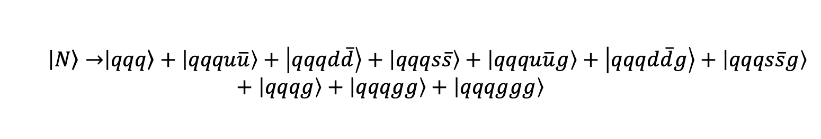
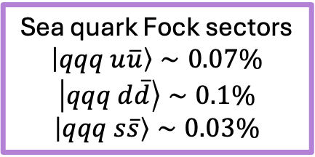
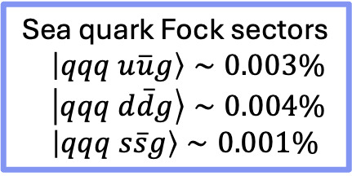


Fock Sector Contribution
  $$\left|\left.N\right\rangle →\right|\left.qqq\right\rangle +\left|qqqu\overline{u}\right\rangle +\left|qqqd\overline{d}\right\rangle +\left|qqqs\overline{s}\right\rangle +\left|qqqu\overline{u}g\right\rangle +\left|qqqd\overline{d}g\right\rangle +\left|qqqs\overline{s}g\right\rangle +\left|qqqg\right\rangle +\left|qqqgg\right\rangle +\left|qqqggg\right\rangle$$
Valence Fock sector
$$\left|qqq\right\rangle ∼59.64\%$$
Sea quark Fock sectors
$\left|qqq u\overline{u}g\right\rangle ∼0.003\%$
$\left|qqq d\overline{d}g\right\rangle ∼0.004\%$
$\left|qqq s\overline{s}g\right\rangle ∼0.001\%$
Sea quark Fock sectors
$$\left|qqq u\overline{u}\right\rangle ∼0.07\%$$
$$\left|qqq d\overline{d}\right\rangle ∼0.1\%$$
$$\left|qqq s\overline{s}\right\rangle ∼0.03\%$$
Dynamic gluon Fock sectors
$\left|qqqg\right\rangle ～39.32\%$
Dynamic gluon Fock sectors
$$\left|qqq gg\right\rangle ～0.82\%$$
Dynamic gluon Fock sectors
$$\left|qqq ggg\right\rangle ∼0.006\%$$

Slide 20
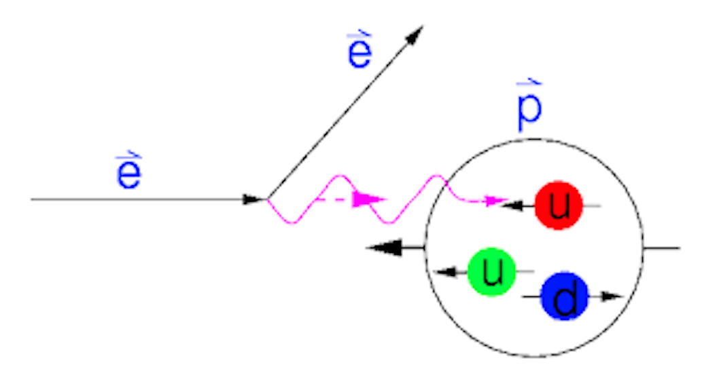
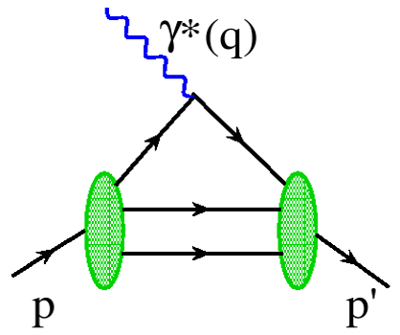
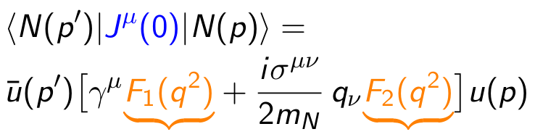

Electromagnetic Form Factor
Elastic scattering of proton
[R. Hofstadter, 1961]
$$e\left(p\right)+h\left(P\right)→e\left(p^{′}\right)+h(P^{′})$$
Elastic electron scattering established the extended nature of the proton (proton radius)
Dirac Form Factor
Pauli Form Factor
The Fourier transformation of these form factors provide spatial distributions (charge and magnetization distributions)

Slide 21
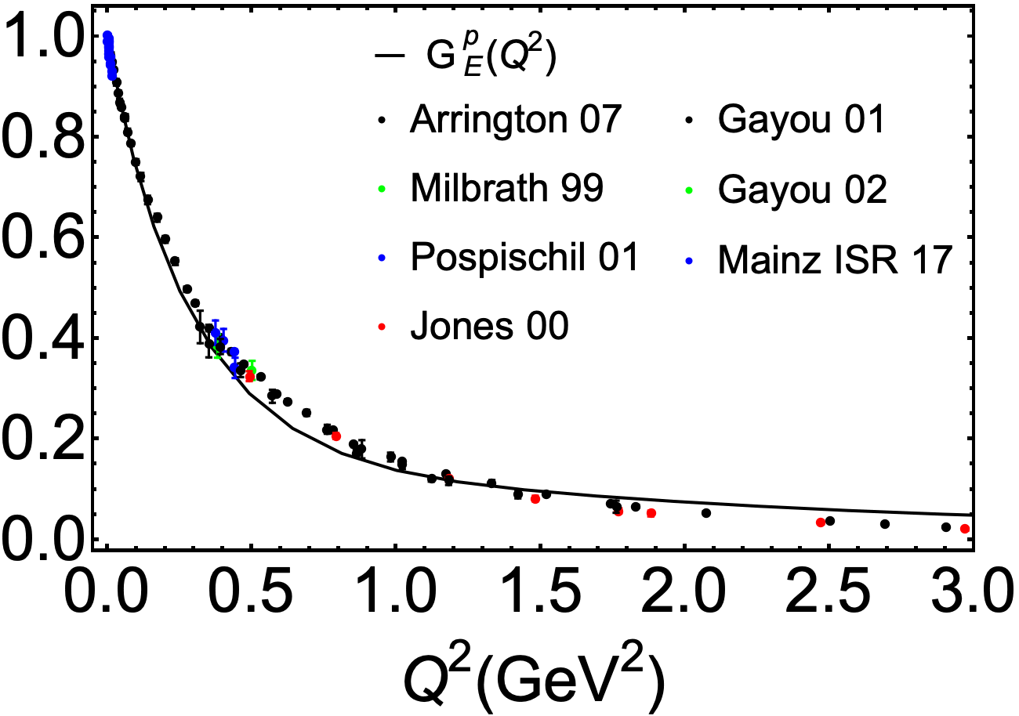
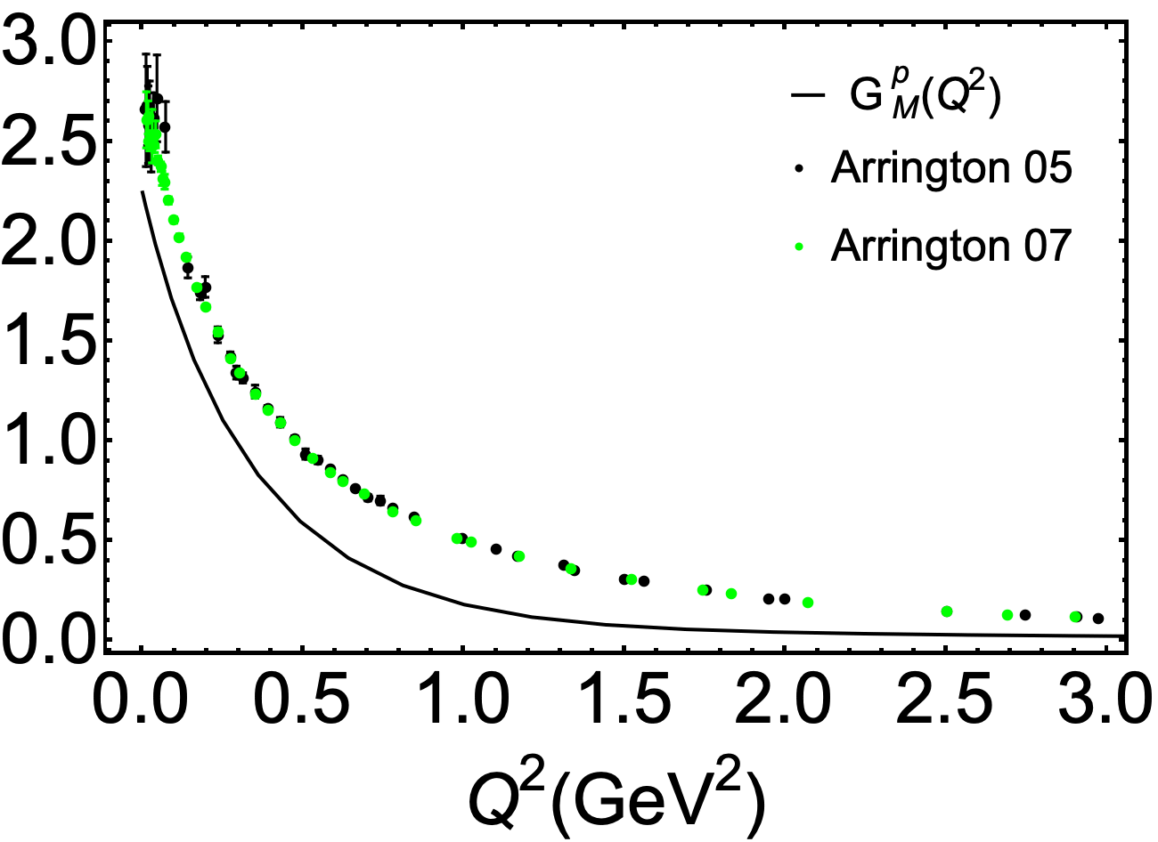
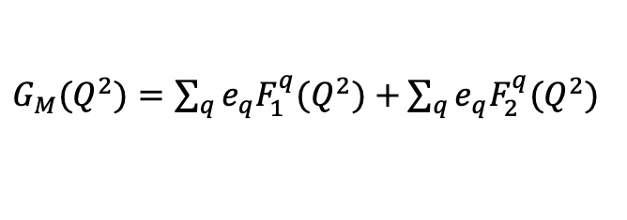
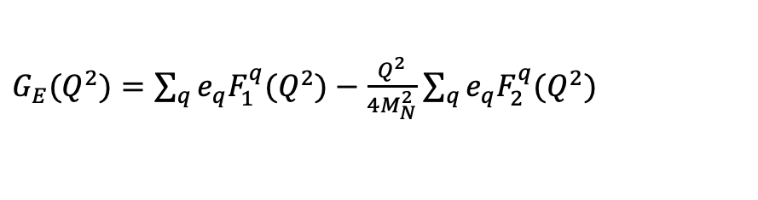
Proton Form Factors
Sachs form factors
$G_{E}(Q^{2})=\sum_{q}{e_{q}F_{1}^{q}(Q^{2})}−\frac{Q^{2}}{4M_{N}^{2}}$ $\sum_{q}{e_{q}F_{2}^{q}(Q^{2})}$
$G_{M}(Q^{2})=\sum_{q}{e_{q}F_{1}^{q}(Q^{2})}+$ $\sum_{q}{e_{q}F_{2}^{q}(Q^{2})}$
Preliminary
Preliminary
Qualitative agreement in general trends between BLFQ results and exp data
Pauli form factor underestimated

Slide 22
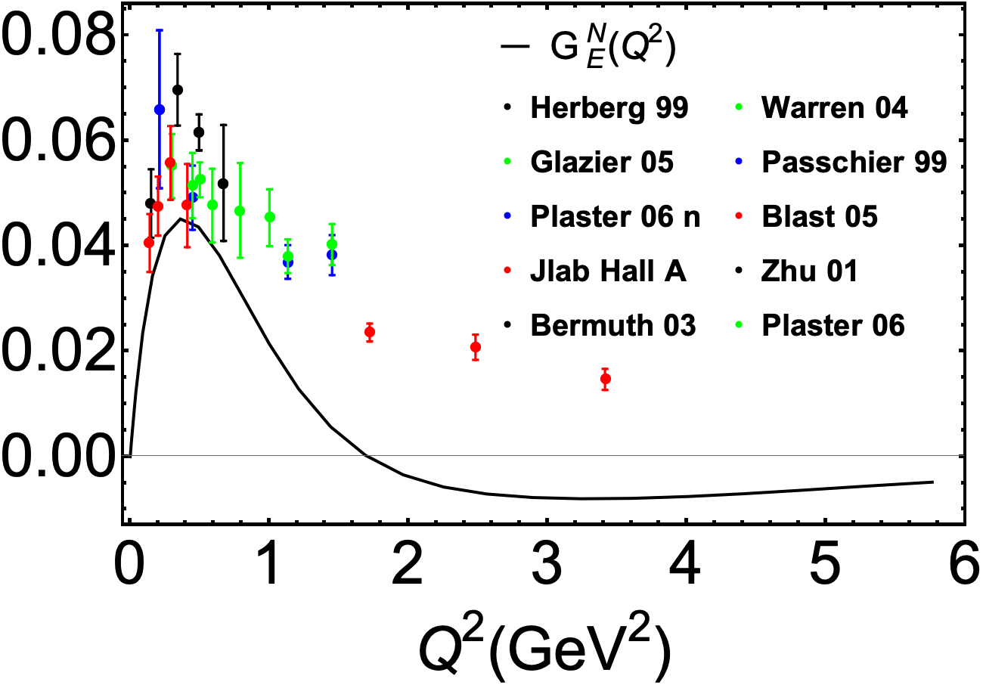
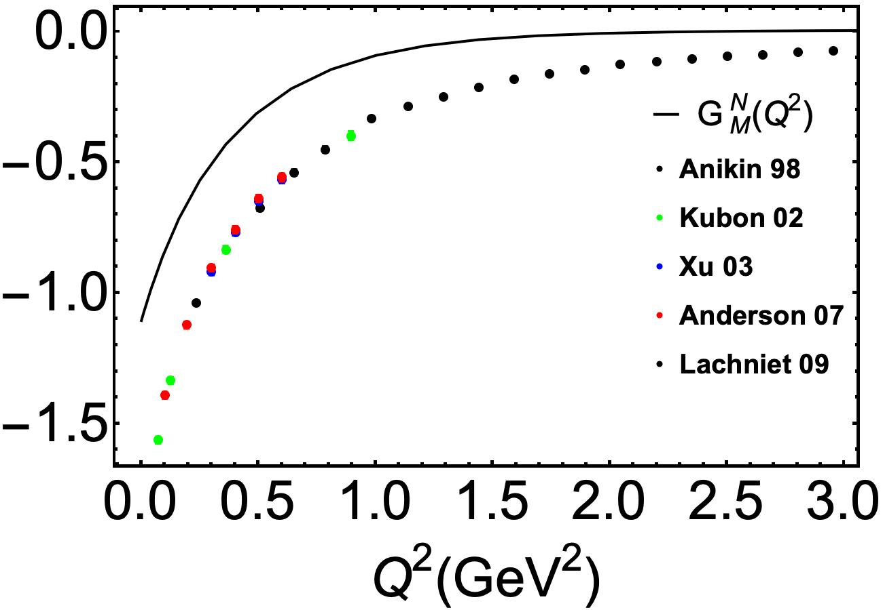
Neutron Form Factors
Sachs form factors
$G_{E}(Q^{2})=\sum_{q}{e_{q}F_{1}^{q}(Q^{2})}−\frac{Q^{2}}{4M_{N}^{2}}$ $\sum_{q}{e_{q}F_{2}^{q}(Q^{2})}$
$G_{M}(Q^{2})=\sum_{q}{e_{q}F_{1}^{q}(Q^{2})}+$ $\sum_{q}{e_{q}F_{2}^{q}(Q^{2})}$
Preliminary
Preliminary
Neutron Electric form factor qualitative agree with experimental data.
Need more work and Larger Kmax and Nmax to improve the results.

Slide 23






Parton Distribution Functions (PDF)
Deep Inelastic Scattering (SLAC 1968)
$$X$$
$$e\left(p\right)+h\left(P\right)=e^{′}\left(p^{′}\right)+X(P^{′})$$
$$X$$
Discovery of spin ½ quarks and partonic structure
Parton distribution functions (PDFs) are extracted from DIS processes.
$$Φ^{\left[γ^{+}\right]}\left(x,Q^{2}\right)=\int{\frac{dz^{−}}{8π}} e^{ixP^{+}z^{−}/2}⟨P,Λ\left|\overline{ψ}\left(z\right)γ^{+}ψ\left(0\right)\right|P,Λ⟩$$
PDFs encode the distribution of longitudinal momentum and polarization carried by the constituents

Slide 24




Unpolarized PDF
$$g=2.2$$

Slide 25




Unpolarized PDF
Preliminary
Unpolarized PDFs:
$$μ_{0}^{2}=0.23 {GeV}^{2}$$
Parton number density distribution in longitudinal direction
All results are at the initial scale
Valence quarks contribute mainly at $x\sim 0.3$
Gluon distributions are larger than those of sea quark
Gluon and sea quark dominate in small $x$ region

Slide 26

Conclusions & Outlook
Light-Front Quantization
  Hamiltonian QCD framework
  Natural parton interpretation
Basis Light-Front Quantization
  Nonperturbative many-body approach
  Toward first-principles nucleon structure
New Opportunities
  Electron-Ion Collider (EIC)
  Modern HPC platforms

Slide 27


Outlook
  $$\left|\left.N\right\rangle →\right|\left.qqq\right\rangle +\left|qqqg\right\rangle +\left|qqqgg\right\rangle +\left|qqqggg\right\rangle +\left|qqq gggg\right\rangle +\left|qqq ggggg\right\rangle +\left|qqq gggggg\right\rangle$$
Extend BLFQ to higher multi-gluon Fock sectors
Probe quark and gluon structure at small and large $x$
Investigate $k_{g}^{+}=0$modes and instanton physics
Clarify the role of zero modes in chiral symmetry breaking
Toward a unified first-principles description of hadrons and confinement

Slide 28



Outlook
Current status
Deutron calculation
$$\left|qqq qqq\right\rangle +\left|qqq qqq g\right\rangle$$
Full QCD interaction
EMC effect
Intrinsic charm
Sea asymmetry
Origin of spin and mass

Slide 29
Thank you!

Slide 30










Main Advantage II
2. Frame-independence
Lorentz boost transformation:
longitudinal:
$${\tilde{x}}^{0}=γ(x^{0}+βx^{3})$$
$${\tilde{x}}^{+}=e^{φ}x^{+}$$
$${\tilde{x}}^{3}=γ(x^{3}+βx^{0})$$
$${\tilde{x}}^{−}=e^{−φ}x^{−}$$
$β=\frac{ν}{c}$, $γ=\frac{1}{\sqrt{1−β^{2}}}$
$βγ=sinh φ$, $γ=cosh φ$
transverse boost:
$${\tilde{x}}^{+}=x^{+}$$
$${\tilde{x}}^{−}=x^{−}−2φx^{1}$$
$${\tilde{x}}^{1}=x^{1}−φx^{+}$$
$${\tilde{x}}^{2}=x^{2}$$
The boosts leave equal-light-front-time surfaces unchanged.
frame-independent wave function

Slide 31








Axial Form Factors
Provide information on axial charge distributions
$$G_{A}\left(Q^{2}\right)=G_{u}\left(Q^{2}\right)−G_{d}(Q^{2})$$
Black line: valence quark
Preliminary
$$G_{u}\left(0\right)=0.95$$
$$G_{d}\left(0\right)=−0.25$$
$$G_{A}\left(0\right)=1.20$$
$$G_{g}\left(0\right)=0.11$$

Slide 32






Dimension of Basis Space
Expansion in BLFQ basis
  $$|\left.N\right\rangle =|\left.qqq\right\rangle +\left|qqqg\right\rangle +\left|qqq q\overline{q}\right\rangle +\left|qqq gg\right\rangle +\left|qqq ggg\right\rangle +|qqq q\overline{q} g⟩$$
$$N_{max}=7, K_{max}=16$$
 | $$|\left.qqq\right\rangle$$ | $$\left|qqqg\right\rangle$$ | $$\left|qqq q\overline{q}\right\rangle$$ | $$\left|qqq gg\right\rangle$$ | $$\left|qqq ggg\right\rangle$$ | $$|qqq q\overline{q} g⟩$$
dimension | 35,088 | 592,960 | 3,901,500 | 5,169,360 | 19,603,584 | 7,128,576
color config | 1 | 2 | 3 | 6 | 22 | 8
  $$|\left.N\right\rangle =|\left.qqq\right\rangle$$
Basis Dimension= 35, 088
  $$|\left.N\right\rangle =|\left.qqq\right\rangle +\left|qqqg\right\rangle +\left|qqq gg\right\rangle +\left|qqq ggg\right\rangle$$
Basis Dimension= 25,400,992
  $$|\left.N\right\rangle =|\left.qqq\right\rangle +\left|qqqg\right\rangle +\left|qqq q\overline{q}\right\rangle +\left|qqq gg\right\rangle +\left|qqq ggg\right\rangle +|qqq q\overline{q} g⟩$$
Basis Dimension= 58,491,220

Slide 33
Color Structure
  $$\left|\left.N\right\rangle →\right|\left.qqq\right\rangle +\left|qqqu\overline{u}\right\rangle +\left|qqqd\overline{d}\right\rangle +\left|qqqs\overline{s}\right\rangle +\left|qqqu\overline{u}g\right\rangle +\left|qqqd\overline{d}g\right\rangle +\left|qqqs\overline{s}g\right\rangle +\left|qqqg\right\rangle +\left|qqqgg\right\rangle +\left|qqqggg\right\rangle$$
$\left|qqq\right\rangle$ ～ 1 color singlet state
$\left|qqq g\right\rangle$ ～ 2 color singlet states
$\left|qqq q\overline{q}\right\rangle \sim 3$ color singlet states
$\left|qqq gg\right\rangle \sim 6$ color singlet states
$\left|qqq q\overline{q}g\right\rangle \sim 8$ color singlet states
$\left|qqq ggg\right\rangle \sim 22$ color singlet states
Complicated color structure in higher Fock sectors
Hidden color structure for nuclei

