Slide 1
Basis Light Front Quantization (BLFQ)
for QCD:
hadrons without spatially confining terms
James P. Vary
Iowa State University
Light-Cone 2026:
Applications at EIC Era
SUNY - Stony Brook
Long Island, NY
June 22-26, 2026
Notes:
File: Nucleus-2022_Moscow.pptx
File: IMP_Huizhou_November_2023_final.pptx
JV: Note that the file was revised 12/1/24 with updated slides for the BE2 ratios and the Mn/Mp ratios to reflect the corrections made in the resubmitted version of the manuscript. In the case of the Mn/Mp ratios the only correction was the reference numbers
File: Vary_shell_Model_at_75_2024_final.pptx (revised as indicated above)
File: Vary_CENS_Frontiers_Meeting_final.pptx
File: Vary_CENS_Frontiers_Meeting_final.pptx
File is online at: https://ntse.khb.ru/files/uploads/2026/vary_ntse_2026.pdf
File: NTSE2026_Vary_Full_rev.pptx
File: IMP_Huizhou_June_2026_Vary_full.pptx

Slide 2
Dirac’s forms of relativistic dynamics [Dirac, Rev. Mod. Phys. 21, 392 1949]
Instant form is the well-known form of dynamics starting with x⁰ = t = 0
Front form defines relativistic dynamics on the light front (LF): x⁺ = x⁰+x³ = t+z = 0
Adapted from talk by Yang Li
Notes:
Taken from Phys624_light_front_field_theory.pptx
Adapted from Yang Li’s talk in Florida – May 2016
In the front form, 7 of the 10 Poincare’ generators are kinematic (J^- or ang. mo. projection along the longitudinal direction, 3-boosts, 3-translations) and 3 are dynamical (Hamiltonian and 2 rotations –one about x and one about y)
Shown in LC2016-Lisbon (previous version)
Shown in LC2017 – Mumbai (previous version)
LC2018 – this is an updated version
Discuss choosing the maximal set of commuting observables to define the basis for BLFQ . . .
Not Shown at LC2019 or LC2021
File: LC2021_Vary_Jeju_Korea
File: . . . LC2023_BLFQ (where these notes were improved)
Adapted from PHYS526 file: 12-LC2023_BLFQ.pptx
File: LC2024_BLFQ_Vary_final.pptx
File: AN_Mitra_Symposium_full.pptx (shown at symposium)
File: ECT_July_2025_Vary_full.pptx
File: IMP_Huizhou_June_2026_Vary_full.pptx

Slide 3
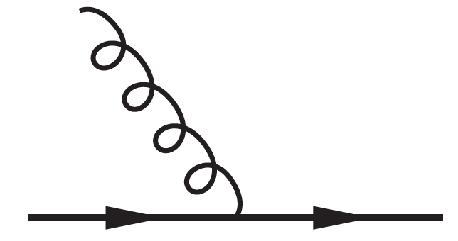
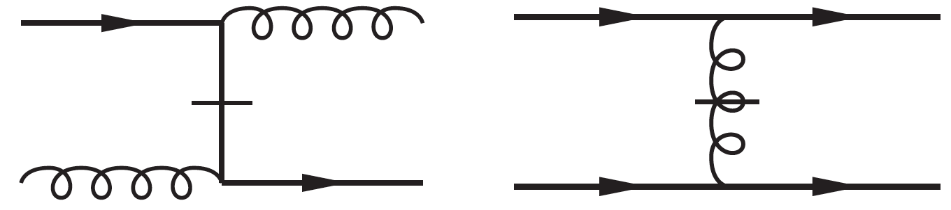
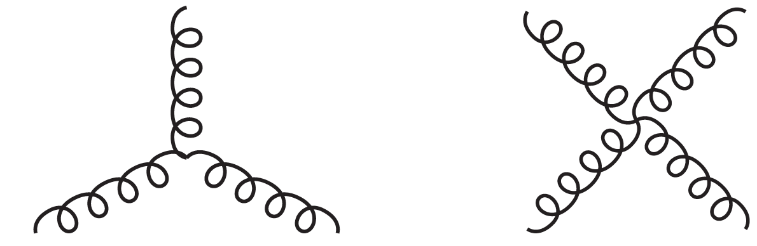
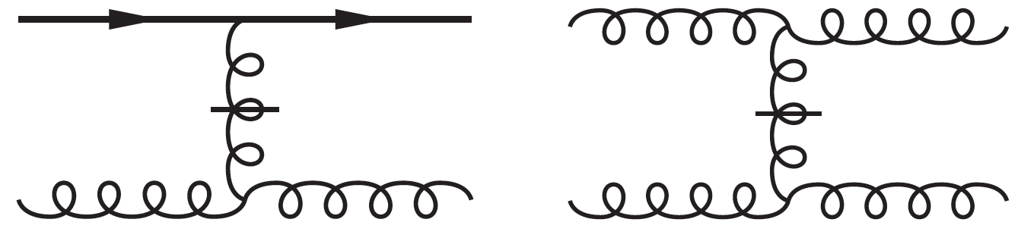
Light Front (LF) Hamiltonian Defined by its
Elementary Vertices in LF Gauge
QED & QCD
QCD
Notes:
Now in: LC2017_Vary_Mumbai_full_updated.pptx
darker images are from Yang Li’s 2016 Florida talk
Shown in LC2016-Lisbon
Shown in LC2017 – Mumbai
Shown in LC2018 - JLAB
Resides in file: LC2019_Vary_Paris_full_updated.pptx
Shown at LC2019
Shown in LC2021 – File: LC2021_Vary_Jeju_Korea
Adapted from PHYS526 file: 12-LC2023_BLFQ.pptx
File: LC2024_BLFQ_Vary_final.pptx
File: AN_Mitra_Symposium_full.pptx (shown at symposium)
File: ECT_July_2025_Vary_full.pptx
File: IMP_Huizhou_June_2026_Vary_full.pptx

Slide 4
Discretized Light Cone Quantization
[H.C. Pauli & S.J. Brodsky, PRD32 (1985)]
Basis Light Front Quantization
[J.P. Vary et al., PRC81 (2010)]
Orthonormal:
Complete:
For mesons we adopt (later extended to baryons):
[Y. Li, et al., PLB758 (2016)]
Notes:
New version for LC2018 – specific to hadrons
*J.P. Vary, et al., PRC81, 035205 (2010).
**Y. Li, et al., PLB758, 118 (2016).
Shown at LC2018, May 2018, JLAB
Modified and shown at LC2019, Paliseau, France
Resides in file: LC2019_Vary_Paris_full_updated.pptx
Shown at LC2019 and LC2021
File: LC2021_Vary_Jeju_Korea_final.pptx
Adapted from PHYS526 file: 12-LC2023_BLFQ.pptx
File: LC2024_BLFQ_Vary_final.pptx
File: AN_Mitra_Symposium_full.pptx (shown at symposium)
File: ECT_July_2025_Vary_full.pptx
File: IMP_Huizhou_June_2026_Vary_full.pptx

Slide 5
BLFQ
Symmetries & Constraints
All J ≥ J_{z} states
in one calculation
Finite basis
regulators
Preserve transverse
boost invariance
Notes:
Shown in LC2016-Lisbon
Shown in LC2017-Mumbai
Updated in LC2018 to include Longitudinal mode regulator
Shown at LC2018, May 2018, JLAB
Resides in file: LC2019_Vary_Paris_full_updated.pptx
File: Phys624_from_LC2019_Vary_Paris.pptx
Updated to add last line for transverse motion boost invariance and for convenience of relative motion 2DHO basis
for the two-fermion applications (Li, et al.,)
Shown at LC2019 and LC2021
File: LC2021_Vary_Jeju_Korea_final.pptx
Adapted from PHYS526 file: 12-LC2023_BLFQ.pptx
File: LC2024_BLFQ_Vary_final.pptx
File: AN_Mitra_Symposium_full.pptx (shown at symposium)
File: ECT_July_2025_Vary_full.pptx
File: IMP_Huizhou_June_2026_Vary_full.pptx

Slide 6
Notes:
Adapted from file: YangLi_StrongInteraction_Lecture_Phys625.pdf – page 9
Earlier version shown in LC2017 – Mumbai
This version is updated for LC2018
Shown at LC2018, May 2018, JLAB
Resides in file: LC2019_Vary_Paris_full_updated.pptx
Shown at LC2019 and at LC2021
File: LC2021_Vary_Jeju_Korea_final.pptx
File: Granada_Hamiltonian_Methods_Vary
Note that DIS and DVCS are two processes depicted to leading order in the two small diagrams at the upper
left and upper right of the “integration flow chart” for various ”distributions” of experimental interest
Adapted from PHYS526 file: 12-LC2023_BLFQ.pptx
File: LC2024_BLFQ_Vary_final.pptx
File: AN_Mitra_Symposium_full.pptx (shown at symposium)
File: ECT_July_2025_Vary_full.pptx
File: IMP_Huizhou_June_2026_Vary_full.pptx

Slide 7
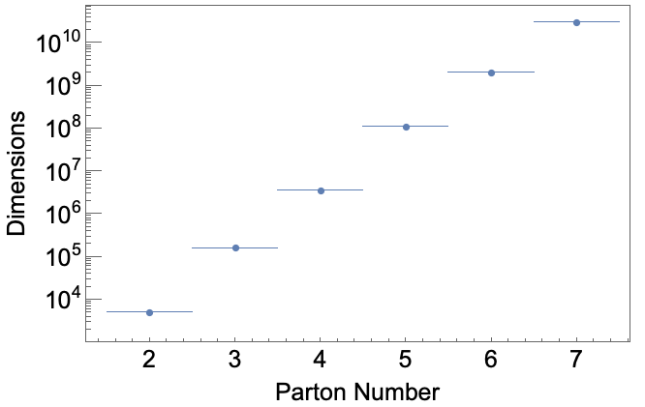
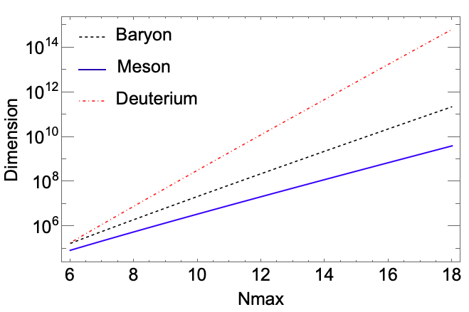

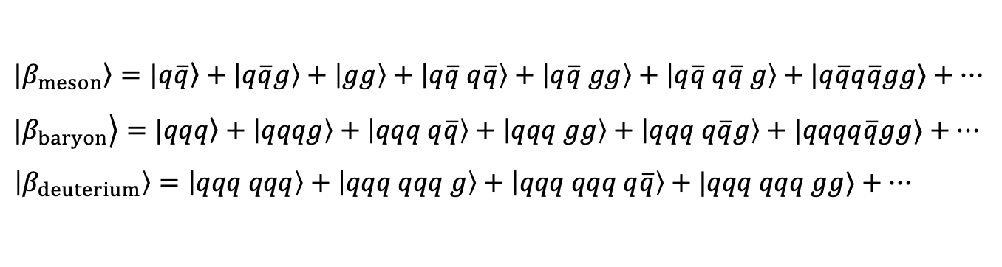
BLFQ Basis States
BLFQ basis: expansion in Fock space beyond the valence sector
$$|\left.β_{meson}\right\rangle =|\left.q\overline{q}\right\rangle +\left|q\overline{q}g\right\rangle +\left|gg\right\rangle +\left|q\overline{q} q\overline{q}\right\rangle +\left|q\overline{q} gg\right\rangle +\left|q\overline{q} q\overline{q} g\right\rangle +|q\overline{q}q\overline{q}gg⟩+…$$
$$|\left.β_{baryon}\right\rangle =|\left.qqq\right\rangle +\left|qqqg\right\rangle +\left|qqq q\overline{q}\right\rangle +\left|qqq gg\right\rangle +\left|qqq q\overline{q}g\right\rangle +|qqqq\overline{q}gg⟩+…$$
$$\left|β_{deuterium}\right\rangle =\left|qqq qqq\right\rangle +\left|qqq qqq g\right\rangle +\left|qqq qqq q\overline{q}\right\rangle +|qqq qqq gg⟩+…$$
. . .
Dimensions increase with number of Partons at fixed regulators and when extending the regulators towards the continuum limit
=> motivation for quantum computing
Including global
color singlets
$N_{max}=10$, $K_{max}$=16
Space and spin only
= Kmax
Notes:
File: Siqi_Xu_EicC_CDR.pptx
From File: IGFAE_Santiago_de_Compostela_BLFQ_Vary_Full.pptx
Here, I interchanged the first two lines to achieve a more natural ordering
Adapted from PHYS526 file: 12-LC2023_BLFQ.pptx
Future improvements: Add which system (e.g. baryon) to the left panel and define the Fock space truncation for both panels.
Also, what is Kmax for the right panel? For example = Nmax?
Also, are only basis states that are global color singlets included?
Answers from Siqi’s email of 11/25/24:
Regarding the slides:
Left Panel: The basis dimensions shown are for each Fock sector, not specific to mesons or protons. For example, when the Parton number equals 3, it represents the qqq Fock sector only. In this calculation, we removed the color index, so the basis dimensions are the same whether it’s qqq or qq̅g.
Right Panel: This shows the basis dimensions for physical states. For mesons, this would include the sum of all Fock sectors, along with the color contributions. On the x-axis, I set Nmax = Kmax, so only Nmax is displayed.
File: LC2024_BLFQ_Vary_final.pptx
JV_Jan_2025: Added the points about counts without and with color factors included.
JV : For LC2026, I extended the description in the second major bullet to cover both panels.
File: AN_Mitra_Symposium_full.pptx (shown at symposium)
File: ECT_July_2025_Vary_full.pptx
File: IMP_Huizhou_June_2026_Vary_full.pptx

Slide 8
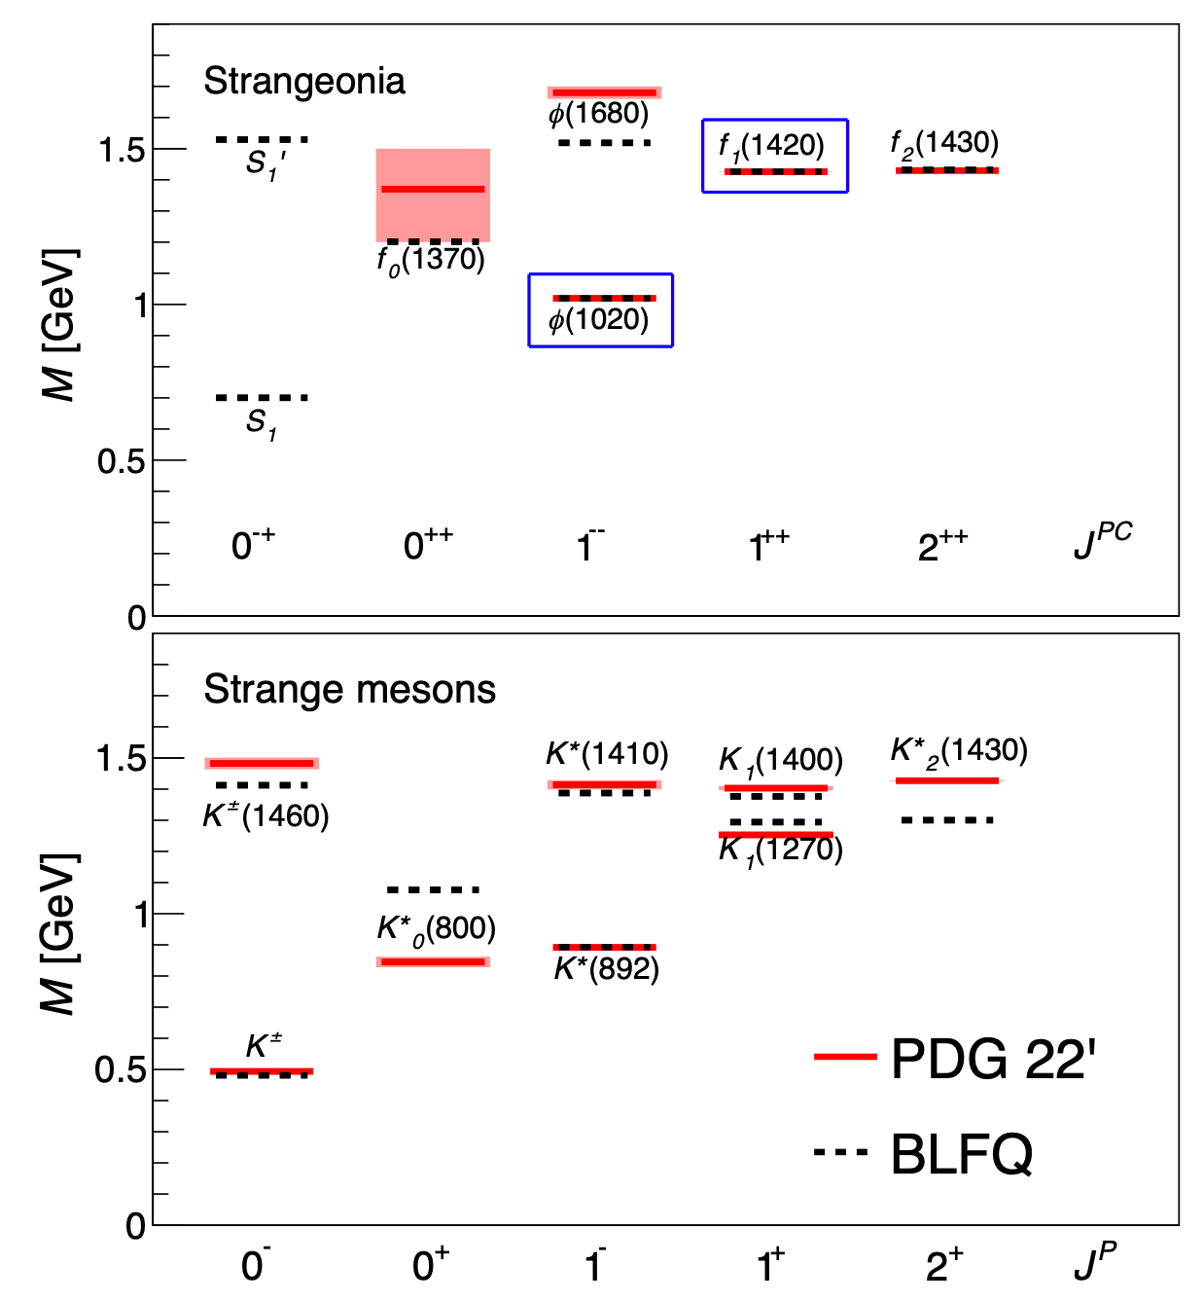
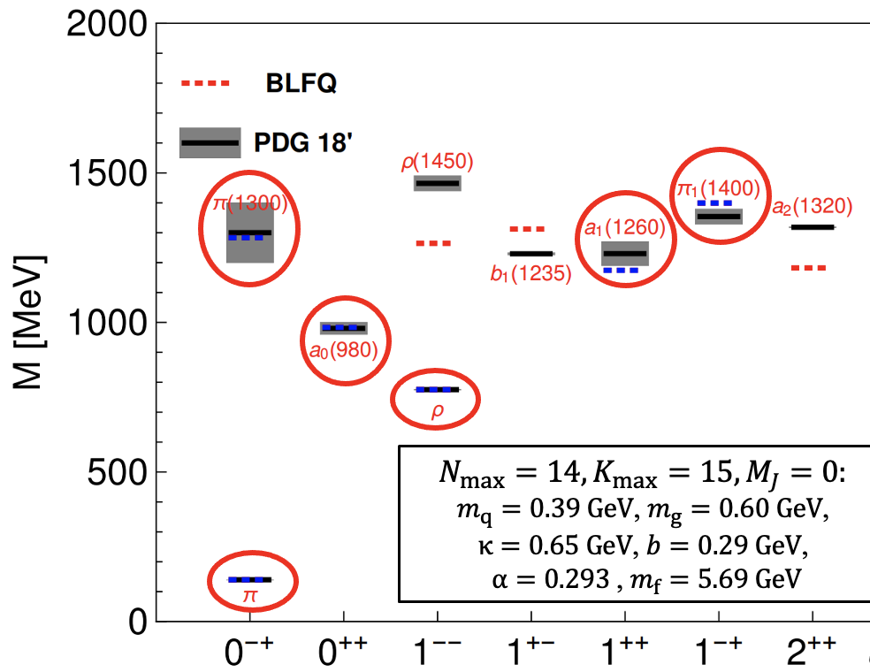
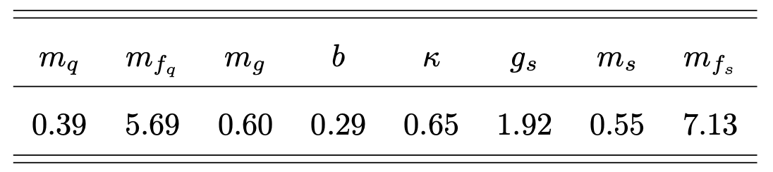
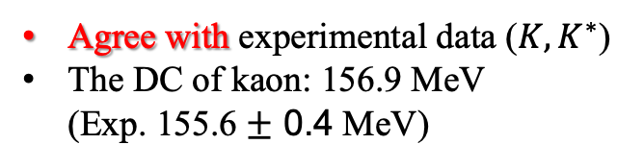
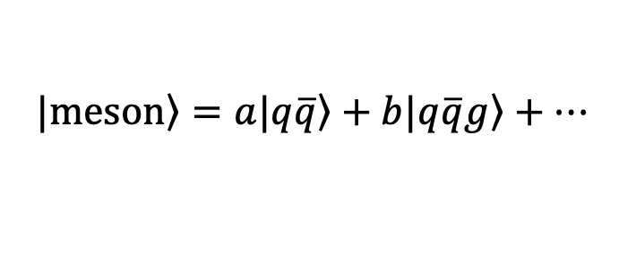
Strange meson mass spectrum
$$\left.|meson\right\rangle =a\left.|q\overline{q}\right\rangle +b\left.|q\overline{q}g\right\rangle +…$$
Agree with experimental data ($K, K^{∗}$)
The DC of kaon: 156.9 MeV
(Exp. 155.6 $±$ 0.4 MeV)
[J. Lan et al, Phys.Lett.B 868 (2025) 139654]
Notes:
File: Jiangshan_Lan_BLFQ_StrangeMeson_LC2026.pptx

Slide 9
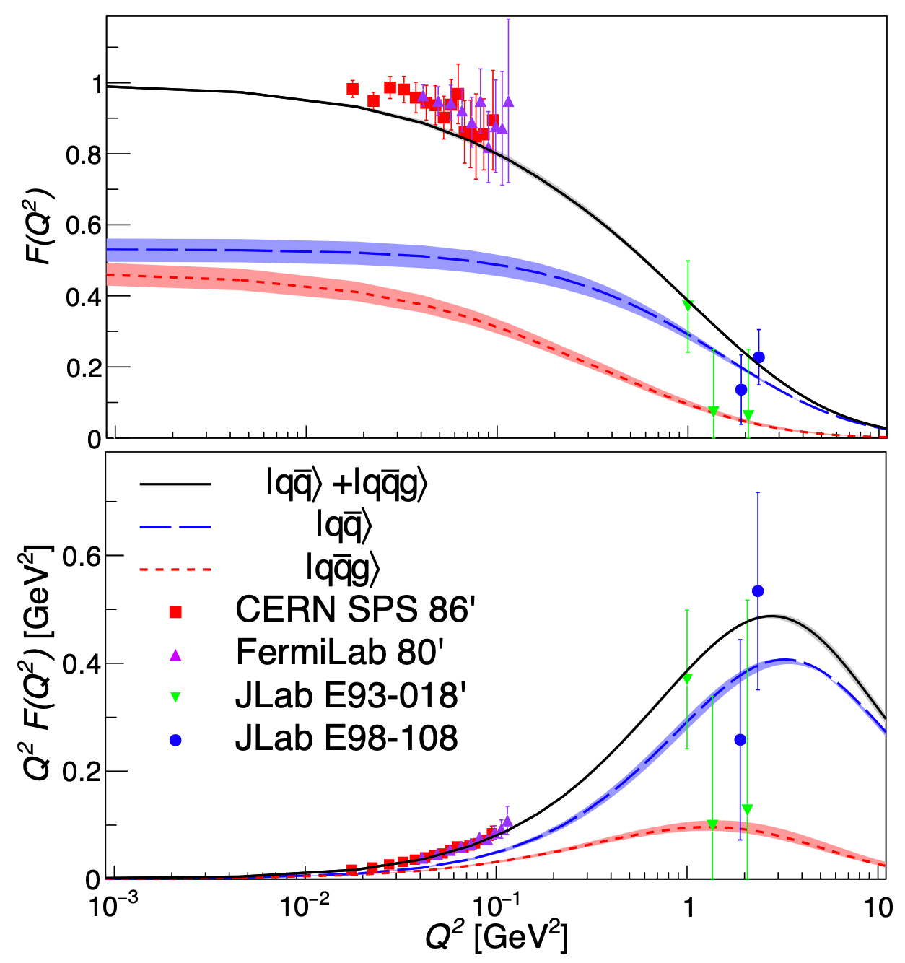
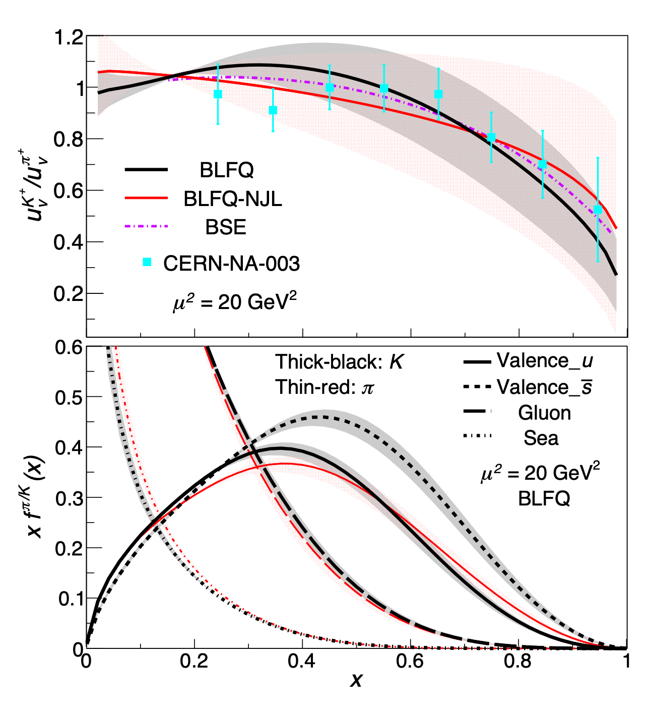
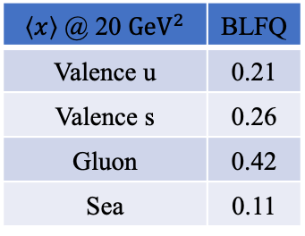
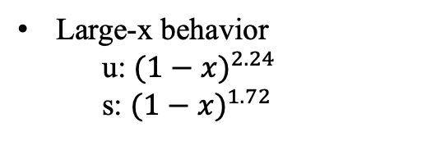
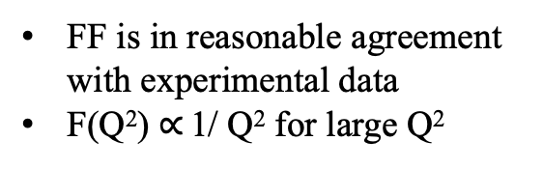
Kaon form factor
Kaon PDF
$\left\langle x\right\rangle$ @ 20 ${GeV}^{2}$ | BLFQ
Valence u | 0.21
Valence s | 0.26
Gluon | 0.42
Sea | 0.11
FF is in reasonable agreement with experimental data
F(Q²) $∝$ 1/ Q² for large Q²
Large-x behavior
u: ${(1−x)}^{2.24}$
s: ${(1−x)}^{1.72}$
[J. Lan et al, Phys.Lett.B 868 (2025) 139654]
Notes:
File: Jiangshan_Lan_BLFQ_StrangeMeson_LC2026.pptx

Slide 10
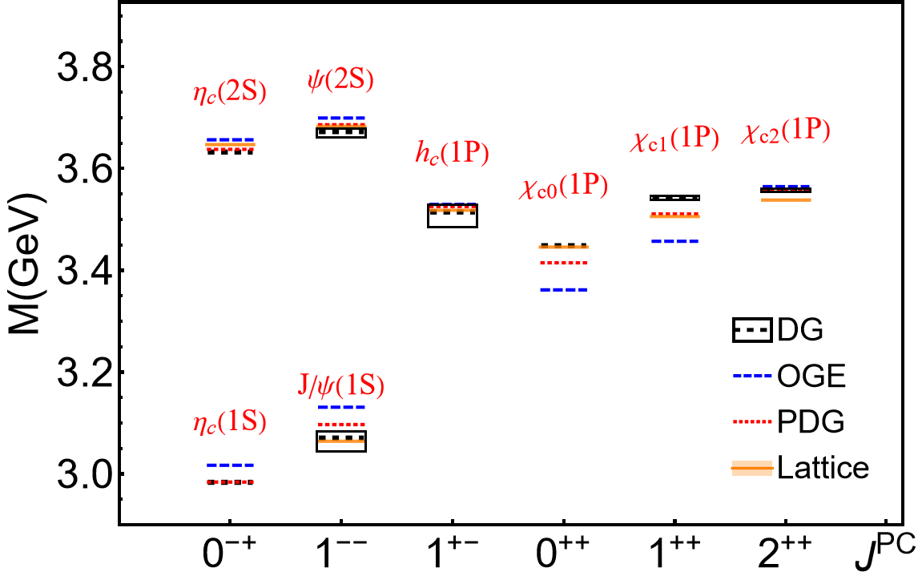
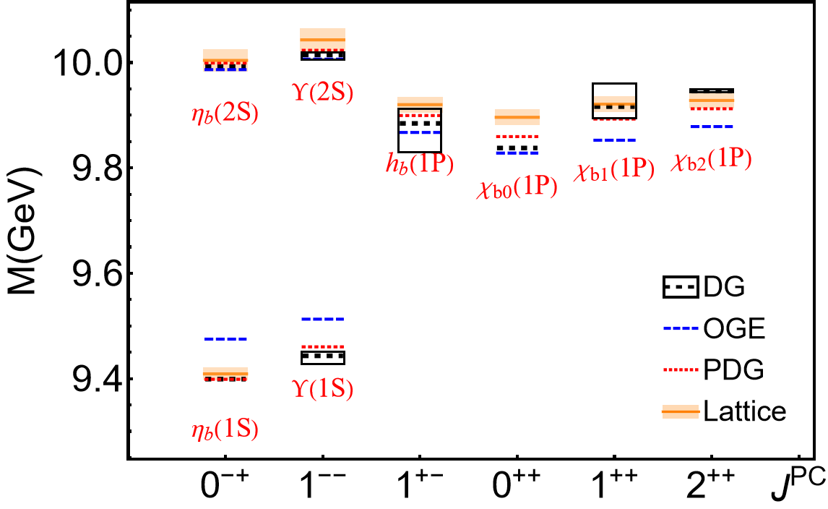
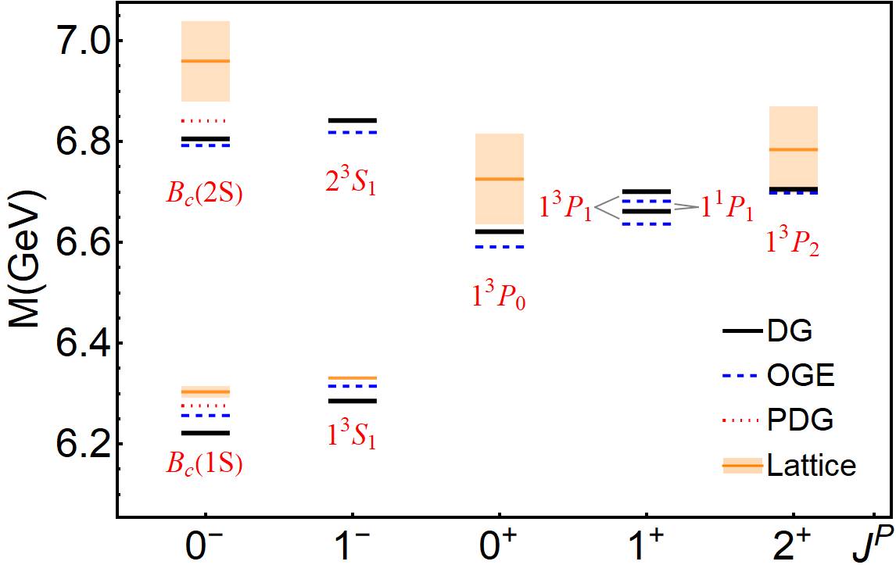
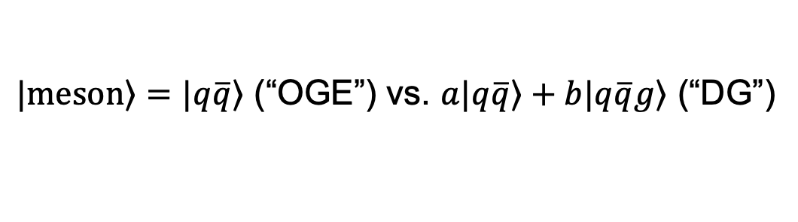

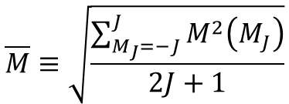
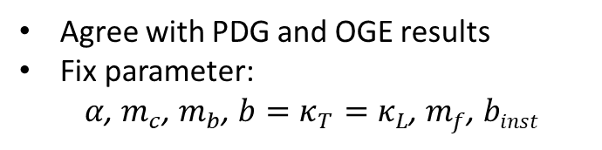

Mass spectrum
$\left.|meson\right\rangle =\left.|q\overline{q}\right\rangle$ (“OGE”) vs. $a\left.|q\overline{q}\right\rangle +b\left.|q\overline{q}g\right\rangle$ (“DG”)
Charmonium
Bottomonium
$B_{c}$meson
$$\overline{M}≡\sqrt{\frac{\sum_{M_{J}=−J}^{J}{M^{2}\left(M_{J}\right)}}{2J+1}}$$
$$δM_{J}≡\max\left[M\left(M_{J}\right)\right]−\min\left[M\left(M_{J}\right)\right]$$
Agree with PDG and OGE results
Fix parameter:
$α$, $m_{c}$, $m_{b}$, $b=κ_{T}=κ_{L}$, $m_{f}$, $binst$
[Jiatong Wu, et al] arXiv:2603.08114
Notes:
Added by JPV: Quoting from the preprint:
“We calculate the rms deviation between
the masses of our lowest 8 states and the PDG
data. For the charmonium (bottomonium) system, the
obtained rms mass deviation is 17.24 MeV (23.40 MeV)
in the MJ = 0 sector. As a comparison, the earlier BLFQ
OGE calculation yields 31 MeV (38 MeV) for the charmonium
(bottomonium) system [22 ], where the lowest 8
(14) states below the D .D (B .B ) threshold are considered.”
06/19/26 Email reply from Jiatong Wu provides:
“The rms deviations (GeV) in the Mj=0 sector for the 8 states:
bbbar:
0.0234 (DG vs PDG) 0.0415 (OGE vs PDG) 0.0511 (DG vs OGE)
ccbar:
0.0172 (DG vs PDG) 0.0327 (OGE vs PDG) 0.0477 (DG vs OGE)
bcbar:
0.0323 (DG vs OGE)
For the bcbar system, the PDG provides results for 2 states, unlike the bbbar and ccbar systems which have 8 states. If you need them, I have also listed them here:
bcbar:
0.0457 (DG vs PDG) 0.0371 (OGE vs PDG)”
JV suggests including these rms results in the revised paper.
File: Jiatong_Wu_heavymeson_260616_LC.pptx

Slide 11

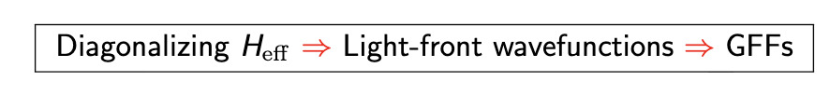
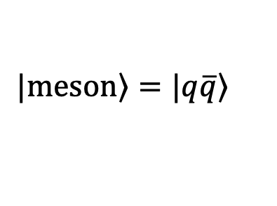
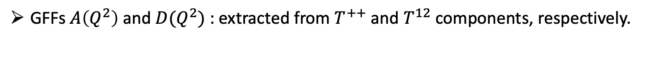
GFFs of Light Mesons in BLFQ-NJL Model
$$\left.|meson\right\rangle =\left.|q\overline{q}\right\rangle$$
Light Meson GFFs are parametrized as:
GFFs $A\left(Q^{2}\right)$ and $D(Q^{2})$ : extracted from $T^{++}$ and $T^{12}$components, respectively.
Effective Hamiltonian for BLFQ-NJL Model:
$$H_{ eff }=\frac{{\vec{κ}}^{⊥2}+m_{q}^{2}}{x} + \frac{{\vec{κ}}^{⊥2}+m_{\overline{q}} }{1−x} +κ^{4} {\vec{ζ}}^{⊥2} − \frac{κ^{4}}{{\left(m_{q}+m_{\overline{q}}\right)}^{2}}∂_{x}(x\left(1−x\right)∂_{x })+H_{eff}^{NJL}$$
Kinetic energy
Confining potential
NJL interaction
A. Sain, et. al, arXiv:2605.18350 [hep-ph]
Notes:
File: Amrita_Sain_Light_Mesons_GFFs_Updated.pptx

Slide 12
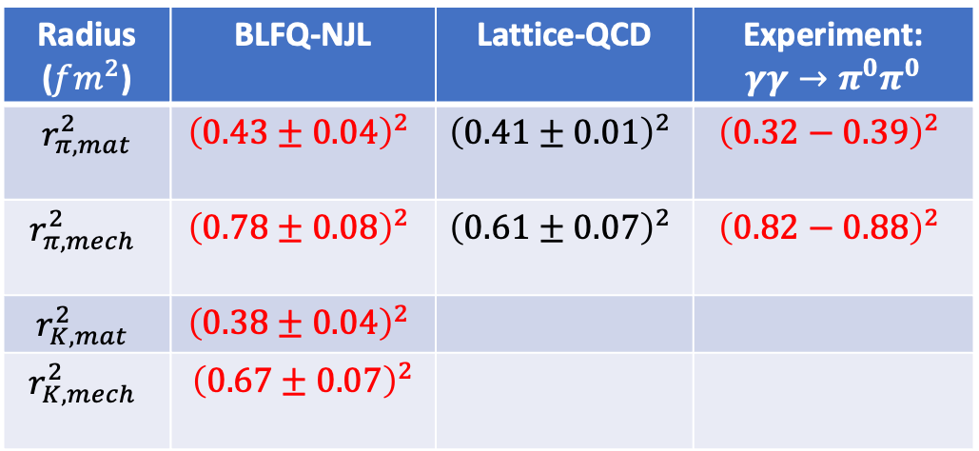
Results of GFFs and Radii of Light Mesons
Pion
Kaon
Pion
Radius ($fm^{2}$) | BLFQ-NJL | Lattice-QCD | Experiment: $$γγ→π^{0}π^{0}$$
$r_{π, mat}^{2}$ | $${\left(0.43±0.04\right)}^{2}$$ | $${\left(0.41±0.01\right)}^{2}$$ | $${\left(0.32−0.39\right)}^{2}$$
$$r_{π,mech}^{2}$$ | $${\left(0.78±0.08\right)}^{2}$$ | $${\left(0.61±0.07\right)}^{2}$$ | $${\left(0.82−0.88\right)}^{2}$$
$$r_{K,mat}^{2}$$ | $${\left(0.38±0.04\right)}^{2}$$
$$r_{K,mech}^{2}$$ | $${\left(0.67±0.07\right)}^{2}$$
Kaon
Radii consistent with lattice QCD and experiment
Lattice: PRD 108 (2023);
Exp: PRD 97 (2018);
A. Sain, et. al, arXiv:2605.18350 [hep-ph]
Notes:
06/19/26 Email from Amrita Sain responding to JV’s questions
Dear Prof. Vary,
Attachment is the updated version of my slides.
Comments on our results:
1. The form factor A(Q^2) for both the pion and kaon is found to be in overall agreement with recent lattice QCD and dispersive results.
2. D(Q^2) is enhanced in magnitude at low Q^2 relative to both lattice QCD and dispersive determinations. This behavior arises from extracting the D-term using transverse components of the QCD energy–momentum tensor, which are more sensitive to the small-x region and to light-front zero-mode effects in the present truncated framework. Nevertheless, at large Q^2, our results for D(Q^2) are consistent with both lattice QCD and dispersive analyses.
3. Pion mass (matter) radius is in excellent agreement with recent lattice simulations and is reasonably consistent with the phenomenologically extracted value from the two-photon process within uncertainties.
4. Our prediction for the mechanical radius is larger than the lattice QCD result but closer to the value obtained from the two-photon process.
5. Our kaon’s mass and mechanical radii are smaller than those of the pion, as expected.
6. Pressure exhibits a positive core and a negative tail, consistent with the von Laue stability condition, while the shear distribution remains positive throughout the transverse plane.
Thank you,
Best Regards,
Amrita Sain
File: Amrita_Sain_Light_Mesons_GFFs_Updated.pptx

Slide 13
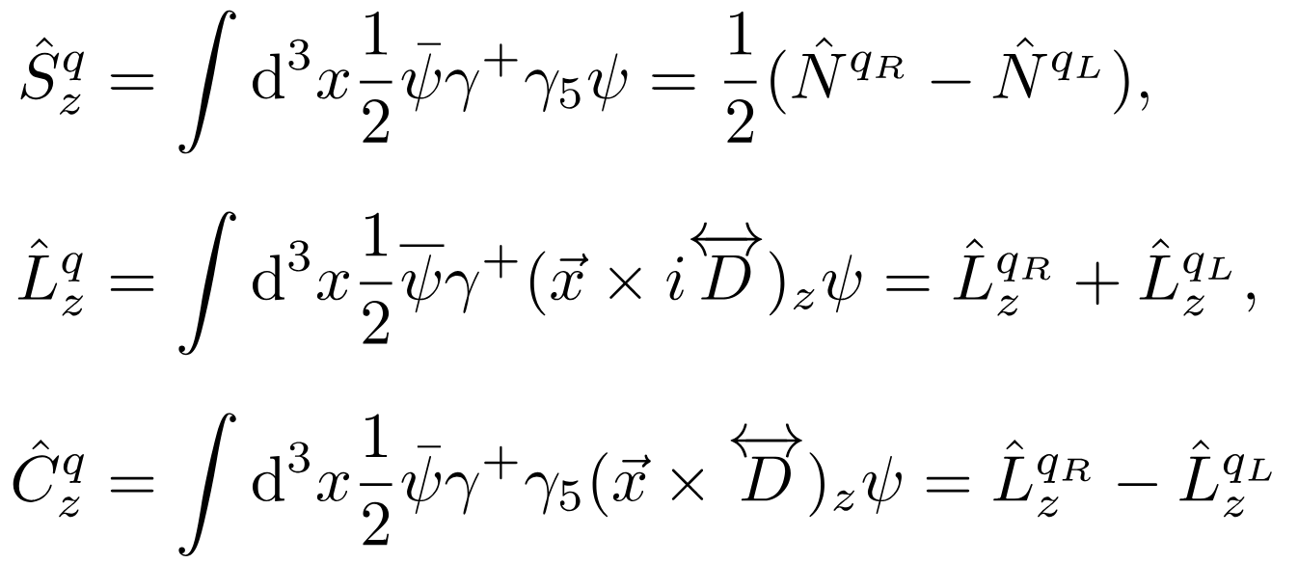
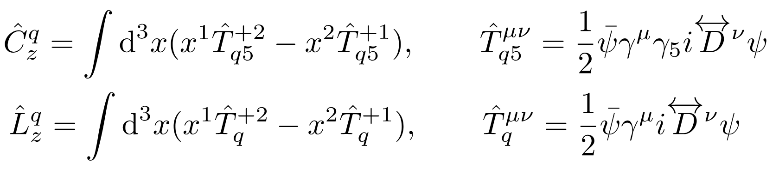
Spin-orbit correlation in heavy quarkonia – see Xianghui Cao talk today
Spin-orbit correlation in QCD
[Lorce:2014mxa, Lorce:2025ayr]
quark spin
quark OAM
quark spin-orbit correlation
where $q_{R}/q_{L}$ denotes the contribution of right/left-hand fermion and $\hat{N}$ is the quark number operator
Spin-orbit correlation (SOC) defined from parity-odd energy-momentum tensor (EMT):
Notes:
File: Tianyang_Hu_spin-orbit_correlation_results_for_LC2026.pptx

Slide 14
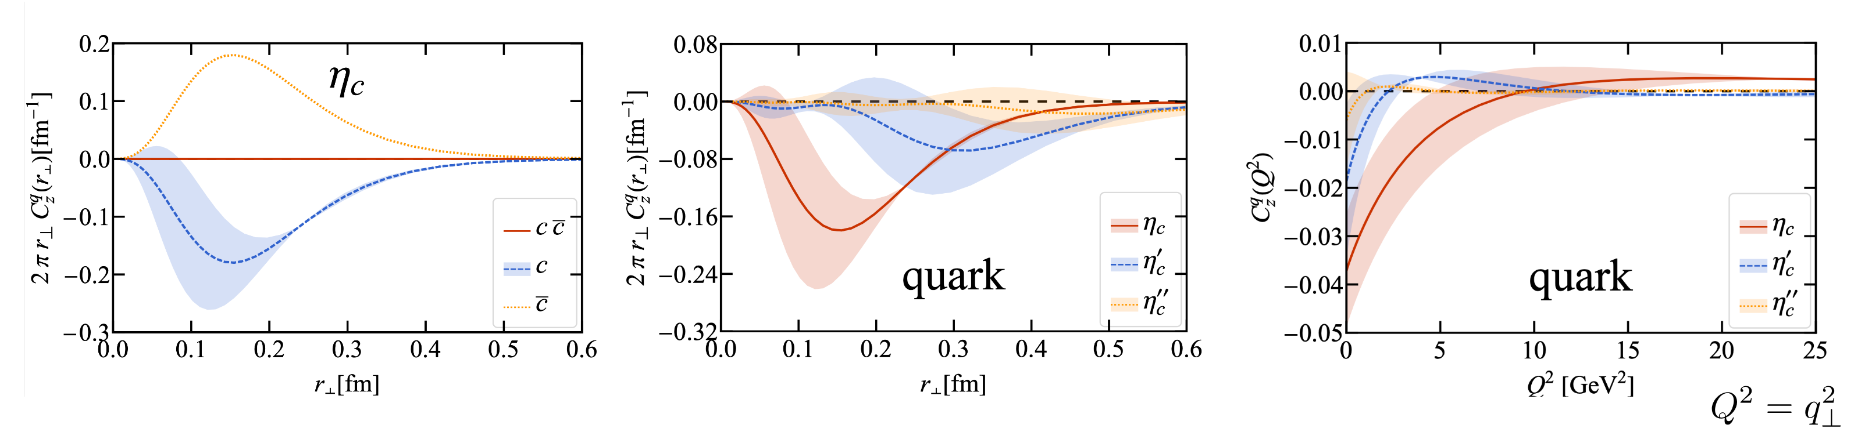
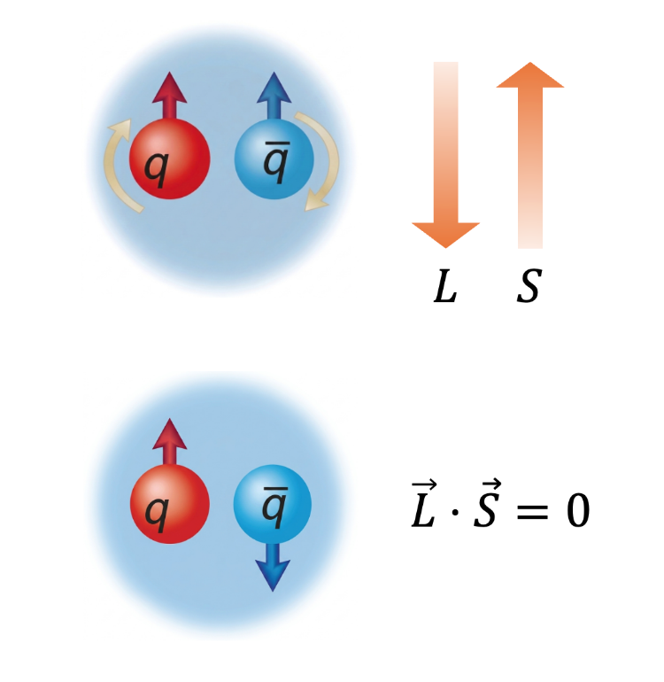
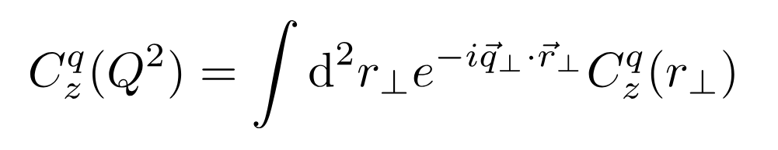
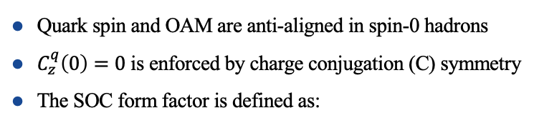
Spin-orbit correlation: $η_{c}$
Quark spin and OAM are anti-aligned in spin-0 hadrons
$C_{z}^{q}\left(0\right)=0$ is enforced by charge conjugation (C) symmetry
The SOC form factor is defined as:
Notes:
File: Tianyang_Hu_spin-orbit_correlation_results_for_LC2026.pptx

Slide 15
Overview of released BLFQ results for the proton
5 BLFQ papers in 2025 and 4 BLFQ papers in 2026 (to date)
Notes:
File: Chandan_Mondal_Nucleon-BLFQ-slide.pdf (from Chandan 06/19/26)

Slide 16
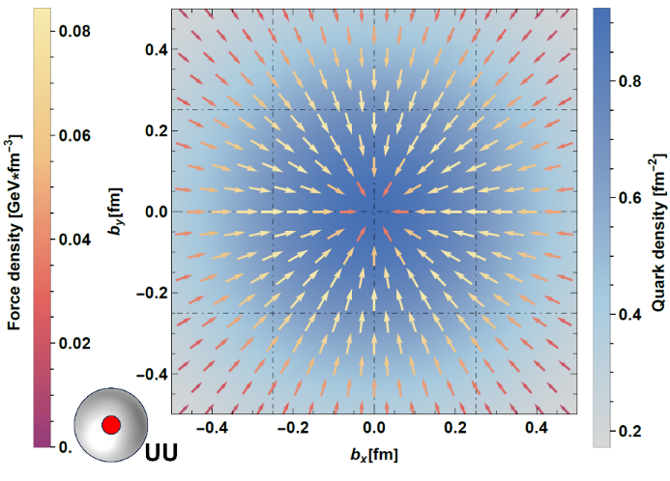
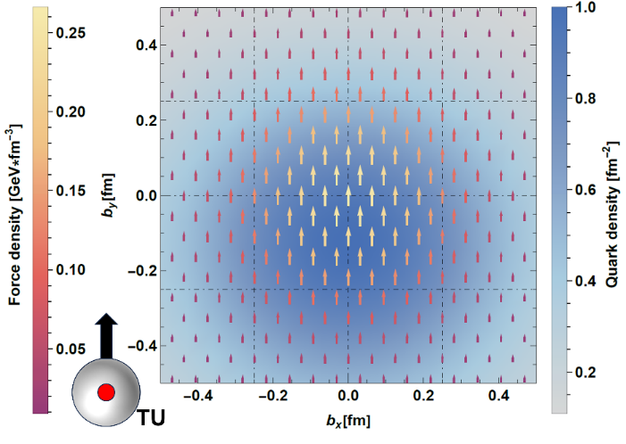
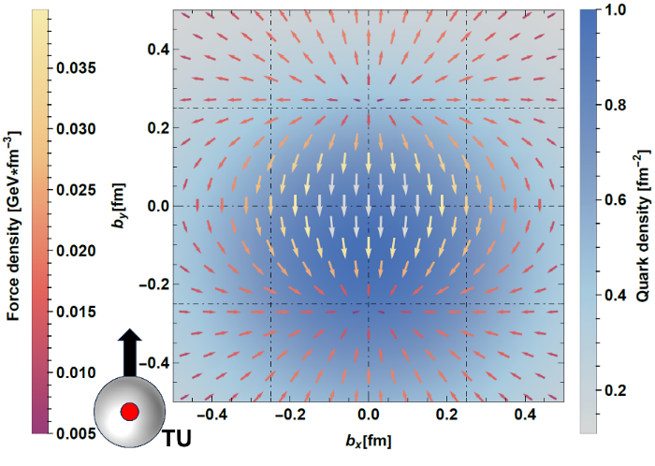
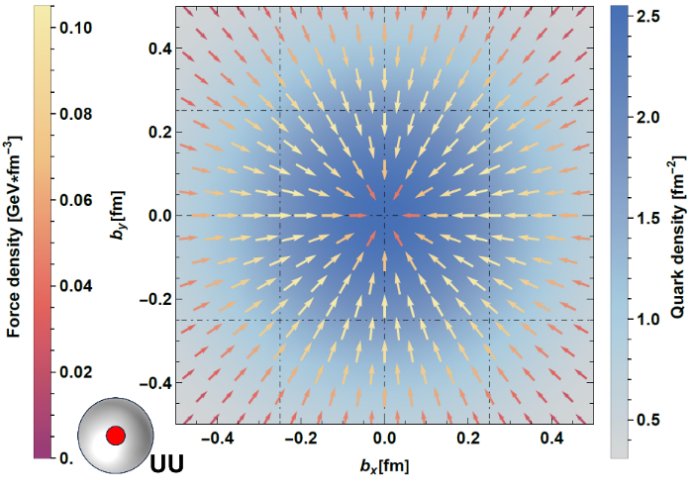
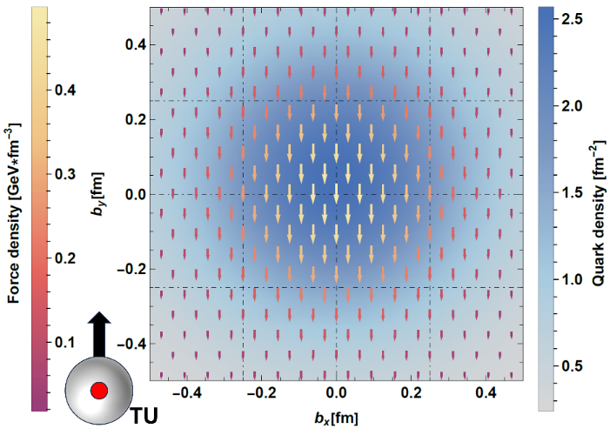
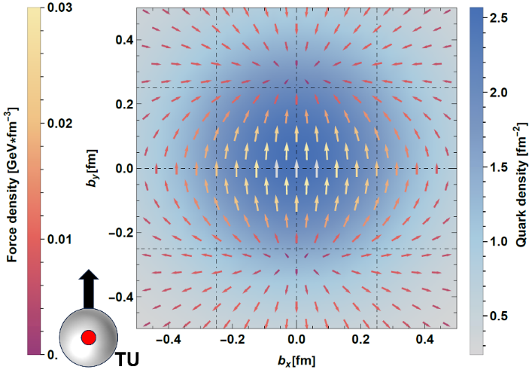
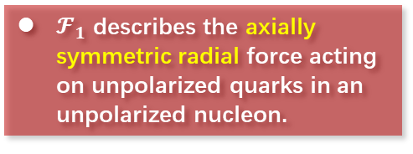

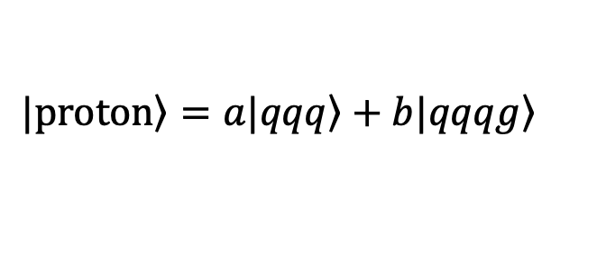
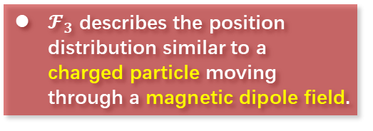

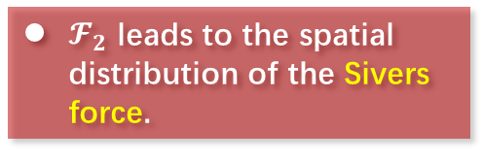



Force distribution in impact parameter space
$$\left.|proton\right\rangle =a\left.|qqq\right\rangle +b\left.|qqqg\right\rangle$$
[Z. Zhang, et al., arXiv: 2603.25548]
$d$ quark
$$ℱ_{1}(b^{2})$$
$$ℱ_{2}(b^{2})$$
$$ℱ_{3}(b^{2})$$
$u$ quark
$𝓕_{1}$ describes the axially symmetric radial force acting on unpolarized quarks in an unpolarized nucleon.
$𝓕_{2}$ leads to the spatial distribution of the Sivers force.
$𝓕_{3}$ describes the position distribution similar to a charged particle moving through a magnetic dipole field.
Notes:
D quark distributions are in the upper panels, while u quark in the lower panels. The TU means proton is transversely polarized and quark is unpolarized.
File: Ziqi_Zhang_Color_Lorentz_Force_v2.pptx
File: JPVz124_Ziqi_Zhang_etal_Transverse_Force_in_Proton_2603.25548v1.pdf [PRD]
Includes qqq and qqqg Fock sectors

Slide 17
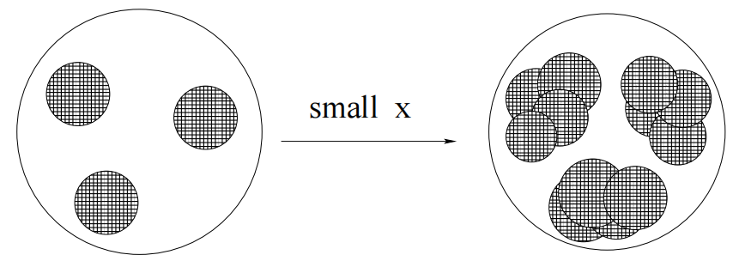


Exploring Nucleon Structure at Small-x via BLFQ
The Physics of Small-x: Gluon Saturation
At small-x, researchers predict rapid growth of gluon density inside the proton
Eventually, Gluon saturation sets in at saturation scale $Q_{s}(x)$
Method
Dipole model
BK
equation
Dipole model
BLFQ
Nucleon LFWFs at moderate x
Dipole amplitude
$$N(x_{0},r,b)$$
at initial scale
$$N(x,r,b)$$
at small $x$
(γ* p → J/ψ p) dσ/dt
vs. experiment
Xiaoyi Wu et al, in preparation
Notes:
File: Xiaoyi_Wu_small-x_v2.pptx
JPVz128_Xiaoyi_Wu_etal_J-Psi_photoprod_in_pp_scatg.pdf [journal?]
Includes only valence sectors for both proton and J/Psi

Slide 18
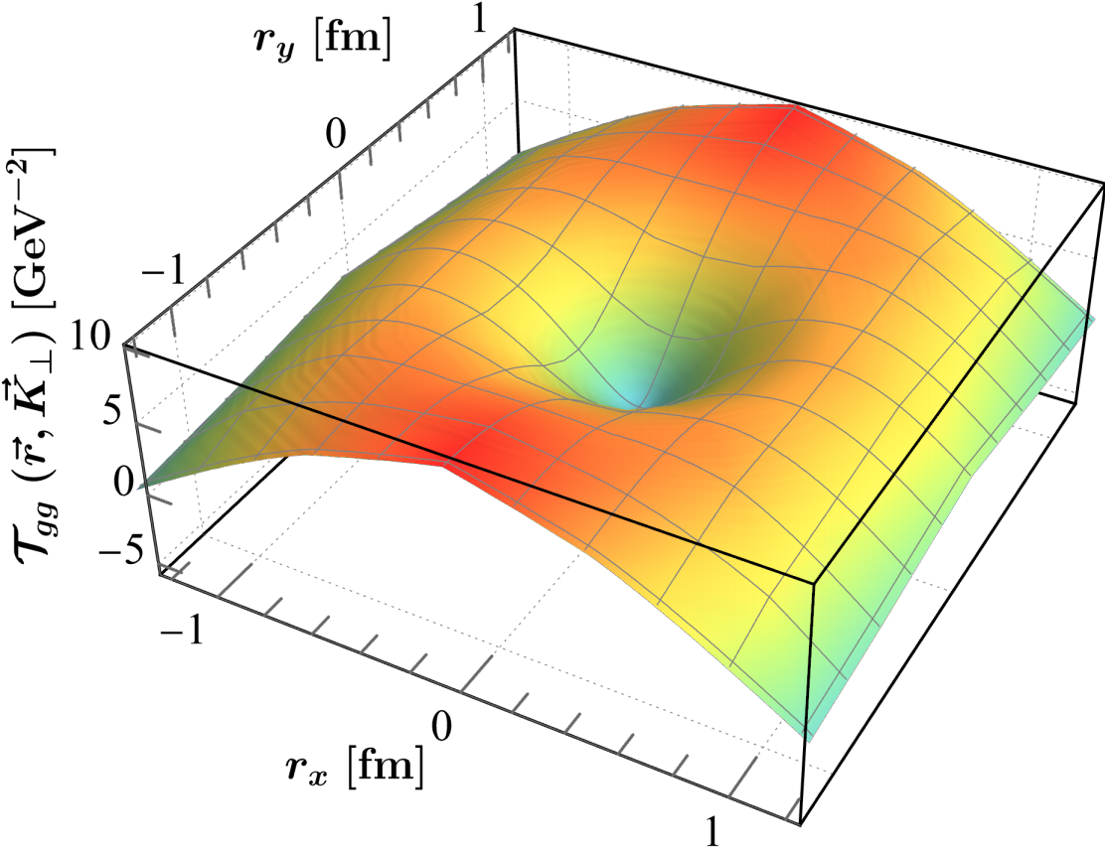
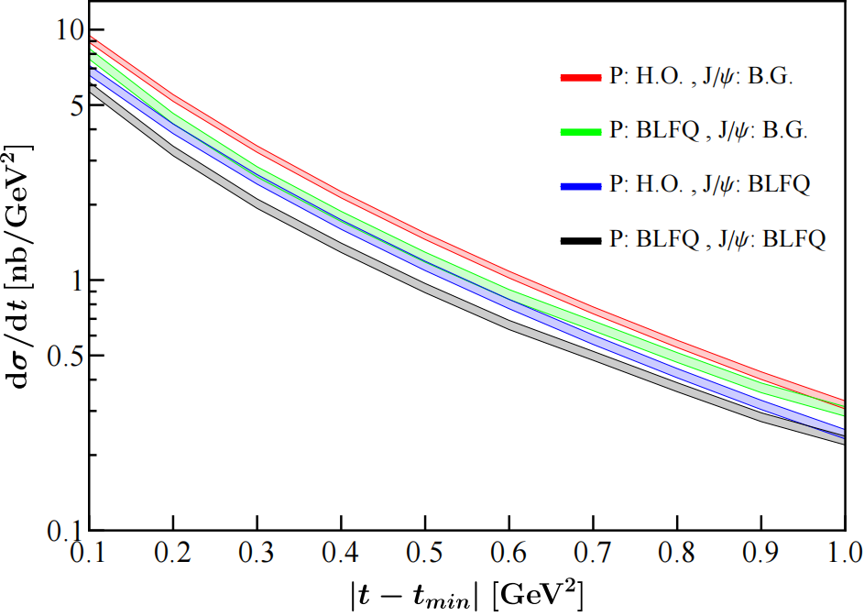
Dipole scattering amplitude & J/ψ differential cross section at initial scale
Initially employs only valence sectors for the proton and the meson
In Progress:
• Computing dipole scattering amplitude with a dynamical gluon
• Evolve that amplitude & cross section to the small x scale, and compare
with experimental data
Xiaoyi Wu et al, in preparation
Notes:
File: Xiaoyi_Wu_small-x_v2.pptx
JPVz128_Xiaoyi_Wu_etal_J-Psi_photoprod_in_pp_scatg.pdf [journal?]
Includes only valence sectors for both proton and J/Psi

Slide 19
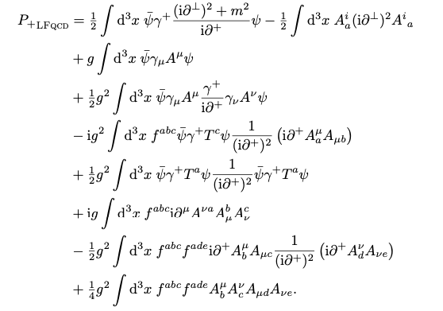
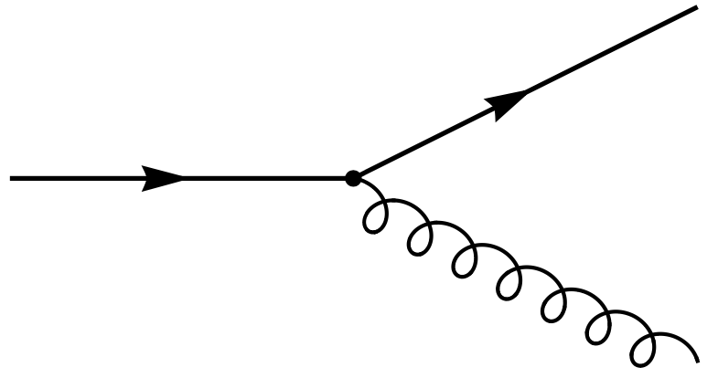
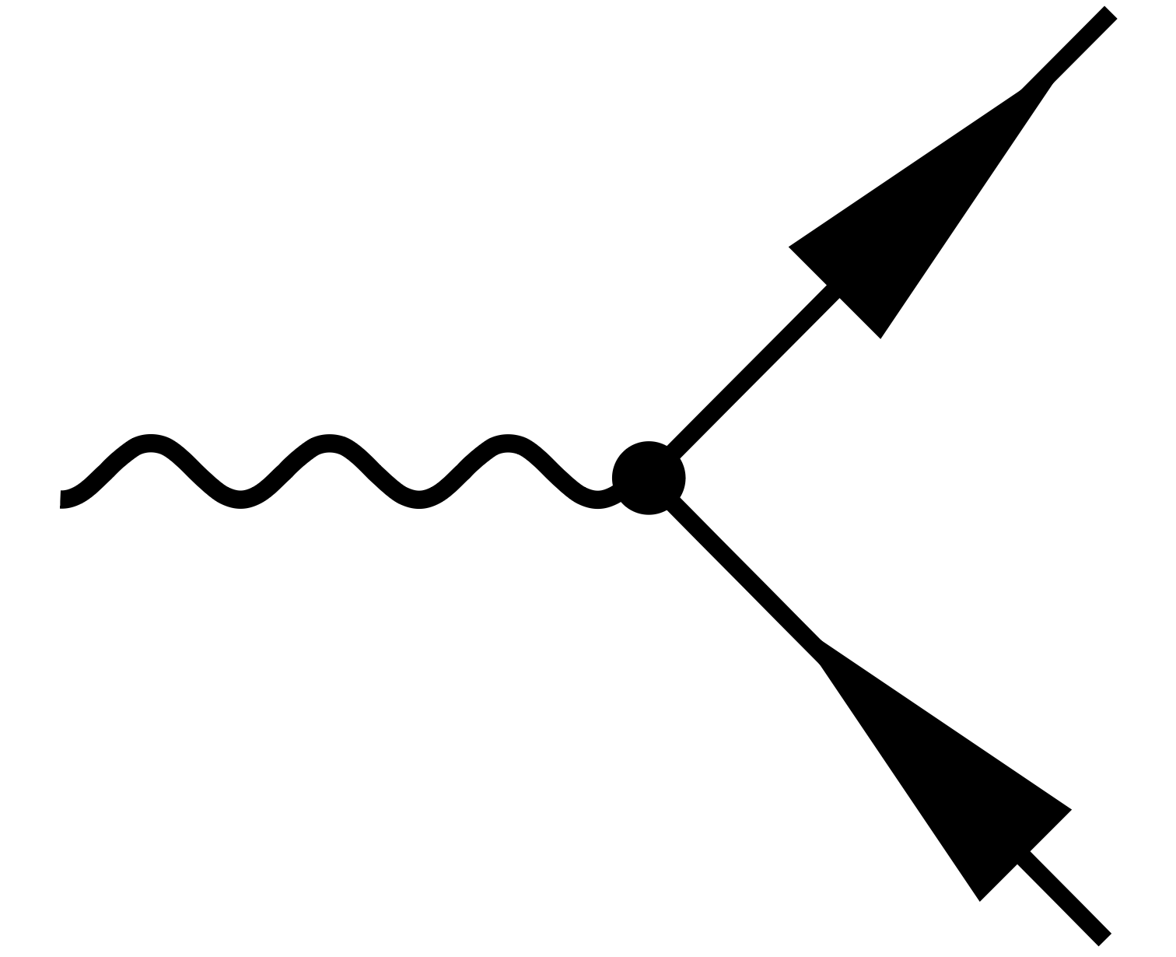
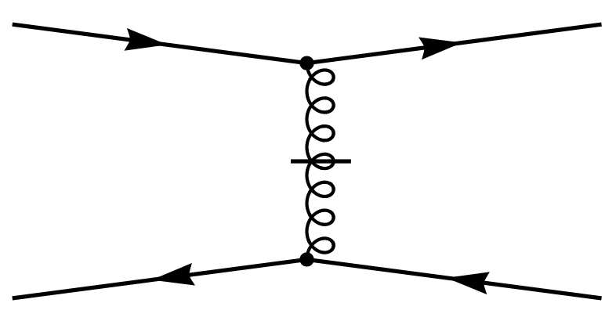










QCD Light-front Hamiltonian
[S. Brodsky, H-C Pauli, S. Pinsky, ‘97]
QCD light-front Hamiltonian from QCD Lagrangian:
$$ℒ_{QCD}=\overline{ψ}\left(iD−m\right)ψ−\frac{1}{4}G_{μν}^{α}G_{α}^{μν}$$
$$A^{+}=0$$
/
$${ P}_{QCD}^{−}=H_{K}+H_{I}$$
$$H_{K}=$$
$$H_{I}=$$
$ψ$: quark field operator
$A_{μ}^{a}$: gluon field operator
7 terms in $H_{I}$
Notes:
Add Fock sector
File: Sqi_Xu_Light_cone_2026.pptx

Slide 20


Input Parameters
Truncation Parameters: up to 6-parton Fock sectors with
$N_{max}=7$ & $K=6$
  $$\left|\left.N\right\rangle →\right|\left.qqq\right\rangle +\left|qqqu\overline{u}\right\rangle +\left|qqqd\overline{d}\right\rangle +\left|qqqs\overline{s}\right\rangle +\left|qqqu\overline{u}g\right\rangle$$
  $+\left|qqqd\overline{d}g\right\rangle +\left|qqqs\overline{s}g\right\rangle +\left|qqqg\right\rangle +\left|qqqgg\right\rangle +\left|qqqggg\right\rangle$
Input Parameters:
$$m_{u}$$ | $$m_{d}$$ | $$m_{s}$$ | $$m_{f}$$ | $$g$$ | $$b_{inst}$$ | $$b$$
0.3 GeV | 0.299 GeV | 0.5 GeV | 1.0 GeV | 2.2 | 3.0 GeV | 0.6 GeV
determined by fitting electromagnetic Form Factors and proton mass
separate quark mass in the quark-gluon vertex $m_{f}$ is needed
$$M_{p}=0.93 GeV$$
$$∝gb+…$$
Spin no flip
$$∝gm_{f}+…$$
Spin flip
Notes:
File: Sqi_Xu_Light_cone_2026.pptx

Slide 21








Fock Sector Contribution
  $$\left|\left.N\right\rangle →\right|\left.qqq\right\rangle +\left|qqqu\overline{u}\right\rangle +\left|qqqd\overline{d}\right\rangle +\left|qqqs\overline{s}\right\rangle +\left|qqqu\overline{u}g\right\rangle +\left|qqqd\overline{d}g\right\rangle +\left|qqqs\overline{s}g\right\rangle +\left|qqqg\right\rangle +\left|qqqgg\right\rangle +\left|qqqggg\right\rangle$$
Valence Fock sector
$$\left|qqq\right\rangle ∼59.64\%$$
Sea quark Fock sectors
$\left|qqq u\overline{u}g\right\rangle ∼0.003\%$
$\left|qqq d\overline{d}g\right\rangle ∼0.004\%$
$\left|qqq s\overline{s}g\right\rangle ∼0.001\%$
Sea quark Fock sectors
$$\left|qqq u\overline{u}\right\rangle ∼0.07\%$$
$$\left|qqq d\overline{d}\right\rangle ∼0.1\%$$
$$\left|qqq s\overline{s}\right\rangle ∼0.03\%$$
Dynamic gluon Fock sectors
$\left|qqqg\right\rangle ～39.32\%$
Dynamic gluon Fock sectors
$$\left|qqq gg\right\rangle ～0.82\%$$
Dynamic gluon Fock sectors
$$\left|qqq ggg\right\rangle ∼0.006\%$$
Notes:
File: Sqi_Xu_Light_cone_2026.pptx

Slide 22




Unpolarized PDF
Preliminary
Unpolarized PDFs:
$$μ_{0}^{2}=0.23 {GeV}^{2}$$
Parton number density distribution in longitudinal direction
All BLFQ results are at the initial scale
Valence quarks contribute mainly at $x\sim 0.3$
Gluon distributions are larger than those of sea quark
Gluon and sea quark dominate in small $x$ region
Notes:
File: Sqi_Xu_Light_cone_2026.pptx
JV: added “BLFQ” to make “All BLFQ results . . . “

Slide 23




Glueball Spectrum and Structure in BLFQ
(a)
(b)
(c)
(a) The three-gluon interaction
(b) The four-gluon interaction
(c) The instantaneous-gluon-interaction
Z.Y. Lin, C. Mondal, S.Q. Xu, X.B Zhao, J.P. Vary, in preparation
Notes:
File: Glueball_ZiyangLin_for_LC2026.pptx

Slide 24



Preliminary
Based solely on the light-front QCD Hamiltonian,
BLFQ yields low-lying glueball states exhibiting different Fock-sector compositions.
Z.Y. Lin, C. Mondal, S.Q. Xu, X.B Zhao, J.P. Vary, in preparation
Notes:
File: Glueball_ZiyangLin_for_LC2026.pptx

Slide 25

Deuteron in BLFQ with 6q and 6q+1g sectors
Electromagnetic Form Factors: Preliminary results
Satvir Kaur, McCartor Awardee session, LC2026
Notes:
File: Satvir_Kaur_NTSE2026_deuteron-BLFQ-Prof-Vary.pptx
File: IMP_Huizhou_June_2026_Vary_full.pptx

Slide 26



DLCQ solutions for critical coupling of ϕ⁴ in 1+1 D
Green dashed – without zero modes:
Red solid – include zero mode corrections:
S. Jawadekar, M. Sharaf and J.P. Vary, in preparation
Notes:
Shreeram_Jawadekar_Final_oral_exam.pptx page28

Slide 27
Outlook
JLAB and EIC experiments will benefit from a comprehensive
theory program that includes complementary relativistic approaches:
wave equations, lattice simulations, BLFQ, . . .
BLFQ is expanding rapidly towards including the full scope
of QCD dynamics through a wide range of efforts well beyond
those glimpsed briefly here (LC2026 talks by Siqi Xu, Satvir Kaur and
Xianghui Cao). See also important RGPEP developments in LC2026
talks by Stan Glazek and Kamil Serafin.
AI and quantum computing represent powerful new tools that will
further accelerate progress in achieving more complete results to
higher precision (LC2026 talks by Peter Love and Jie Pan)
Notes:
From: Vary_C2R2_South_Korea.pptx
File: AN_Mitra_Symposium_full.pptx (shown at symposium)
File: ECT_July_2025_Vary_full.pptx
IMP_Huizhou_June_2026_Vary_full.pptx

