Slide 1


String breaking in the Schwinger model: jet fragmentation and thermalization
David Frenklakh
Based on
2301.11991
2404.00087
2506.14983

Slide 2
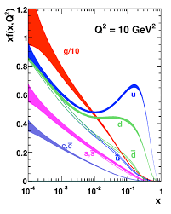
Motivation
Real-time nonperturbative dynamics in QCD
Parton distribution functions

Slide 3
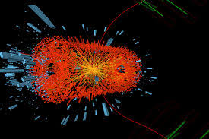
Motivation
Real-time nonperturbative dynamics in QCD
Parton distribution functions
Dynamics of matter in extreme conditions

Slide 4
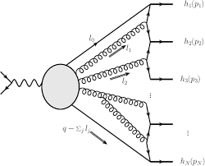
Motivation
Real-time nonperturbative dynamics in QCD
Parton distribution functions
Dynamics of matter in extreme conditions
Hadronization

Slide 5

Motivation
Real-time nonperturbative dynamics in QCD
Parton distribution functions
Dynamics of matter in extreme conditions
Hadronization
Entanglement (+magic?)

Slide 6
Motivation
Real-time nonperturbative dynamics in QFT/QMBS
Parton distribution functions
Dynamics of matter in extreme conditions
Hadronization
Entanglement (+magic?)
+
Dynamical phase transitions
Materials
Quantum thermalization

Slide 7
Motivation
Real-time nonperturbative dynamics in QFT/QMBS
Parton distribution functions
Dynamics of matter in extreme conditions
Hadronization
Entanglement (+magic?)
+
Dynamical phase transitions
Materials
Quantum thermalization
This talk

Slide 8

Real-time nonperturbative dynamics in QFT/QMBS

Slide 9
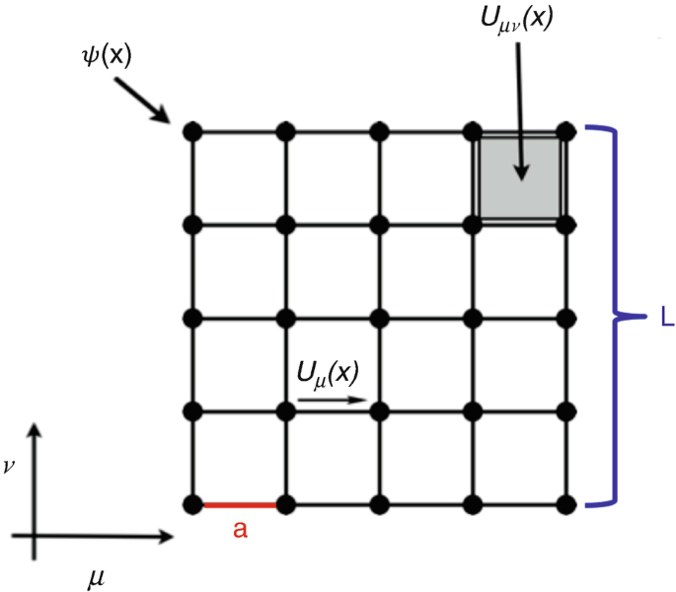
Real-time nonperturbative dynamics in QFT/QMBS
Euclidean lattice QFT
Sign problem

Slide 10

Real-time nonperturbative dynamics in QFT/QMBS
Euclidean lattice QFT
Sign problem

Slide 11
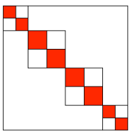
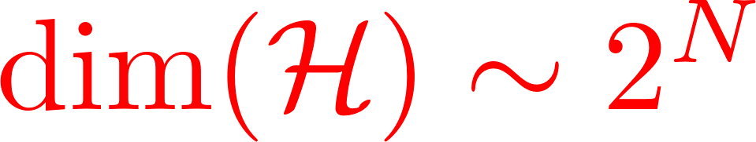
Real-time nonperturbative dynamics in QFT/QMBS
Euclidean lattice QFT
Sign problem
Exact diagonalization

Slide 12

Real-time nonperturbative dynamics in QFT/QMBS
Euclidean lattice QFT
Sign problem
Exact diagonalization

Slide 13
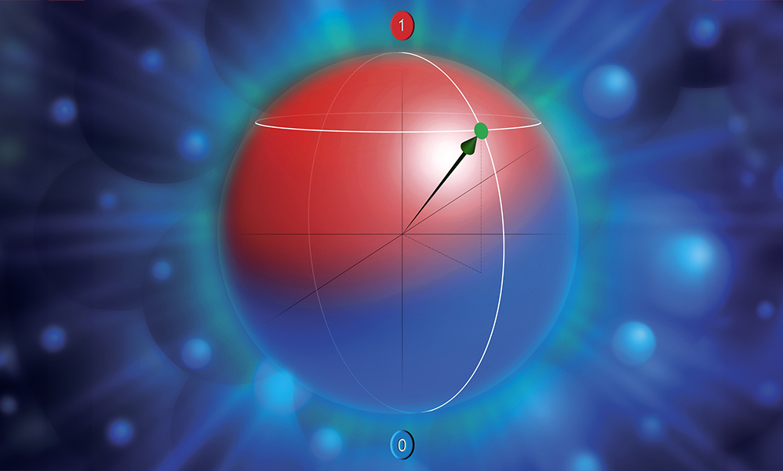
Real-time nonperturbative dynamics in QFT/QMBS
Euclidean lattice QFT
Quantum simulation
Great progress
No quantum
advantage yet
Sign problem
Exact diagonalization

Slide 14
Real-time nonperturbative dynamics in QFT/QMBS
Euclidean lattice QFT
Quantum simulation
Great progress
No quantum
advantage yet
Sign problem
Exact diagonalization

Slide 15

Real-time nonperturbative dynamics in QFT/QMBS
Euclidean lattice QFT
Quantum simulation
Great progress
No quantum
advantage yet
Sign problem
Exact diagonalization
Tensor networks
Robust, efficient
Mostly 1+1D

Slide 16
Real-time nonperturbative dynamics in QFT/QMBS
Euclidean lattice QFT
Quantum simulation
Great progress
No quantum
advantage yet
Sign problem
Exact diagonalization
Tensor networks
Robust, efficient
Mostly 1+1D

Slide 17
Real-time nonperturbative dynamics in QFT/QMBS
Euclidean lattice QFT
Quantum simulation
Great progress
No quantum
advantage yet
Sign problem
Exact diagonalization
Tensor networks
Robust, efficient
Mostly 1+1D
See also J. Montgomery’s talk later today

Slide 18




Schwinger model and jets: history
1974
Massless Schwinger model with external source
time

Slide 19


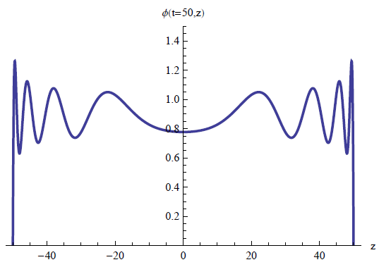
Schwinger model and jets: history
1974
2010s
Massless Schwinger model with external source
time

Slide 20





Schwinger model and jets: history
2020s
2010s
Massive Schwinger model with real-time methods

Slide 21
Schwinger model and jets: history
2020s
2010s
Massive Schwinger model with real-time methods

Slide 22
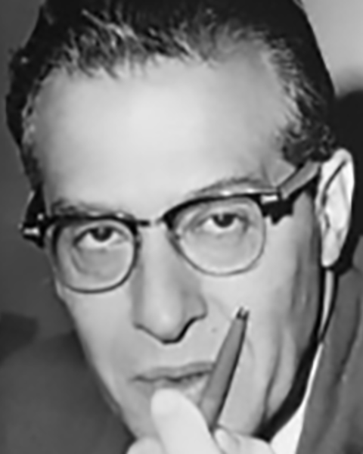

Schwinger model
Single-flavor (1+1)-dimensional QED:
Features include:
Linear potential between “quarks” – confinement
Spontaneous chiral symmetry breaking at m=0
No dynamical gauge field

Slide 23
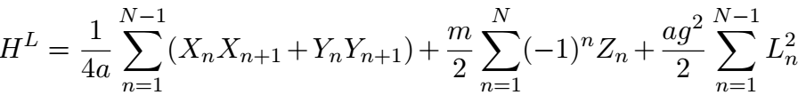
Schwinger model
Single-flavor (1+1)-dimensional QED:
Features include:
Linear potential between “quarks” – confinement
Spontaneous chiral symmetry breaking at m=0
No dynamical gauge field

Slide 24

Schwinger model + jets
Add the external
charges:
Single-flavor (1+1)-dimensional QED:
Features include:
Linear potential between “quarks” – confinement
Spontaneous chiral symmetry breaking at m=0
No dynamical gauge field

Slide 25

Schwinger model + jets
Add the external
charges:
Single-flavor (1+1)-dimensional QED:
Features include:
Linear potential between “quarks” – confinement
Spontaneous chiral symmetry breaking at m=0
No dynamical gauge field

Slide 26
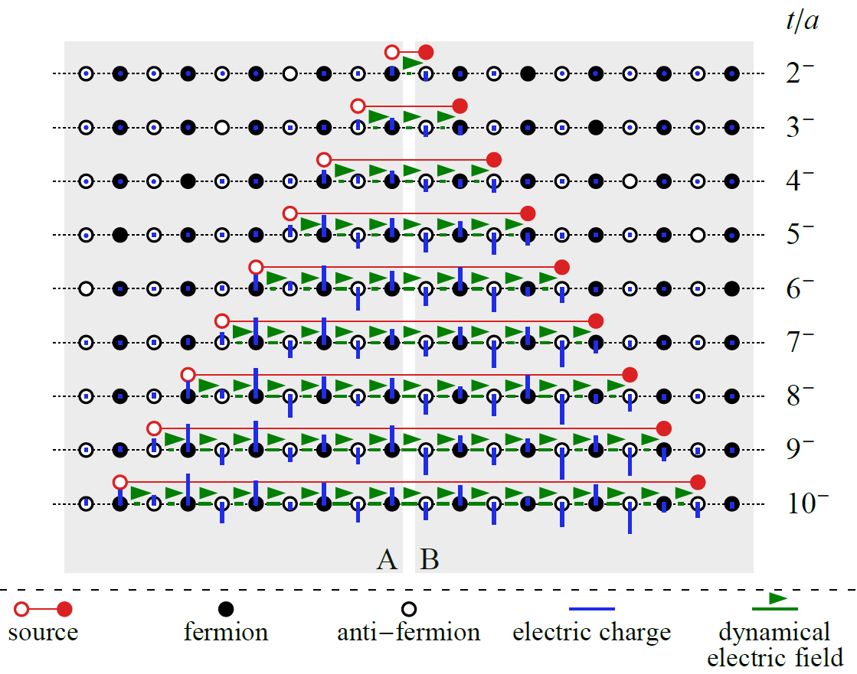

Screening, chiral condensate and entanglement
Induced charge density

Slide 27
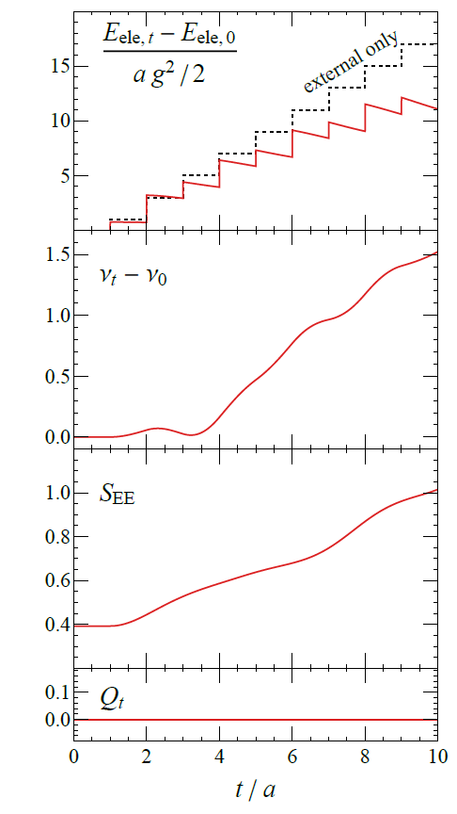
Screening, chiral condensate and entanglement
Electric energy
Chiral condensate
Entanglement entropy
Total charge

Slide 28
Screening, chiral condensate and entanglement
Screening the
electric field
Effects of the dynamical
pair production:

Slide 29

Screening, chiral condensate and entanglement
Screening the
electric field
Effects of the dynamical
pair production:
Destroying
vacuum
condensate

Slide 30


Screening, chiral condensate and entanglement
Screening the
electric field
Effects of the dynamical
pair production:
Destroying
vacuum
condensate
Entangling
the jets

Slide 31
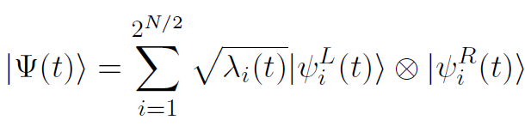
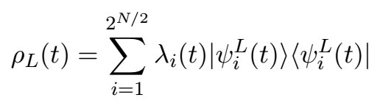
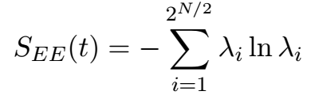
Entanglement spectrum
L
R
Schmidt spectrum

Slide 32
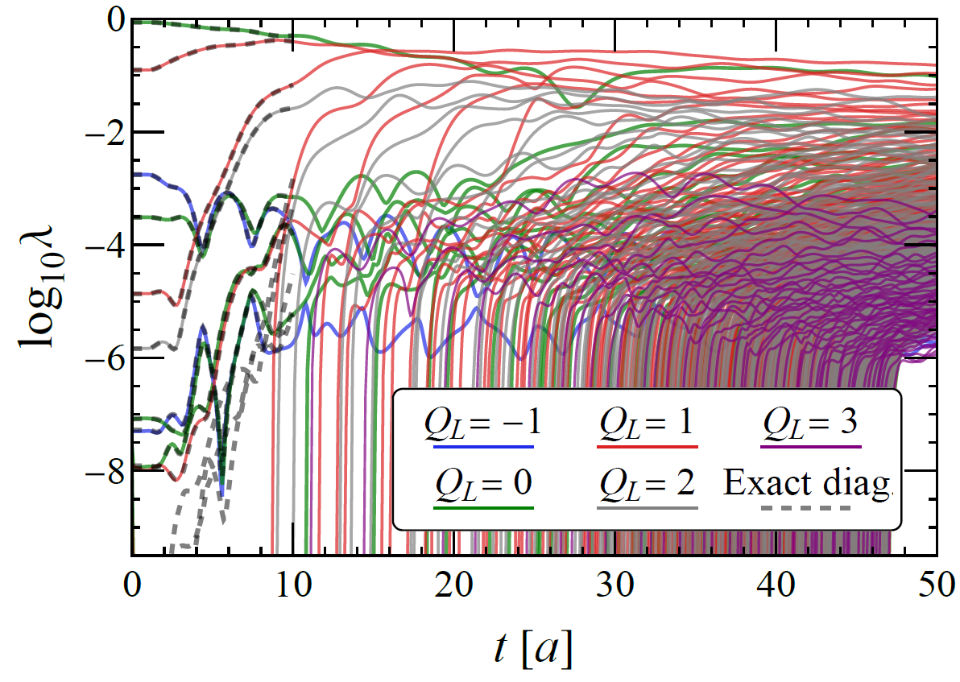
Entanglement spectrum
L
R
Schmidt spectrum

Slide 33
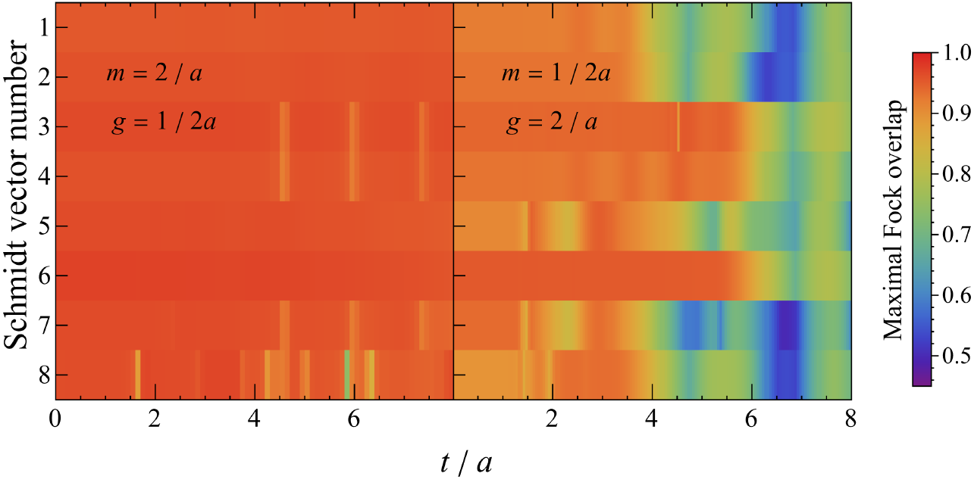

Hadronization in real time
computational
basis state
Schmidt vector
Weak coupling
Strong coupling

Slide 34
Hadronization in real time
Hadronization
computational
basis state
Schmidt vector
Weak coupling
Strong coupling

Slide 35
Thermalization
Far from equilibrium isolated quantum systems
generically evolve towards “looking thermal”
Eigenstate thermalization hypothesis (Srednicki, 1994)

Slide 36
Thermalization
Far from equilibrium isolated quantum systems
generically evolve towards “looking thermal”
Eigenstate thermalization hypothesis (Srednicki, 1994)
“Looking thermal”: expectation values of operators signal a consistent,
time-independent temperature

Slide 37
Thermalization
Far from equilibrium isolated quantum systems
generically evolve towards “looking thermal”
Eigenstate thermalization hypothesis (Srednicki, 1994)
“Looking thermal”: expectation values of operators signal a consistent,
time-independent temperature
How can a mixed state emerge during unitary evolution?
Consider a subsystem: entanglement mixed state

Slide 38
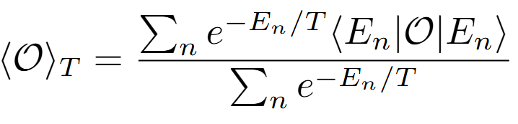
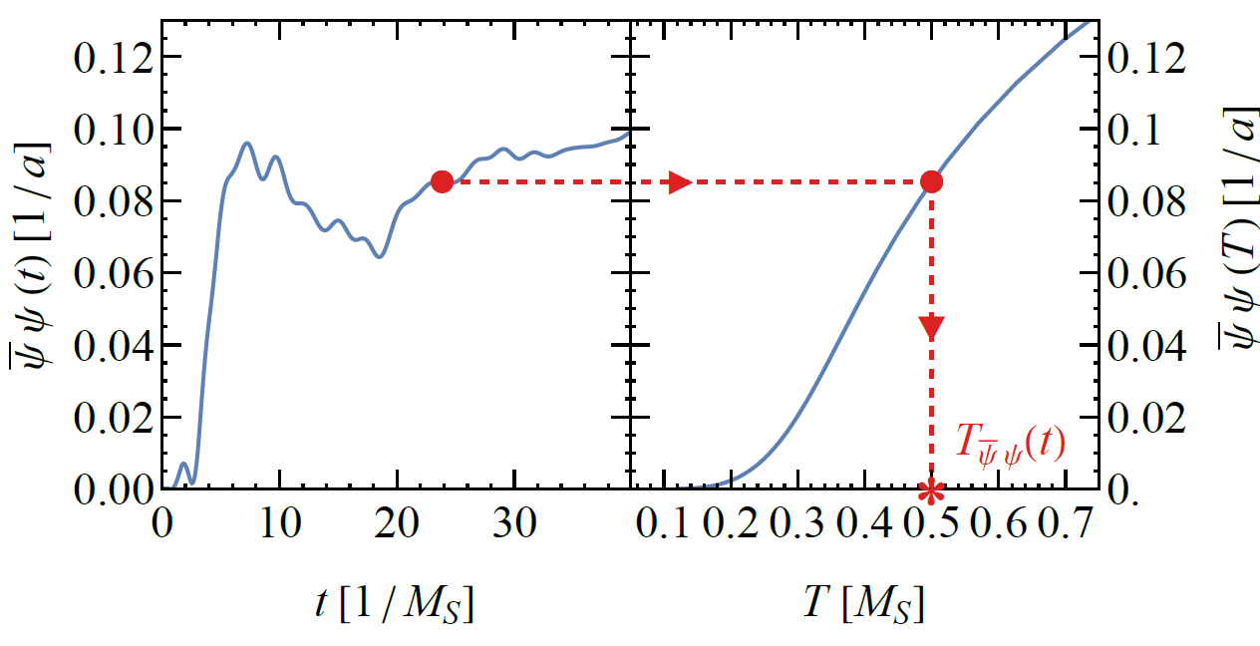
Local operators
Full diagonalization
OR
Tensor networks: purification
(requires ancillas,
doubling system size)

Slide 39
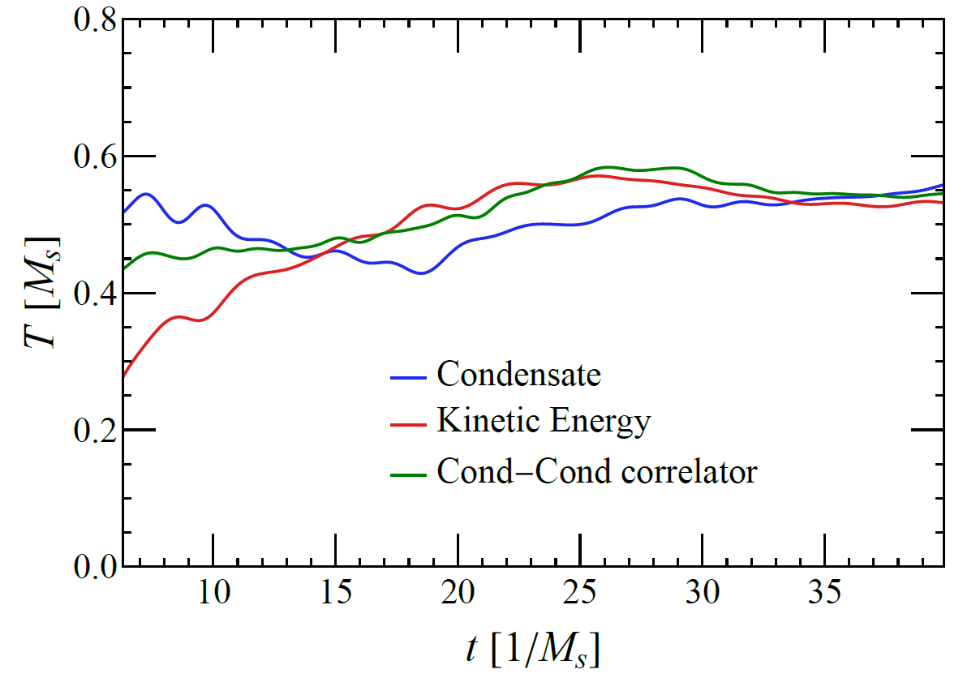
Local operators
Full diagonalization
OR
Tensor networks: purification
(requires ancillas,
doubling system size)

Slide 40
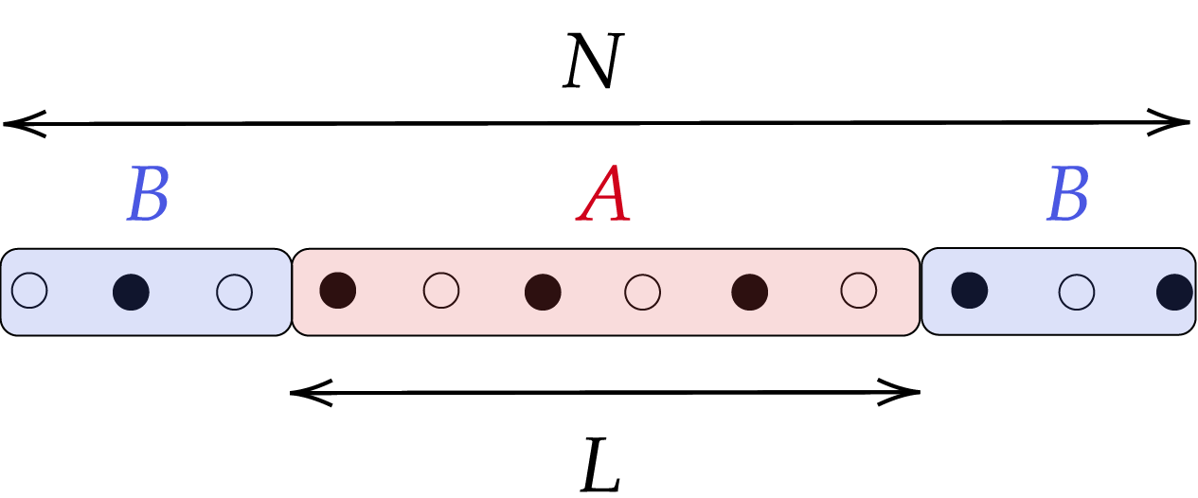
Beyond local operators: entropy

Slide 41
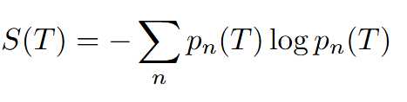
Beyond local operators: entropy
T

Slide 42
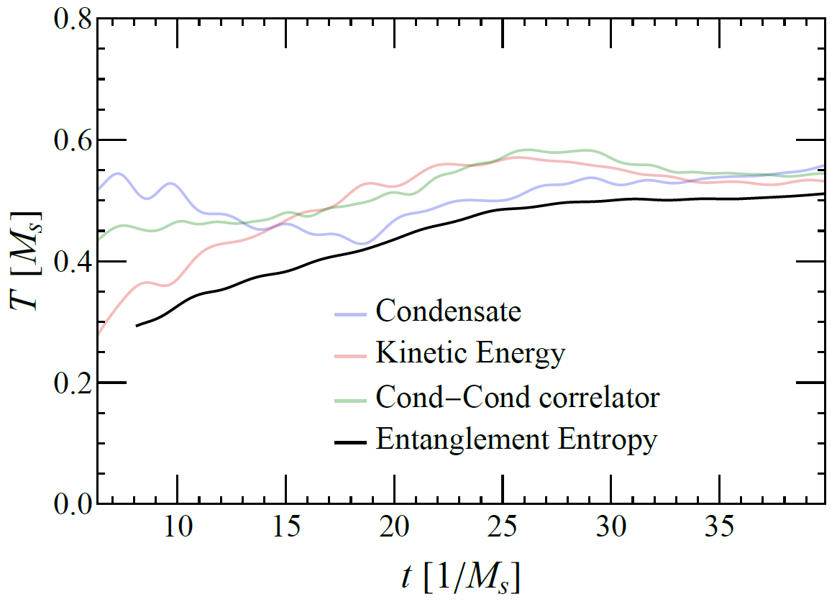
Beyond local operators: entropy
T

Slide 43
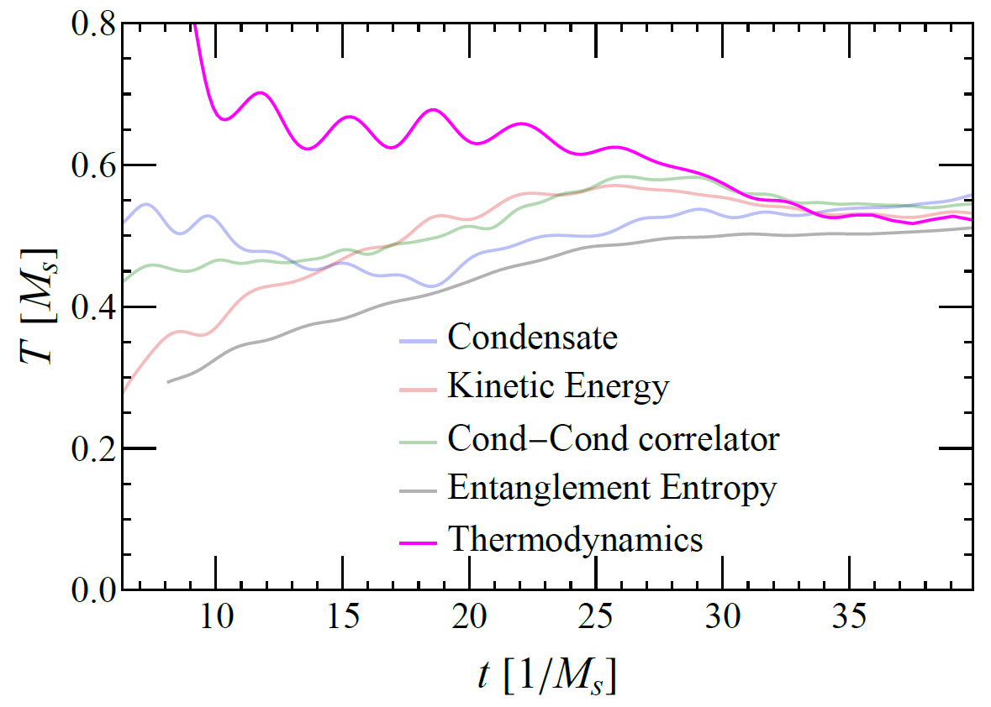
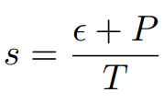
Beyond local operators: entropy

Slide 44
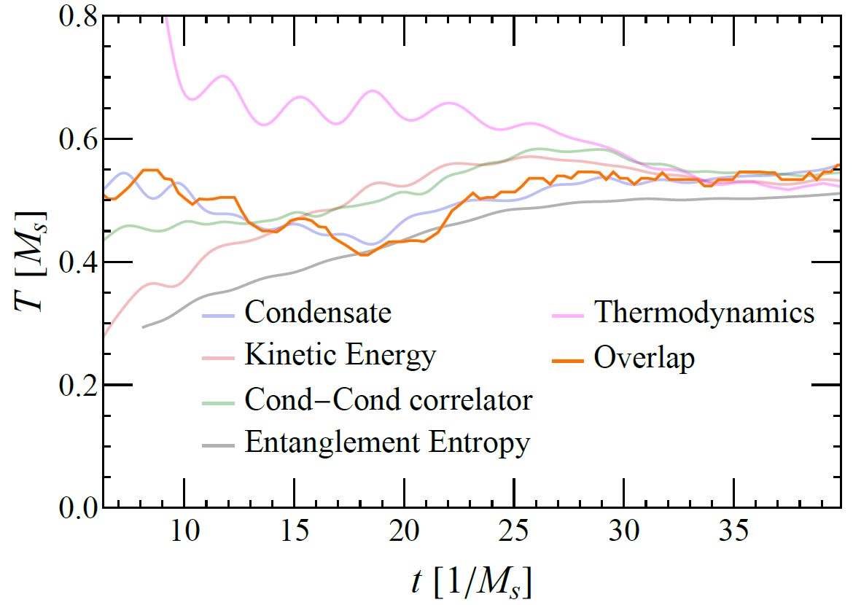
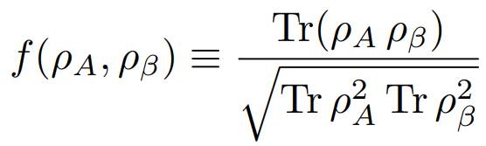

Density matrix comparison
Maximize over T

Slide 45
Conclusion
Mimic real-time QCD processes through the prism of QIS
Reveal striking relationship between thermalization and entanglement
Outlook:
Translate QIS insights into phenomenology
2+1 dimensions : angular structure, energy correlators, quantum advantage?
Nonabelian models: baryons

Slide 46

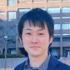
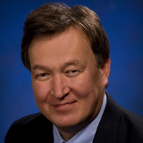
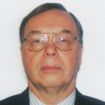




Based on
Real-Time Nonperturbative Dynamics of Jet Production in Schwinger Model: Quantum Entanglement and Vacuum Modification
Phys. Rev. Lett. 131, 021902 (2023)
Quantum real-time evolution of entanglement and hadronization in jet production: Lessons from the massive Schwinger model
Phys. Rev. D 110, 094029 (2024)
A.Florio DF K.Ikeda D.Kharzeev V.Korepin S.Shi K.Yu
Thermalization from quantum entanglement: jet simulations in the massive Schwinger model
Phys.Rev.D 112, 094502 (2025)
A.Florio DF S.Grieninger D.Kharzeev A.Palermo S.Shi

