Slide 1
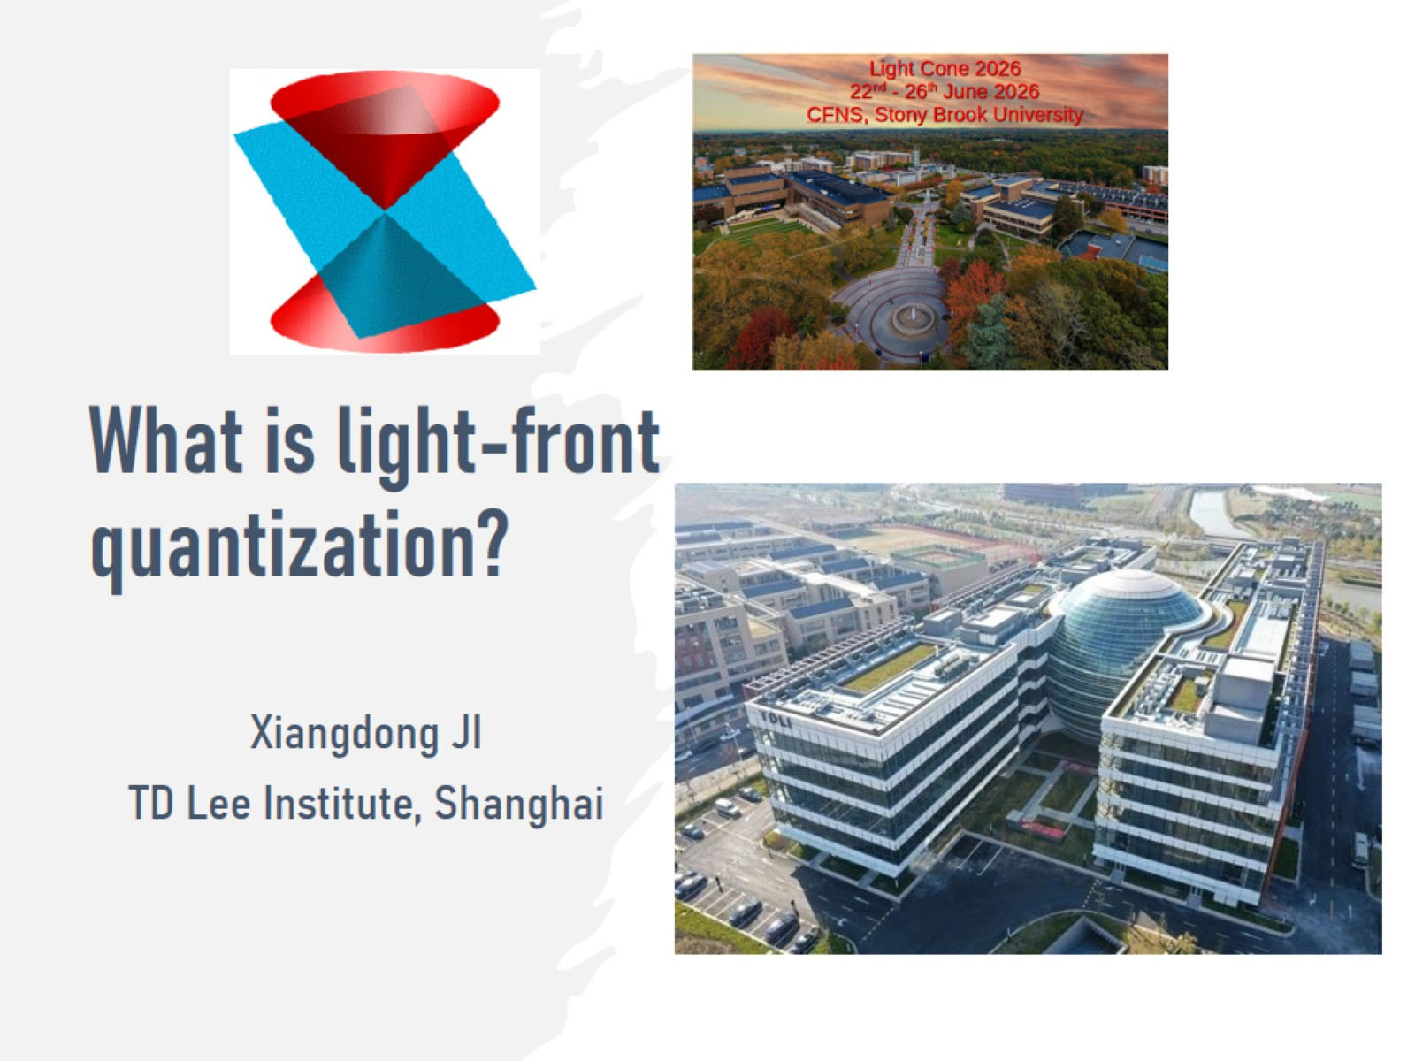
What is light-front quantization?

Slide 2
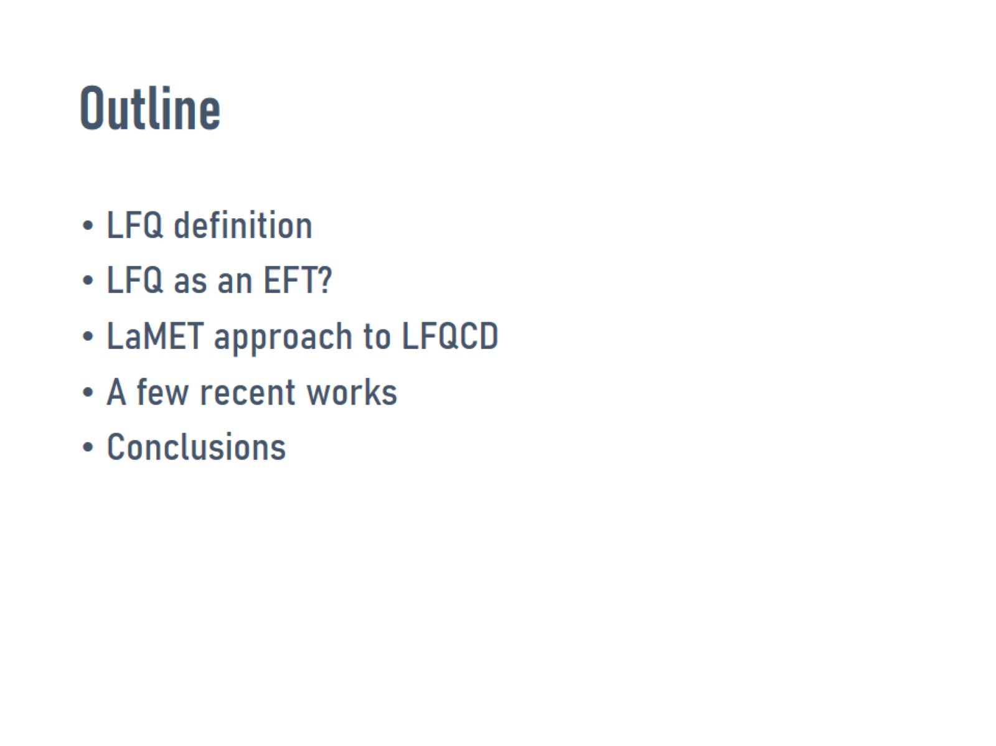
Outline

Slide 3
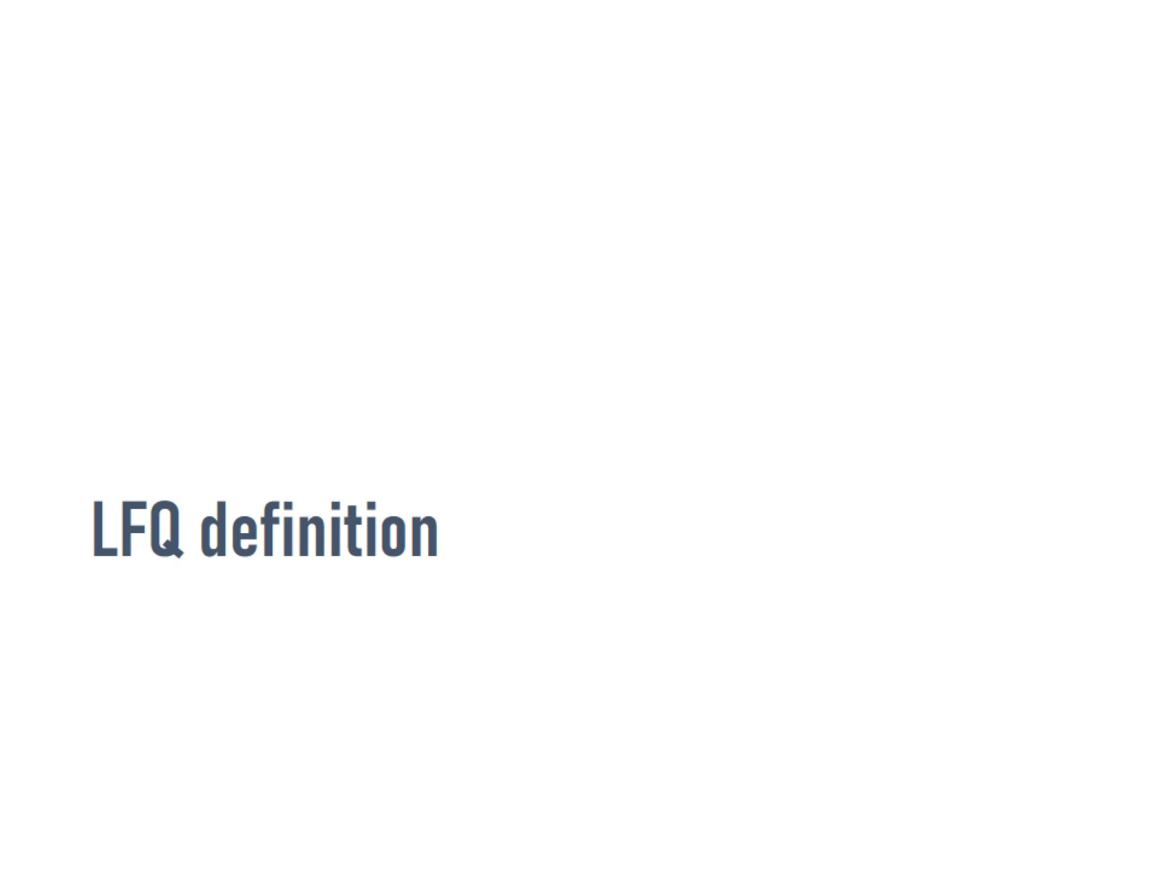
LFQ definition

Slide 4
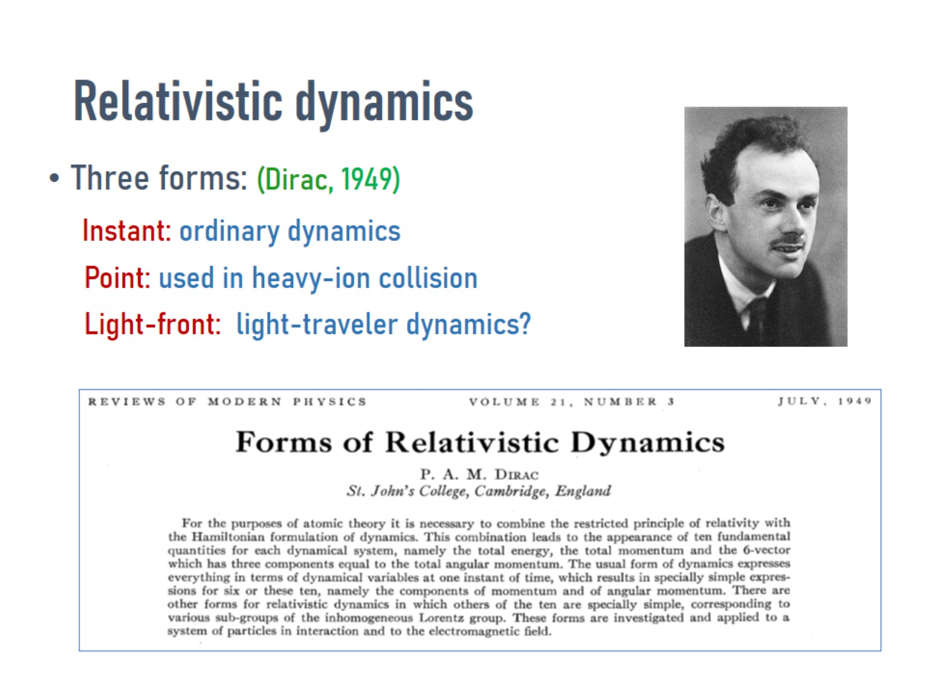
Relativistic dynamics

Slide 5
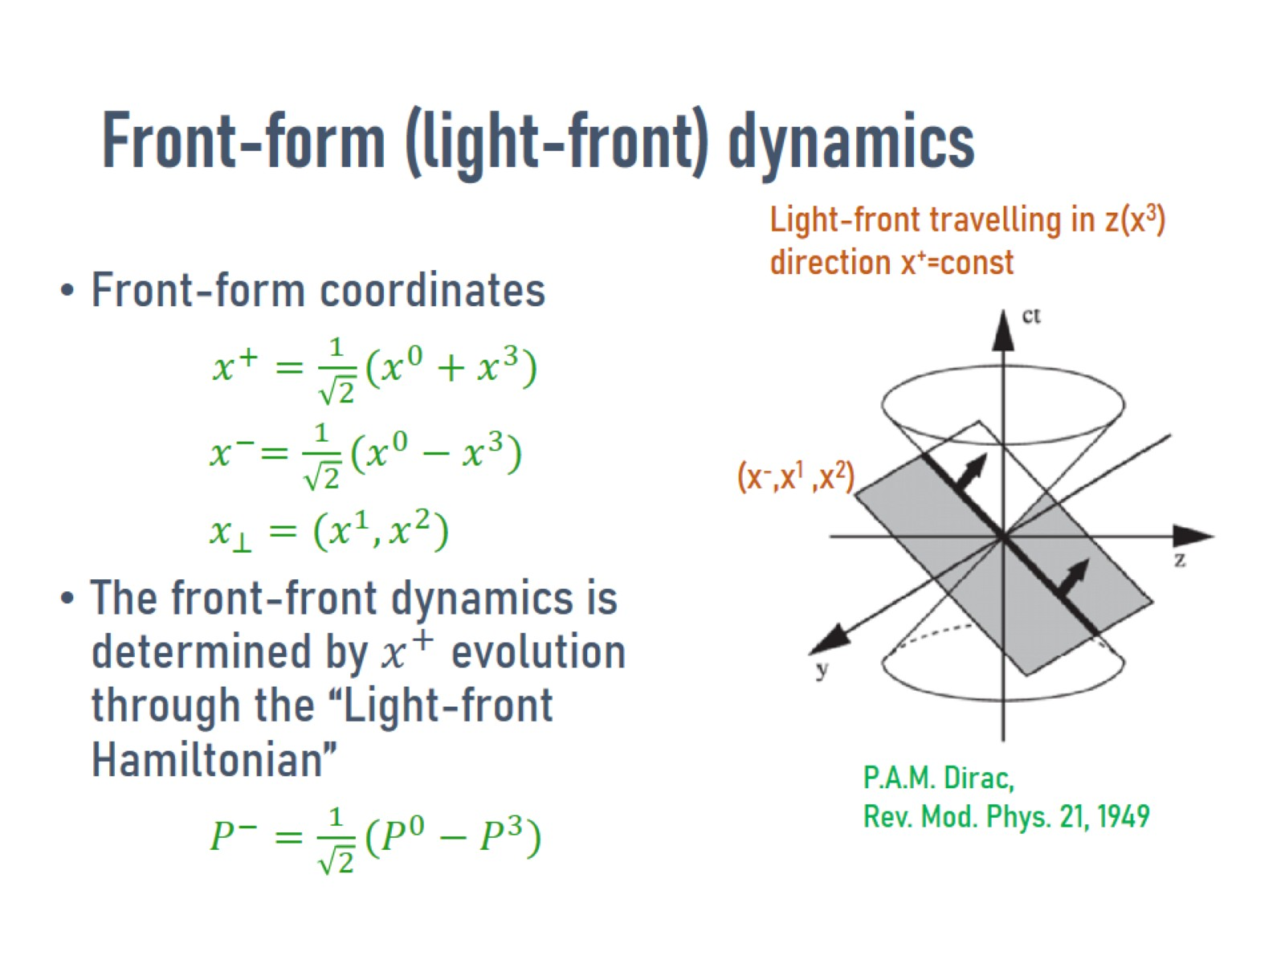
Front-form (light-front) dynamics

Slide 6
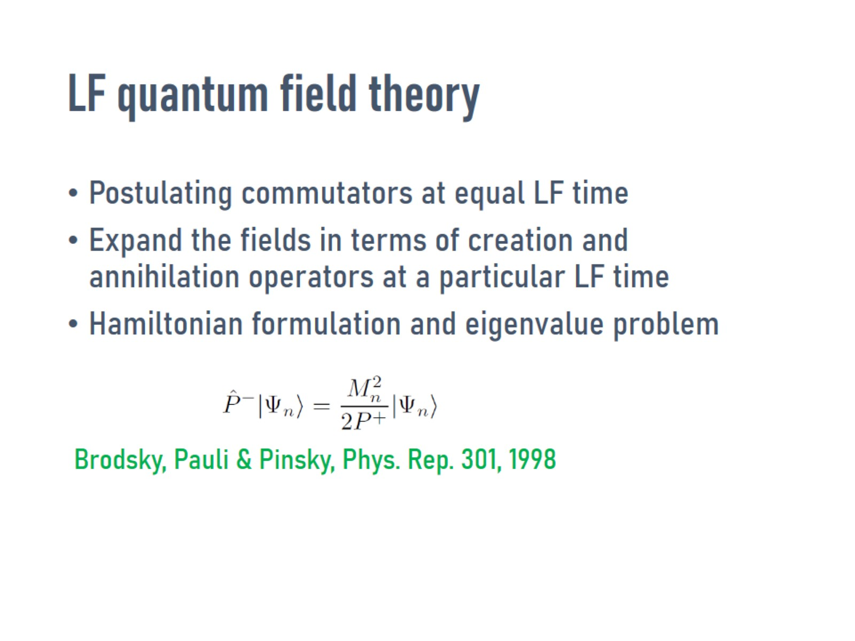
LF quantum field theory

Slide 7
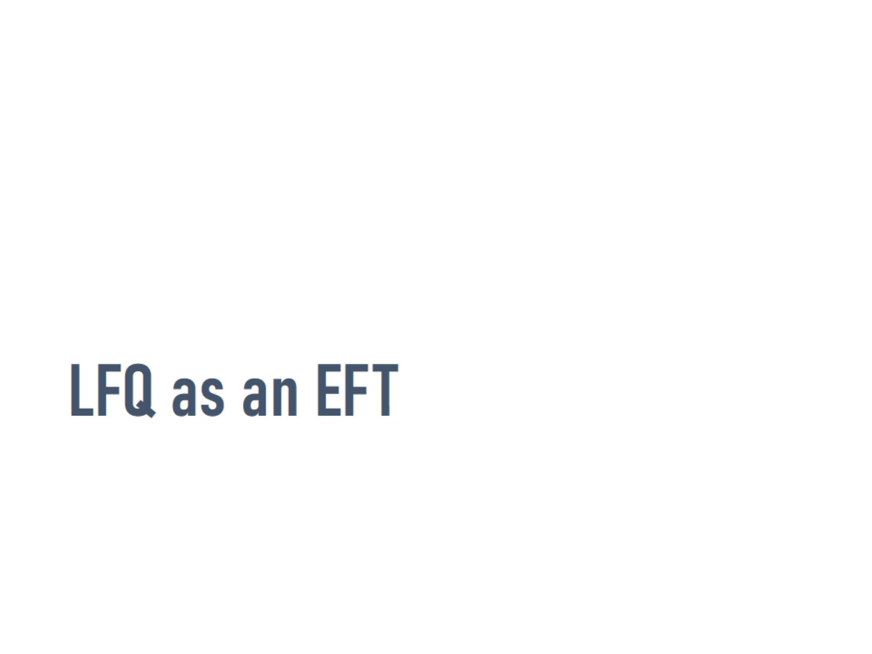
LFQ as an EFT

Slide 8
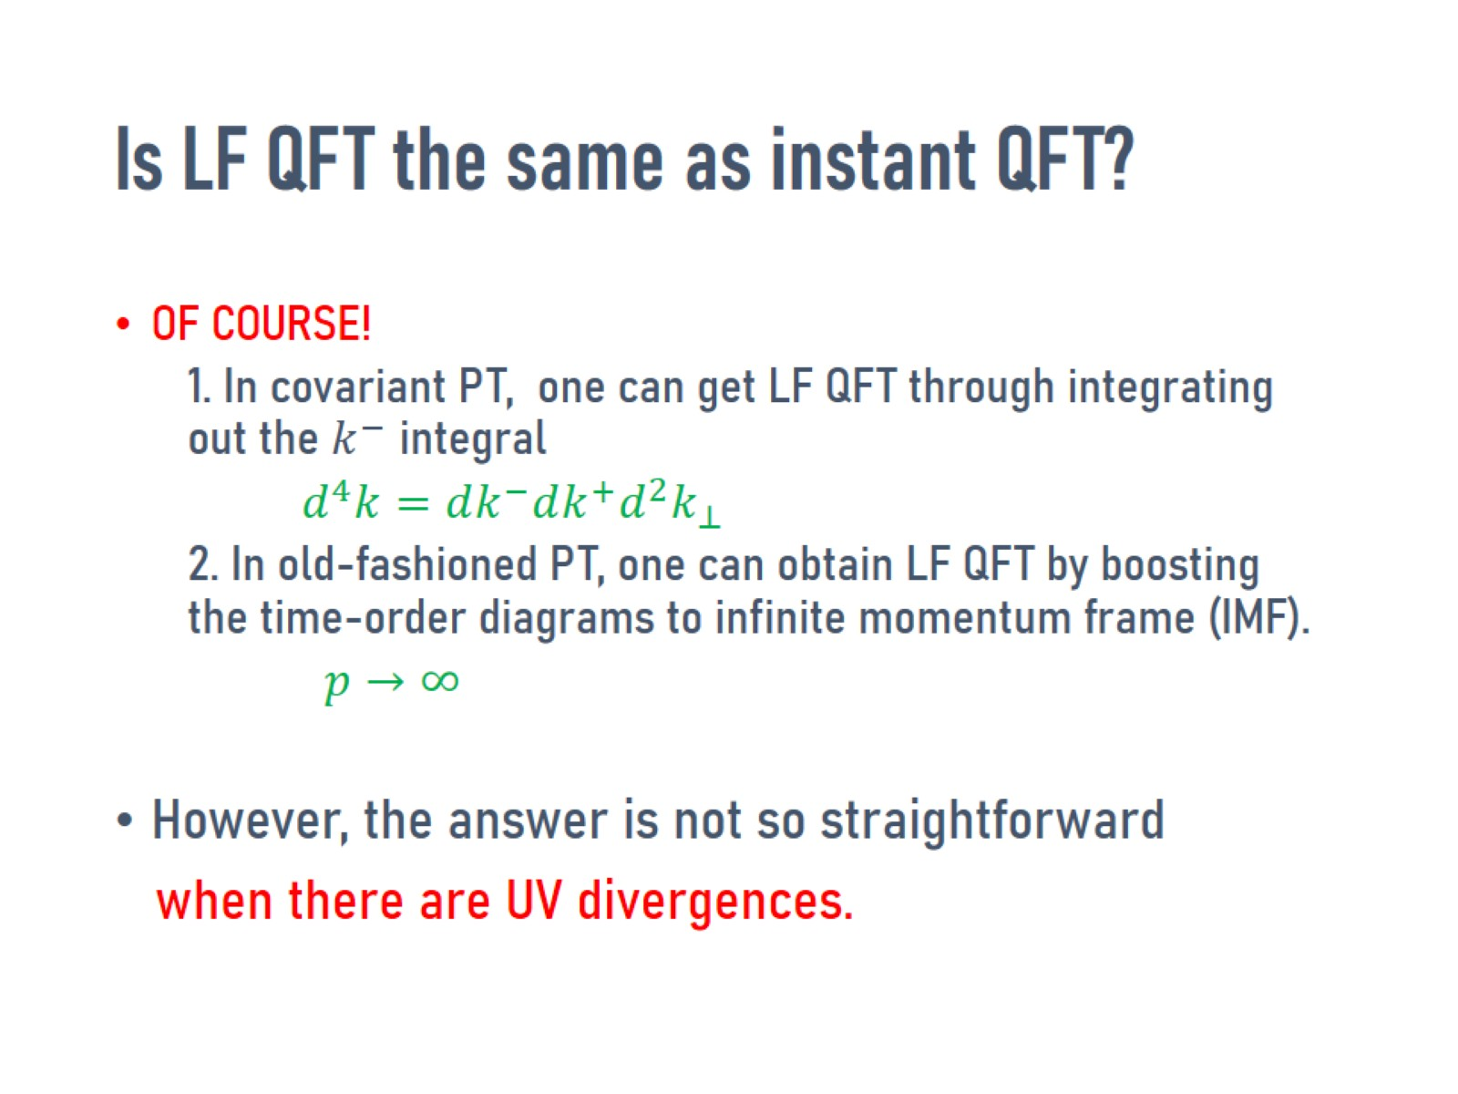
Is LF QFT the same as instant QFT?

Slide 9
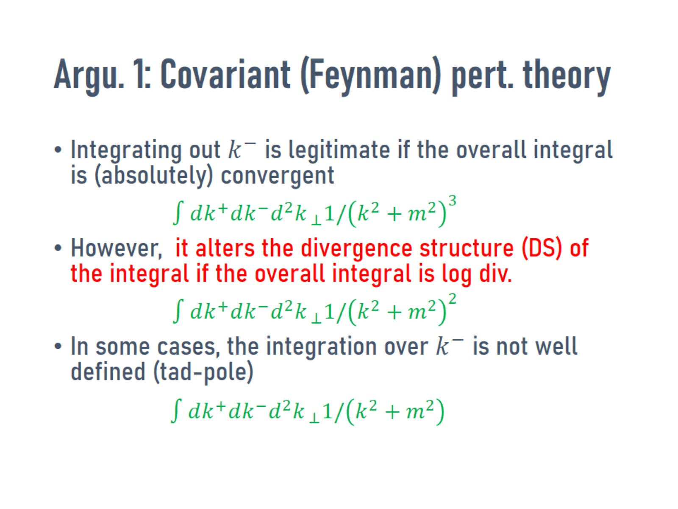
Argu. 1: Covariant (Feynman) pert. theory

Slide 10
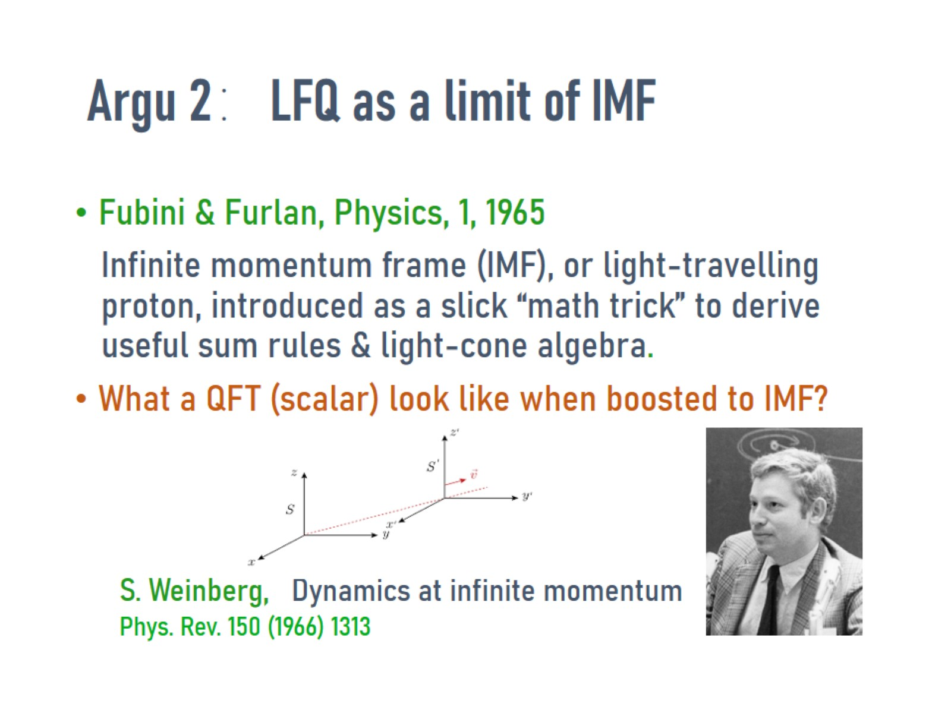
Argu 2：LFQ as a limit of IMF

Slide 11
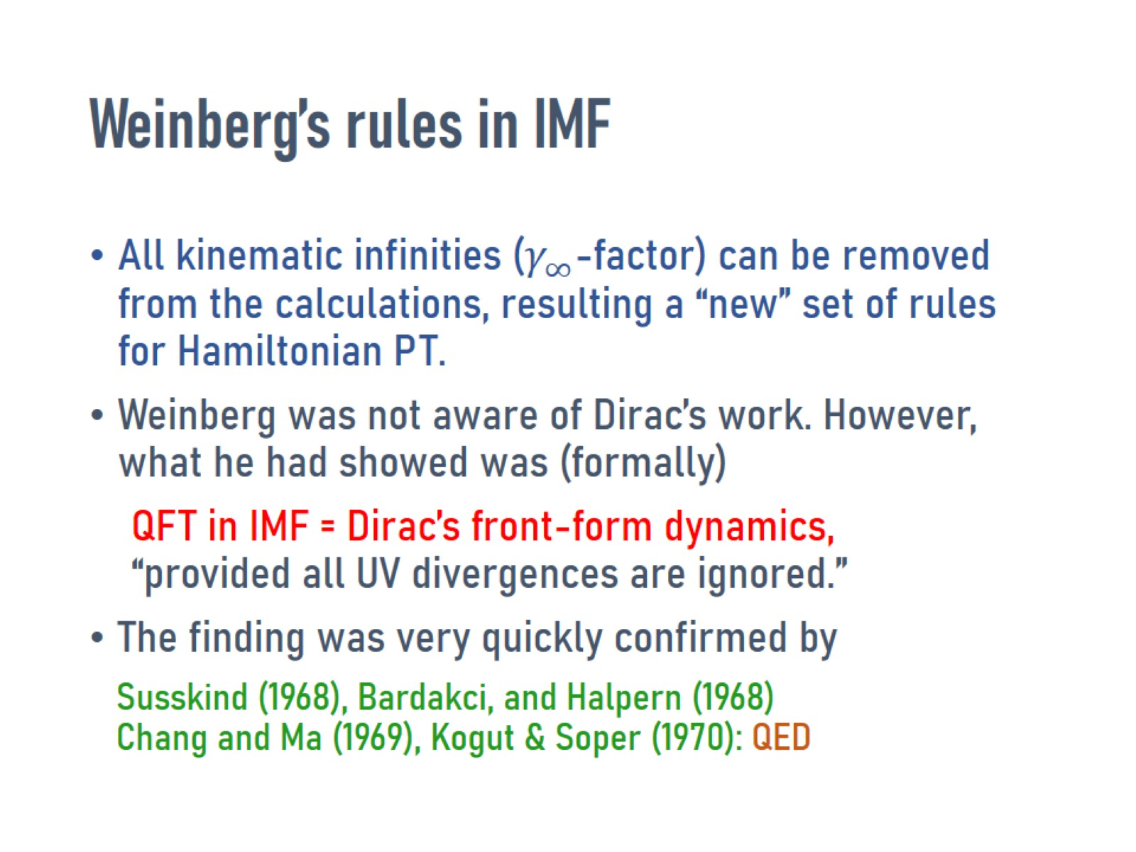
Weinberg’s rules in IMF

Slide 12
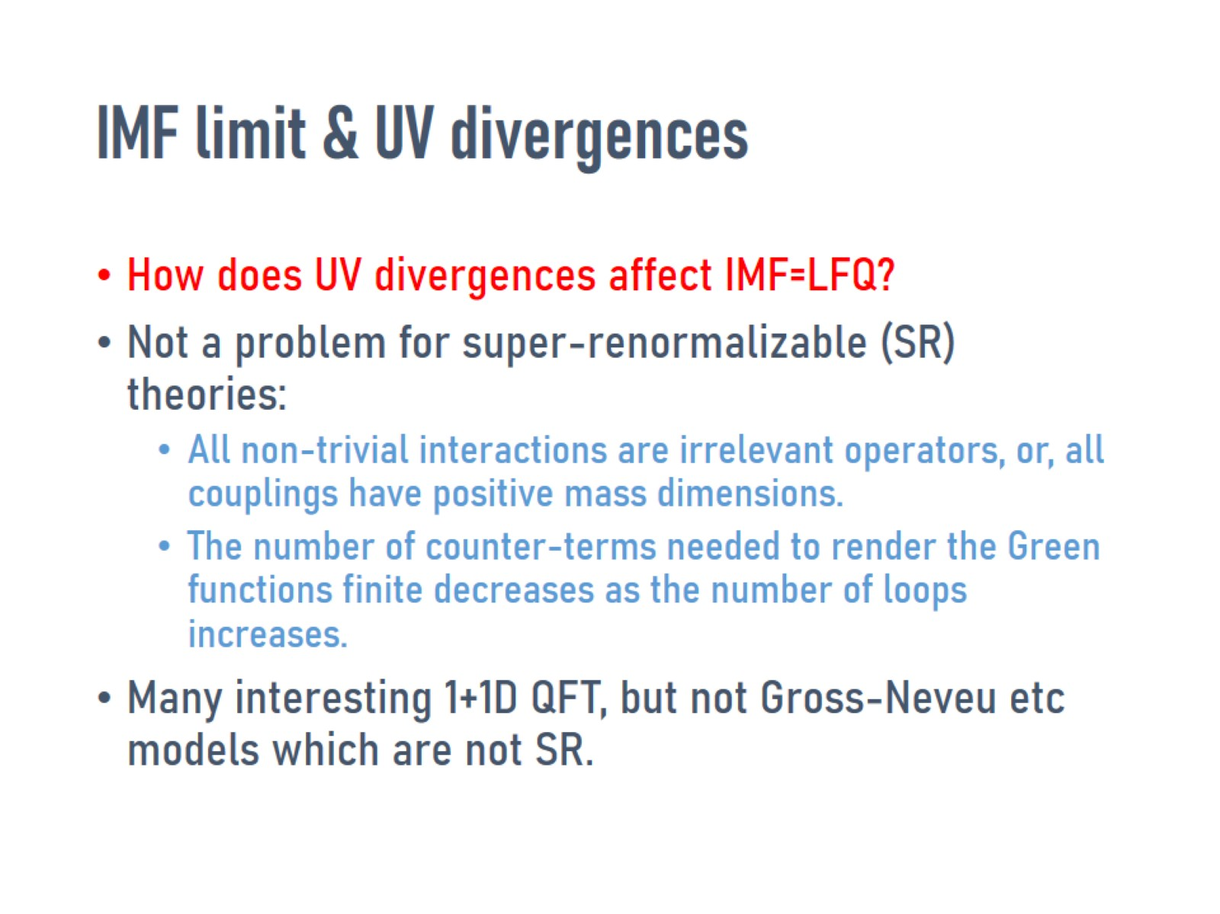
IMF limit & UV divergences

Slide 13
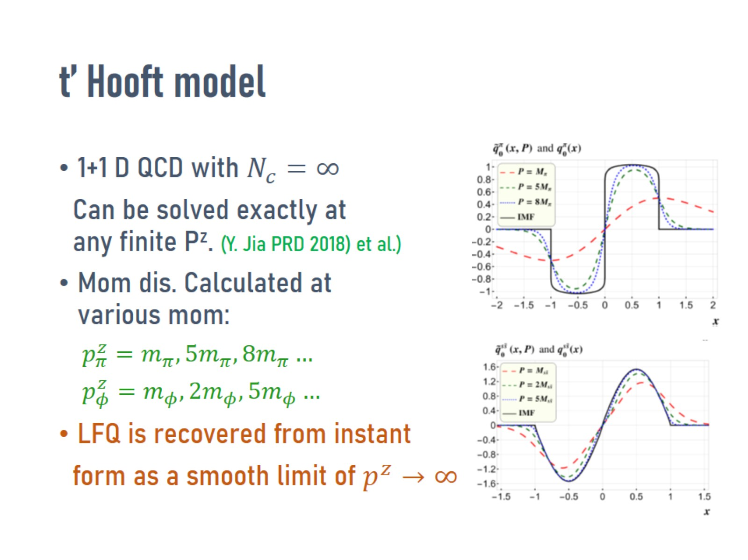
t’ Hooft model

Slide 14
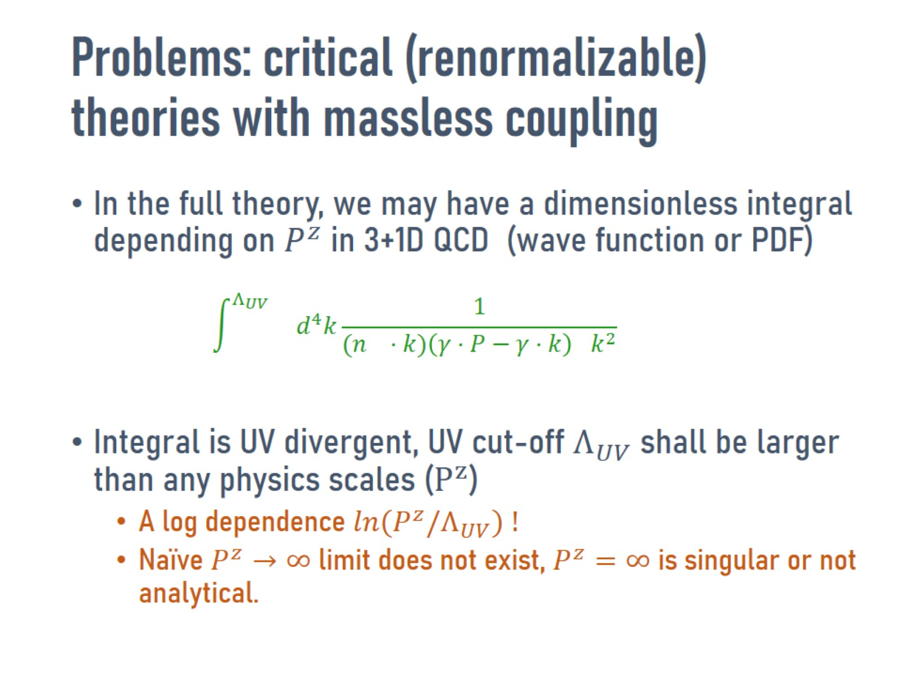
Problems: critical (renormalizable) theories with massless coupling

Slide 15
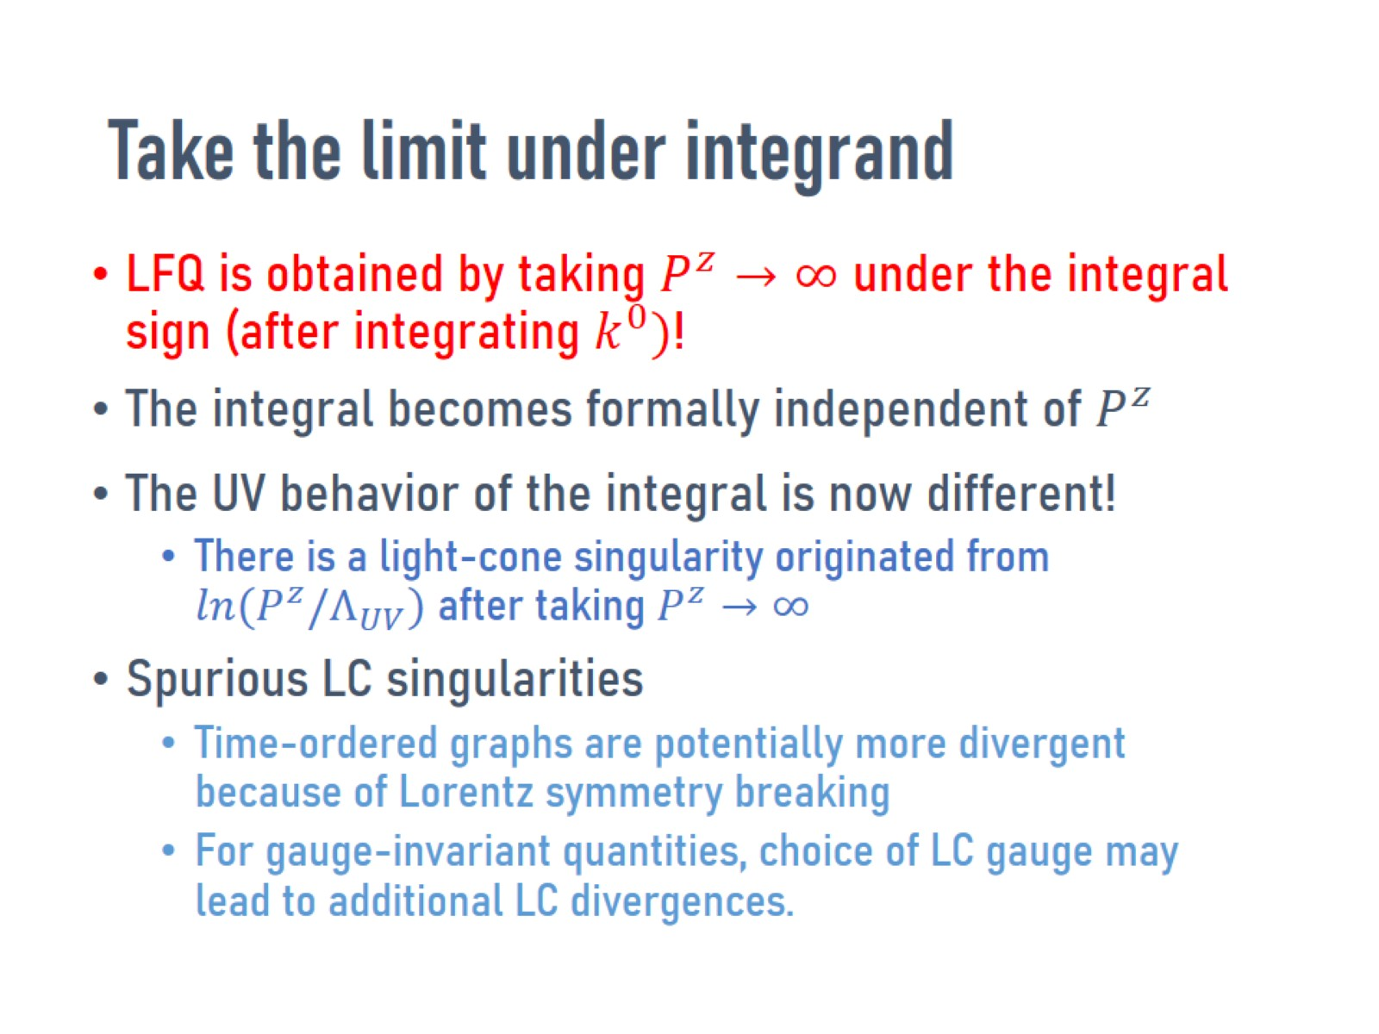
Take the limit under integrand

Slide 16
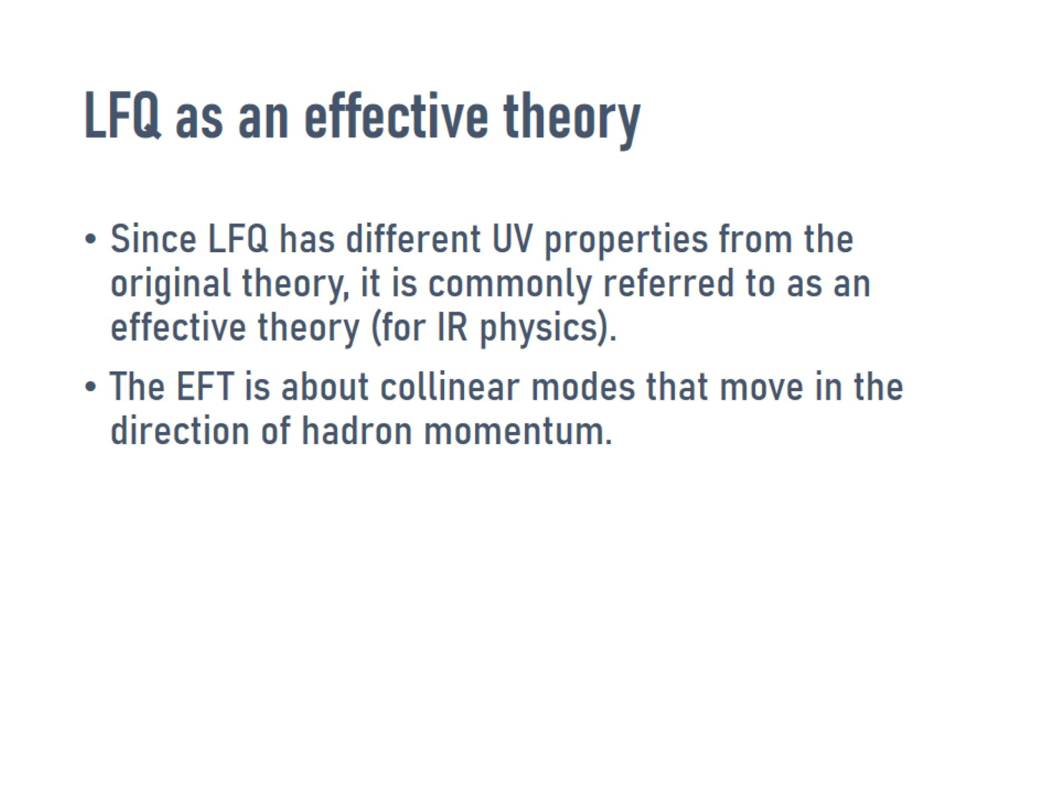
LFQ as an effective theory

Slide 17
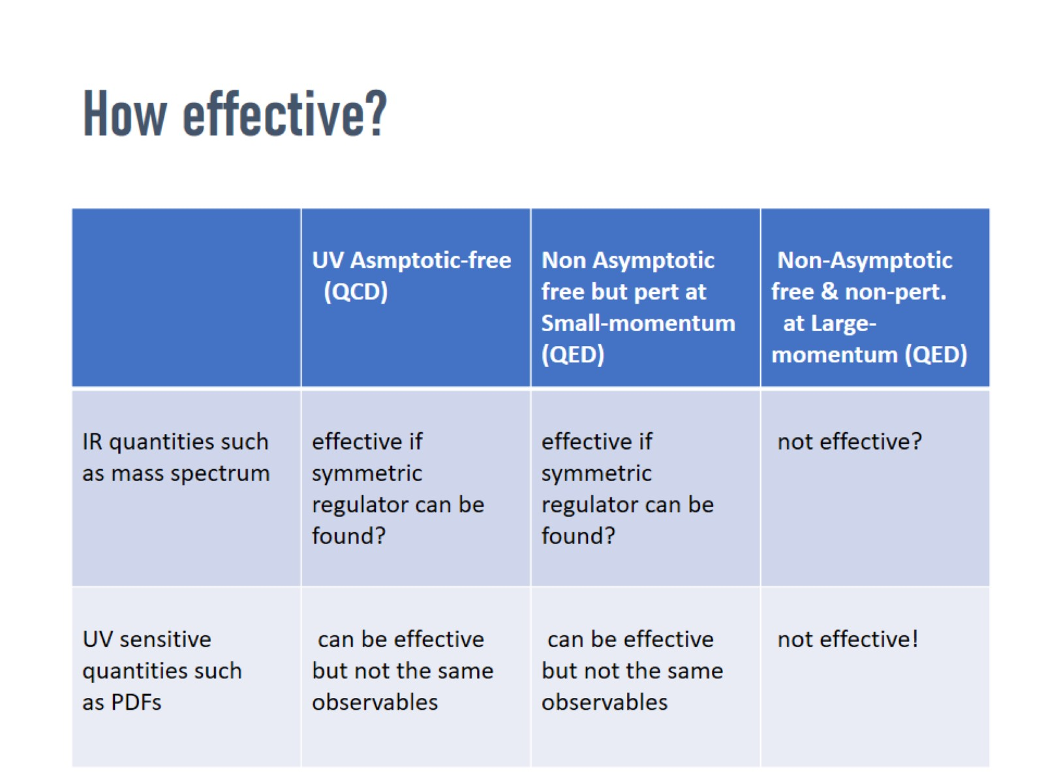
How effective?

Slide 18
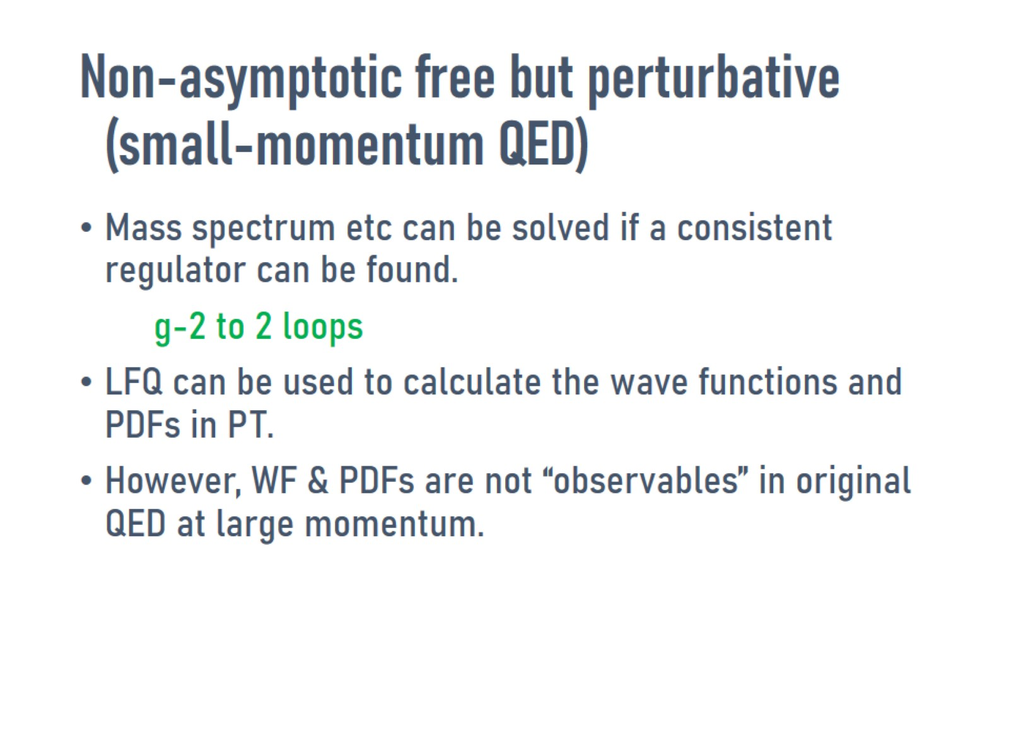
Non-asymptotic free but perturbative
(small-momentum QED)

Slide 19
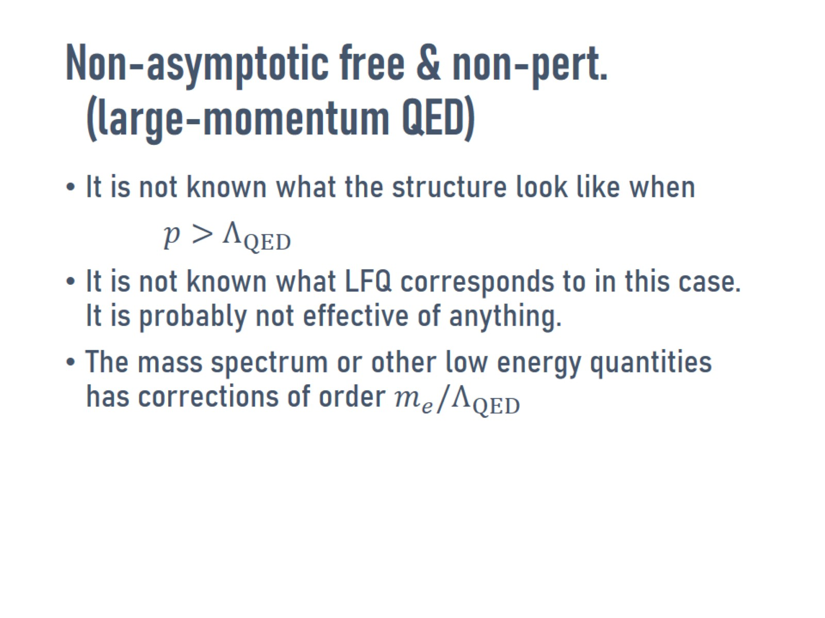
Non-asymptotic free & non-pert.
(large-momentum QED)

Slide 20
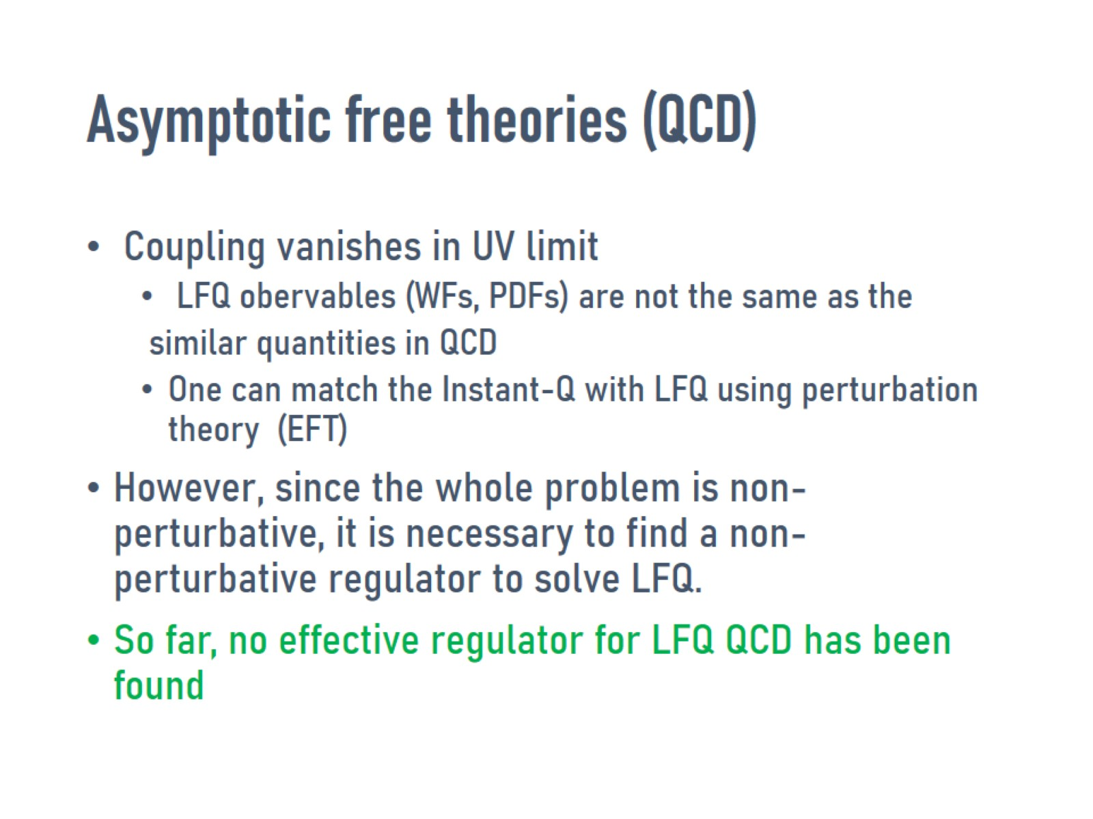
Asymptotic free theories (QCD)

Slide 21
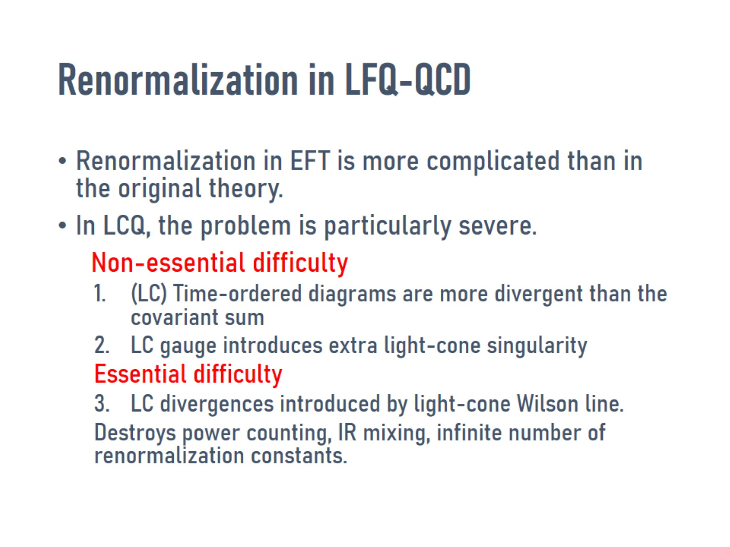
Renormalization in LFQ-QCD

Slide 22
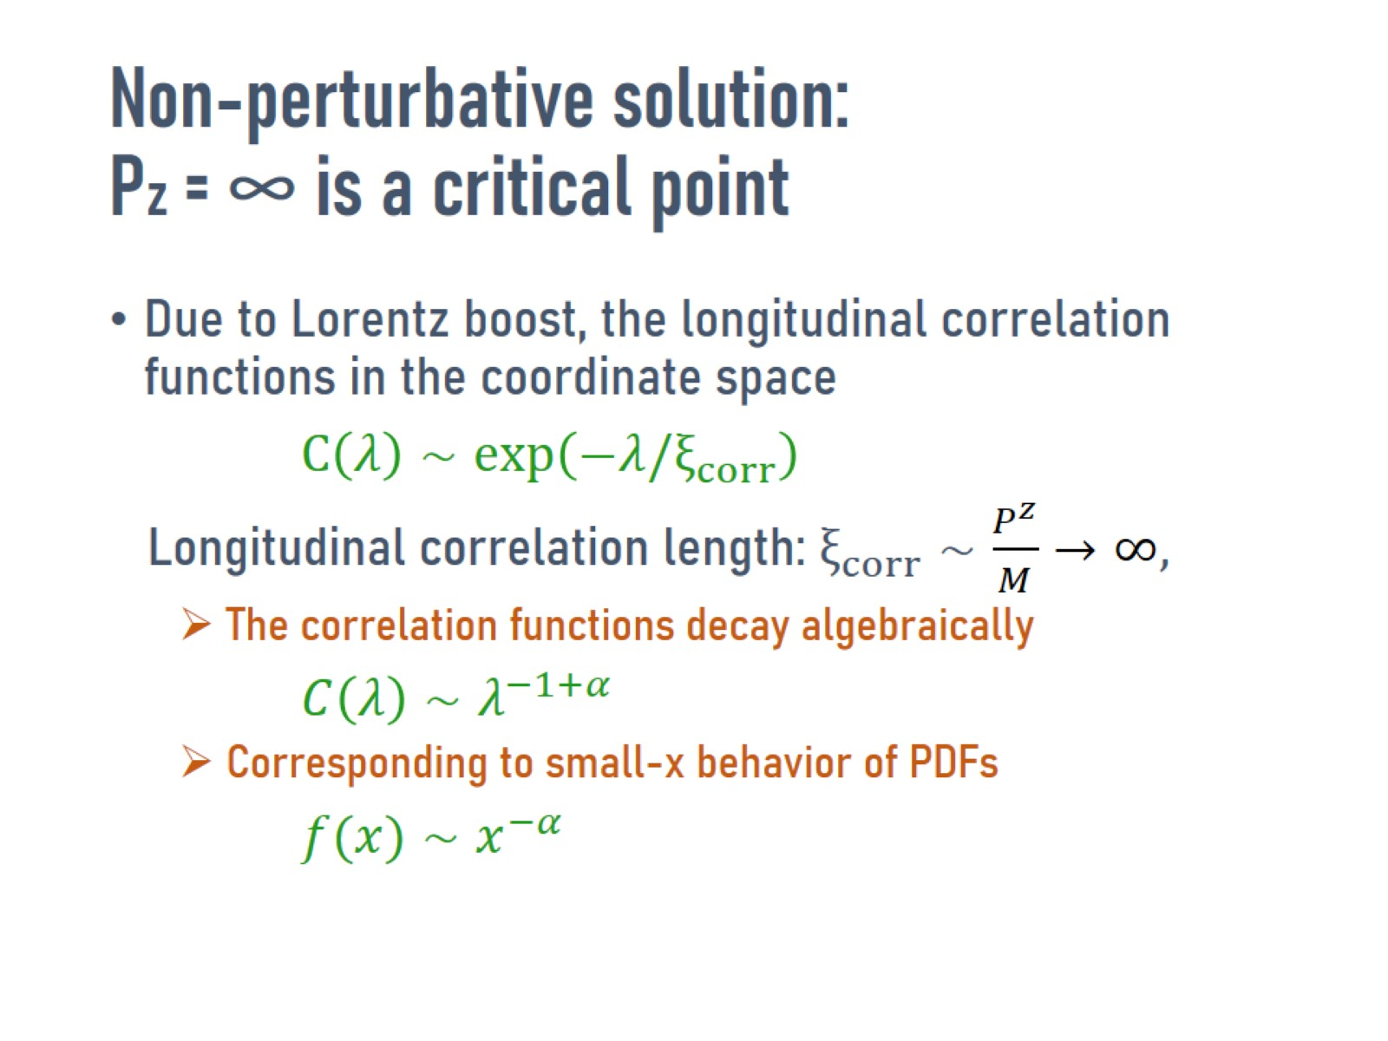
Non-perturbative solution:
Pz = ∞ is a critical point

Slide 23
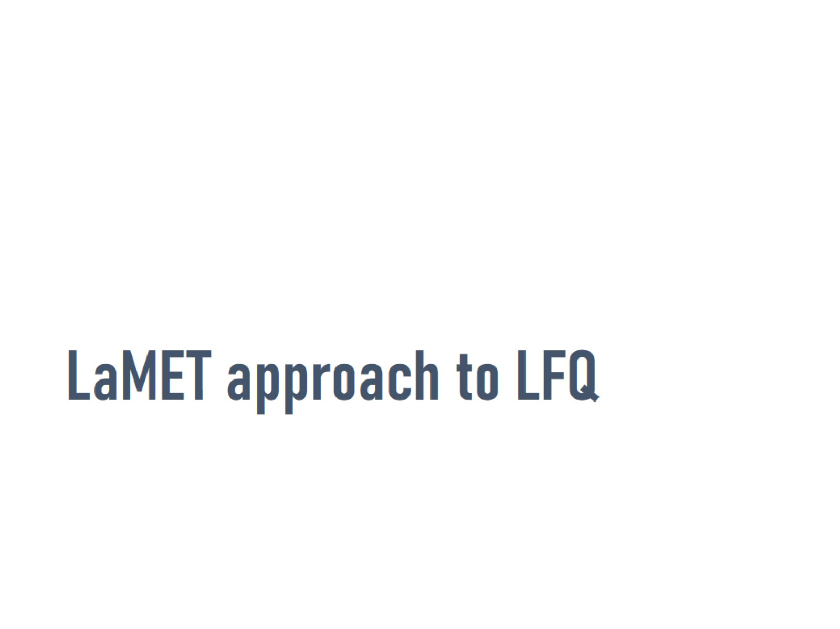
LaMET approach to LFQ

Slide 24
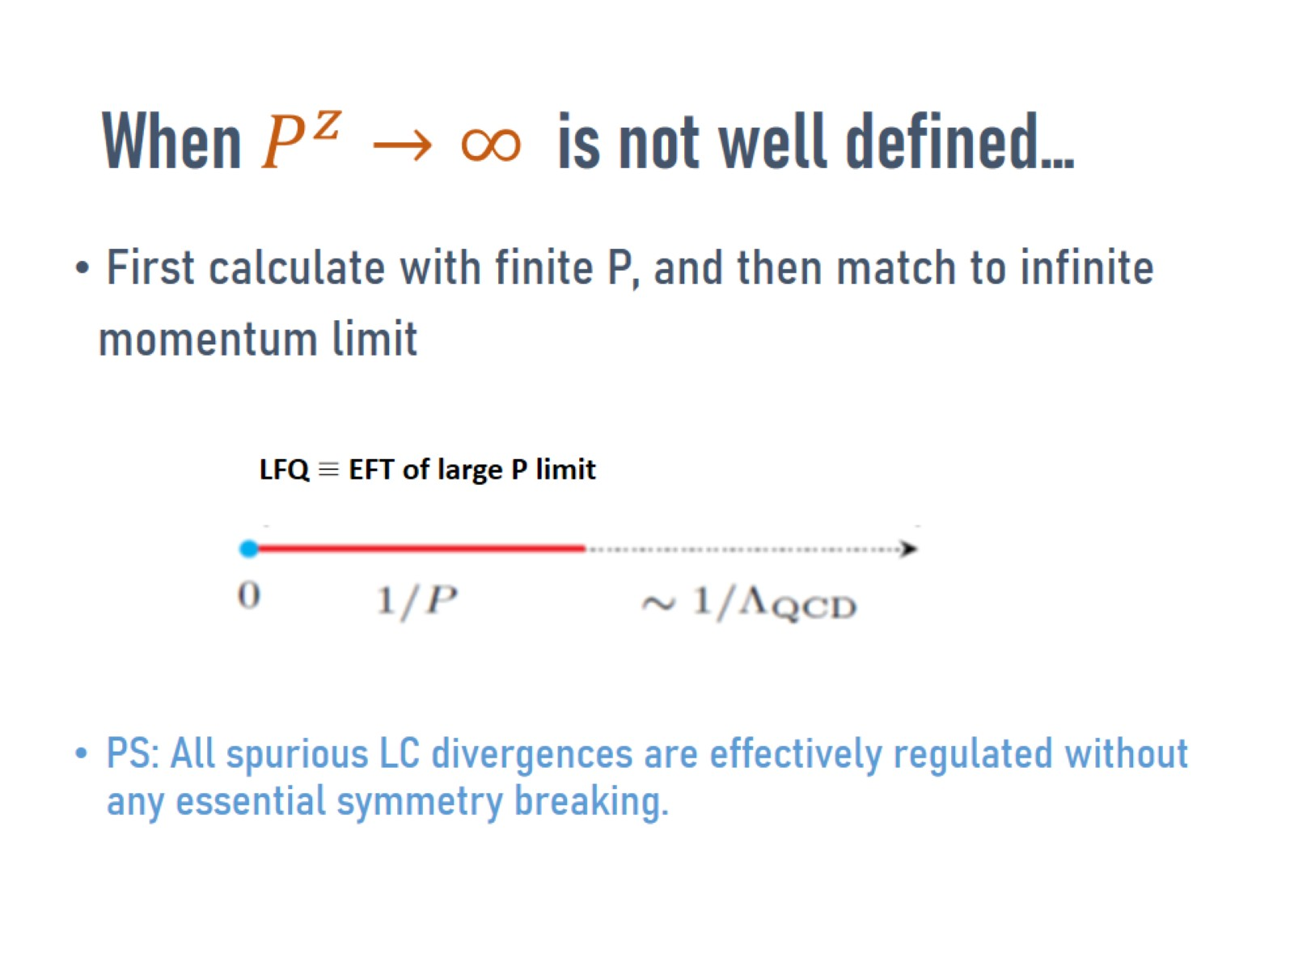

When $P^{z}→∞$ is not well defined…

Slide 25
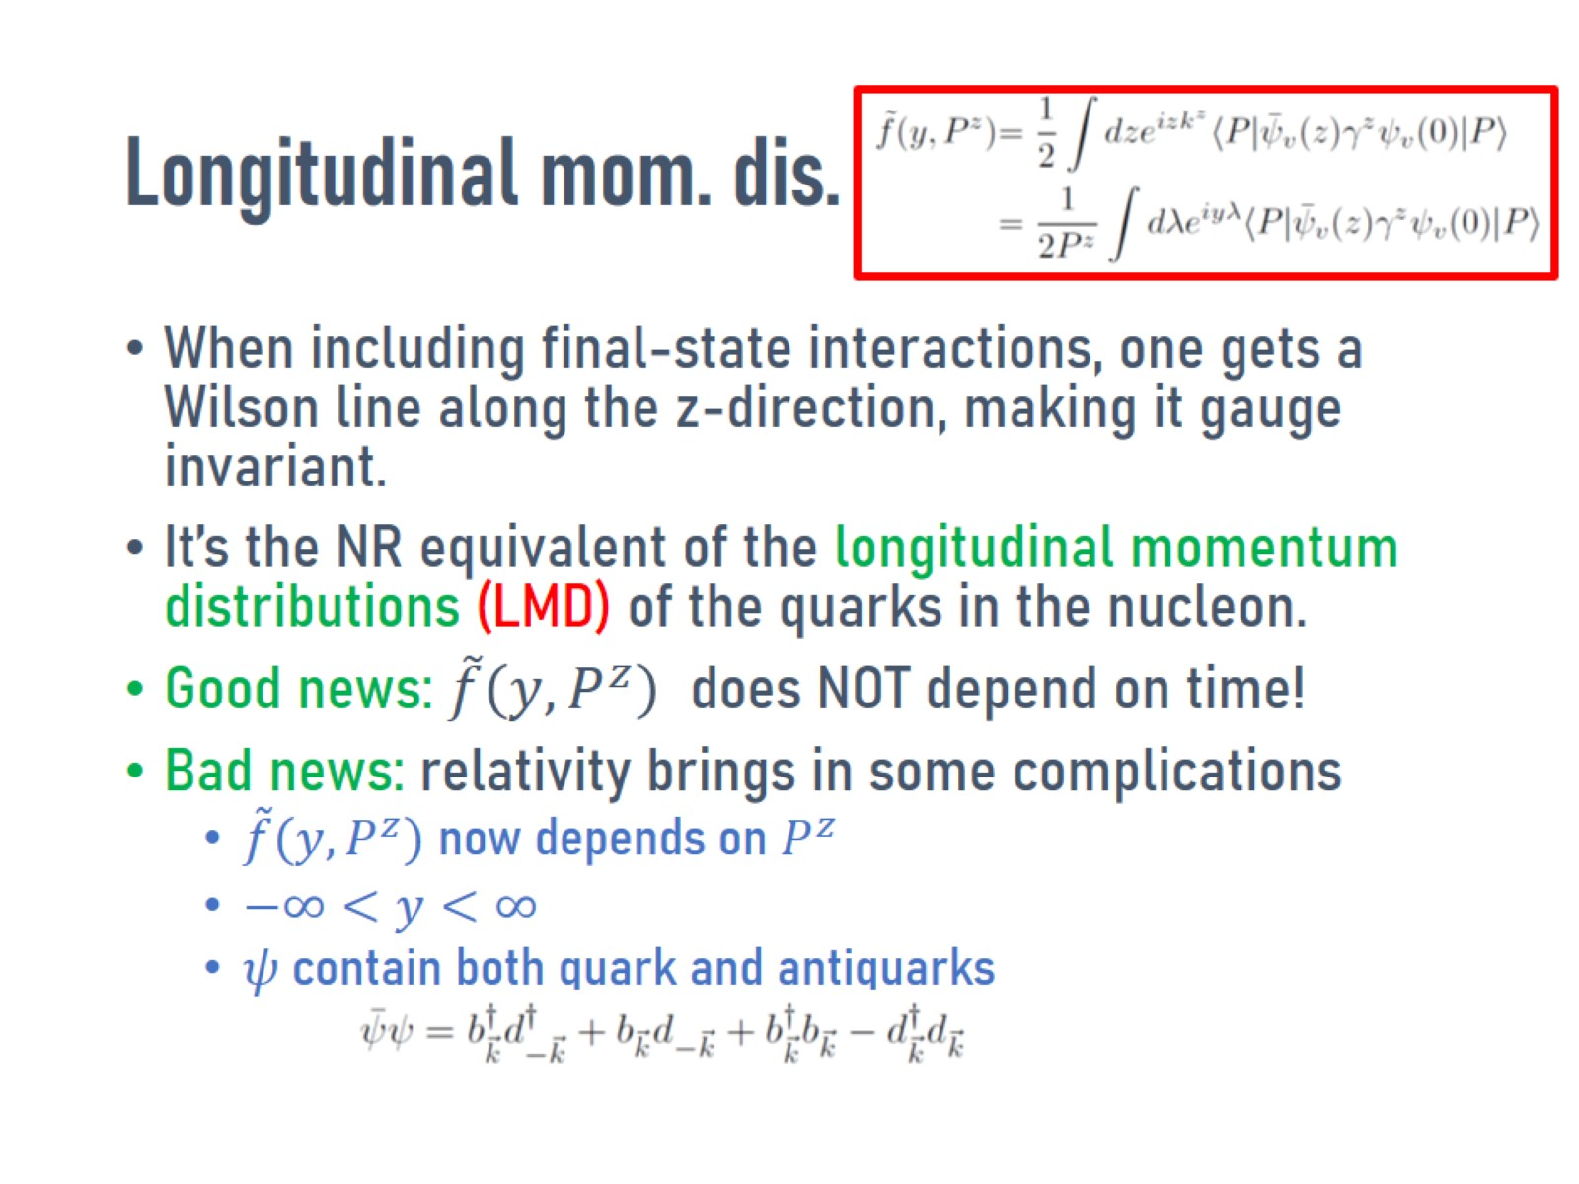

Longitudinal mom. dis. $\tilde{f}(y,P^{z})$

Slide 26
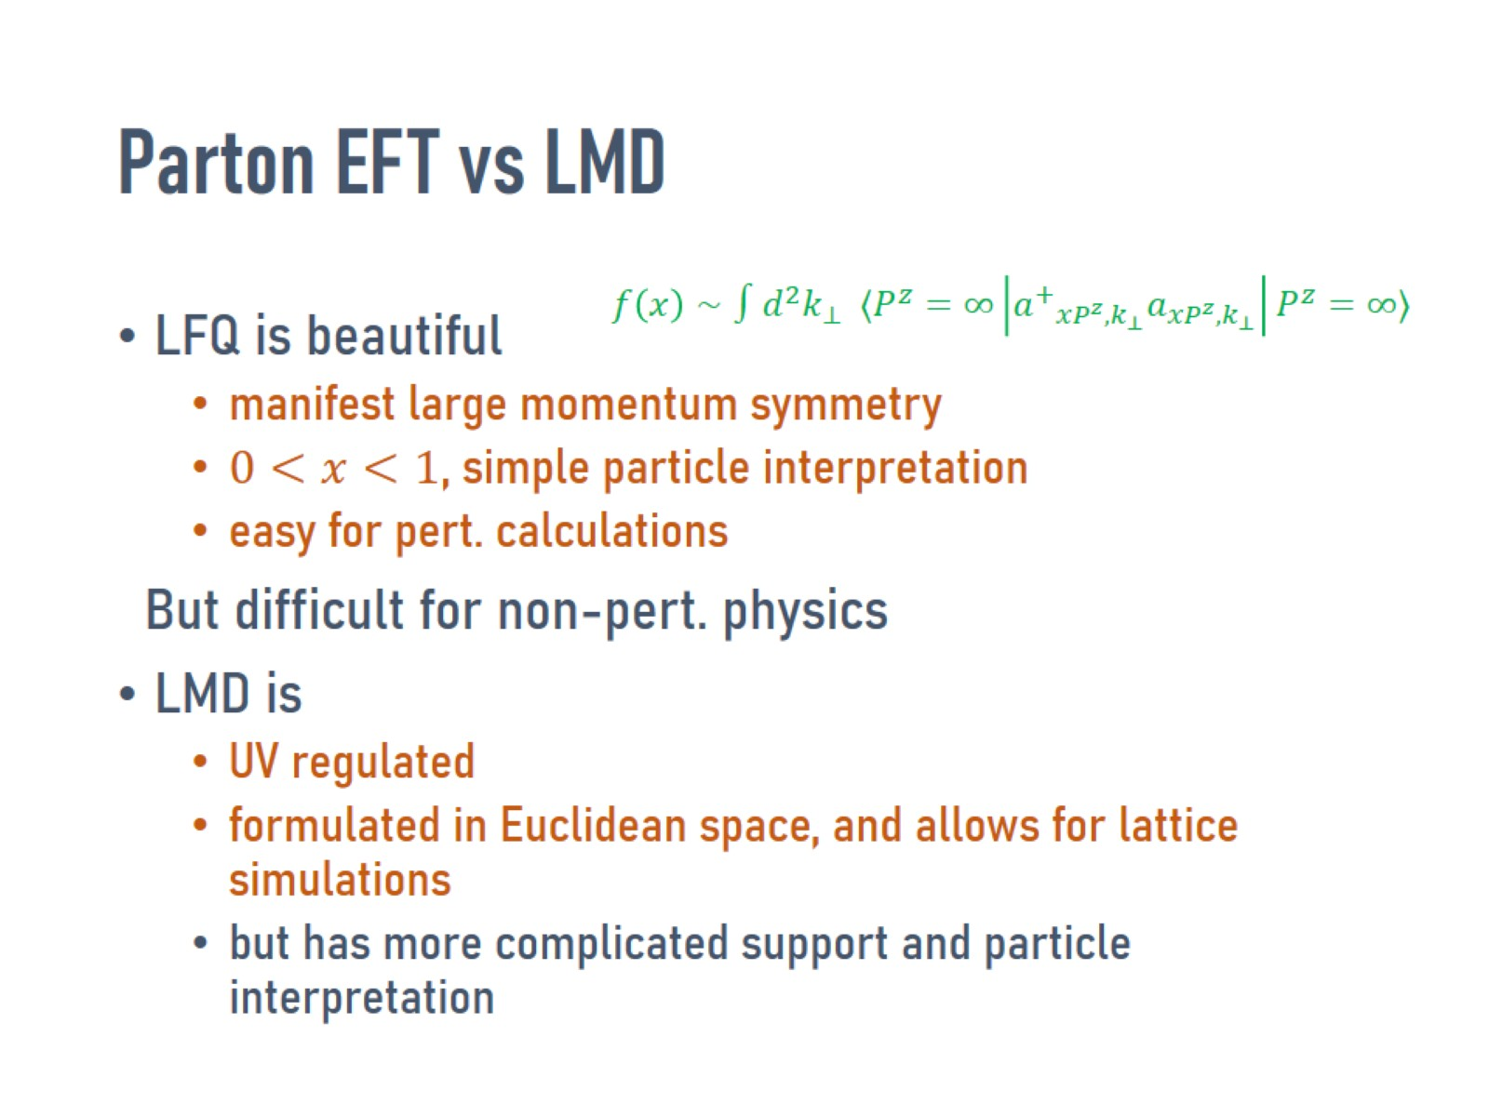
Parton EFT vs LMD

Slide 27
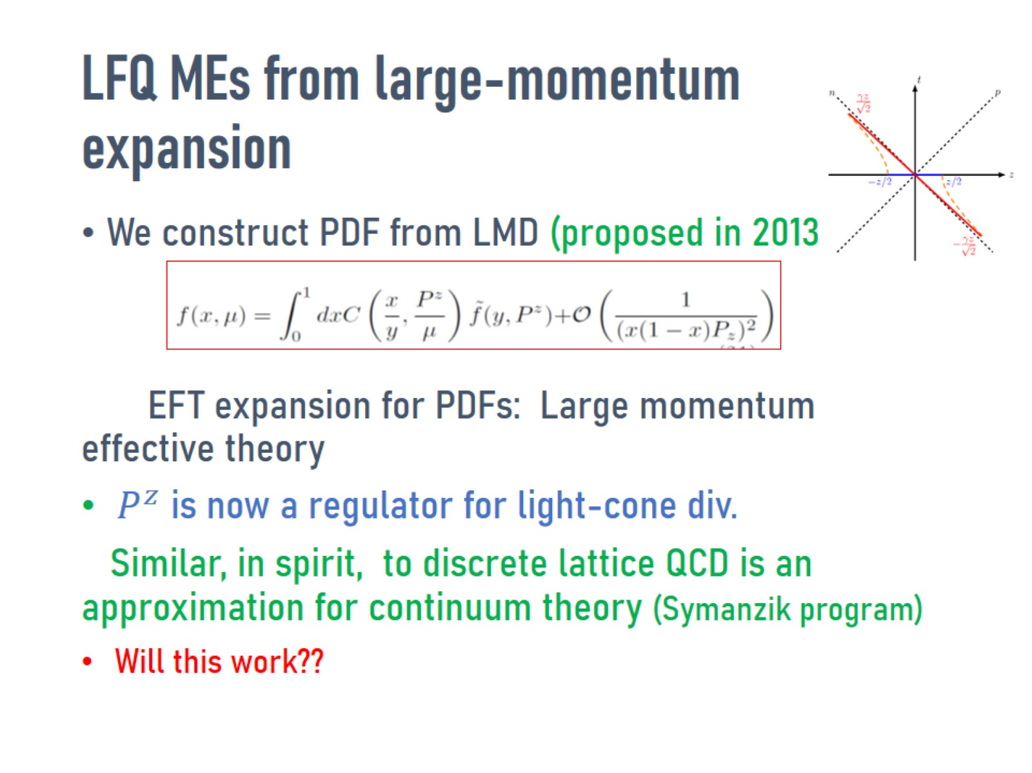
LFQ MEs from large-momentum expansion

Slide 28
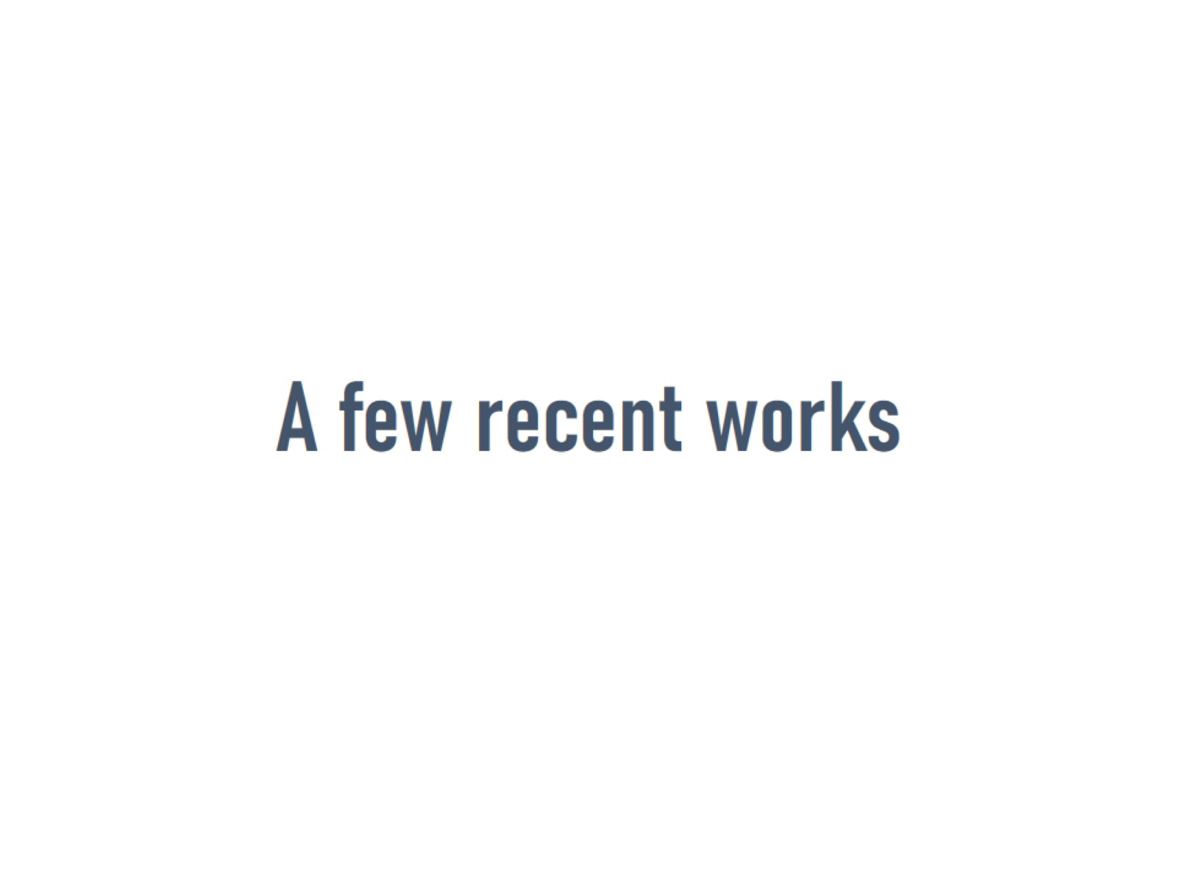
A few recent works

Slide 29
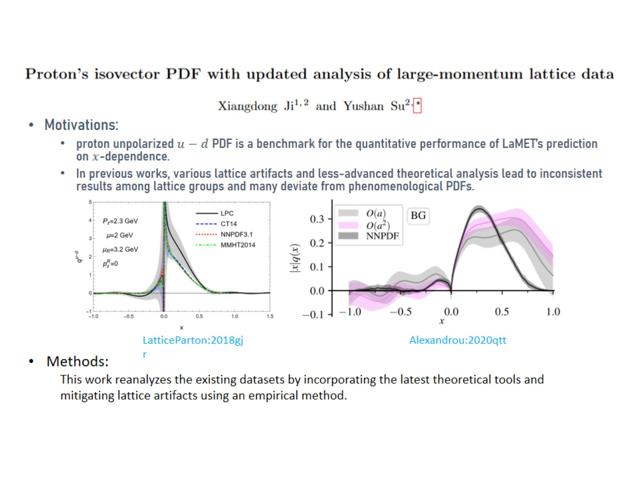

Slide 30
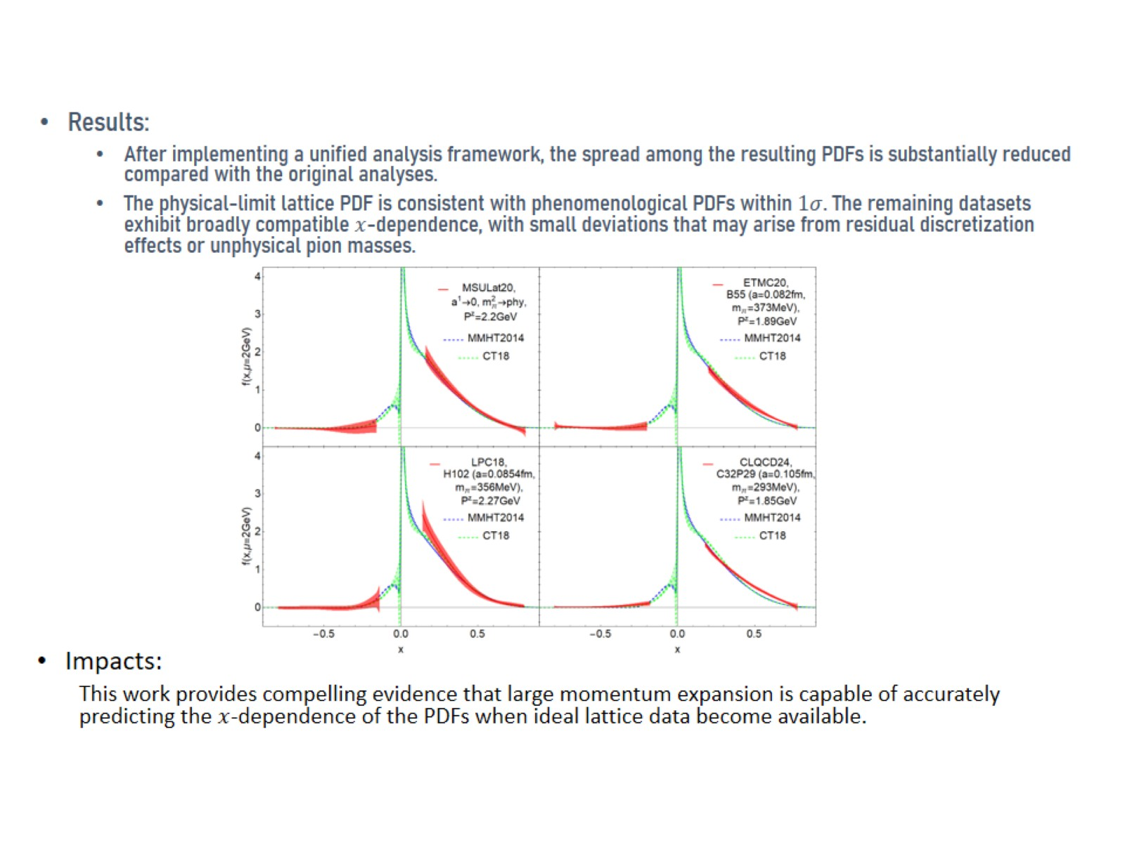

Slide 31
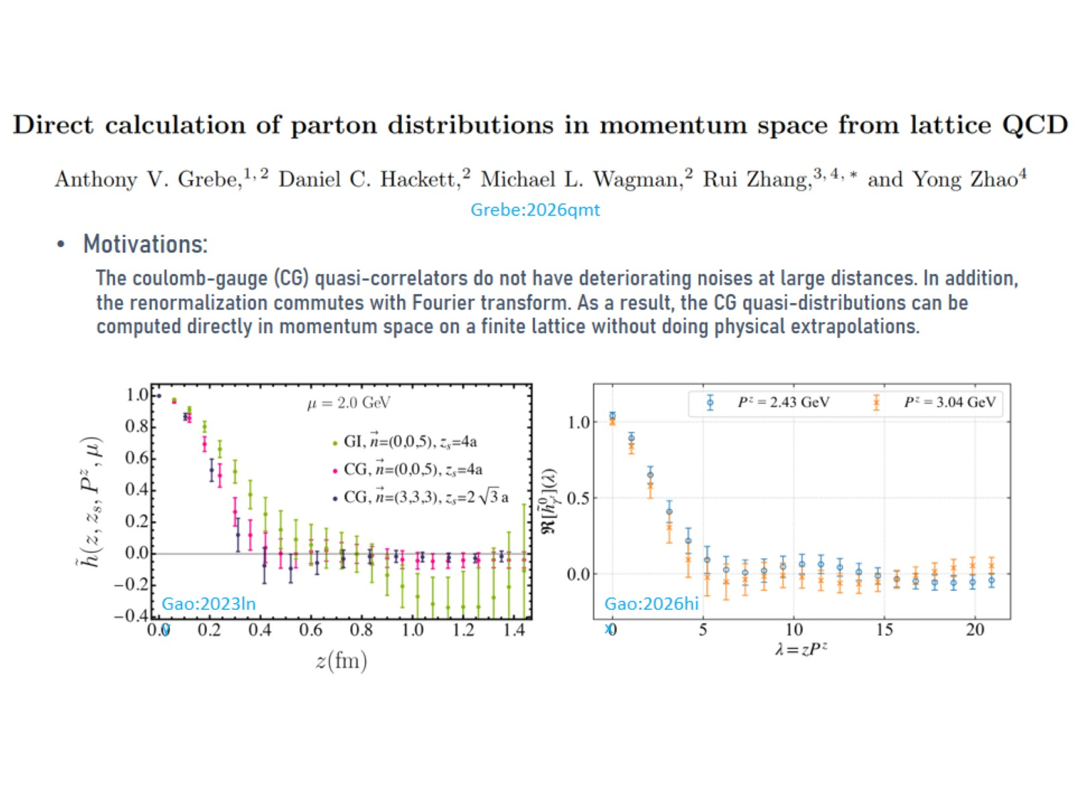

Slide 32
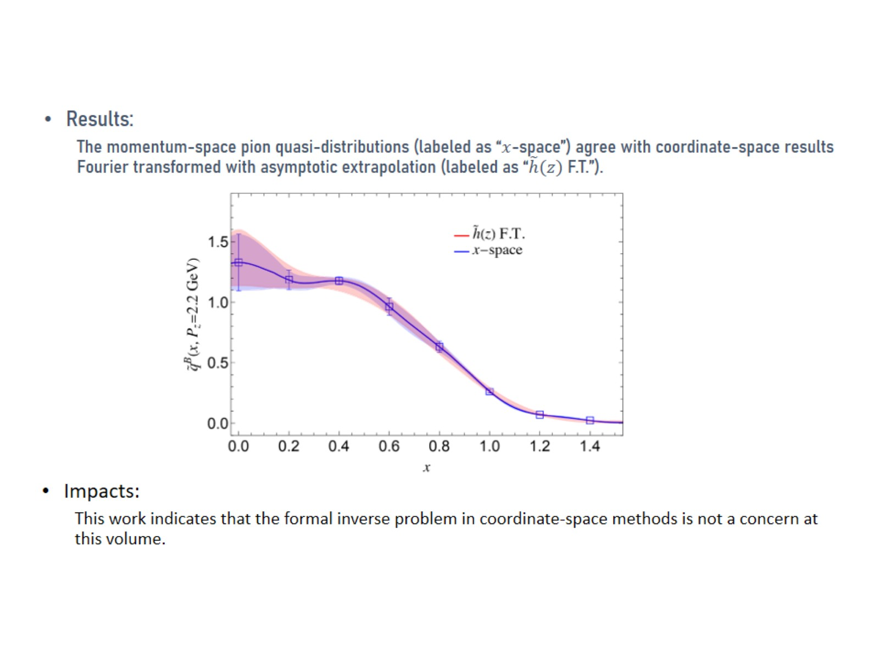

Slide 33
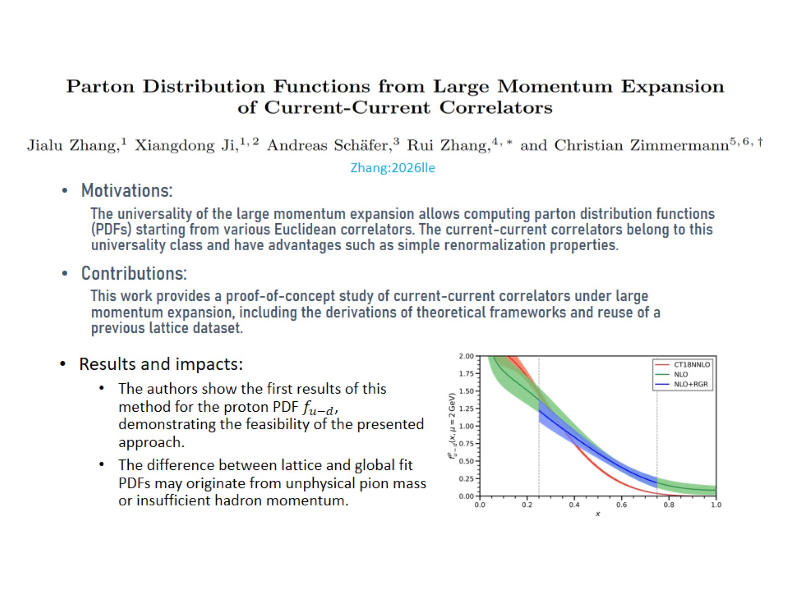

Slide 34
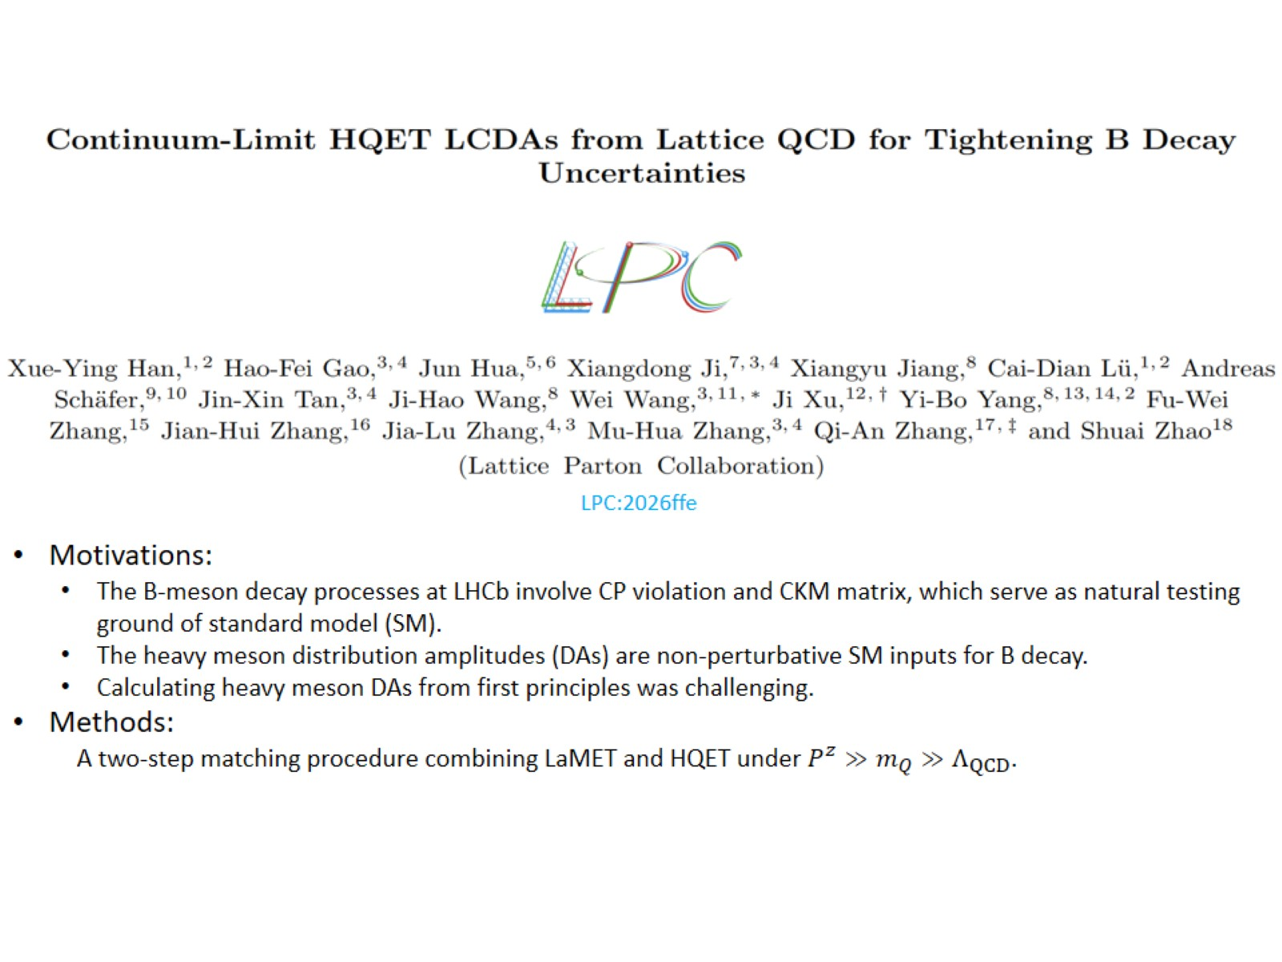

Slide 35
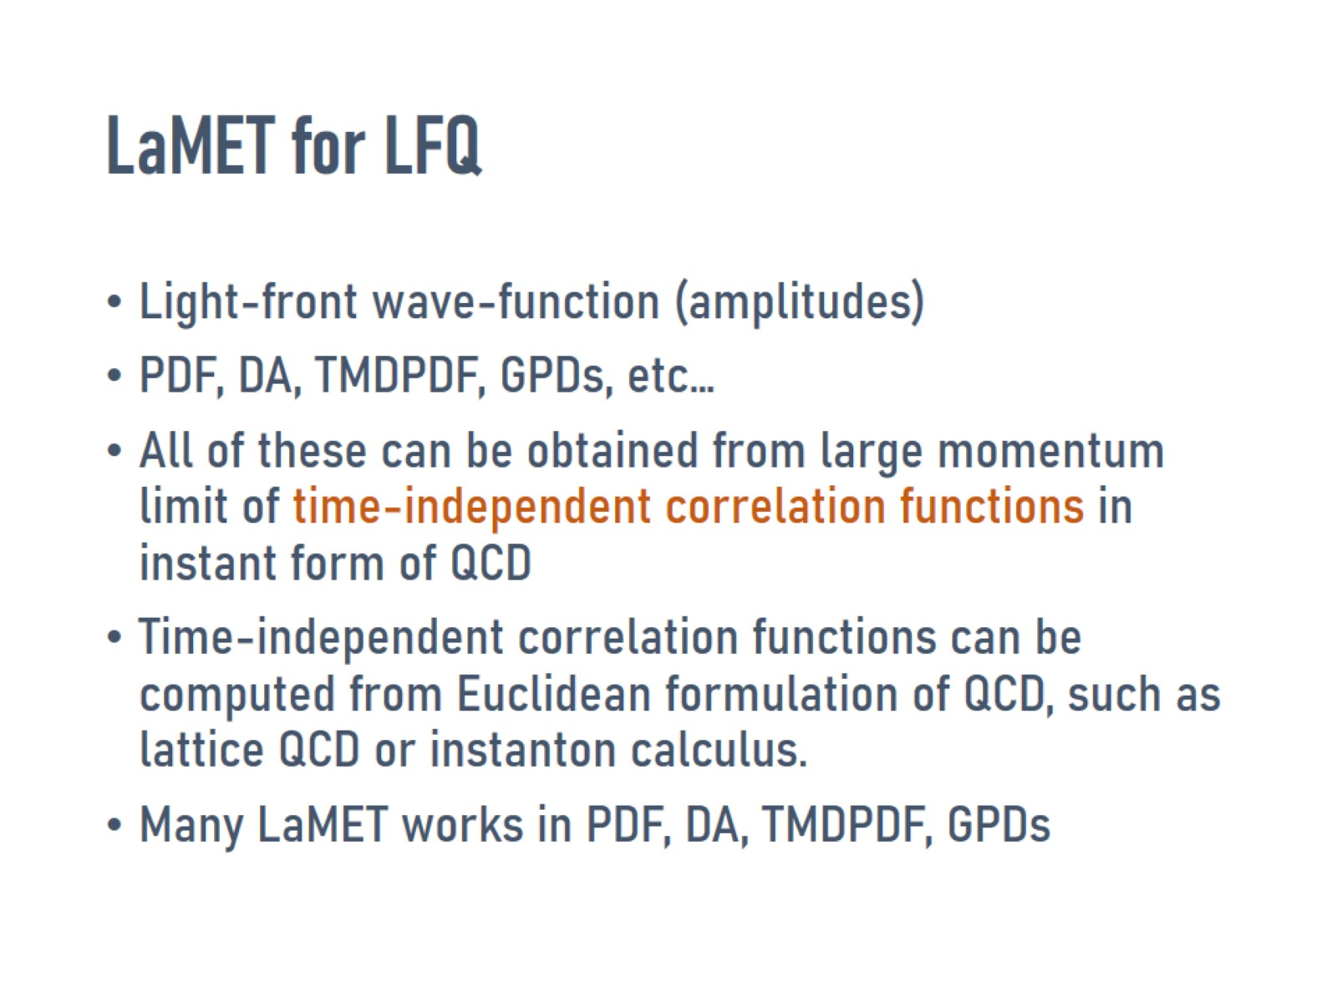
LaMET for LFQ

Slide 36
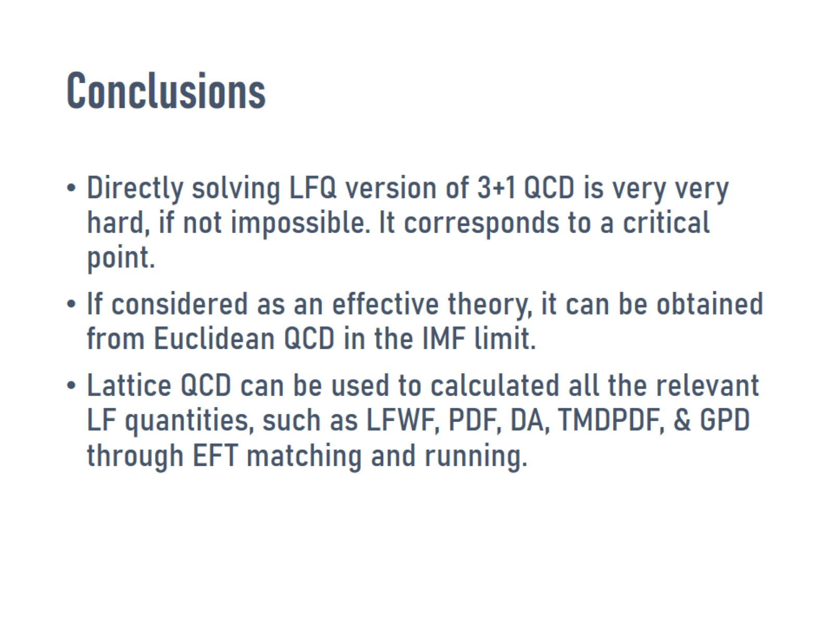
Conclusions

