Slide 1



Extracting hadron 3D structure from experimental data and lattice QCD
Simonetta Liuti
University of Virginia

Slide 2

Remembering Claudio Ciofi degli Atti
1940-2026

Slide 3
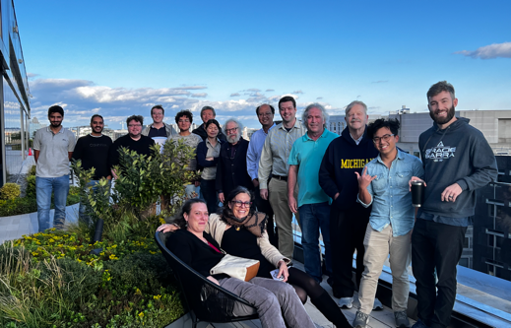


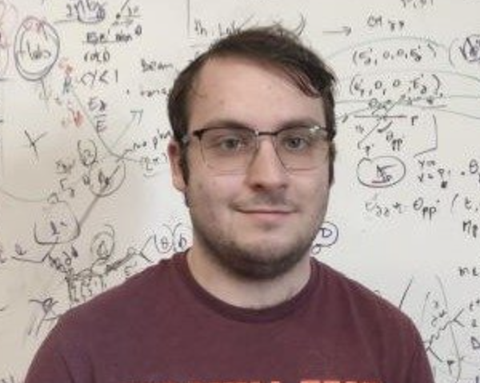
Students/postdocs
The ExclAIm collaboration
Douglas Adams
Adil Khawaja
Kemal Tegzin
Jitao Xu (CS, ODU)
Zaki Panjsheeri
Computational/ML
Prasanna Balachandran, Gia-Wei Chern (UVA), Yaohang Li (ODU)
Lattice QCD
Michael Engelhardt (NMSU), Huey-Wen Lin (MSU)
Phenomenology
Marie Boer (VT), Gary Goldstein (Tufts), Matt Sievert (NMSU), SL
Saraswati Pandey
Brannon Semp

Slide 4
Outline
Motivation: imaging the proton at small x
Disconnected diagrams and LQCD results on moments
Brief recap on GPD analyses using data and LQCD
Including disconnected contribution in low x PDFs/GPDs analysis
Impact on hadron imaging
Conclusions and Outlook

Slide 5
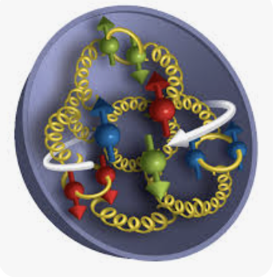
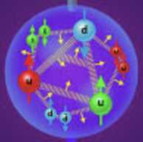
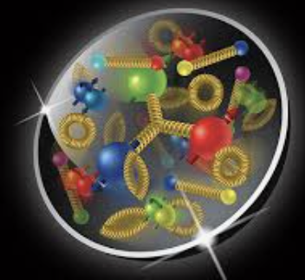
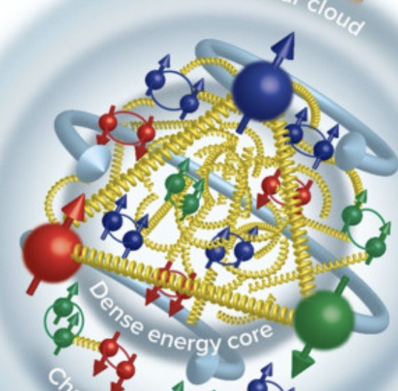
1. The standard one-body picture of hadron tomography is incomplete
The Nucleon Hall of Fame
Gluons distributed evenly
Valence quarks inside
Sea quarks outside
Gluons inside
Valence quarks outside
Sea quarks outside
Baryon junction
High density gluons inside
Valence quarks outside
Sea quarks distributed evenly
Images taken from BNL, Jlab, APS websites

Slide 6
More Than One Active Parton
One-body imaging is not enough: information on QCD correlations between constituents is missing
Valence structure and gluons: what is the relative positions and correlations among valence quarks and gluons?
Sea structure and gluons: how are disconnected sea quarks spatially correlated with valence quarks and gluons?
There is more: How do gluonic hot spots, baryon junctions, saturation and other vacuum fluctuations emerge from the underlying correlated structure?

Slide 7
One-body imaging cannot reveal how constituents are arranged with respect to one another.
Correlated Hadron Structure
Two-body densities
Relative parton separations
Multi-parton correlations
Hot spots
Baryon number flow
QCD Dynamics
Connected/disconnected diagrams and sea-quark generation
QCD vacuum fluctuations
Nonperturbative “topology”/baryon junctions
Emerges from

Slide 8
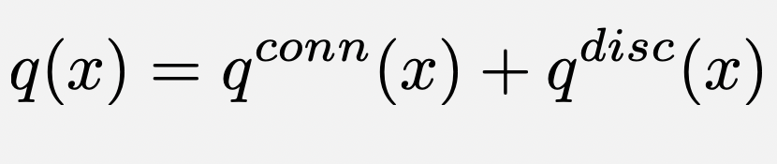
2. Connected/disconnected diagrams
To understand the dynamics of quark and gluon structure/correlators we need Beyond One-Body density distributions
Lattice QCD separates:
connected contributions
disconnected contributions
How do we connect this to phenomenology?

Slide 9
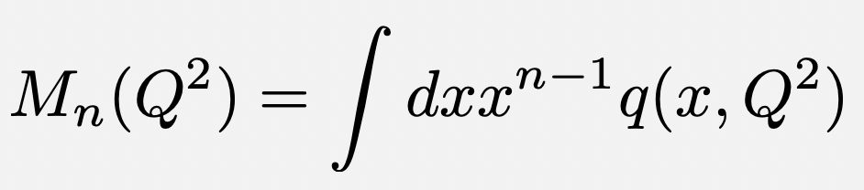
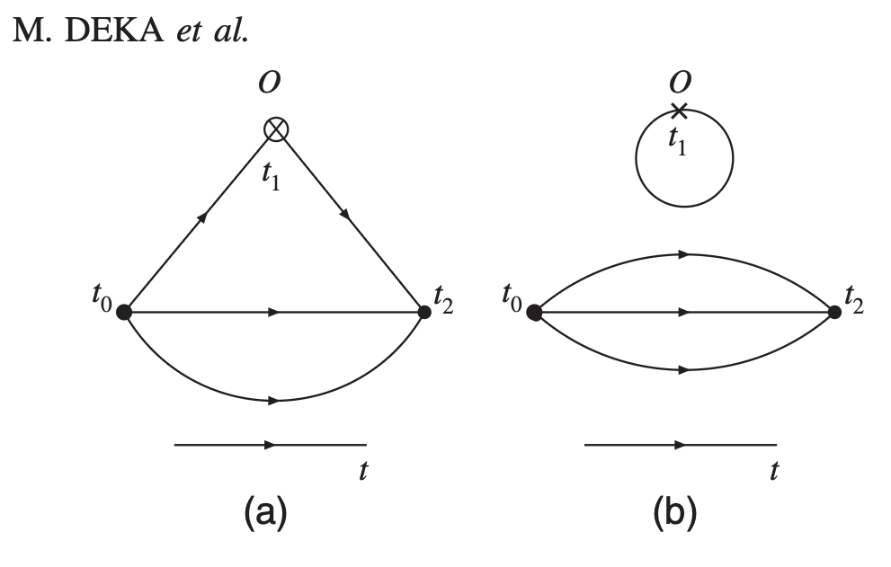
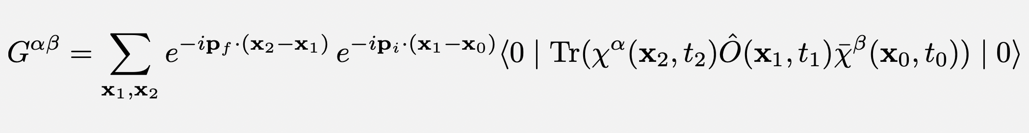
Moments calculation in LQCD
PRD 79 (2009) 094502
Not Feynman diagrams!
Gauge fields are missing
these are manifestations of correlated vacuum and multi-parton structure beyond one-body densities!
connected
disconnected
3p function

Slide 10
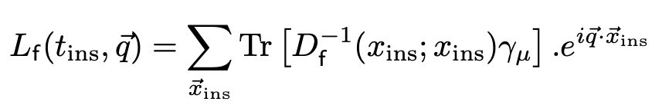
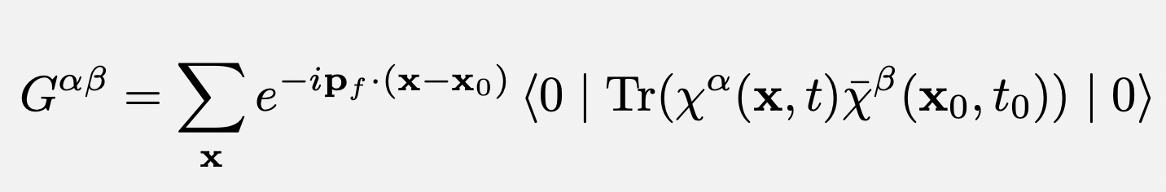
More facts about disconnected diagrams (from a phenomenologist perspective…)
They are harder to calculate because they probe the response of the QCD vacuum in the presence of a nucleon
They are evaluated using stochastic methods on the ratio
The noise to signal ratio increases with sink time (t₂) perhaps more than other quantities
Recent advances/techniques/“tricks” have allowed them to be calculated precisely for form factors/moments at the physical pion mass
Higher moments calculation only available at four-momentum transfer, t=0
Quark loop
2p function
C. Alexandrou et al., hep-lat 2507.20910 (2025), S. Syritsin et al., PoS LATTICE2024 (2025) 340
Liang et al. PRD 102 (2020) 034514

Slide 11
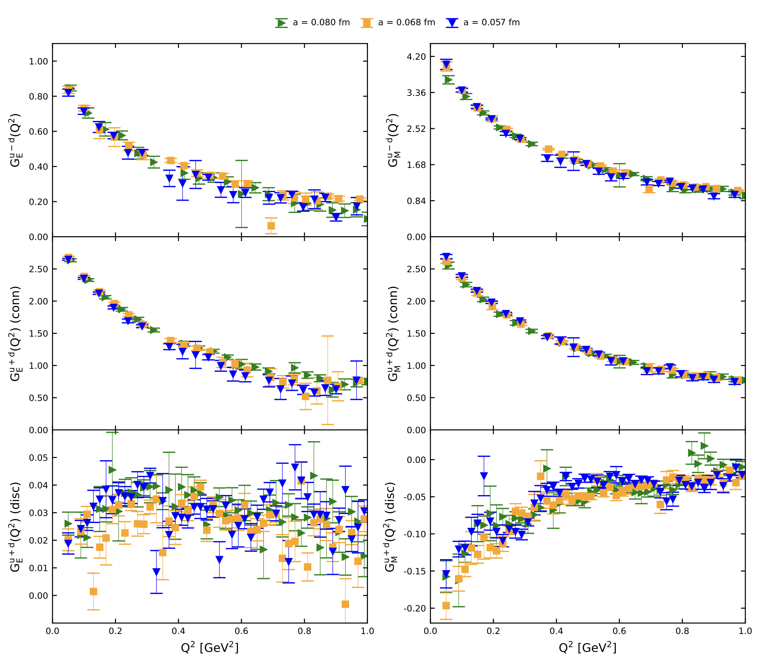
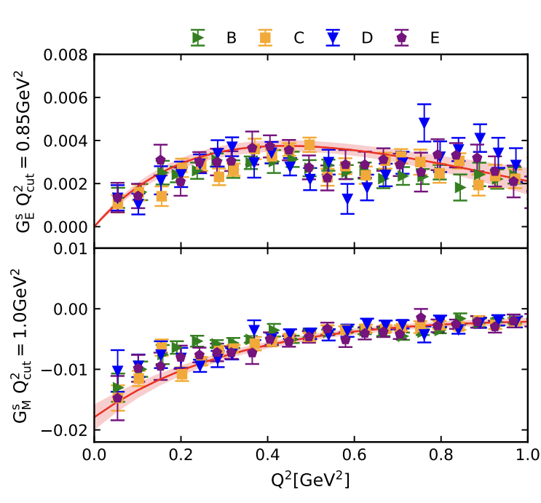
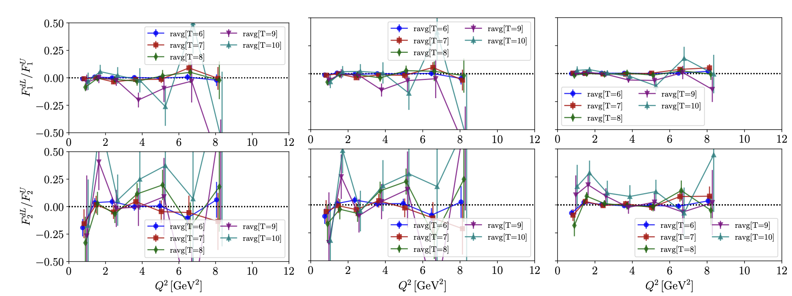
Continuum limit: arXiv:2605.02049
disconnected
connected
disconnected
C. Alexandrou et al., hep-lat 2507.20910 (2025)
Phys.Rev.D 113 (2026) 11,
S. Syritsyn et al., PoS LATTICE2024 (2025) 340

Slide 12
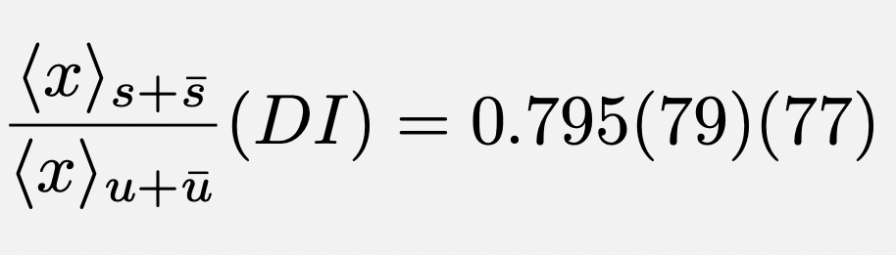
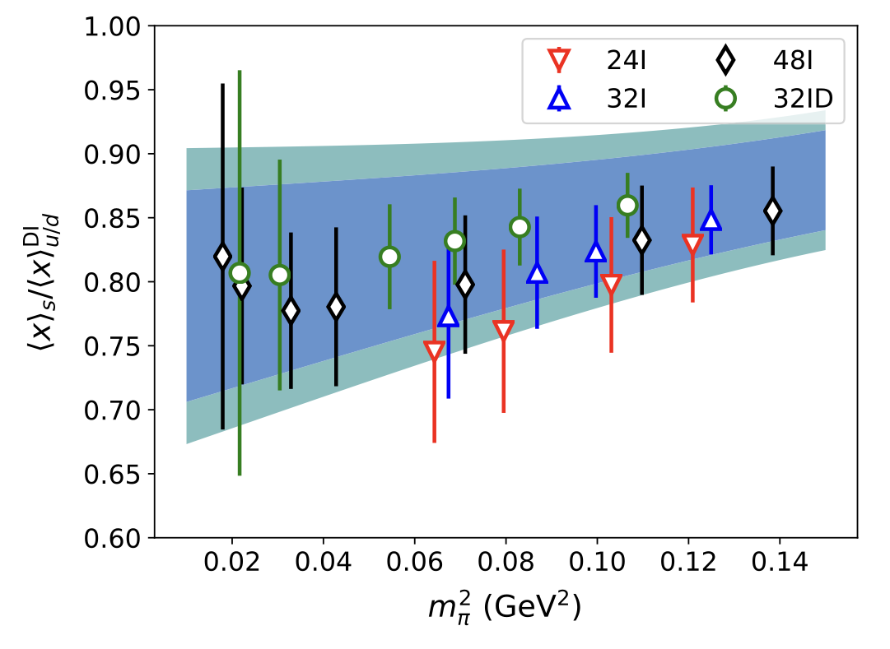
2nd moment
Liang et al. PRD 102 (2020) 034514

Slide 13
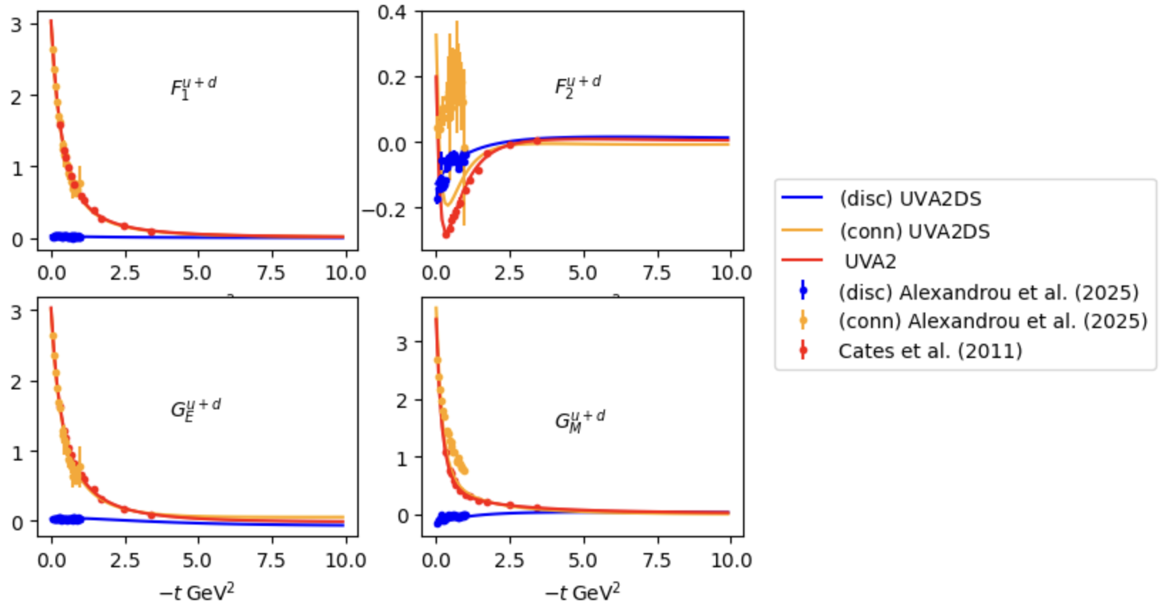
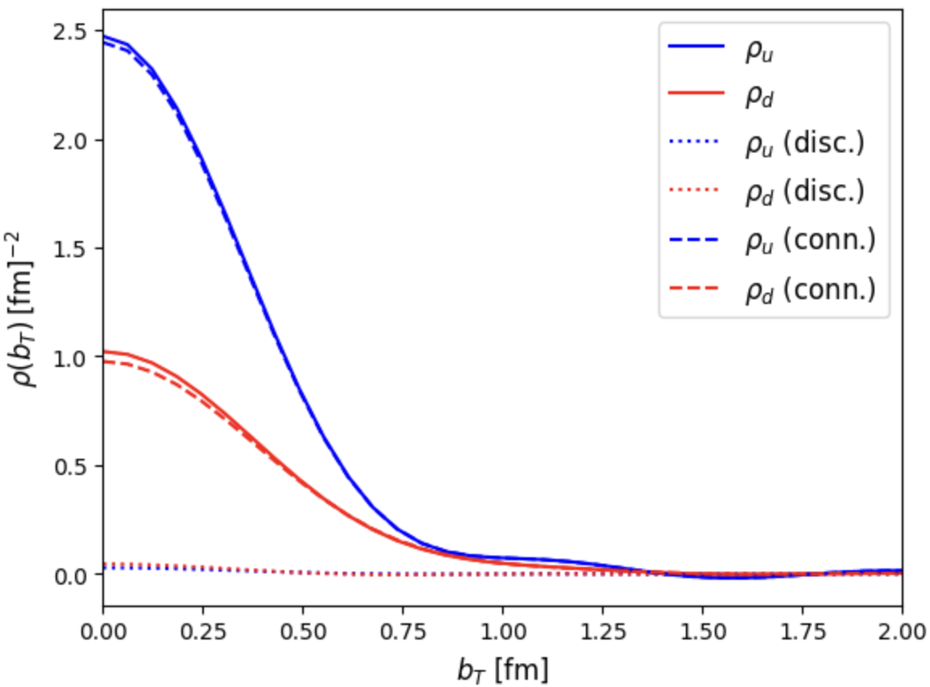
3. Brief recap on GPDs extraction
PDFs → longitudinal momentum x
Q²
Q²
GPDs as hybrids:3D imaging in b with varying x
Soper, Burkardt
large x
x
t-dependent Form Factors and b-dependent spatial structure: t → b
low x
Fourier
quark
gluon
based on Shanahan et al.
b
t

Slide 14
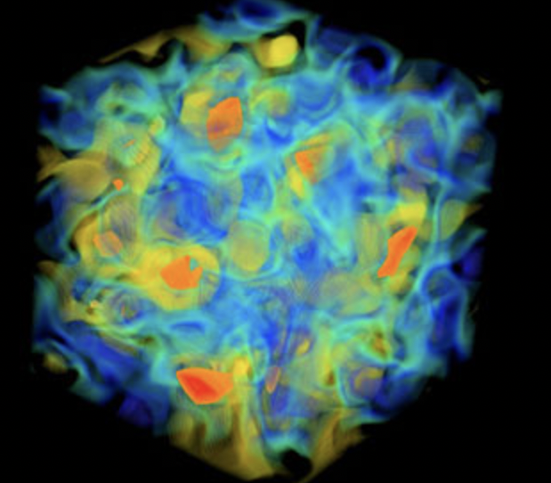
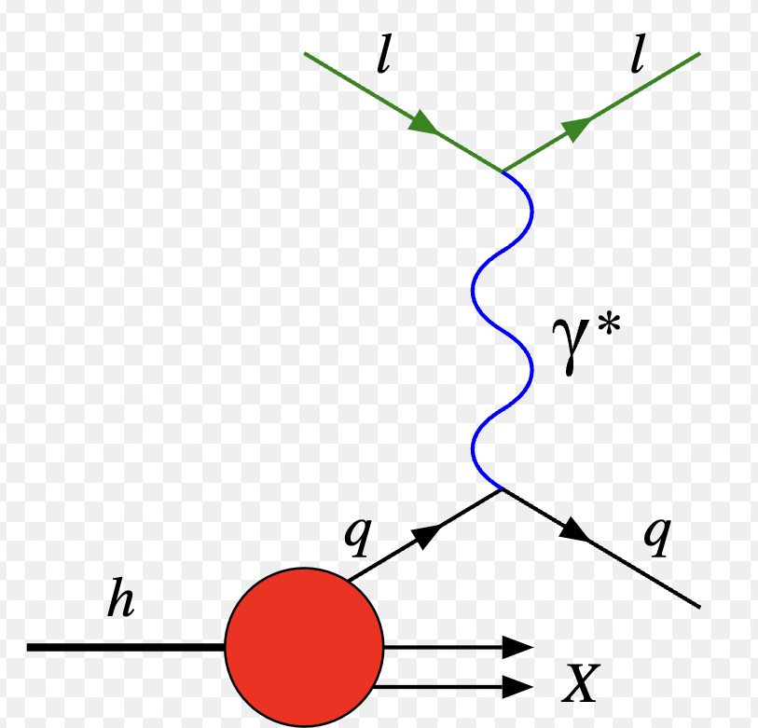
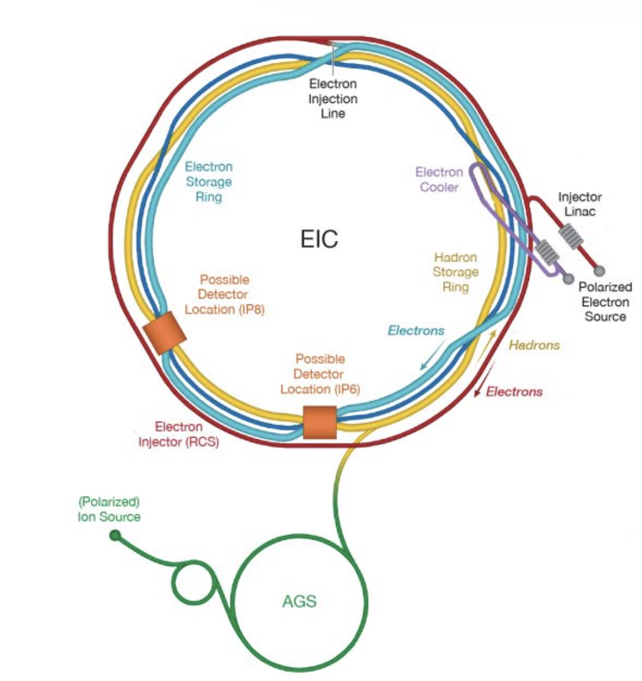
Imaging hadron structure requires solving nested Inverse Problems in QCD
Inverse
Forward
GPDs
  Cross section parametrization in terms of Compton Form Factors
  Deeply Virtual Compton Scattering (DVCS)
Notes:
We want to merge ML and physics to use machines to generate interpretable understandable models which humans can understand, while solving inverse problems

Slide 15


$$→ξ$$
$$ξ$$
Submitted to PRD
arXiv:2410.23469v1

Slide 16
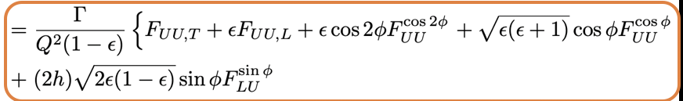
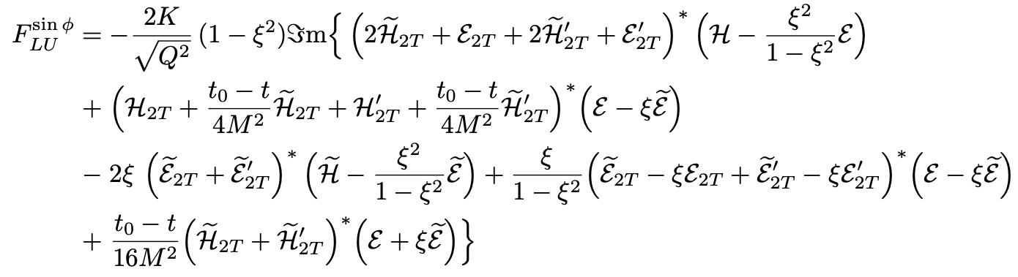

Unpolarized cross section example
dσ
Twist 3
Twist 2
Twist 3 GPDs
B. Kriesten and S. Liuti, Phys.Rev. D105 (2022)
GPD (Old)
“Cahn CFF”
OAM
$L∙$S
Transverse OAM
Transverse Spin
(*) T-odd

Slide 17
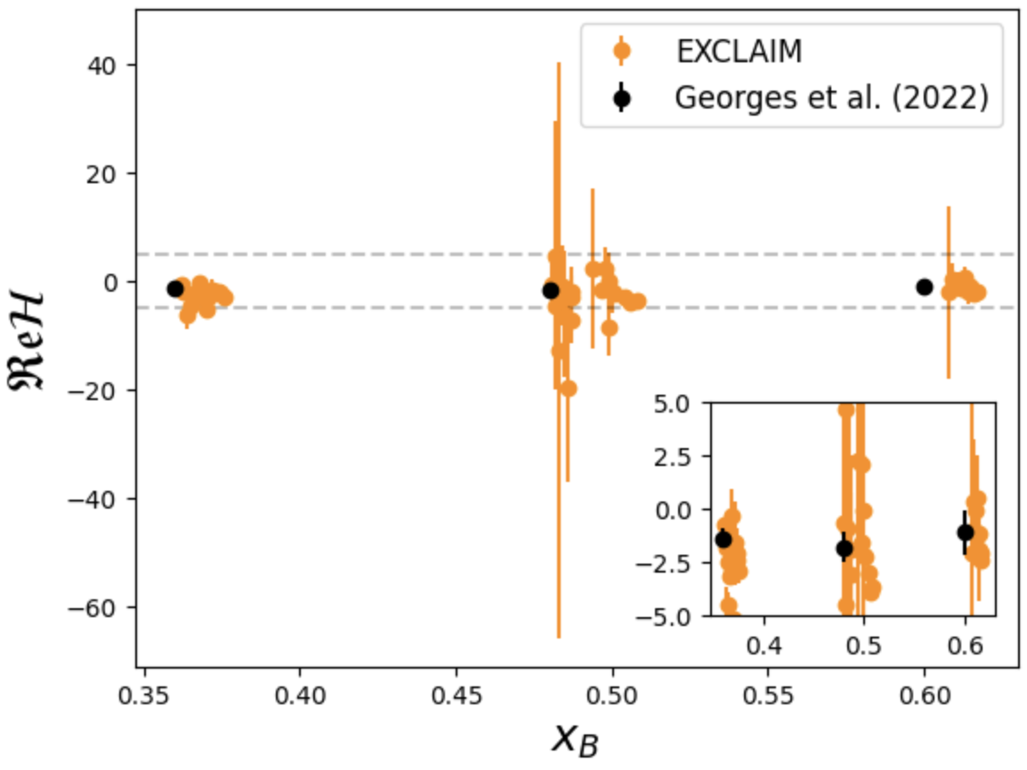
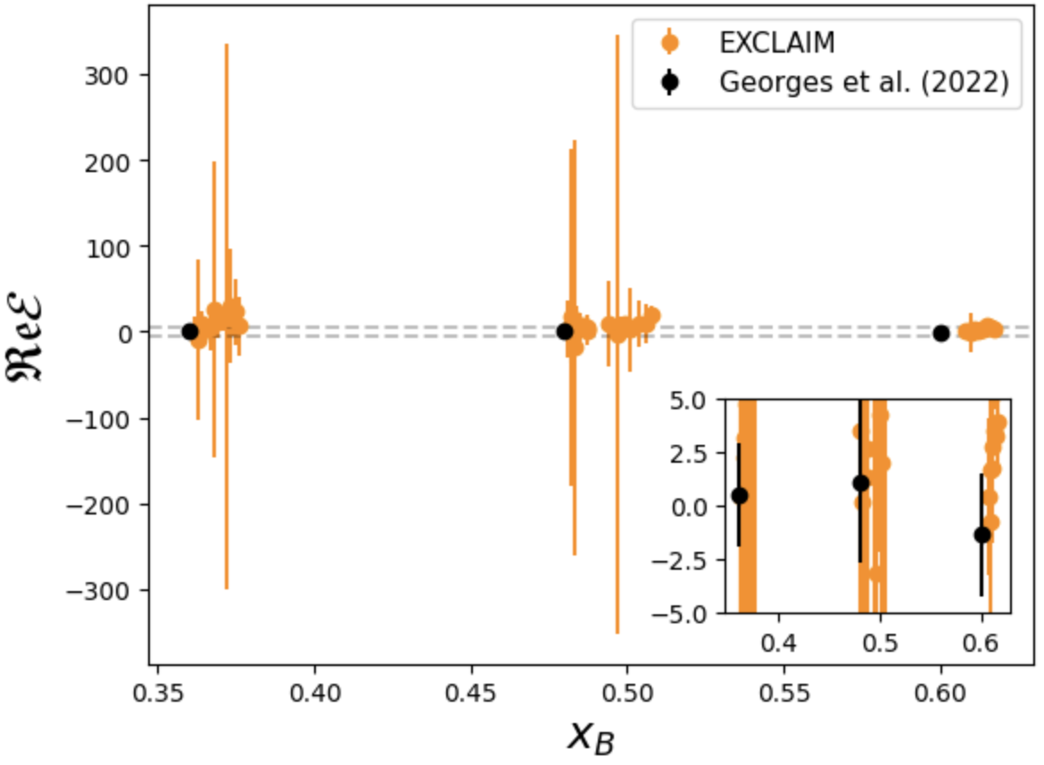
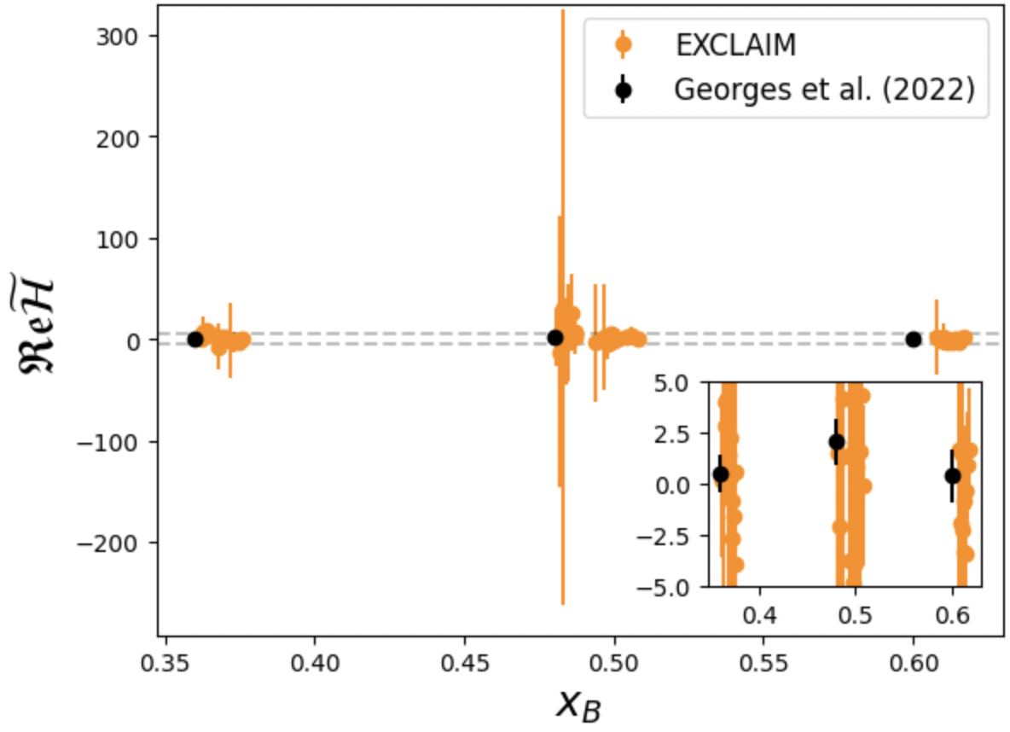
Marginal Posterior CFF Results (Saraswati’s talk)
H
E
~
H

Slide 18

Assuming a QCD factorized scenario → CFFs → GPDs
Assume known from PQCD
Second Inverse Problem!

Slide 19
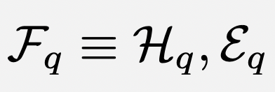
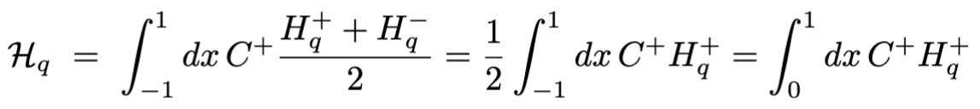
DVCS Compton Form Factors relation to GPDs
Re
Im
Only H⁺ contributes!

Slide 20
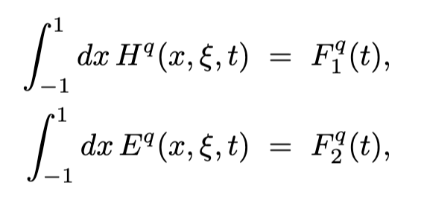
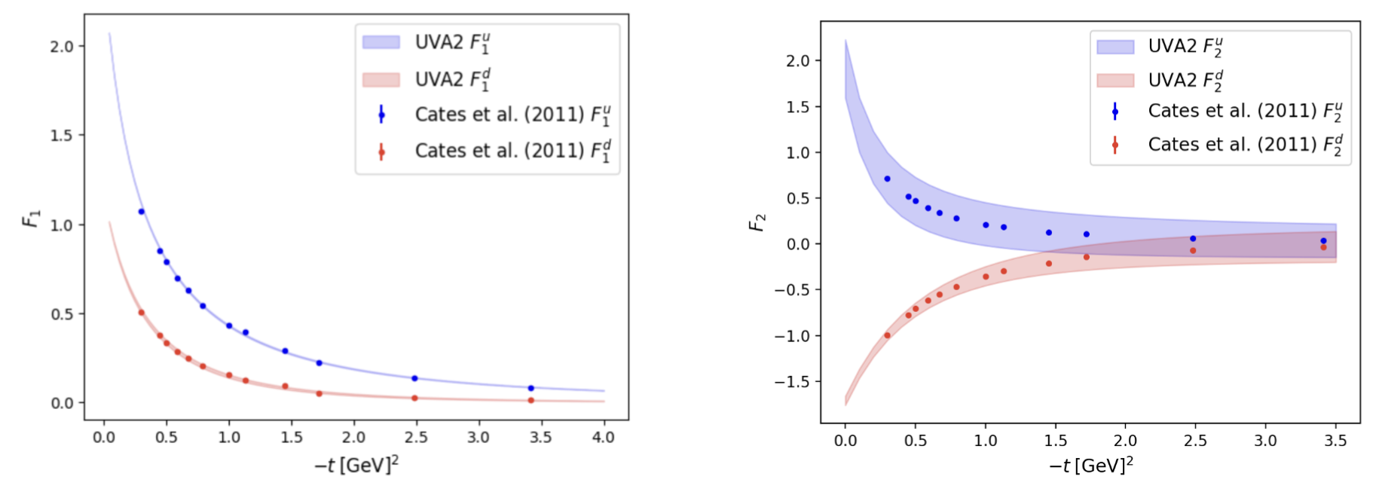
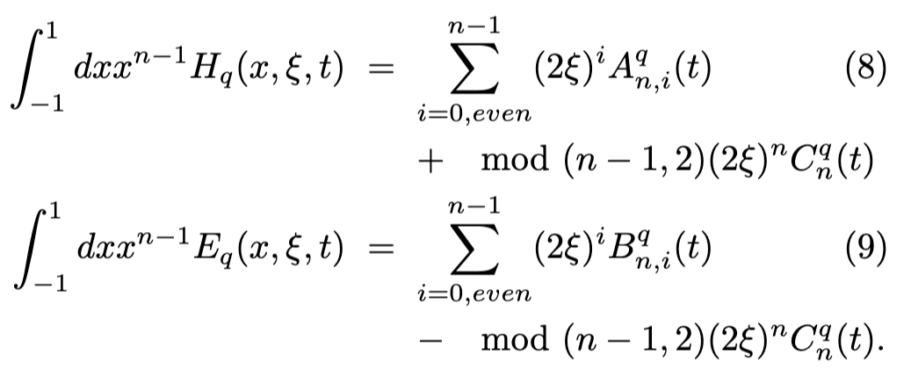
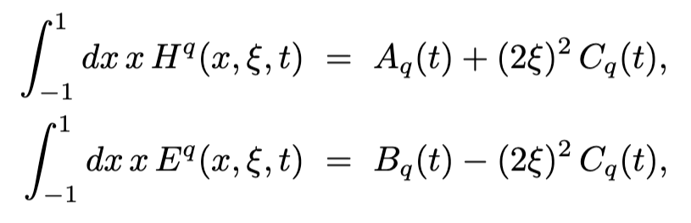
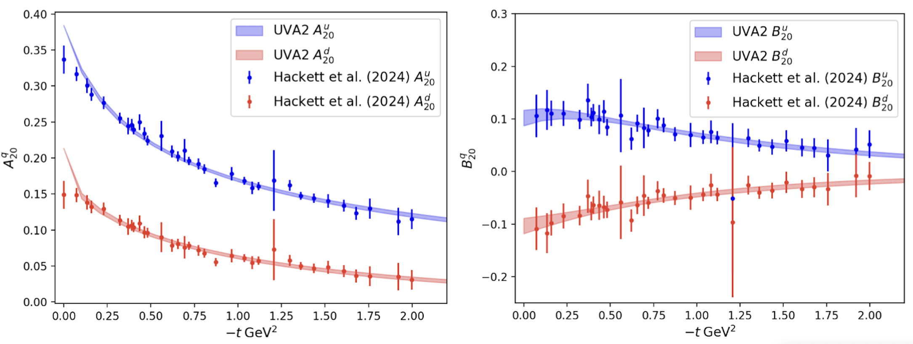
Mellin Moments, Generalized Form Factors and GPDs
Experiment
M_{n}
n=1
LQCD
n=2
fitting more moments from LQCD, up to n=6 (Bhattacharia et al.)
Panjsheeri et al. [arXiv:2511.03065v2 [hep-ph]]

Slide 21
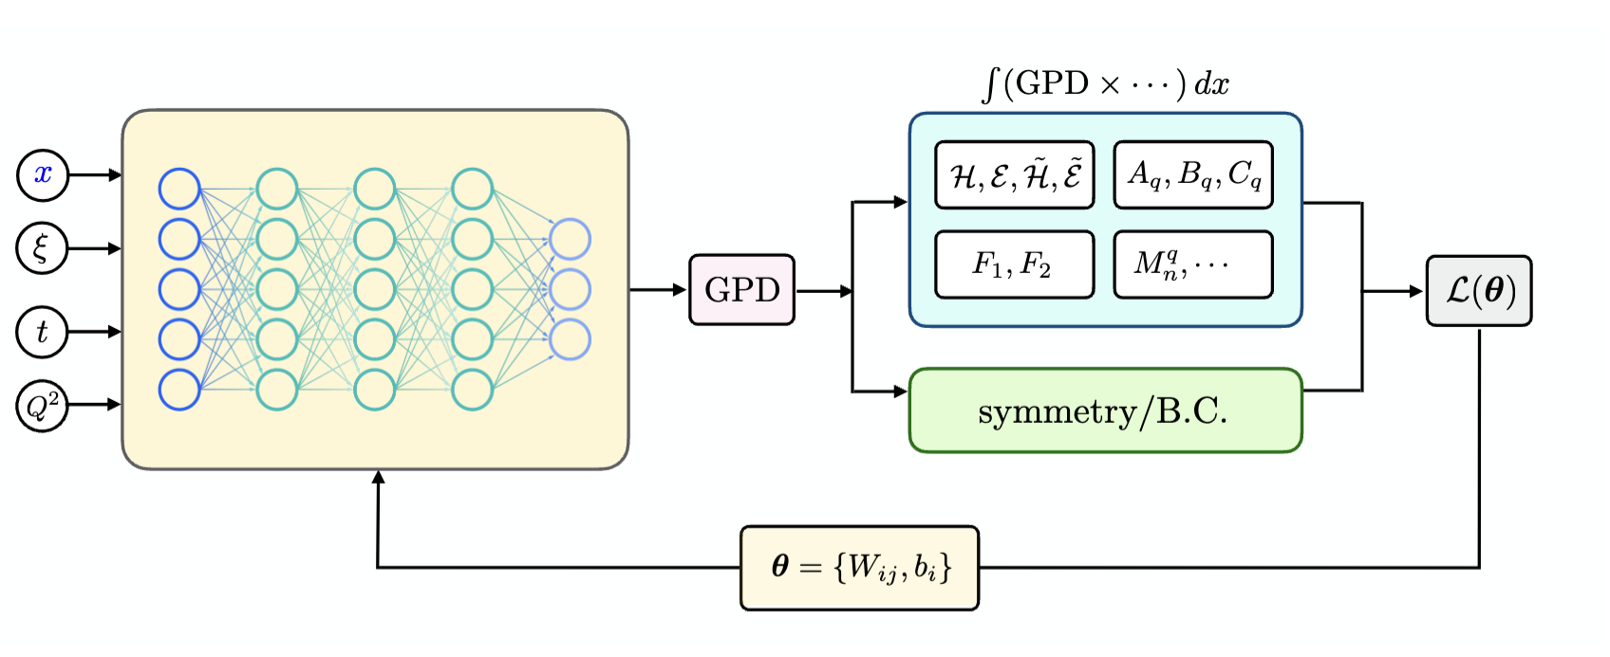
NNGPD parametrization
Deep learning framework: NN with weights and parameters $θ$ determined by composite loss function, L (θ)
Compton Form Factors
Generalized Form Factors
Elastic Form Factors
Mellin Moments
Output
Input
Input
Jitao Xu, Jang (Jason) Ho, Zaki Panjsheeri et al., [arXiv:2605. 06994 hep-ph]]
Fixed NN architecture NNGPD(4 nodes,1 hidden layer,100 neurons per layer, output layer is 1)
Notes:
Hidden layer is where the non linear activation happens

Slide 22
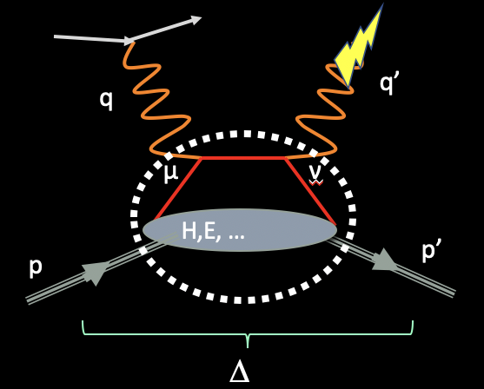
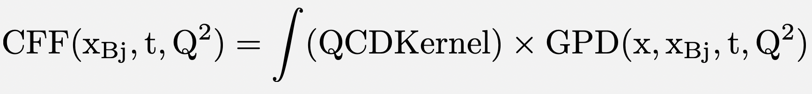
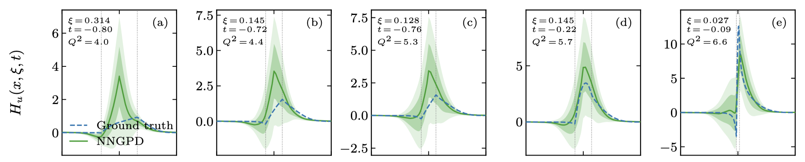
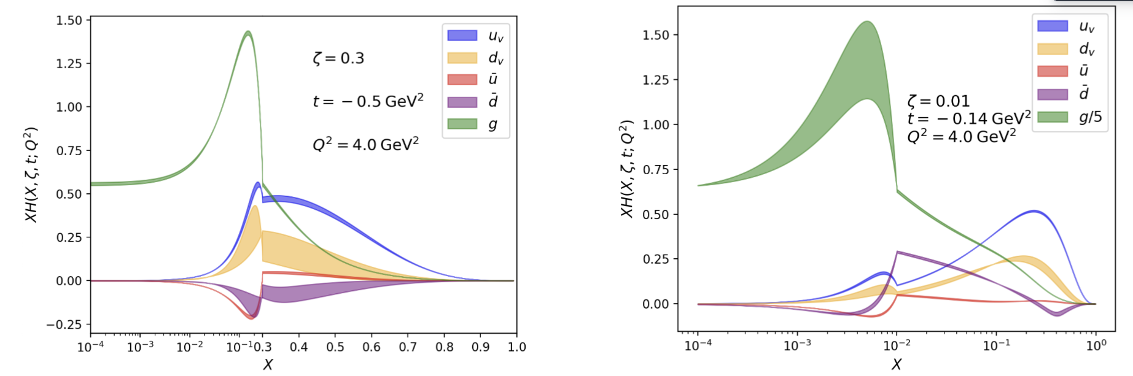
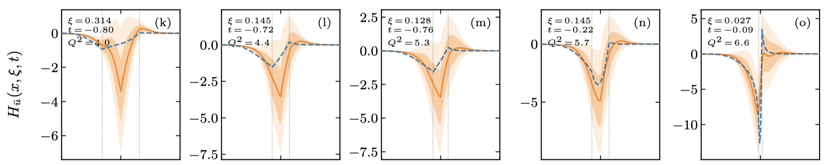
Inverse problem in GPD fits
Hessian based fit (Z.Panjsheeri et al., )
NNGPD (Jitao Xu, Jang (Jason) Ho, Zaki Panjsheeri et al)

Slide 23
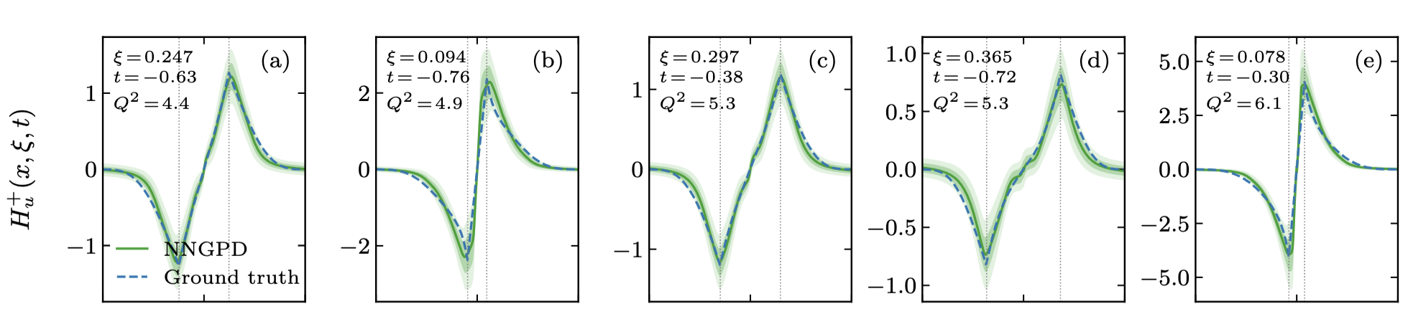
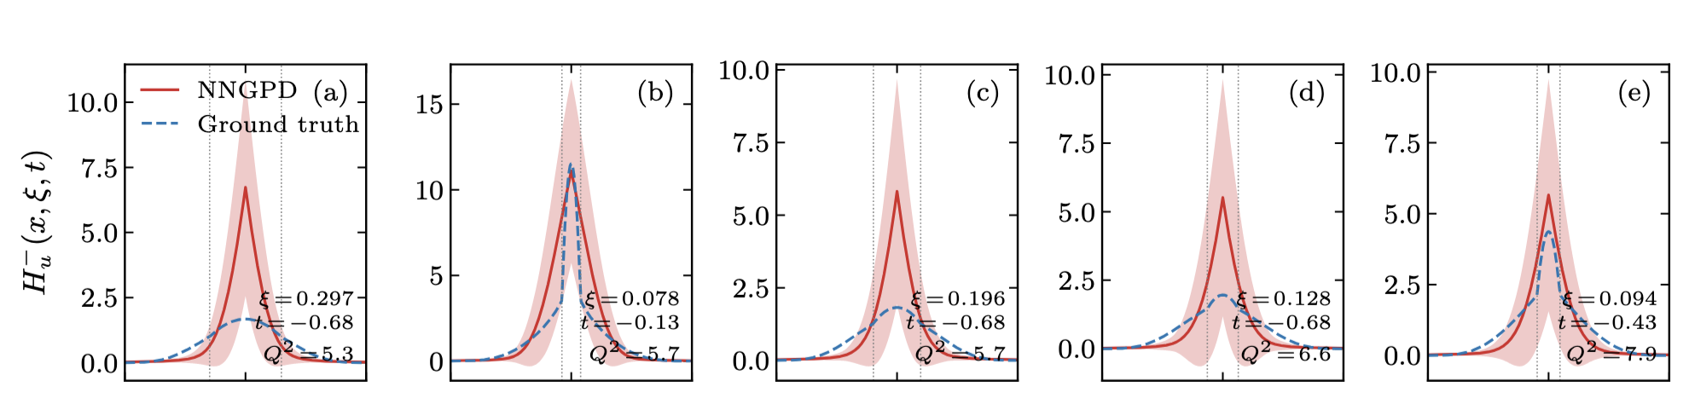
Putting together all the information (reduces the issue of shadow GPDs)
Jitao Xu, Jang (Jason) Ho, Zaki Panjsheeri et al., [arXiv:2605. 06994 hep-ph]]

Slide 24
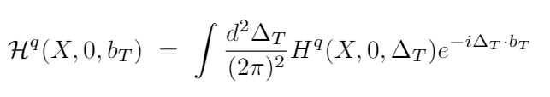
Circle back to spatial density through Fourier transform

Slide 25
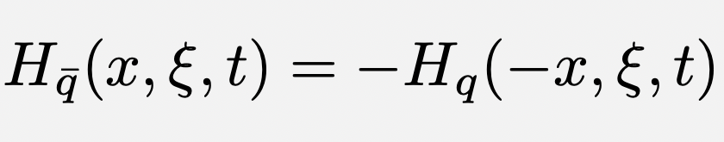
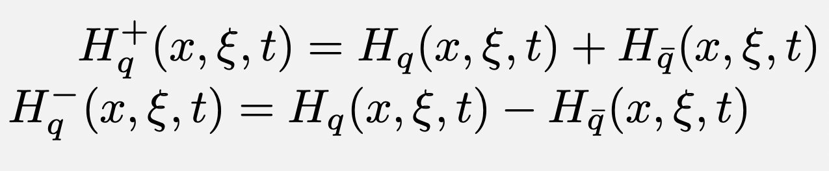
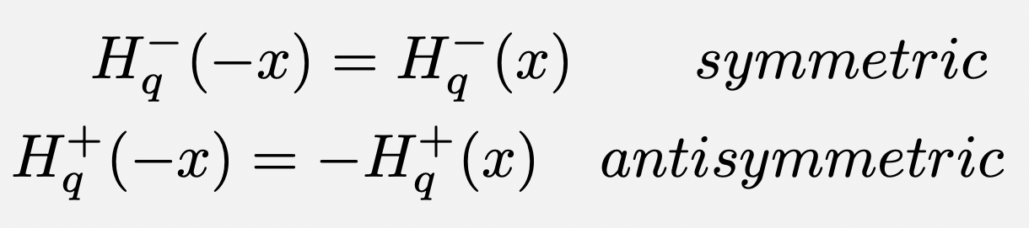
4. Impact of GPD analyses on low x physics

Slide 26
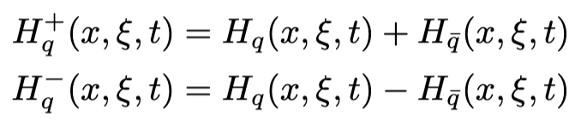
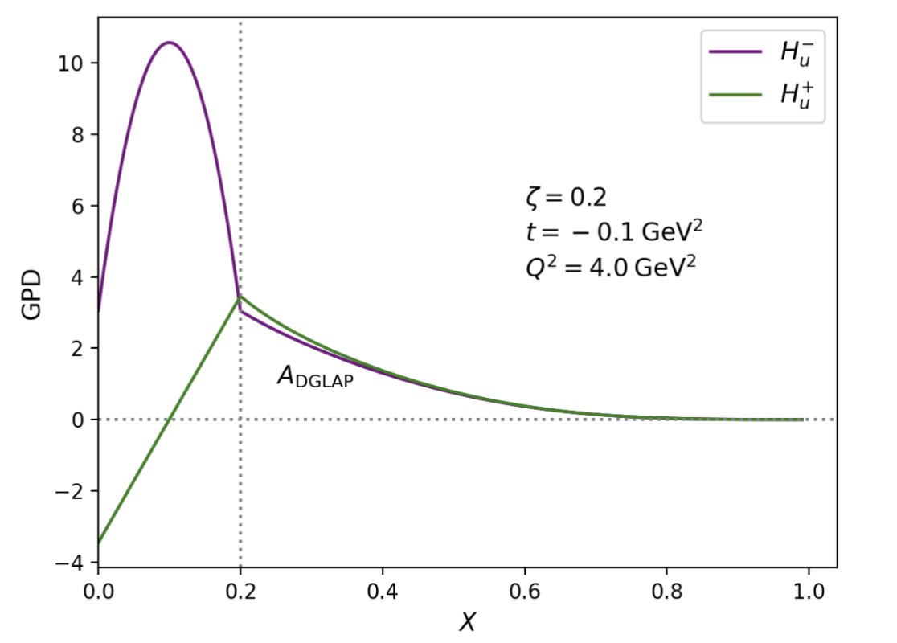
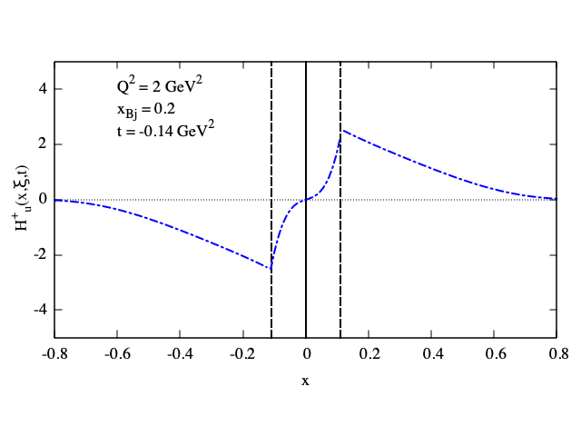
antisymmetric
symmetric
H⁺
H⁻
H⁺
Panjsheeri et al. [arXiv:2511.03065v2 [hep-ph]]

Slide 27
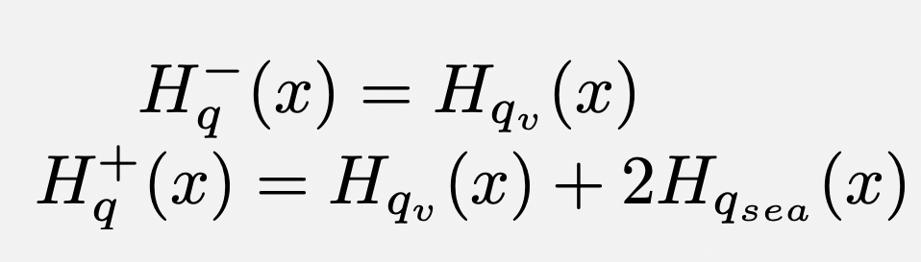


Kuti Weisskopf ansatz
only valence quarks can contribute to the form factor
UVA parametrization
Panjsheeri et al. [arXiv:2511.03065v2 [hep-ph]], in EPJC

Slide 28



Allowing for disconnected sea
Sea quarks contribution to GPD and form factor
Panjsheeri, Pandey, Semp, SL: arXiv:2512.20853

Slide 29

Effect of DI on Pauli FF/GPD E is prominent: important for imaging!

Slide 30





2nd Moments
F₁
H⁻
F₂
E⁻
A₂₀
β=7
β=1
β=7
B₂₀
β=1
Panjsheeri, Pandey, Semp, SL: arXiv:2512.20853
-t(GeV²)
x

Slide 31


Comparison with previous PDF analysis (T-J Hou et al, PRD106 (2022)096008)
DS
DS
CS
CS

Slide 32


Spatial densities
Radii
Concentrated in the center!
Panjsheeri, Pandey, Semp, SL: arXiv:2512.20853

Slide 33


There is more…
Connection with Baryon Stopping found in RHIC data (Experiment: Magdy, Tribedi, Bill Li et al., Theory: Kharzeev and Frenklakh)
Excess q-qbar pairs: disconnected diagrams to quantify this?
Baryon junction transported by q qbar pairs from vacuum!
Magdy et al. arXiv:2504.0982
Panjsheeri, Pandey, Semp, SL: arXiv:2512.20853

Slide 34

2. QCD Evolution
(some preliminary work by K-F Liu PRD96 (2017)
Writing evolution equations for the disconnected sea

Slide 35

Finally, directly to low x with ML using Symbolic Regression (SR) as a technique that discovers explicit mathematical equations directly from data, rather than fitting the parameters of a predefined model
Dotson, Panjsheeri et al.: 2504.13289 accepted in PRD(2026)
Extrapolation
region
Lattice Region
New!! SR Convergence Clustering

Slide 36
Conclusions
Connected and disconnected contributions are a feature of Lattice QCD
Based on a GPD analysis where x and t correlations can be used, we find that disconnected diagrams become increasingly important at low
Disconnected contributions affect GPD/PDF fits
Disconnected contributions give new insights on proton imaging
Disconnected contributions can be identified with the proton structures giving origin to Baryon Stopping at mid-rapidity
A complete description of hadron spatial structure requires access to two-body densities and correlation functions, providing information on the relative positions of quarks and gluons and on the emergence of collective structures, including baryon junctions, within the proton.
Next generation of hadron imaging, moving beyond the question
Where is a parton?
to the more fundamental question
How are quarks and gluons arranged relative to each other inside the proton?

