Slide 1

T-odd Weizsäcker-Williams tmds at small-x
M. Gabriel Santiago
With Daniel Adamiak, Farid Salazar, Yossathorn Tawabutr

Slide 2
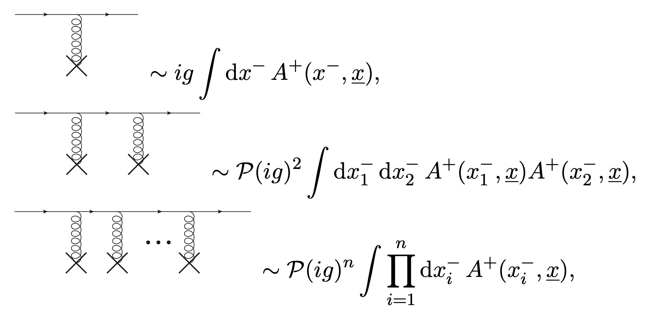
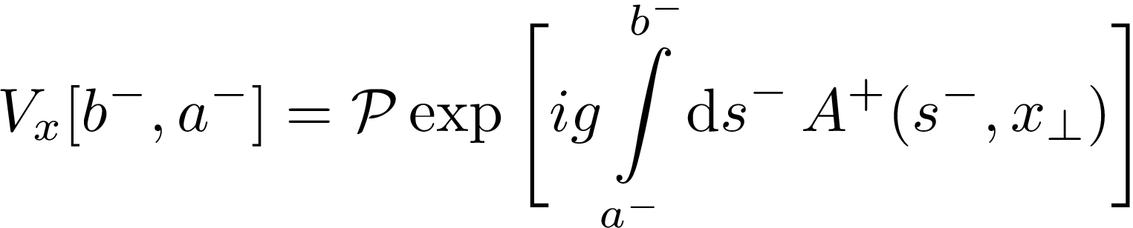

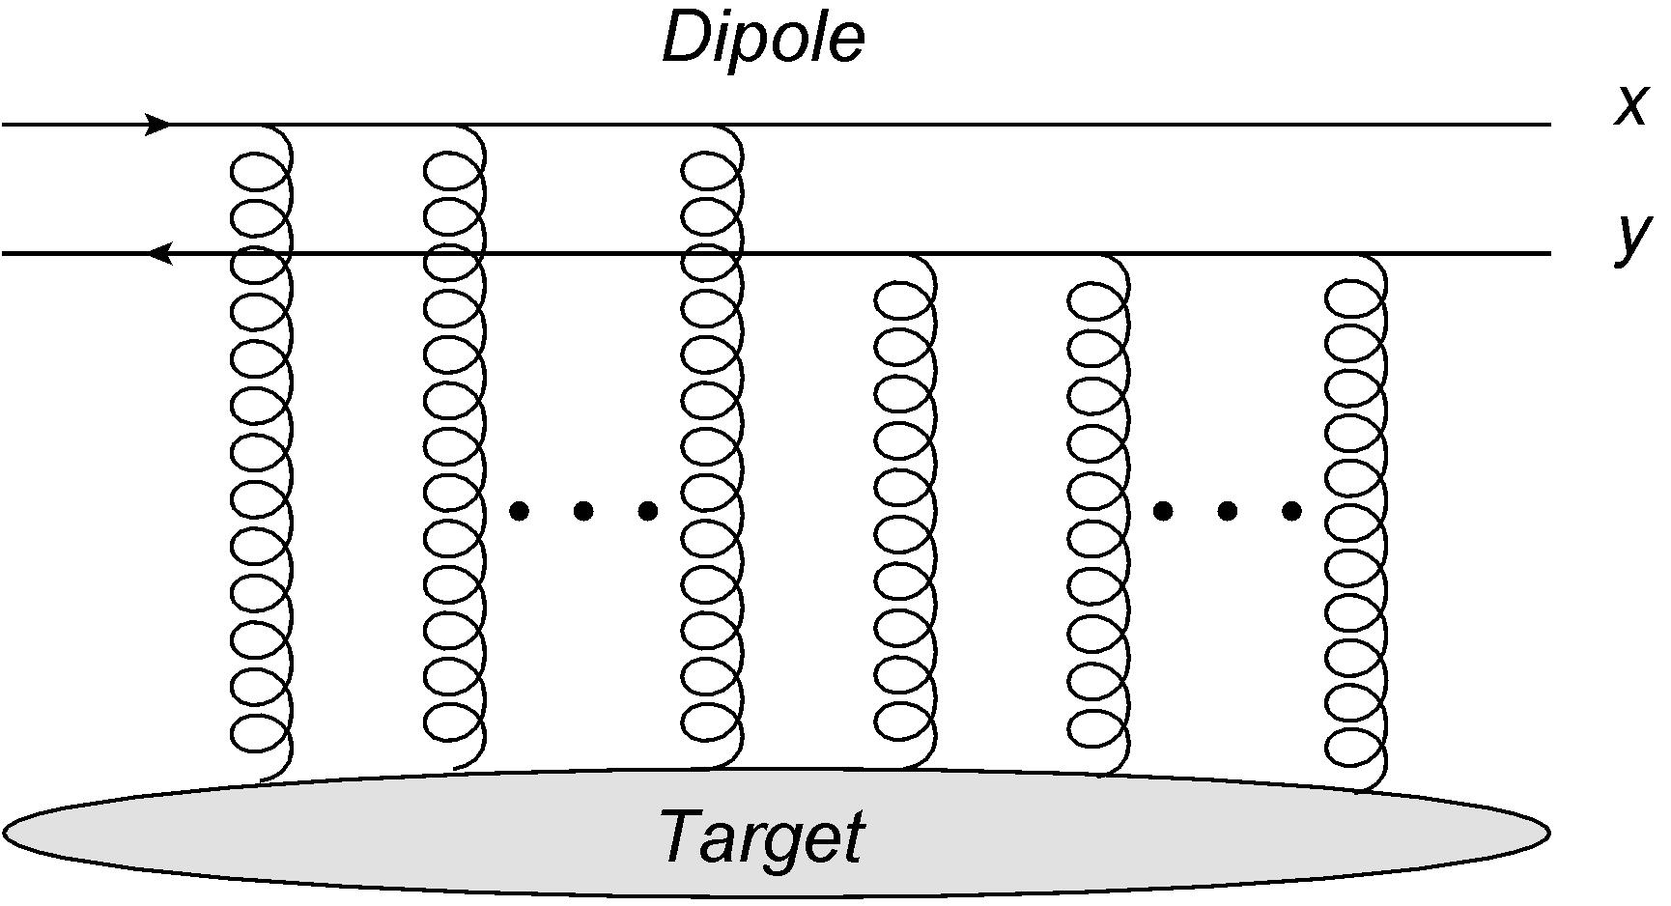

Scattering at small-x
Scattering off a hadronic target at high energy is encoded in correlators of light cone Wilson lines (Balitsky 1996)
These correlators resum an arbitrary number of eikonal gluon exchanges
Angle brackets denote average in the target state

Slide 3
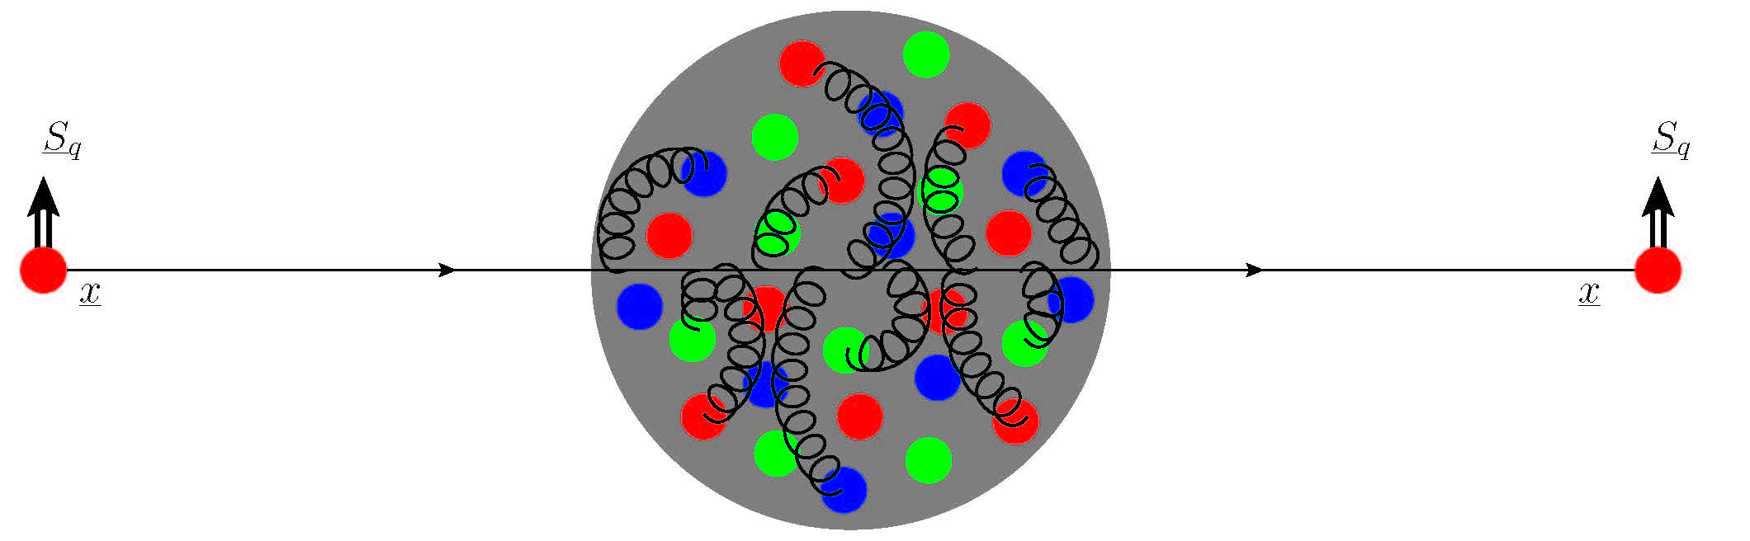
Scattering at small-x
The eikonal approximation severely restricts the interactions with the target
  partons travel along the light cone at fixed transverse position
  no longitudinal momentum transfer to partons
  no spin or flavor changes for the partons
The result is that the Wilson line correlators depend only on the color representation of the projectile partons

Slide 4
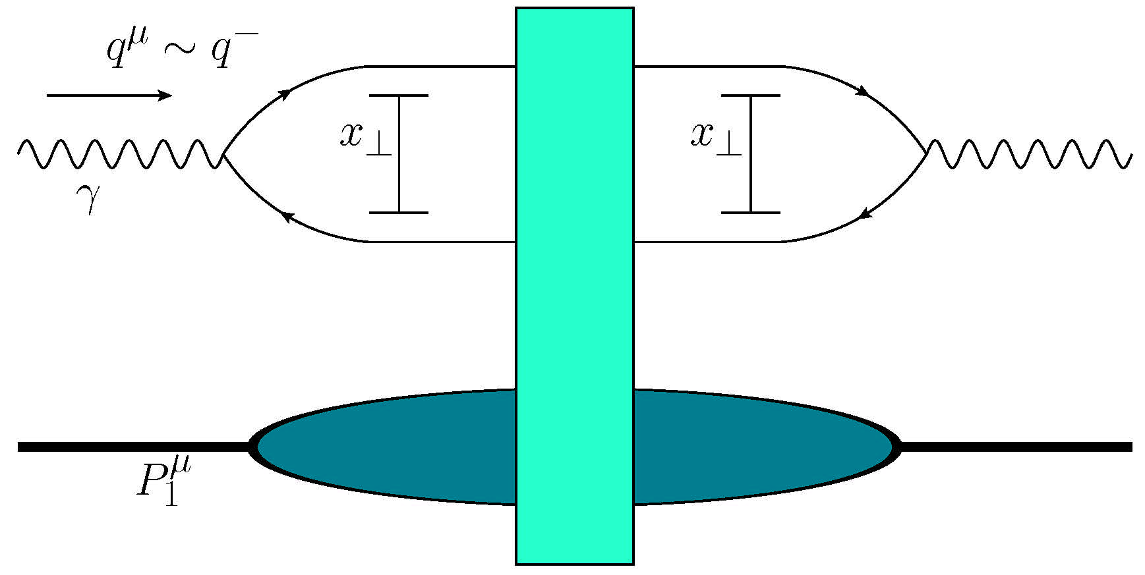
Scattering at small-x
Observables are built from Wilson line correlators averaged in the hadron state and light cone wave functions for the fluctuation of the projectile into long lived color charged fields
Example: dipole picture of Deep Inelastic Scattering
Although the vertices forming the Wilson lines cannot change quantum numbers like the spin of the partons, the averaging in the target state can allow for spin flips of the target hadron (see Adrian’s talk from Tuesday!)
Light front wave functions

Slide 5
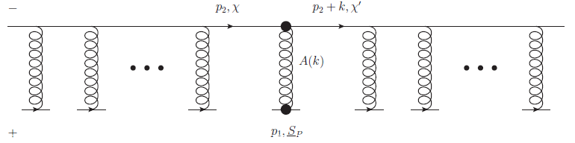



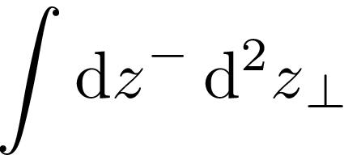

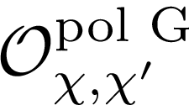



Spin at small-x
Many of the leading-twist TMDs are sensitive to the spin of partons, requiring energy suppressed exchanges to be studied in the small-$x$ formalism
One can insert sub-eikonal (energy suppressed) operators in the Wilson lines which communicate spin and other quantum numbers with the projectile

Slide 6
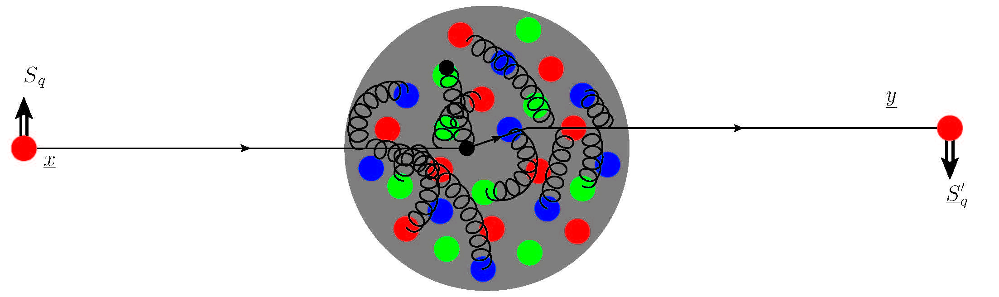
‘polarized Wilson line’
Shifted transverse position!
Altered spin!

Slide 7
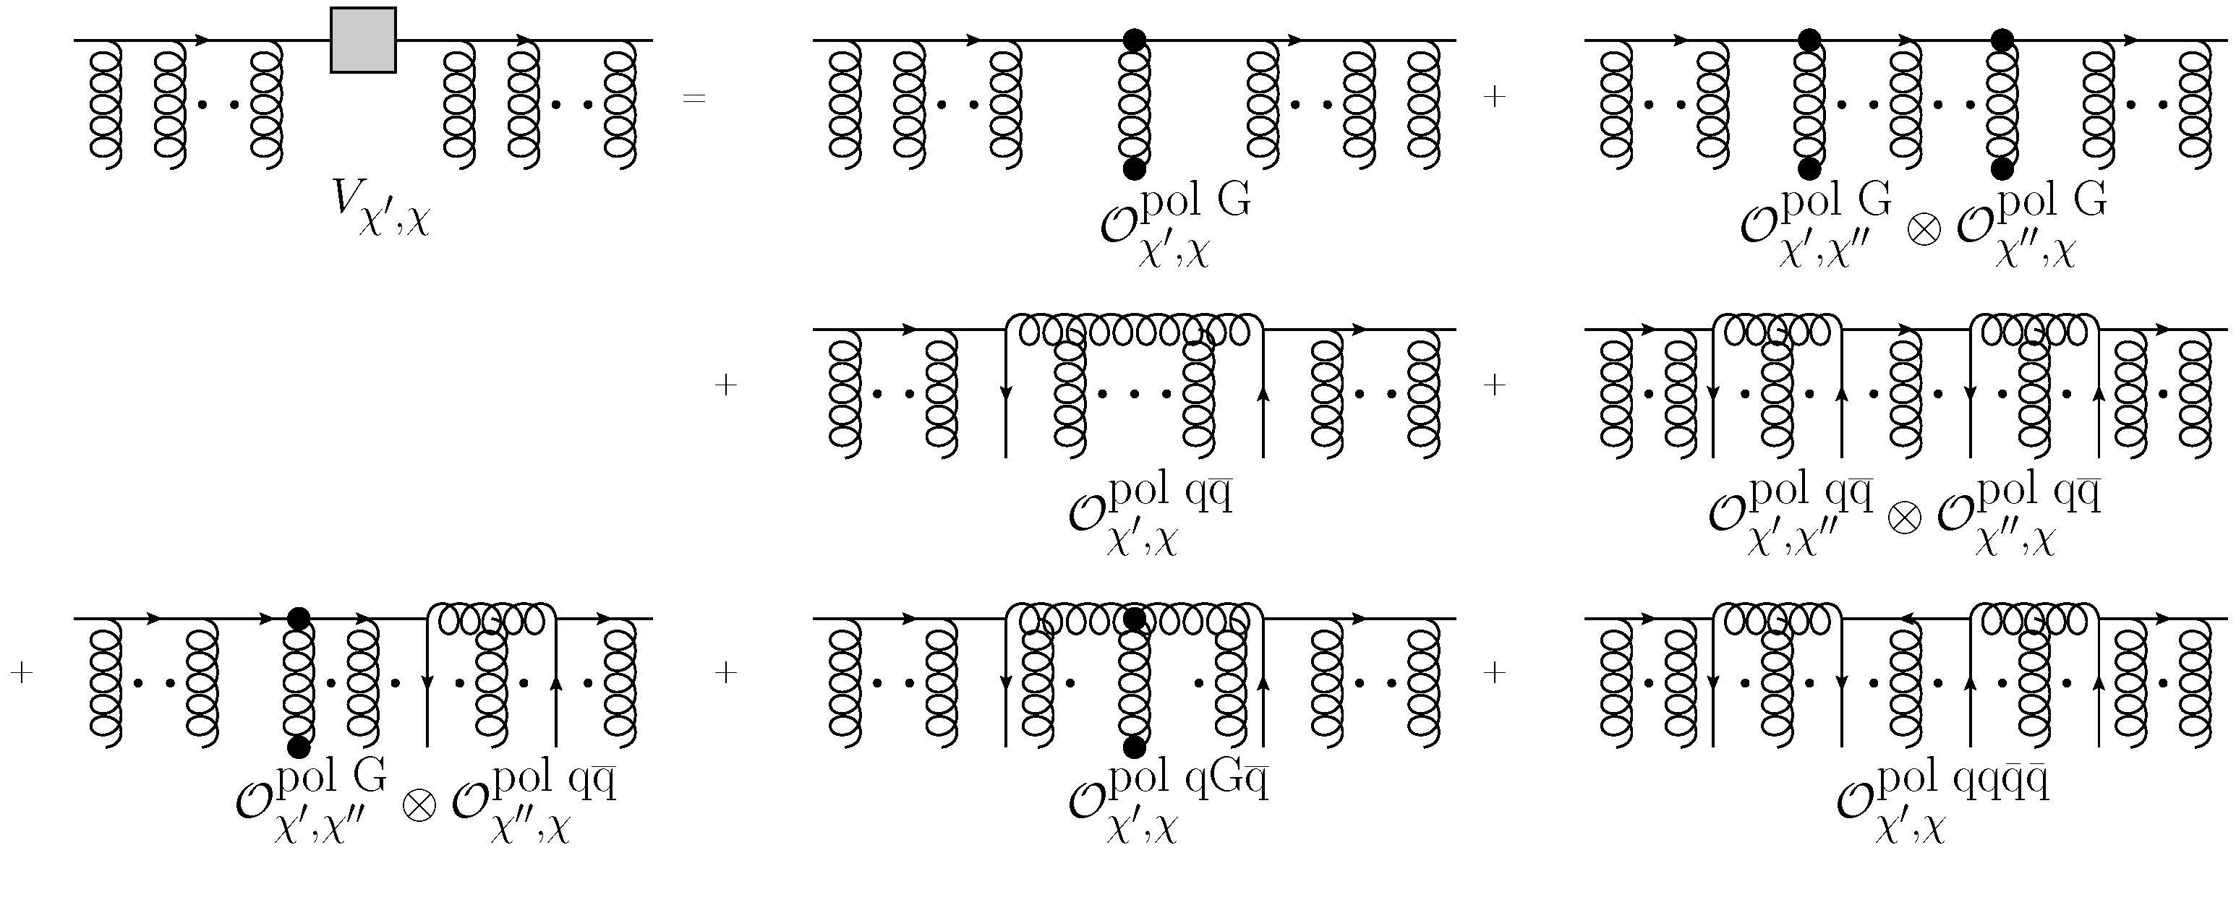
Spin at small-x
It has been shown that to account for longitudinal (Kovchegov, Pitonyak and Sievert 2016) and transverse spin (Kovchegov and Sievert 2019) one needs to include corrections out to sub-sub-eikonal order
We construct a general sub-sub-eikonal polarized Wilson line by adding all possible operator insertions
cf. (Altinoluk et al 2020), (Chirilli 2019) for full sub-eikonal propagator and (Kovchegov, MGS 2021) for full subsub--eikonal propagator

Slide 8
Spin at small-x
Observables can now be built from Wilson line correlators including these sub-eikonal operator insertions
The structure of a given observable will dictate which specific operators enter the calculation
How do we apply this to TMDs?

Slide 9
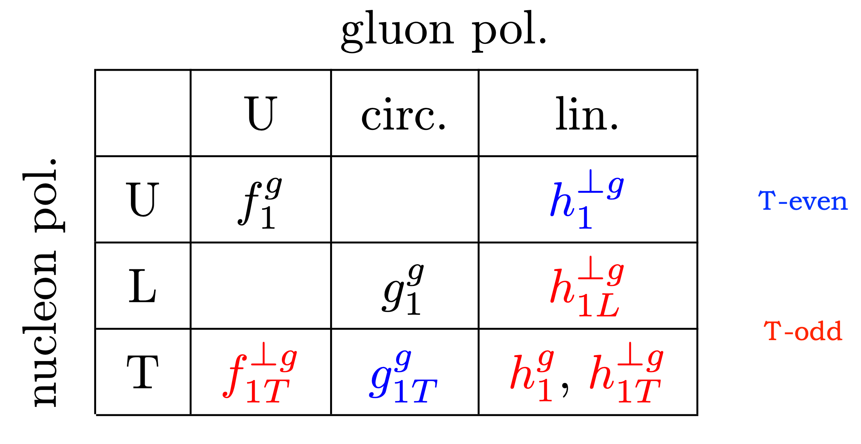
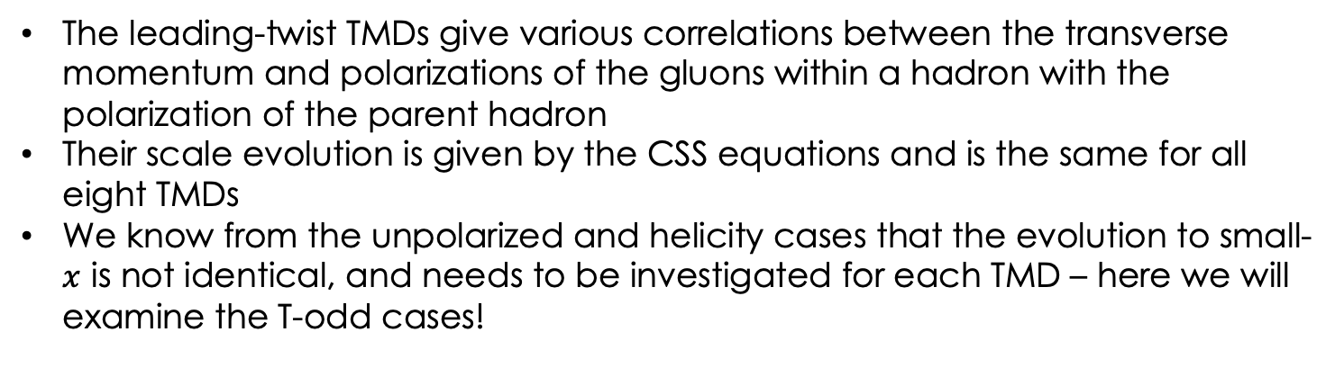
Gluon TMDs
The leading-twist TMDs give various correlations between the transverse momentum and polarizations of the gluons within a hadron with the polarization of the parent hadron
Their scale evolution is given by the CSS equations and is the same for all eight TMDs
We know from the unpolarized and helicity cases that the evolution to small-$x$ is not identical, and needs to be investigated for each TMD – here we will examine the T-odd cases!

Slide 10
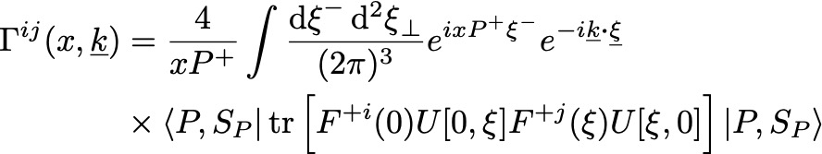
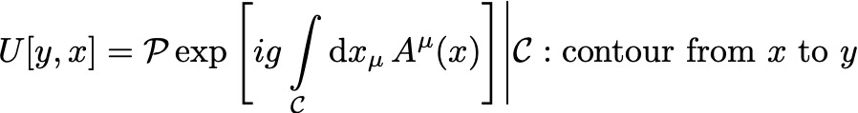
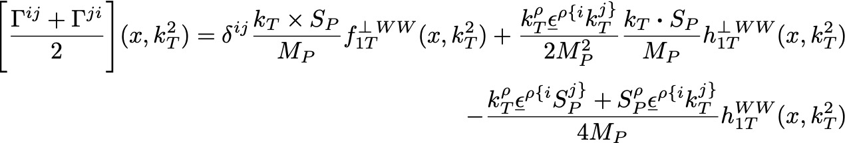

Gluon tmds
The gluon TMDs are defined by a non-local product of field strength operators
Different TMDs are given by various projections of this correlator, for example the T-odd TMDs in a transversely polarized nucleon come from the $i,j$ symmetric correlator as

Slide 11
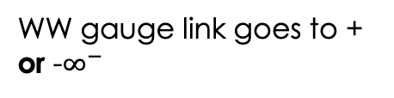

Gluon tmds
The gauge links resum soft gluon radiation and vary process to process (cf. Bomhof et al 2016)
Two gauge links typically encountered are the are the dipole gauge link the Weizsäcker-Williams gauge link, each giving a set of eight leading-twist TMDs
The dipole type arises in several processes like inclusive DIS and SIDIS, and comes from the same dipole amplitude as the sea quark TMDs
The WW type arises in dijet production and allows for a number density interpretation
Other more complicated gauge links can arise in various hard processes
Dipole gauge link goes to + and - $∞^{−}$
WW gauge link goes to + or -$∞^{−}$

Slide 12

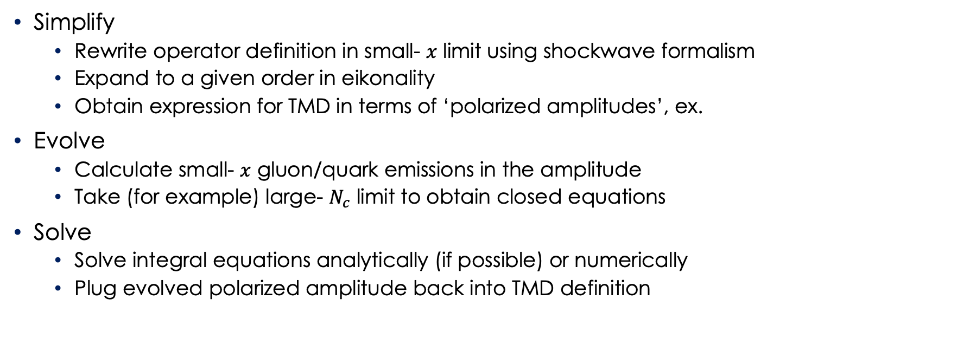
Light cone operator treatment (lcot)
Simplify
  Rewrite operator definition in small- $x$ limit using shockwave formalism
  Expand to a given order in eikonality
  Obtain expression for TMD in terms of ‘polarized amplitudes’, ex.
Evolve
  Calculate small- $x$ gluon/quark emissions in the amplitude
  Take (for example) large- $N_{c}$ limit to obtain closed equations
Solve
  Solve integral equations analytically (if possible) or numerically
  Plug evolved polarized amplitude back into TMD definition
First studied by (Kovchegov, Pitonyak and Sievert 2016) with ongoing developments to today – ex. Brandon’s talk earlier today

Slide 13
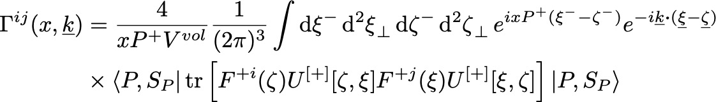
WW TMDs at small-x
We start with the gluon TMD correlator
Now we specify the WW gauge link and translate the operators in the light cone minus and transverse directions to get our dipole coordinates

Slide 14
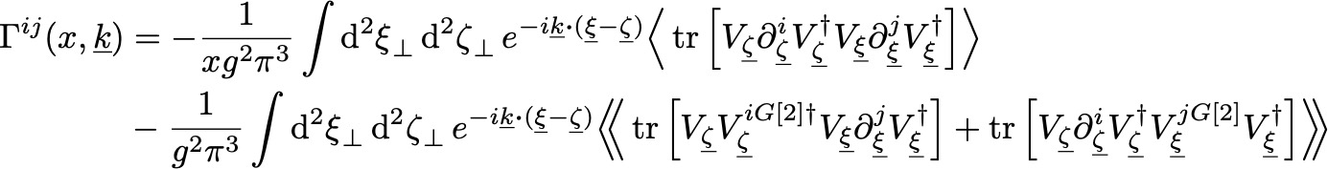
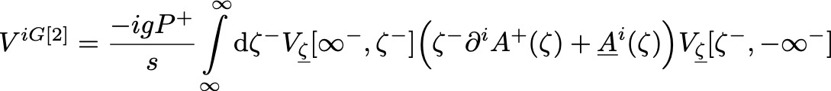
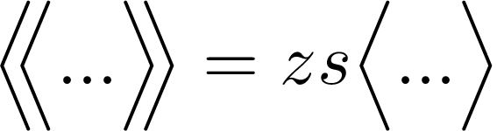

WW TMDs simplified at small-x
Expanding the field strength tensor to leading order in $α_{s}$, expanding the longitudinal Fourier exponential order by order in $x$, and performing some manipulations yields
With this simplified operator, we can obtain small-$x$ asymptotics for seven of the WW TMDs (the worm-gear $h_{1L }^{⊥g,WW}$ may require sub-sub-eikonal contributions)
Yields unpolarized and Boer-Mulders TMDs
Cf. (Kovchegov and Li 2025)
Sub-eikonal polarized amplitudes

Slide 15

Eikonality power counting
Eikonal distributions $q\left(x,k_{T}^{2}\right)∼\frac{1}{x}$, no COM energy suppression
Sub-eikonal distributions $q\left(x,k_{T}^{2}\right)∼x^{0}$, $\frac{1}{s}$ energy suppression
Sub-sub-eikonal distributions $q\left(x,k_{T}^{2}\right)∼x$, $\frac{1}{s^{2}}$ energy suppression

Slide 16

WW TMDs at small-x
Four of the WW TMDs have been studied so far
Three have known small-$x$ evolution
Usual eikonal WW amplitude given by DMMX equation (Dominguez et al 2011)
Sub-eikonal helicity WW amplitude, evolution equation given in (Kovchegov and Li 2025)

Slide 17
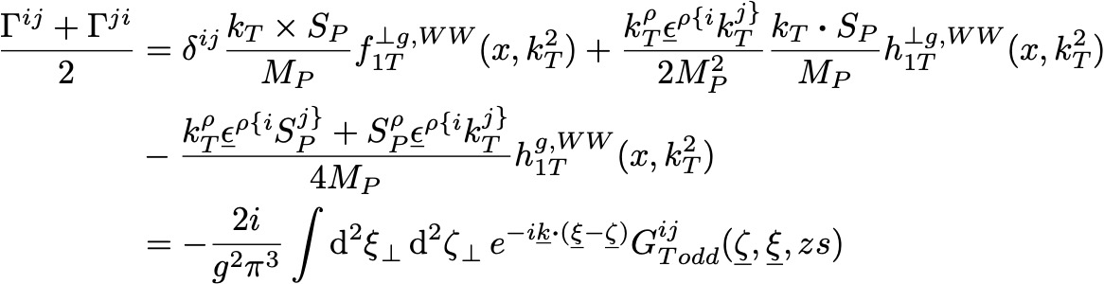

T-odd ww tmds
The T-odd TMDs for a transversely polarized nucleon are given by symmetrizing the correlator in $i↔j$
The $i↔j$ symmetry forces the eikonal terms to cancel, leaving the sub-eikonal amplitude
Spin dependent gluon exchange

Slide 18
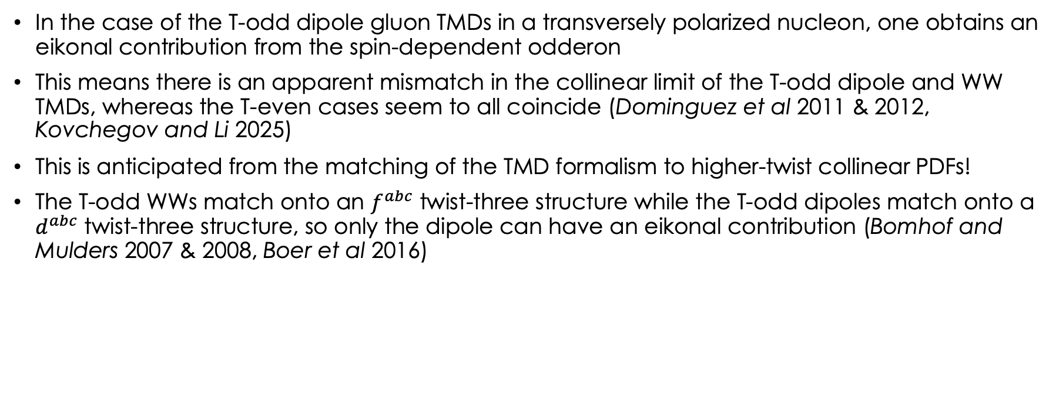
T-odd ww tmds
In the case of the T-odd dipole gluon TMDs in a transversely polarized nucleon, one obtains an eikonal contribution from the spin-dependent odderon
This means there is an apparent mismatch in the collinear limit of the T-odd dipole and WW TMDs, whereas the T-even cases seem to all coincide (Dominguez et al 2011 & 2012, Kovchegov and Li 2025)
This is anticipated from the matching of the TMD formalism to higher-twist collinear PDFs!
The T-odd WWs match onto an $f^{abc}$ twist-three structure while the T-odd dipoles match onto a $d^{abc}$ twist-three structure, so only the dipole can have an eikonal contribution (Bomhof and Mulders 2007 & 2008, Boer et al 2016)

Slide 19
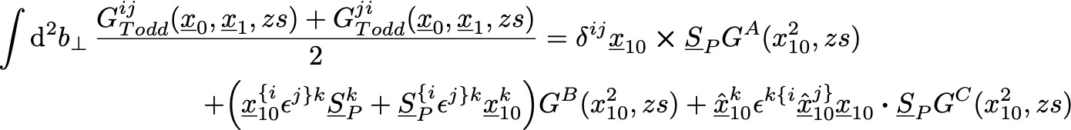
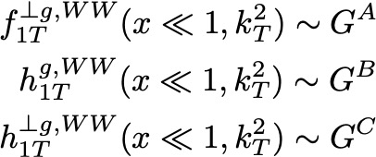
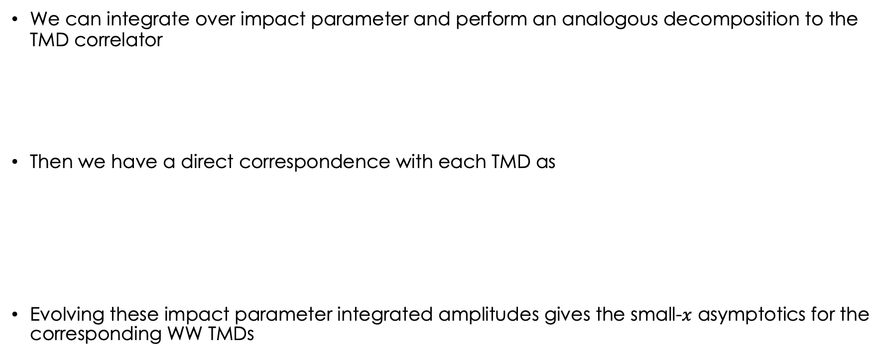
T-odd ww tmds
We can integrate over impact parameter and perform an analogous decomposition to the TMD correlator
Then we have a direct correspondence with each TMD as
Evolving these impact parameter integrated amplitudes gives the small-$x$ asymptotics for the corresponding WW TMDs

Slide 20
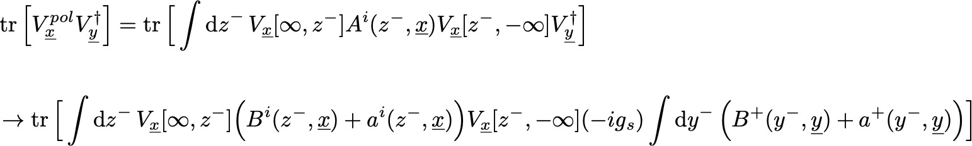
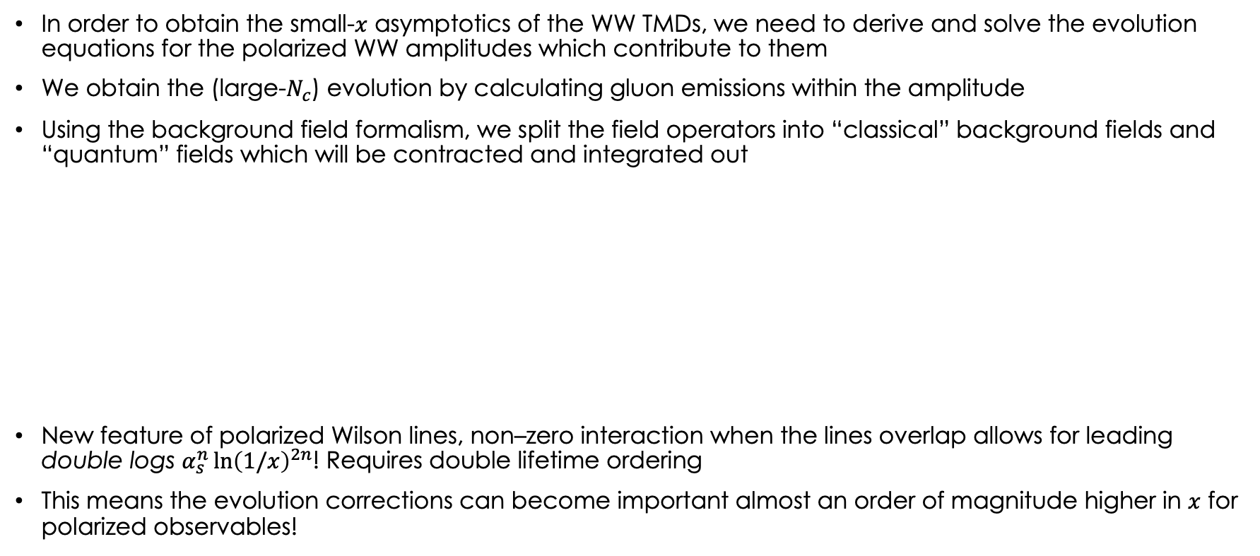
T-odd WW amplitude evolution
In order to obtain the small-$x$ asymptotics of the WW TMDs, we need to derive and solve the evolution equations for the polarized WW amplitudes which contribute to them
We obtain the (large-$N_{c}$) evolution by calculating gluon emissions within the amplitude
Using the background field formalism, we split the field operators into “classical” background fields and “quantum” fields which will be contracted and integrated out
New feature of polarized Wilson lines, non–zero interaction when the lines overlap allows for leading double logs $α_{s}^{n}{\ln\left(1/x\right)}^{2n}$! Requires double lifetime ordering
This means the evolution corrections can become important almost an order of magnitude higher in $x$ for polarized observables!

Slide 21
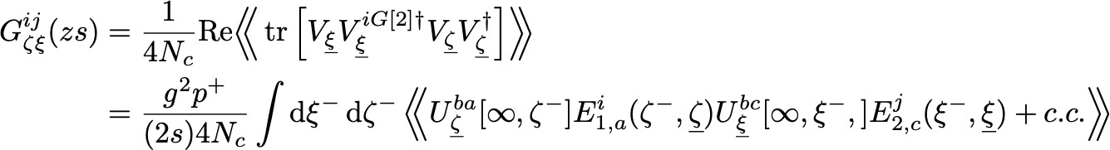

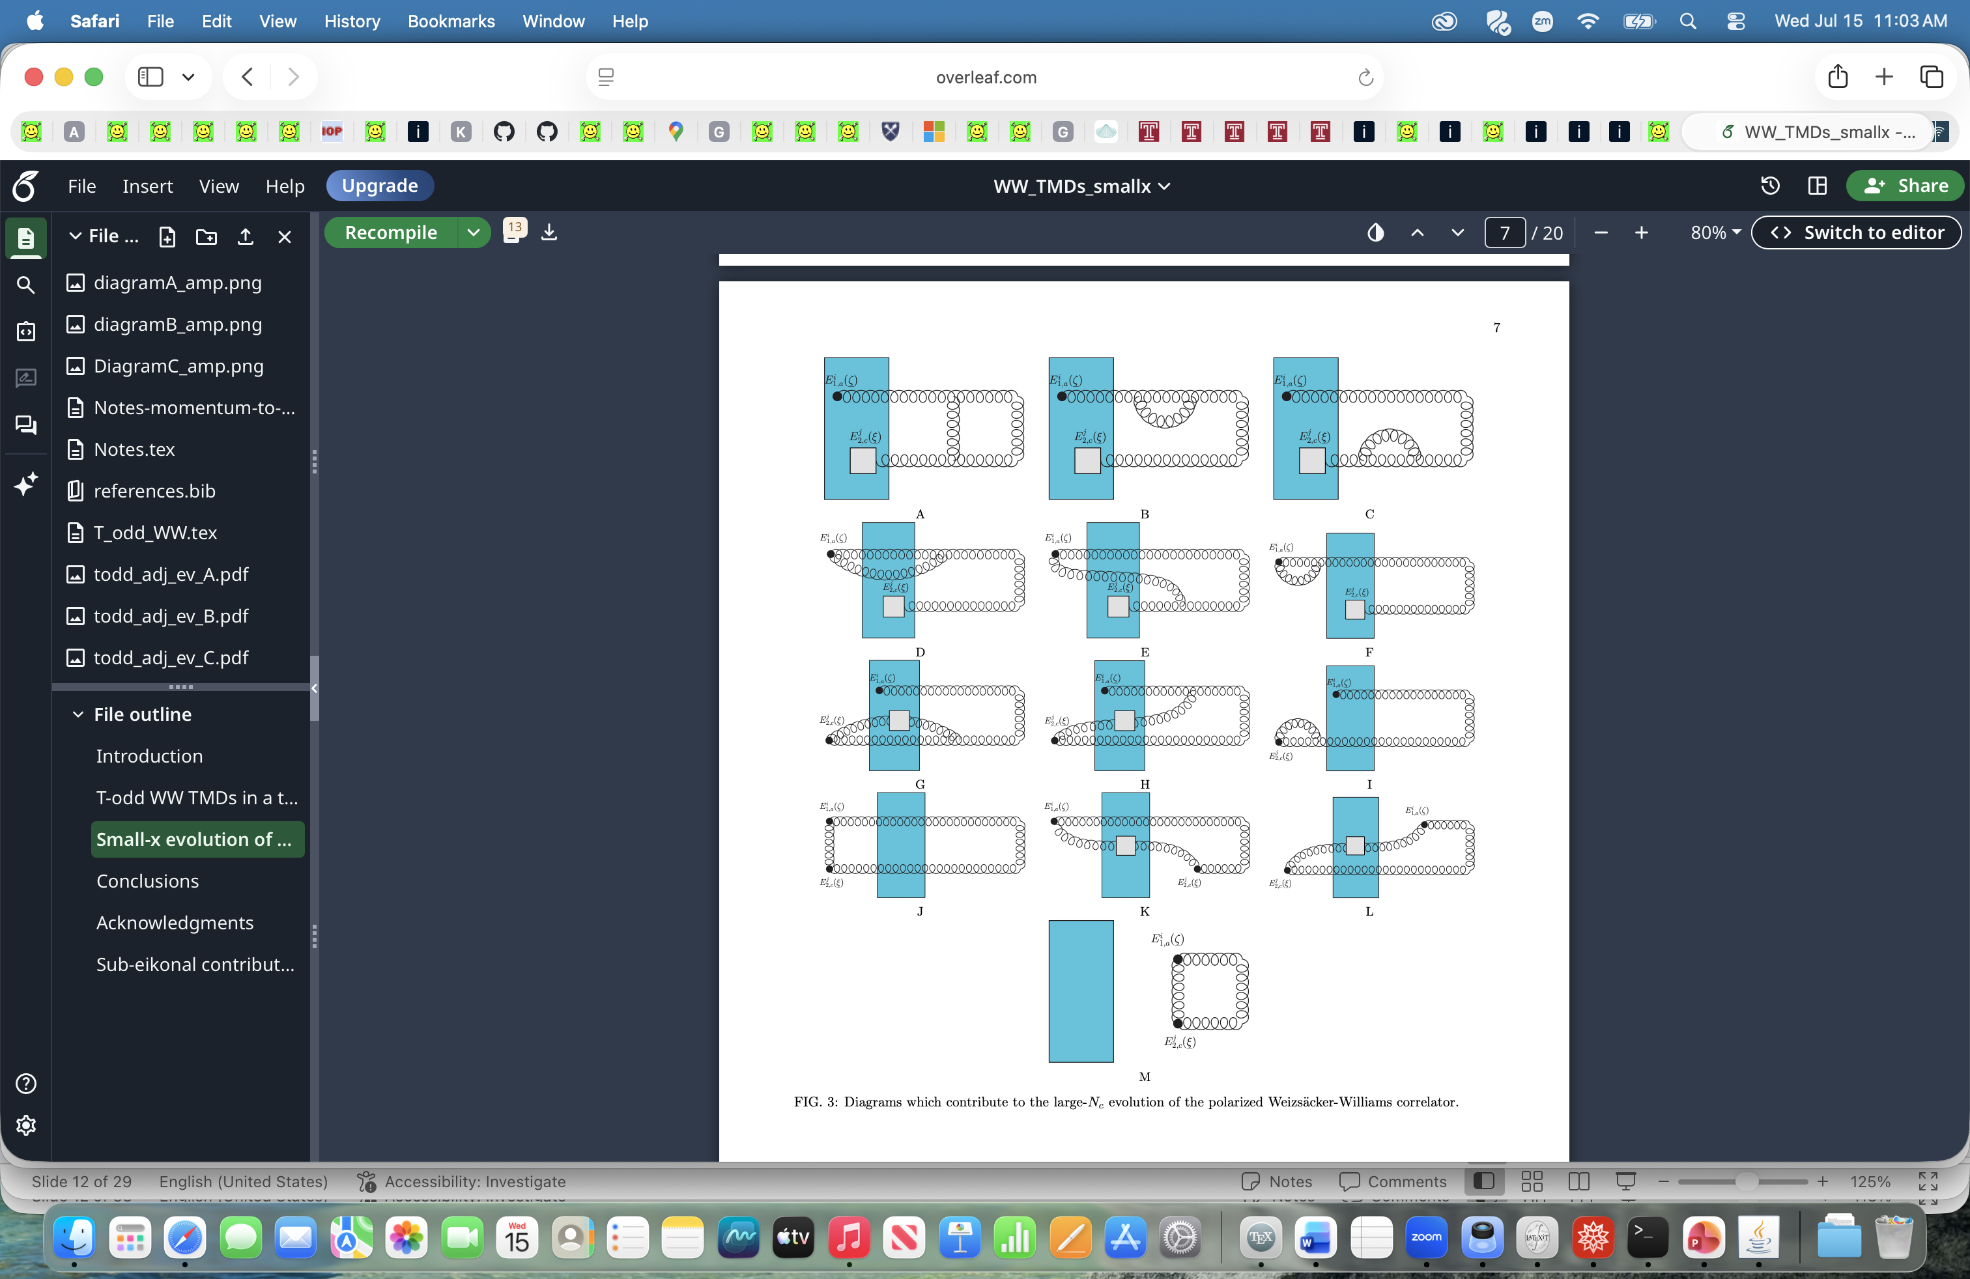

T-odd WW amplitude evolution
Applying this method to the WW correlator, we start with the amplitude defined in terms of adjoint Wilson lines for simplicity
The diagrams which contribute to the large-$N_{c}$ evolution of the general sub-eikonal WW correlator are
Couple to other polarized amplitudes
Give BFKL in the dilute limit

Slide 22
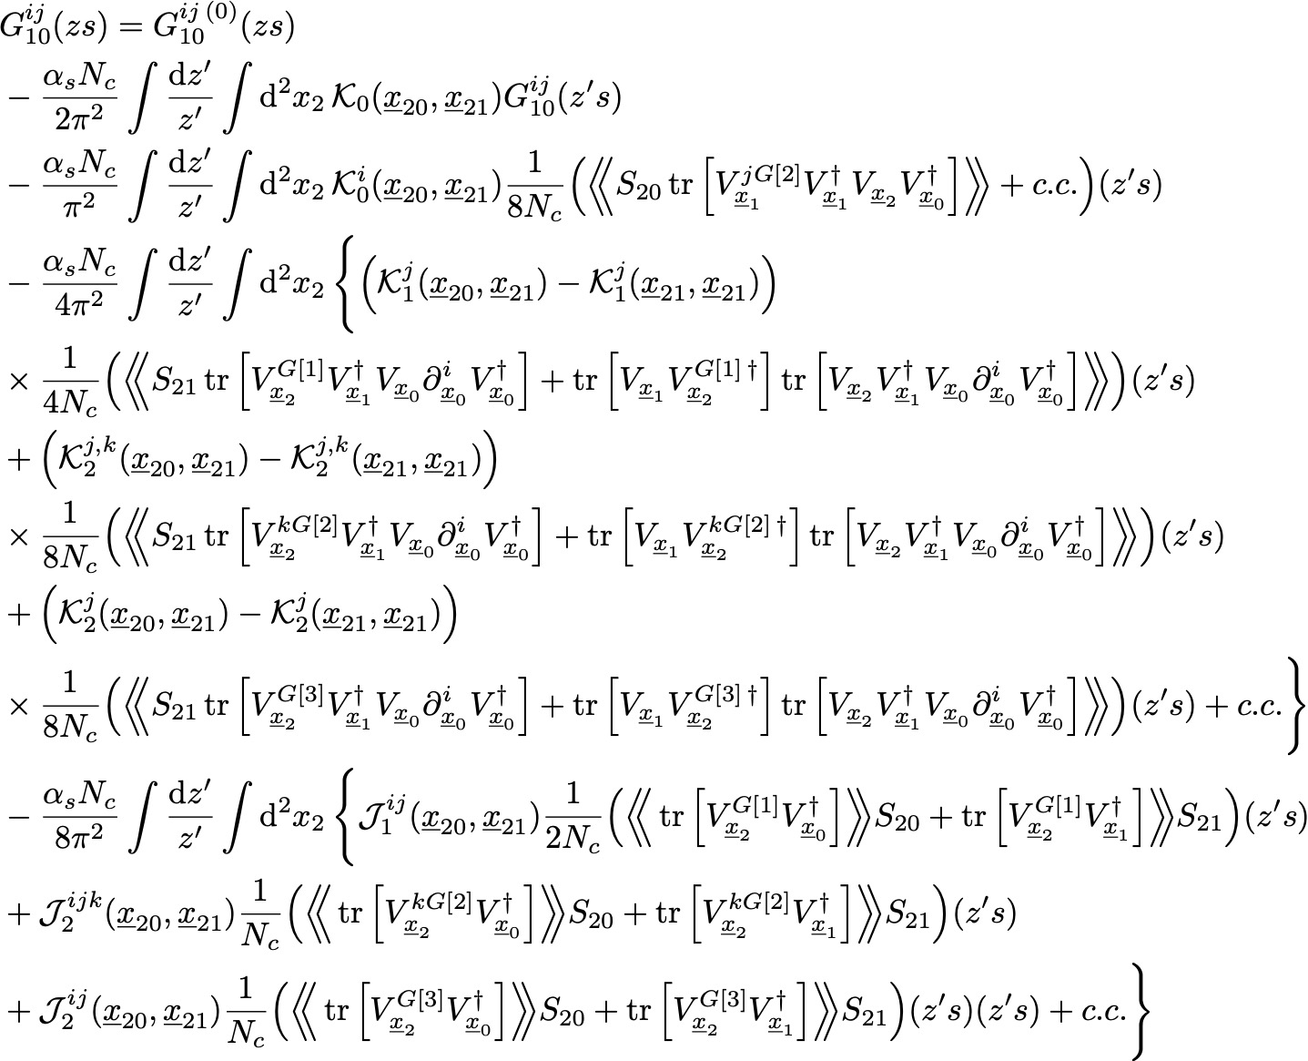
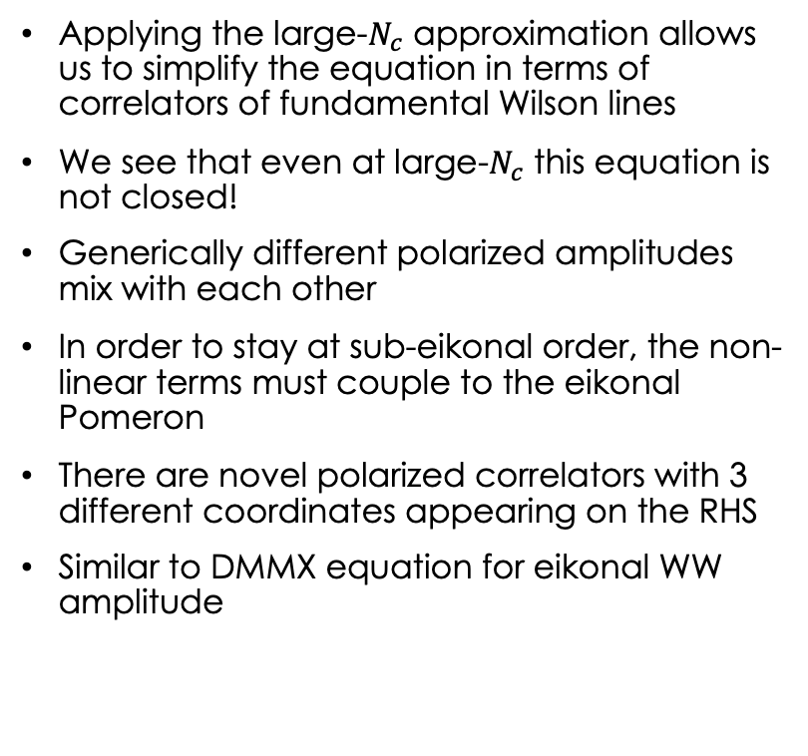
T-odd WW amplitude evolution
Applying the large-$N_{c}$ approximation allows us to simplify the equation in terms of correlators of fundamental Wilson lines
We see that even at large-$N_{c}$ this equation is not closed!
Generically different polarized amplitudes mix with each other
In order to stay at sub-eikonal order, the non-linear terms must couple to the eikonal Pomeron
There are novel polarized correlators with 3 different coordinates appearing on the RHS
Similar to DMMX equation for eikonal WW amplitude

Slide 23
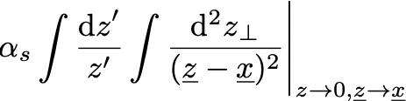
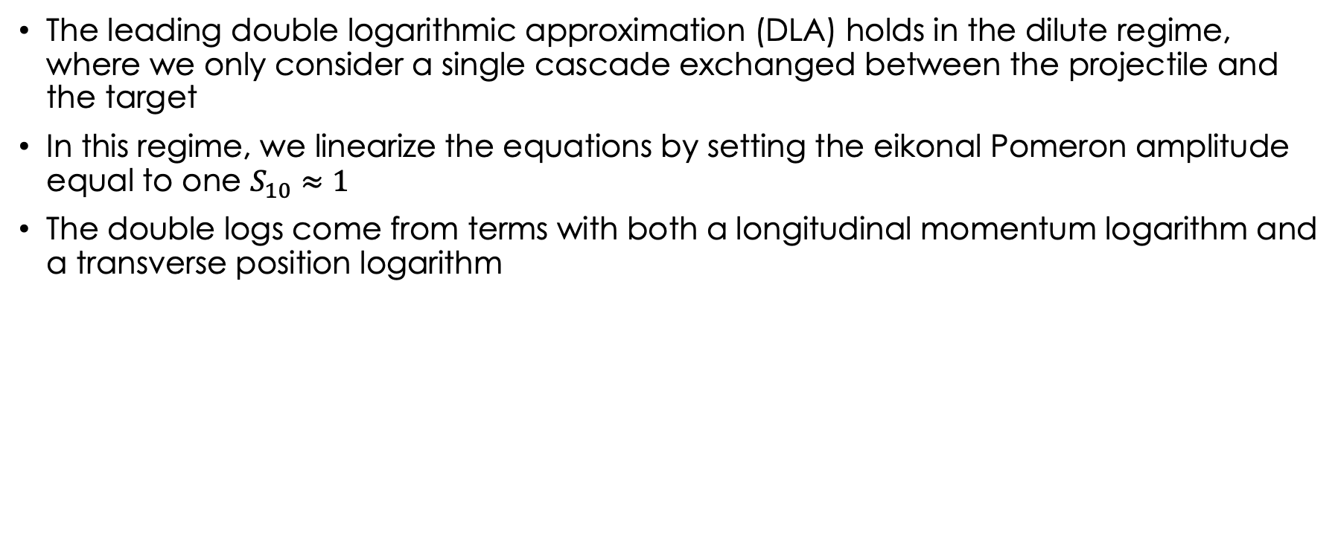
Dilute regime: DLA evolution
The leading double logarithmic approximation (DLA) holds in the dilute regime, where we only consider a single cascade exchanged between the projectile and the target
In this regime, we linearize the equations by setting the eikonal Pomeron amplitude equal to one $S_{10}≈1$
The double logs come from terms with both a longitudinal momentum logarithm and a transverse position logarithm

Slide 24
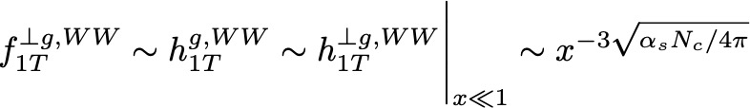
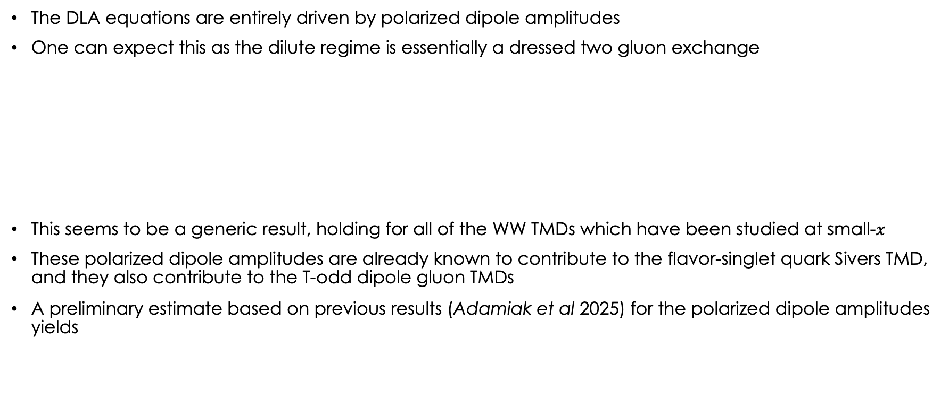
Preliminary results for T-odd ww tmds
The DLA equations are entirely driven by polarized dipole amplitudes
One can expect this as the dilute regime is essentially a dressed two gluon exchange
This seems to be a generic result, holding for all of the WW TMDs which have been studied at small-$x$
These polarized dipole amplitudes are already known to contribute to the flavor-singlet quark Sivers TMD, and they also contribute to the T-odd dipole gluon TMDs
A preliminary estimate based on previous results (Adamiak et al 2025) for the polarized dipole amplitudes yields

Slide 25
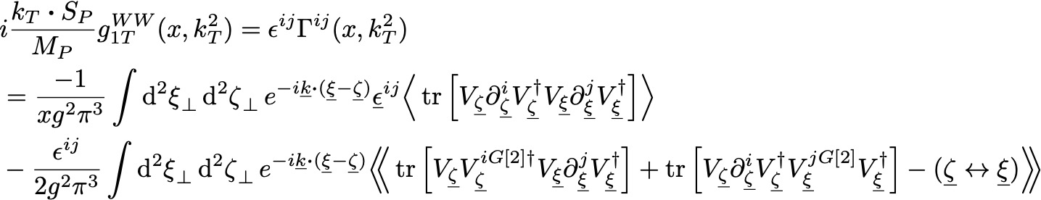
Aside: T-even ww worm gear
The T-even WW TMD for a transversely polarized nucleon is the worm gear
The eikonal contribution is difficult to rule out on general grounds, but perturbative calculations give zero to any finite order
The evolution equation is analogous to the T-odd case, being determined entirely by polarized dipole amplitudes at DLA
eikonal
sub-eikonal

Slide 26
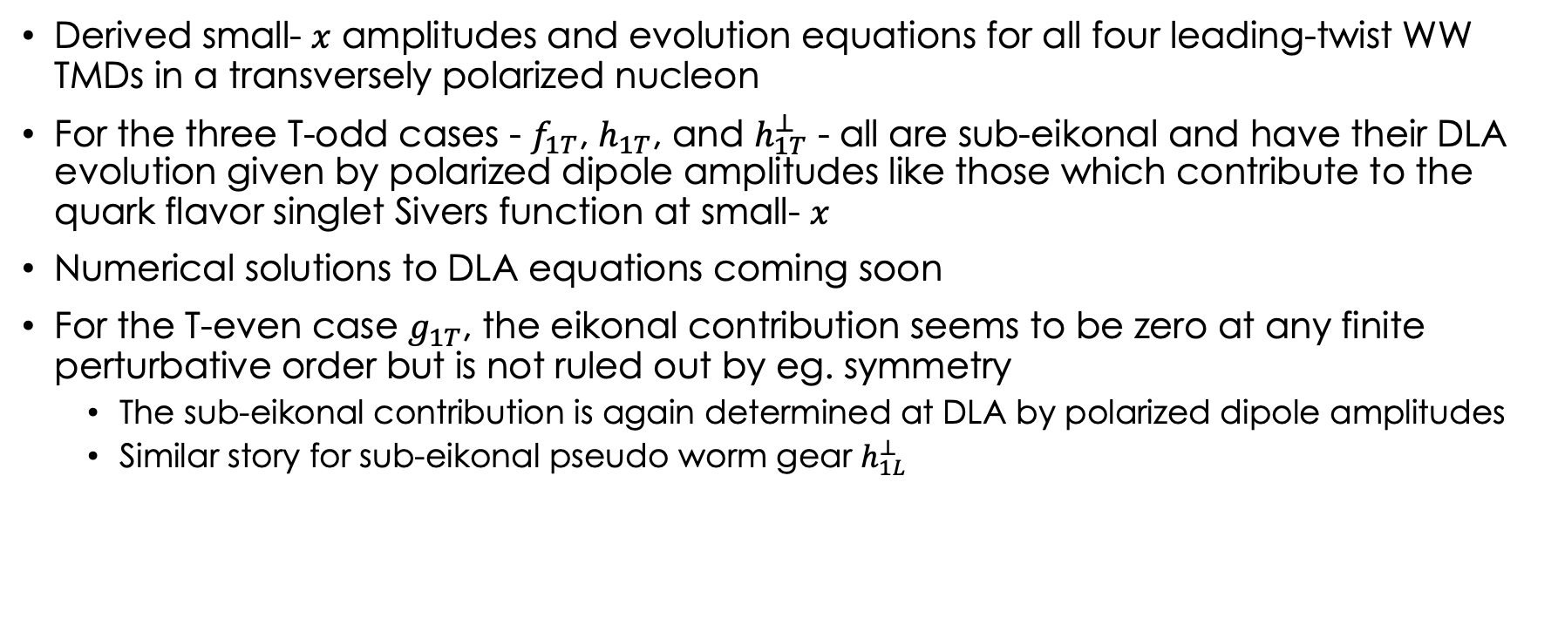
conclusions
Derived small- $x$ amplitudes and evolution equations for all four leading-twist WW TMDs in a transversely polarized nucleon
For the three T-odd cases - $f_{1T}$, $h_{1T}$, and $h_{1T}^{⊥}$ - all are sub-eikonal and have their DLA evolution given by polarized dipole amplitudes like those which contribute to the quark flavor singlet Sivers function at small- $x$
Numerical solutions to DLA equations coming soon
For the T-even case $g_{1T}$, the eikonal contribution seems to be zero at any finite perturbative order but is not ruled out by eg. symmetry
  The sub-eikonal contribution is again determined at DLA by polarized dipole amplitudes
  Similar story for sub-eikonal pseudo worm gear $h_{1L}^{⊥}$

Slide 27
backup

Slide 28

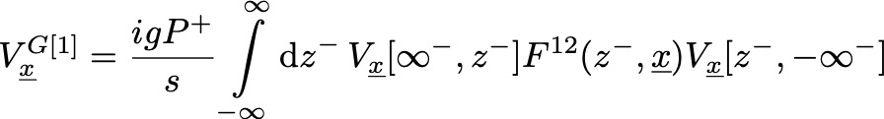

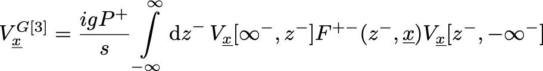

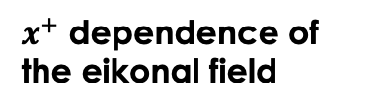
Relevant sub-eikonal Wilson lines
Several structures contribute at leading order to the WW TMDs we consider here
Sub-eikonal phase term
‘Chromomagnetic’ interaction term
$x^{+}$ dependence of the eikonal field

Slide 29
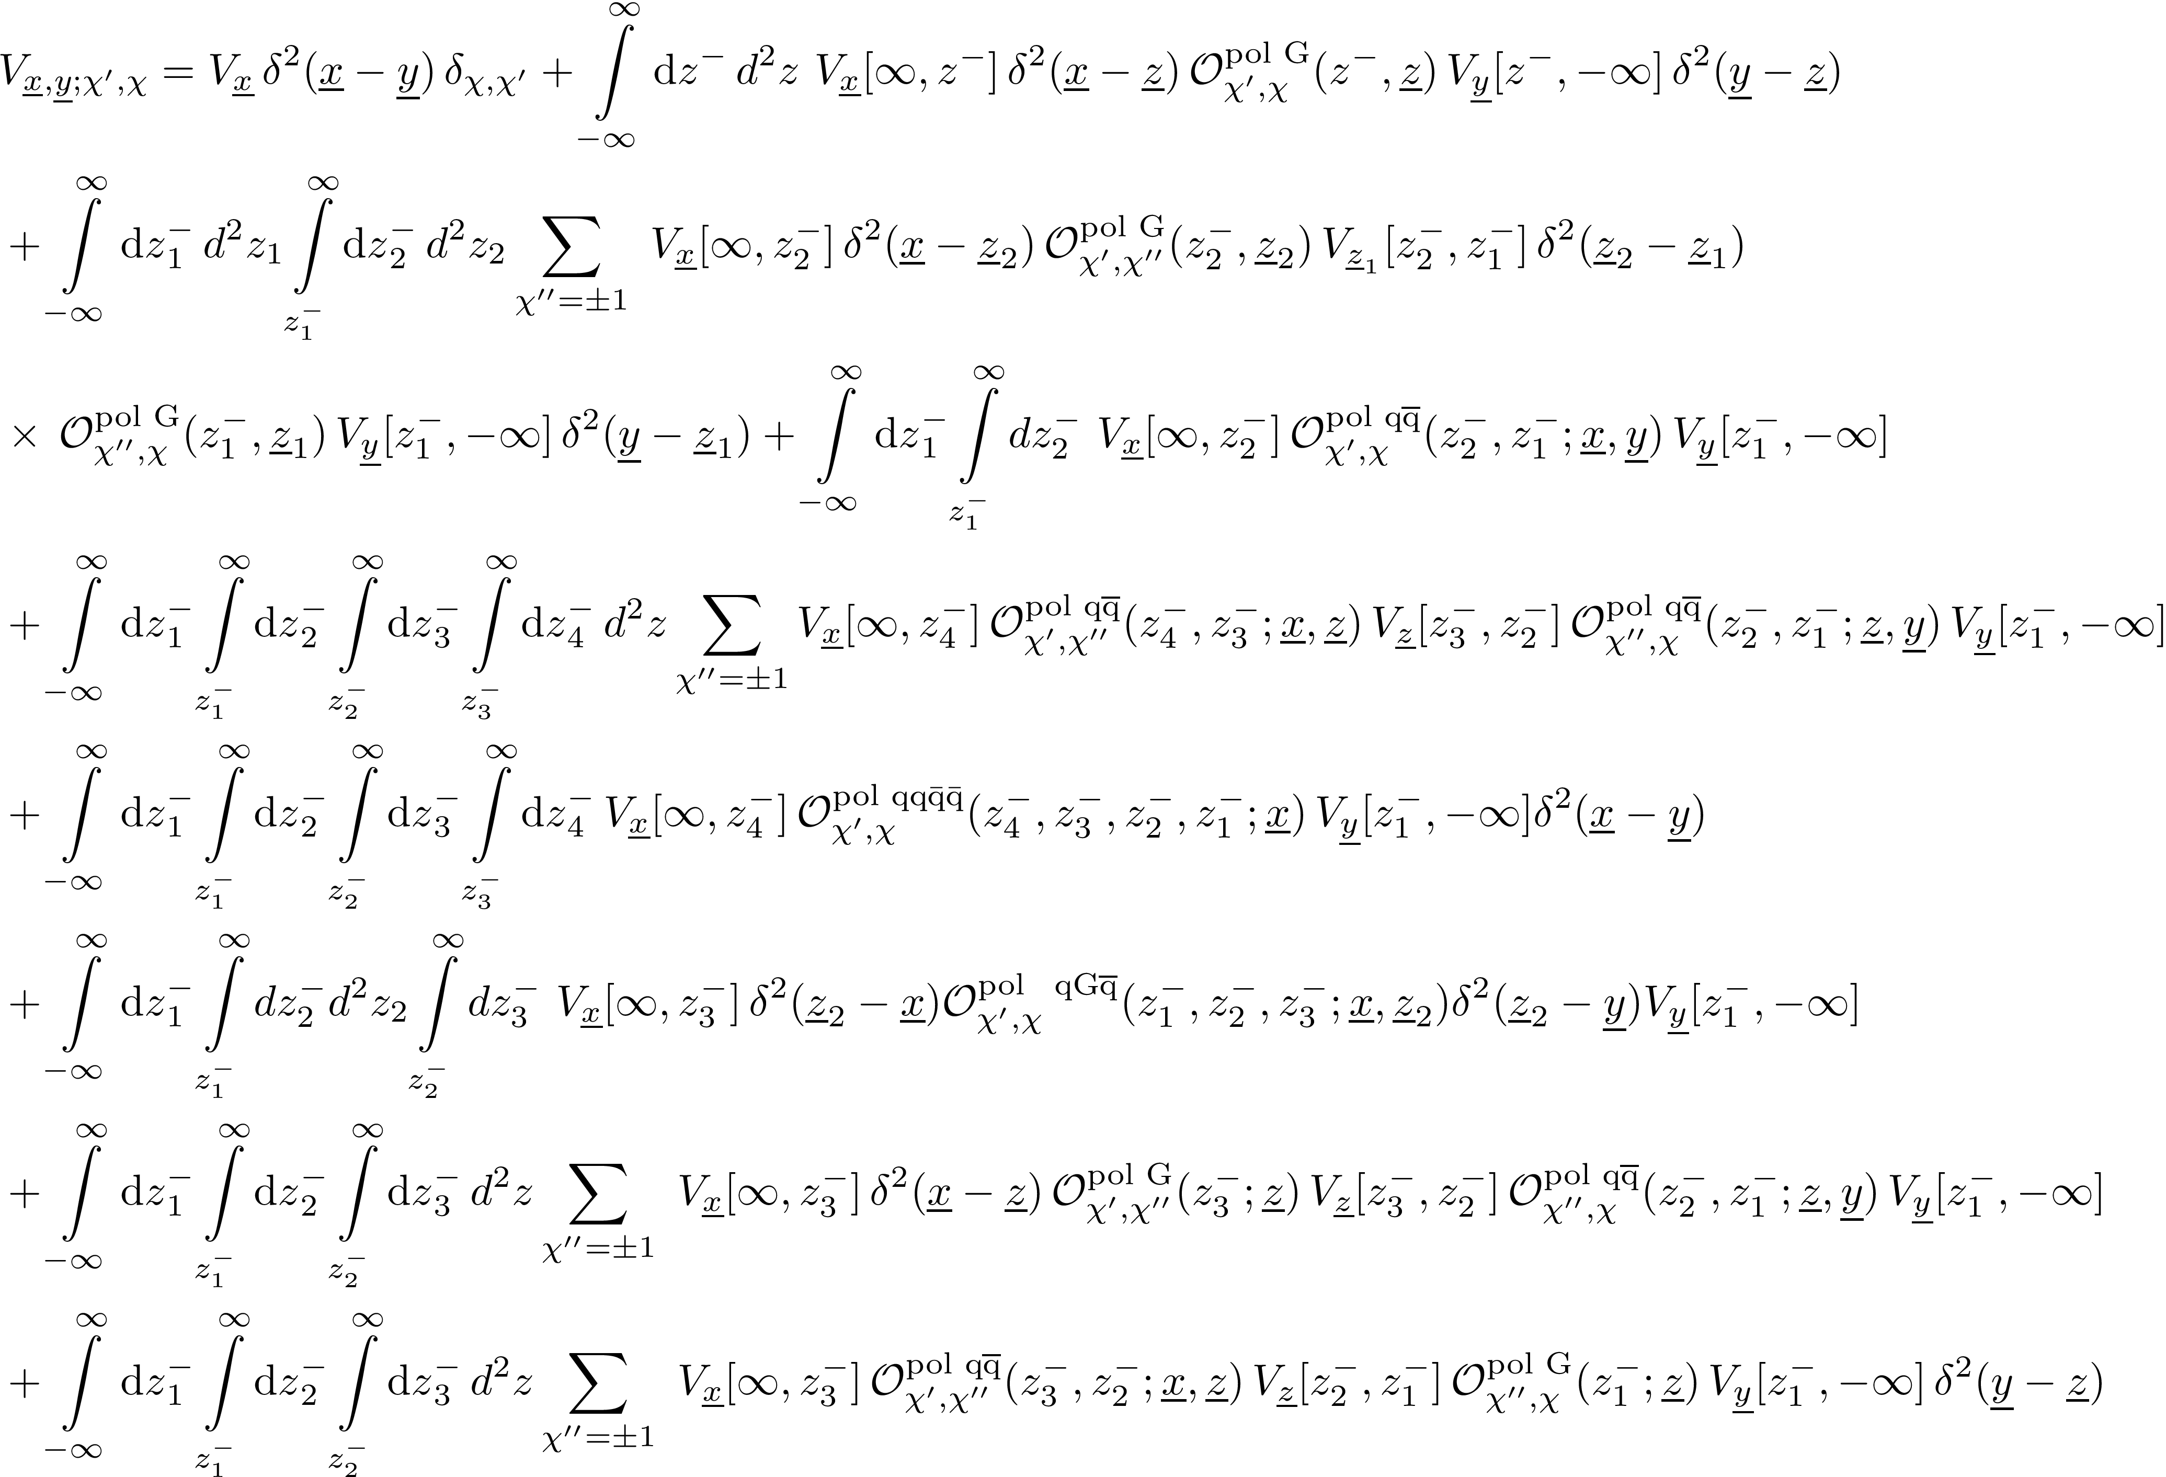
Sub-sub-eikonal Polarized Wilson Line

Slide 30
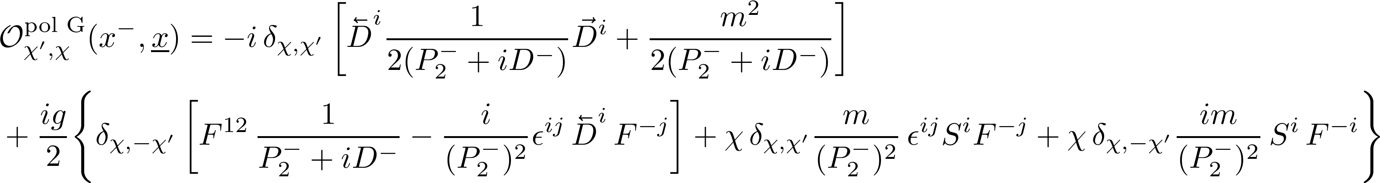
Sub-sub-eikonal Operators

Slide 31

Sub-sub-eikonal Operators

Slide 32

Sub-sub-eikonal Operators

