Slide 1
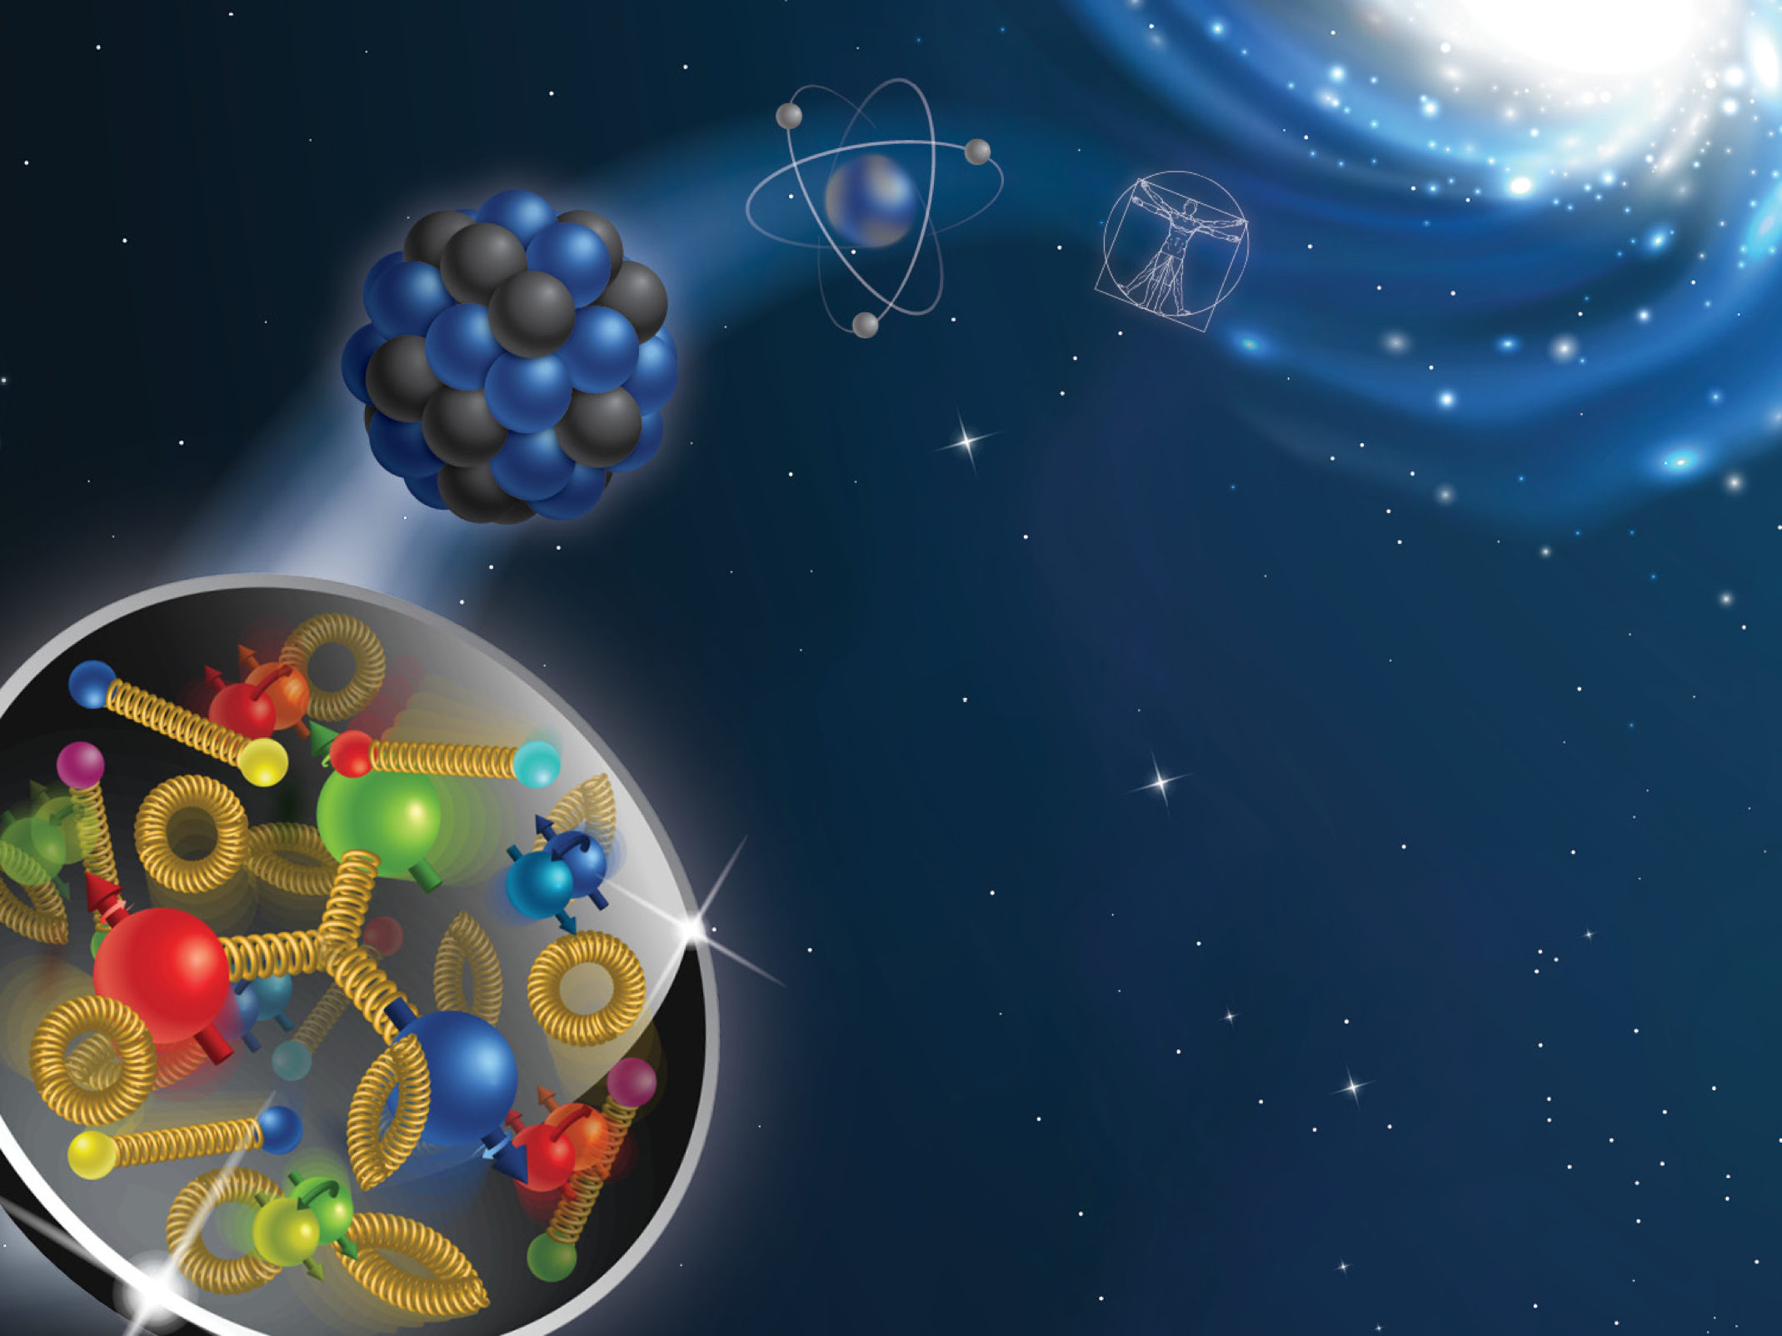
The 2026 CFNS Summer School on the Physics of the
Electron-Ion Collider

Slide 2

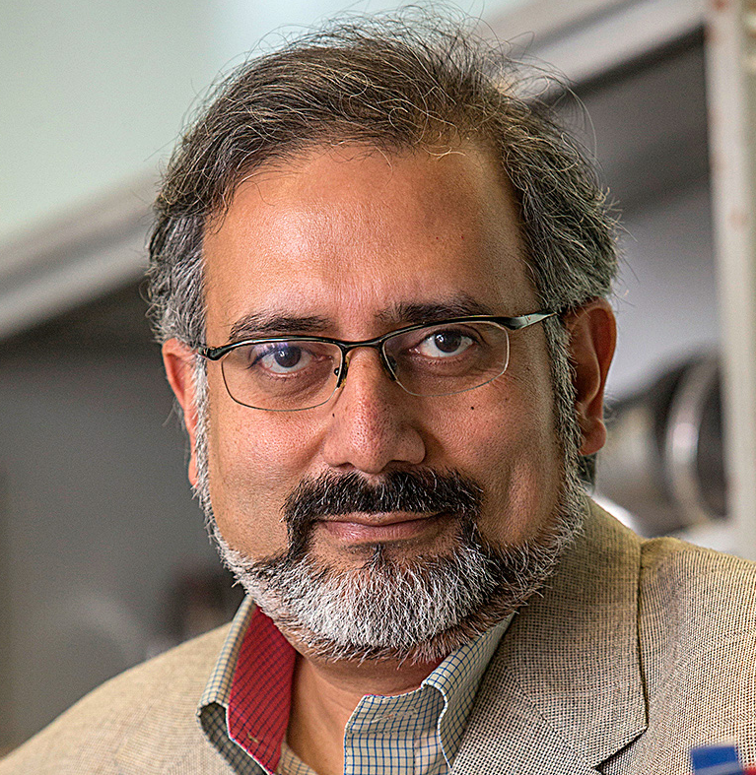
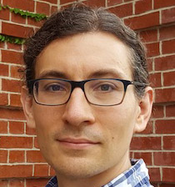

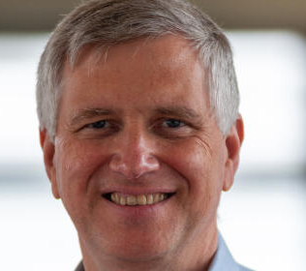
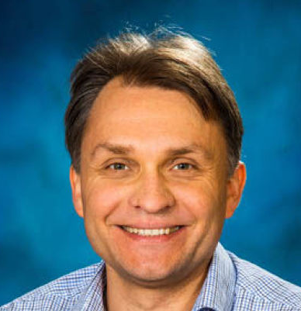
School organizers
Abhay Deshpande (SBU/BNL)
Ross Corliss(SBU)
Socorro Delquaglio (SBU)
Melissa Laguerre (SBU)
Fred Olness (SMU)
Alexei Prokudin (PSU Berks)

Slide 3
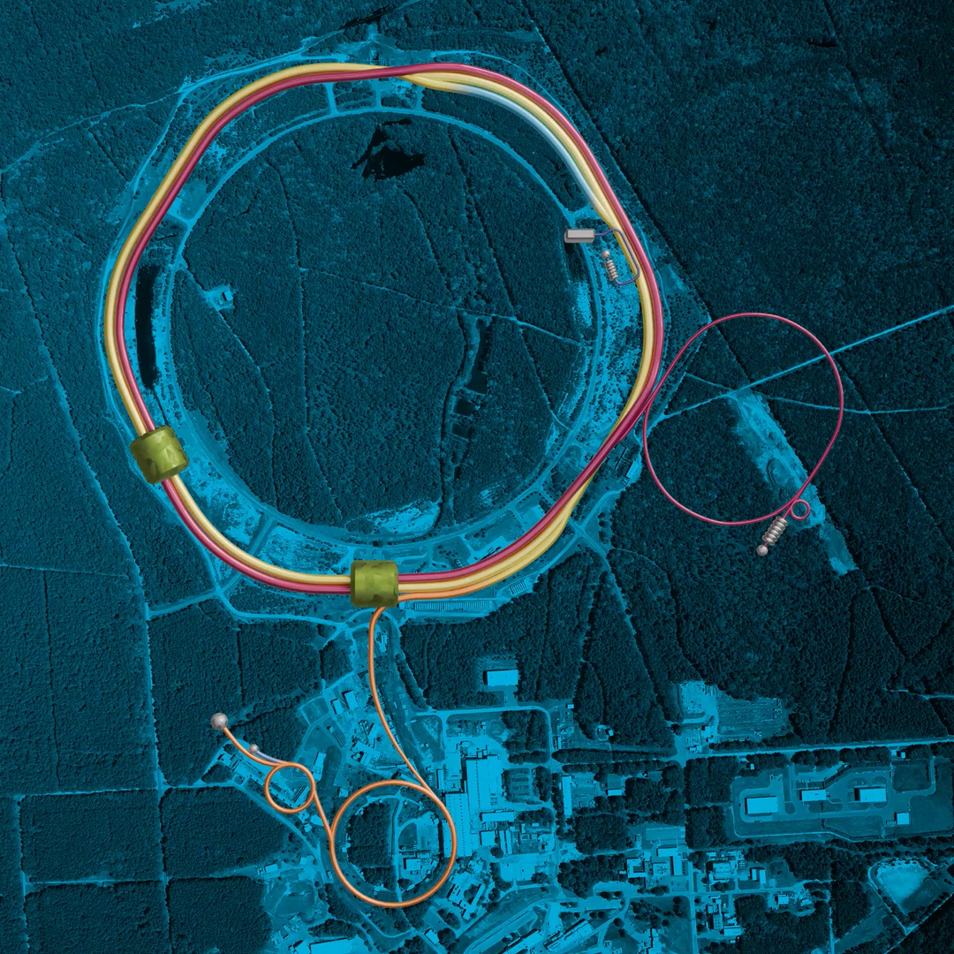
Welcome to the 2026 CFNS Summer School dedicated to the physics of the EIC
It is our seventh school! We have had more than 250 students from North and South Americas, Europe, Australia, and Asia
The Electron-Ion Collider is at a very mature stage and your participation in the project is crucial for its success!
This year we have 34 students and we are looking forward to a very productive school

Slide 4
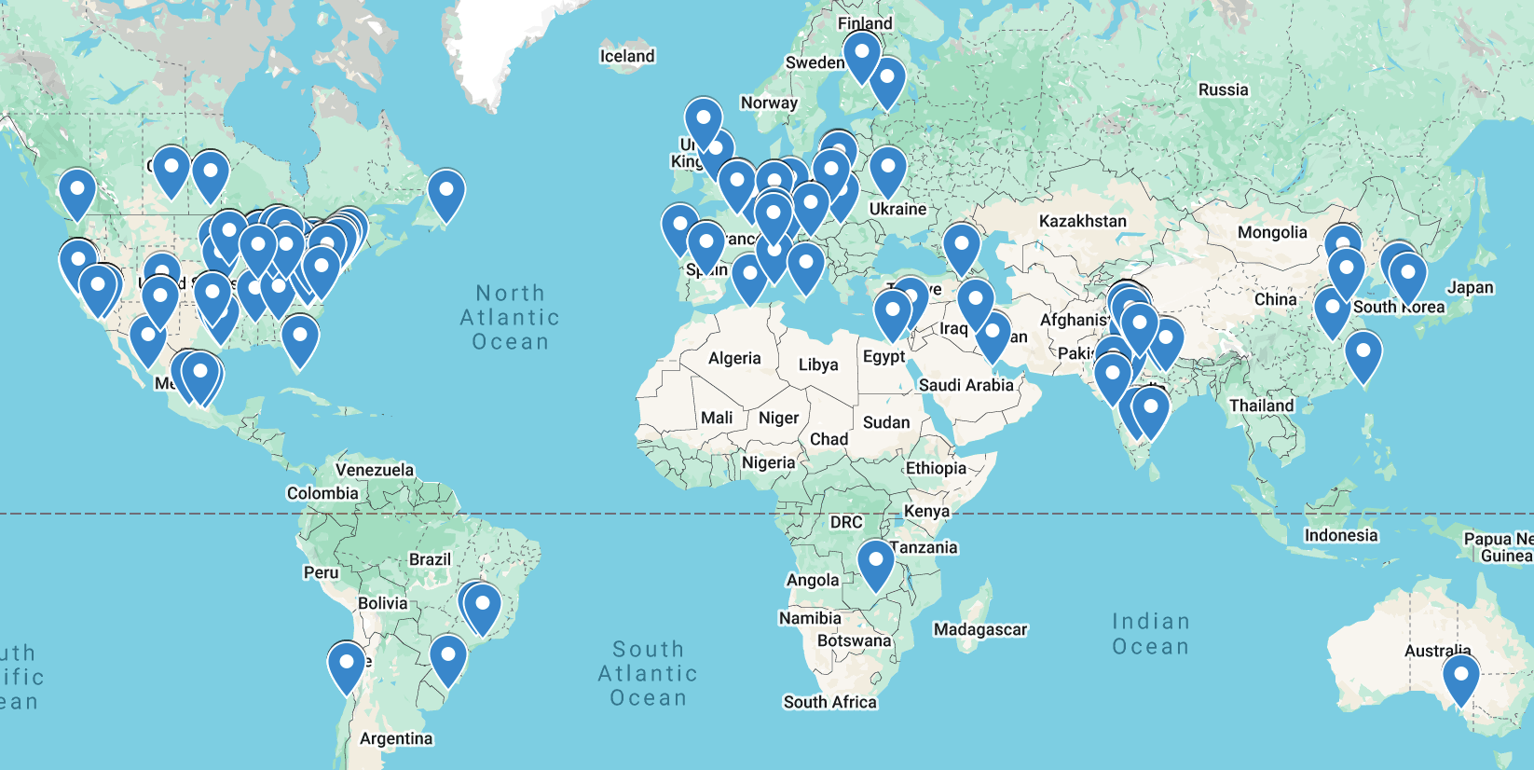
Geography of the school 2019-2025

Slide 5
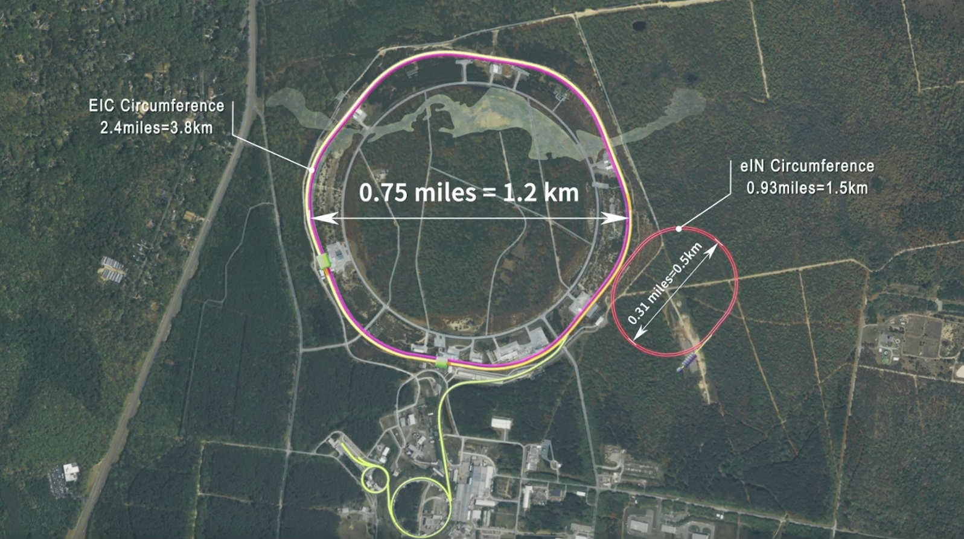
The electron-ion collider @ BNL
High luminosity: (~10³³ - 10³⁴ cm⁻² s⁻¹) (~1000 times that of HERA)
Variable CM energy: 29 — 140 GeV
Highly polarized ~70% electron and ~70% nucleon beams
Ion beams from deuterons to heavy nuclei such as gold, lead, or uranium
Possibility of more than one interaction region
White Paper (2012)
Accardi et al, arXiv:1212:1701

Slide 6
The electron-ion collider: scientific questions
White Paper (2012)
Accardi et al, arXiv:1212:1701
How do the nucleonic properties such as mass and spin emerge from partons and their underlying interactions?
How are partons inside the nucleon distributed in both momentum and position space?
How do color-charged quarks and gluons, and jets, interact with a nuclear medium? How do the confined hadronic states emerge from these quarks and gluons? How do the quark-gluon interactions create nuclear binding?
How does a dense nuclear environment affect the dynamics of quarks and gluons, their correlations, and their interactions? What happens to the gluon density in nuclei? Does it saturate at high energy, giving rise to gluonic matter or a gluonic phase with universal properties in all nuclei and even in nucleons?

Slide 7
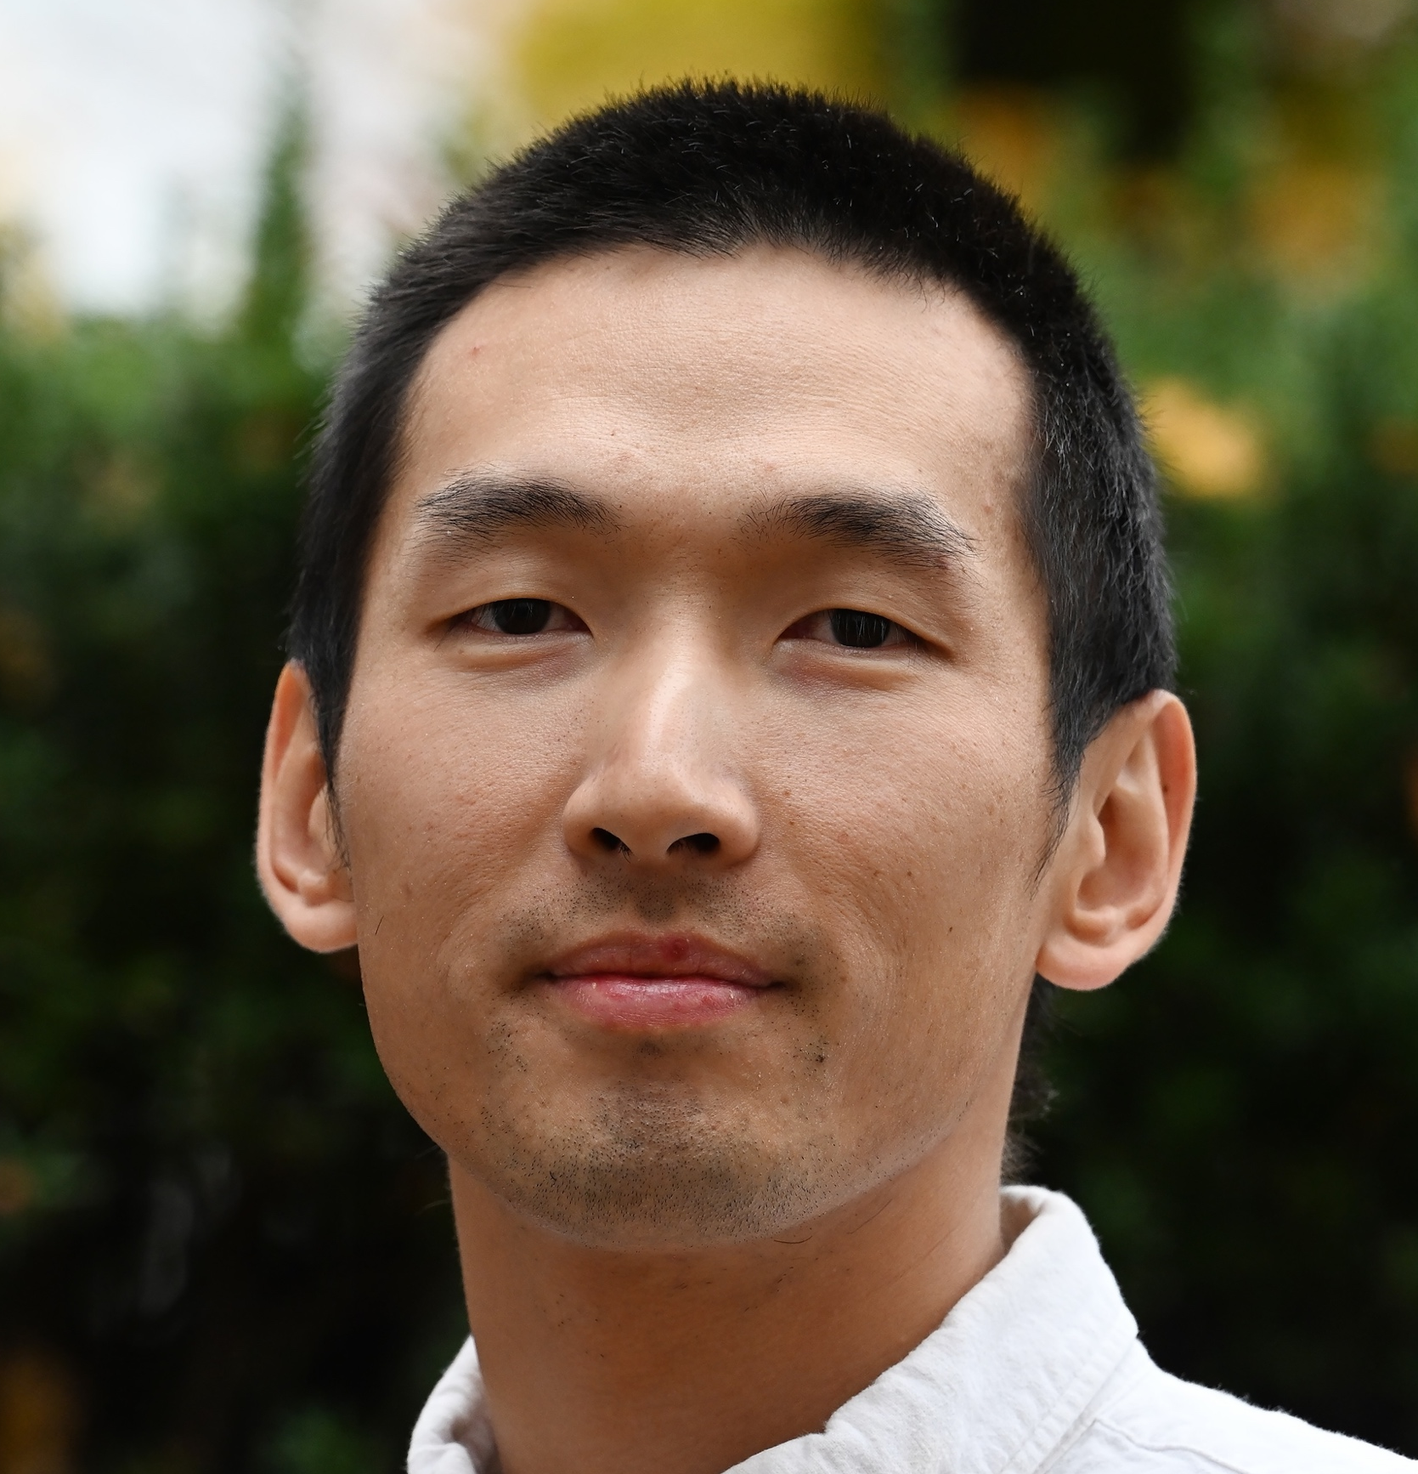
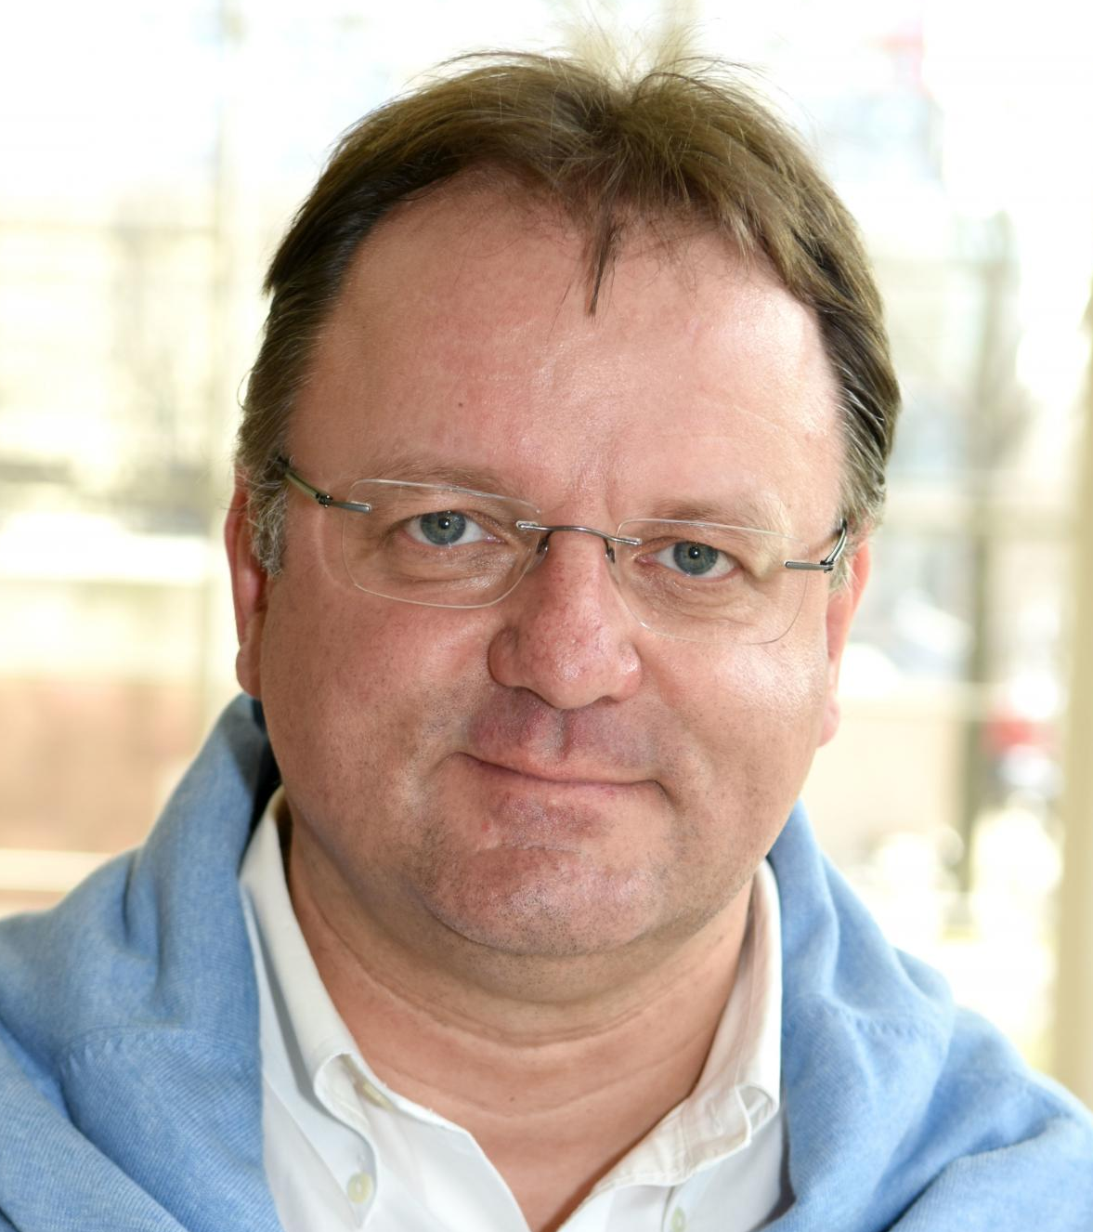
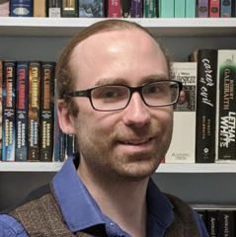
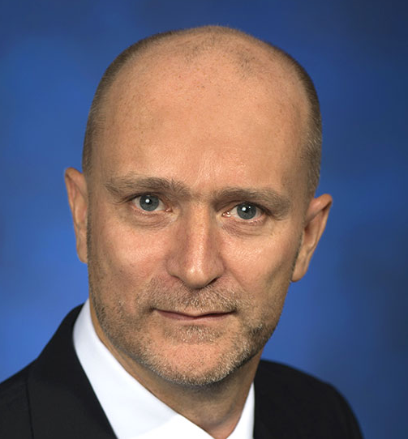
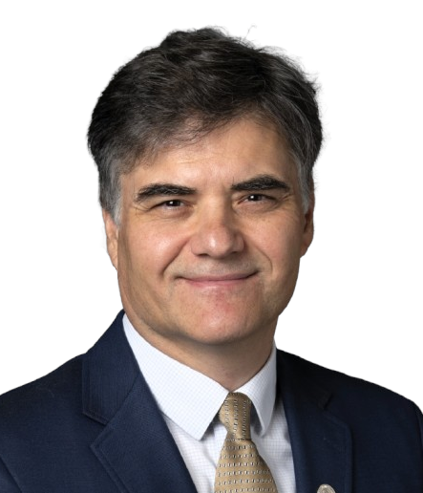
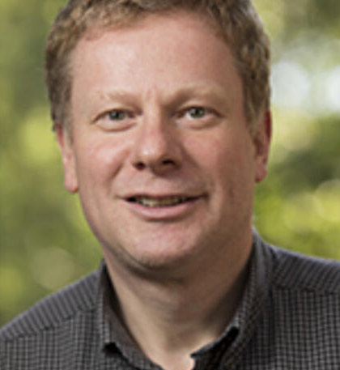
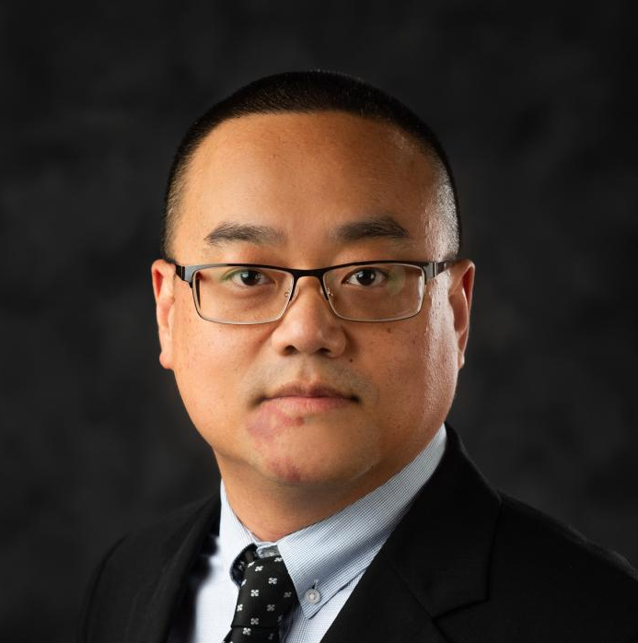
The SCHool lecturers: first week
Fred Olness (SMU)
QCD Intro, xFitter tutorial
Kong Tu (BNL)
EIC Intro
Bernd Surrow (Temple)
EIC physics and detector
Philip Ilten
(U. Cincinnati)
MC tutorial
Christoph Montag (BNL)
Accelerator technology
Pavel Nadolsky (MSU)
Collinear physics
Abhay Deshpande (SBU/BNL)
EIC perspective
Andreas Metz (Temple)
3D structure
Bill Li (Mississippi State University)
Forward physics

Slide 8
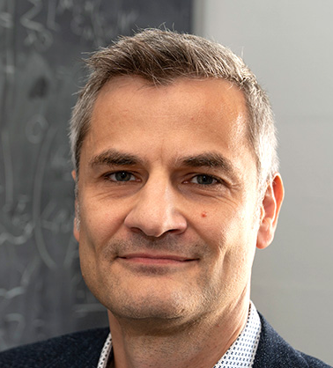
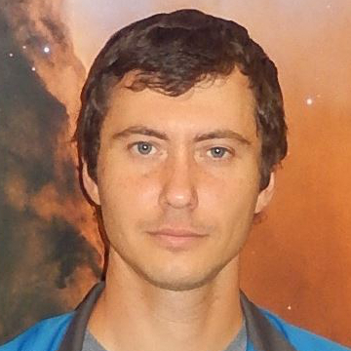
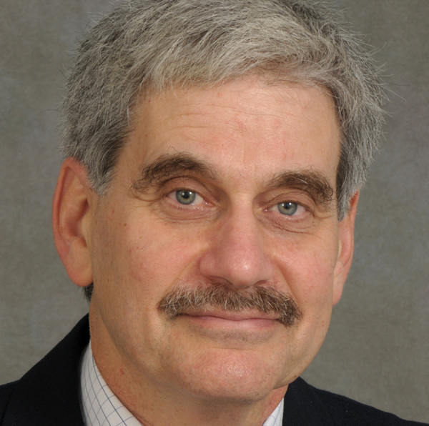
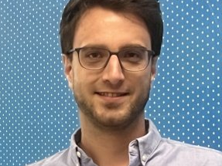
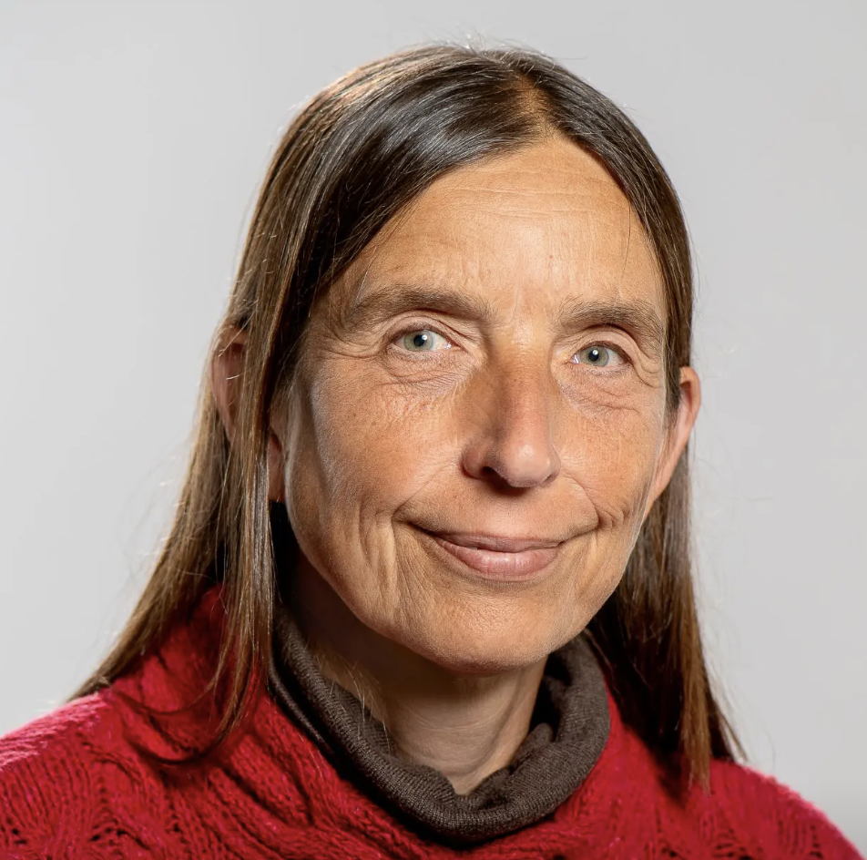
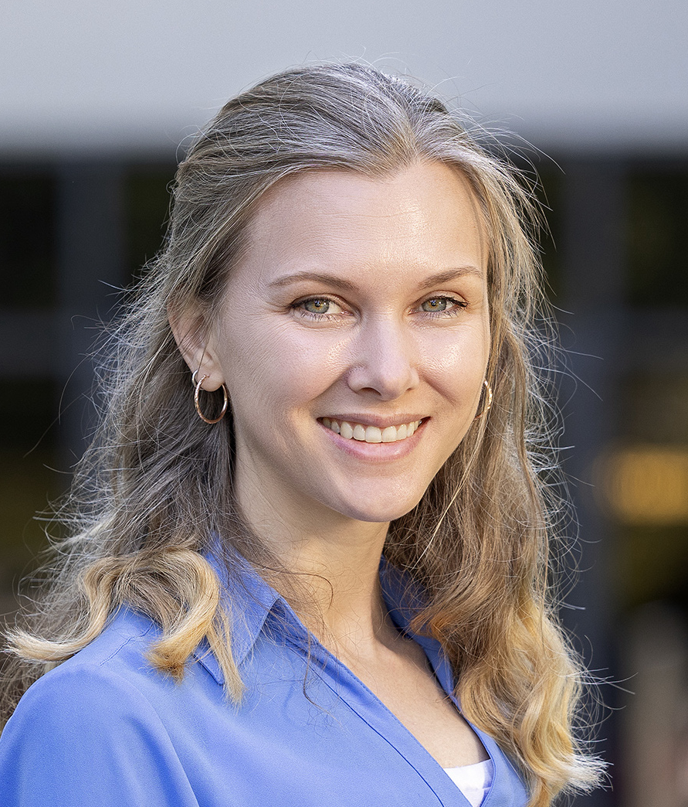
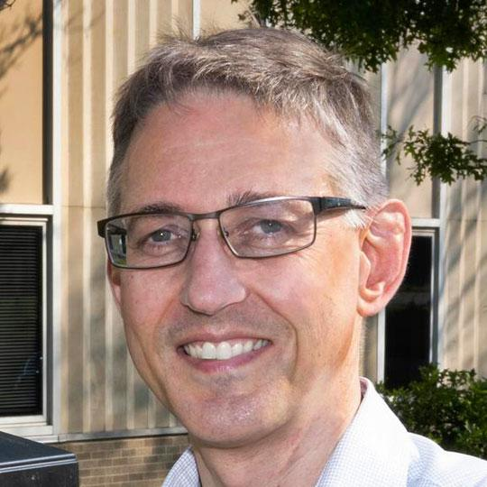
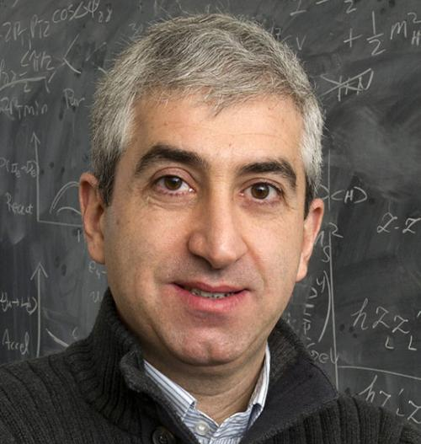
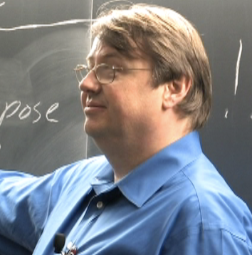
The SCHool lecturers: SECOND week
Ross Corliss (SBU)
Calorimetry/polarimetry
Bjoern Schenke (BNL)
Small-x
Sergey Syritsyn (SBU)
Lattice QCD
George Sterman (SBU)
Jets
Felix Ringer (SBU)
Jets at the EIC
Ramona Vogt (Llnl)
Heavy quarks
Holly Szumila Vance (FIU)
EIC software tutorial
Wolfram Fischer (BNL)
Intro to EIC Accelerator Collaboration
Thomas Hemmick(SBU)
Tracking and Particle ID
Hooman Davoudiasl (BNL)
BSM searches at the EIC

Slide 9

the school schedule
The school runs in person 8:00 am - 3:30 pm ET US.
In the evening, we have discussion at 7:30 pm
(snacks & drinks are provided)
The program is posted on Indico: https://indico.cfnssbu.physics.sunysb.edu/event/604/timetable/
Students’ presentations (optional) will be on Fridays, please, send us your titles.

Slide 10
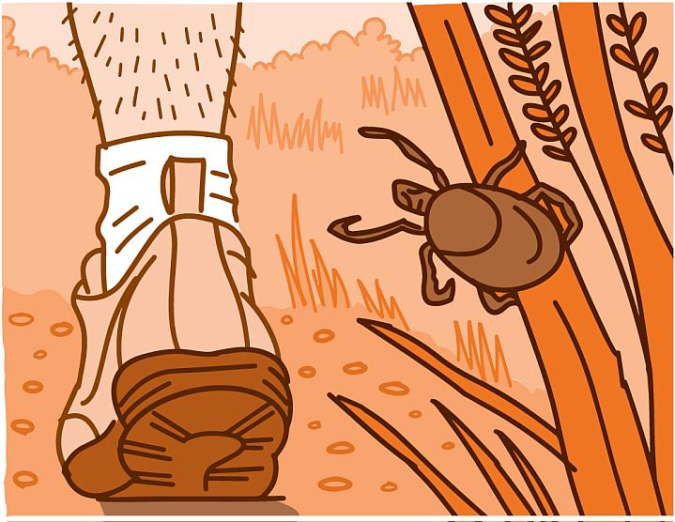
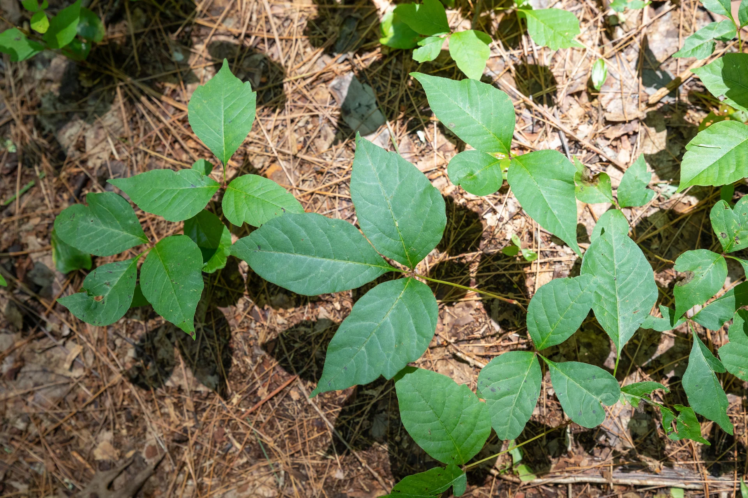
Warnings:
Beware
Ticks transmit lime disease. Seek for medical help if you are bitten.
Poison ivy causes a painful rash.

Slide 11
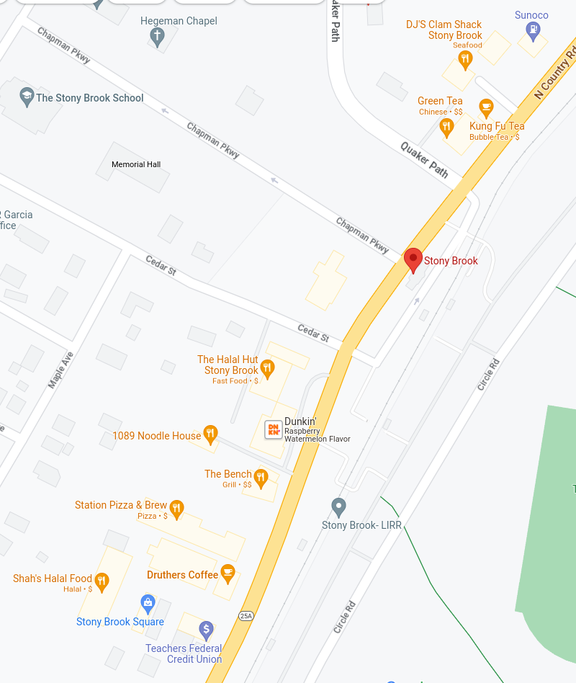
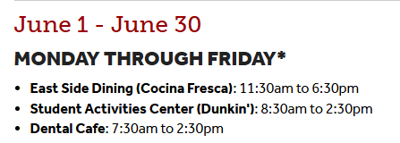
Meals
Breakfast is provided every weekday
8:00 am
School dinner is at Port Jeff
June 3^{d} at 18:00
School BBQ
June 5th
Dinner Suggestion:
Since we have a bit more time for dinner,
you might want to try some of the off-campus options near the LIRR.
We then return at 7:30 pm for snacks and a relaxing discussion session
Lunch Suggestion:
Since we have only 90mins for lunch, we suggest the
on-campus
SAC option.

