Slide 1
Tracking Detectors
TK Hemmick

Slide 2

Pop Quiz Hot Shot
You already learned about calorimetry from Ross Corliss.
Let’s test your knowledge and use it to justify the need for tracking detectors.
Question 0: What movie is that?

Slide 3
Particle Interactions with Matter
pion
Infinite Block of Material
proton
muon
electron
Four fundamental forces: Gravity, Weak, E&M, strong
Participants
  Pion Strong, E&M
  Proton Strong, E&M
  Muon E&M
  Electron E&M
    Bremsstrahlung sets in for the electron.
    Allows short detector
    Allows high precision
Question 1:
How do you compare the range over which these different particles lose their energy in matter?
Medium Range
Long Range
Short Range

Slide 4
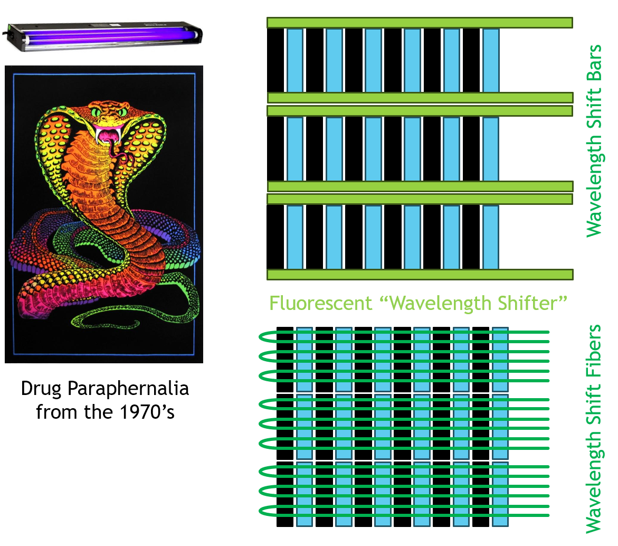
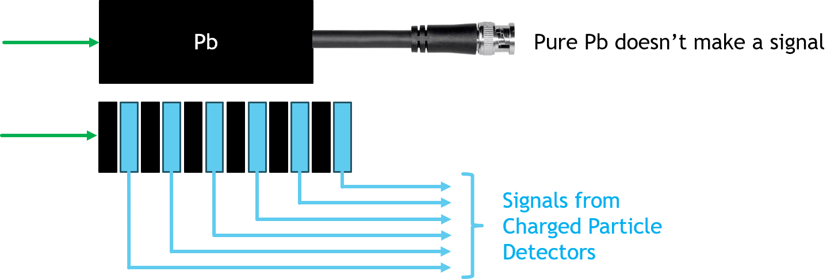
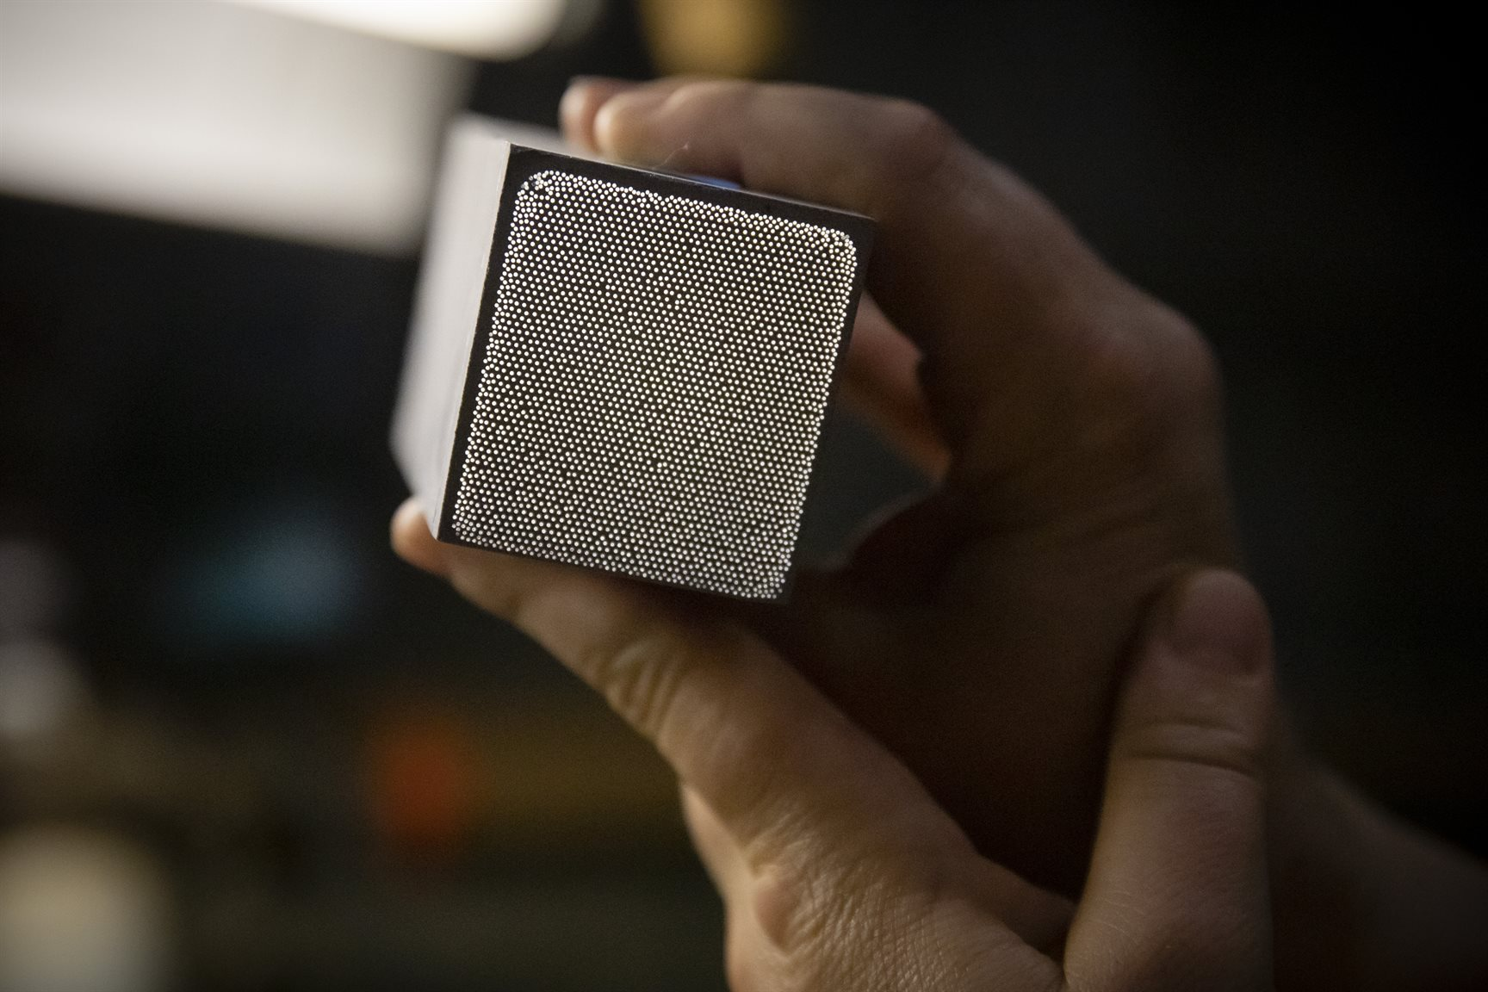
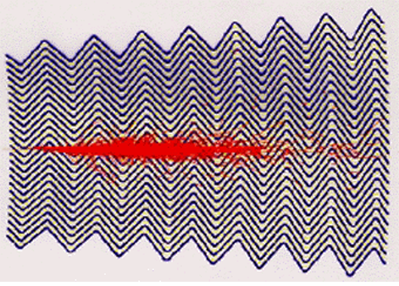
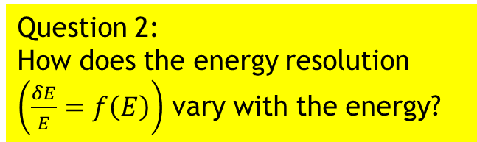
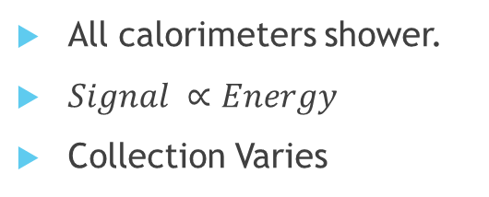
Different Styles One Goal
UV → Visible → Sensor
Shower Particles → Light → Sensor
All calorimeters shower.
$Signal ∝Energy$
Collection Varies
Cheap
Redirection
Light w/in Fibers → Sensor
Electron → Accordian → Back
Question 2:
How does the energy resolution $\left(\frac{δE}{E}=f\left(E\right)\right)$ vary with the energy?

Slide 5
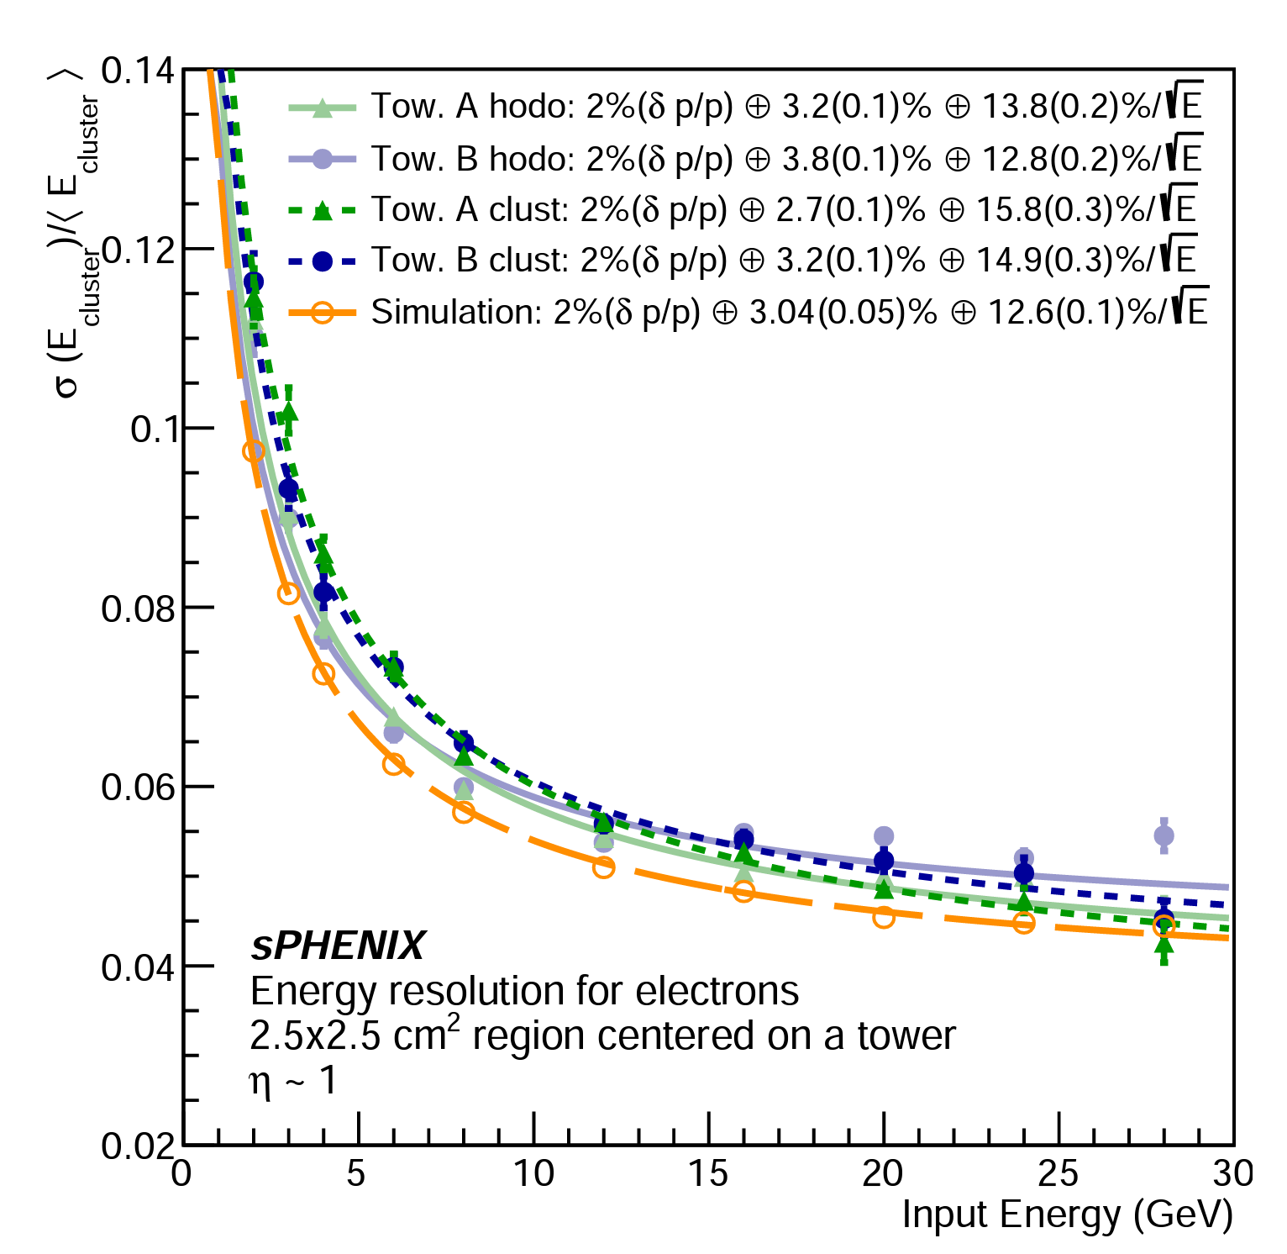
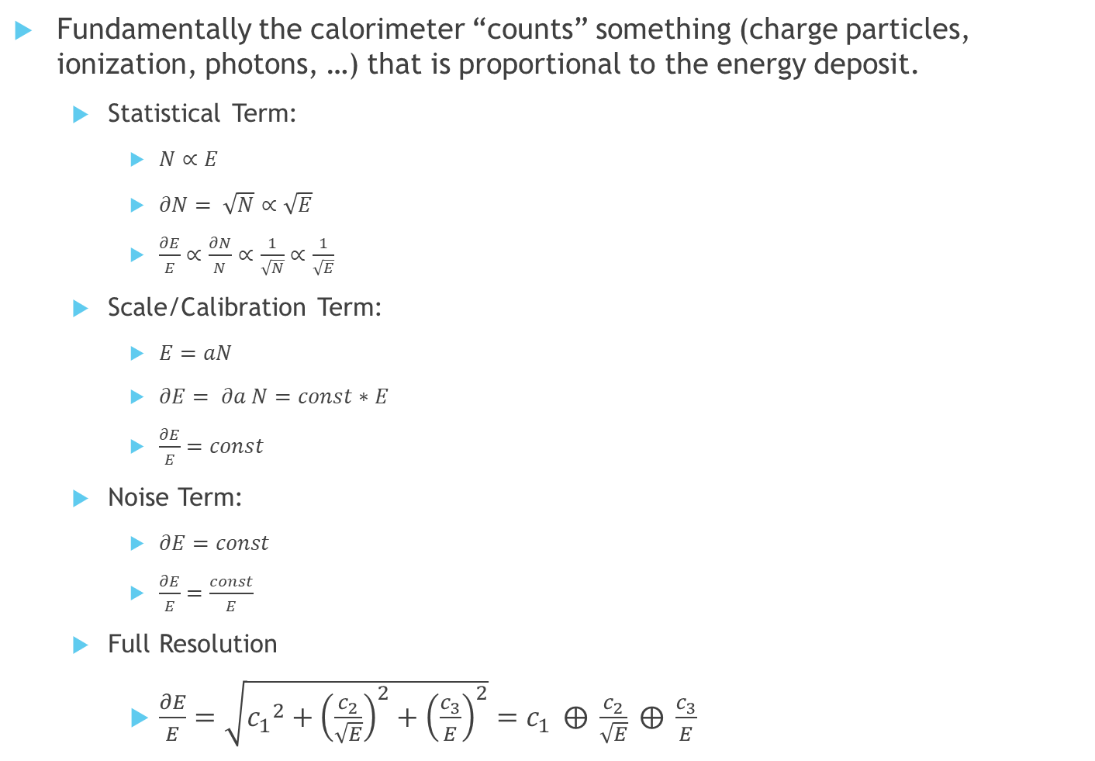
Calorimeter Energy Resolution
Fundamentally the calorimeter “counts” something (charge particles, ionization, photons, …) that is proportional to the energy deposit.
  Statistical Term:
    $N∝E$
    $∂N= \sqrt{N}∝\sqrt{E}$
    $\frac{∂E}{E}∝\frac{∂N}{N}∝\frac{1}{\sqrt{N}}∝\frac{1}{\sqrt{E}}$
  Scale/Calibration Term:
    $E=aN$
    $∂E= ∂a N=const∗E$
    $\frac{∂E}{E}=const$
  Noise Term:
    $∂E=const$
    $\frac{∂E}{E}=\frac{const}{E}$
  Full Resolution
    $\frac{∂E}{E}=\sqrt{{c_{1}}^{2}+{\left(\frac{c_{2}}{\sqrt{E}}\right)}^{2}+{\left(\frac{c_{3}}{E}\right)}^{2}}=c_{1} ⨁{ \frac{c_{2}}{\sqrt{E}} ⨁{ }\frac{c_{3}}{E}}$
Question 3:
For which energies to you abandon Calorimetry and Search for a different solution?
C₁ = 3.5%
C₂ = 13.3%
Often
negligible

Slide 6
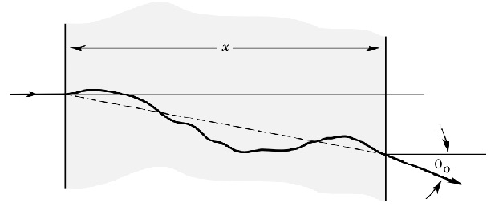

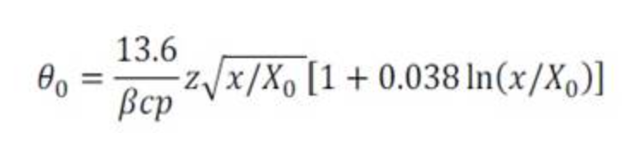
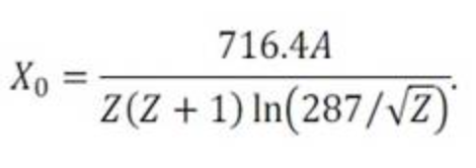
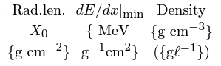




Calorimeters vs Spectrometers
Question 4:
Which should particles encounter first trackers or calorimeters & why?
Calorimeters
  Measures energy
  Best energy resolution at highest momentum/energy
  DESTRUCTIVE to the particle (cannot measure again)
Magnetic spectrometers
  Measures momentum
  Best momentum resolution at lower momentum
    Position Resolution: $\frac{∂p}{p}=c_{2}p$
    Multiple Scattering: $\frac{∂p}{p}=c_{1}$
    Total: $\frac{∂p}{p}=\sqrt{{c_{1}}^{2}+{\left(c_{2}p\right)}^{2}}=c_{1}⊕c_{2}p$
  Non-destructive to the particle:
    Gas remains the lowest radiation length (X₀) material…study that first!
    Good news: little energy loss to the gas; Bad news: tiny signals!
α
$$β∝\frac{1}{p}$$
$$∂β=const ∝\frac{∂p}{p^{2}}$$
$$\frac{∂p}{p}∝const ×p$$
$$∂β$$
$$∂β=\frac{const}{p}∝\frac{∂p}{p^{2}}$$
$$\frac{∂p}{p}=const$$

Slide 7
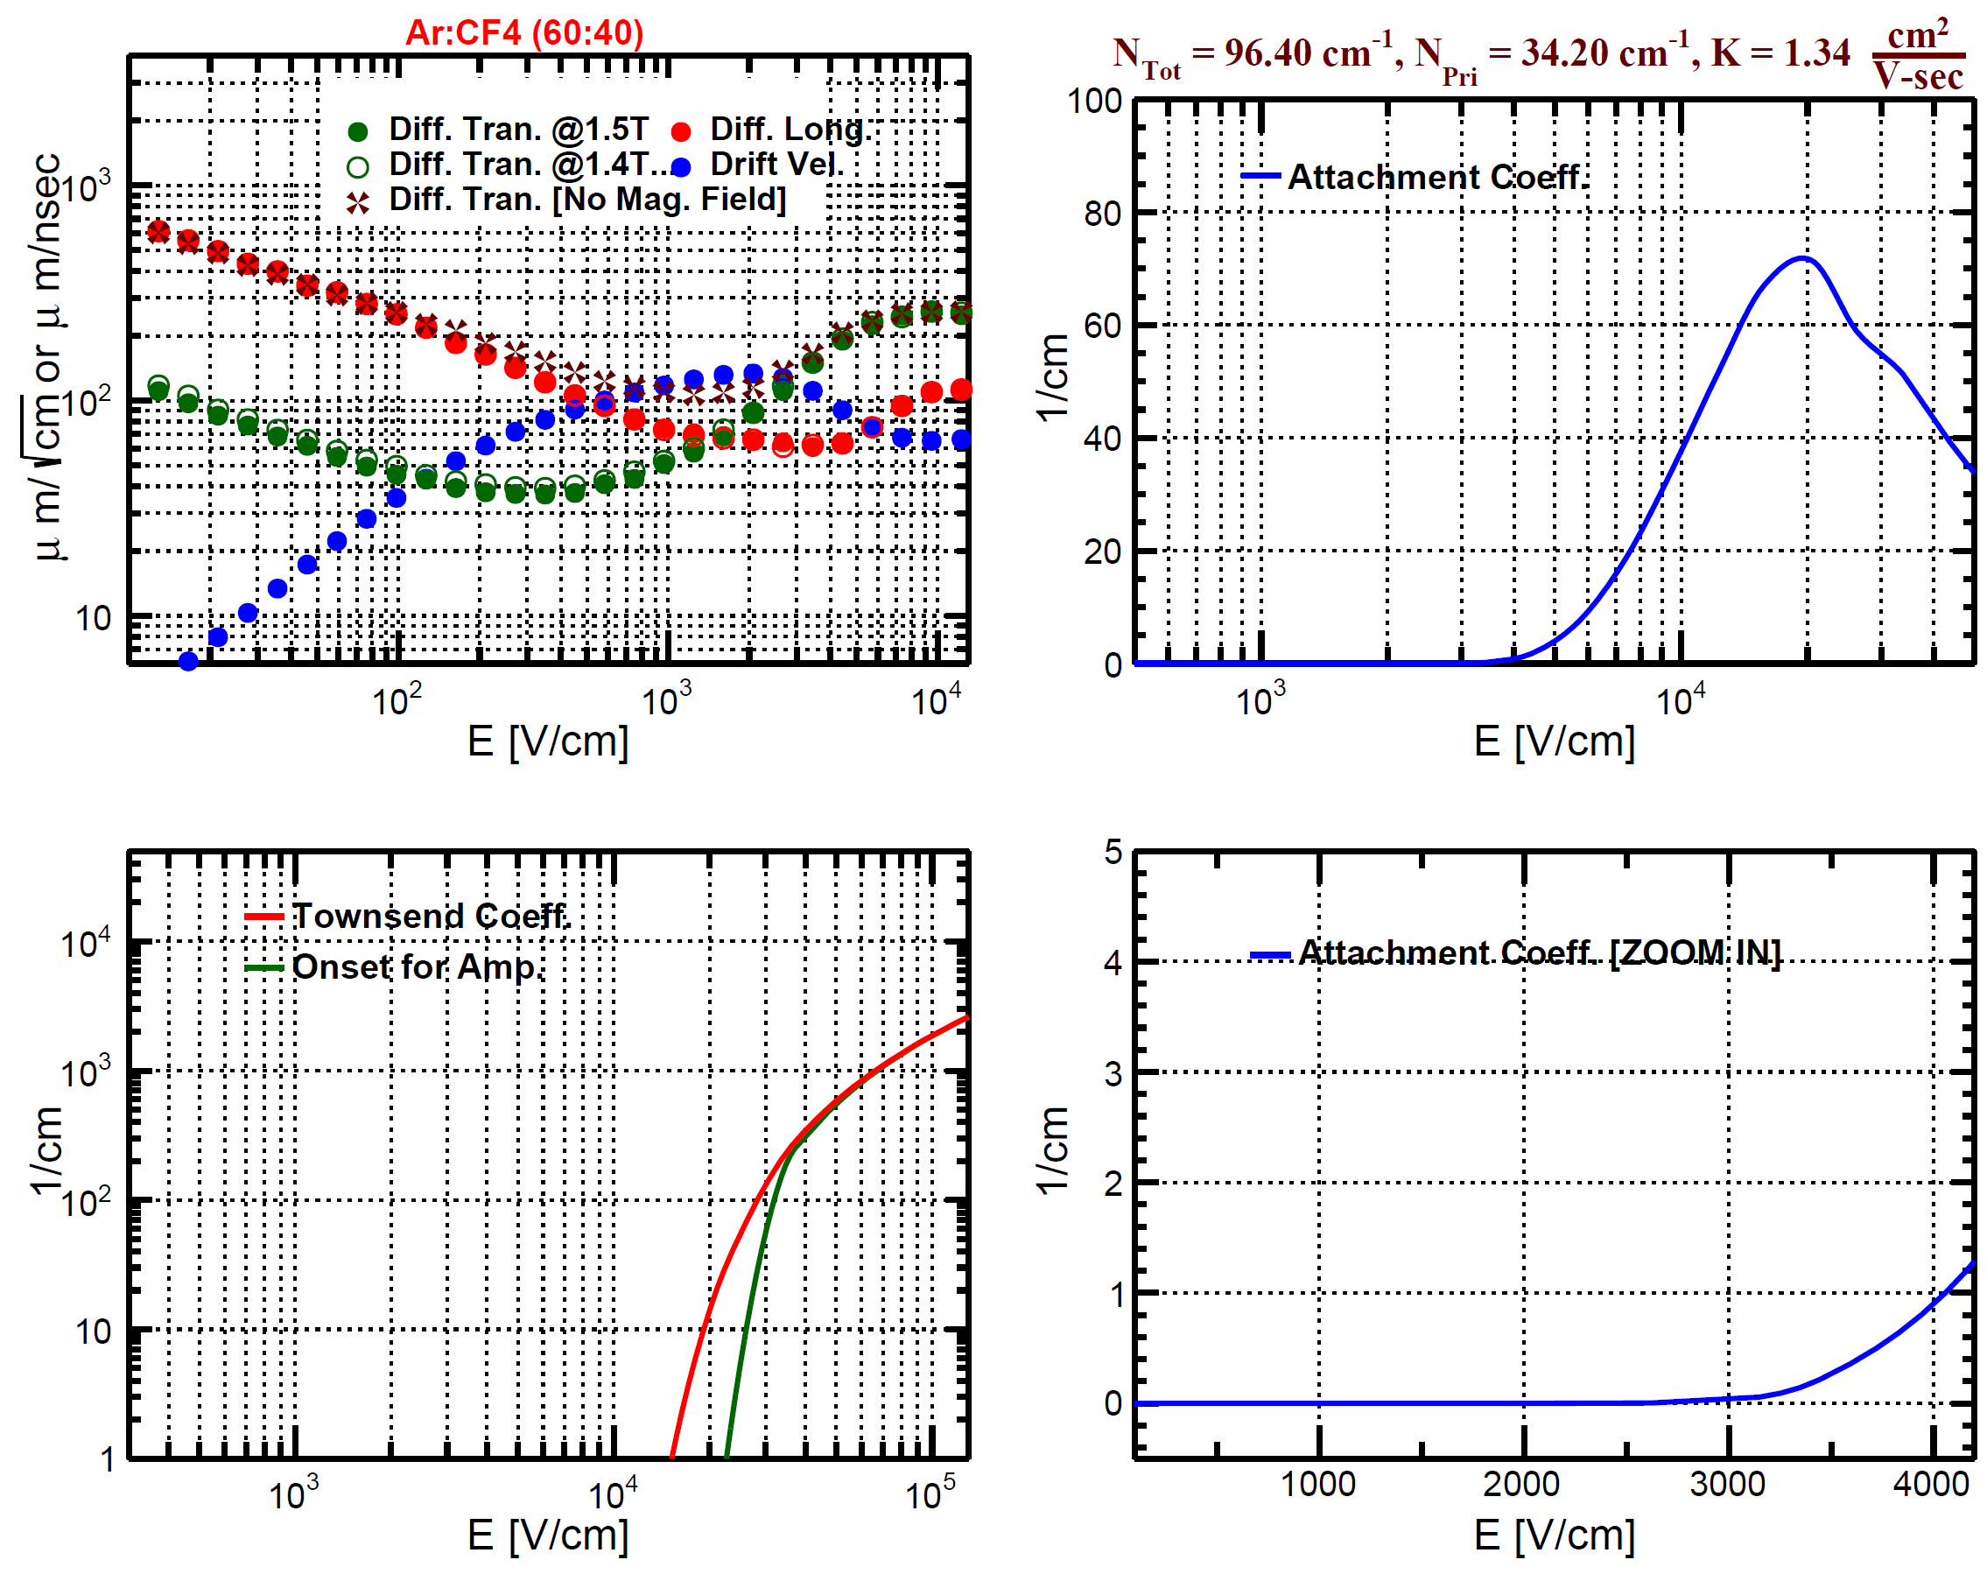
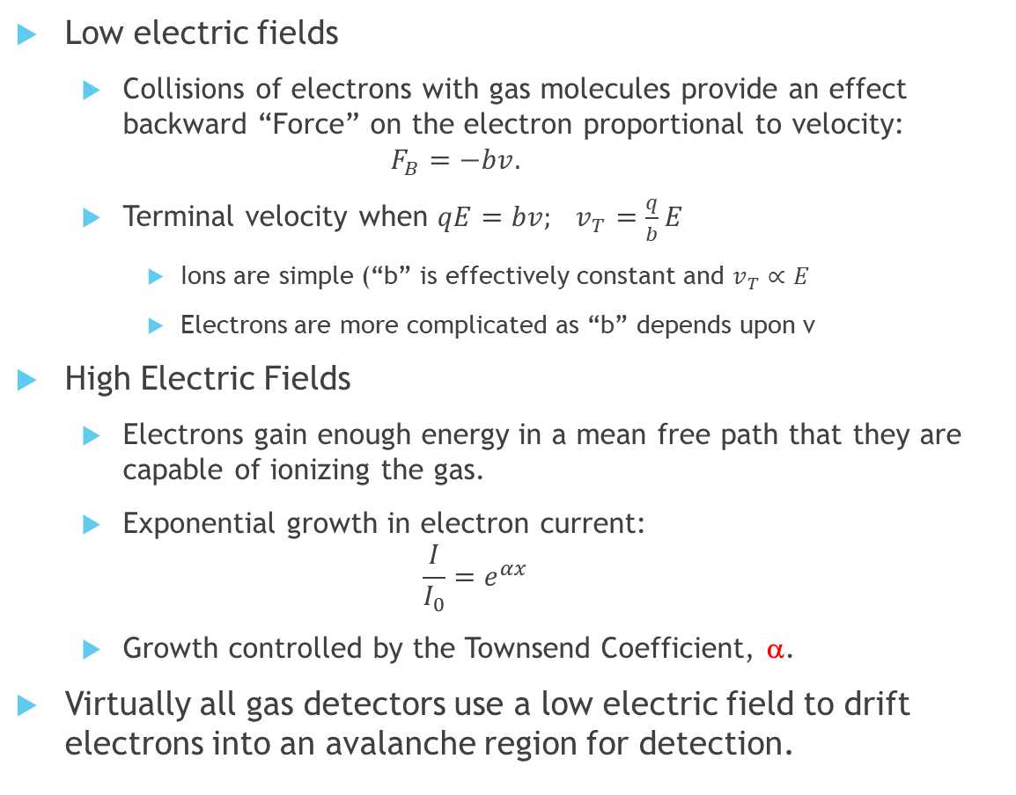
Electron Motion in a Gas
Low electric fields
  Collisions of electrons with gas molecules provide an effect backward “Force” on the electron proportional to velocity:
  $F_{B}=−bv.$
  Terminal velocity when $qE=bv; v_{T}=\frac{q}{b}E$
    Ions are simple (“b” is effectively constant and $v_{T}∝E$
    Electrons are more complicated as “b” depends upon v
High Electric Fields
  Electrons gain enough energy in a mean free path that they are capable of ionizing the gas.
  Exponential growth in electron current:
  $\frac{I}{I_{0}}=e^{αx}$
  Growth controlled by the Townsend Coefficient, α.
Virtually all gas detectors use a low electric field to drift electrons into an avalanche region for detection.

Slide 8
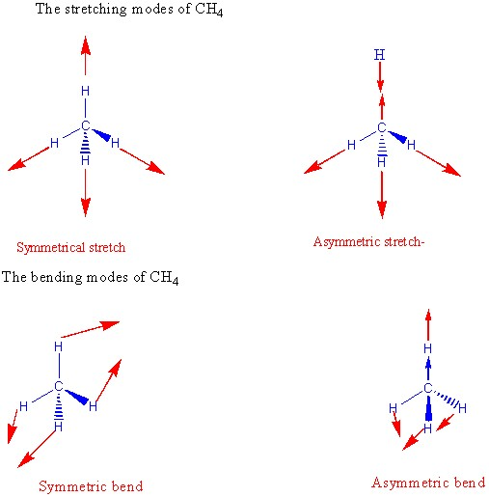
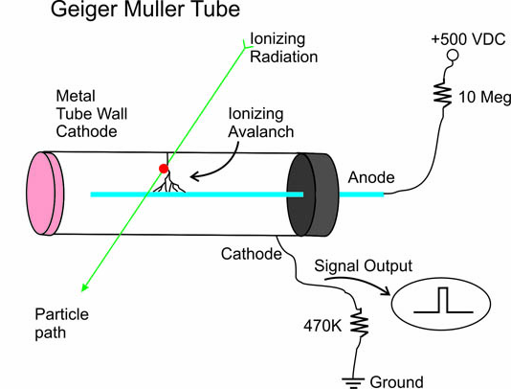
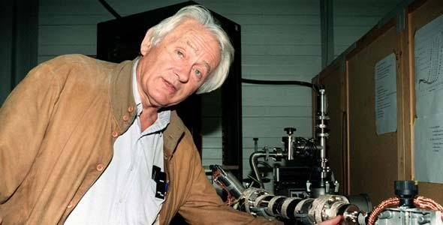
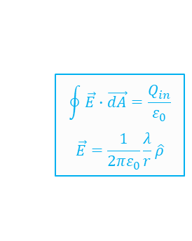
Geiger-Muller → Charpak (Nobel 1993)
$$\oint{\vec{E}∙\vec{dA}}=\frac{Q_{in}}{ε_{0}}$$
$$\vec{E}=\frac{1}{2πε_{0}}\frac{λ}{r}\hat{ρ}$$
With a pure noble gas, photons from the avalanche create ionization in the outer region.
The avalanche “runs away”
  Good news: BIG signal
  Bad news:
    Dead time while wire recharges
    Insensitive to energy deposited
Complex molecules have the ability to absorb energy as vibrations and rotations.
Adding this “quench” to the gas breaks the feedback loop.
“Proportional Counter’

Slide 9
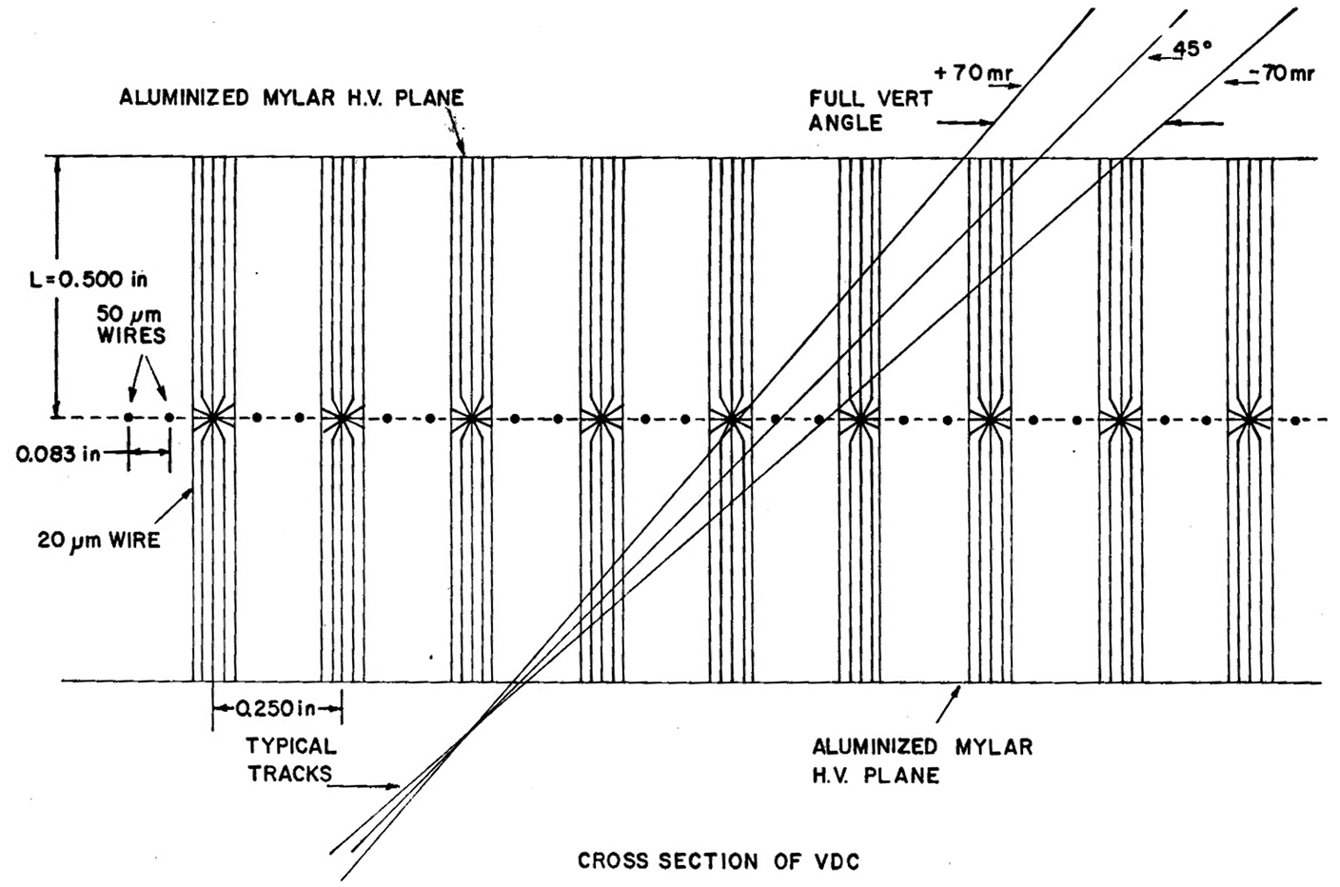
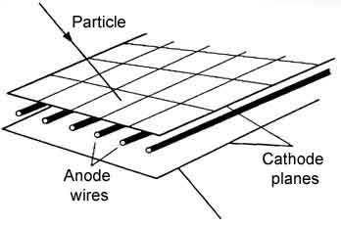
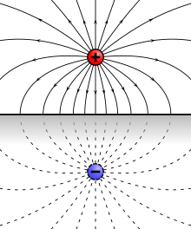
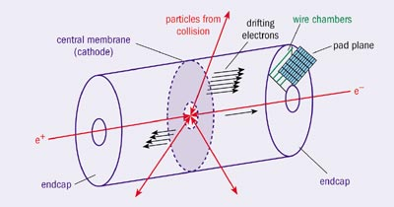
Gas Chamber Evolution
Drift Chamber
MWPC
Pad Plane
Time Projection Chamber
Positive
Cloud
Around
Wire
Segmented
Pad Plane

Slide 10
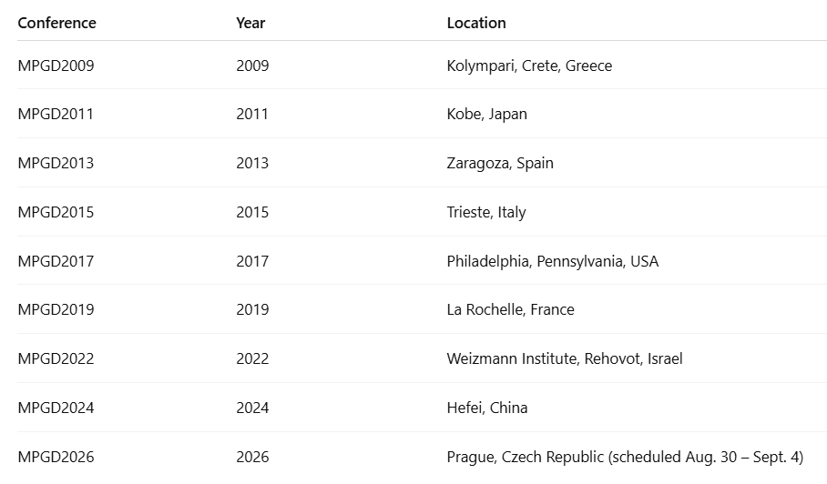
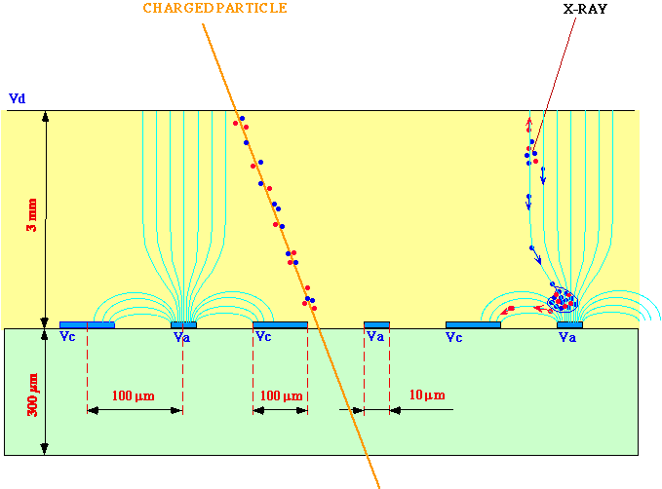
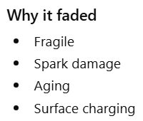

Beyond the Wire Chamber: MPGD
Micro Strip Gas Chamber (MSGC)
The first MPGD.
Lithographic “wires”.
Launched a new field.
Anton Oed, 1988
To get a strong avalanche, wires must be thin.
Thin wires are fragile.
Micro-Pattern Gas Detectors:
  Seek to use modern techniques to manufacture mechanically robust electrodes.
  Many competing concepts available today.

Slide 11
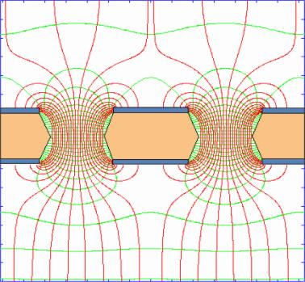
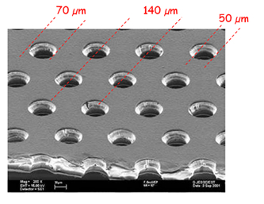
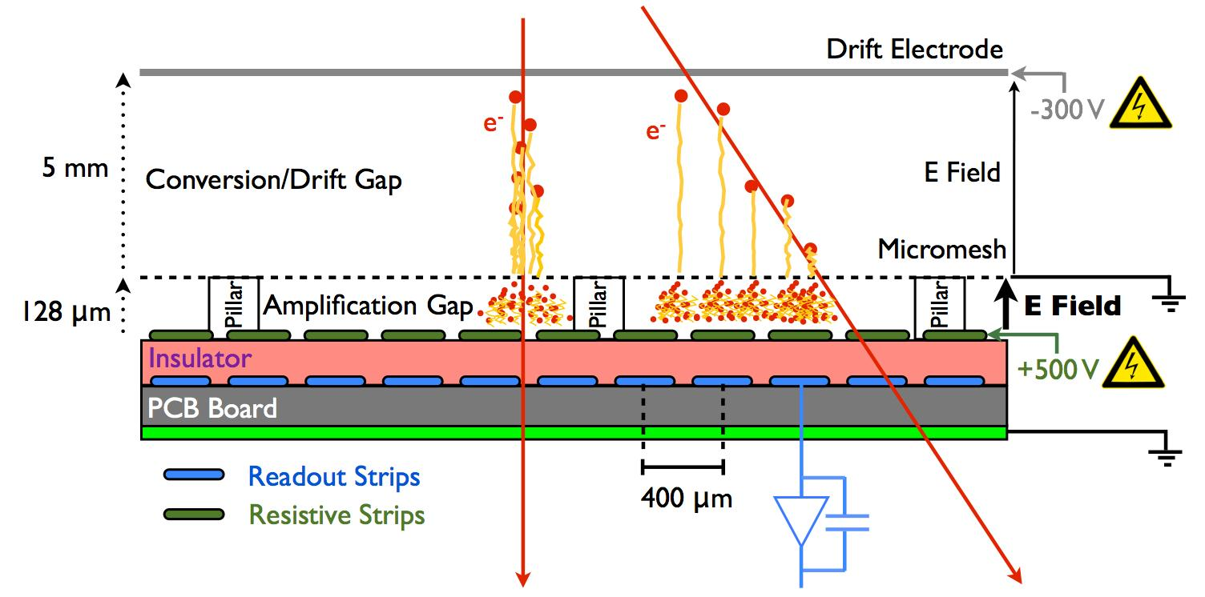
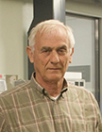
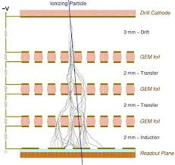
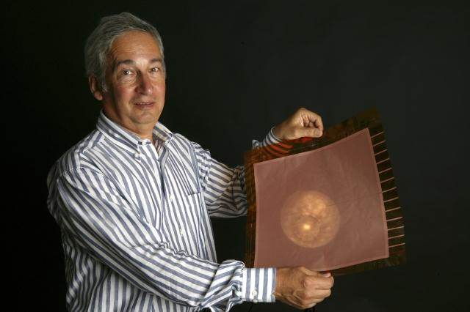
Most common MPGDs in use Today
Gas Electron Multipliers GEMs
microMEGAS
Ioannis Giomataris
Fabio Sauli

Slide 12
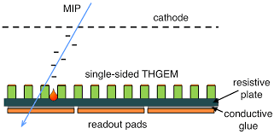
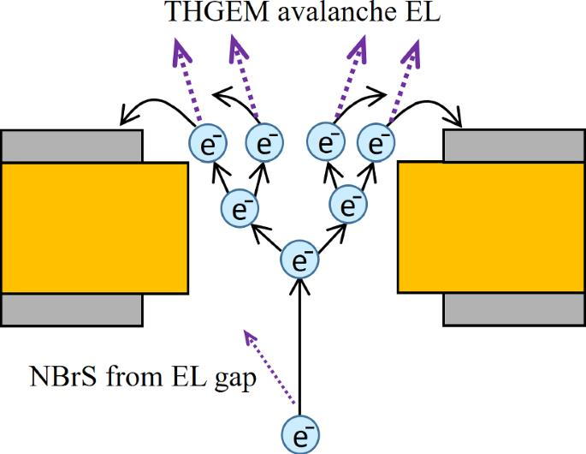
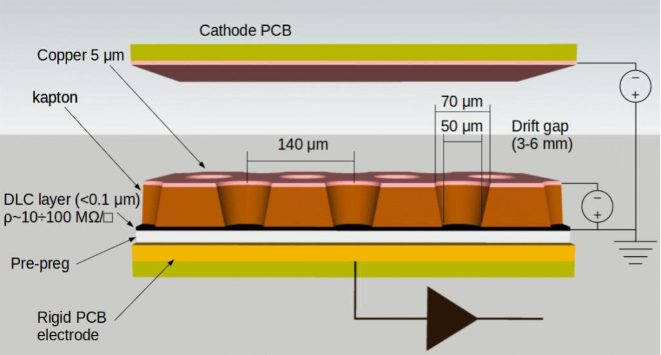
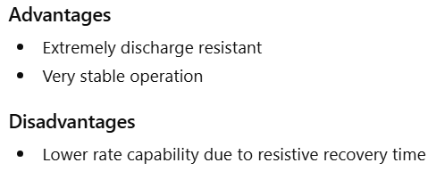
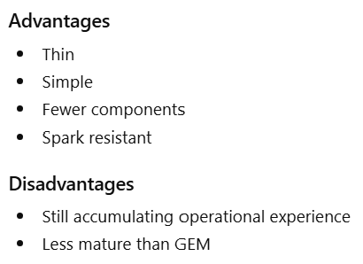
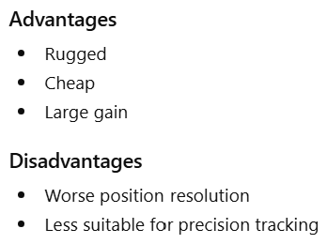
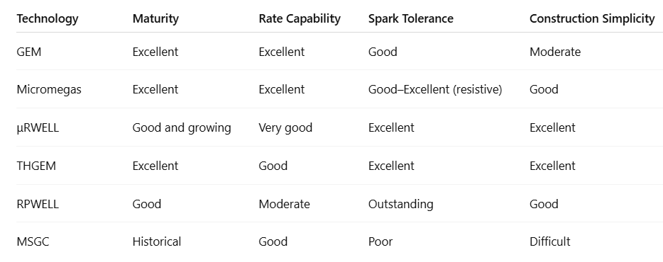
Cutting Edge Alternatives
RPWELL
Thick GEM
μRWELL
Macro Pattern Gas Detector
Drilled Holes
Burgeoning field.
Developments favoring PID will be in tomorrow’s lecture.

Slide 13
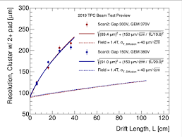
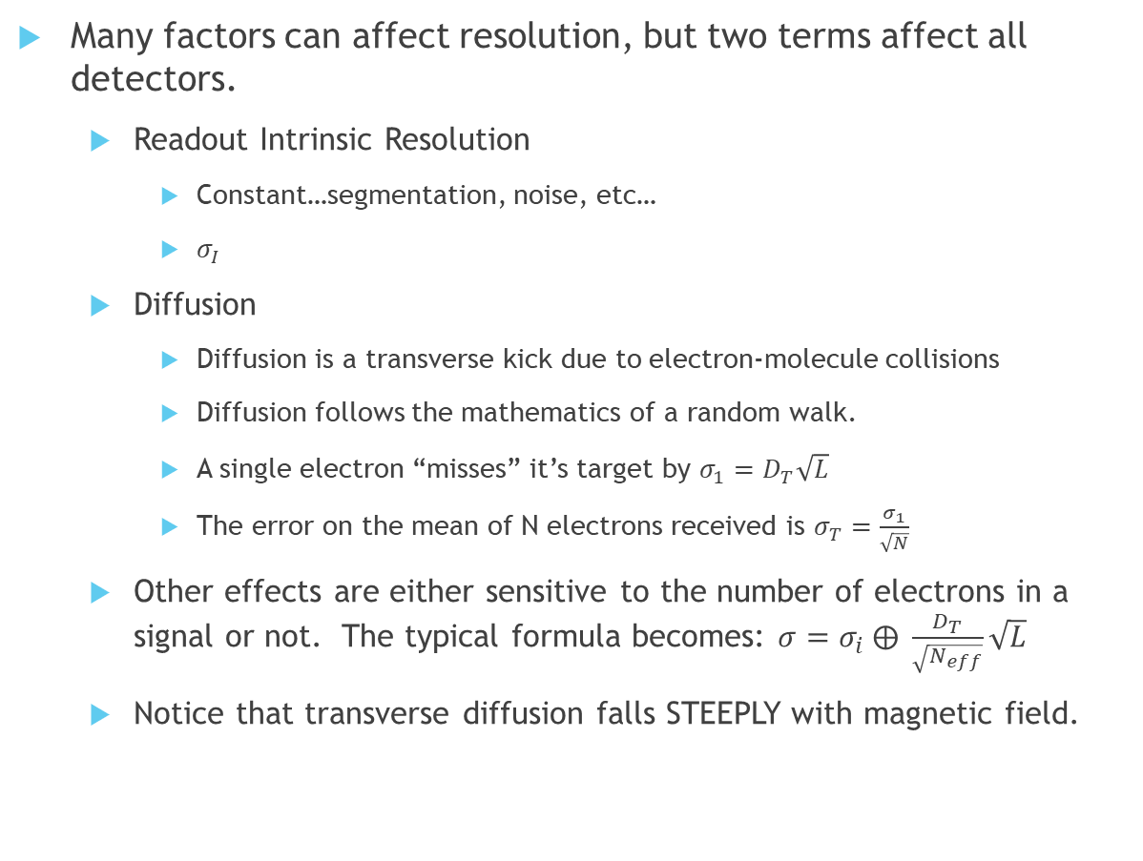
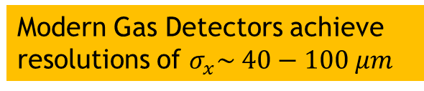

Precision of Gas Measurements
Many factors can affect resolution, but two terms affect all detectors.
  Readout Intrinsic Resolution
    Constant…segmentation, noise, etc…
    $σ_{I}$
  Diffusion
    Diffusion is a transverse kick due to electron-molecule collisions
    Diffusion follows the mathematics of a random walk.
    A single electron “misses” it’s target by $σ_{1}=D_{T}\sqrt{L}$
    The error on the mean of N electrons received is $σ_{T}=\frac{σ_{1}}{\sqrt{N}}$
  Other effects are either sensitive to the number of electrons in a signal or not. The typical formula becomes: $σ=σ_{i} ⨁ \frac{D_{T}}{\sqrt{N_{eff}}}\sqrt{L}$
  Notice that transverse diffusion falls STEEPLY with magnetic field.
$D_{T}$has units of $\frac{μm}{\sqrt{cm}}$
Modern Gas Detectors achieve resolutions of $σ_{x}\sim 40−100 μm$

Slide 14
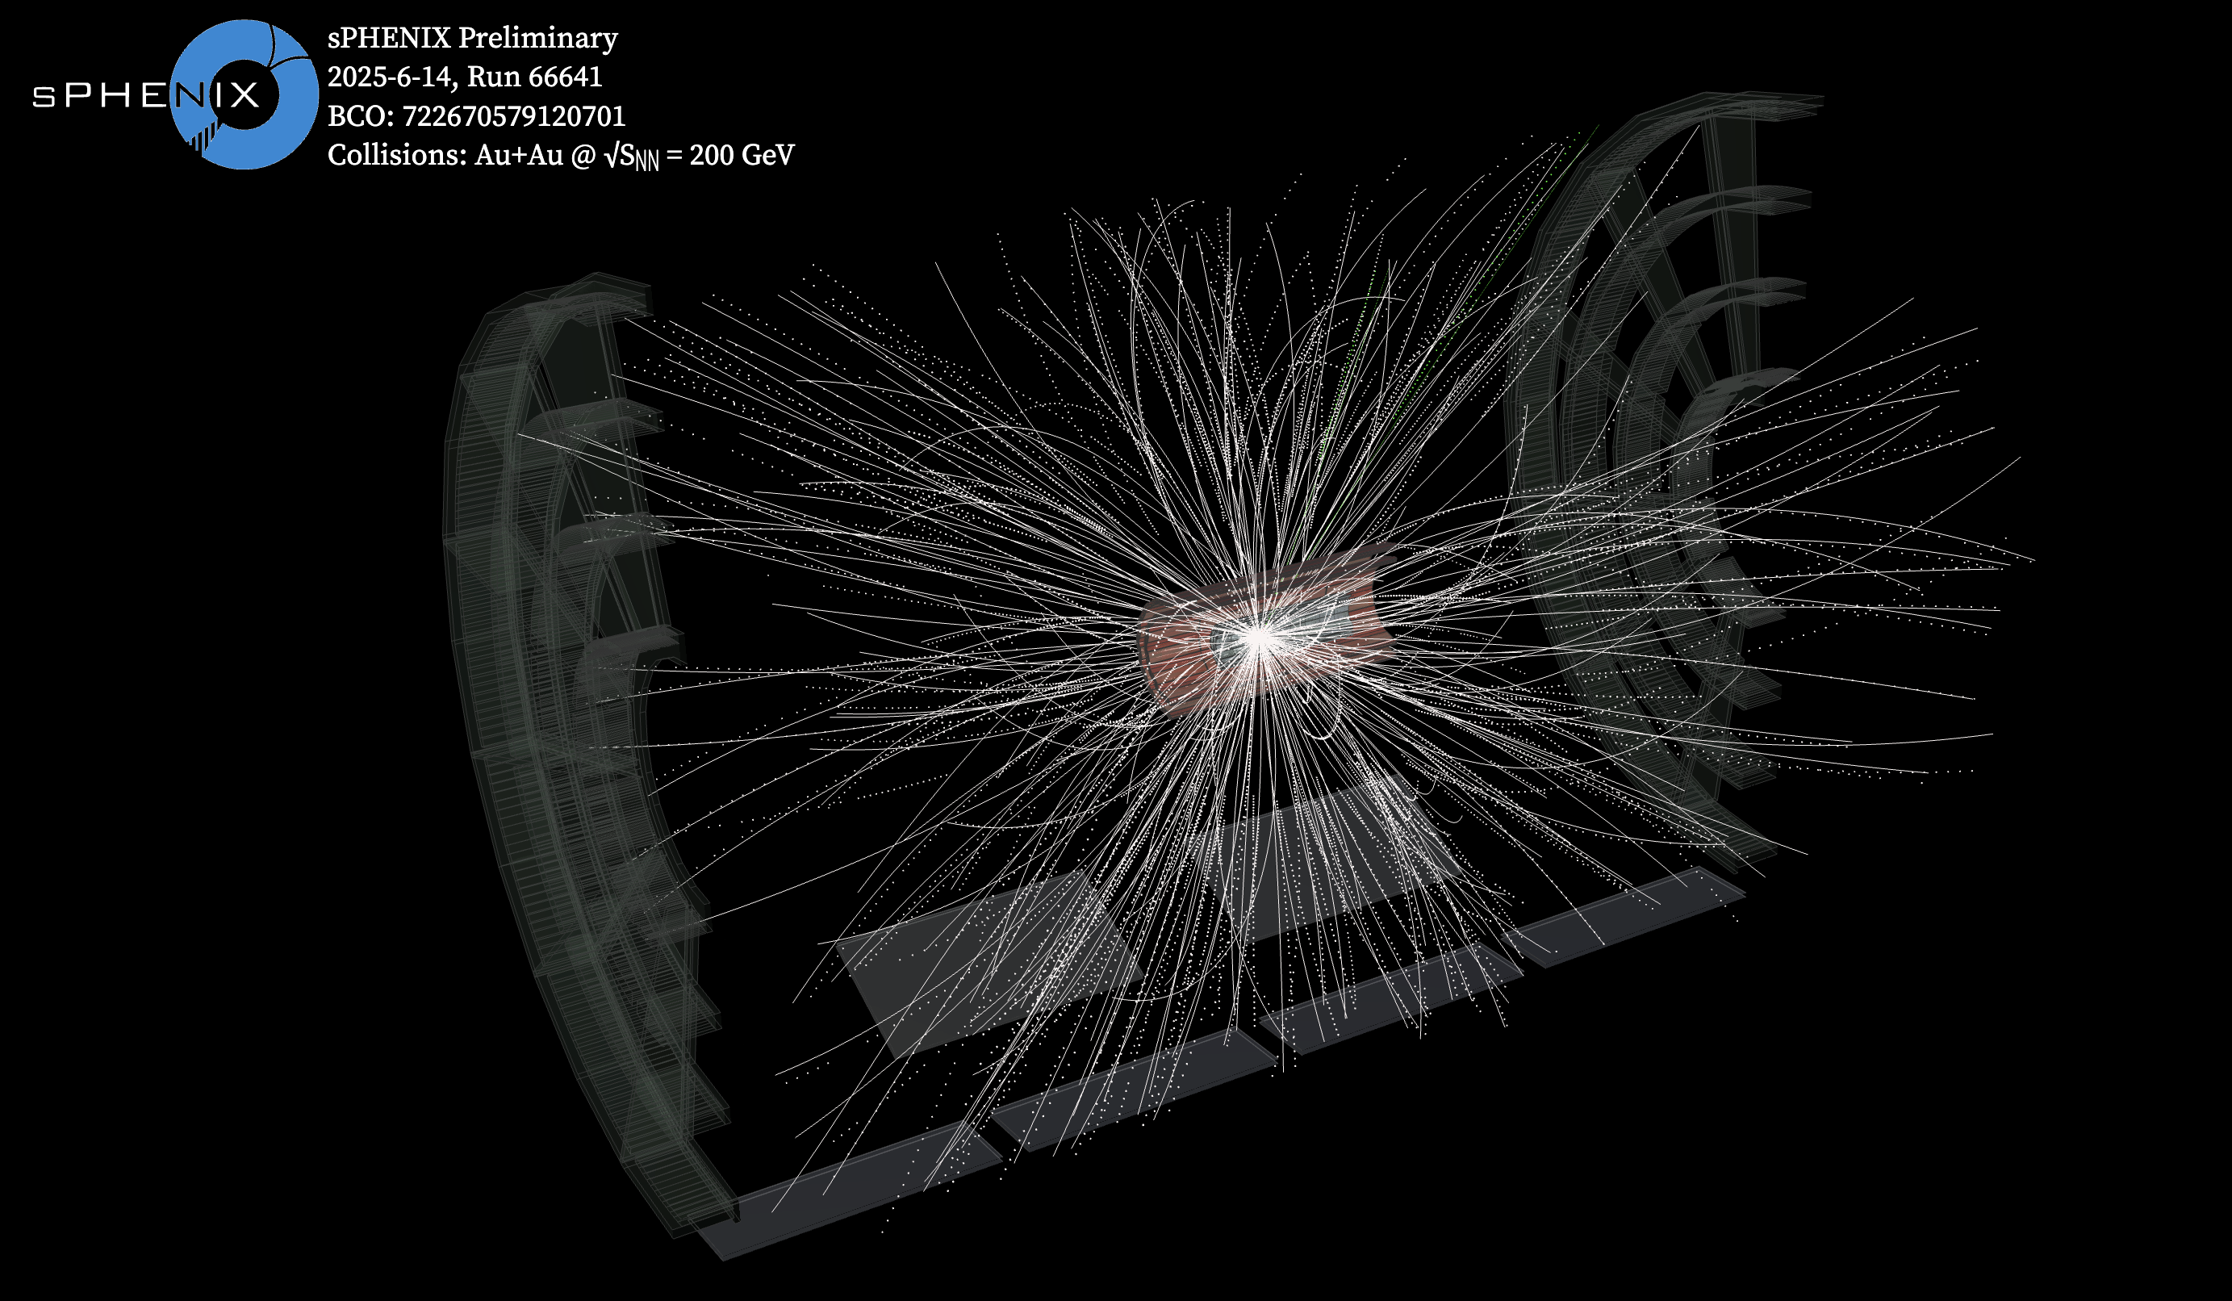
sPHENIX TPC Example

Slide 15
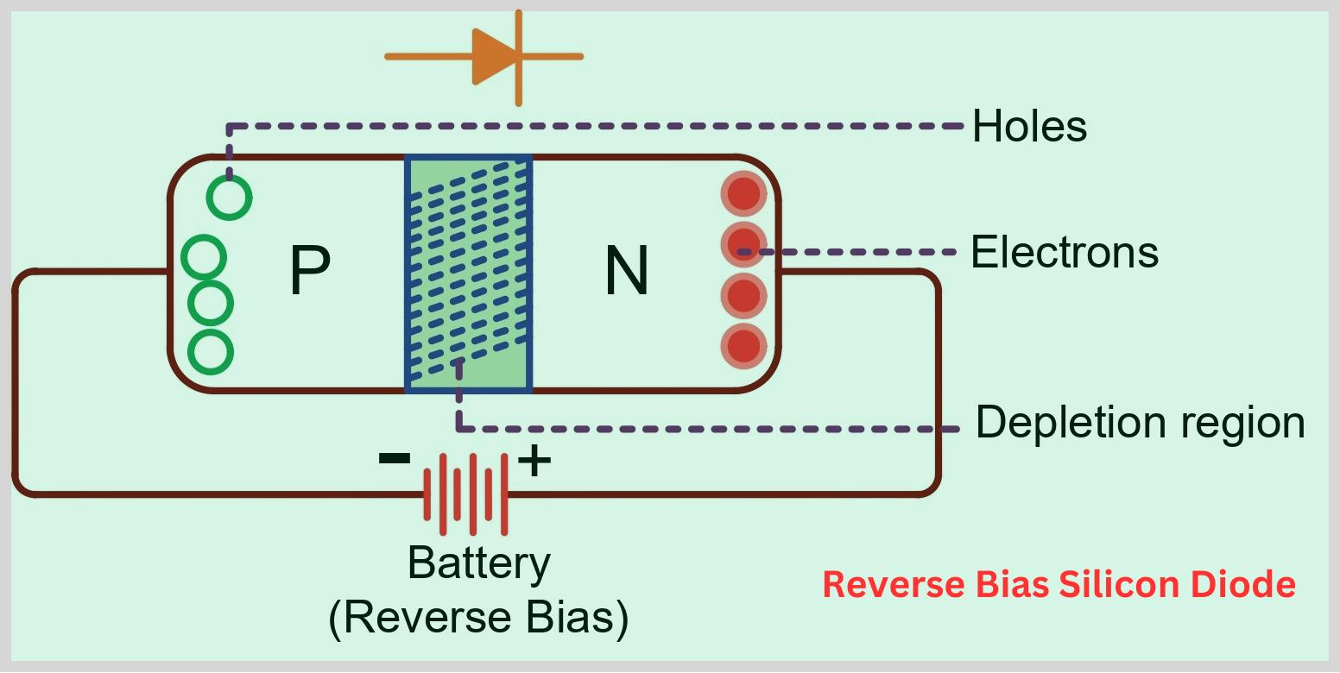
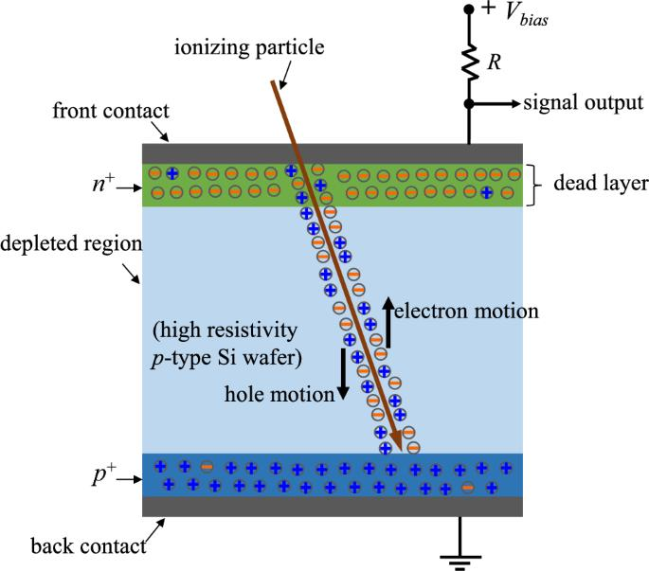
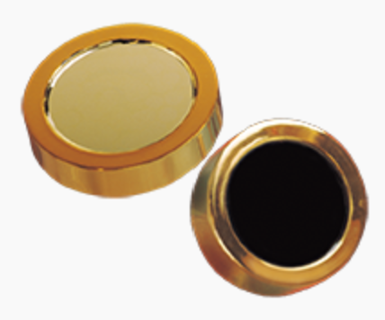
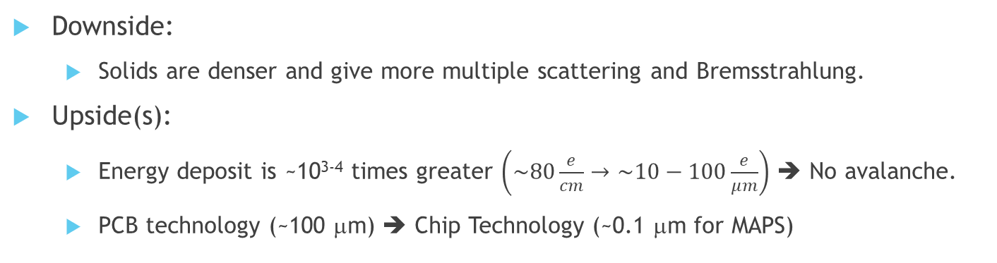
From Gas to Solid Detectors
When a diode is reverse biased, the current flow stops.
Ionization Electrons Flow Briefly → signal!
Silicon Detector c. 1970
Downside:
  Solids are denser and give more multiple scattering and Bremsstrahlung.
Upside(s):
  Energy deposit is ~10³⁻⁴ times greater $\left(\sim 80\frac{e}{cm}→\sim 10−100\frac{e}{μm}\right)$ ➔ No avalanche.
  PCB technology (~100 μm) ➔ Chip Technology (~0.1 μm for MAPS)
Still a staple today:
Simple measurement.
High Electron Statistics
Good energy resolution

Slide 16
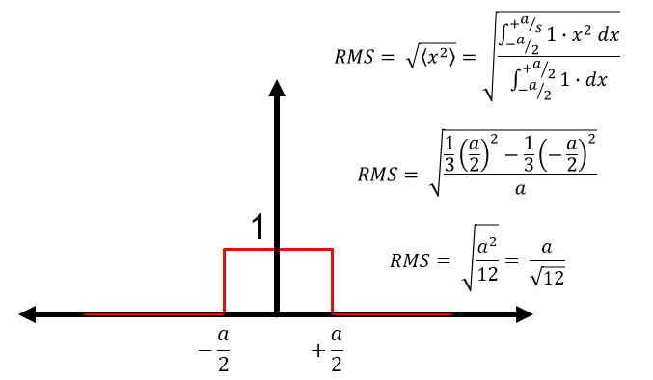





Segmentation starts the Revolution!
RMS smaller than strip pitch !!
Bond by “rubbing”
Tiny Connections
Strip pitch 25-100 μm
1970’s Silicon Detectors were the size of a quarter.
Chip are microscopic patterns of semi-conductors and metals.
Print the pattern of detector you want.
  First segment into lines (most often called strips).
  Connect sensors to readout electronics (e.g. wire bonds).
  ALEPH, DELPHI, CDF, D0 were early adopters.
  Earliest implementations often provided binary (hit/no-hit) info."
CMS Silicon Strip Detectors

Slide 17






Double-Sided Strip Detectors
BaBar
Strips provide an asymmetric resolution:
  Good: $σ_{⊥}=\frac{pitch}{\sqrt{12}}$
  Bad: $σ_{∥}=\frac{chip}{\sqrt{12}}$
Solution: Orthogonal Strips on two sides!
  Twice as many electronics channels.
  Good resolution in all directions.
  Limitation:
    Ambiguity when more than one particle per chip.
Adopted by:
  BaBar SVT
  Belle SVD
  LEP Silicon Systems
Belle
Limited by Ambiguity!

Slide 18




Hybrid Pixel Detectors
ATLAS
ROC is Read Out Card
Question:
  If you segment a plane into pixels,
  How do you get the signals out.
Answer:
  Send them out of plane!
  Wafer #1 is an array of pixel sensors.
  Wafer #2 is a readout circuit (digitizes, formats, transmits data)
  An array of “soft metal bumps” is pressed to make the contacts.
    Indium, PbSn, Lead-free Solders (SnAg, SnAgCu, …)
Superb resolution!
Expensive & large material budget.
CMS

Slide 19





Monolithic Active Pixel Detectors (MAPS)
ALice PIxel Detector
(ALPIDE)
ALICE
Hybrid Pixel Detectors are expensive and thick!
  If you only care about high momentum thickness is OK.
  If you require precision at low momentum, need a new solution.
New solution
  We have stripped & pixelized but retained a “parallel plate” field.
  Ionization electrons can be DIRECTED to a small collection point.
  In this way we create space for the readout electronics:
    Within the area of the pixel itself.
    On the SAME WAFER!
Examples:
  ALICE ITS2 (and future ITS3); sPHENIX MVTX.
sPHENIX
NOTE:
$$Noise ∝Capacitance$$
Point collection → Low Noise!

Slide 20


Technology Overview
Silicon Detector Evolution
Comparison to Gas Detectors
Silicon detectors presently provide the best position resolution.
Practical limitations ($$) most often lead to “mixed technologies”:
  Silicon pixel detectors near the collision to catch short-lived decays.
  Gas detectors at larger distance to contain costs.

Slide 21



ePIC Detector for EIC.
Larger Radius
Near IP
ePIC deliberately uses each tracking detector technology where it is strongest.

Slide 22


Summary
Welcome to Nuclear Physics!!!
Detector Technology is fun and exciting.
No time for so many things readout electronics, streaming mode…
Present technology capabilities are excellent and the future is better.
You are entering nuclear physics at an amazing time.
Particularly with the future electron-ion collider.
Tomorrow we will discuss PID Technology
(including one that also tracks: AC-LGAD)

Slide 23

ePIC Detector for EIC

