Slide 1


Particle Identification Detectors
TK Hemmick

Slide 2



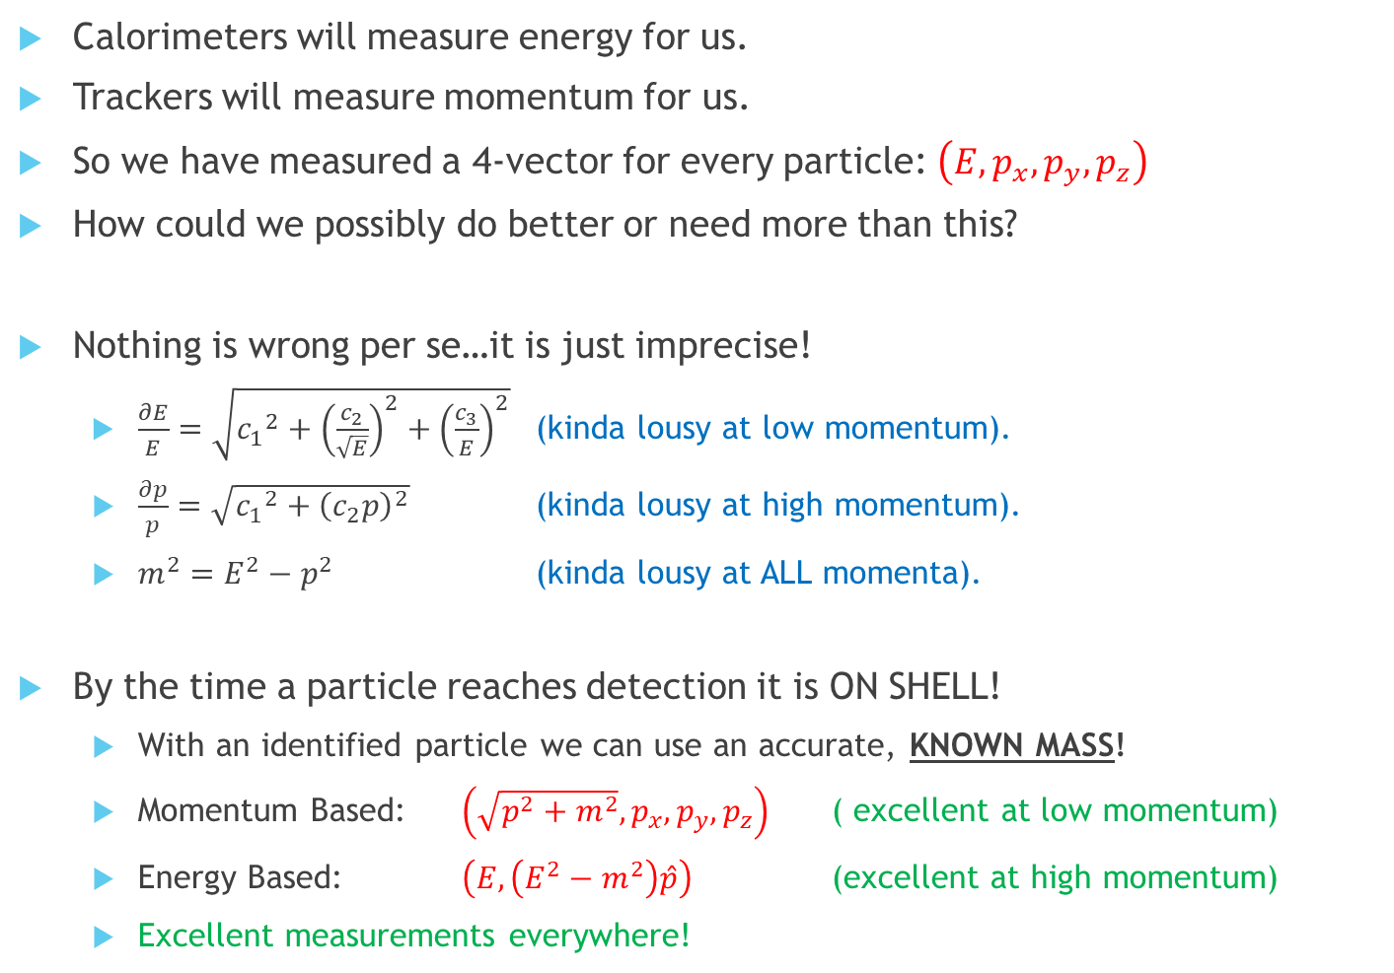
How can there be more?
Calorimeters will measure energy for us.
Trackers will measure momentum for us.
So we have measured a 4-vector for every particle: $\left(E, p_{x}, p_{y}, p_{z}\right)$
How could we possibly do better or need more than this?
Nothing is wrong per se…it is just imprecise!
  $\frac{∂E}{E}=\sqrt{{c_{1}}^{2}+{\left(\frac{c_{2}}{\sqrt{E}}\right)}^{2}+{\left(\frac{c_{3}}{E}\right)}^{2}}$ (kinda lousy at low momentum).
  $\frac{∂p}{p}=\sqrt{{c_{1}}^{2}+{\left(c_{2}p\right)}^{2}}$ (kinda lousy at high momentum).
  $m^{2}=E^{2}−p^{2}$ (kinda lousy at ALL momenta).
By the time a particle reaches detection it is ON SHELL!
  With an identified particle we can use an accurate, KNOWN MASS!
  Momentum Based: $\left(\sqrt{p^{2}+m^{2}},p_{x}, p_{y}, p_{z}\right)$ ( excellent at low momentum)
  Energy Based: $\left(E, \left(E^{2}−m^{2}\right)\hat{p}\right)$ (excellent at high momentum)
  Excellent measurements everywhere!
EXCELLENT!

Slide 3
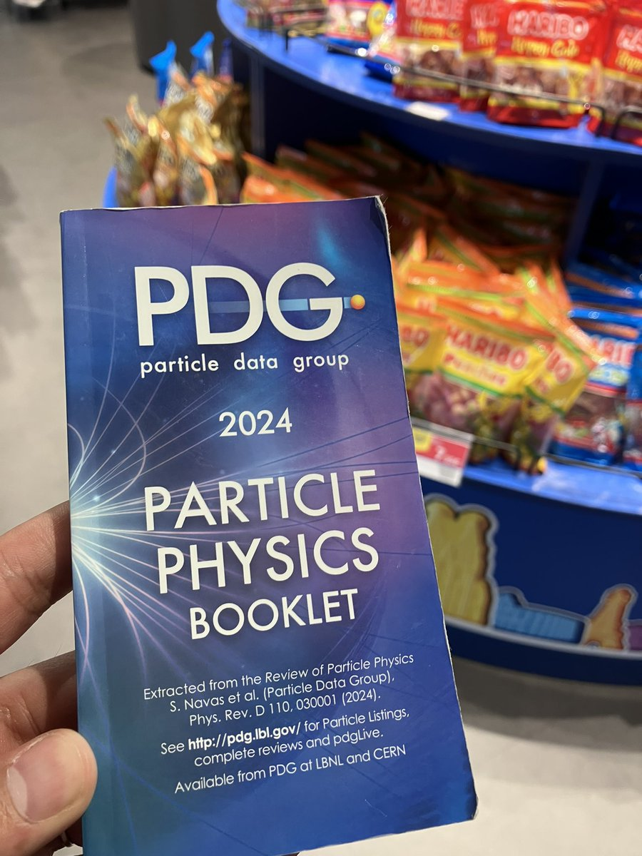

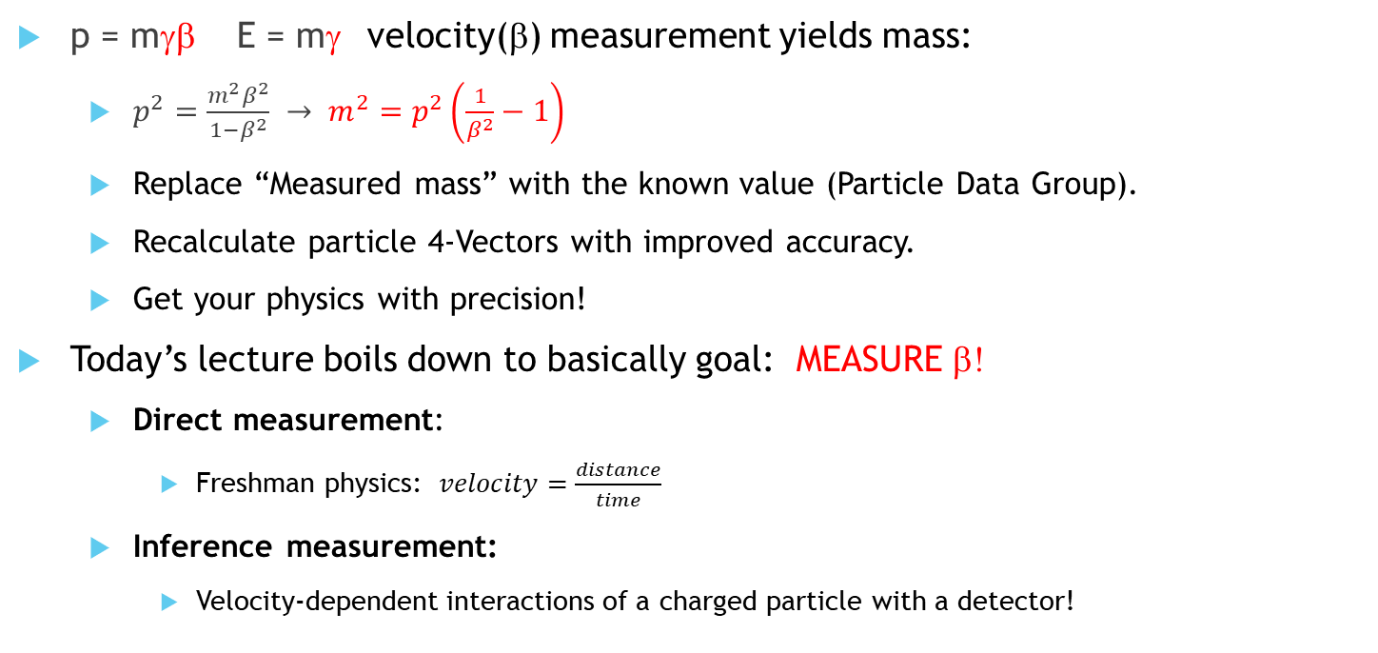
PID is really a Velocity Measurement
p = mγβ E = mγ velocity(β) measurement yields mass:
  $p^{2}=\frac{m^{2}β^{2}}{1−β^{2}} → m^{2}=p^{2}\left(\frac{1}{β^{2}}−1\right)$
  Replace “Measured mass” with the known value (Particle Data Group).
  Recalculate particle 4-Vectors with improved accuracy.
  Get your physics with precision!
Today’s lecture boils down to basically goal: MEASURE β!
  Direct measurement:
    Freshman physics: $velocity=\frac{distance}{time}$
  Inference measurement:
    Velocity-dependent interactions of a charged particle with a detector!
NOTE: ePIC has made choices in PID technologies.
This presentation covers a broader scope.

Slide 4
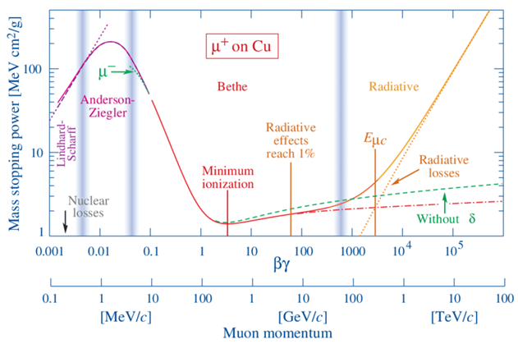
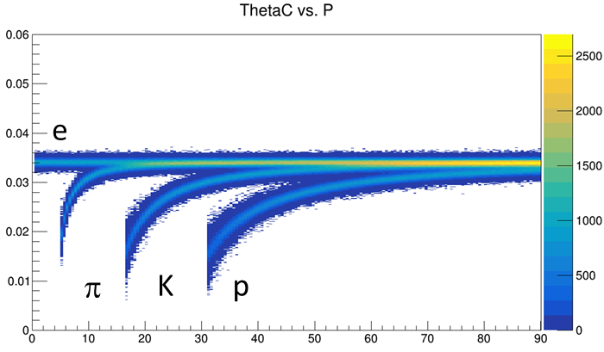
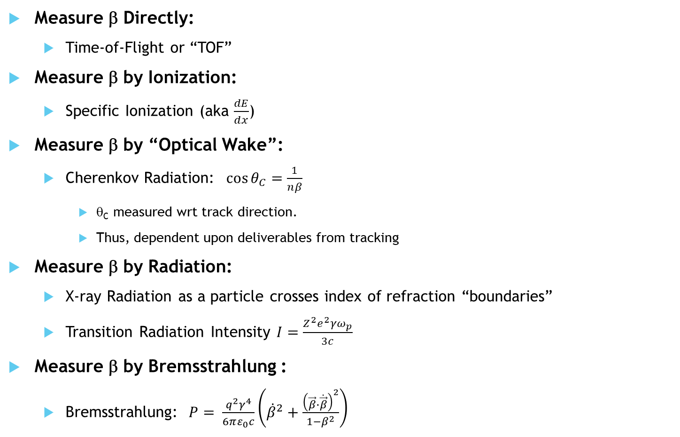
β Measurement Overview
Measure β Directly:
  Time-of-Flight or “TOF”
Measure β by Ionization:
  Specific Ionization (aka $\frac{dE}{dx}$)
Measure β by “Optical Wake”:
  Cherenkov Radiation: $\cos{θ_{C}=\frac{1}{nβ}}$
    θ_{C} measured wrt track direction.
    Thus, dependent upon deliverables from tracking
Measure β by Radiation:
  X-ray Radiation as a particle crosses index of refraction “boundaries”
  Transition Radiation Intensity $I=\frac{Z^{2}e^{2}γω_{p}}{3c}$
Measure β by Bremsstrahlung :
  Bremsstrahlung: $P= \frac{q^{2}γ^{4}}{6πε_{0}c}\left({\dot{β}}^{2}+\frac{{\left(\vec{β}∙\dot{\vec{β}}\right)}^{2}}{1−β^{2}}\right)$
eID mechanisms
Addressed Previously by Ross Corliss

Slide 5
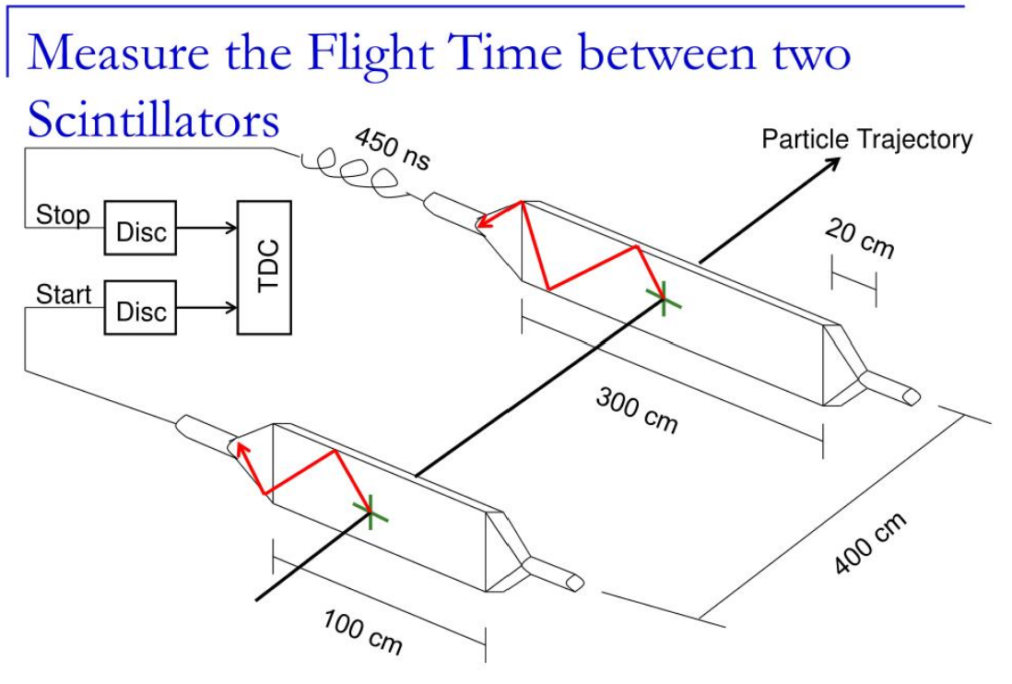
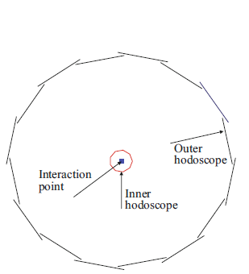
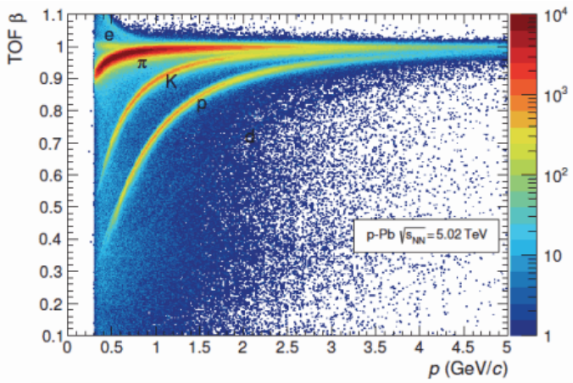
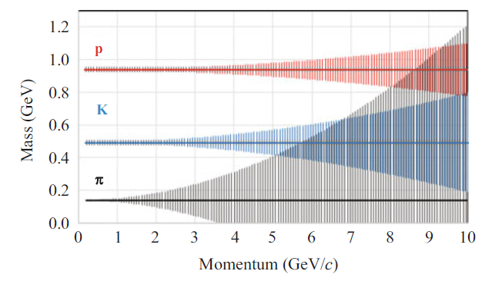
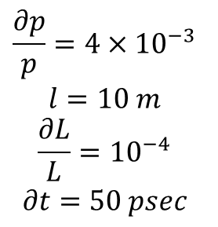

Basic Concept for Time-of-Flight (TOF)
Collider Geometry
$$β=\frac{1}{c}\frac{ΔL}{Δt}$$
$$\frac{∂p}{p}=4×{10}^{−3} \\ l=10 m \\ \frac{∂L}{L}={10}^{−4} \\ ∂t=50 psec$$
Intellectually simple.
The technology development lies in achieving excellent time resolution:
  Prompt medium response.
    e.g. Avoid scintillators doped with molecules having “delayed light”
  Quick Sensor Response
    Electrons avalanche with a “transit time”.
    Transit time “spread” degrades resolution
Rule of Thumb:
Transit time spread < Transit time.
Tiny avalanche zones have smaller TTS

Slide 6
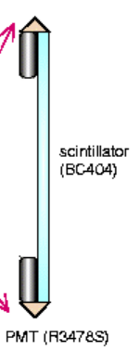
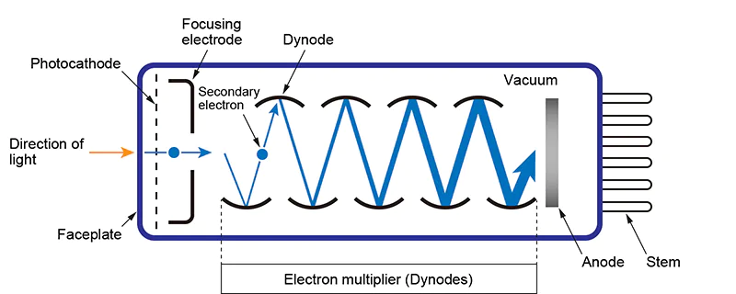
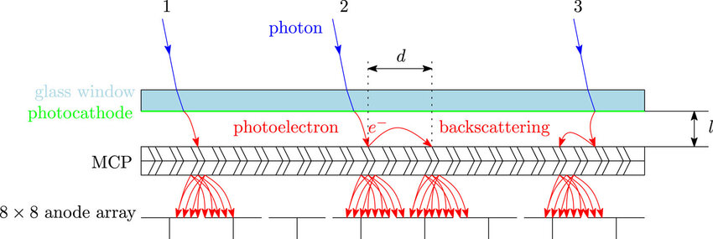
The “Classic” TOF: Scintillator Hodoscope
Vacuum Avalanche
Scintillator Slat
Photomultiplier Tube (PMT)
Micro Channel Plate (MCP-PMT)
Fast Plastic Scintillator
Small PMTs with only 10 dynodes
Smaller PMTs are usually faster because electron trajectories are shorter and more uniform. Fewer dynodes help somewhat, but the dominant factor is often the photocathode-to-first-dynode geometry. The real breakthrough in timing came from MCP-PMTs, which replaced the dynode chain entirely and reduced transit-time spreads from hundreds of picoseconds to a few tens of picoseconds.

Slide 7
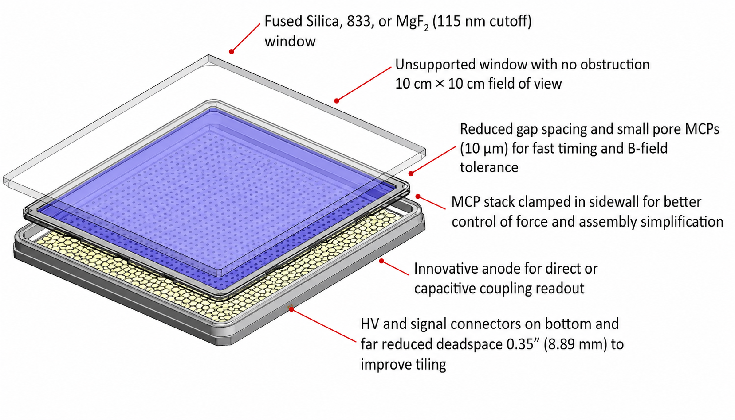
Fast Light Sensors for ePIC
Large Area Picosecond Photon Detector (LAPPD)
High-Rate Picosecond Photon Detector (HRPPD)
Vacuum Avalanche
Direct measurements of velocity require a fast charge collection device.
The time resolution is automatically helped by small devices:
  LGAD: Low Gain Avalanche Device. Instantly small.
  MCP: Micro Channel Plate ➔ LAPPD (Large Area Picosecond Photon Detector)

Slide 8
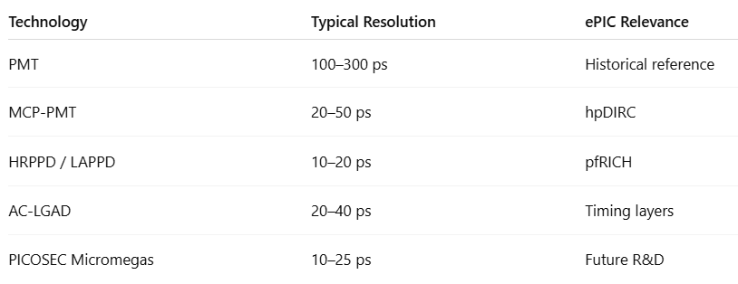
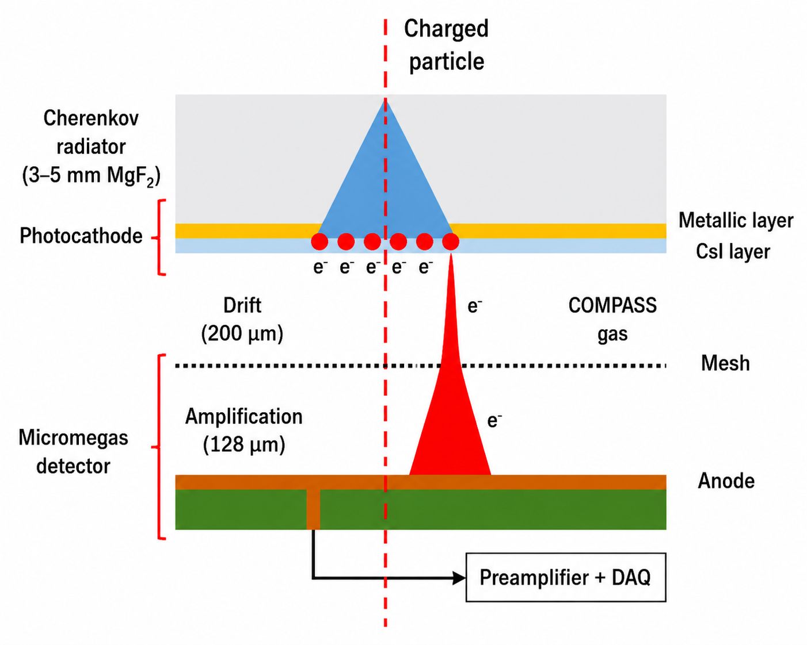
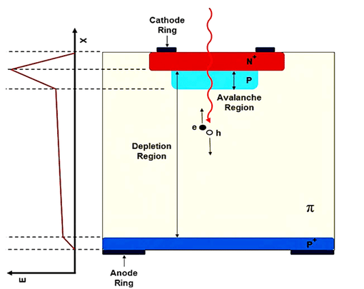
Fast Timing in Gas & Silicon!
PICOSEC DETECTOR
Low Gain Avalanche Device
Historically, Si not used for timing
Avalanche → large fast-rising pulse!
  Excellent timing!
Cherenkov Light is instantaneous
CsI withstands contact with the gas
MicroMEGAS: “tiny” avalanche region.
Silicon Avalanche
These devices are BOTH trackers and TOF detectors!

Slide 9

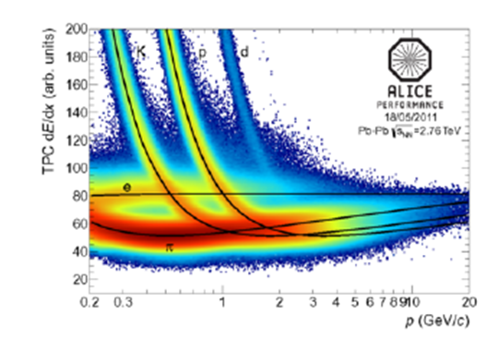
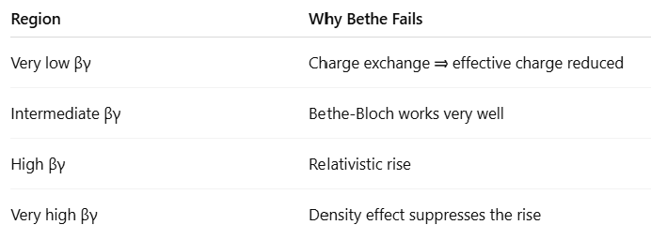
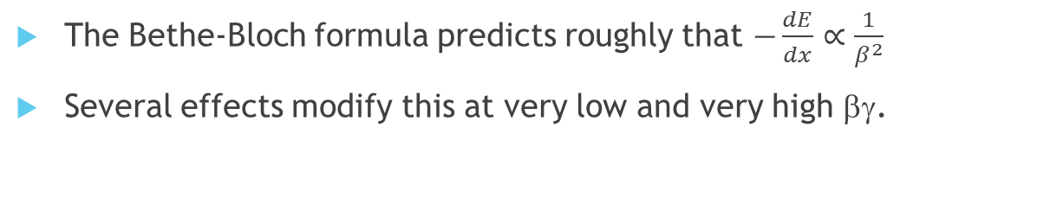
Ionization used for particle ID
Particles separate into bands if plotted vs. momentum
Fundamentally Dependent upon βγ !
The Bethe-Bloch formula predicts roughly that $−\frac{dE}{dx}∝\frac{1}{β^{2}}$
Several effects modify this at very low and very high βγ.

Slide 10
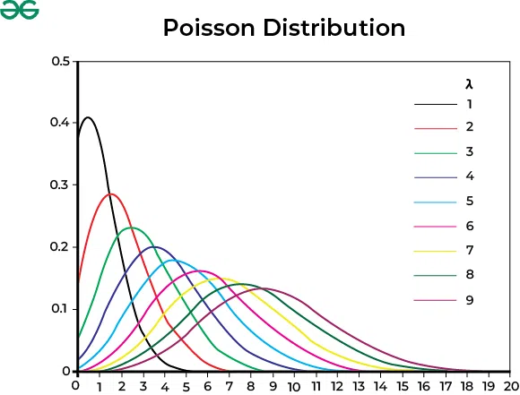
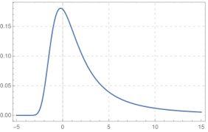
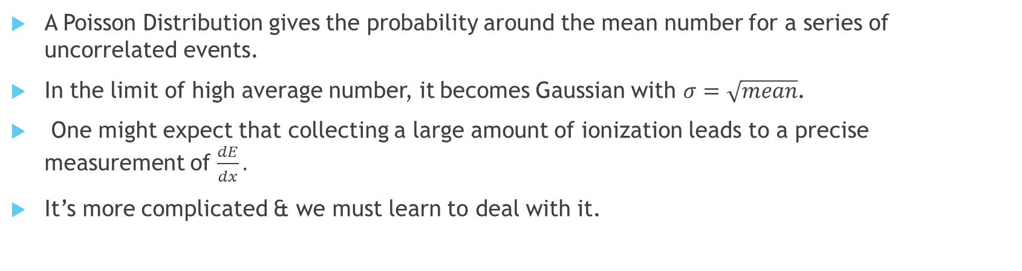
The Misery of the Landau Tail!
Landau Distribution
“Long tail” Yuch!
A Poisson Distribution gives the probability around the mean number for a series of uncorrelated events.
In the limit of high average number, it becomes Gaussian with $σ=\sqrt{mean}$.
One might expect that collecting a large amount of ionization leads to a precise measurement of $\frac{dE}{dx}.$
It’s more complicated & we must learn to deal with it.

Slide 11
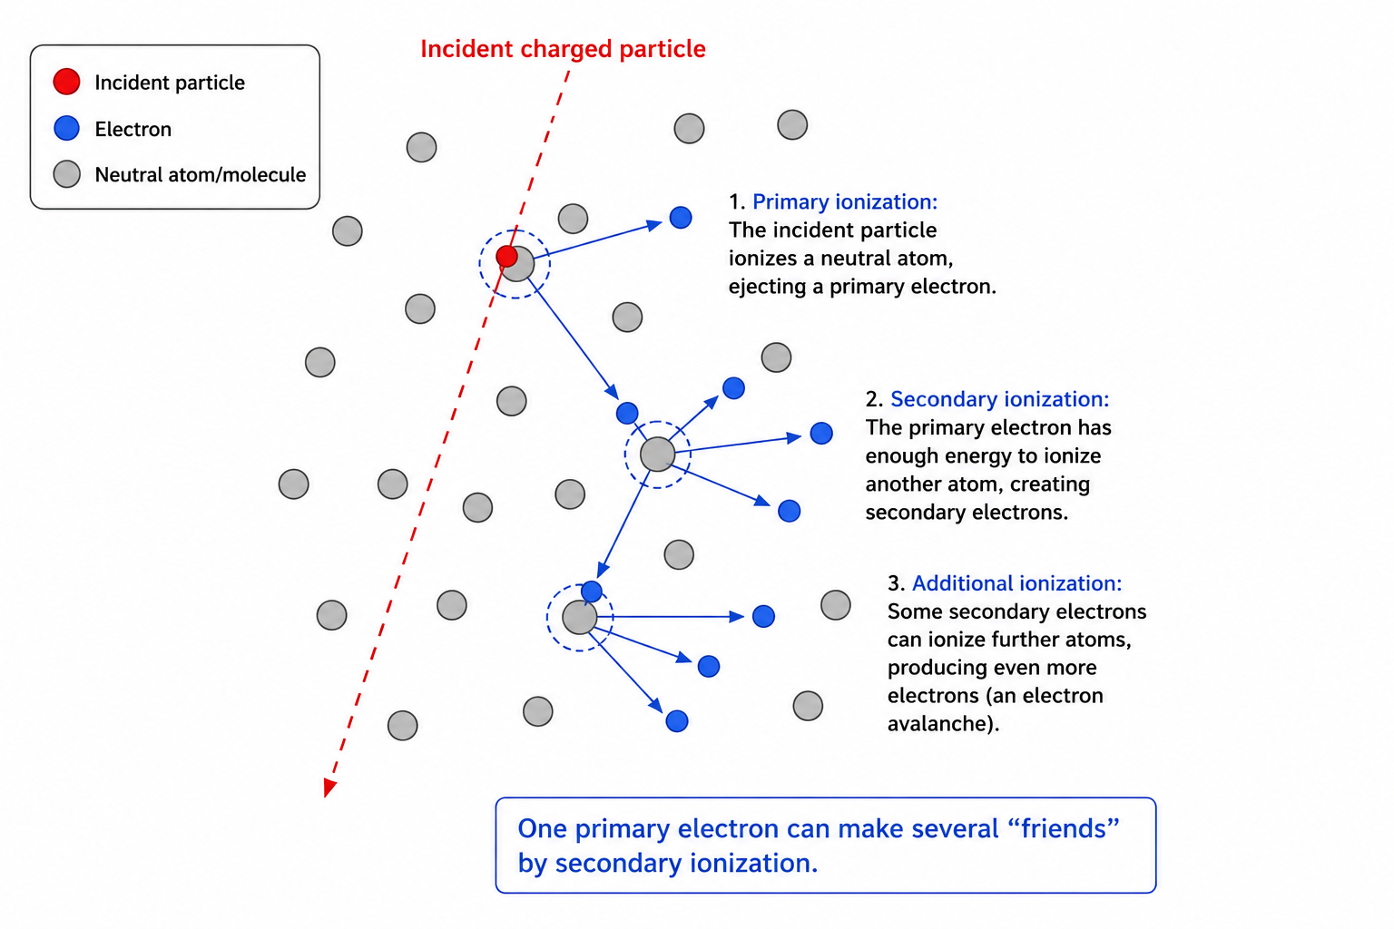

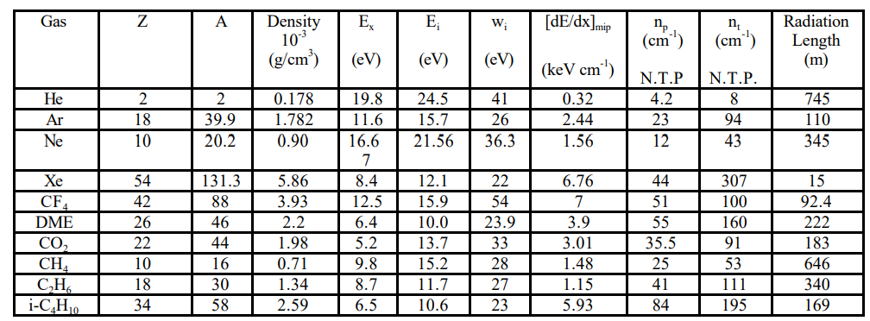
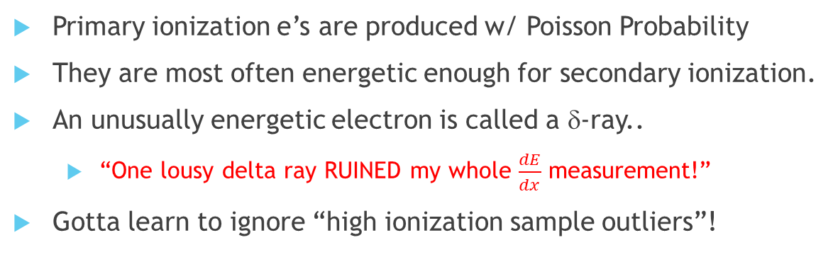
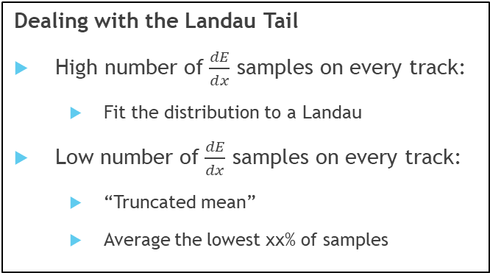

Deal with the Landau Tail!
Dealing with the Landau Tail
High number of $\frac{dE}{dx}$ samples on every track:
  Fit the distribution to a Landau
Low number of $\frac{dE}{dx}$ samples on every track:
  “Truncated mean”
  Average the lowest xx% of samples
Primary ionization e’s are produced w/ Poisson Probability
They are most often energetic enough for secondary ionization.
An unusually energetic electron is called a δ-ray..
  “One lousy delta ray RUINED my whole $\frac{dE}{dx}$ measurement!”
Gotta learn to ignore “high ionization sample outliers”!
$In Argon: \frac{N_{total}}{N_{primary}} \sim 4 !$

Slide 12

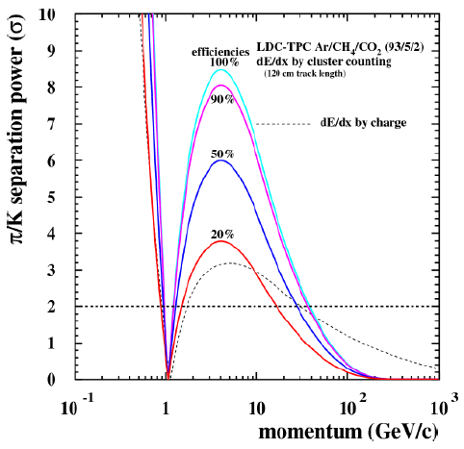
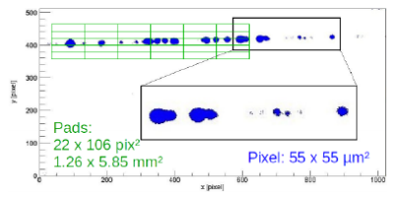
Cluster Counting Concept
So Cool!
Dealing with the Landau Tail
Read out a TPC with Silicon Pixels!
“Count” the primaries.
Ideally restores Poisson Statistics!
Existing Concept (using “Timepix”)
  Avalanche onto Silicon Pixels
  Tiny Pixels (smaller than cluster spacing)
  Sufficient gain for single electron
In principle can work
Expensive for large area.
This is one of the very few detector concepts that attempts to defeat the Landau distribution itself.

Slide 13
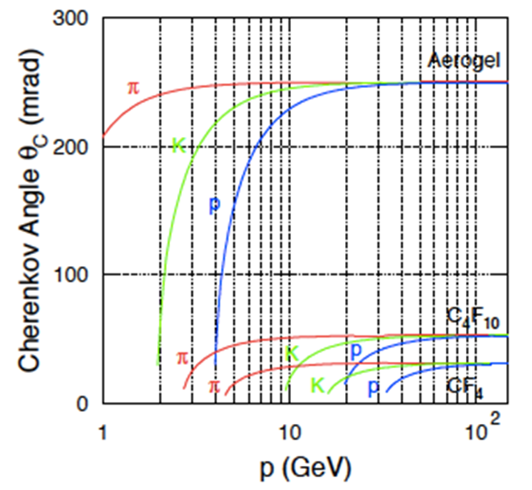
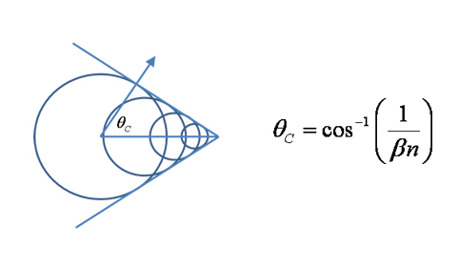
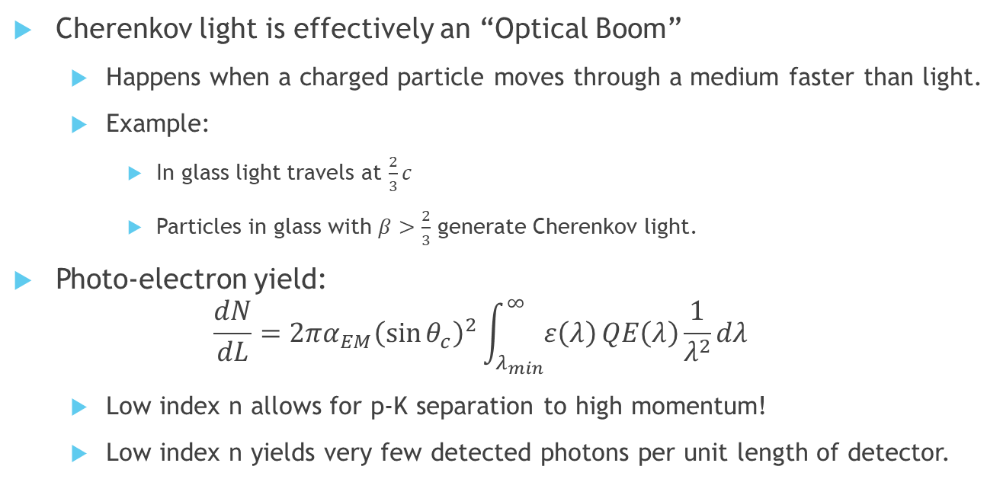
Cherenkov Light is Velocity Dependent
Cherenkov Angle determines β!
Cherenkov light is effectively an “Optical Boom”
  Happens when a charged particle moves through a medium faster than light.
  Example:
    In glass light travels at $\frac{2}{3}c$
    Particles in glass with $β>\frac{2}{3}$ generate Cherenkov light.
Photo-electron yield:
$\frac{dN}{dL}=2πα_{EM}{\left(\sin{θ_{c}}\right)}^{2}\int_{λ_{min}}^{∞}{ε\left(λ\right)}QE\left(λ\right)\frac{1}{λ^{2}}dλ$
  Low index n allows for p-K separation to high momentum!
  Low index n yields very few detected photons per unit length of detector.
Index of refraction drives the detector design

Slide 14
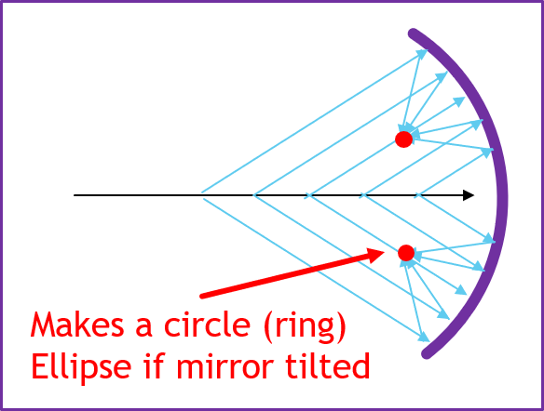
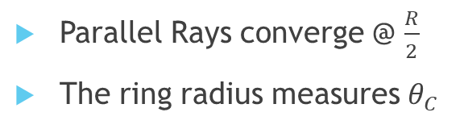
How to Determine θ_{C}
Focus the Light
Proximity Focus
Don’t Focus
Snell
θ_{C}
θ_{C}
Gap
Parallel Rays converge @ $\frac{R}{2}$
The ring radius measures $θ_{C}$
Cherenkov in Medium
Light follows Snell’s Law
Gap allows ring to grow.
Doesn't determine θ_{c}
Best used:
  Low index.
  Only e’s radiate

Slide 15
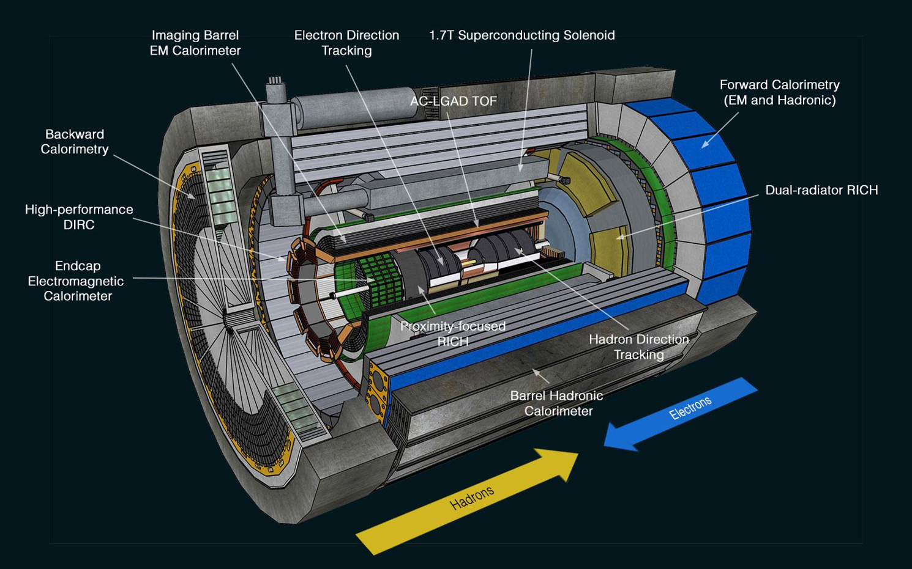
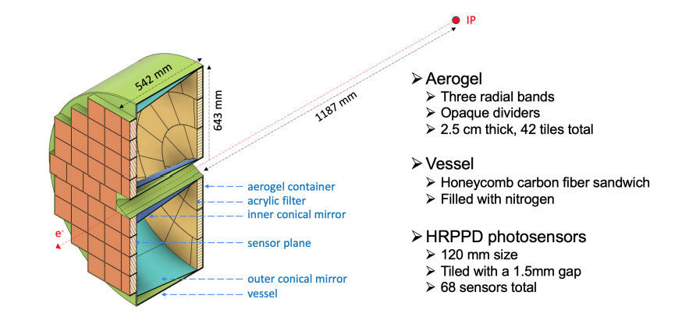
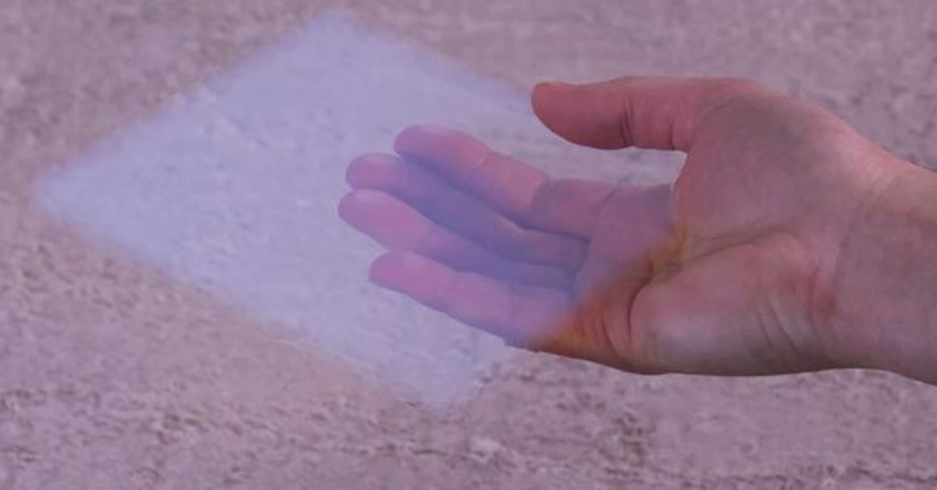
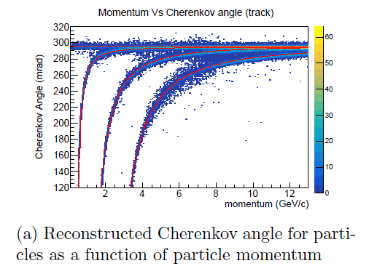
Electron arm Proximity Focused RICH
Aerogel is extremely low-density solid.
Layer of aerogel makes Cherenkov light.
The gap between Aerogel and the HRPPD expands the ring.
Measures β by measuring θ_{C}
π
K
p

Slide 16
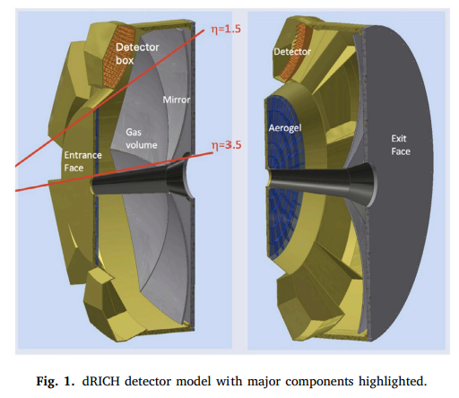
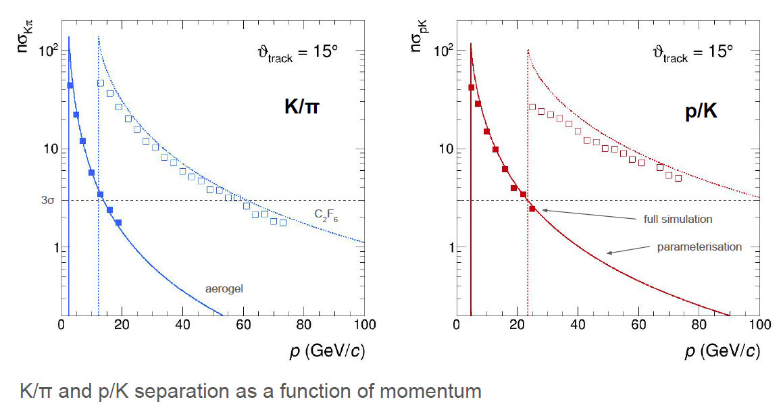
Dual RICH
Cherenkov radiator
○ Refractive Index
n = 1.02 (aerogel) 1.0008 (C₂F₆)
○ Length of the radiator
L = 4 cm (aerogel) , 160 cm (C₂F₆)
Mirrors
Photon Detector
3 mm pixel size; 200-500 nm MAPMT
Particle Generation
Originate from the vertex
In the proton-going direction the hadron momenta are HIGH.
  Need a quite low index gas radiator.
To ALSO measure lower momenta, incorporate an aerogel proximity focus!

Slide 17

Space Availability Dilemma!
Low index; Low θ_{c}; light exits face
β~1
High index; Large θ_{c}; light exits end
The pfRICH required a ~40 cm gap to expand the ring.
The Dual RICH required a 1.6 meter gas radiator to reach to high momentum.
The barrel only has a few cm room for PID!
Calculate the index of refraction for the threshold of Total Internal Reflection

Slide 18
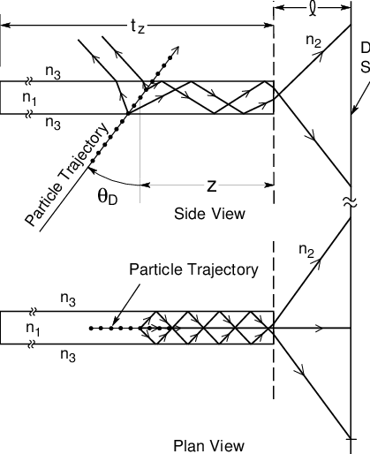
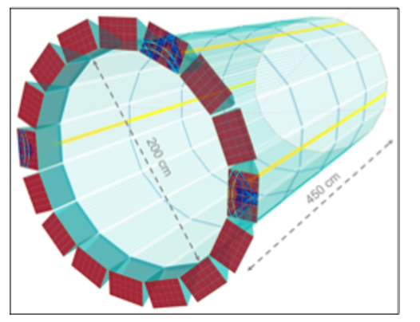
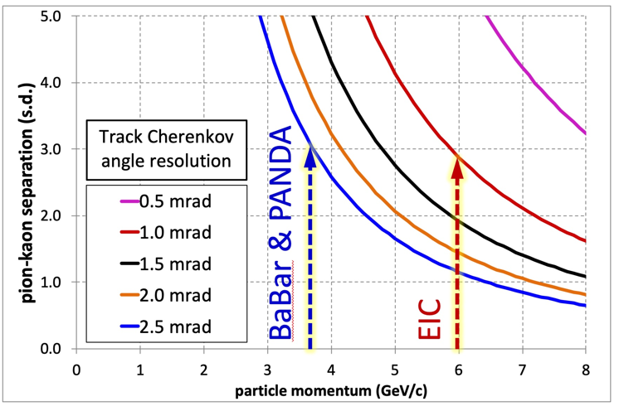
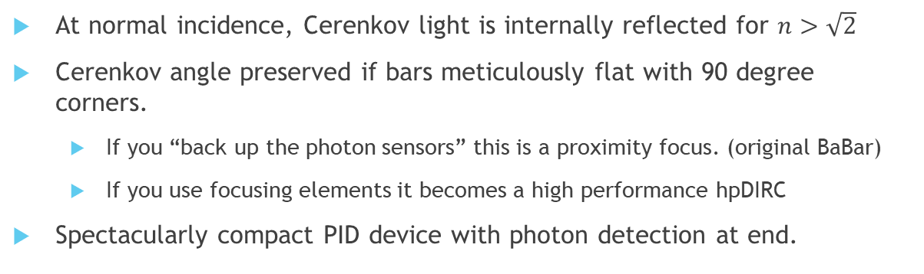
Detection of Internally Reflected Cherenkov: DIRC
hpDIRC
:
At normal incidence, Cerenkov light is internally reflected for $n>\sqrt{2}$
Cerenkov angle preserved if bars meticulously flat with 90 degree corners.
  If you “back up the photon sensors” this is a proximity focus. (original BaBar)
  If you use focusing elements it becomes a high performance hpDIRC
Spectacularly compact PID device with photon detection at end.
18

Slide 19
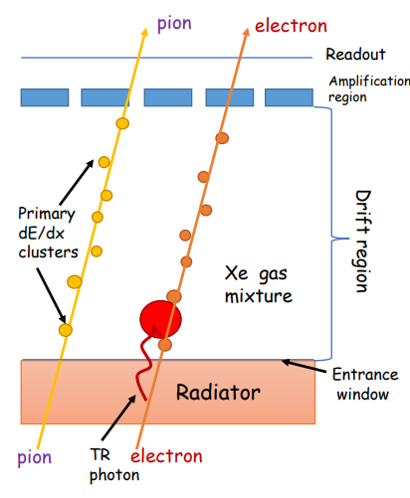
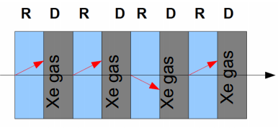
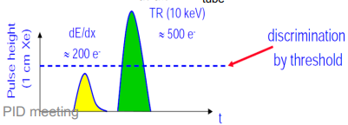
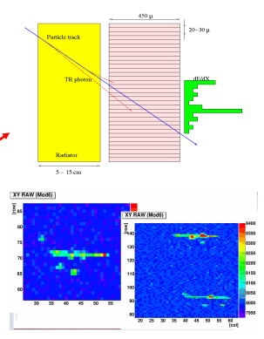

eID by Transition Radiation (TRD)
3: ID TR photons by energy/pos
1: Make TR photons:
Index, n, change
X-ray regime
Film, foam, fleece
2: Layered to get more photons
4: Reject Pions
“Threshold detector” (TR X-rays produced or not)
P_{min} ~ 1 GeV (rejection ~constant at higher momentum)
Balance between X₀ and rejection

Slide 20


Summary
PID Performance vs Momentum
Particle ID will be a critical requirement in ePIC.
No one technique can span the full range of momenta of particles produced at EIC.
When PID is critical, a suite of detector technologies must be applied.
If we have met our goal, you should be able to look at the diagram of ePIC:
  Understand the role of each detector system.
  Understand why the layer order is correct.
  Understand how the chosen technology of each system matches the physics.

