Slide 1
Physics-Informed Symbolic Regression for Quantum Evolution
Nadeem Altamimi
Advisor: Matthew Sievert
EXCLAIM collaboration

Slide 2
Symbolic Regression
SR is a machine learning technique that produces analytical expressions that best describes a data set that we train it on. It finds both the mathematical structure and the numerical coefficients

Slide 3
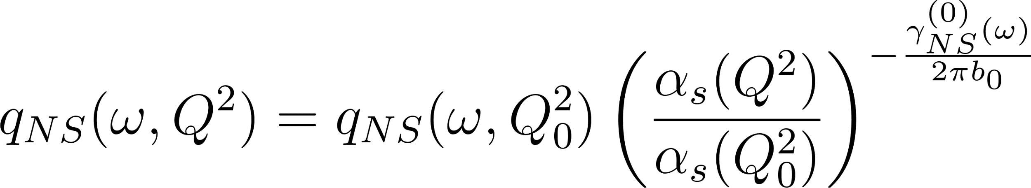
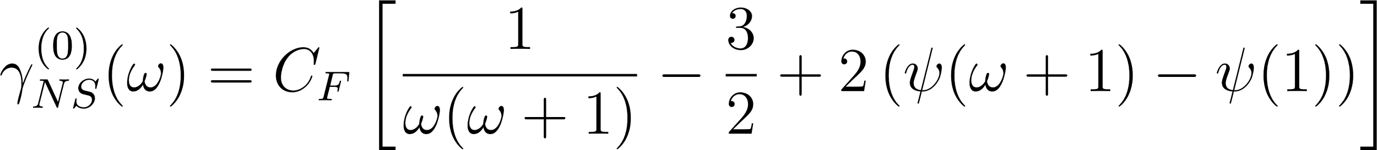
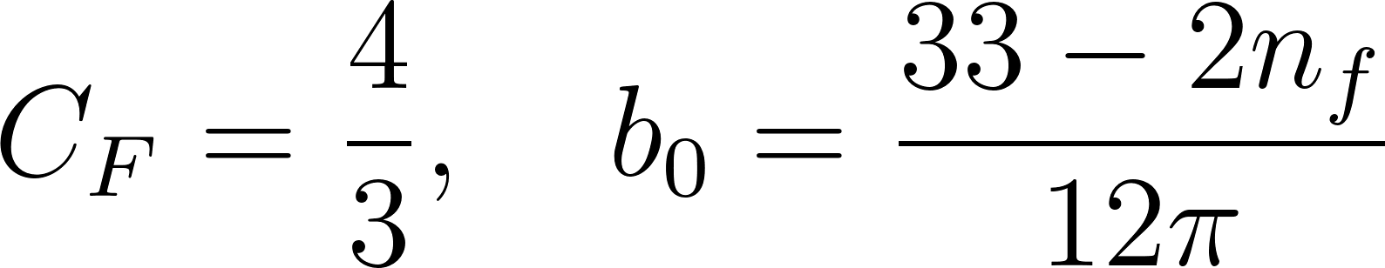
DGLAP Evolution
The non-singlet solution in Mellin space:

Slide 4
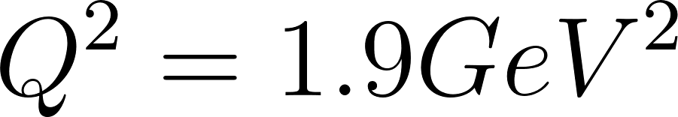
PySR for PDFs
Following the HERAPDF parametrization starting at scale :
And in Mellin space:

Slide 5
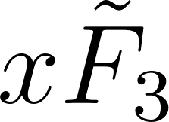
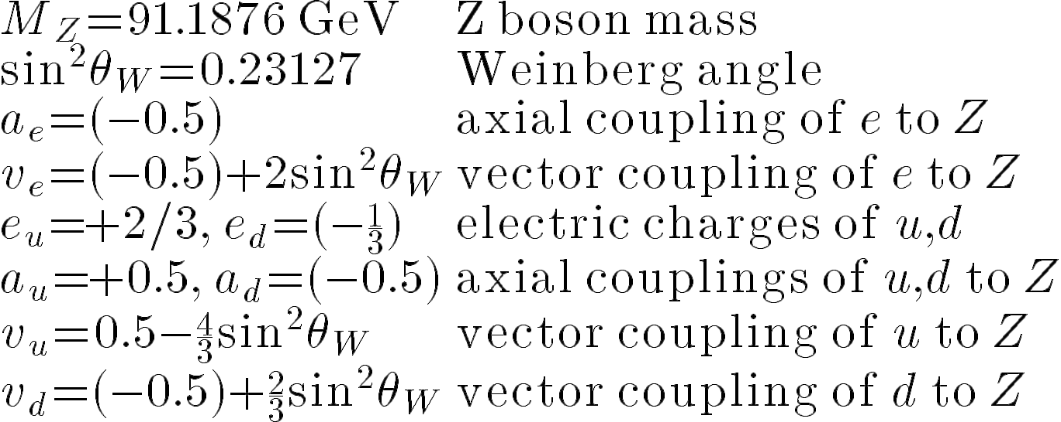
Extracting 𝛄(⍵) from Structure Functions
We can use DGLAP evolution to extract the anomalous dimensions from the structure function :
Then for the PDFs u and d we plug in the evolved equations in Mellin space which will get us the structure function in Mellin space too

Slide 6
Custom Loss Function
Start with an initial guess for 𝛄(⍵)
Write the PDFs in Mellin space
Inverse transform to x-space
Calculate MSE with PDF / Structure function data in x-space

Slide 7
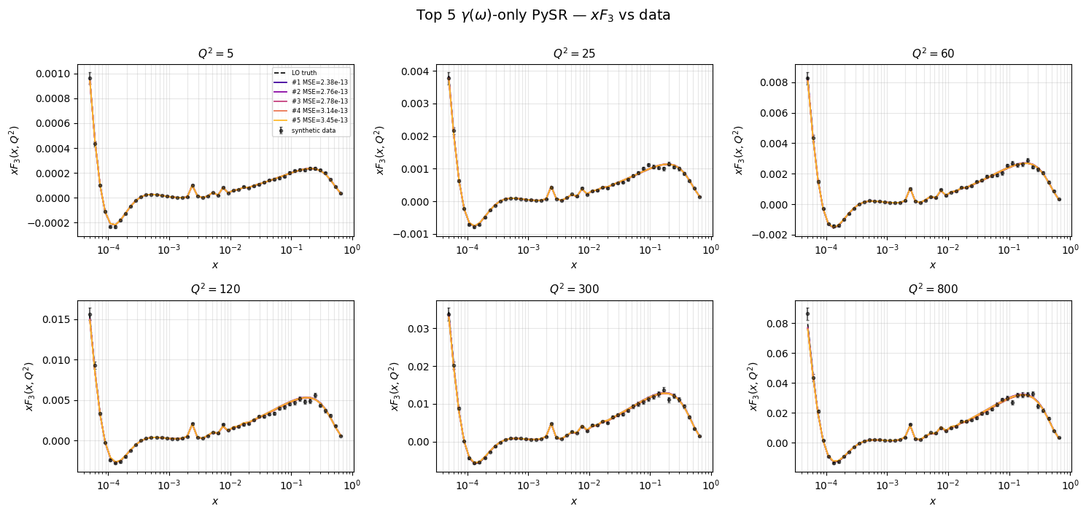
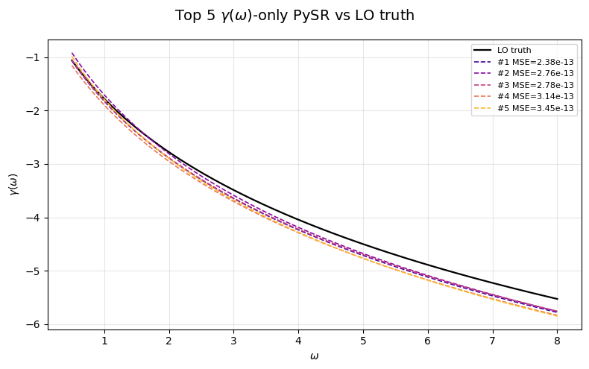
Model Comparison: 𝛄(⍵) vs 𝛄(⍵,Q^2)
We start with data that is constructed from LO𝛄(⍵) and we do let PySR guess 𝛄(⍵) then 𝛄(⍵,Q^2)

Slide 8
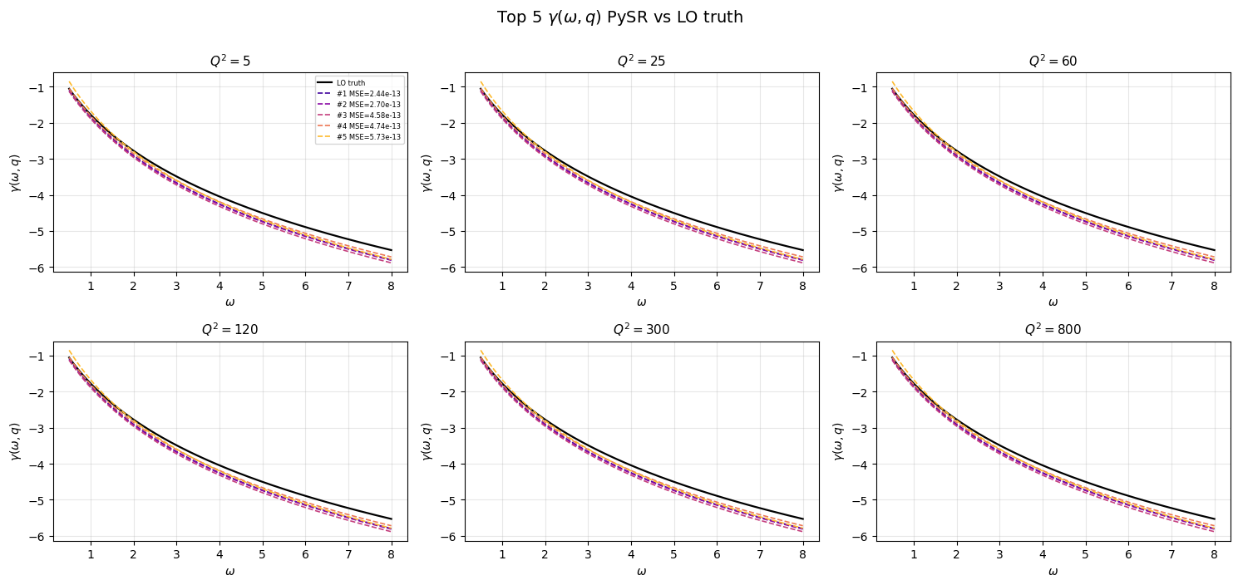
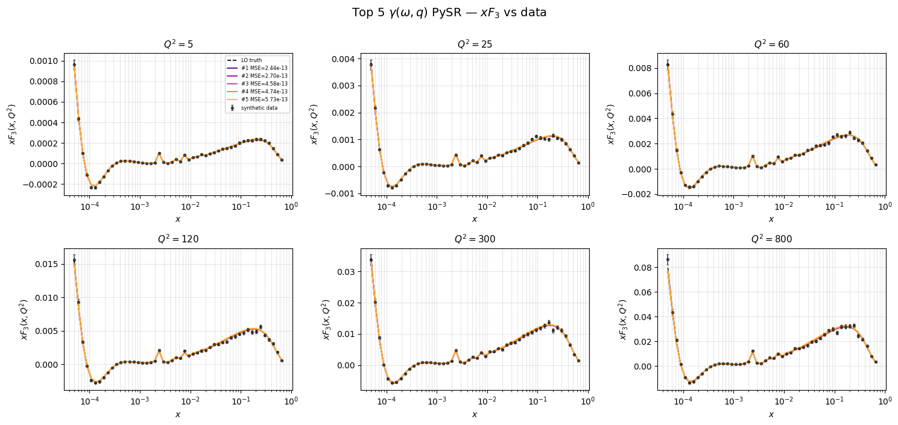
Model Comparison: 𝛄(⍵) vs 𝛄(⍵,Q^2)
These top 5 equations are Q^2 independent!

Slide 9
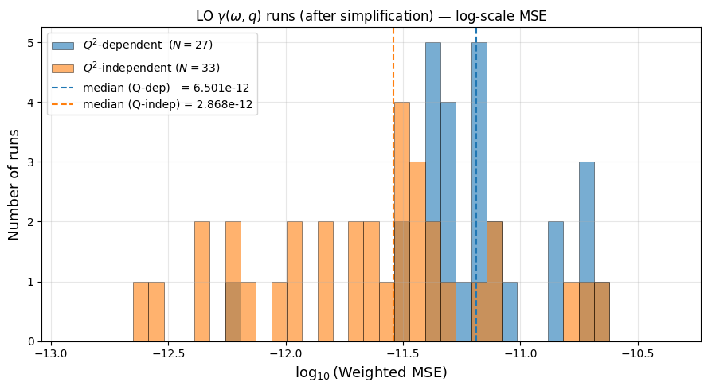
Model Comparison: 𝛄(⍵) vs 𝛄(⍵,Q^2)

Slide 10
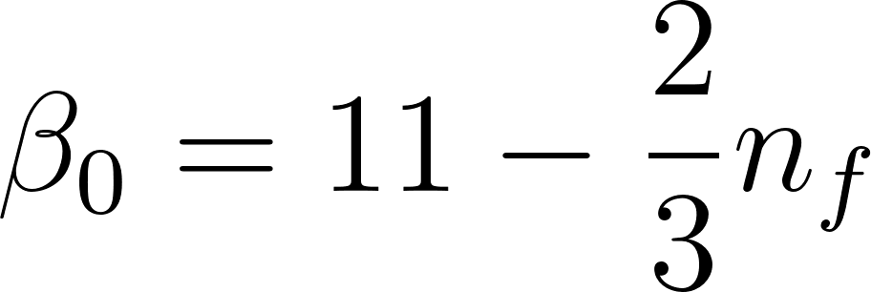
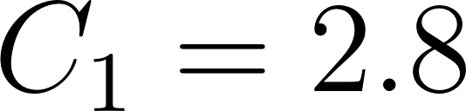
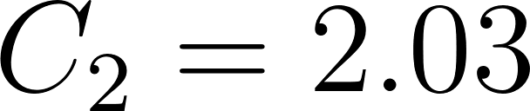
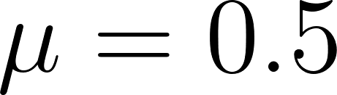
Model Comparison: 𝛄(⍵) vs 𝛄(⍵,Q^2)
We use this Q^2 dependent form:
Where:

Slide 11
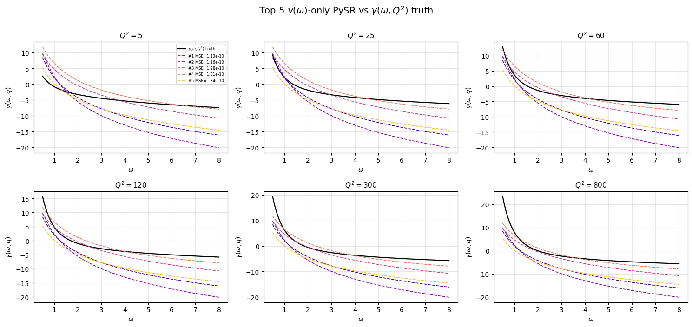
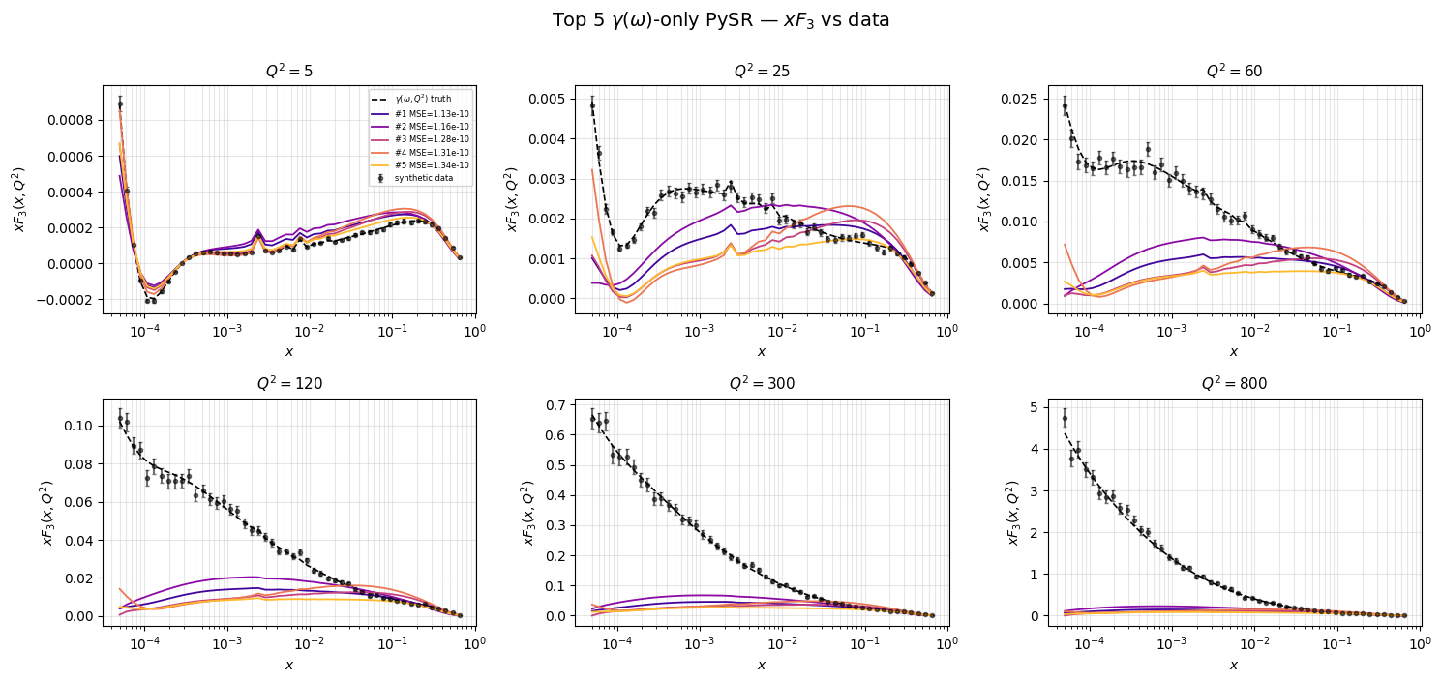
Model Comparison: 𝛄(⍵) vs 𝛄(⍵,Q^2)

Slide 12
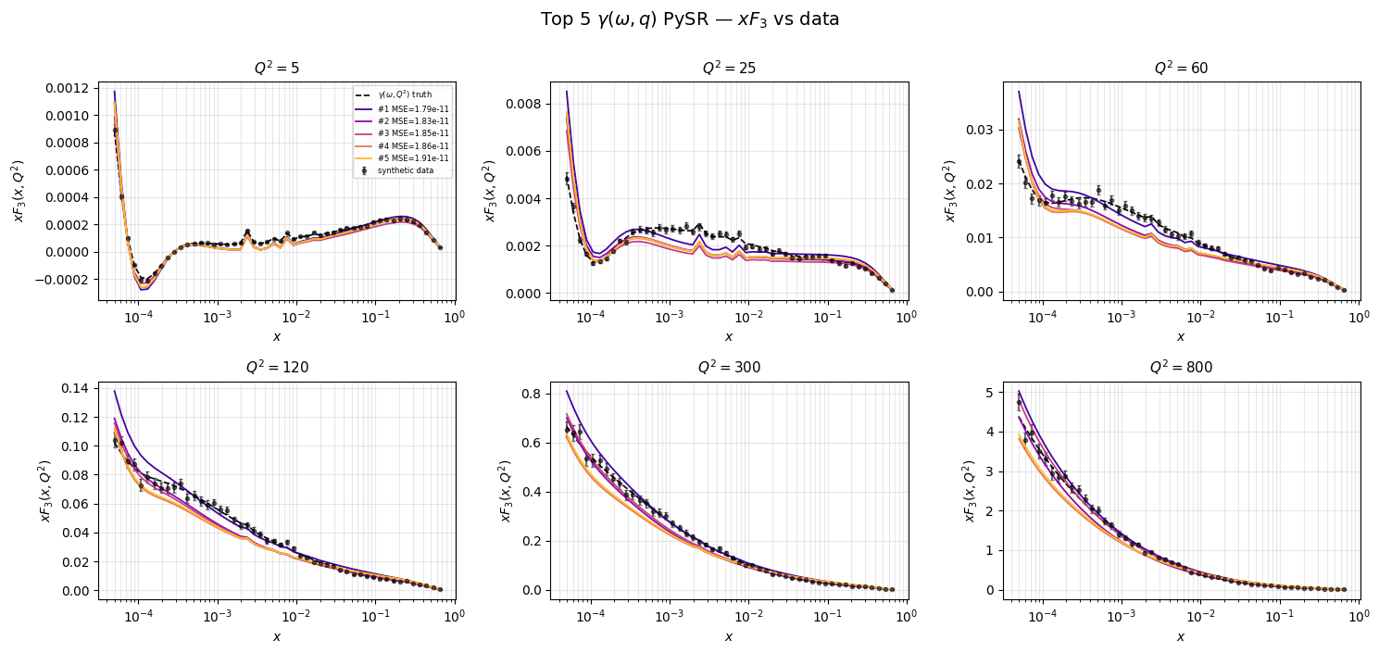
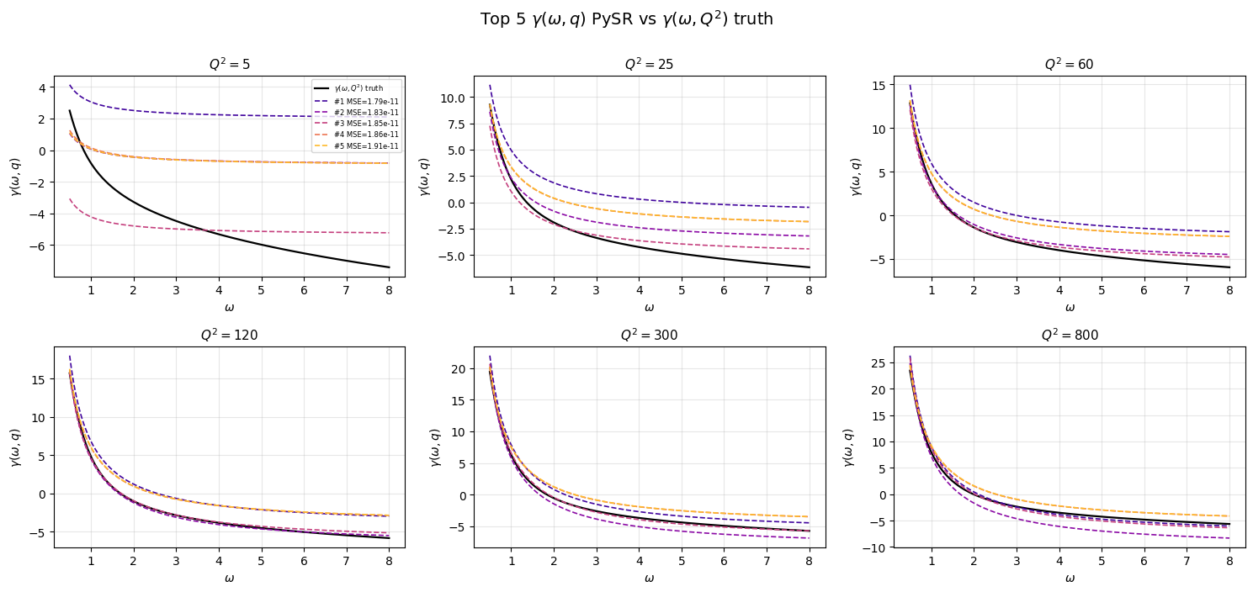
Model Comparison: 𝛄(⍵) vs 𝛄(⍵,Q^2)

Slide 13
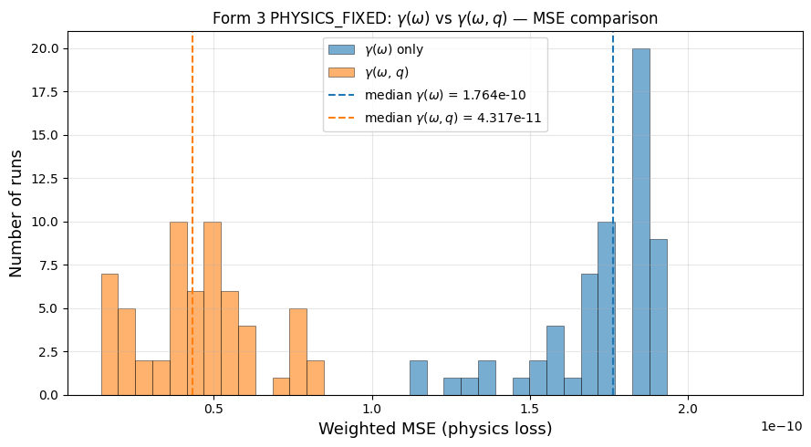
Model Comparison: 𝛄(⍵) vs 𝛄(⍵,Q^2)
Plotting the distribution of MSE’s for both PySR models, we can see that the true model gave better fits, showing that PySR managed to distinguish between the truth and the other model.

Slide 14
Thank you

