Slide 1

Charmed Hypernuclei and Scintillating-Fiber Detectors for Low-Momentum Heavy-Flavor Tracking
Marceline Myers
Advisor: Dr. Zhangbu Xu
Center for Nuclear Research
Department of Physics, Kent State University
Notes:
c

Slide 2
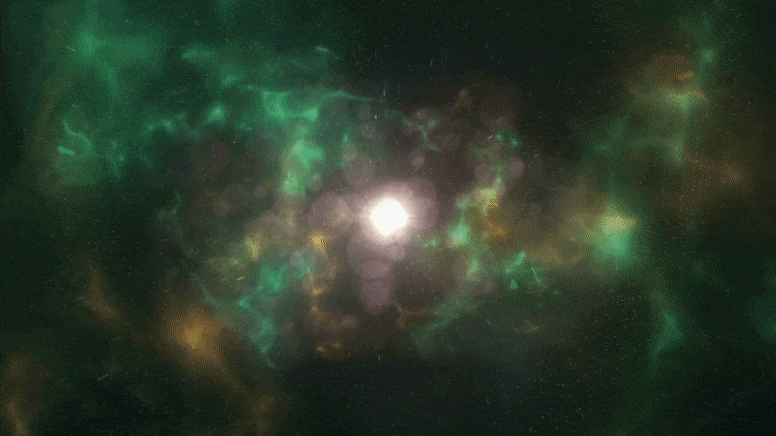
Charmed Hypernuclei and Scintillating-Fiber Detectors for Low-Momentum Heavy-Flavor Tracking
Marceline Myers
Advisor: Dr. Zhangbu Xu
Center for Nuclear Research
Department of Physics, Kent State University
Notes:
c

Slide 3
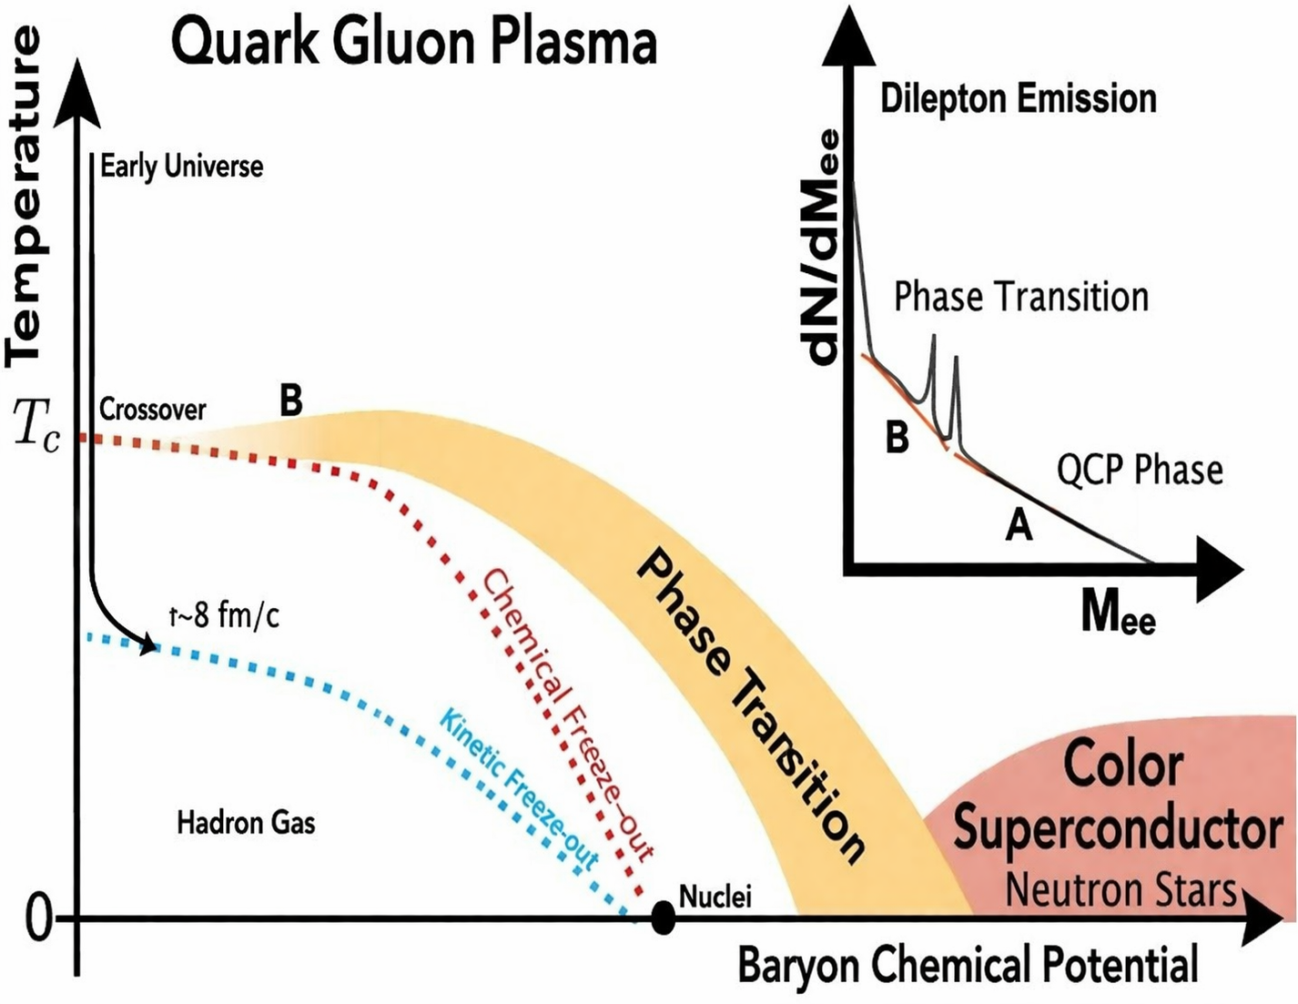
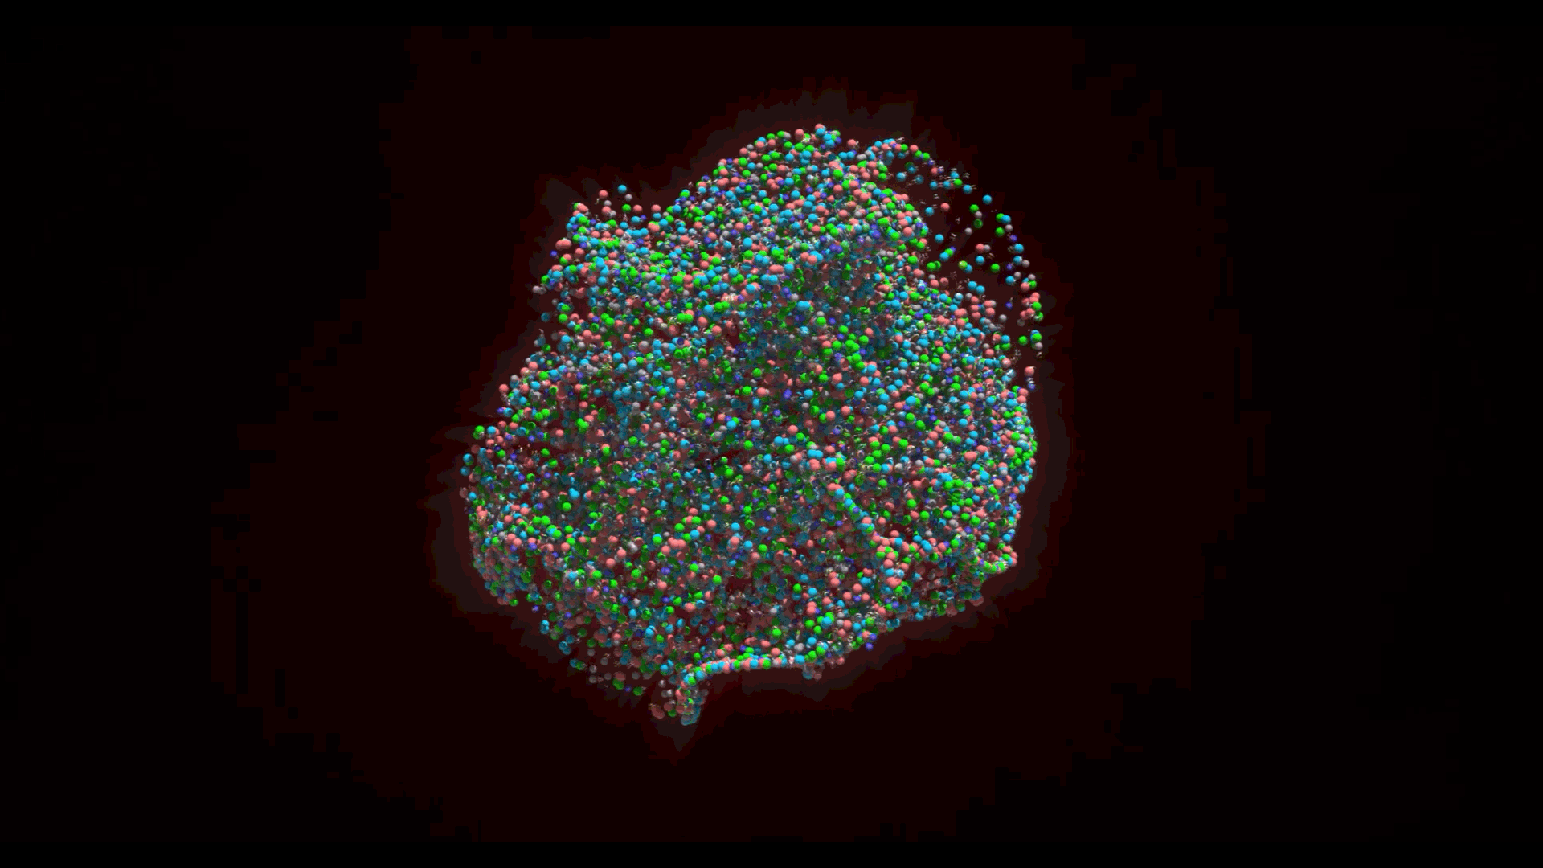
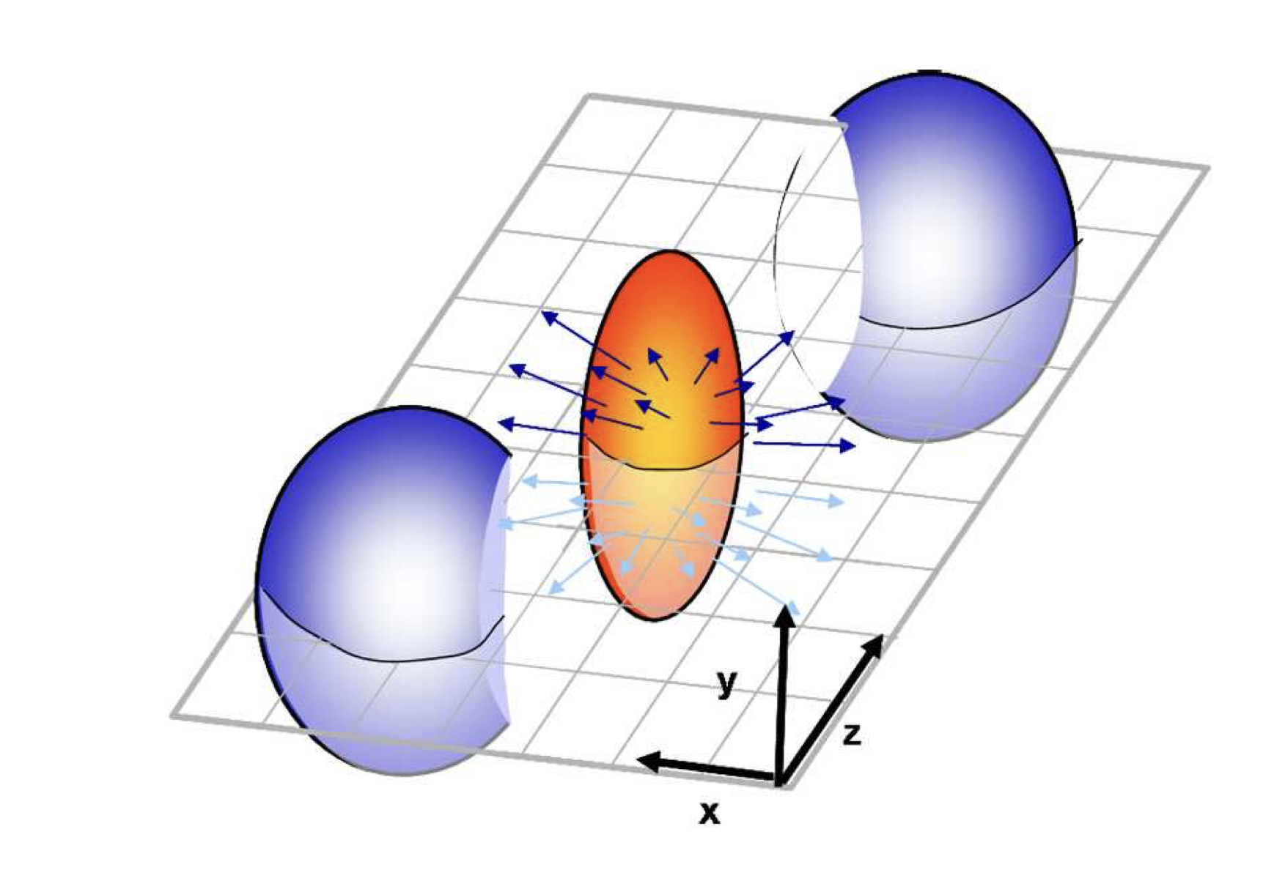


$$τ \sim fm/c$$
CV
At high temperatures/density hadrons dissolve
Quarks and Gluons become deconfined
This state is called Quark Gluon Plasma (QGP)
$$τ \sim 8 fm/c$$
Chemical Freeze-out
Recreated in heavy-ion collisions
https://www.kent.edu/physics/news/kent-state-scientists-help-measure-primordial-matter-trillions-degrees [Adapted]
https://scitechdaily.com/a-quantum-of-solace-resolving-a-mathematical-puzzle-in-quarks-and-gluons-in-nuclear-matter
https://home.cern/news/news/physics/hearing-sound-quark-gluon-plasma

Slide 4
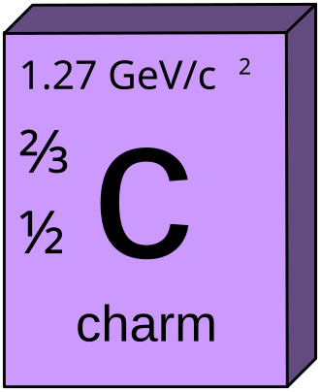
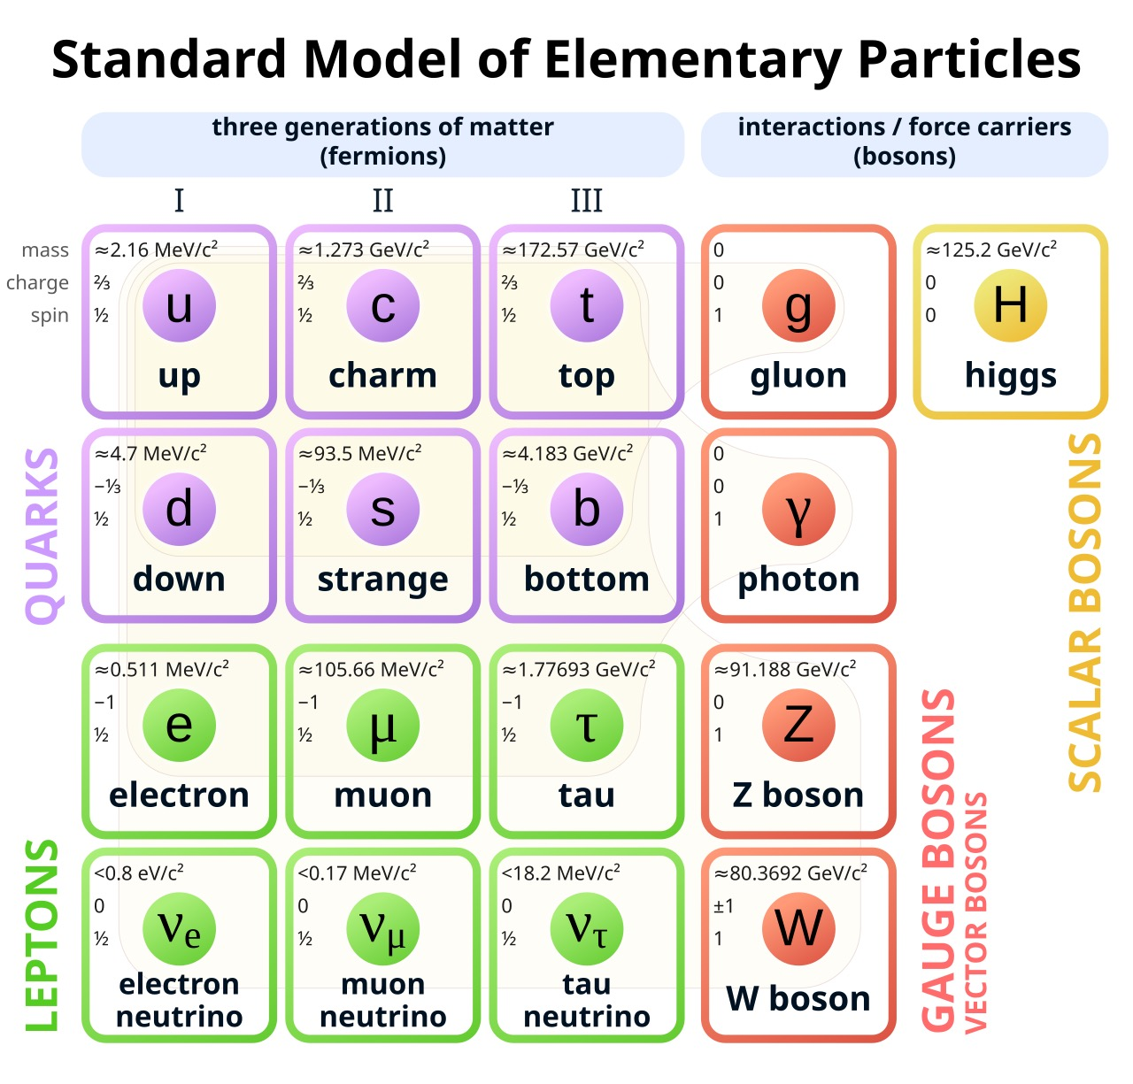
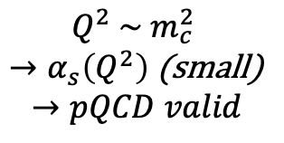





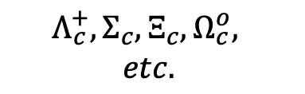
$$gg→cc$$
Charmed Hadronization Channels
Mesons
c + q
$D^{0}, D^{+}$, ${D_{s}}^{−}, D_{s}^{0}$
c + c
$$J/ψ$$
Heavy $→$ sets the hard scale
Produced Early
Traverse full QGP evolution
Diffusion
Energy Loss
Baryons
$$Q^{2} \sim m_{c}^{2}$$
$→α_{s}\left(Q^{2}\right)$ (small)
$$→pQCD valid$$
c + q + q
$$Λ_{c}^{+}, Σ_{c}, Ξ_{c}, Ω_{c}^{o},$$
$$etc.$$
Exotic Charmed Nuclei
$τ_{production}$ ~ $\frac{1}{2m_{c}}$
https://en.wikipedia.org/wiki/Charm_quark
https://www.physik.uzh.ch/~che/FeynDiag/Listing.php

Slide 5


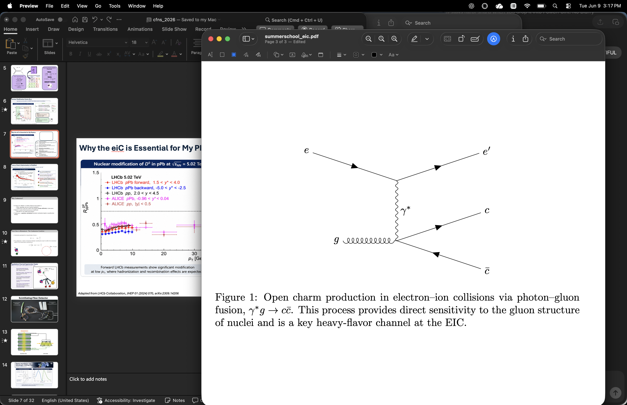
Why the eiC is Essential
Access to low-x gluons
The EIC will directly probe the gluons that generate charm quarks inside nuclei
Clean charm production environment
Electron-ion collisions provide a cleaner environment than heavy-ion collisions.
Directly relevant to my goal
Understanding low-x gluons and nuclear structure and
provides the foundation for studying exotic charm systems such as:
*charmed hypernuclei
*charmed hyper-clusters
*bound charm-nucleus states
Hadronization and recombination
Charm hadrons can be studied as they form inside nuclear matter.
Adapted from the Electron-Ion Collider White Paper (2023), Fig. 1.2.

Slide 6
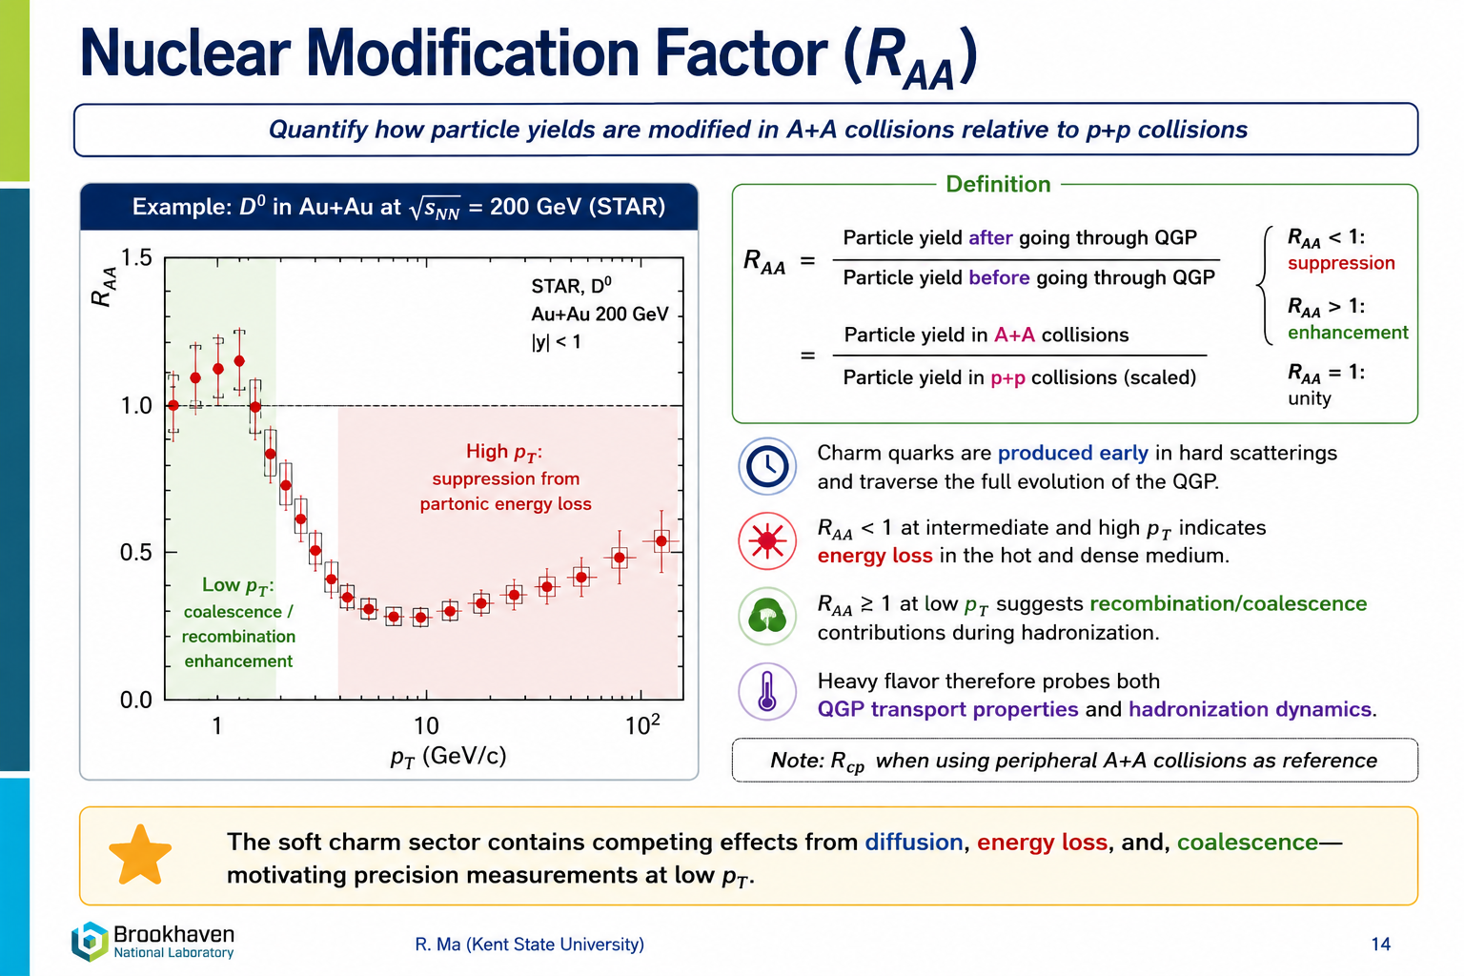
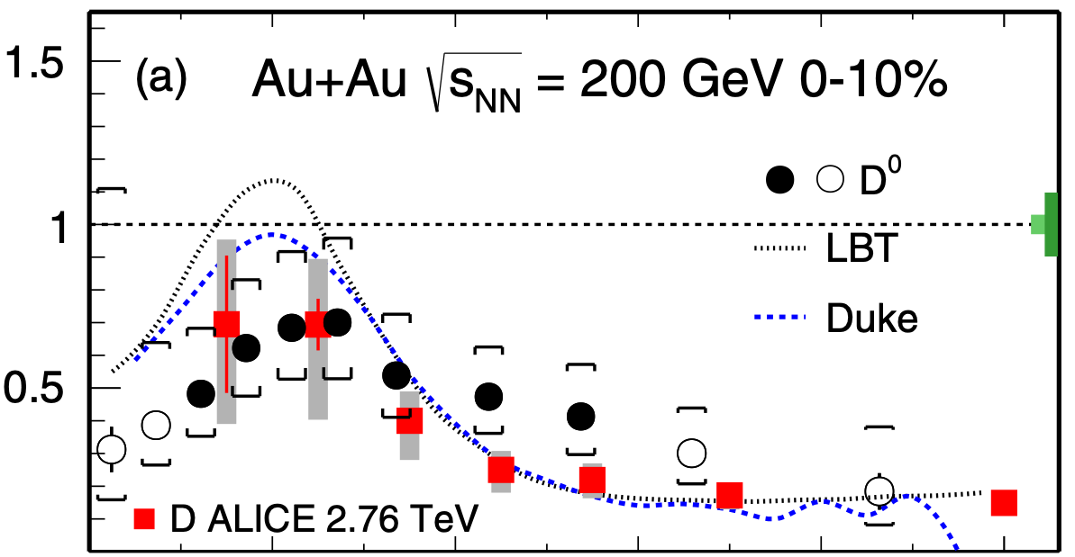

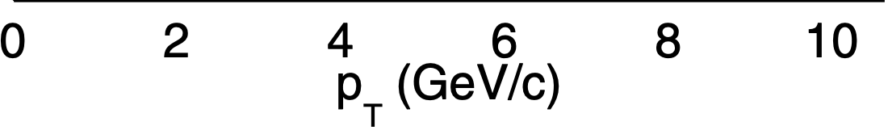
Nuclear Modification Factor (R_{AA})
High p_{T}:
Suppression from partonic energy loss in QGP
Low p_{T}:
Coalescence/recombination enhancement
(Adapted from STAR Collaboration, Phys. Rev. Lett. 113, 142301 (2014); Phys. Rev. C 99, 034908 (2019))

Slide 7
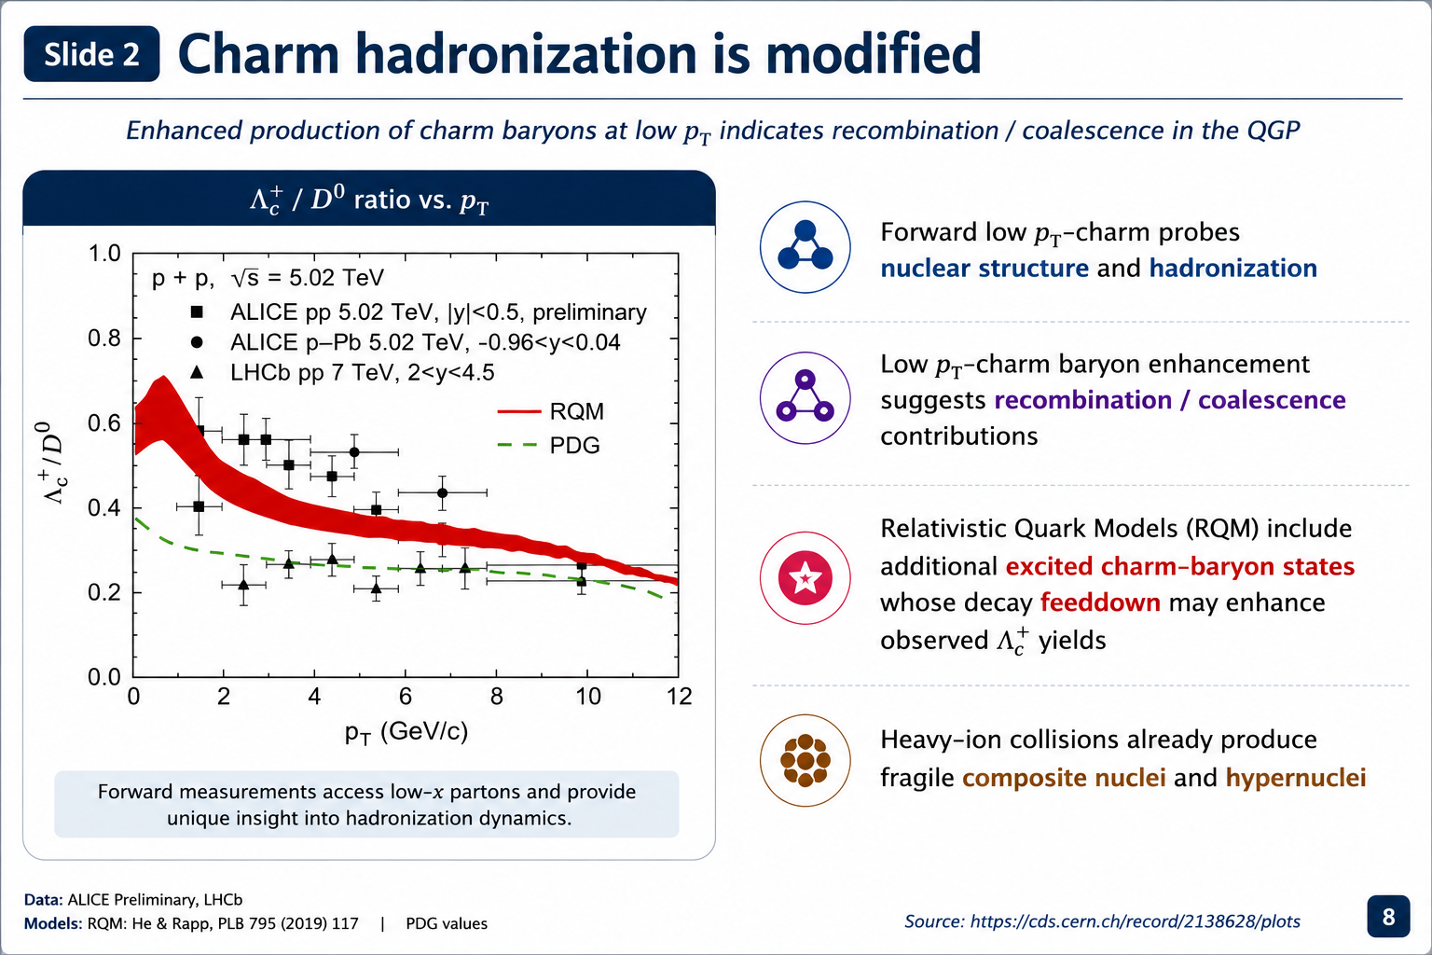
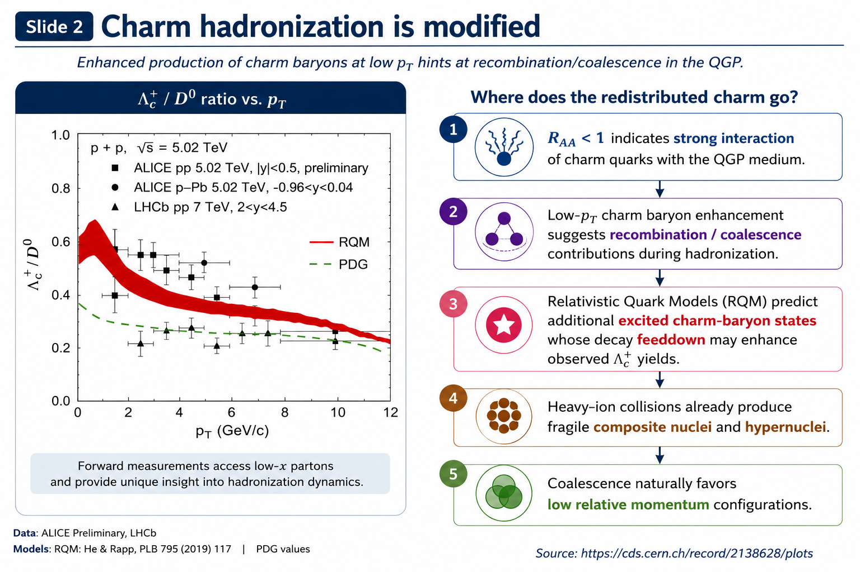
Low-p_{T} Charm Hadronization is Modified
R_{AA} < 1 indicates strong interaction of charm quarks with the QGP medium
At low p_{T}, charm quarks can recombine with nearby light quarks during hadronization.
Enhanced Λc⁺ / D⁰ production suggests modified charm hadronization beyond vacuum fragmentation. Relativistic Quark Models (RQM) predict additional excited charmed states!
This motivates searches for exotic charm-bound systems and hyper-nuclear topologies.
Coalescence naturally favors low relative momentum configurations
Adapted from M. He and R. Rapp, Phys. Lett. B 795 (2019) 117, arXiv:1902.08889, with ALICE/LHCb data.

Slide 8


Slide 9
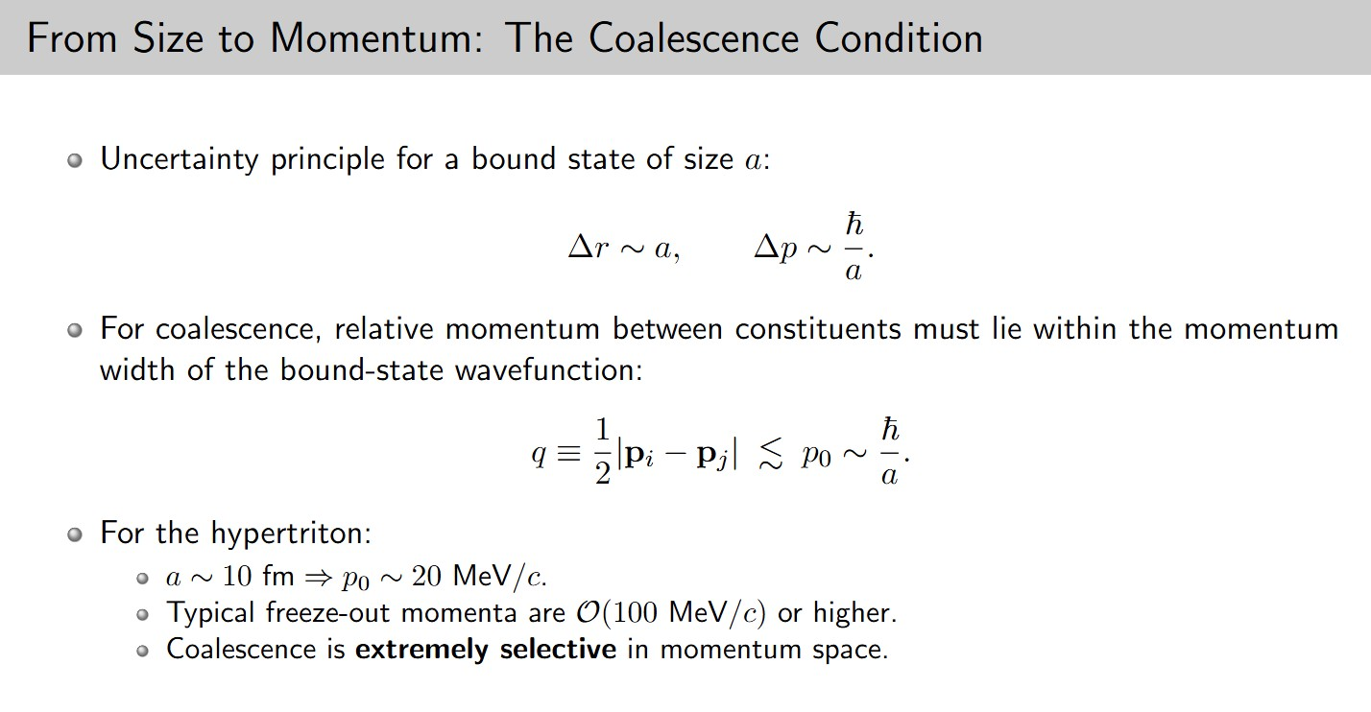

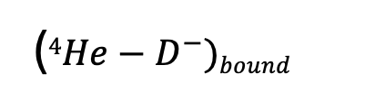
(${4He−D}^{−})bound$
$$4He$$
$$D^{−}$$
Notes:
Your coalescence slide narration
“To understand when a bound state can form, we start from the uncertainty principle.
A bound state of size a corresponds to a characteristic momentum scale \Delta p \sim \hbar/a.”
(brief pause, point to equation)
“This means the wavefunction only allows a limited spread in relative momentum.”
(as He⁴ and D⁻ start moving)
“So for coalescence, what matters is not the total momentum, but the relative momentum between the constituents.”
(as they get closer)
“We define that as
q = \frac{1}{2} |\mathbf{p}_i - \mathbf{p}_j|,
which measures how differently the particles are moving.”
(as they align / move together)
“If this relative momentum is small—meaning the particles are moving together—then they can remain within the spatial extent of the bound-state wavefunction.”
(as they “blamo” into the dashed circle)
“Only in that case, when q \lesssim p_0 \sim \hbar/a, can they effectively overlap and form a bound state—in this case a ^4\mathrm{He} + D^- hypercluster.”

Slide 10
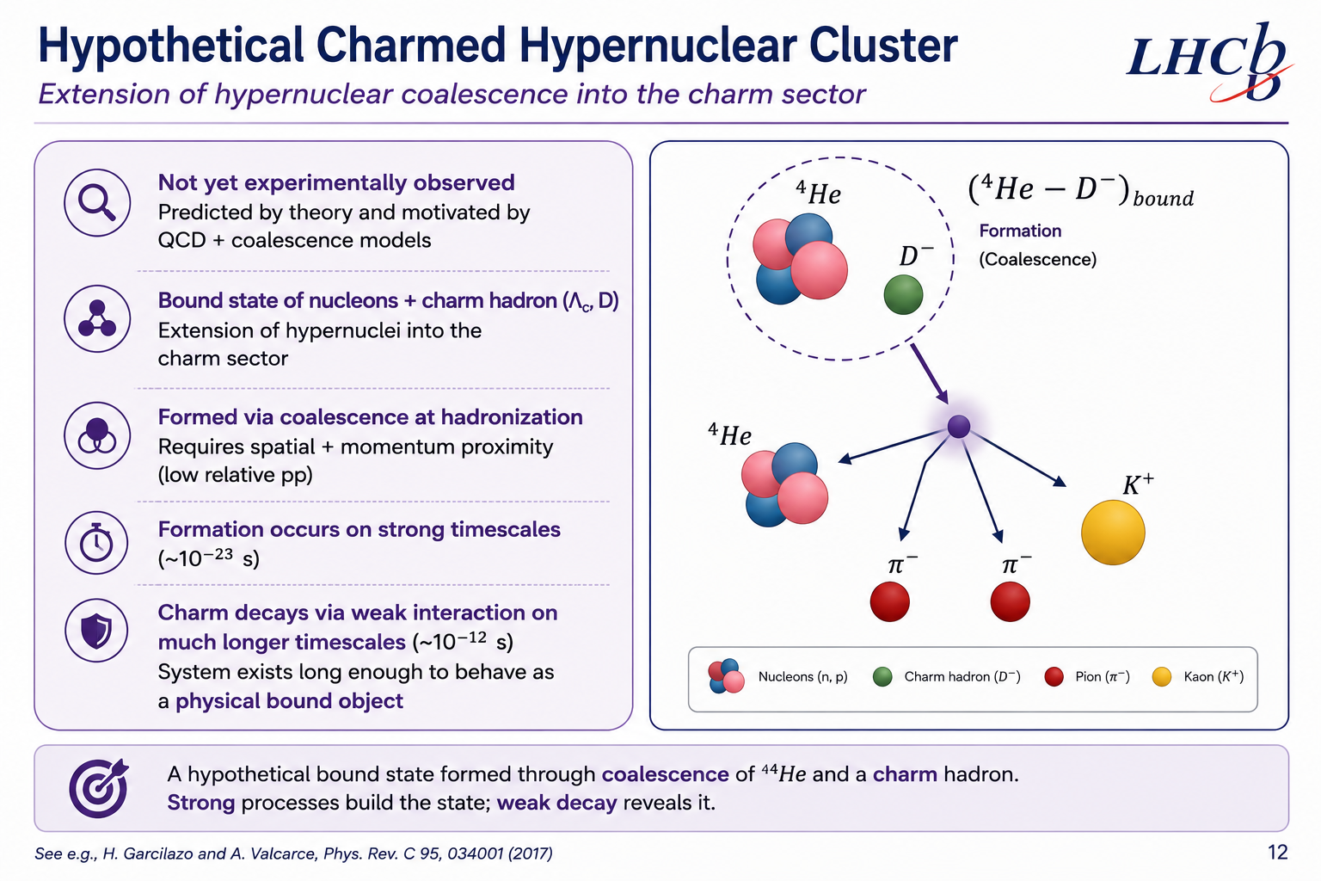
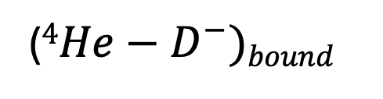



(${4He−D}^{−})bound$
_{Formation}
_{(Coalescence)}
$$K^{+}$$
$$π^{−}$$
$$π^{−}$$

Slide 11
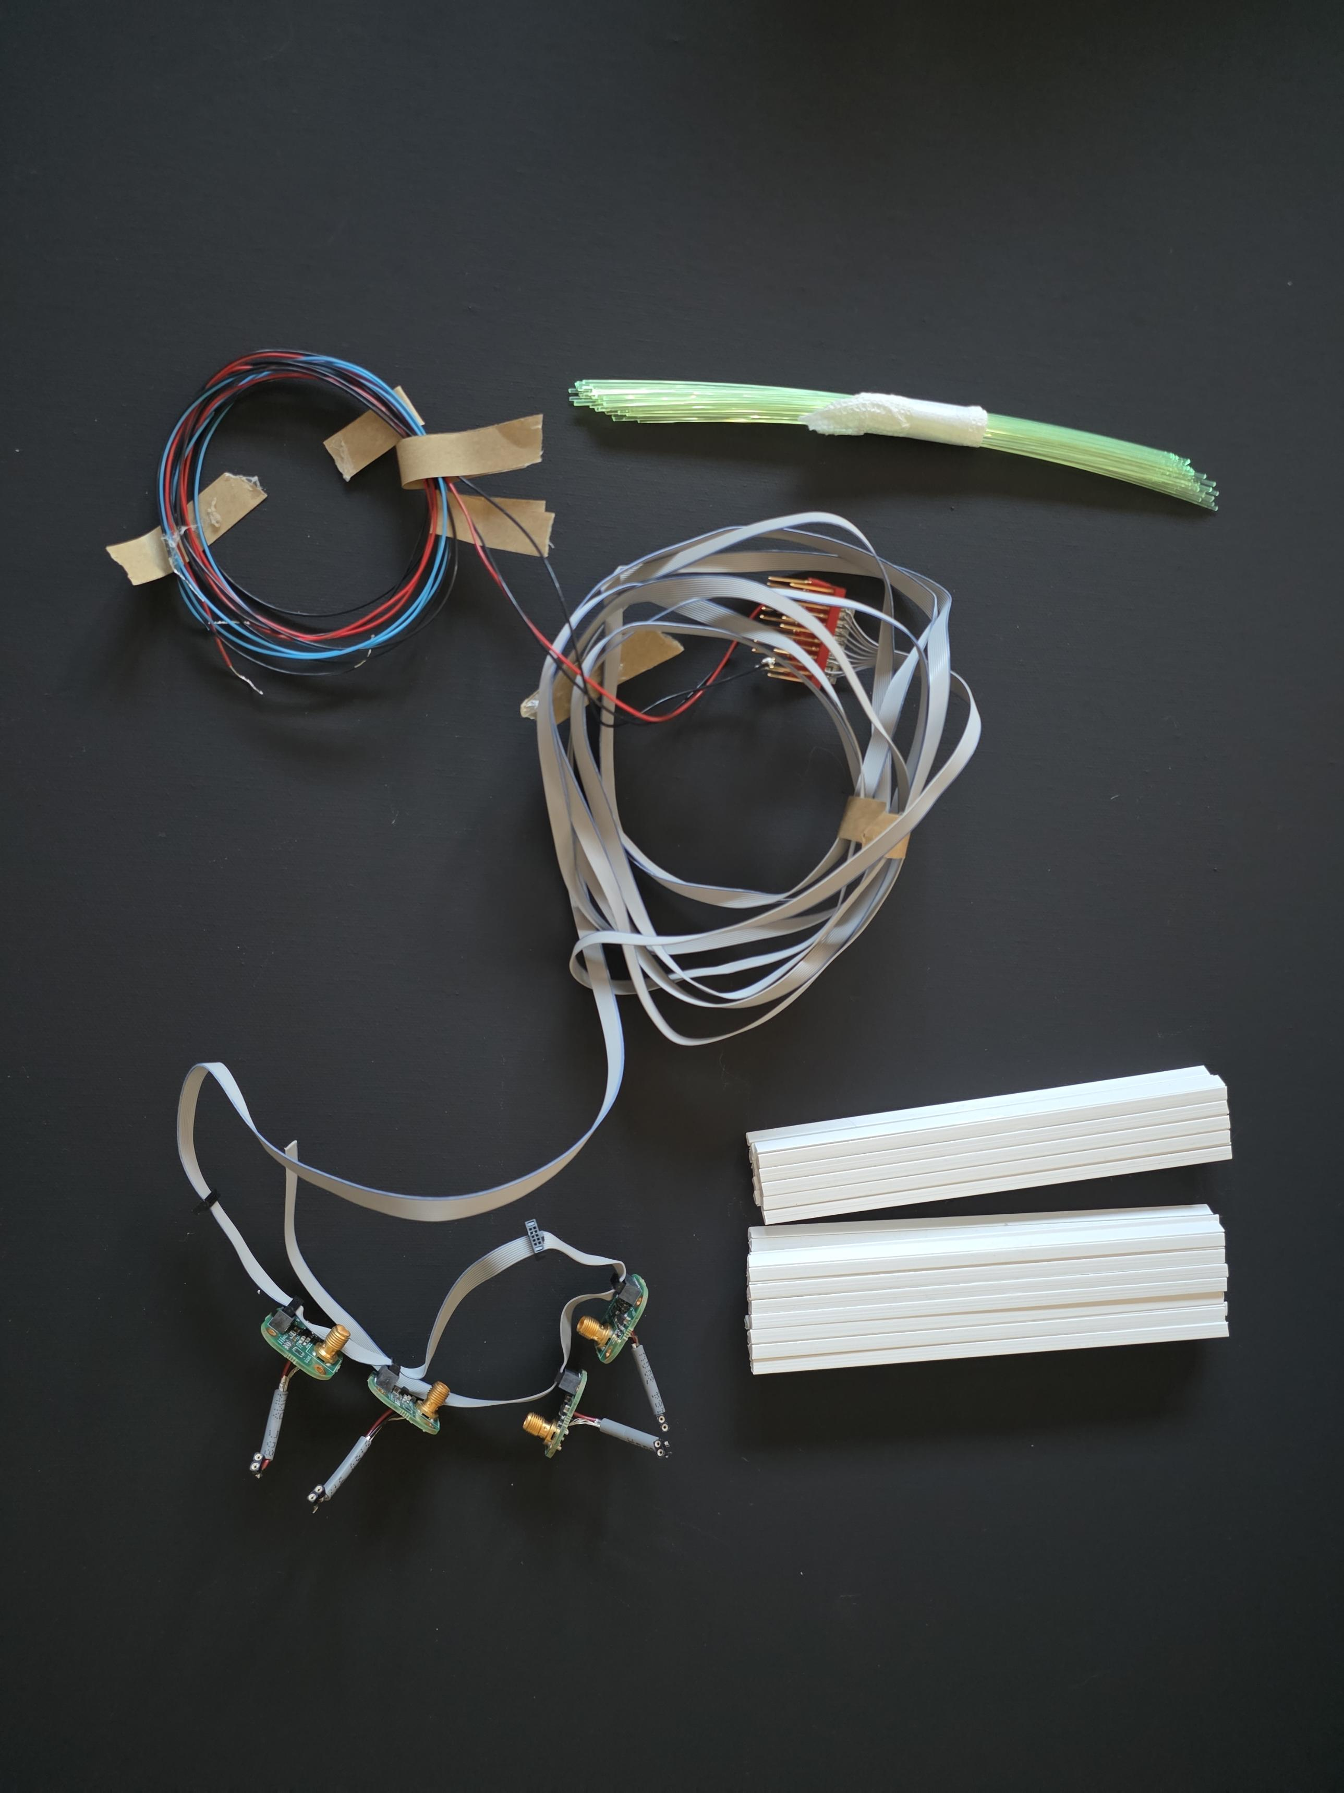
Scintillating-Fiber Detector

Slide 12
Charged Particle
Scintillator Bars
Optical Fiber
(Wavelength shifting)
(top-down view)
(front view)
Notes:
The scintillator bars are plastic polystyrene with dopants extruded in a square shape
with a 5 mm side fabricated at Fermilab [16] and ISMA (Ukraine). The bars are coated with
100 µm titanium dioxide for internal reflection of the scintillating light. The material has
a short attenuation length of 5 cm requiring light collection nearby the particle incidence.
Each bar has a 2.3 mm diameter hole at it centers to accommodate a 2 mm diameter
da Silva, Cesar L. 9The Magnet Station: A soft particle tracker to reach unexplored quantum field regimes.

Slide 13
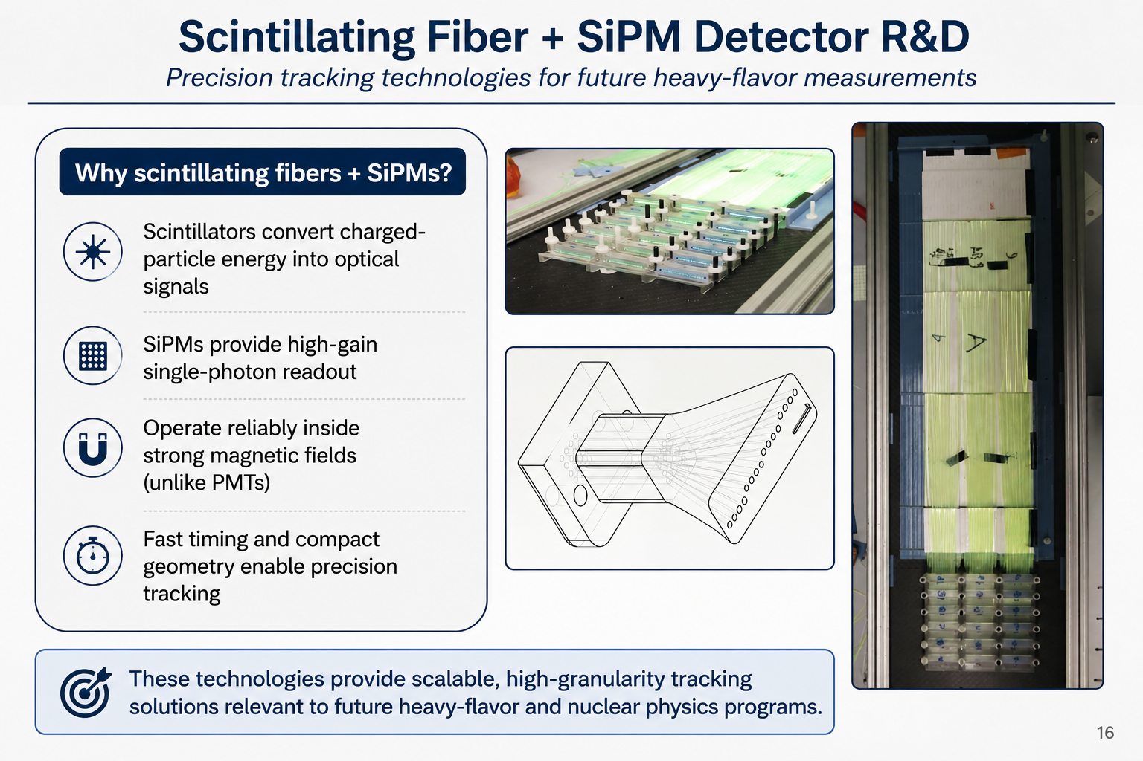
Scintillators convert charged-particle energy into optical signals
SiPMs provide high-gain single-photon readout
Operate reliably inside strong magnetic fields (unlike Photo-Multiplier Tubes)
Fast timing and compact geometry enable precision tracking
Adapted from C. L. da Silva et al., Magnet Station proposal (LANL).

Slide 14
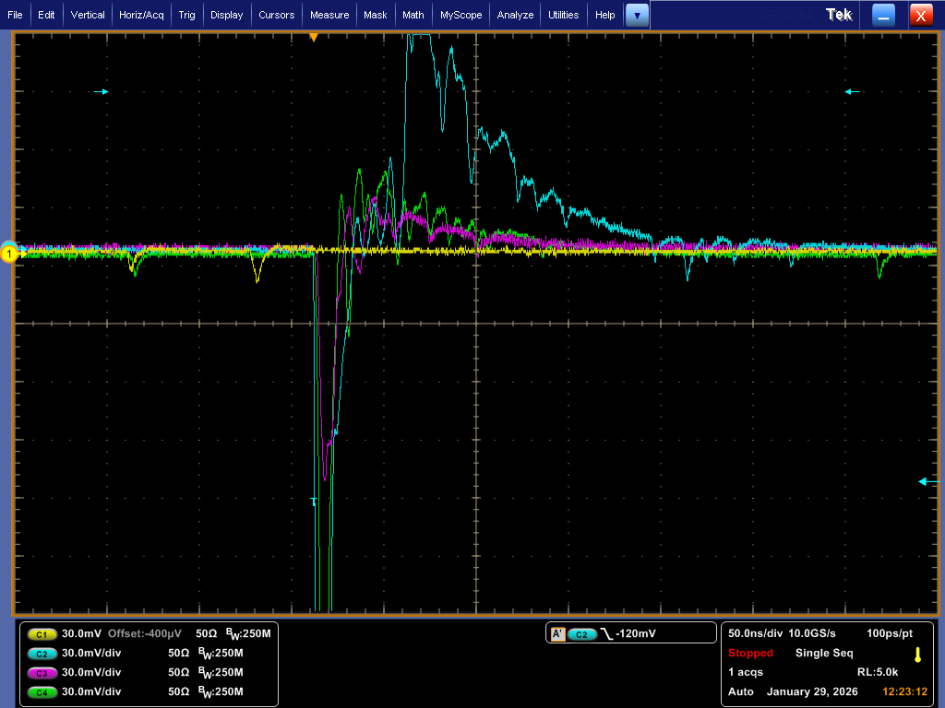
Pre-Amplifier
Multi-channel Read out
Cosmic
Muon
SiPMs
Oscilloscope from individual fiber channels

Slide 15



Butternut Squash
Wonton Soup
Thank you! ☺☺☺

Slide 16
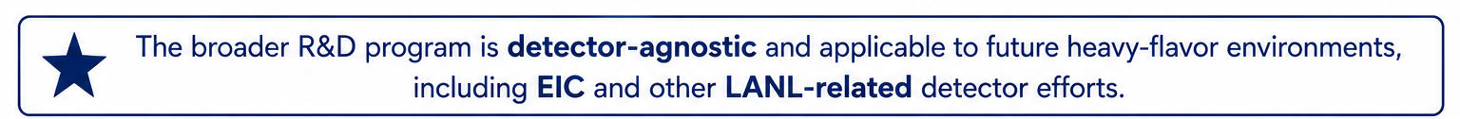
Next Steps ☺
LHCb Analysis Development
Laboratory Development
Detector R&D Studies
LHCb Software & tools
Working with LHCb Starterkit and ROOT Framework
Cosmic muon validation
Controlled and abundant input source
Light transport & yield
Photon transport in scintillating fibers
D meson Reconstruction
Reconstructing open charm hadrons from hadronic decay channels
Electronics & DAQ integration
System integration and data acquisition development
Signal formation & SiPM response
Charge, time, and saturation effects
Analysis techniques
Applying selections, PID and tracking quality cuts; invariant mass fits to extract signal
Local R&D environment
Establishing a detector R&D lab at Kent State University with future eiC/LANL applications
Threshold behavior
Response to soft charged particle
Extension to He⁴ & heavy-flavor topologies Hypernuclei and exotic final states
Channel response & detector calibration
Uniformity and alignment studies

Slide 17
Citations
Heavy-Ion and Charm Hadronization Physics
• STAR Collaboration, Phys. Rev. Lett. 113, 142301 (2014)
D⁰ nuclear modification factor in Au+Au collisions.
• STAR Collaboration, Phys. Rev. C 99, 034908 (2019)
Charm hadronization and low-pₜ enhancement studies.
• ALICE Collaboration, JHEP 04, 108 (2018)
Λc⁺/D⁰ production measurements in pp and p–Pb collisions.
• LHCb Collaboration, CERN CDS Record 2138628
Forward charm hadronization and RpPb measurements.
Figures adapted from:
• STAR Collaboration
• ALICE Collaboration
• LHCb Collaboration
• CERN CDS
Additional figures adapted for educational and presentation purposes.
Detector and Instrumentation References
• LHCb Collaboration detector geometry and tracking figures
• Kuraray / Luxium scintillating fiber documentation
• Hamamatsu SiPM documentation and response characteristics
Software and Analysis Tools
• CERN ROOT Data Analysis Framework
• LHCb Starterkit and analysis tutorials

