Slide 1





MOLLER Experiment Equipment Overview
Sudip Bhattarai
Idaho State University
CFNS Summer School, Jun 1-12, 2026

Slide 2
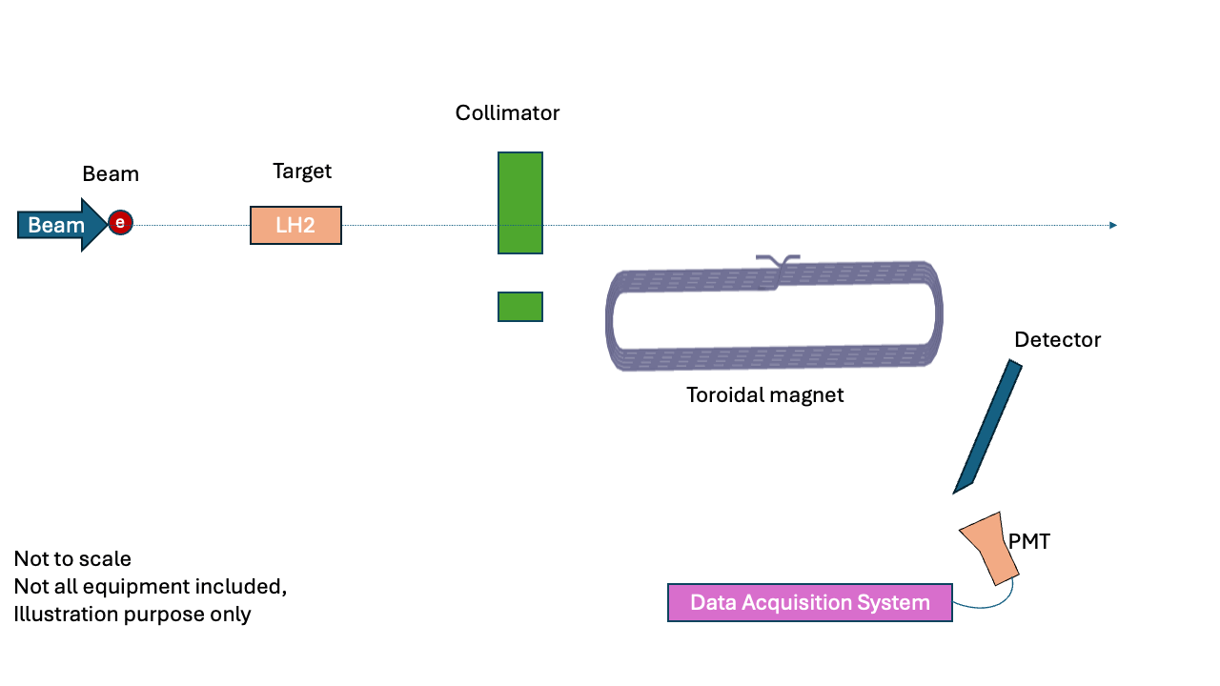
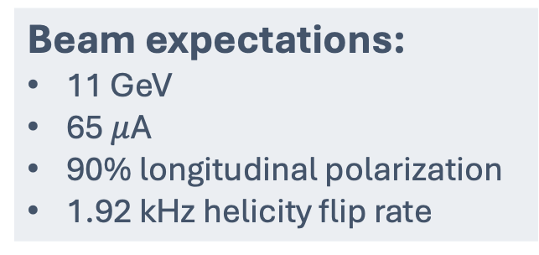
Basic illustration
Beam expectations:
11 GeV
65$μ$A
90% longitudinal polarization
1.92 kHz helicity flip rate
Target:
Liquid hydrogen
1.25 m long
High luminosity
Low density fluctuation

Slide 3
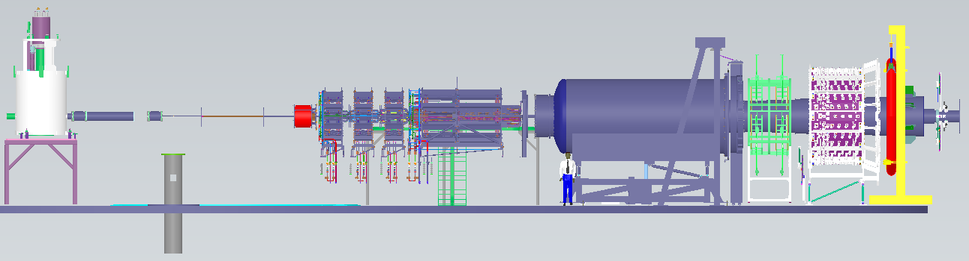
Big picture:
Target
Collimator
Downstream Torus Magnet
Main
Detector
e- beam
SAMs

Slide 4
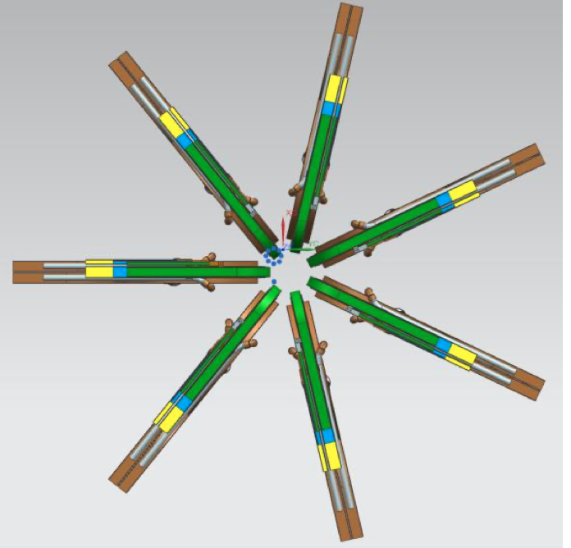
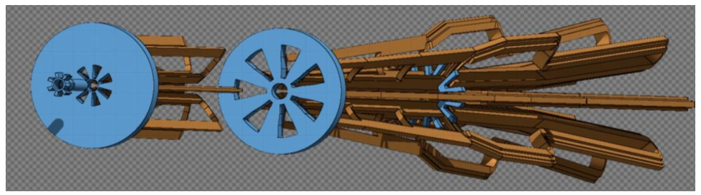
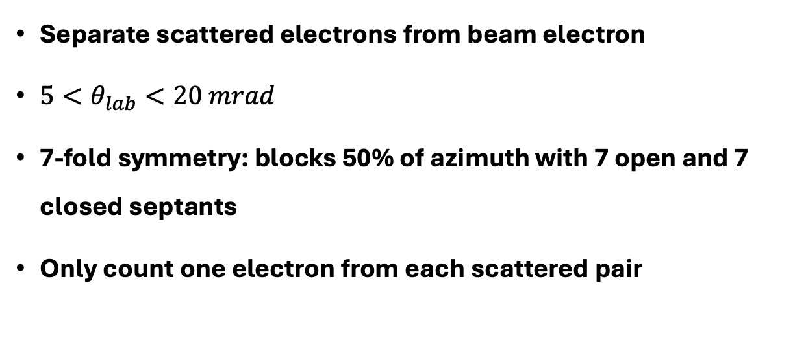
Collimator and spectrometers
Separate scattered electrons from beam electron
$5<θ_{lab}<20 mrad$
7-fold symmetry: blocks 50% of azimuth with 7 open and 7 closed septants
Only count one electron from each scattered pair
Closed sectors for magnet coils
Open sectors for electrons to pass through

Slide 5
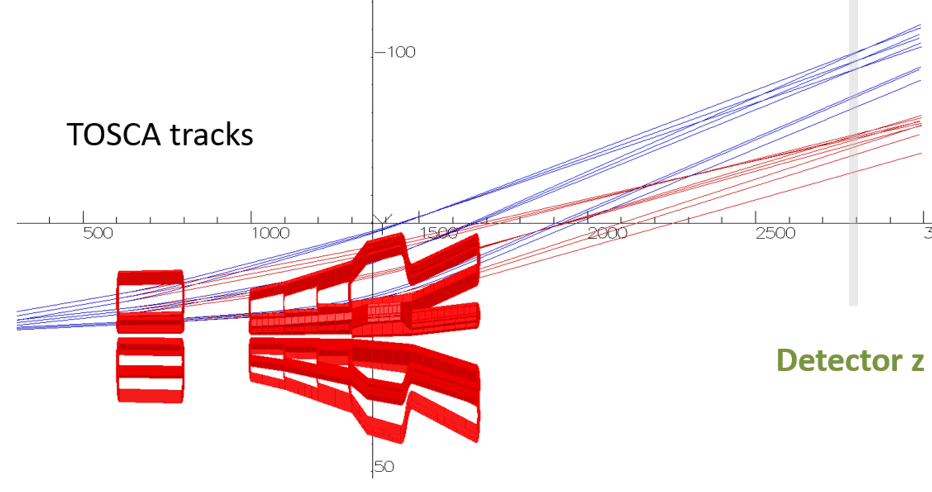
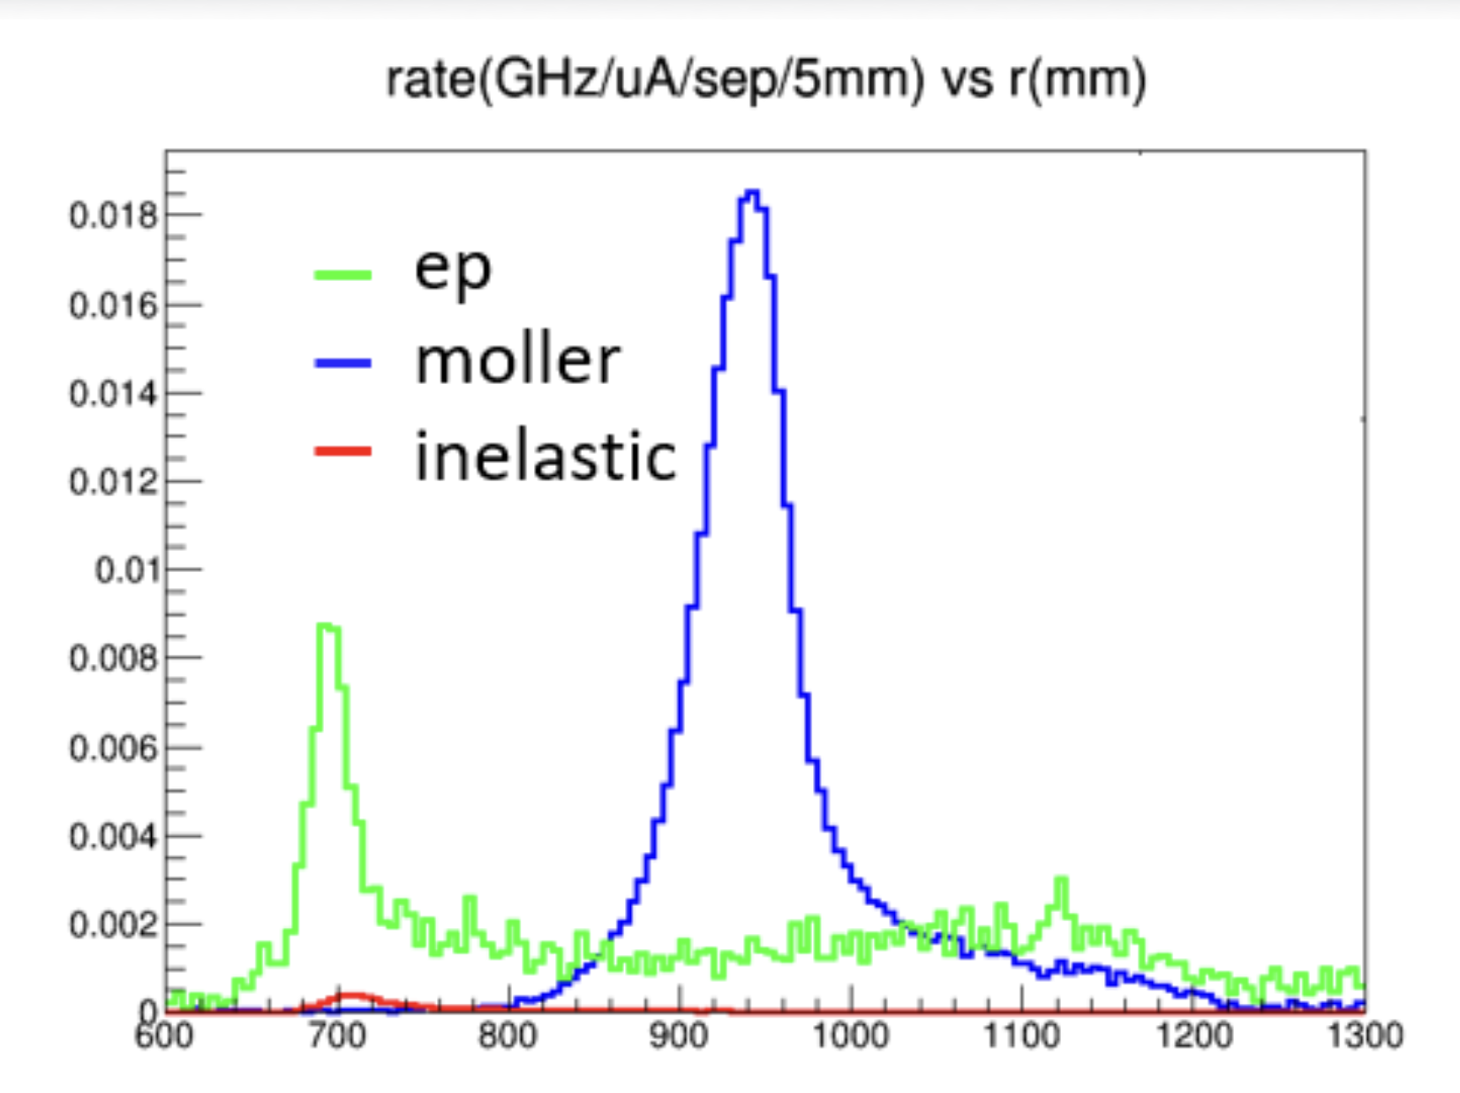
Torus Magnets
Moller scattered electrons
eP scattered electrons
Detector plane
Upstream Torus:
Flare all the particles
Downstream Torus:
Separate eP from Moller

Slide 6
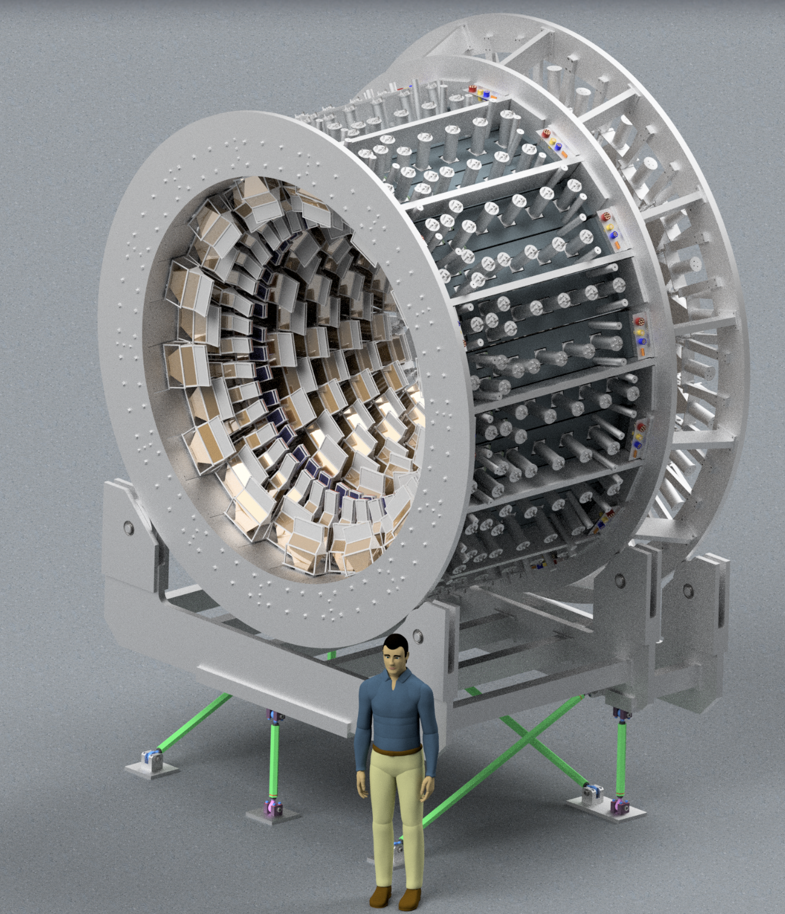
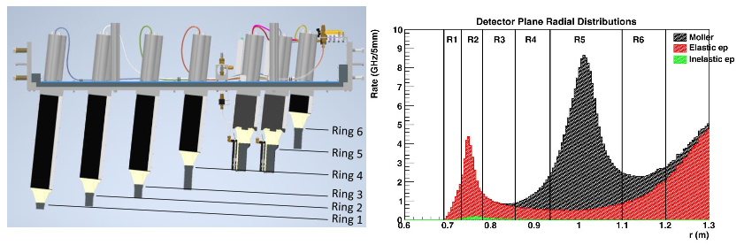
Detector System
Main detector:
  Full azimuthal coverage
  Six radial rings (ring 5 for Moller scattered electrons)
  224 individual Cherenkov detector + 28 Sampling calorimeter (Shower-max)
Additional 100+ auxiliary detectors

Slide 7
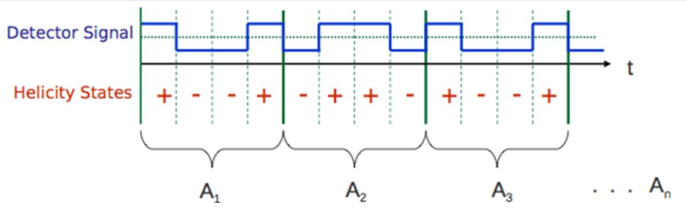
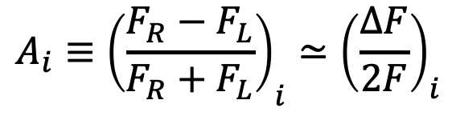
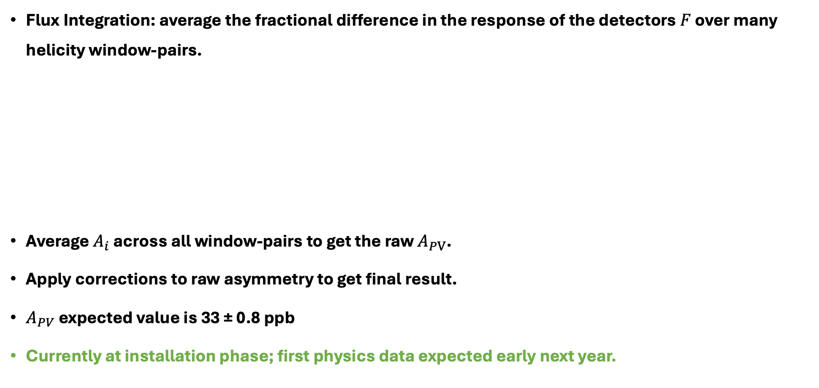
Asymmetry measurement
Flux Integration: average the fractional difference in the response of the detectors $F$ over many helicity window-pairs.
Average $A_{i}$across all window-pairs to get the raw $A_{PV}$.
Apply corrections to raw asymmetry to get final result.
$A_{PV}$ expected value is 33 ± 0.8 ppb
Currently at installation phase; first physics data expected early next year.
$$A_{i}≡{\left(\frac{F_{R}−F_{L}}{F_{R}+F_{L}}\right)}_{i}≃{\left(\frac{ΔF}{2F}\right)}_{i}$$
6

Slide 8
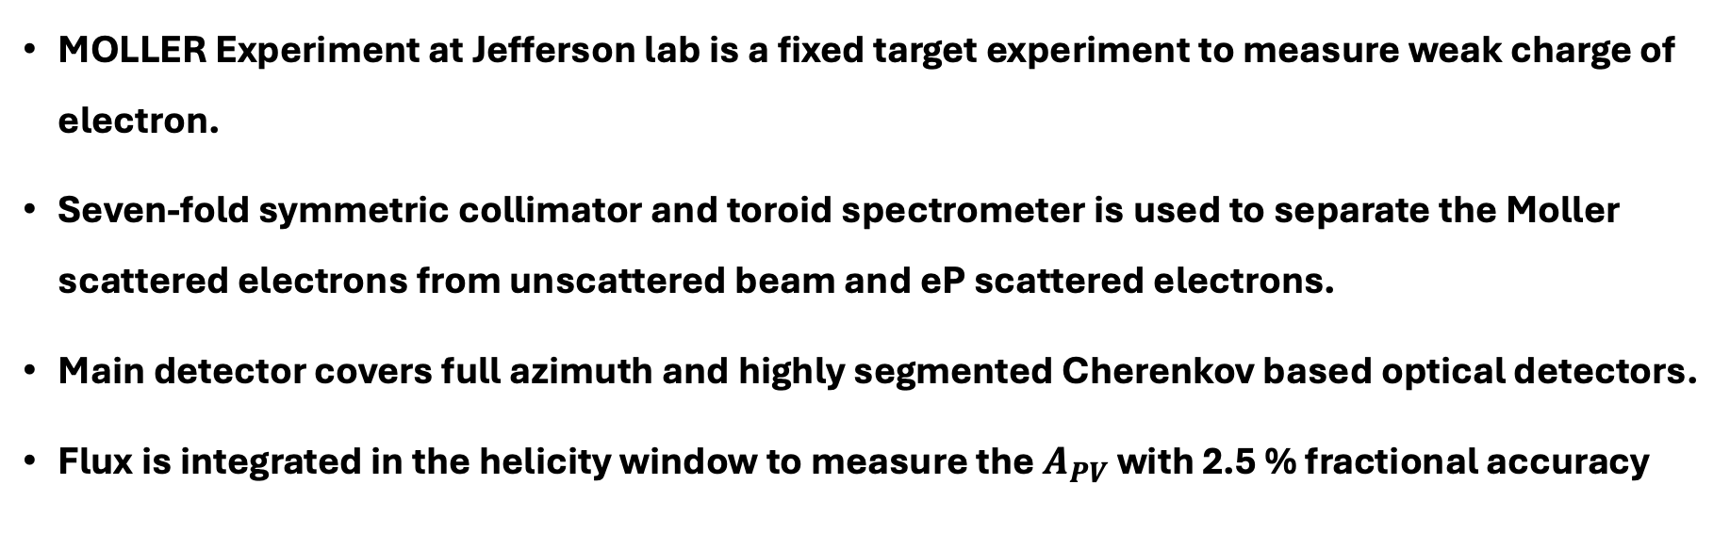
Summary
MOLLER Experiment at Jefferson lab is a fixed target experiment to measure weak charge of electron.
Seven-fold symmetric collimator and toroid spectrometer is used to separate the Moller scattered electrons from unscattered beam and eP scattered electrons.
Main detector covers full azimuth and highly segmented Cherenkov based optical detectors.
Flux is integrated in the helicity window to measure the $A_{PV}$ with 2.5 % fractional accuracy
Thank you !!!

Slide 10
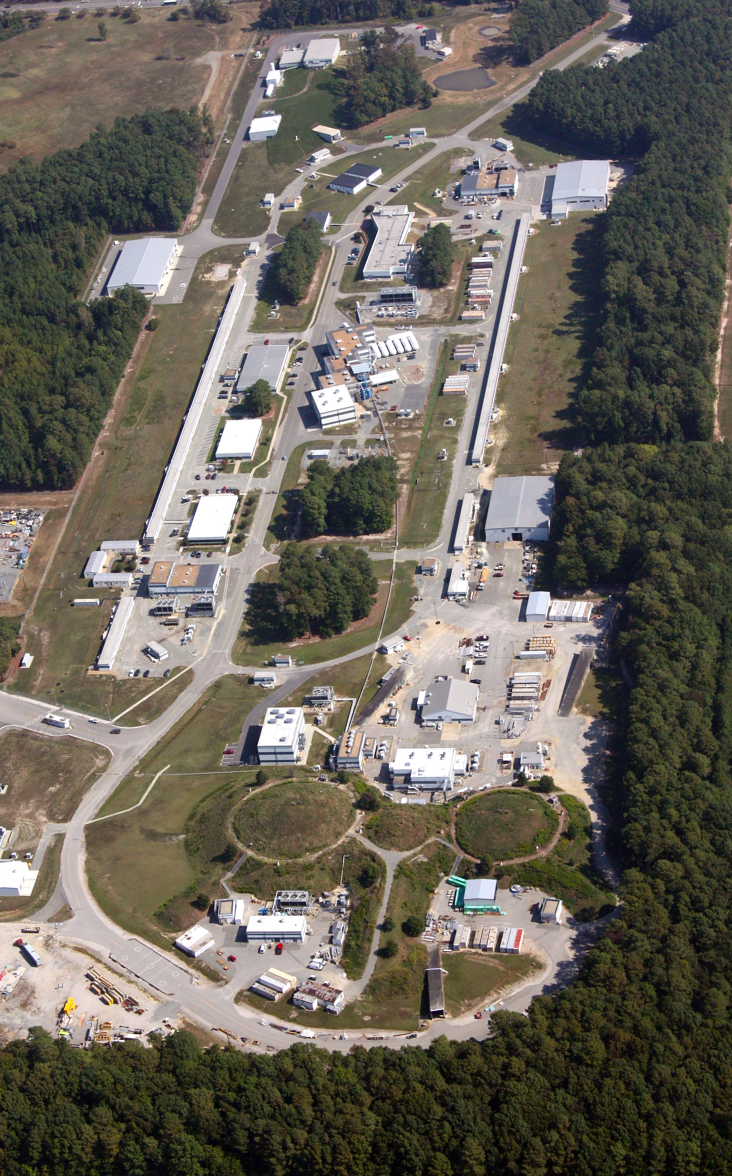
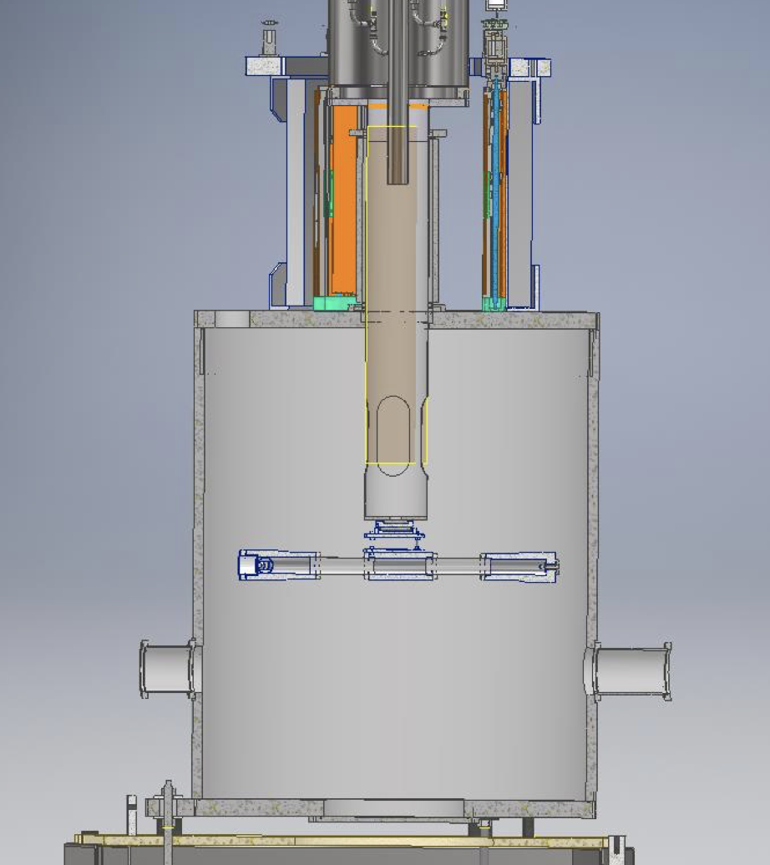
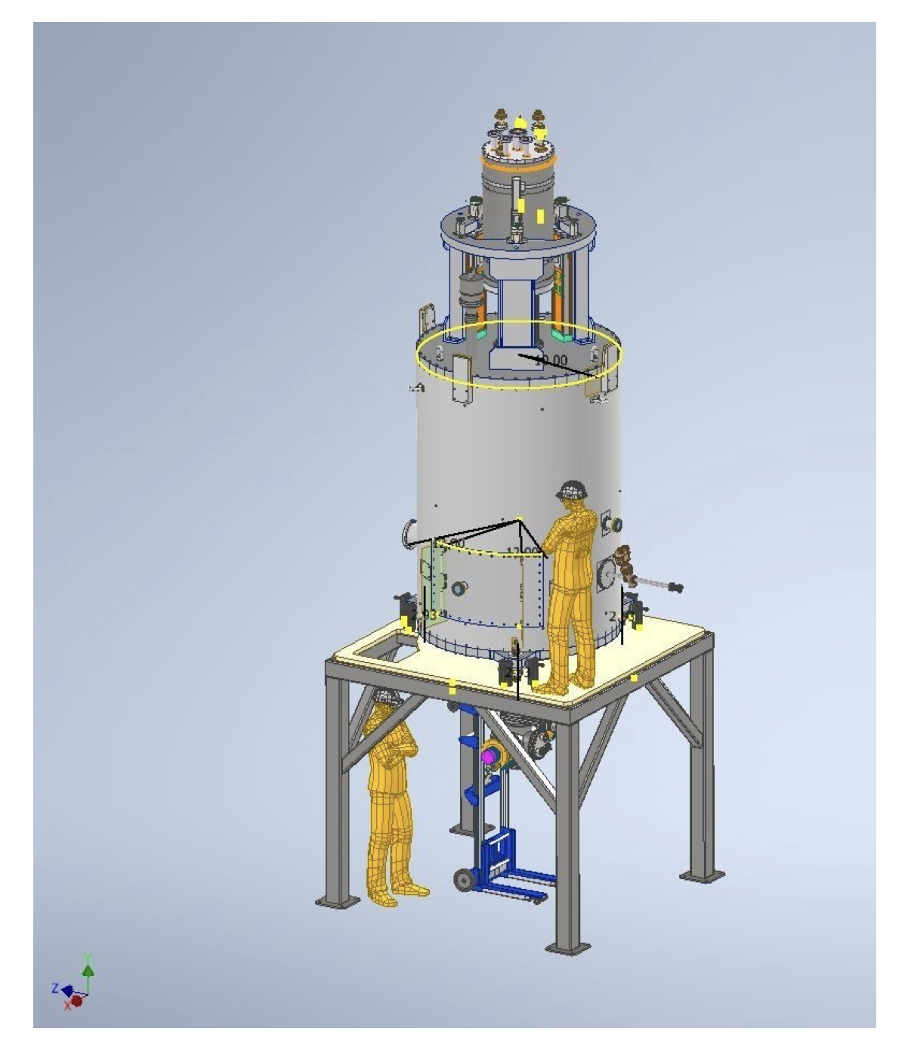
Backups

Slide 11
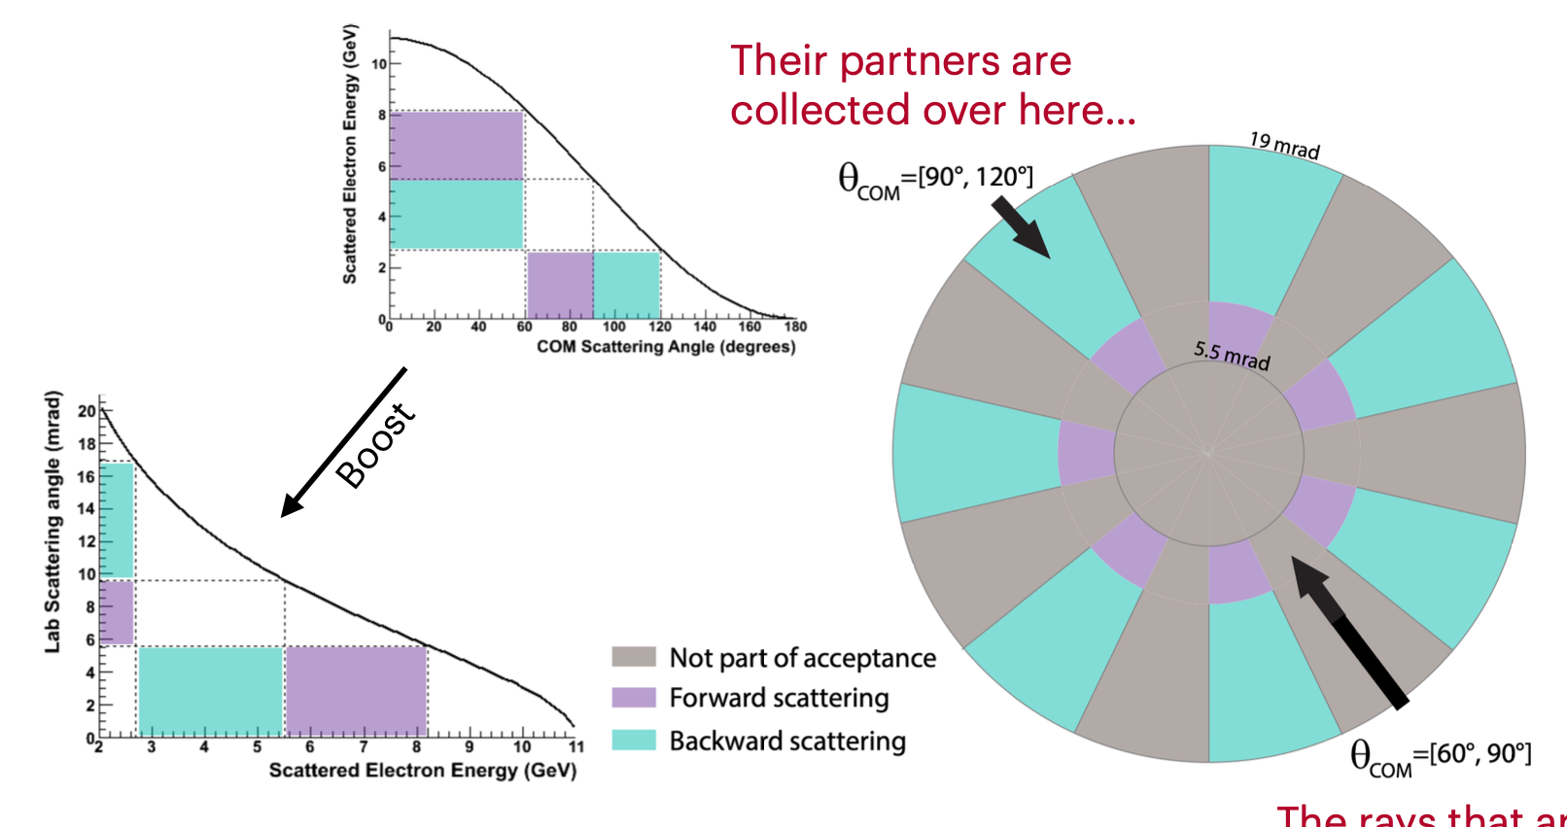
Backups

