Slide 1


Koopman- von Neumann
Field Theory
Dirac Algebra, Spinors, Pauli matrices, and other tools for relativistic classical mechanics
Presented by Daniel Piasecki

Slide 2
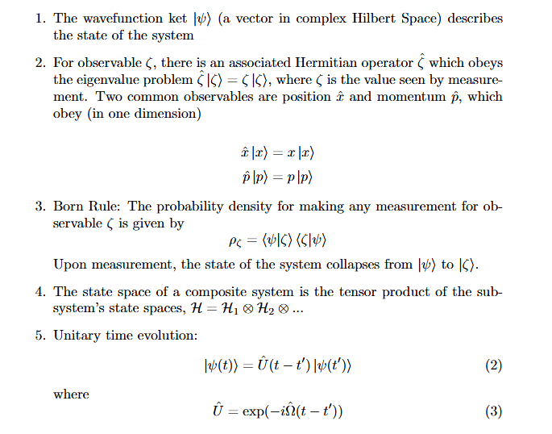
Dirac-von Neumann Axioms

Slide 3




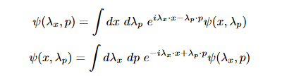
Main Difference between Nonrelativistic Classical and Quantum:
Commutation Relations of Algebra of Observables
Quantum Algebra:
Canonical Commutation Relationship
Classical Algebra:
Commutation of Position and Momentum
… Leads to Quantum Mechanics
… Leads to Classical Mechanics/Liouville Equation

Slide 4
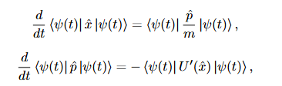





Using Dirac-von Neumann Axioms and Ehrenfest Theorems to derive Quantum/Classical Dynamics:
Quantum Case)
Schrödinger Equation

Slide 5


Using Dirac-von Neumann Axioms and Ehrenfest Theorems to derive Quantum/Classical Dynamics:
Classical Case)
Problem!

Slide 6

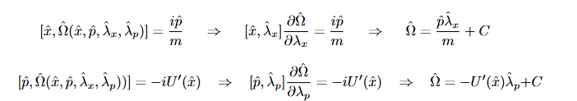

Using Dirac-von Neumann Axioms and Ehrenfest Theorems to derive Quantum/Classical Dynamics:
Classical Case)
Koopman Generator

Slide 7


Using Dirac-von Neumann Axioms and Ehrenfest Theorems to derive Quantum/Classical Dynamics:
Classical Case)
Since x and p commute, classical
wavefunctions must be wavefunctions on
phase space. Effectively, x and p have been
deconjugated (no wavenature) to get
classical mechanics of point particles.
Note:

Slide 8


Using Dirac-von Neumann Axioms and Ehrenfest Theorems to derive Quantum/Classical Dynamics:
Classical Case)
Since x and p commute, classical
wavefunctions must be wavefunctions on
phase space. Effectively, x and p have been
deconjugated (no wavenature) to get
classical mechanics of point particles.
Poisson Bracket from Quantum-like Commutators:
Born Rule
Liouville Equation

Slide 9
Nonrelativistic Koopman Mechanics/
Quantum
Mechanics
Dirac-von Neumann Axioms: Universal Axioms for Quantum-Classical Mechanics

Slide 10

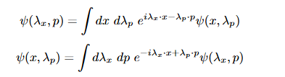
Hidden Variables… for Classical Mechanics (instead of for Quantum Mechanics)
The “hidden variables” of Classical Mechanics, λx and λp, are actually well-known in QM.
They happen to be the Bopp Operators of Phase Space Quantum Mechanics:
They can also be thought of as the inverse Fourier space of classical position and momentum:

Slide 11
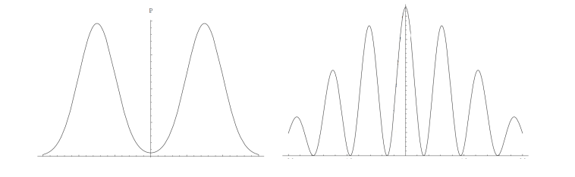
Some Results of Nonrelativistic Koopman Theory
Double Slit Experiment: Classical Distribution

Slide 12
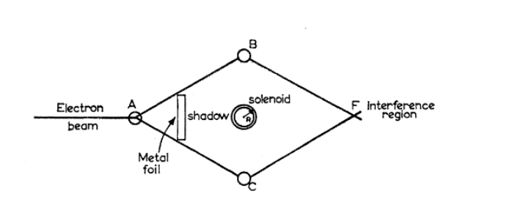
Some Results of Nonrelativistic Koopman Theory
Aharanov-Bohm Effect: No effect on Koopman wavefunction

Slide 13


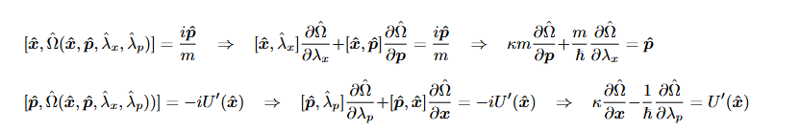





Some Results of Nonrelativistic Koopman Theory
Wigner Function: Natural setting in Koopman Theory
Interpolating Quantum-Classical Algebra:
Surprisingly, the Wigner function is a wavefunction
on phase space, not a quasiprobability distribution.
This explains the Wigner’s function’s lack of positive
definiteness.

Slide 14
Applications of Nonrelativistic Koopman Theory
Quantum-classical system coupling (Radonji et al., 2014; Bondar et al., 2019;
Gay-Balmaz and Tronci, 2023)
Quantum friction (Campos et al., 2015; Bondar et al., 2016a; Zhdanov et al., 2016, 2017; Vuglar et al., 2018)
Speed limit for quantum dynamics (Shanahan et al., 2018)
Generalizations of measurement theory (Morgan, 2020)
Advancement of efficient numerical methods (Cabrera et al.,2015, 2016; Bondar et al., 2016b; Koda, 2016)
Novel treatments of classical electromagnetism (Rajagopal and Ghose, 2016; Piasecki, 2025)
Quantum algorithms to simulate nonlinear non-Hamiltonian classical dynamics (Joseph, 2020)
And many other avenues of investigation

Slide 15
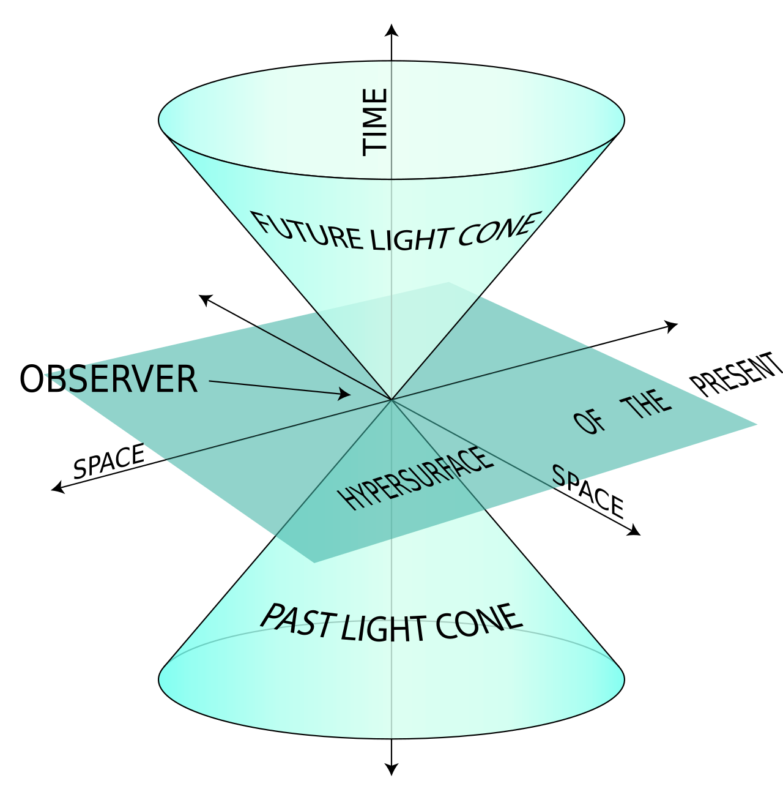
Relativizing Koopman Theory
Standard Koopman Theory is based on DvN axioms, which are not relativistic
A relativistic formalism is desired, but underdeveloped
Can a relativistic Koopman formalism be extended to QCD? After all, QCD heavily features the Wigner Operator (and derived PDFs). Classical limit of QCD is Quark-Gluon Plasma.

Slide 16
But… this is far from straightforward.
What are features that distinguish QM from QFT?
  Space and time treated as parameters, not operators
  Second quantization of Fields
  Spinors and Dirac Algebra
  We desire a Koopman Field Theory that describes massive point particles with classical spin.

Slide 17



Spacetime Geometry Considerations:
Classical/Quantum Particles with Spin
Is a formalism possible with Dirac spinor on one end, and classical spinning particle on the other,
with a Wigner style interpolation between the two? In a way that is not ad hoc?
Quantum Limit:
Classical Limit:
Liouville-Vlasov Relativistic Dynamics^
On one end you have Clifford algebras and spinors, and on the other end you don’t.
Is it the Dirac equation too different from Vlasov flow?

Slide 18



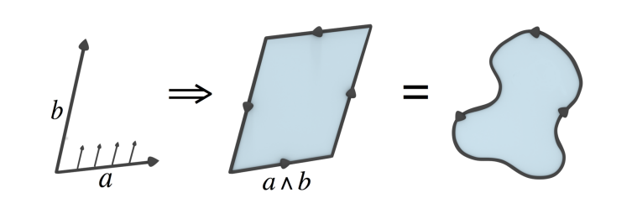
Detour: Spacetime Geometry and Clifford Algebra
What are the Dirac gamma matrices?
Clifford-Grassmann Product:
Dot Product: Relativistic Inner Product
Wedge Product: Generalization of Cross Product to any dimension
Very intuitive, geometric picture in Euclidean space:

Slide 19

Detour: Spacetime Geometry and Clifford Algebra
What are the Dirac gamma matrices?
Clifford-Grassmann Product:
Represents a Geometric Decomposition into Contributing Parts:
Any vector on spacetime has the vector decomposition:
The gamma mu’s here are notation for an orthonormal spacetime basis:

Slide 20



Detour: Spacetime Geometry and Clifford Algebra
CG Product is a means to study the properties of spacetime. It has been introduced by other researchers
to study geometry, but leads to some interesting conclusions.
For example, the resulting algebra encodes all spacetime observables in the form of a multivector:
Spacetime has an intrinsic complex structure, even if we assume the spacetime basis elements are purely real:

Slide 21



Detour: Spacetime Geometry and Clifford Algebra
CG Product is a means to study the properties of spacetime. It has been introduced by other researchers
to study geometry, but leads to some interesting conclusions.
Leads to very elegant means to rotor objects in spacetime (boosts, spatial rotations):
Defining relative “Euclidean” vectors:
Property of Duality:
You can always rewrite rotors in terms of relative vectors and the complex spacetime structure i.

Slide 22

Why the long detour?
We have not introduced any quantum assumptions into the discussion, only geometric considerations
for thinking about spacetime.
However, we learn a few surprises:
Spacetime Basis form a Dirac Clifford Algebra
Satisfying the Clifford Algebra, the spacetime basis vectors can be given 4x4 representation as the commonly
recognized Dirac matrices. The lack of commutativity of the Dirac “spacetime basis” matrices can be
intuitively understood as a consequence of the wedge product (analogous to the cross product), which
does not commute.

Slide 23
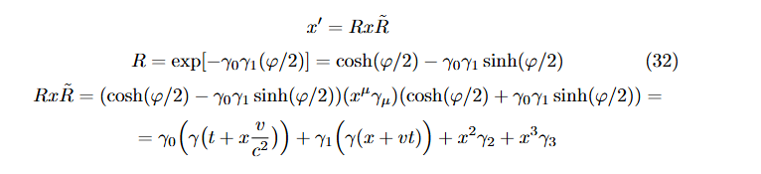
Why the long detour?
The Dirac matrices have a natural interpretation as a representation of the spacetime basis.
2. Rotors are a way to represent boosts and rotations, but in quantum-like fashion with double
sided exponential:

Slide 24





Why the long detour?
The Dirac matrices have a natural interpretation as a representation of the spacetime basis.
2. Rotors are a way to represent boosts and rotations, but in quantum-like fashion with double
sided exponential:
Note:
Both of these
are relativistic classical
examples utilizing the
Dirac matrices

Slide 25

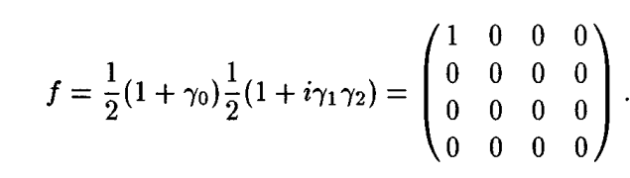
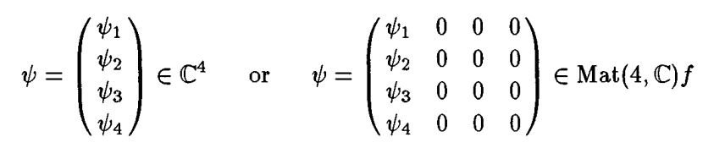
Why the long detour?
3. Spinors are a subset of rotors
Another equivalent way to understand spinors is as minimal left ideals of a Clifford algebra:
The above two definitions are equivalent. Both will be used in the following.
The important point is that we have spinors without quantum reasoning, as geometric objects that
encode spacetime momentum and orientation.

Slide 26


Why the long detour?
4. Division by 2 in rotor/spinor is a representational issue
Division by 2 can be seen as a representational issue of going from double sided sandwich product to single
rotor parameterization for particles. From this perspective, the rotation of 720 degrees actually corresponds
to a physical rotation of 360 degrees.

Slide 27



Introducing Koopman Philosophy to Geometric Spinors
Advances in the mathematics of spacetime geometry reveal that many objects we typically think
of as quantum are actually geometric objects. Dirac gamma matrices and spinors naturally arise
with a coherent geometric interpretation.
Importantly, this was not added in arbitrarily. No quantum assumptions were made up to this point.
Sketch of Derivation of Dirac equation)

Slide 28
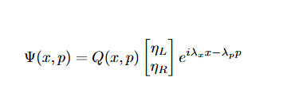
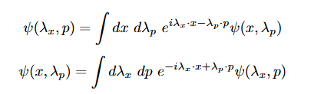
Introducing Koopman Philosophy to Geometric Spinors
Sketch of Derivation of Vlasov equation)

Slide 29







Action Principle for Relativistic Koopman Formalism
We can, of course, carry out a parallel analysis to get the Dirac equation.

Slide 30


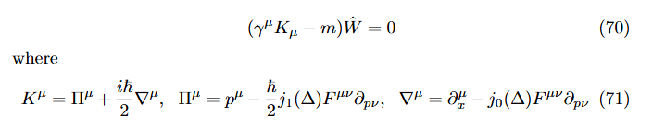


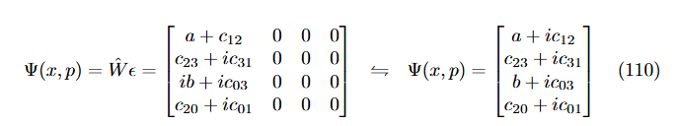
Wigner Operator as a Spinorial Amplitude
Note: Condensed
Matter Application

Slide 31
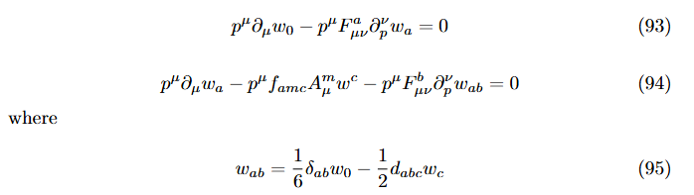



Koopman Treatment of Classical Chromodynamics

Slide 32
Further Work Being Done
Wigner Classification of Classical Point Particles (Casimir Invariants, etc.)
Dyson series of the Liouville Operator
Schematic Diagrams of Classical Scattering Processes
LSZ axiomatic formalism for Koopman Scattering Theory (S-Matrix, etc.)
Fock Phase Space for Classical Statistical Mechanics
Quantum like algorithms for nonequilibrium classical statistical mechanics
Applicability to Spinotronics and Condensed Matter Physics (classical electrons with spin)

Slide 33
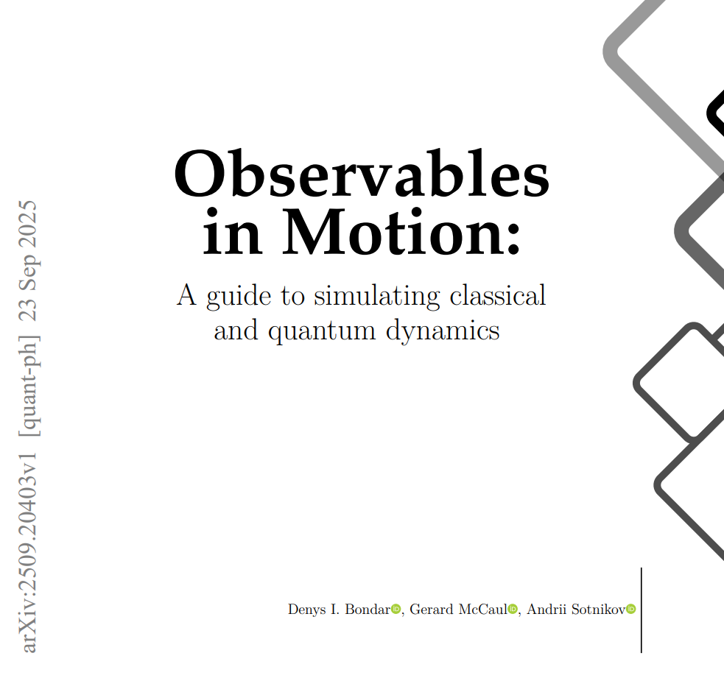
Resources: Computational Classical/Quantum Mechanics in Hilbert Space
Excellent book for nonrelativistic classical/quantum Hilbert space methods and classical computer computations.
arXiv:2509.20403 [quant-ph]

Slide 34
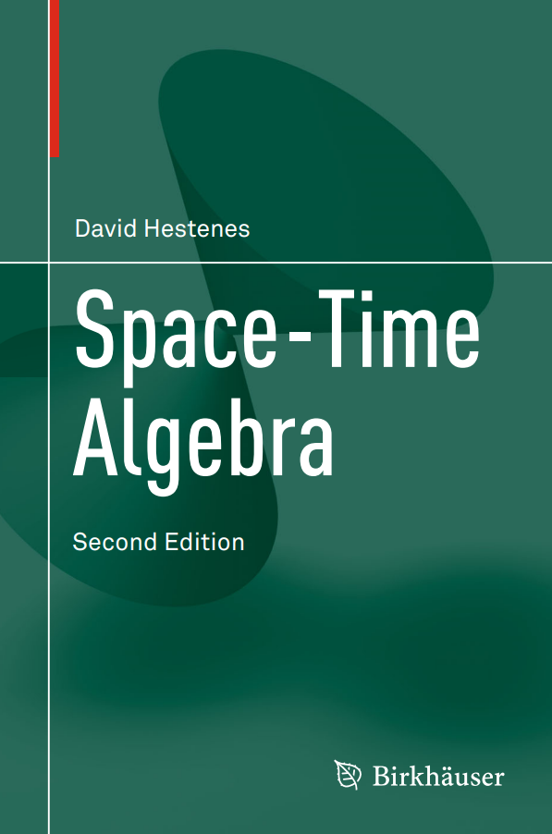
Resources:
Theory of Geometric Spinors
Excellent book for the Clifford Algebra of Spacetime formalism. Goes into Clifford-Grassmann product and geometric intuition, etc.

Slide 35
Thank you!
This line of research may have implications for condensed matter, solid state, plasma physics, statistical mechanics, QCD Parton Distribution Functions, etc.
If you have ideas how to extend the work, feel free to reach out, always happy to chat.
Please feel free to reach out to dpiasec@ncsu.edu
with questions or thoughts.

Slide 36
References:
Origin of the Covariant Wigner Operator as a Quantum Amplitude in QCD by Chueng-Ryong Ji, D.W. Piasecki
Introduction to Koopman-von Neumann Mechanics by Daniel Piasecki
Spacetime Algebra as a Powerful Tool for Electromagnetism by Justin Dressel, Konstantin Y. Bliokh, Franco Nori
Physics Reports 589, 1–71 (2015).
Operational Dynamic Modeling Transcending Quantum and Classical Mechanics by Denys I. Bondar, Renan Cabrera,
Robert R. Lompay, Misha Yu. Ivanov, Herschel A. Rabitz Phys. Rev. Lett. 109, 190403 (2012)
Clifford Algebras and Spinors by P. Lounesto. 2nd ed. Cambridge University Press; 2001.
Images that do not appear in the above but were utilized:
https://en.wikipedia.org/wiki/Light_cone#/media/File:World_line.svg (Light cone)
https://www.wired.com/sponsored/story/a-path-to-breaking-up-forever-chemicals/ (Molecules)

