Slide 1
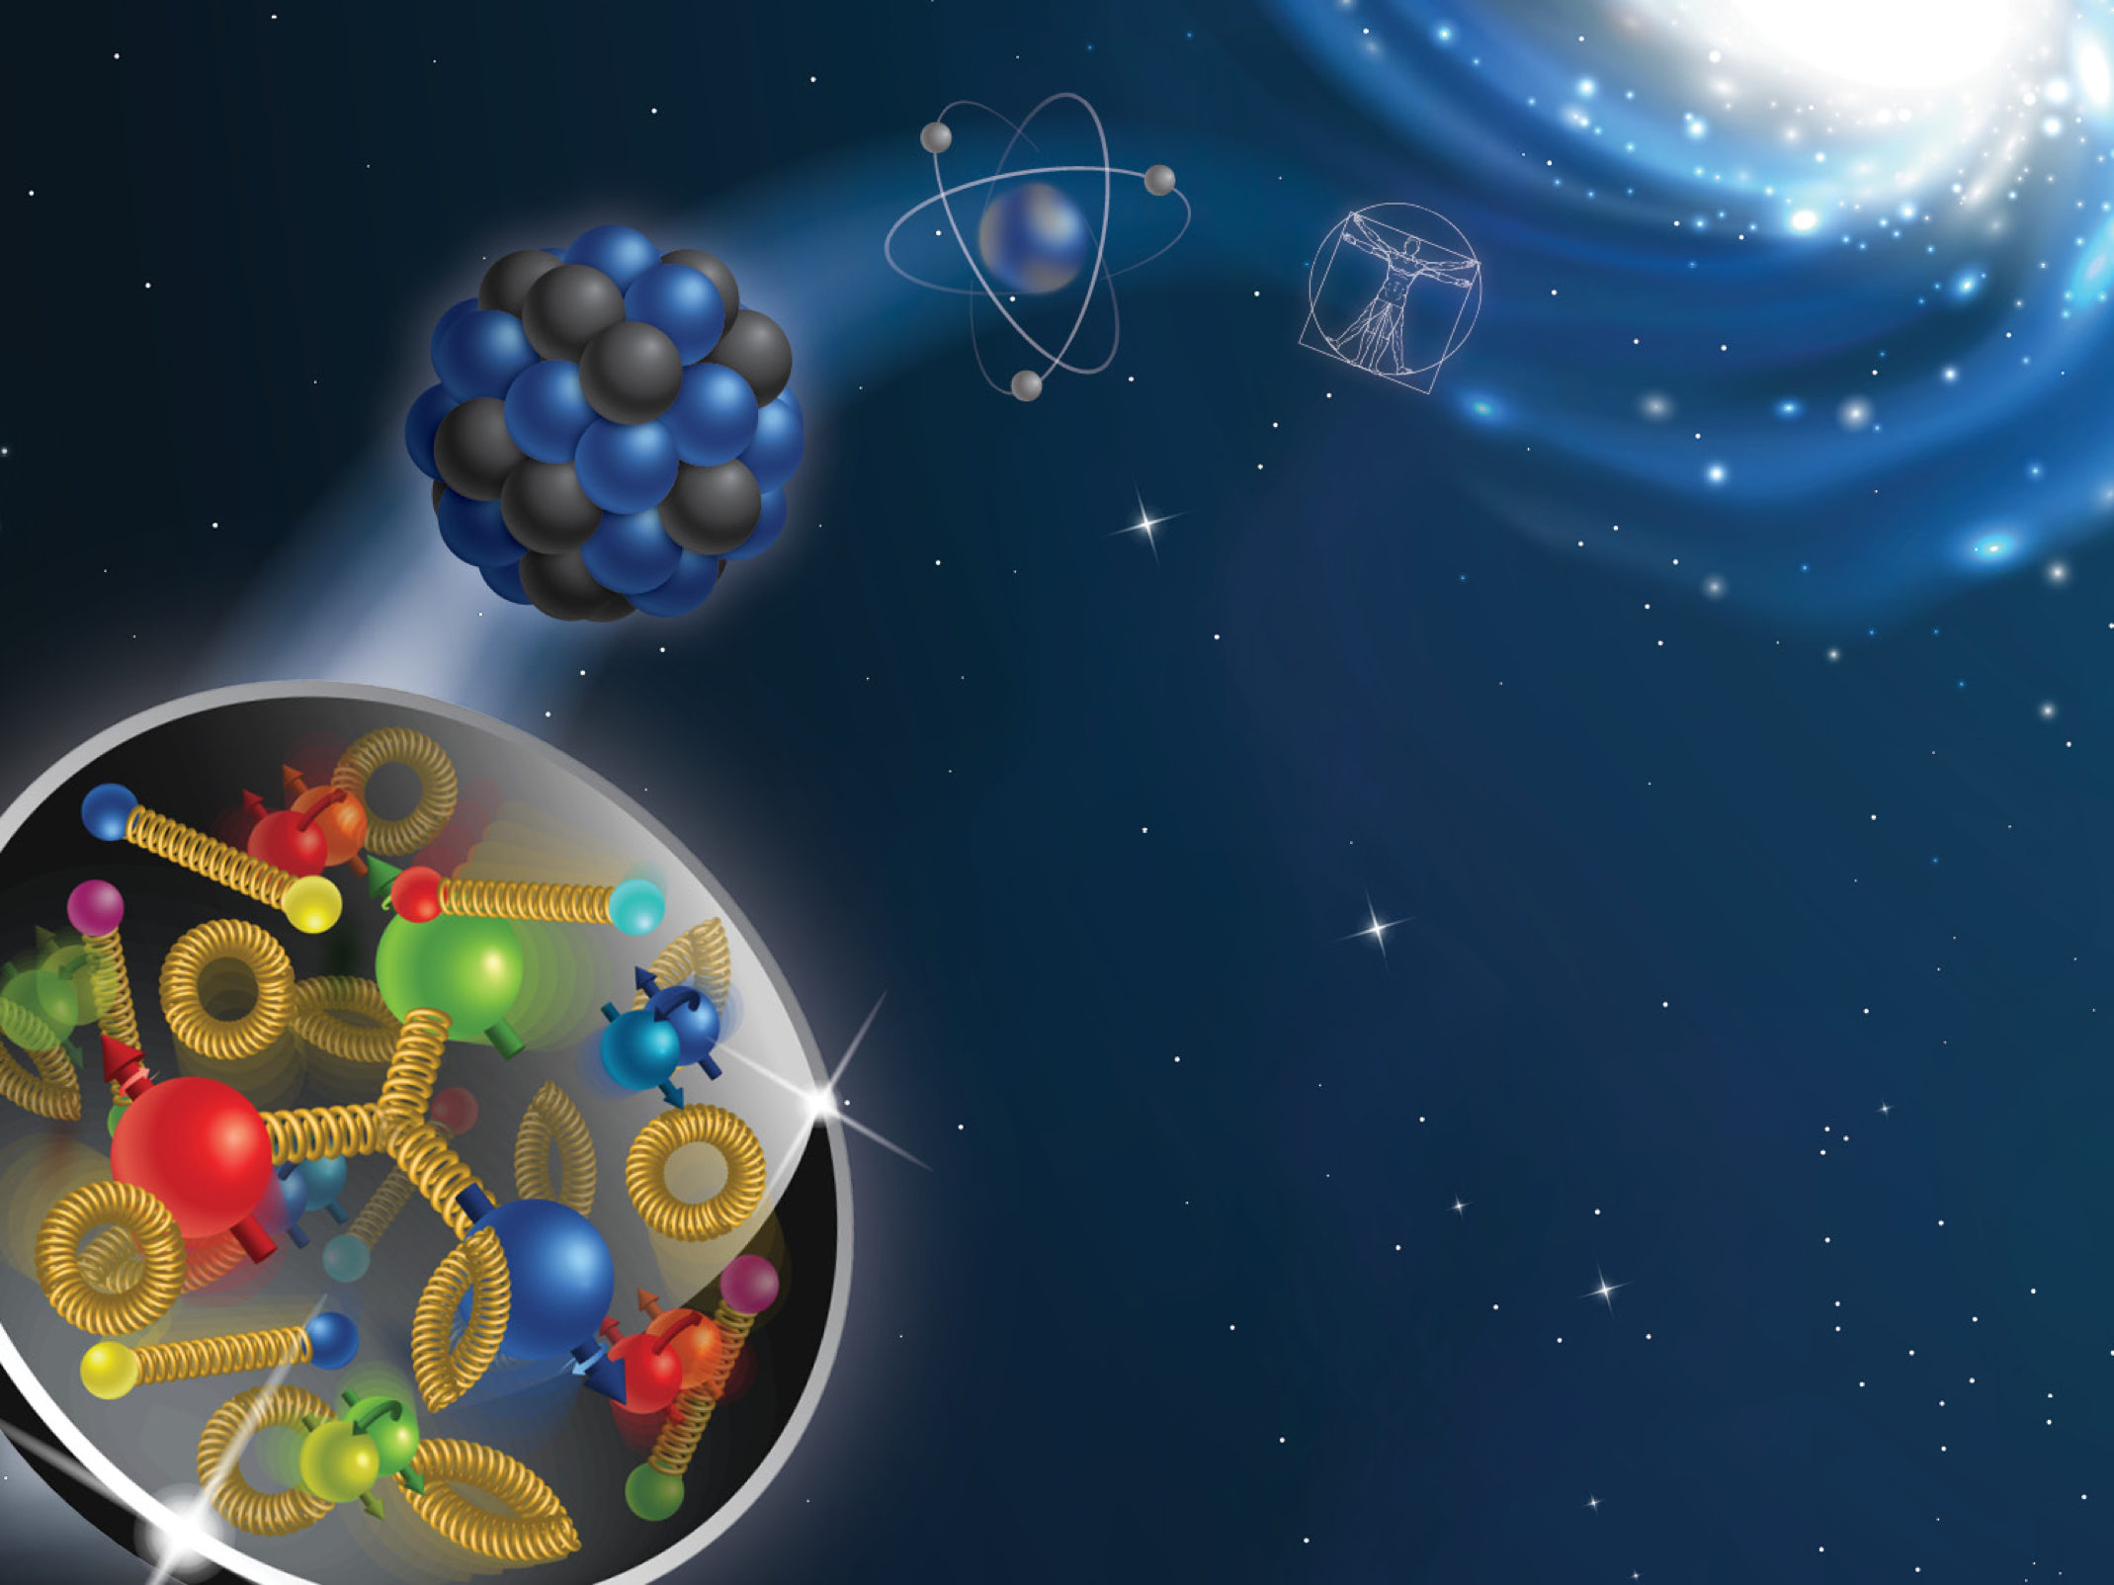
The 2026 CFNS Summer School on the Physics of the
Electron-Ion Collider

Slide 2

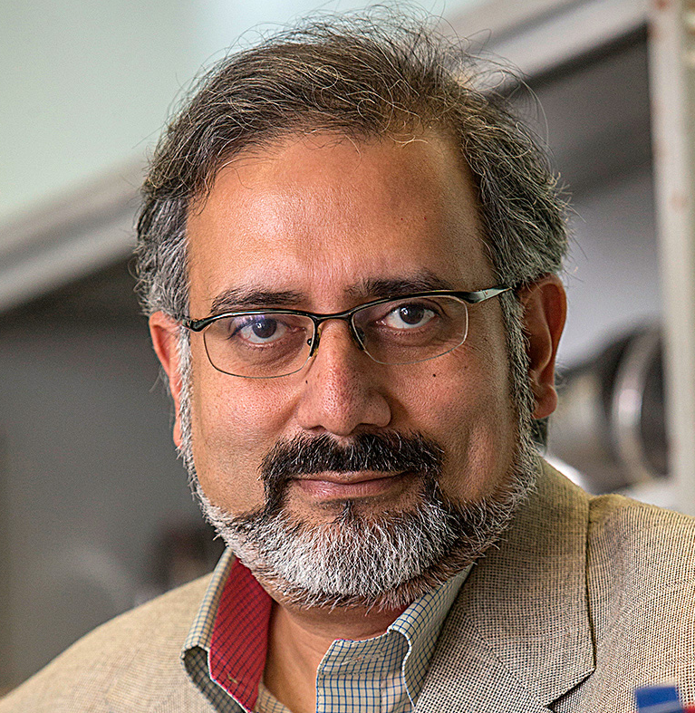
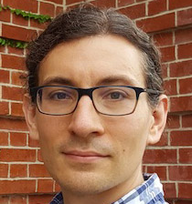
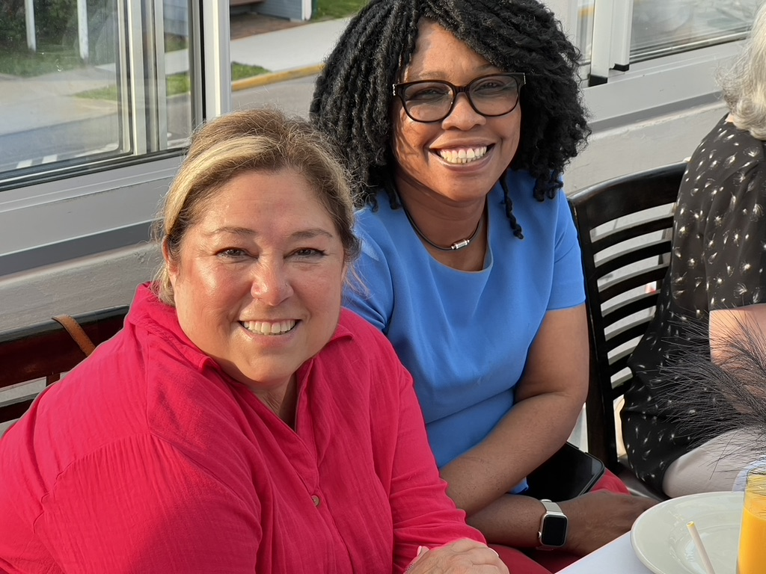
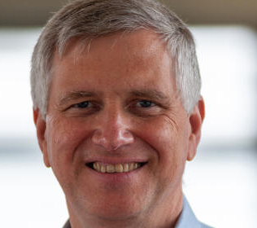
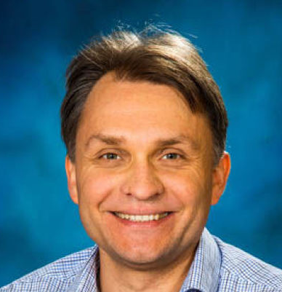
School organizers
Abhay Deshpande (SBU/BNL)
Ross Corliss(SBU)
Socorro Delquaglio (SBU)
Melissa Laguerre (SBU)
Fred Olness (SMU)
Alexei Prokudin (PSU Berks)

Slide 3
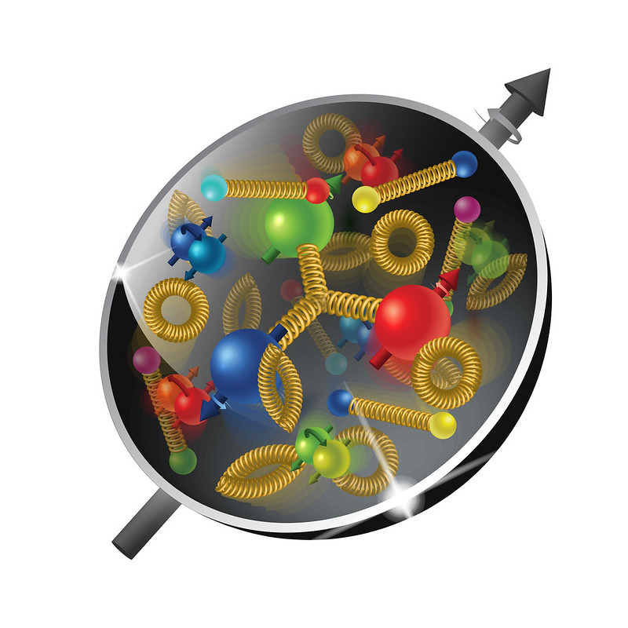
the 2026 CFNS Summer School
This year we have crossed the threshold of 250 students. In the last 7 years, including this year, we had 277 students in total. We also had more than 116 lecturers.
It makes the lectures/student ratio almost 1 lecturer per 2 students.
We have 34 students from 8 countries: USA, Spain, Italy, Germany, China, Mexico, Brazil, and Japan.

Slide 4
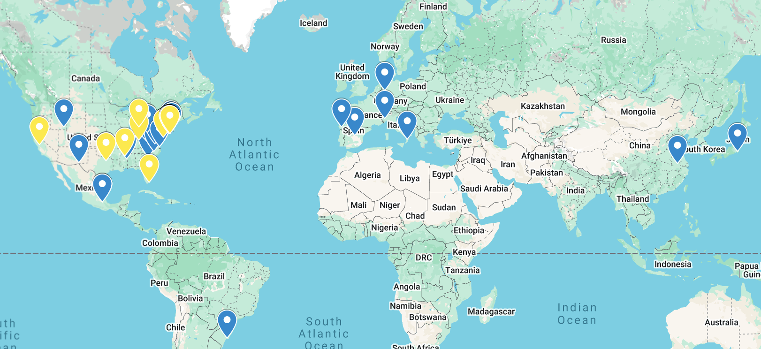
Geography of the 2026 school

Slide 5
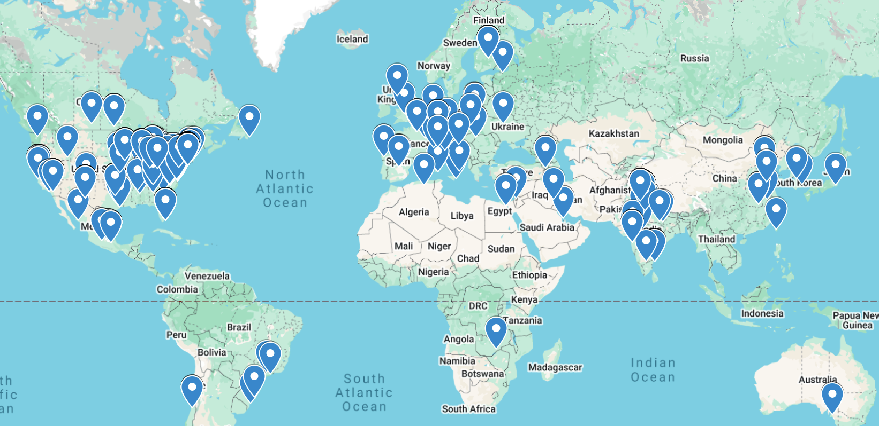
Geography of the school 2019-2026

Slide 6
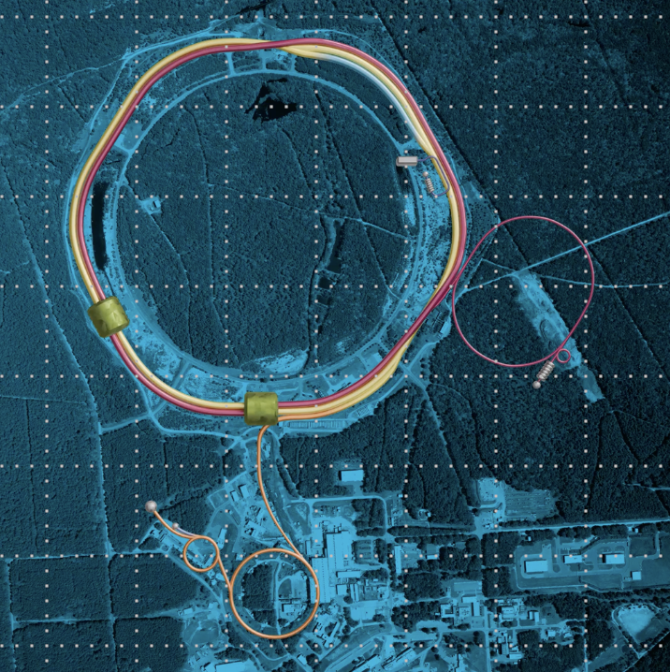
It is an exciting time to be working in nuclear physics!

Slide 7
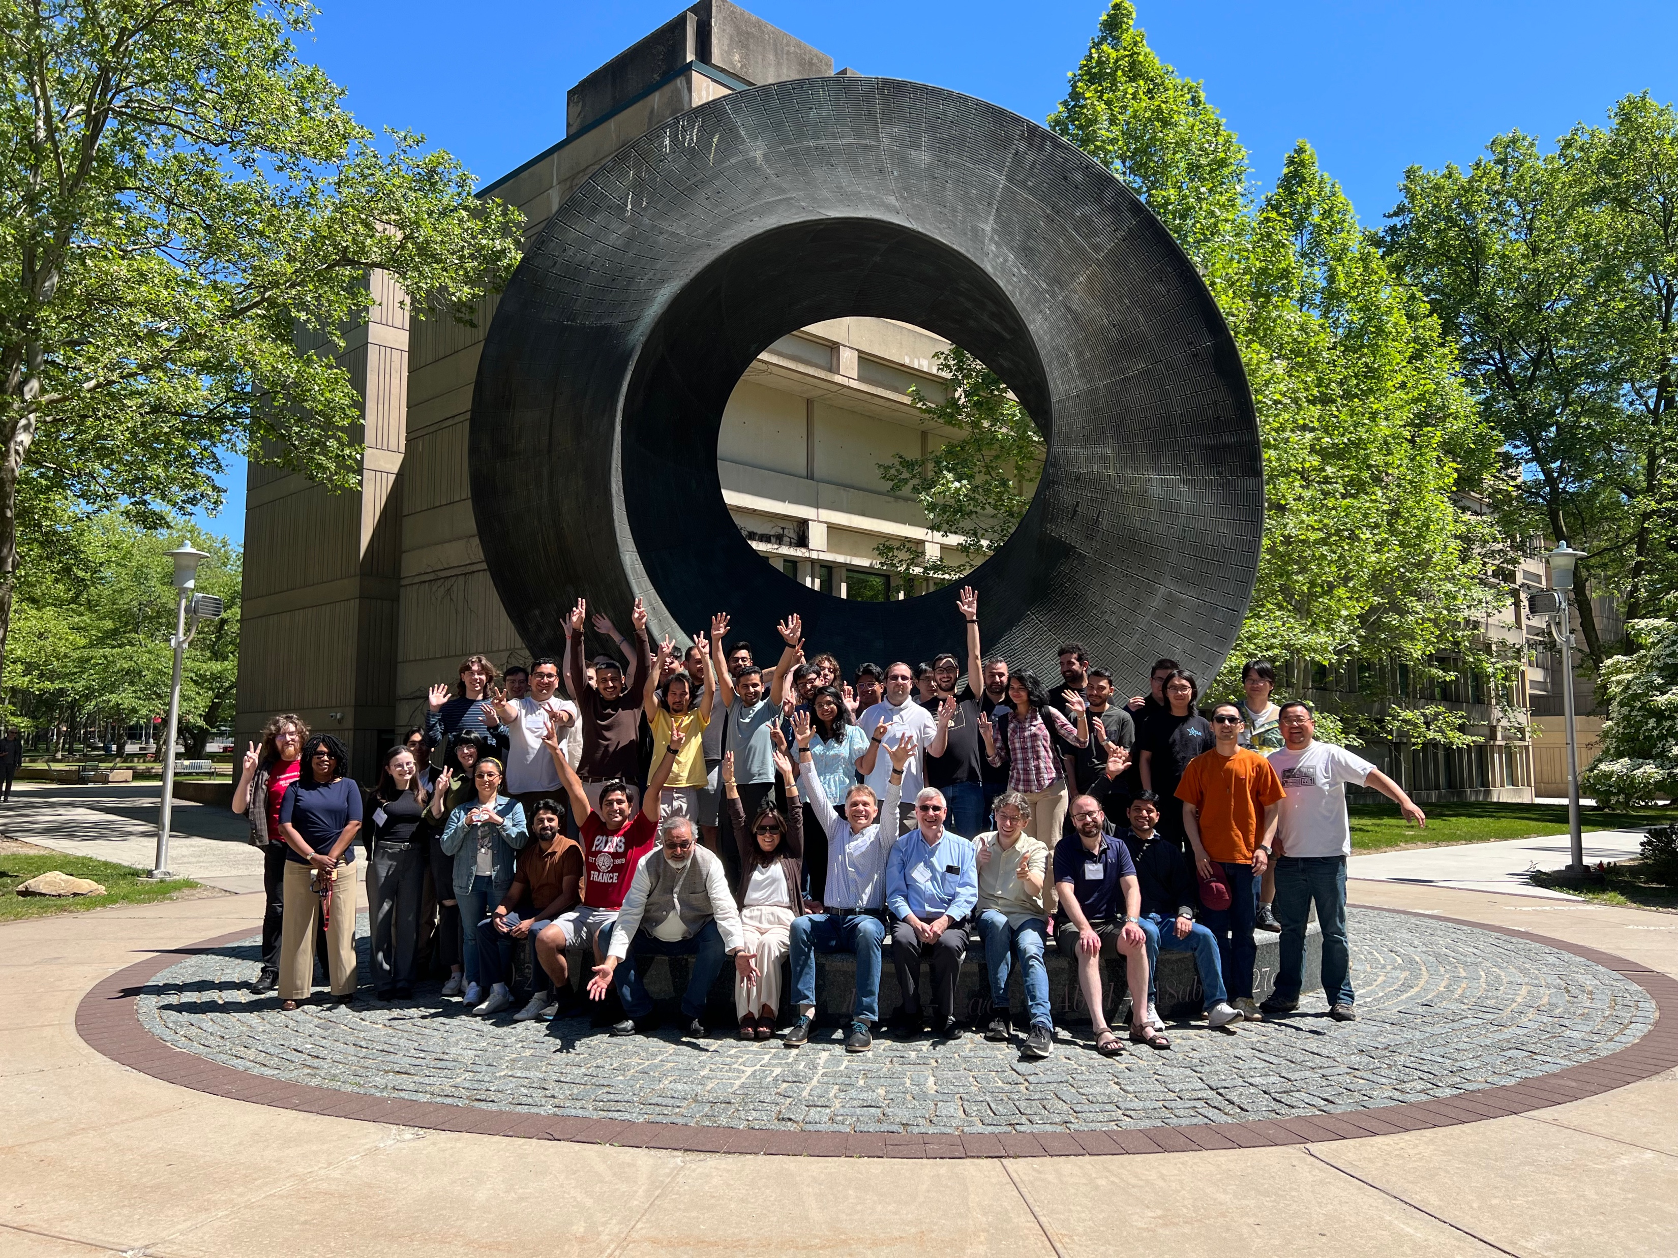

Slide 8

Thank you, Socorro, and melissa!

