Slide 1
QED in 2+1 dimensions with qubits and qumodes
Tommaso Rainaldi – Nov 20, 2025

Slide 2
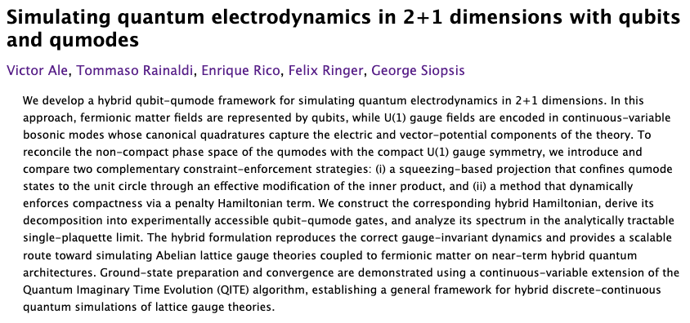
Based on
And previous work by Ringer, Siopsis et al

Slide 3
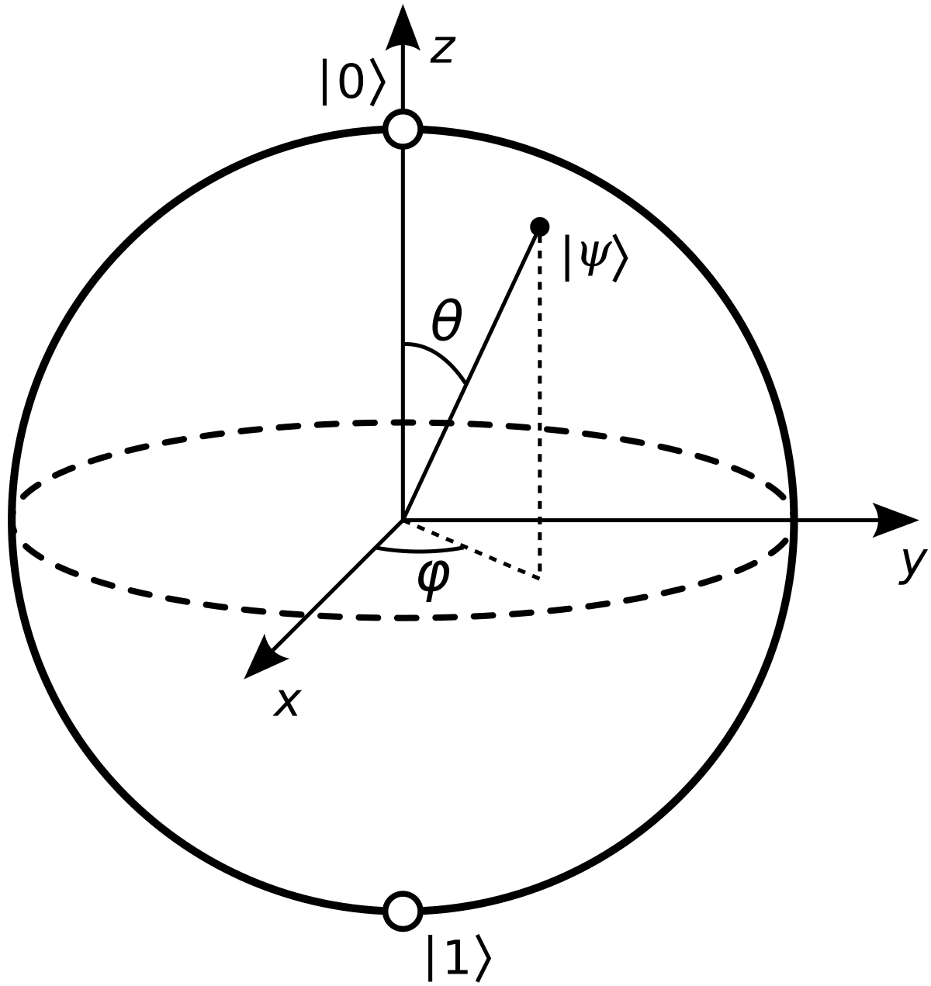
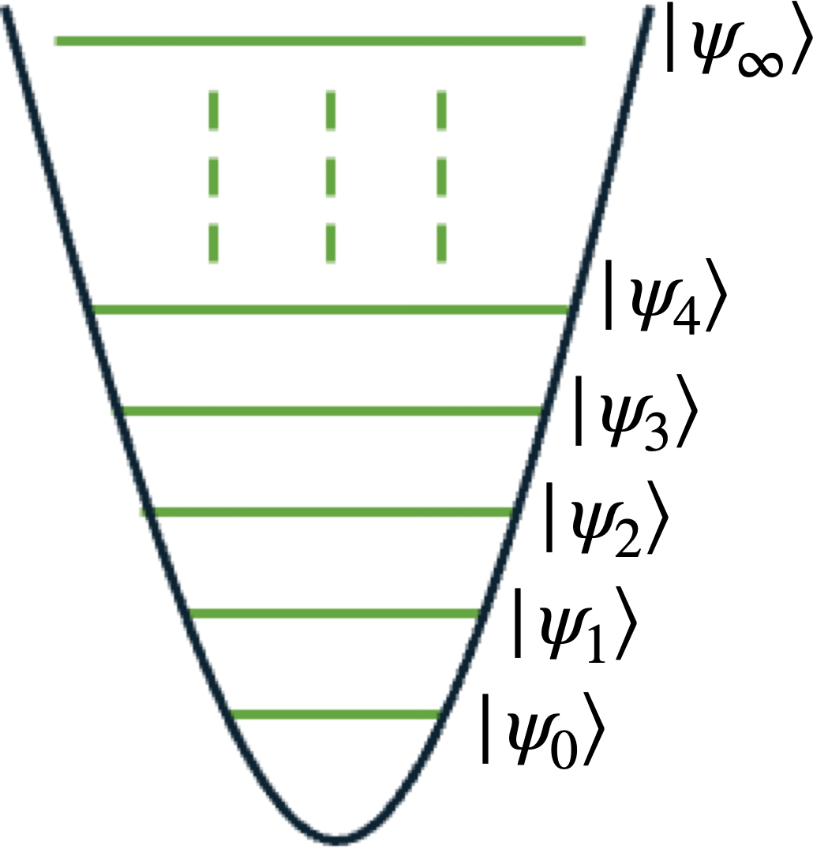
Qubits, (qudits) and qumodes
Elementary units for quantum computation
Qubits
  Realization with: superconducting circuits, cold atoms, trapped ions, topological qubits, …
  Two-dimensional Hilbert space per qubit
  Digital gate-based computing with discrete variables (DV)
Qumodes
  Realization with: photonics, trapped ions, superconducting circuits,…
  Infinite-dimensional Hilbert space per qumode
  Gate-based with continuous variables (CV)

Slide 4
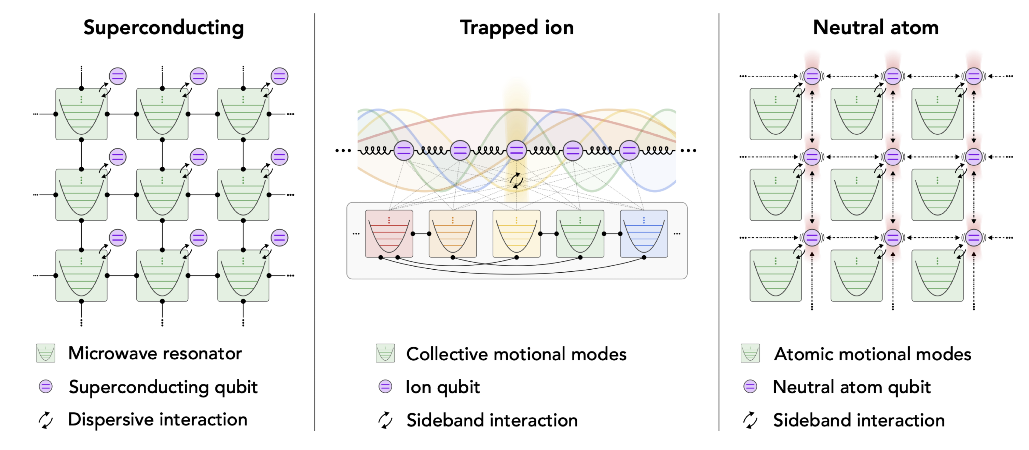
Qubits and qumodes with different platforms
Chuang, Girvin, Wiebe, et al. `24

Slide 5
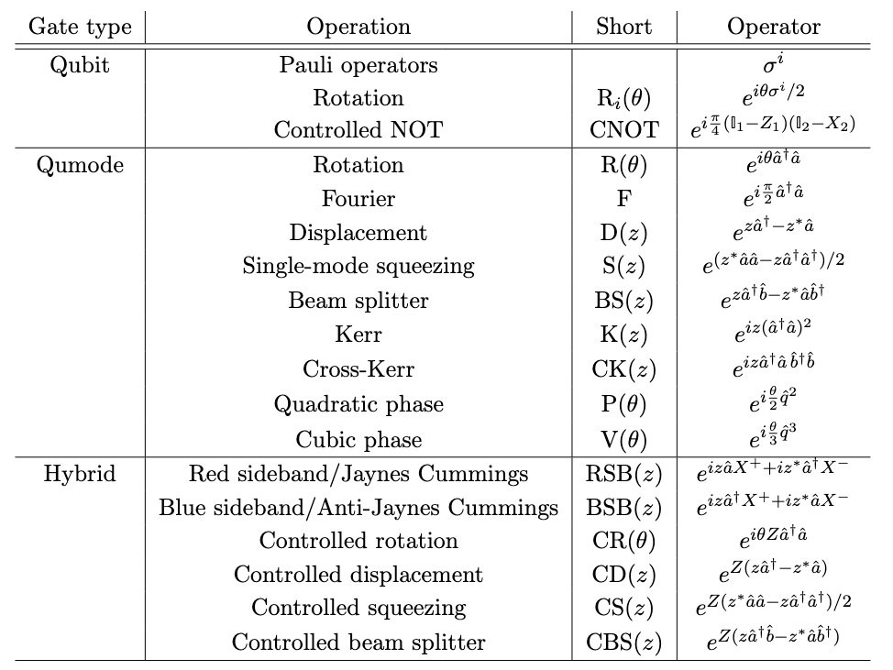
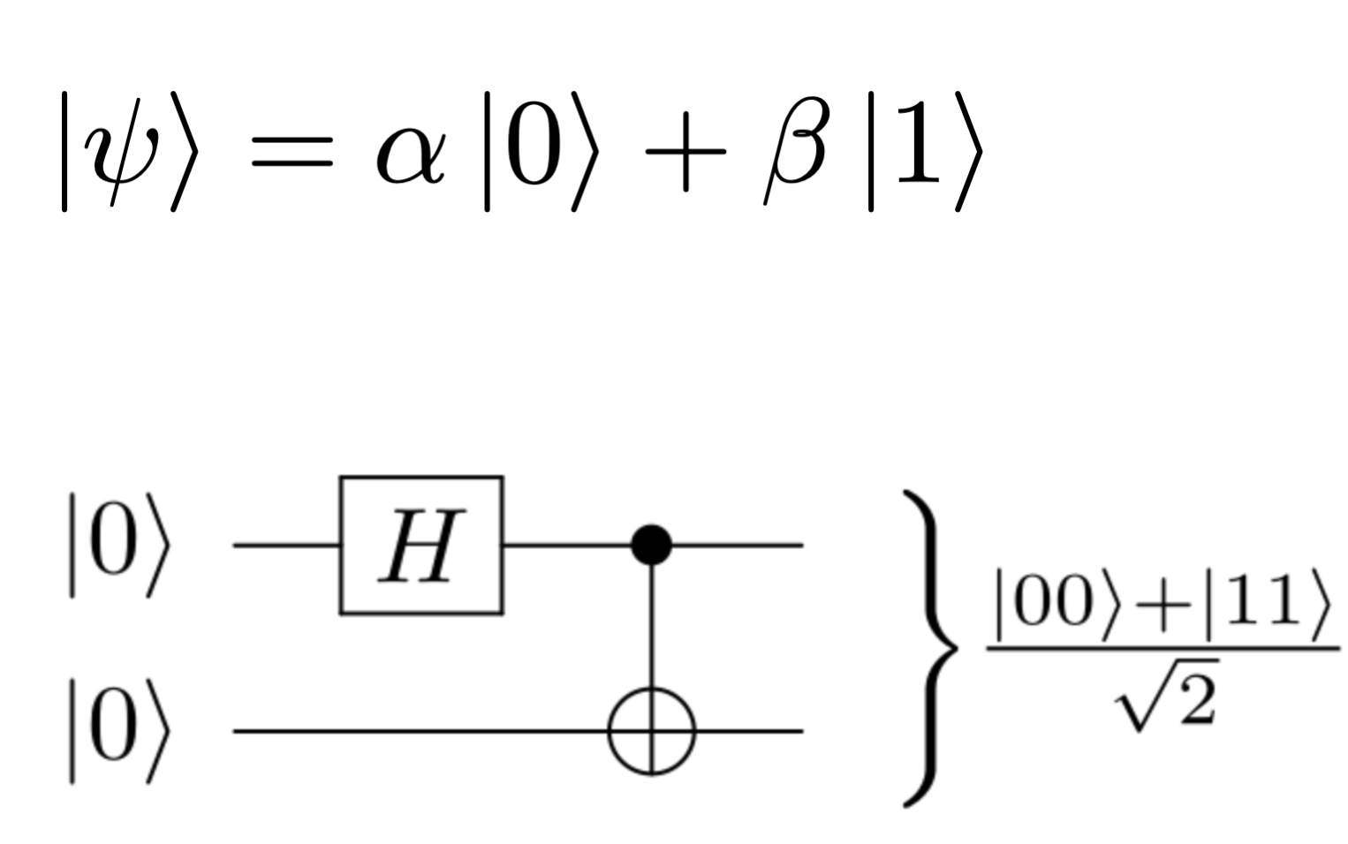
Qubit states and operations
Superposition
Gate = Unitary operation
Entanglement

Slide 6
Qumode states and operations
Lloyd and Braunstein `99
Ladder operators
Quadratures

Slide 7
Hybrid states and operations

Slide 8
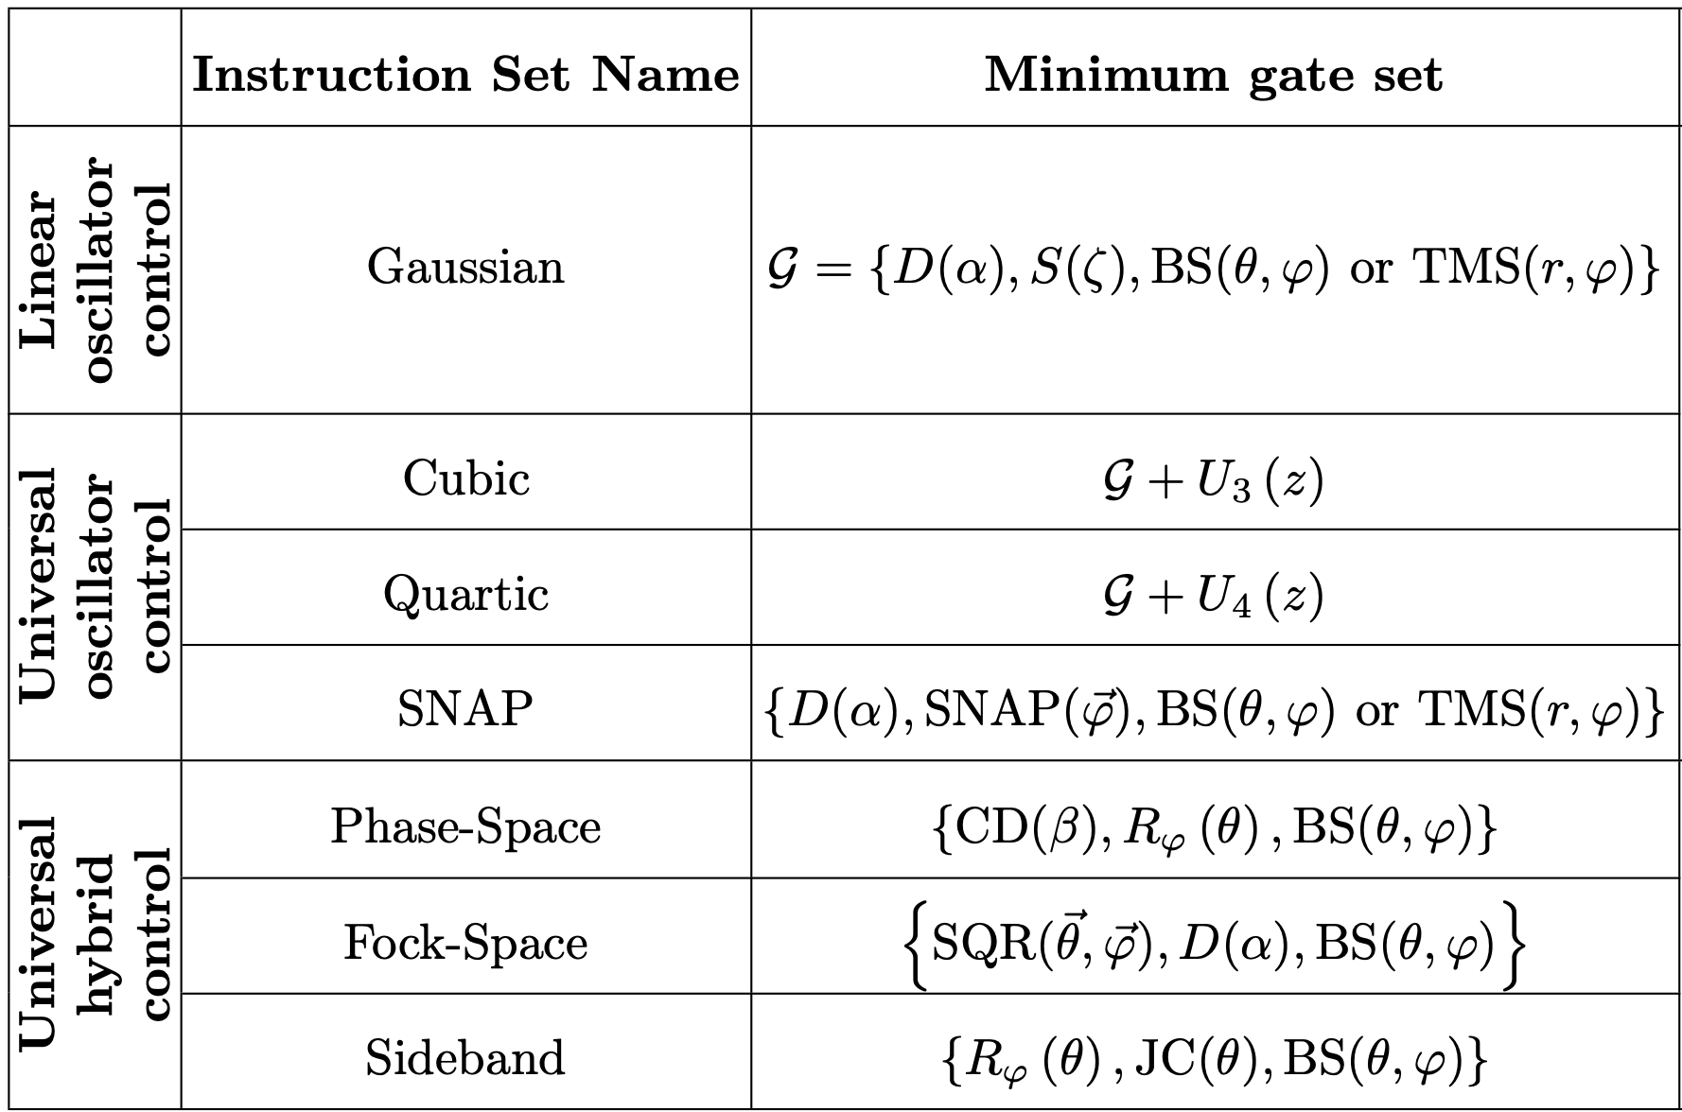
Universal gate set
Minimal set of gates from which you can create any other
Chuang, Wiebe, Girvin et al `24

Slide 9
The steps for the formulation
The QFT Lagrangian (continuum)
Switch to Hamiltonian formulation (continuum)
  Legendre transform
  Choose gauge condition (gauge fixing)
Formulate a discrete version of the Hamiltonian
  Staggered fermion formulation (Kogut-Susskind)
  Compact gauge dofs at each link
Map to qubits and qumodes
  Fermions Jordan-Wigner transformation (for example)
  Bosons QHO spectrum (qumodes)
Discrete space
Continuous time
Qumodes
Qubits

Slide 10
Some selected challenges to tackle
Representation of the Hamiltonian
  Hybrid qubit-qumode, qubit-only, qumode-only
Ground state preparation (or even higher states)
  QITE, VQE (regular, ADAPT, SC-ADAPT,…), non unitary ansatz, adiabatic state preparation,…
Time evolution (Real time dynamics)
  Survival probabilities, correlations, …
Many more …

Slide 11
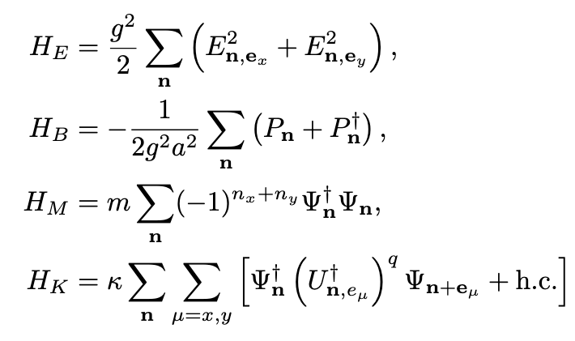
QED in 2+1

Slide 12
One plaquette
Bosonic CCR
Fermionic CAR

Slide 13
Gauss Law
*Evident in the temporal gauge A₀ = 0
Odd site
Even site

Slide 14
Gauss Law

Slide 15
Gauss Law
Only dynamical dofs survive
Massive resource reduction
Only one dynamical gauge link per plaquette
Hamiltonian is block diagonal in total charge sectors

Slide 16
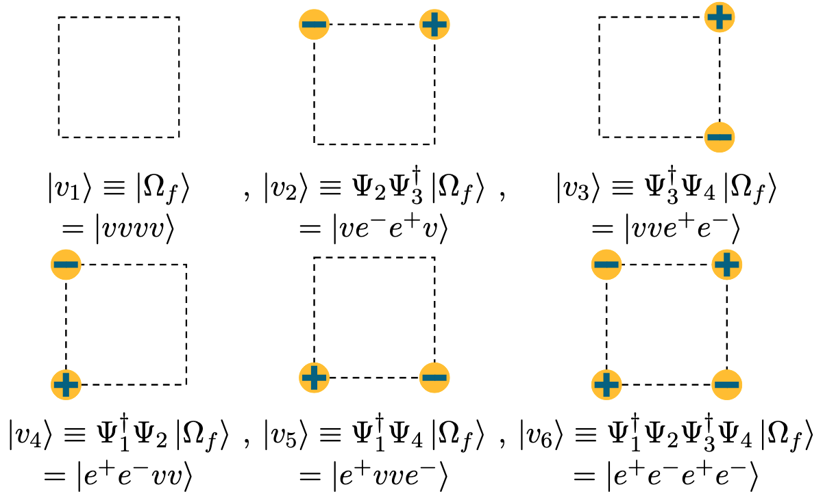
Zero-charge fermion states
Only 6 out of 2⁴ = 16

Slide 17

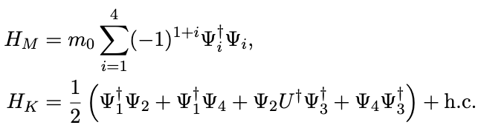
One-plaquette Hamiltonian after Gauss Law
(E,U)

Slide 18
Note:
Bosonic CCR
Fermionic CAR
There is no finite dimensional faithful representation of the Weyl/CCR algebra
There exists finite dimensional faithful representations of the CAR algebra

Slide 19
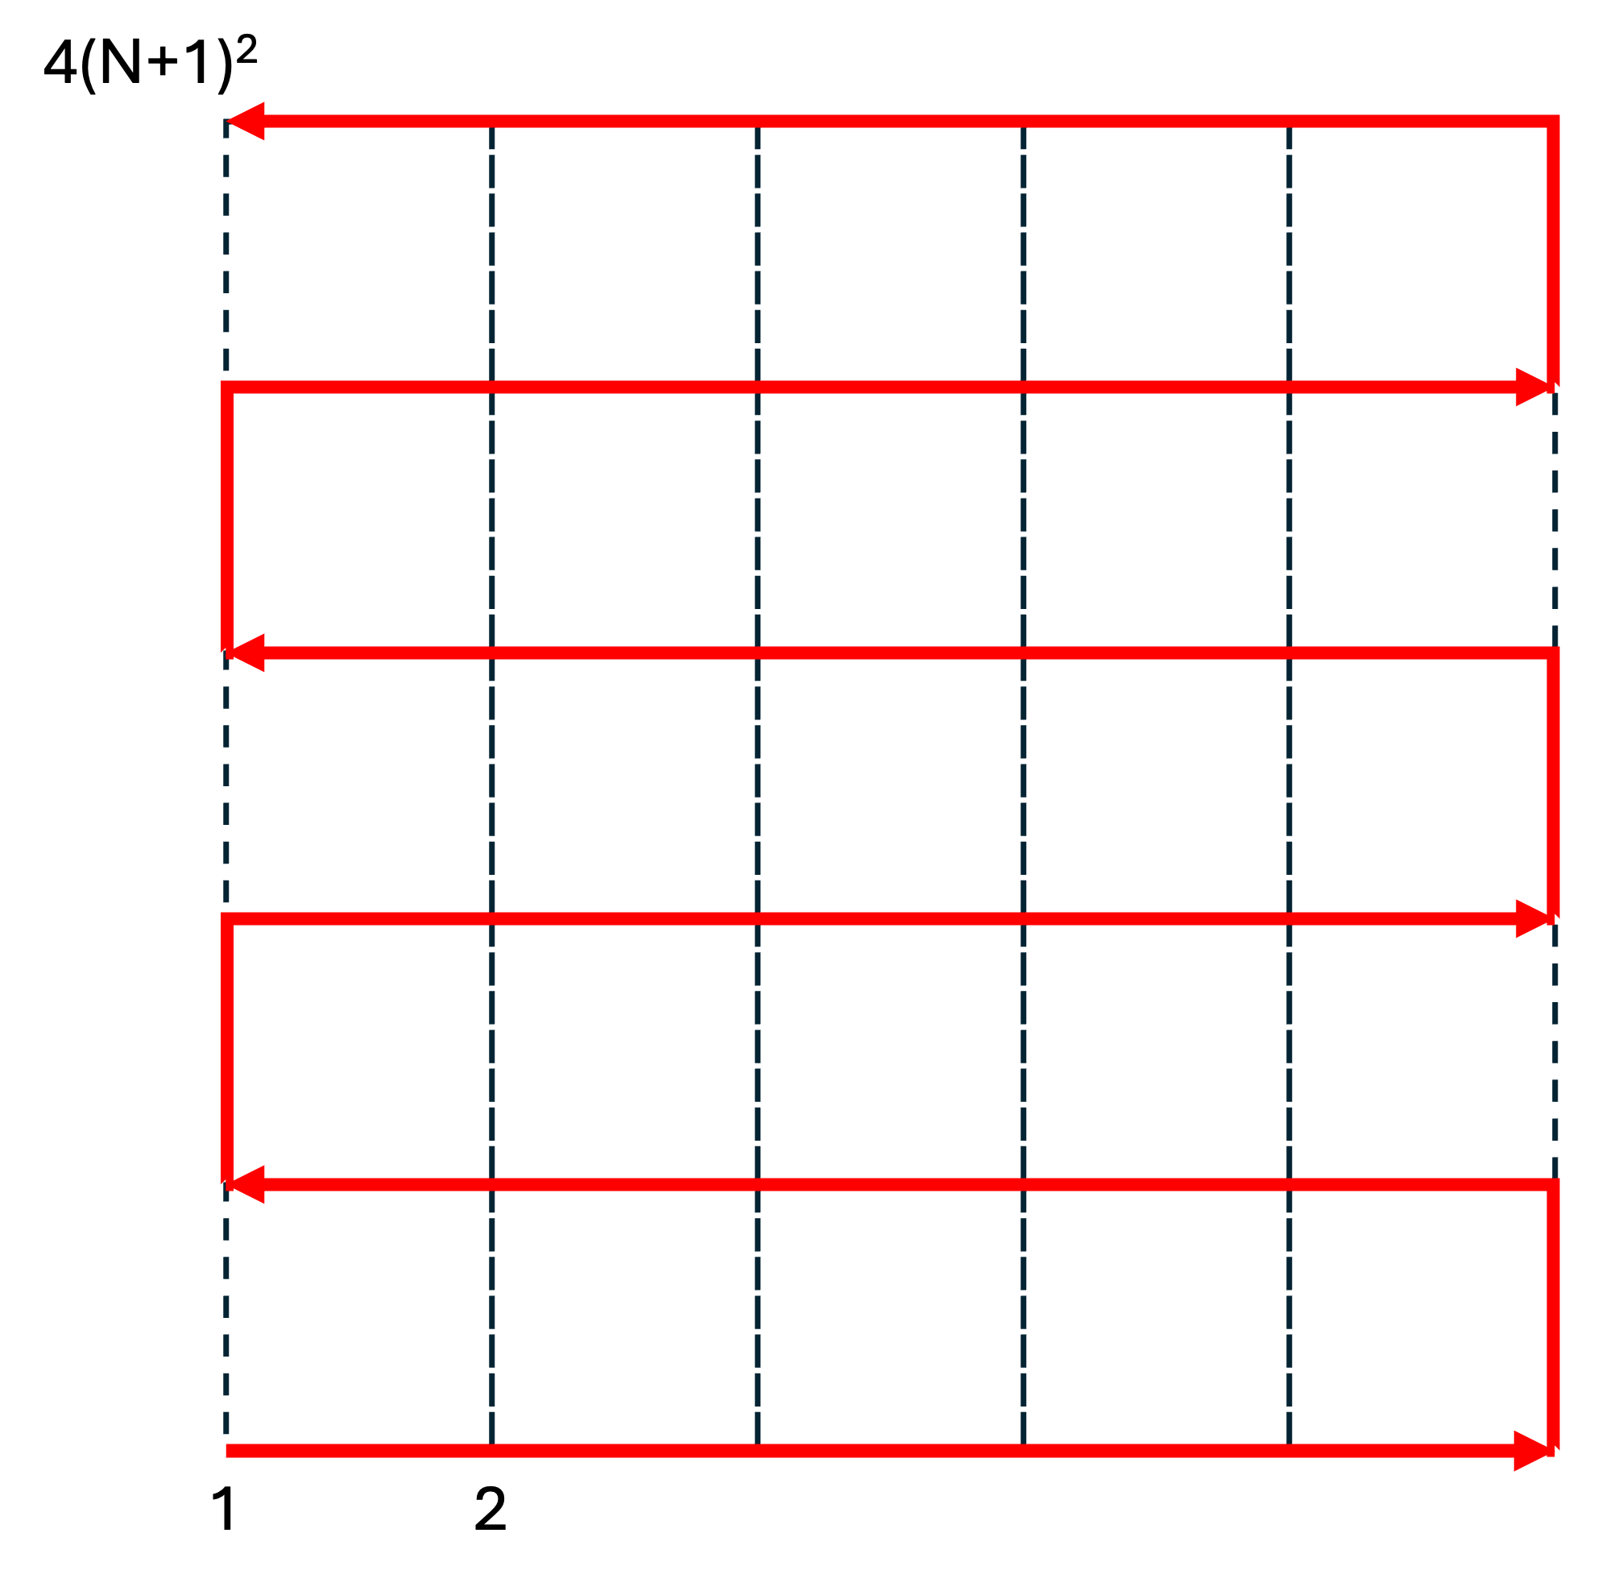
Mapping fermions to qubits
Task: Find a representation of the fermionic CCR in terms of Pauli matrices
Jordan-Wigner transformation (not unique)

Slide 20
Mapping bosons to qumodes
Task: Find a representation of the bosonic CCR in terms of qumodes
or
Qumodes are inherently non-compact but U(1) is a compact group !!
One possible solution:
Use two qumodes per link variable and then constrain them to the unit circle
and

Slide 21
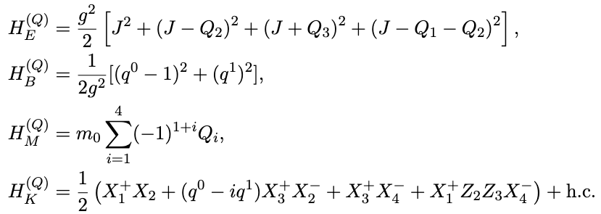
The final Hamiltonian to simulate

Slide 22


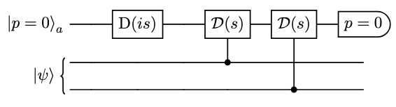
Enforcing the constraint
IMPORTANTLY
Inner product modification
Hamiltonian penalty term
Disfavors unphysical configurations

Slide 23

Time evolution
Trotter-Suzuki formula
Chain of gates (unitaries) for small time steps

Slide 24
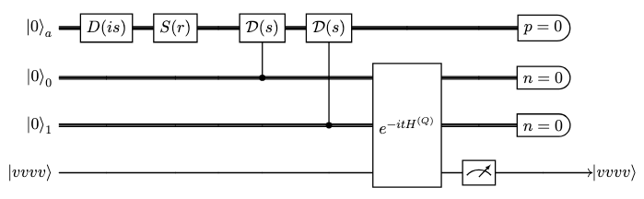
Time evolution
Vacuum of the free theory (not ground state)
Survival probability

Slide 25
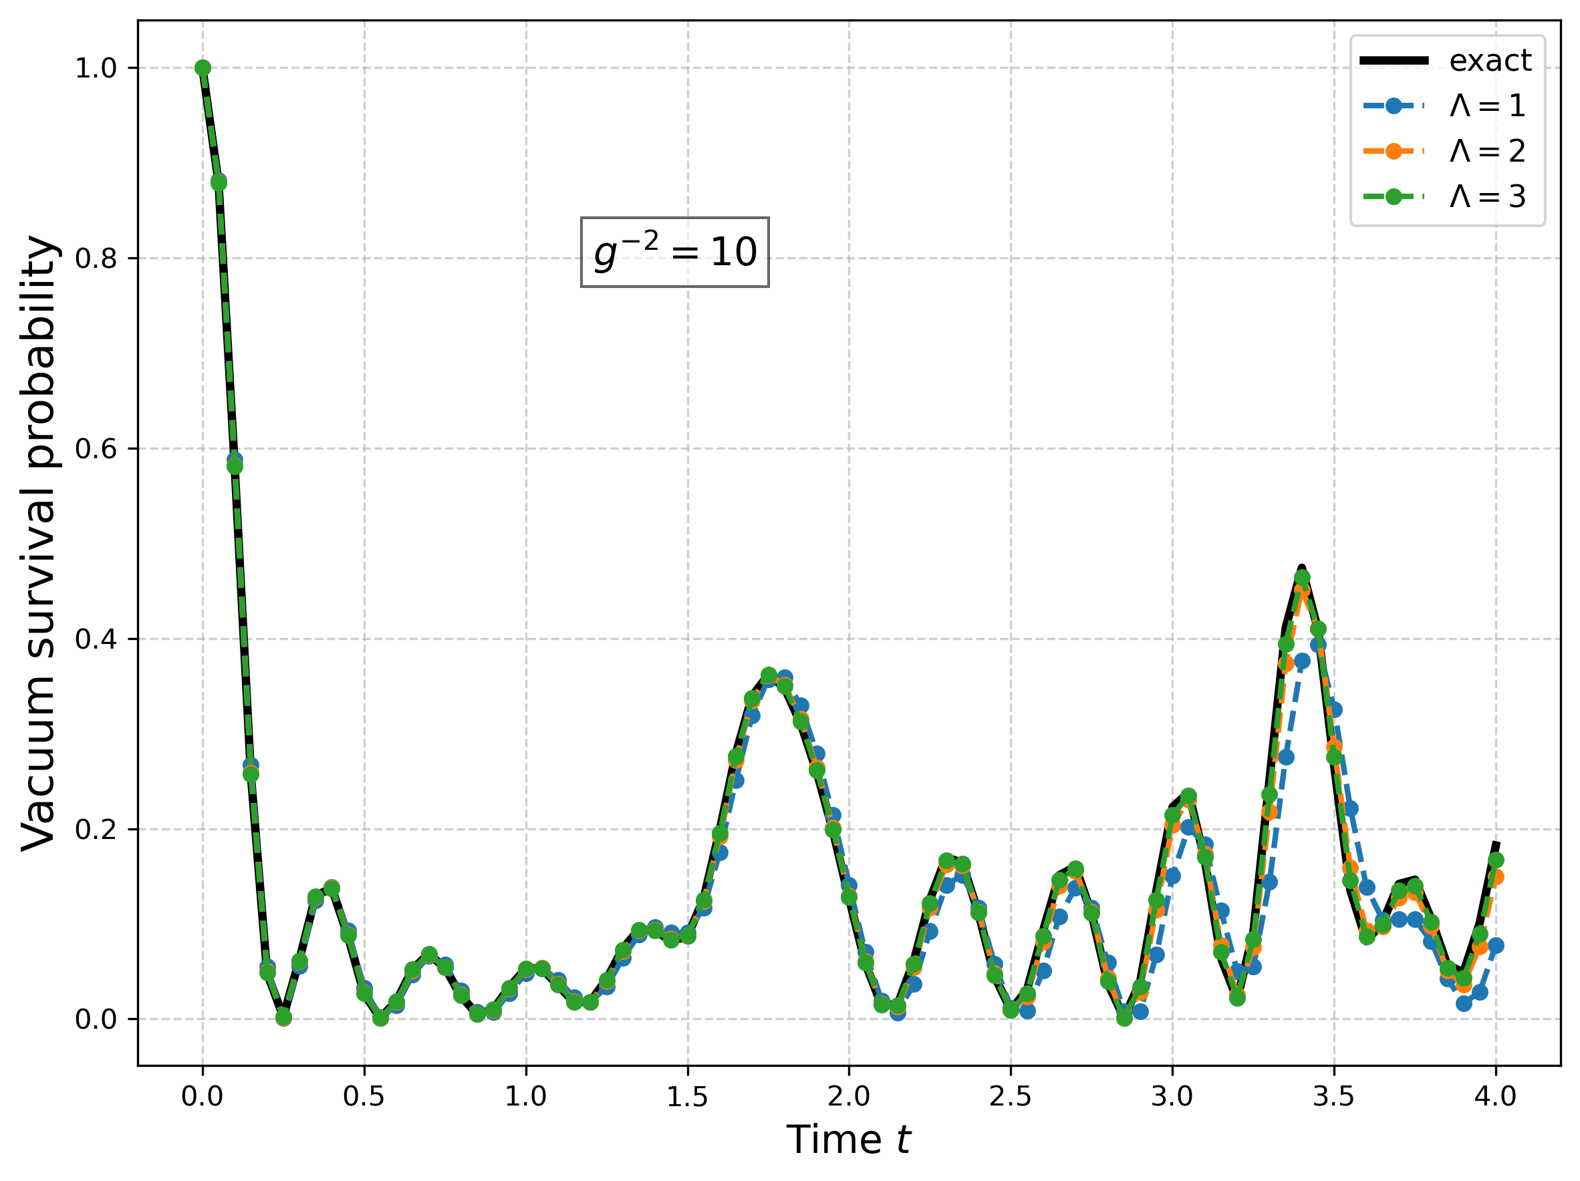
Time evolution
Vacuum of the free theory (not ground state)
Survival probability

Slide 26
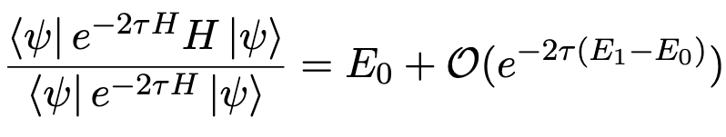
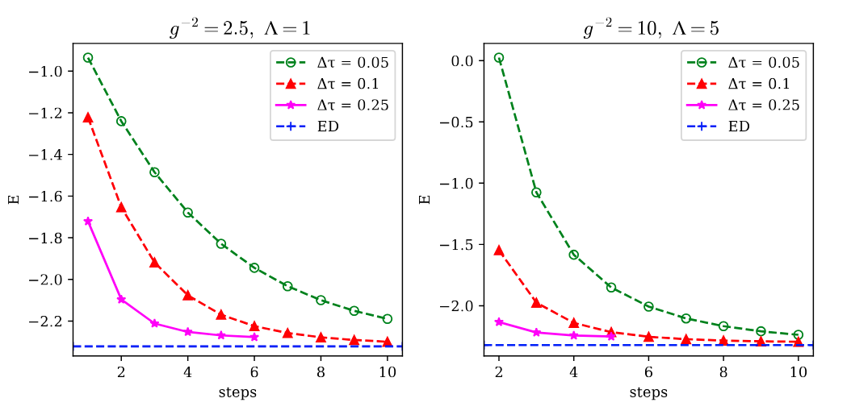
Ground state preparation (Method 1)
Quantum Imaginary Time Evolution (QITE) algorithm
We show the necessary gates and measurements to go to imaginary time
2 METHODS*

Slide 27
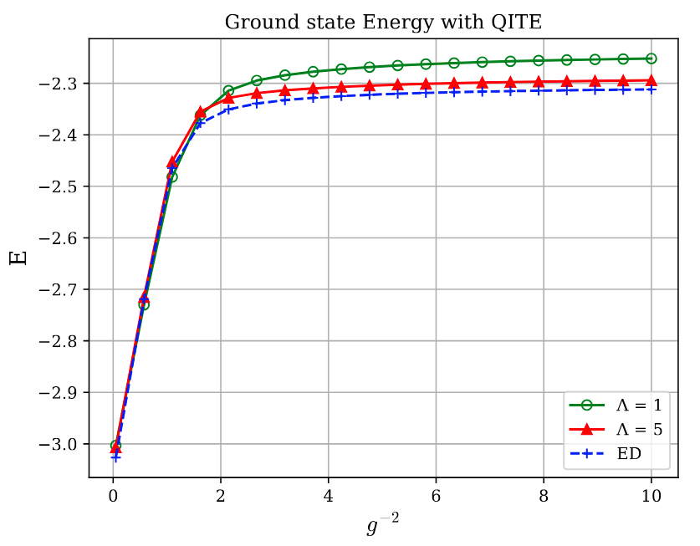
Ground state preparation (Method 1)

Slide 28
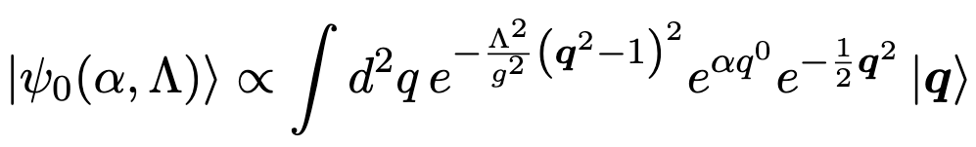
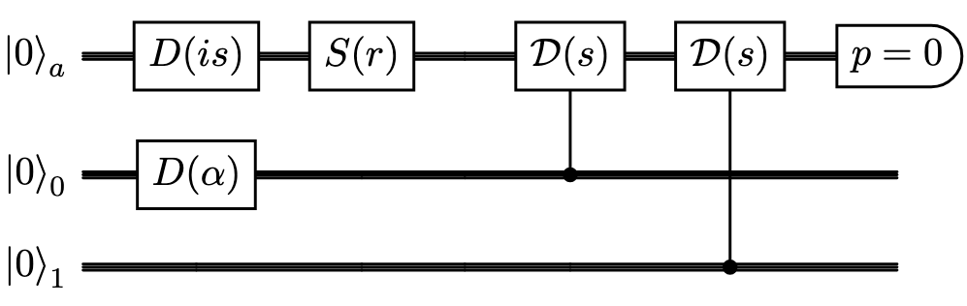
Ground state preparation (Method 2)
Non-unitary ansatz (showing for pure U(1) gauge theory)
Variational parameter

Slide 29
Thank you

Slide 30
Extra

Slide 31

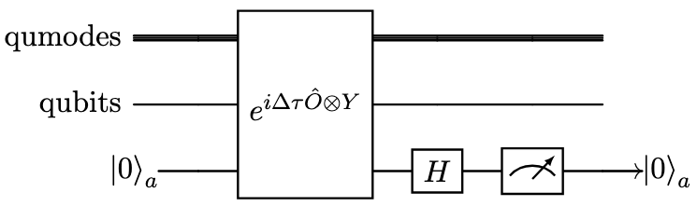
QITE Method A
Zero qubit state
Need one ancilla (extra) qubit + postselection (measurement)

Slide 32


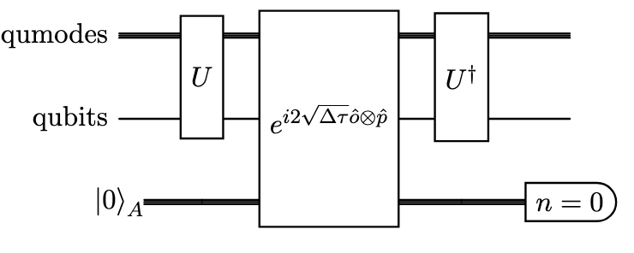
QITE Method B
Zero Fock state
Target operator
Only useful for operators such that
Need one ancilla (extra) qumode + postselection (measurement)

