Slide 1
Polarized Ion Development for next Decade in EIC Injectors
Haixin Huang
March 19th, 2026
EPIOS Workshop
Stony Brook University

Slide 2
AGS as RHIC Polarized Proton Injector
To RHIC Injection
Pol. H⁻ Source
Gγ= 2.2... 4.5
Jump quads in adjacent super-periods I &J
LINAC
BOOSTER
Warm Helical Partial Snake
AGS
200 MeV Polarimeter
Gγ= 4.5 … 45.5
AGS pC CNI Polarimeter
Cold Helical Partial Snake
AGS has been running as RHIC polarized proton injector with dual partial snakes and two horizontal tune jump quads. It has delivered ~70% polarization with ~2*10¹¹/bunch intensity with 80% as input polarization.
Since Run24, the tune jump quads have been replaced with skew quads for polarized proton operation.
Notes:
Show layout & point of polarimeters and experimental locations
Emphasize bunch polarizations prepared at source going through AGS etc. to RHIC
Time spacing between them ~100 ns
Transverse polarization in ring, longitudinal at experiments (optional) using spin rotators
Emphasize none of these techniques existed just 4-5 years ago, all developed here at RHIC with international collaborations led by US and Japanese teams.

Slide 3
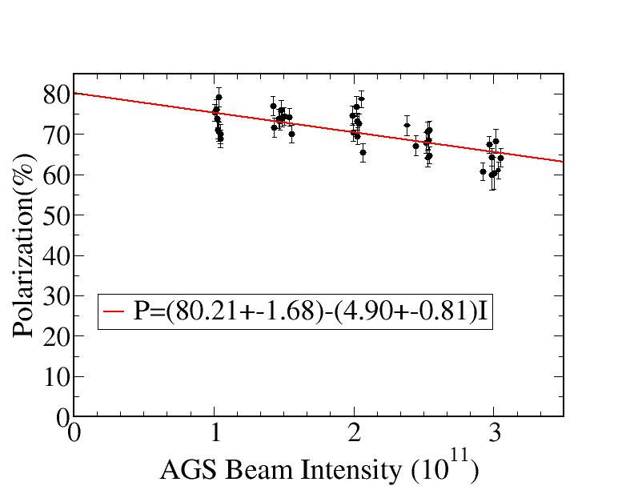
AGS Extraction Polarization vs Intensity
At 3.2E11 intensity, polarization would be 64.5% with current performance.

Slide 4
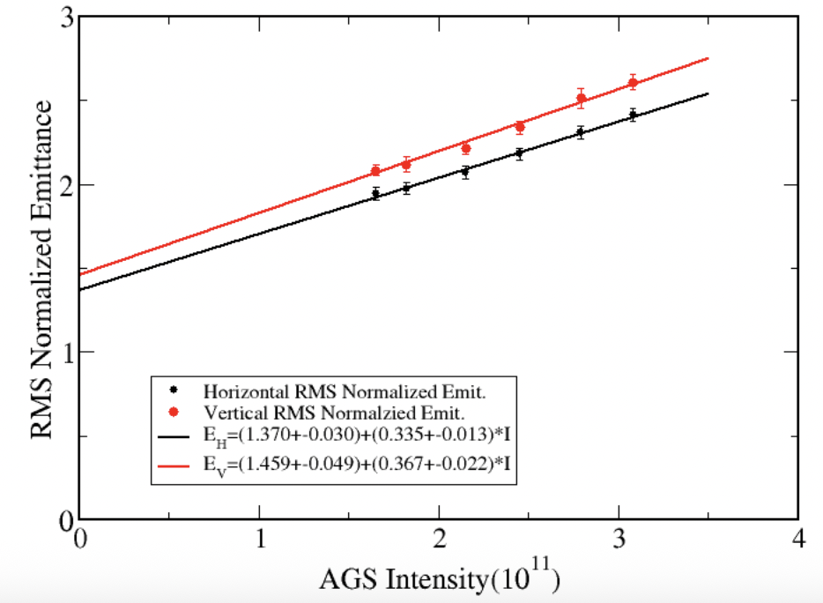
AGS Extraction Emittance vs Intensity
At 3.2E11 intensity, transverse emittance would be 2.44 (H) and 2.63(V), respectively.

Slide 5
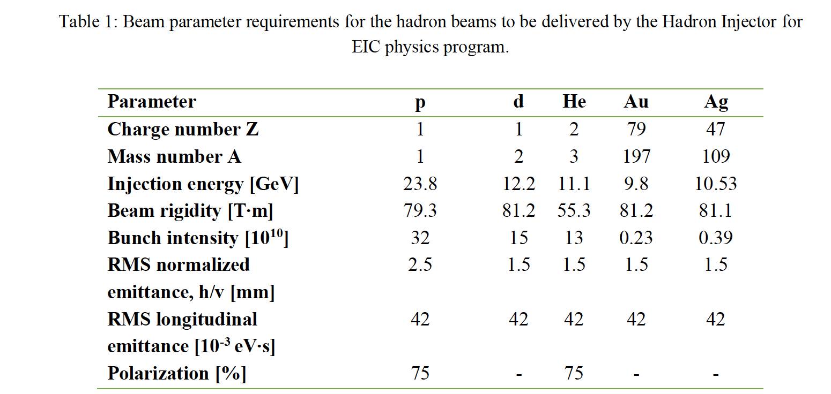
Beam Parameter Requirements for Hadron Beams
For protons: polarization needs to be improved from 65% to 75%. Transverse emittance is about at the level of EIC requirements, but vertical emittance needs some improvement.
For He-3: polarization development in the injectors are needed.
For deuteron: no need for polarization development.

Slide 6
Status of Injectors
RHIC operation finished on Feb. 6, 2026.
RHIC Removal and Repurpose will start next month.
If EIC is ready for beam in 2035, and polarized proton beam is needed in the second year, the polarized beam development needs to be done before 2036, or in a decade.
Polarized He-3 beam is expected to be needed in year 5, or 2039.
AGS cable replacement project is expected to last three years. It will be followed by Accelerator Readiness Review before seeing beam again. This would put the first possible beam in the AGS in the later part of 2029.
Before that, beam is only available in the Booster.

Slide 7
Polarized Proton Status
A pair of partial snakes (~6%+10%) are used for overcoming intrinsic and imperfection resonances (by putting vertical betatron tune inside the spin tune gap).
15 skew quads replaced a pair of tune jump quads to overcome horizontal intrinsic resonances. Due to the limitation of orbit corrector strength, the skew quads were only powered above transition.
Dual RF harmonics are used at injection and early part of energy ramp to reduce peak current and emittance growth associated with space charge effect.
Further improvements could be realized by a full realignment of the AGS magnets to reduce sources of depolarization driven by misalignments.
If polarization is short of EIC requirement, the next step is to replace the warm snake with a cold one. A stronger partial snake likely requires higher injection energy.
The beam emittance increases with intensity due to a few factors including space charge. An additional, more invasive upgrade would involve upgrading the Booster extraction magnet and Booster to AGS transfer line equipment to increase the transfer energy from 1.7 GeV to 2.8 GeV. This would reduce the peak space charge tune shifts by a factor of 3.

Slide 8
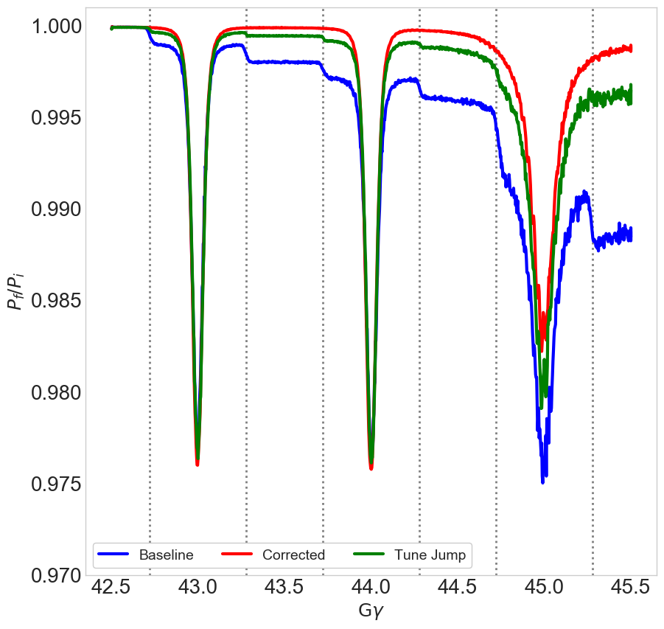
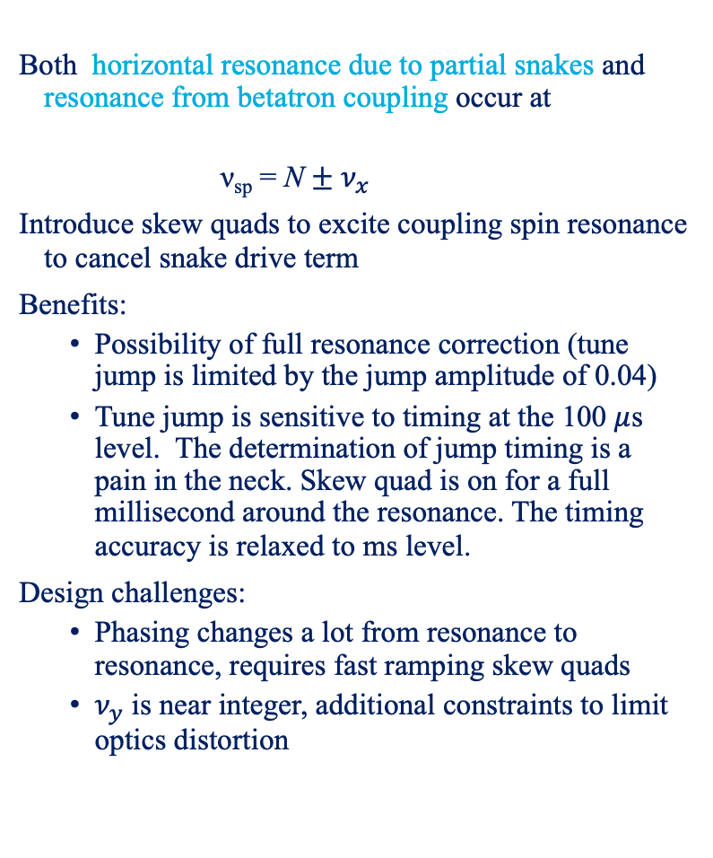
Horizontal Resonance Suppression with Betatron Coupling
Both horizontal resonance due to partial snakes and resonance from betatron coupling occur at
  ν_{sp} = N $±$ $ν_{x}$
Introduce skew quads to excite coupling spin resonance to cancel snake drive term
Benefits:
  Possibility of full resonance correction (tune jump is limited by the jump amplitude of 0.04)
  Tune jump is sensitive to timing at the 100 $μ$s level. The determination of jump timing is a pain in the neck. Skew quad is on for a full millisecond around the resonance. The timing accuracy is relaxed to ms level.
Design challenges:
  Phasing changes a lot from resonance to resonance, requires fast ramping skew quads
  $ν_{y}$ is near integer, additional constraints to limit optics distortion
Correction with 15 skew quadrupoles

Slide 9
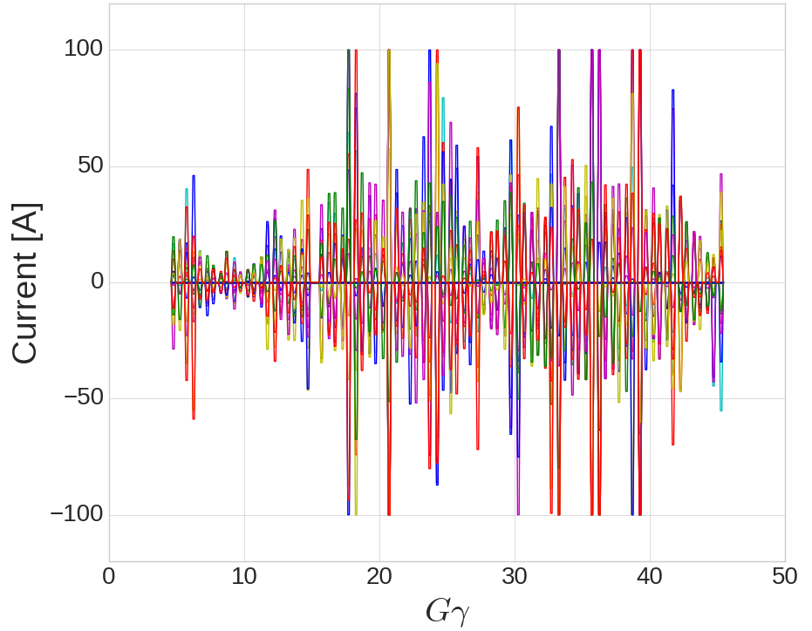
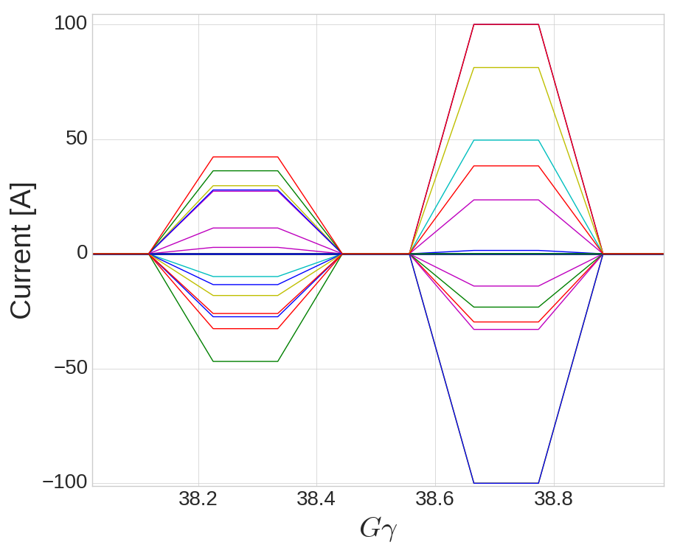
Skew Quad Current Functions
Following results Use 15 quads with 0.35m length.
Current assuming the transfer function of the ‘thin’ quads for cold snake compensation
1 ms ramp up, 1 ms hold, 1 ms ramp down. : rms current is ~25 A
Corrector currents
100 A = 0.07 Tesla pole-tip field
1 ms
1 ms
1 ms
400 ms
So far only pulses above transition are used.

Slide 10
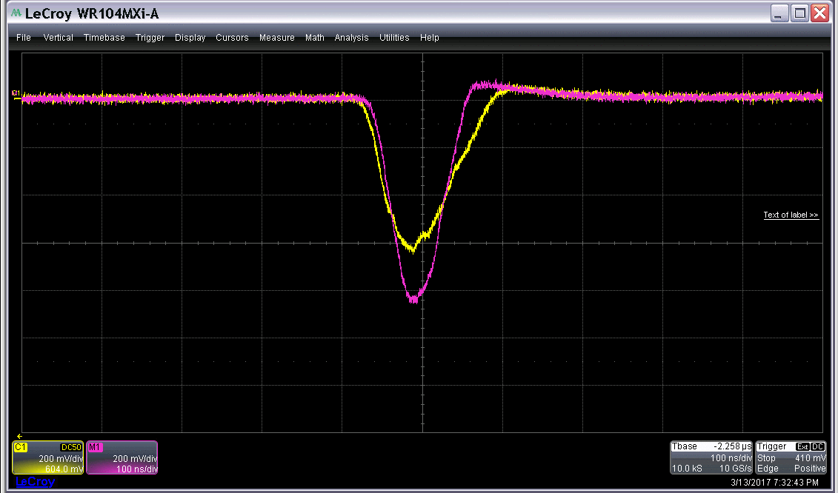
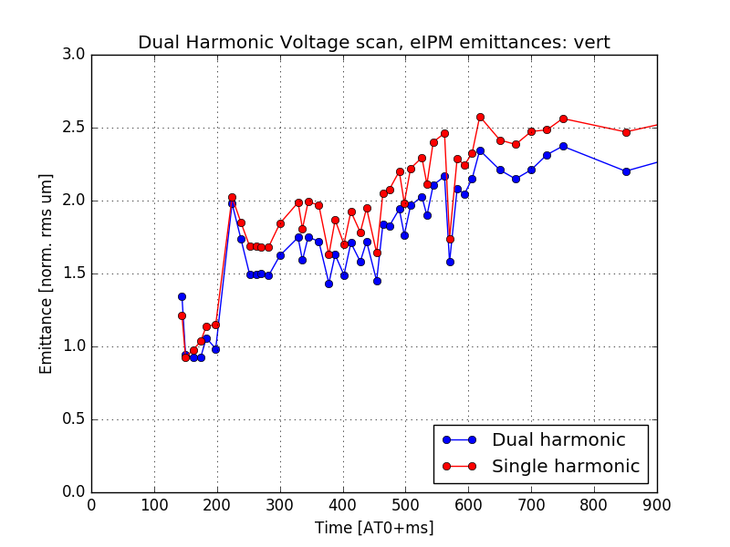
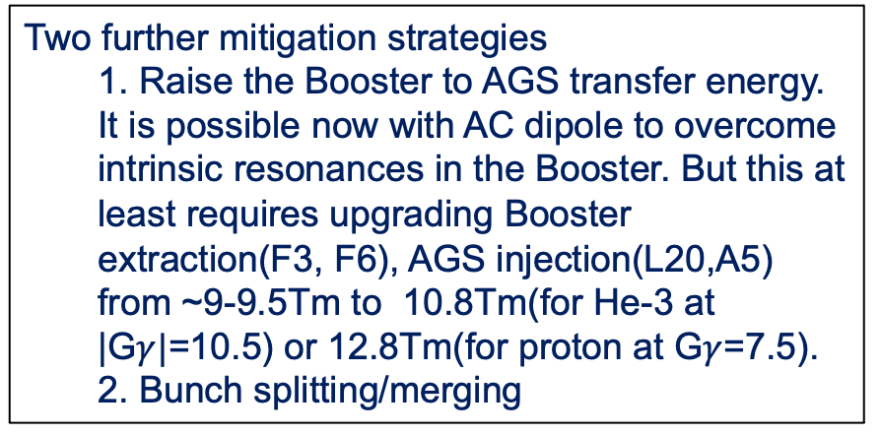
Emittance Preservation in AGS
Demonstrated in Run 17: Peak current-driven emittance growth at AGS injection
AGS Longitudinal distribution
Addition of defocusing RF voltage:
  20% reduction in peak current
  15% reduction in vertical emittance
AGS has large injection space charge tune shifts
  ΔQ_{sc}(x,y) = -0.17, -0.25
Two further mitigation strategies
  1. Raise the Booster to AGS transfer energy. It is possible now with AC dipole to overcome intrinsic resonances in the Booster. But this at least requires upgrading Booster extraction(F3, F6), AGS injection(L20,A5) from ~9-9.5Tm to 10.8Tm(for He-3 at |G$γ|$=10.5) or 12.8Tm(for proton at G$γ$=7.5).
  2. Bunch splitting/merging
AGS Vertical Emittance

Slide 11
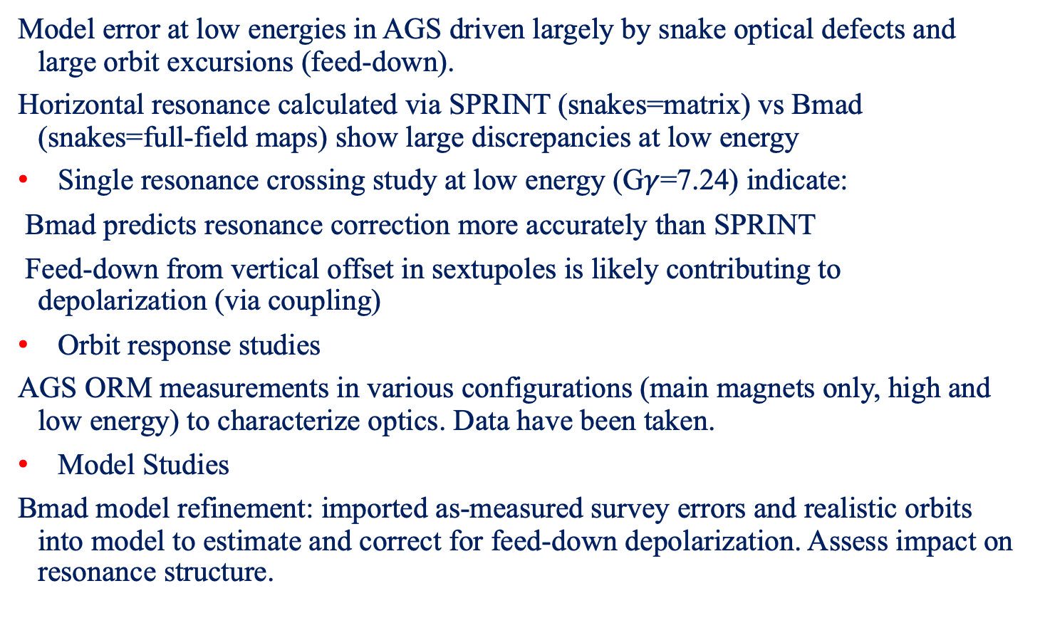
Model Improvement in Coming Years
Model error at low energies in AGS driven largely by snake optical defects and large orbit excursions (feed-down).
Horizontal resonance calculated via SPRINT (snakes=matrix) vs Bmad (snakes=full-field maps) show large discrepancies at low energy
Single resonance crossing study at low energy (G$γ$=7.24) indicate:
Bmad predicts resonance correction more accurately than SPRINT
Feed-down from vertical offset in sextupoles is likely contributing to depolarization (via coupling)
Orbit response studies
AGS ORM measurements in various configurations (main magnets only, high and low energy) to characterize optics. Data have been taken.
Model Studies
Bmad model refinement: imported as-measured survey errors and realistic orbits into model to estimate and correct for feed-down depolarization. Assess impact on resonance structure.

Slide 12
Polarized Proton Plan
AGS survey is ongoing for a full realignment of the AGS magnets to reduce sources of depolarization driven by misalignments. This is expected to be done this year.
AGS BPM upgrade to allow TBT-BPM data. It is expected to benefit polarization. This will be done before 2029.
Further development with skew quads after all of above done will happen in 2029-2030.
If this turns out not enough, the next step is to replace the warm snake with a cold one. Due to stronger optics distortion with stronger partial snake, a higher injection energy will be required.
Consequently, intrinsic resonance in the Booster needs to be corrected. With existing AC dipole, this should be fine.
Higher injection energy also means less space charge effect and less emittance growth. The Booster extraction magnets and AGS injection magnets need to be upgraded.
Rough schedule is to do the upgrade and magnet production in 2-3 years. Commissioning of the new configuration of AGS will be carried out around 2034-2035.

Slide 13
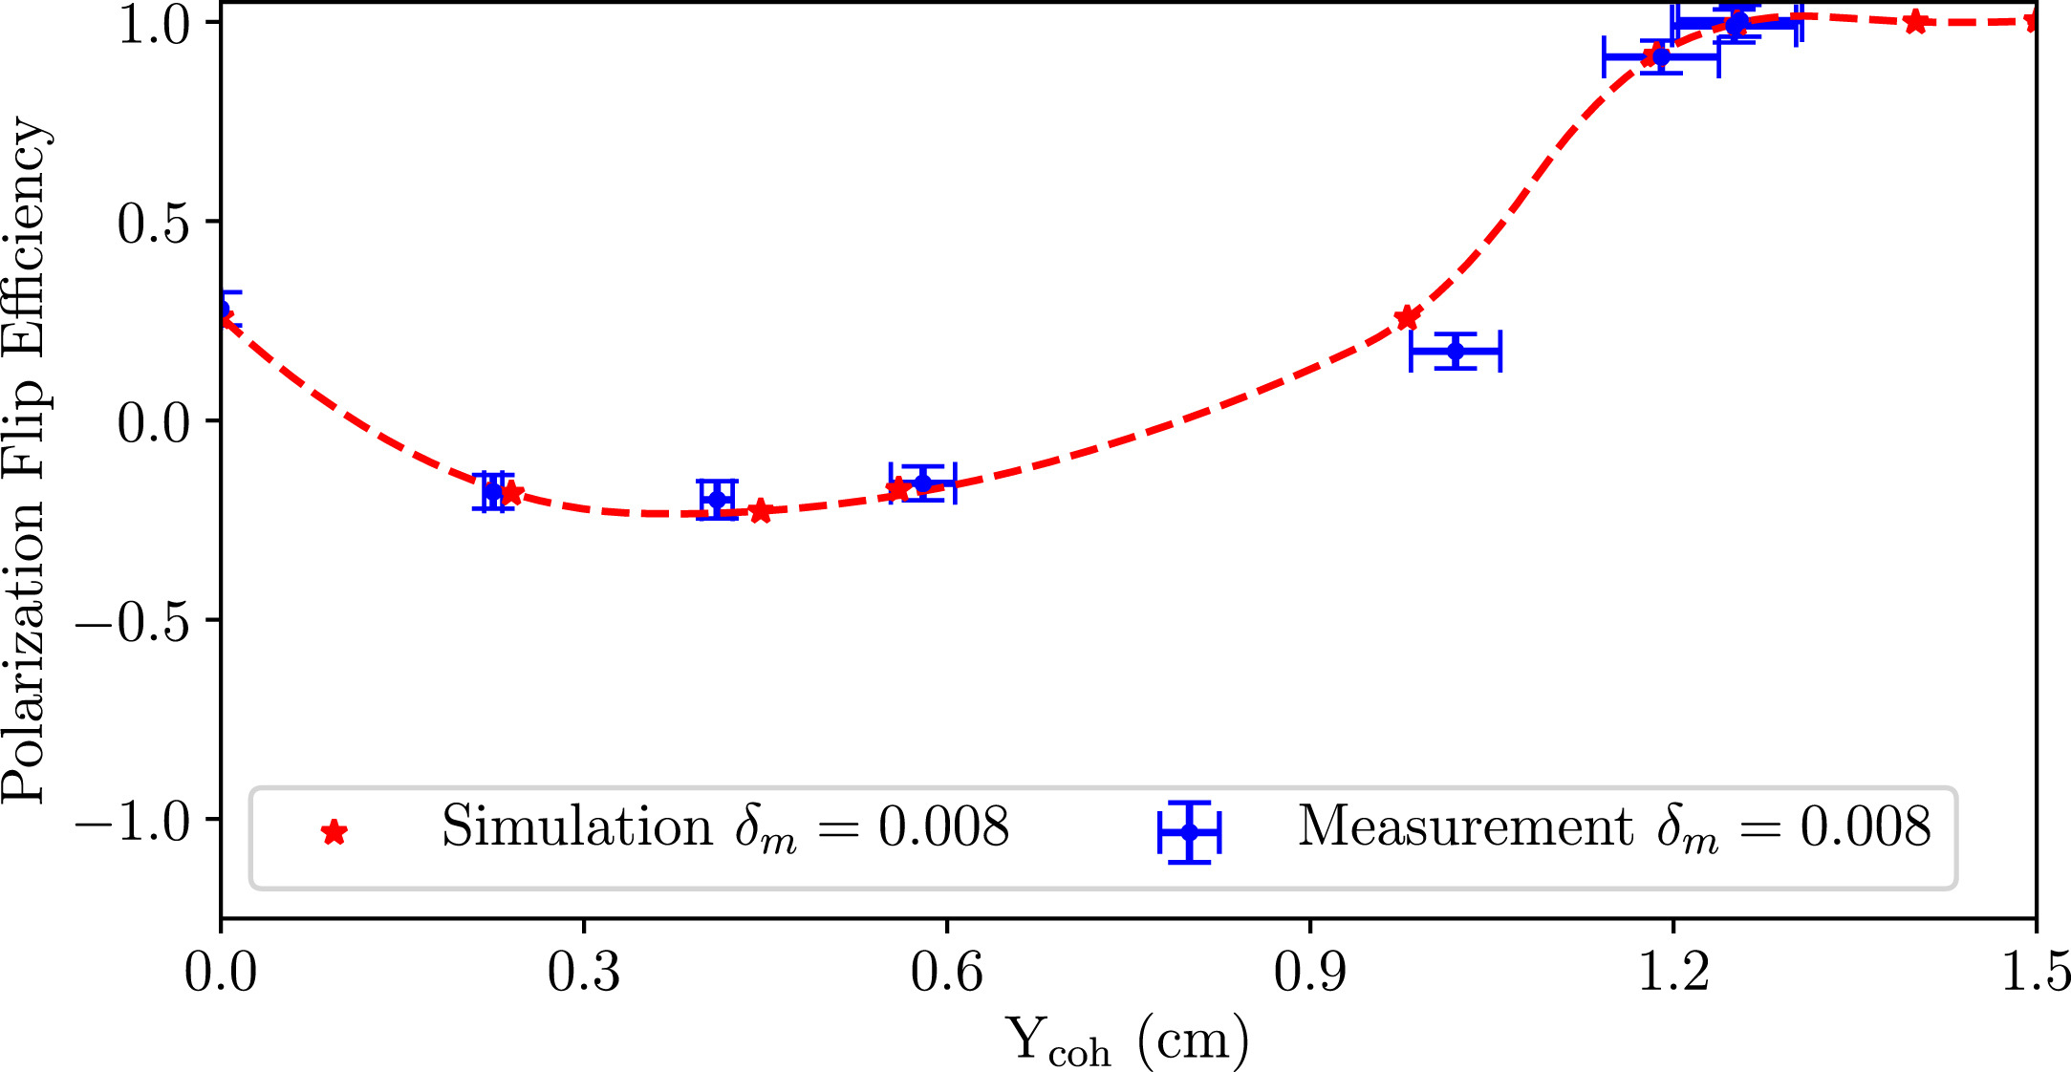
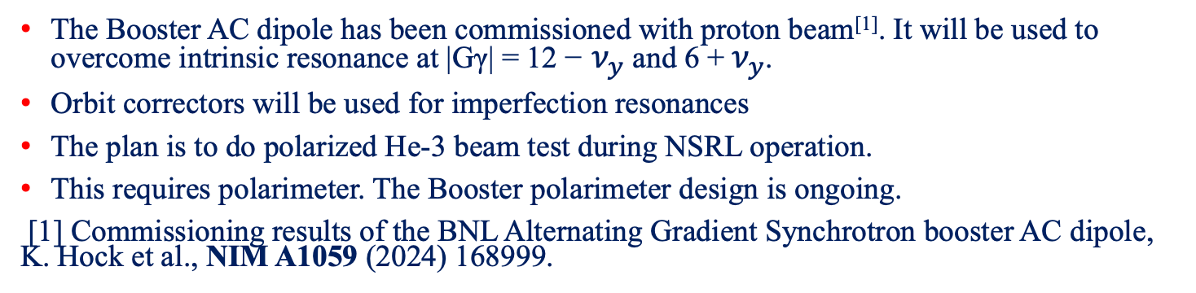
Booster He-3 Plan
The Booster AC dipole has been commissioned with proton beam^{[1]}. It will be used to overcome intrinsic resonance at |Gγ| = 12 − $ν_{y}$ and 6 + $ν_{y}$.
Orbit correctors will be used for imperfection resonances
The plan is to do polarized He-3 beam test during NSRL operation.
This requires polarimeter. The Booster polarimeter design is ongoing.
[1] Commissioning results of the BNL Alternating Gradient Synchrotron booster AC dipole, K. Hock et al., NIM A1059 (2024) 168999.

Slide 14
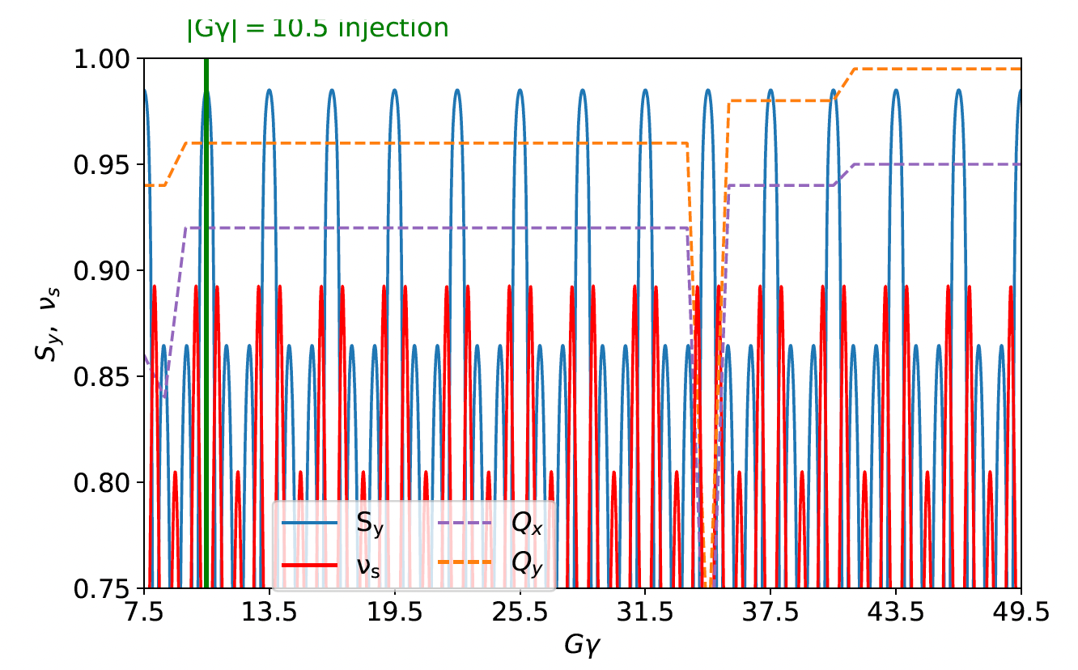
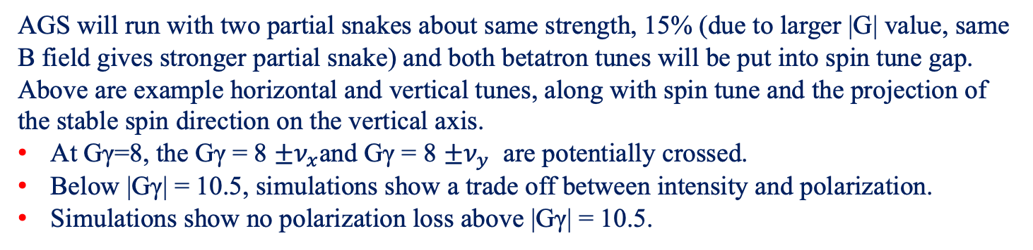
Polarized He-3 in AGS
AGS will run with two partial snakes about same strength, 15% (due to larger |G| value, same B field gives stronger partial snake) and both betatron tunes will be put into spin tune gap.
Above are example horizontal and vertical tunes, along with spin tune and the projection of the stable spin direction on the vertical axis.
At Gγ=8, the Gγ = 8 $±ν_{x}$and Gγ = 8 $±ν_{y}$ are potentially crossed.
Below |Gγ| = 10.5, simulations show a trade off between intensity and polarization.
Simulations show no polarization loss above |Gγ| = 10.5.

Slide 15
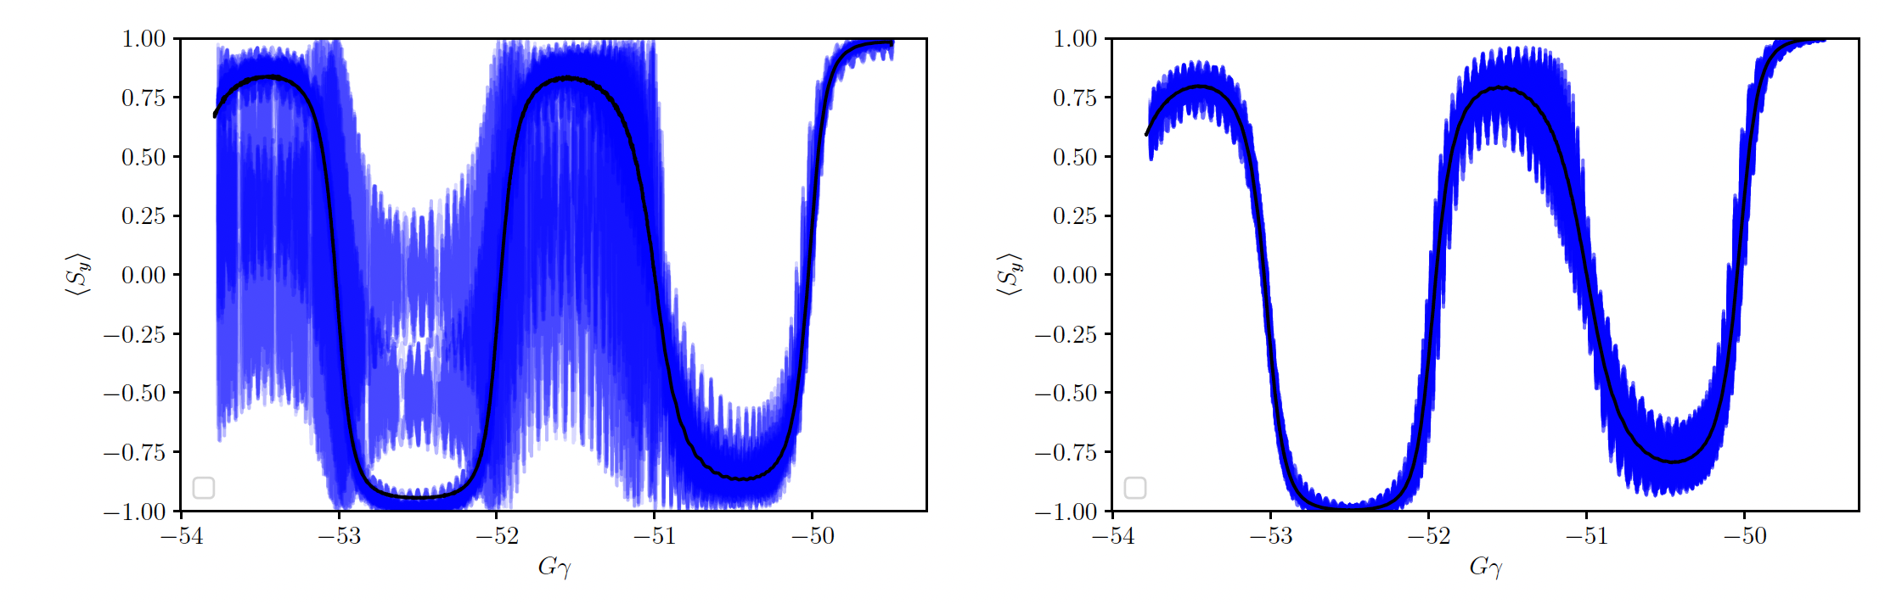
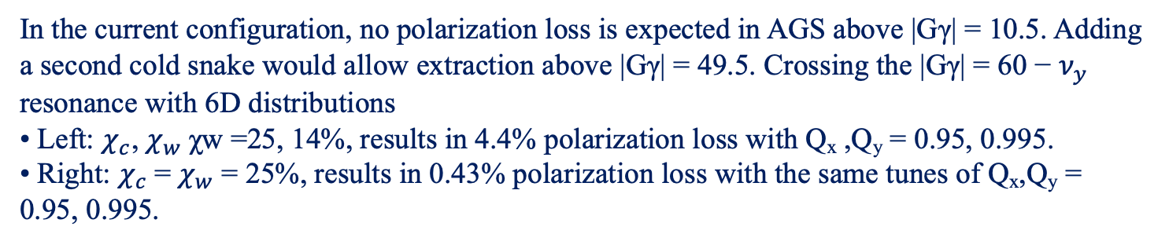
Additional Cold Partial Snake in the AGS
In the current configuration, no polarization loss is expected in AGS above |Gγ| = 10.5. Adding a second cold snake would allow extraction above |Gγ| = 49.5. Crossing the |Gγ| = 60 − $ν_{y}$ resonance with 6D distributions
• Left: $χ_{c}$, $χ_{w}$χw =25, 14%, results in 4.4% polarization loss with Q_{x} ,Q_{y} = 0.95, 0.995.
• Right: $χ_{c}$= $χ_{w}$ = 25%, results in 0.43% polarization loss with the same tunes of Q_{x},Q_{y} = 0.95, 0.995.
The optics distortions from two cold snakes would necessitate higher Booster-to-AGS transfer energy.
If experiment results show that skew quads setup could not reach 75% for 3.2E11 intensity, additional cold snake would also be needed for polarized protons.

Slide 16
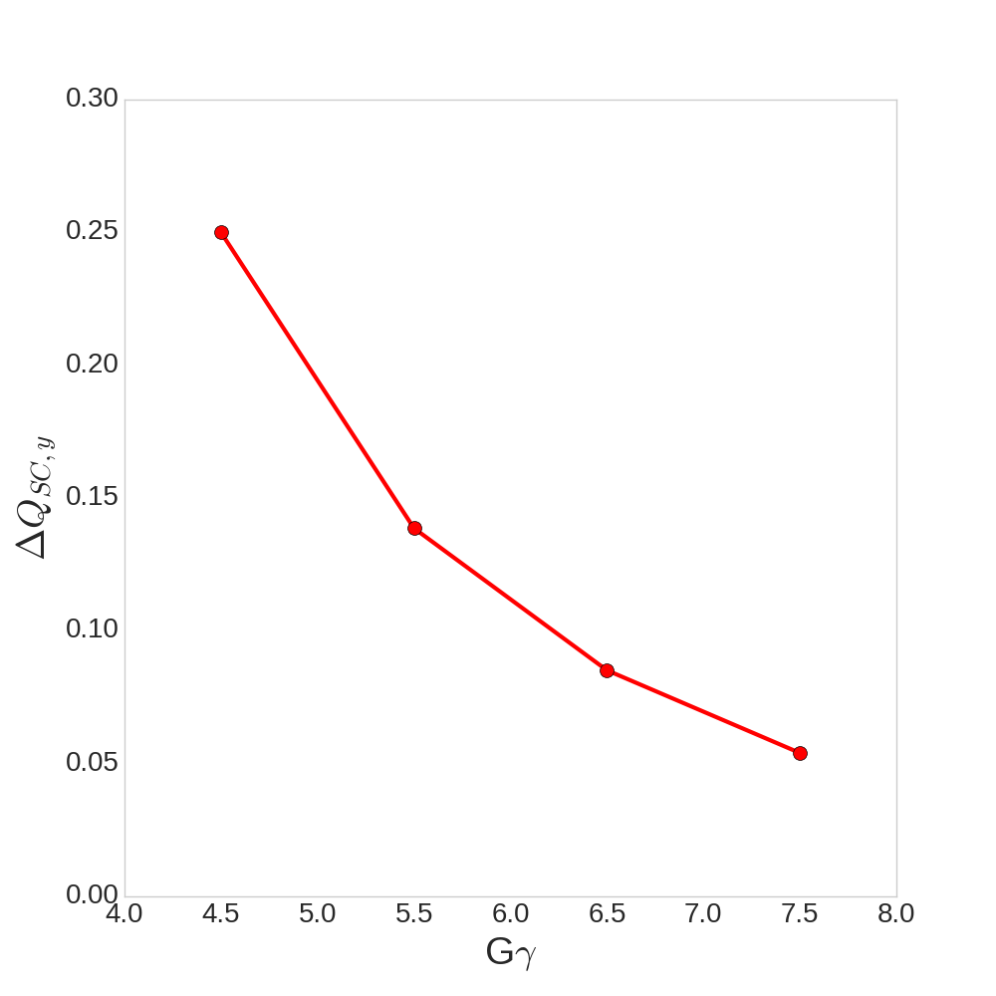
Raising AGS Injection Energy
Actually driven by helium-3 spin considerations
Raising injection of He3 from |G_{He}ɣ| = 7.5 → 10.5 reduce the optical distortion induced by partial snakes and avoids a major AGS resonance crossing
This would also allow higher energy transfer of protons.
|G_{proton}ɣ| = 4.5 → 6.5
Protons injected at the higher rigidity would have space charge tune shift reduced by 70%
Challenges:
Additional spin resonance crossing in the Booster and AGS need to be considered (and avoided)
Spin transparency of the transfer line is energy dependent (-3% pol for G_{proton}ɣ = 6.5)
Expensive: Booster main dipoles and quads, Booster RF, transfer line dipoles and pulsed power need upgrades
Present
Transfer
Transfer at
Upgraded rigidity

Slide 17
Polarized Deuteron in Injectors
The AGS Booster energy range for the deuteron is 0.95 GeV–1.3 GeV, with |Gγ| in the range of 0.14 to 0.2. There are no imperfection resonances in the Booster. If the fractional tune is not between 0.14 and 0.2 (or 0.8–0.86), then intrinsic spin resonances are also avoided.
The AGS energy range is from 1.3 GeV to 10 GeV, with a |Gγ| range of 0.2 to 1.5. There is only one imperfection resonance in this range, at |Gγ| =1, and this resonance is very weak. There are three intrinsic resonances, but none of these are enhanced with the superperiod of 12. Their strengths are very small.
For the given AGS ramp rate, none of these resonances cause a polarization loss.
Conclusion: if polarized source can be built, there is no need for polarization preservation commissioning in the injectors.

Slide 18
Summary
At EIC required 3.2E11 intensity, the proton polarization is around 65%, a gain of 10% polarization from current level is needed. The vertical emittance also needs to be reduced.
Skew quads can reach comparable polarization as tune jump quads with lower energy part pulses off.
Modeling of low energy part will need improvement based on data taken last run.
The plan is to develop skew quads method with better diagnostics and alignment in 2029-2030, after cable replacement and ARR done.
If further polarization improvement is needed, another cold snake and raising AGS injection energy are planned for 2031-2035.
Extensive simulations have been done for polarized He-3 in AGS and Booster. Both betatron tunes will be put into spin tune gap.
Polarized He-3 development will be carried out in the Booster. The goal is to have a Booster polarimeter in the summer of 2027.
Polarized deuteron beam sees only one weak imperfection resonance in AGS and Booster. There is no need for commissioning time to improve polarization.
Polarimetry development for AGS (He³ and proton) is planned in parallel.

Slide 19
Backup Slides

Slide 20
Accelerator Improvement (planned)
BPM upgrade (~2 yrs): TBT capability at all locations (72x2 planes), currently single location. Significantly increases ability to characterize optics and coupling sources
Realignment of AGS: Full survey of AGS (combined function+tune/chrom control magnets).
Towards full general orbit correction of AGS orbit (currently limits to few harmonics by weak correctors)
Consider upgrade of orbit steerers based on assessment after survey (increase number and/or strength of correctors)

Slide 21
Benefits and Schedule of Booster/AGS BPM Upgrade
TbT BPMs capture the beam position every turn, enabling measurement of betatron oscillations, tunes, chromaticity, and coupling.
Allow direct measurement of beta functions, phase advance, and lattice errors.
Enable advanced optics correction techniques.
Provide detailed information on injection mismatch, kicker performance, and orbit transients.
Critical for optimizing injection efficiency and minimizing losses.
It is expected to be finished before 2029, so the new system can be used for AGS polarized beam development.
Better optics is expected to improve polarization preservation (less emittance growth at injection, etc).

Slide 22
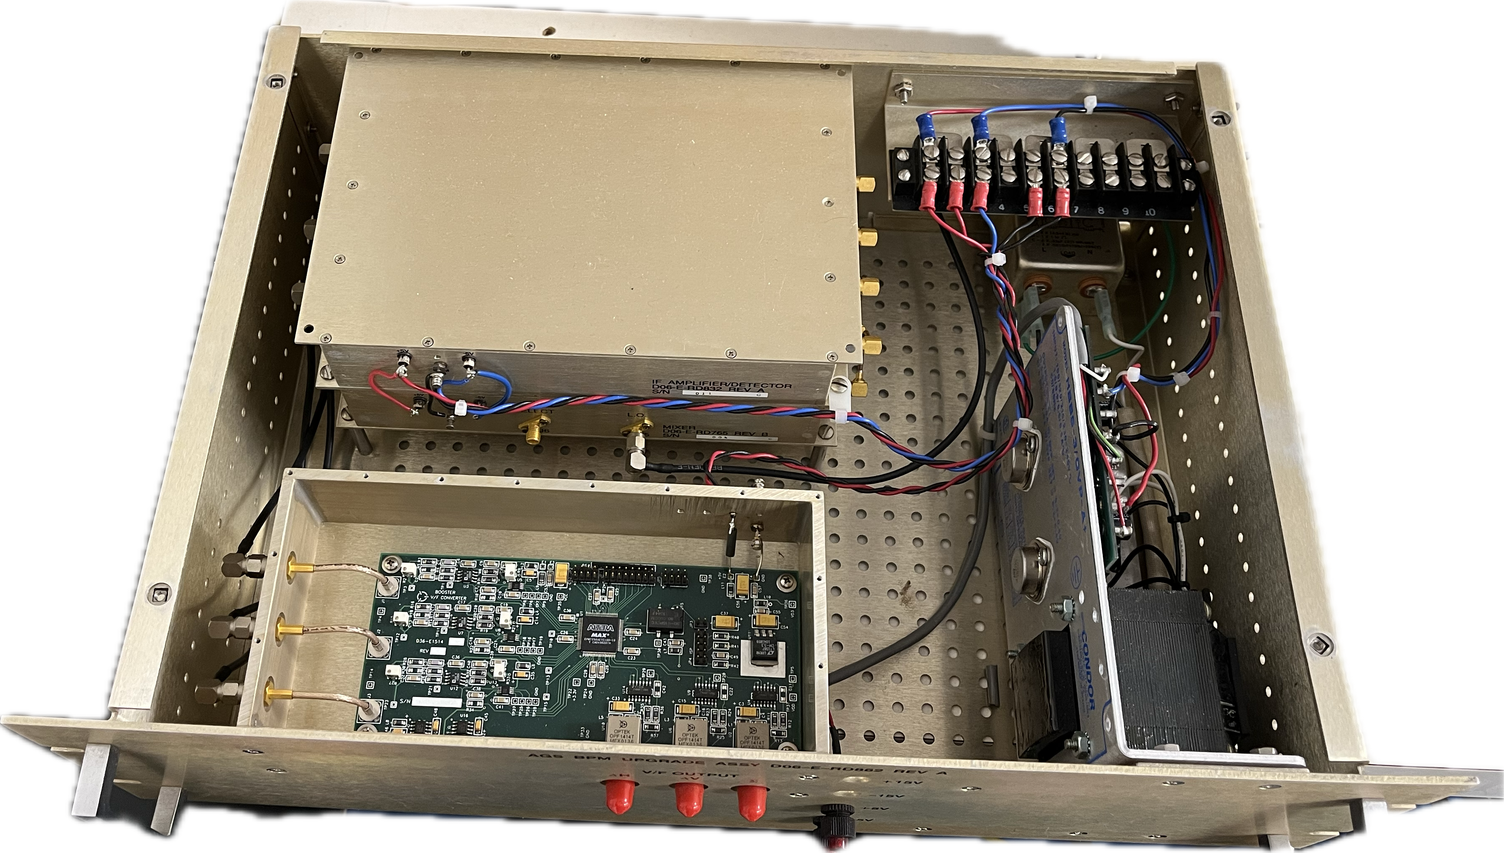
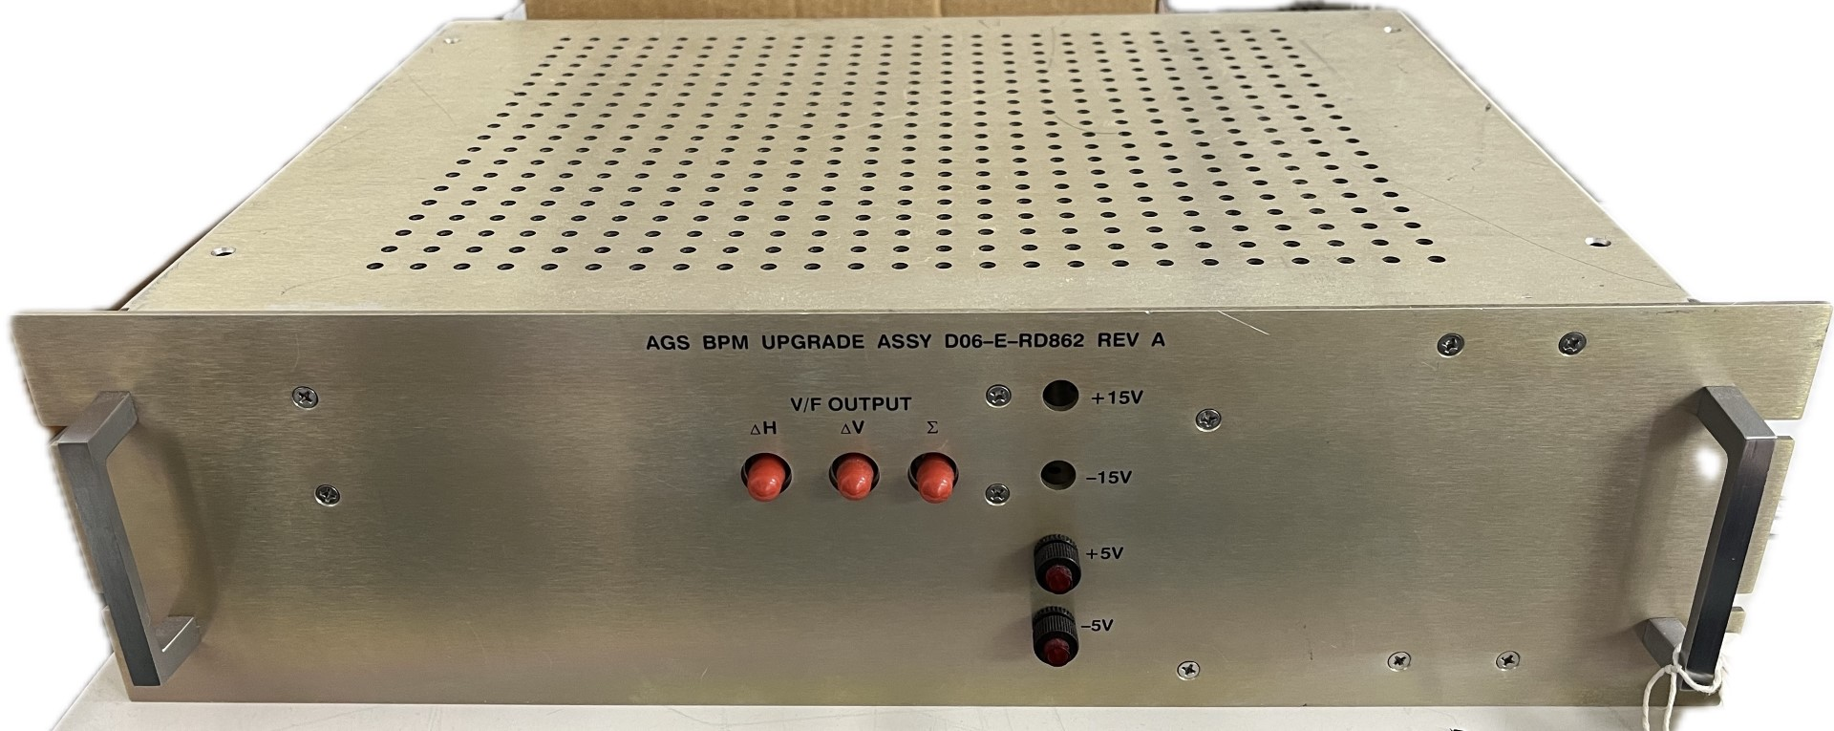
AGS and Booster BPM system upgrade
Existing analog front-end electronics to remain
Existing analog to frequency fiber optic module will be upgraded with analog to digital serial fiber optic module
New processing module being developed for receiving and processing fiber optic serial links from each BPM
This will also eliminate complicated downstream fiber to digital and scalar modules
22

Slide 23
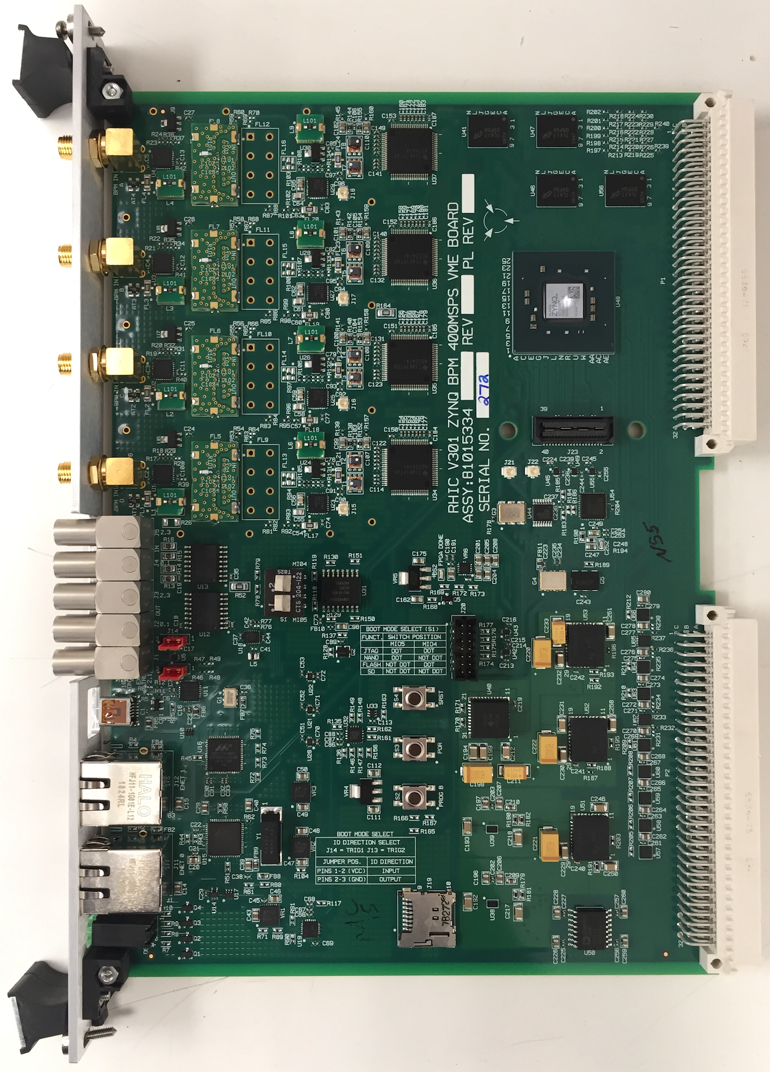
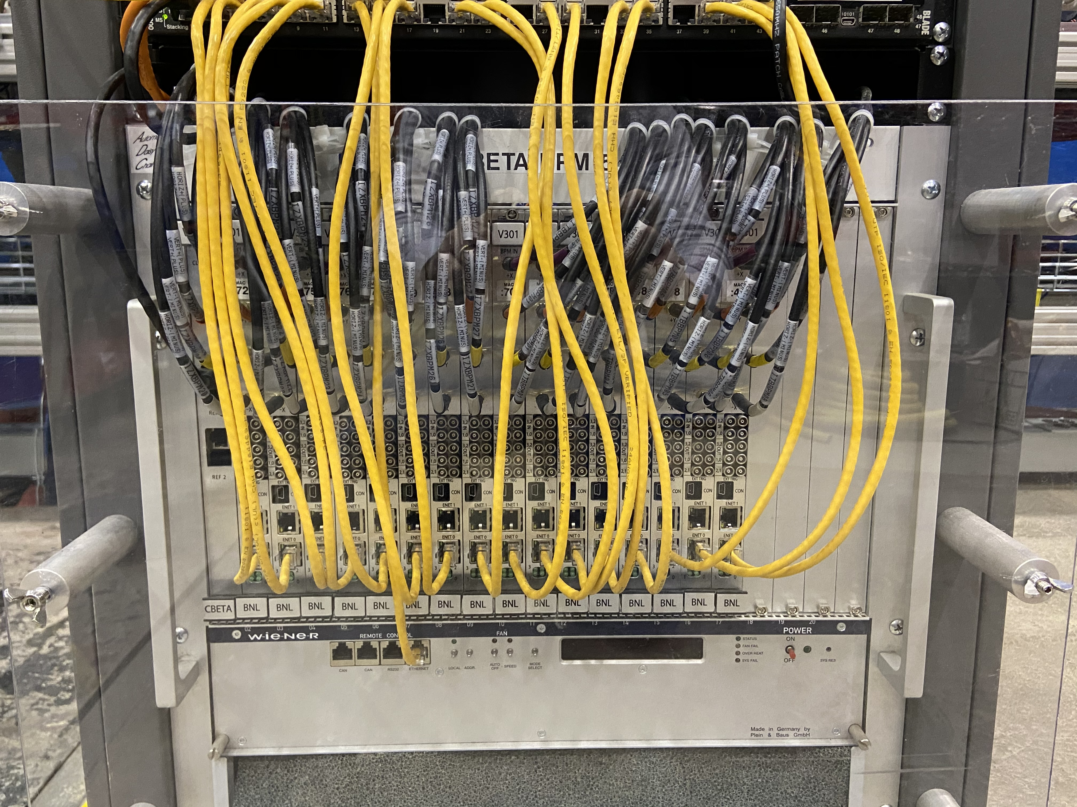
AGS and Booster BPM system upgrade
CBETA V301 BPM modules will be used to provide turn-by-turn measurements
120 modules required
139 available from Cornell
Signals from pickups will be split to both systems
CBETA BPM VME chassis
V301 BPM module
(direct ethernet connection with no VME bus interface)
23

