Slide 1
Polarized Ion Beams at the EIC
Vadim Ptitsyn
EIC Project, BNL
March 18, 2026

Slide 2
Outline
Requirements on polarization in EIC
Hadron (p, ³He⁺²) polarization in EIC
Hadron ring Snakes and spin rotators
Summary

Slide 3
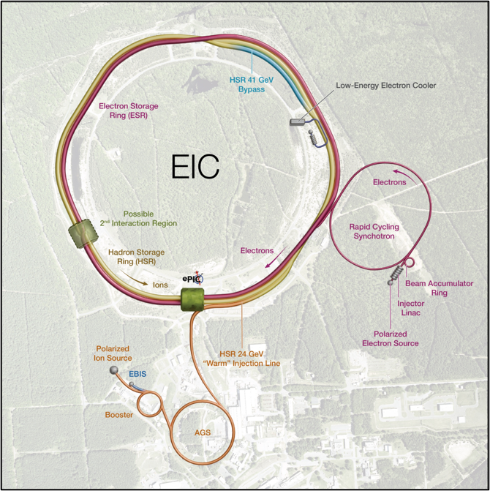
EIC Polarized Beam Requirements
Highly polarized beams of:
  Electrons
  (polarization goal: 70% average)
  Proton, ³He⁺²
  (polarization goal: 70%)
Note: Polarized deuterons under discussion.
Spin orientation at the collision point:
  Electrons: longitudinal
  Hadrons: longitudinal or vertical
Using bunches with opposite spin orientation in the same fill

Slide 4
RHIC Polarized Beam Complex
For more than 20 years provided polarized proton beam for physics experiments.
Injection chain will be re-used in EIC with all polarization-related hardware.

Slide 5
Polarization: RHIC vs EIC Hadron Storage Ring
RHIC
EIC HSR
Provided polarized protons for experiments in energy range from 31 GeV to 255 GeV.
Polarization 60% at 255 GeV has been delivered
Two Siberian Snakes are used in each of the two present RHIC rings to maintain polarization
Feedback during acceleration – on the betatron tune, coupling, and orbit – is crucial for polarization preservation.
Polarized protons: 41 GeV and in 100-275 GeV range.
Also, polarized ³He⁺² ions.
Polarization goal: 70%
Six Siberian Snakes
Re-use RHIC feedback tools
Low Energy Cooling at the injection energy reduces vertical emittance, and, hence, spin resonance strength
Tripled beam current; shorter bunch spacing

Slide 6
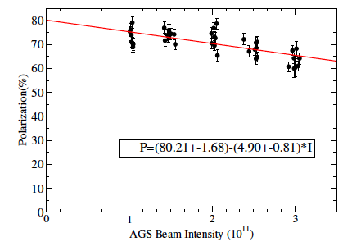
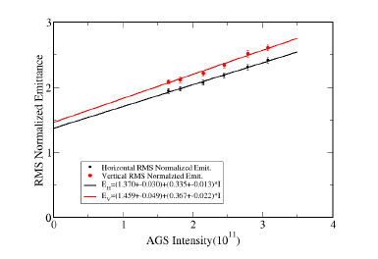
Polarization and Emittance vs. Intensity @AGS Extraction
The intensity dependence is actually emittance dependence.

Slide 7
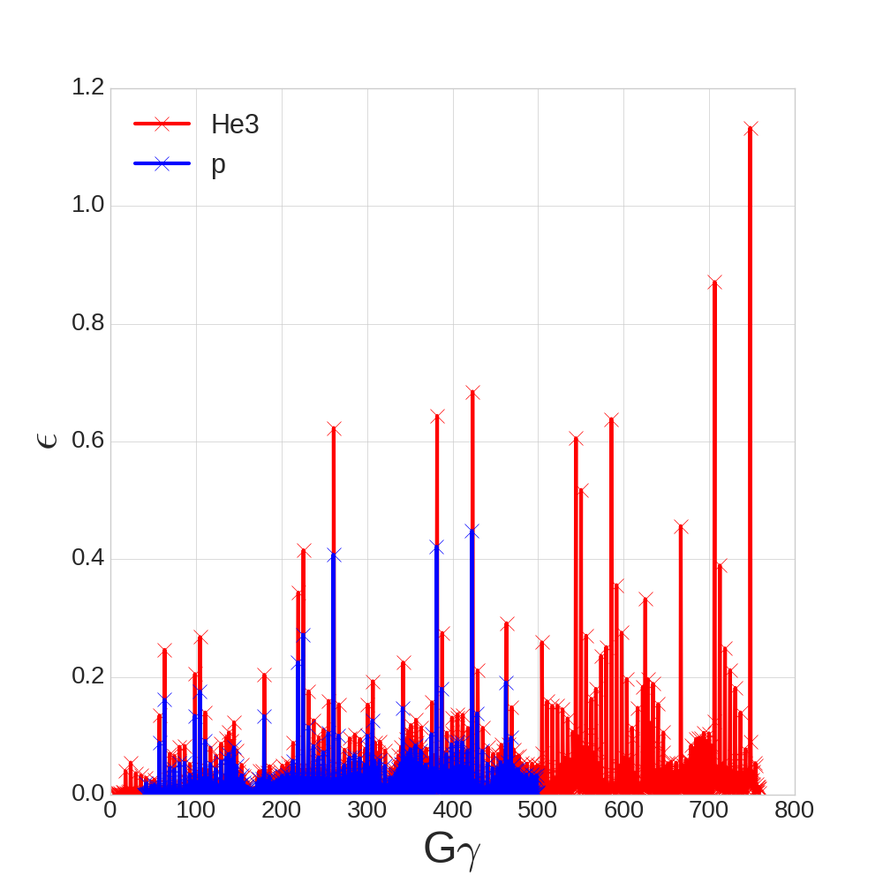
Polarized ³He Acceleration in EIC HSR
 | p | ³He⁺²
m, GeV | 0.938 | 2.808
G | 1.79 | -4.18
E/u, GeV | 24-275 | 16-183
|Gγ | | 46.5-525.5 | 72.6-819.4
Crossing strongest spin resonance with 2 and 6 Snakes
RHIC Siberian snakes and spin rotators can be used for the spin control, with less orbit excursions than with protons.
More spin resonances. Larger resonance strength.
6 Snakes are necessary to preserve ³He polarization at acceleration

Slide 8
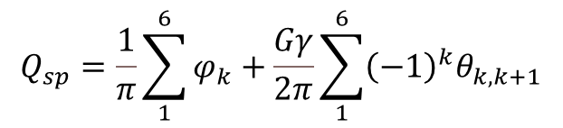
Six Snakes
Number of Snakes will be increased from 2 to 6
Snake arrangement is perfectly symmetric with 60 degree bending angle between Snakes.
Additional Snakes are put in DU7 ”dummy” sections, free of magnets.
-45º
$$Q_{sp}=\frac{1}{π}\sum_{1}^{6}{φ_{k}}+\frac{Gγ}{2π}\sum_{1}^{6}{{\left(−1\right)}^{k}θ_{k,k+1}}$$

Slide 9
Hadron bunch structure
RHIC
38 nC per bunch; 110 bunches
Beam current: 0.33 A
106 ns
EIC HSR
11 nC per bunch; 1160 bunches
Beam current: 1 A
4 consecutive bunches with the
same polarization
10.1 ns
EIC HSR when colliding with 18 GeV electrons
31 nC per bunch; 290 bunches
Beam current: 0.69 A
40.5 ns

Slide 10
EIC Hadron Spin Rotators
RHIC IR6
EIC HSR IR
The Hadron Storage Ring spin rotators:
The spin rotators used presently in RHIC will be re-used in the EIC HSR.
The locations of the spin rotators in the HSR differ considerably from their RHIC locations The net bending angle between HSR spin rotators is non-zero.
Snakes must be adjusted when the rotators are turned on at the store energy.
From RHIC experience:
In order to ensure correct operation of spin
rotators and longitudinal polarization at
the interaction point the polarization measurement between rotators and the IP is required.

Slide 11
Spin Rotation: Helical Dipole
B_{y}
B_{x}
Paraxial helical dipole field (without magnet edges):
λ
Compared with common dipole the helical dipole has
an additional parameter, Helicity R, which can be +1 or -1
Actual helical field is intrinsically nonlinear,
as well as contains longitudinal off-axis component:
But, for initial evaluation of the spin and particle motion near the helical magnet axis, the paraxial helical field is a good approximation.

Slide 12

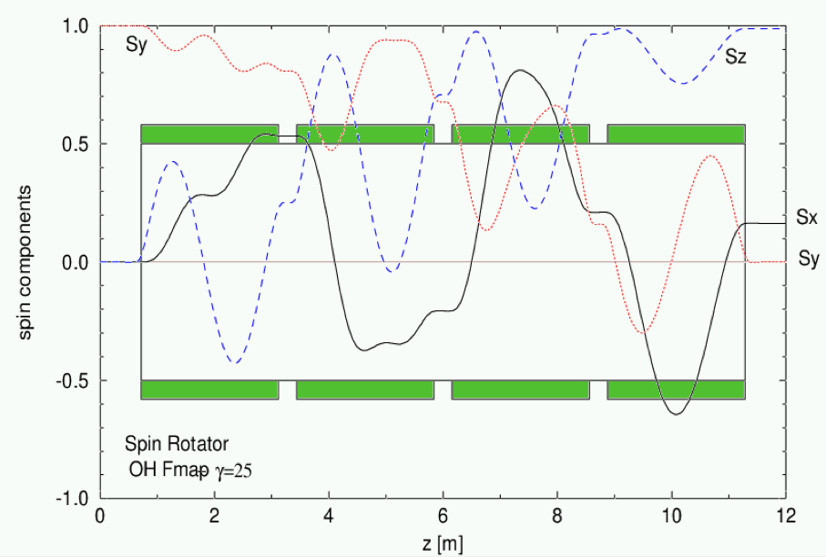
RHIC Snakes and spin rotator will be reused in HSR
Fig.1 The spin rotator scheme, consisting of four helical magnet. The sign demonstrates the magnet helicity ("+" is right-handed, "-" is left-handed
Fig.2 The example of the spin component evolution through the rotator.

Slide 13
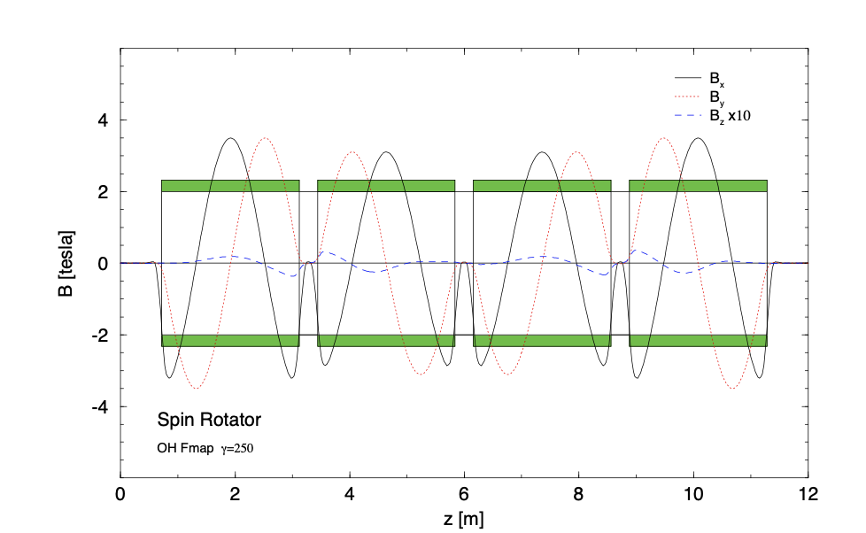
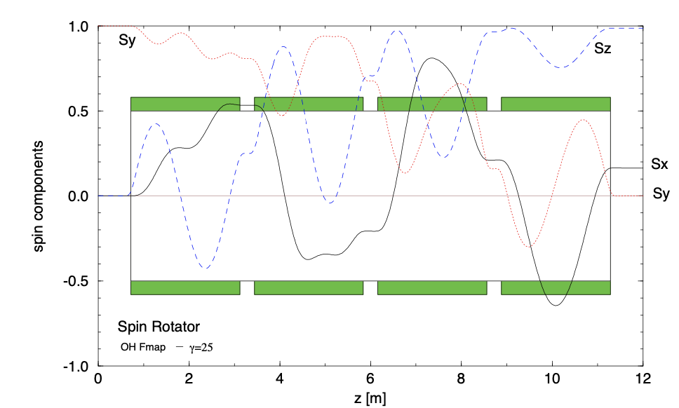
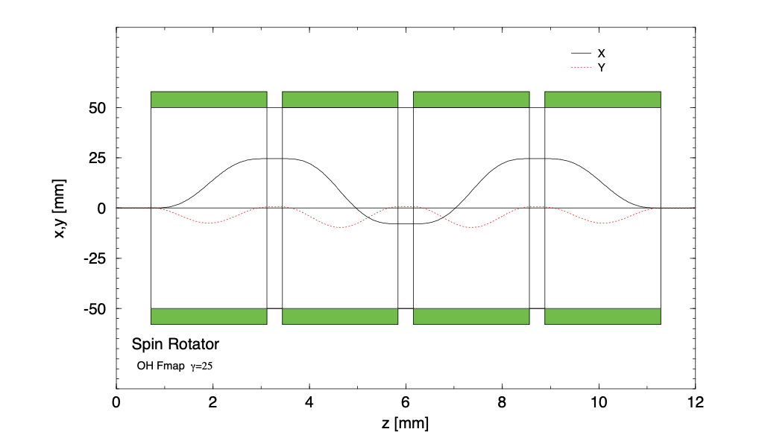
RHIC Spin Rotators
Magnetic Field
Spin
Orbit
Since there are dipole magnets (D0,DX) between
the rotator and the IP, spin direction is not
longitudinal after the rotator. The required spin
direction varies with the beam energy.
Due to large orbit excursion at the injection
the spin rotators are turned on at the store energy.

Slide 14
HSR Rotator Operating Energy Range
The plot shows relation between rotator fields
and the spin orientation after the rotator for protons
The HSR main proton operating energies are
41 GeV, 100 GeV and 275 GeV.

Slide 15
HSR Rotator Operating Energy Range
The plot shows relation between rotator fields
and the spin orientation after the rotator for protons
(R,L,R,L) configuration must be used to produce the longitudinal polarization at 41 GeV.
The sequence of the helical magnets in the 2nd rotator must be changed!

Slide 16
From RHIC to HSR Spin Rotators and Snakes
EIC Hadron Storage Ring (HSR) will re-use the RHIC spin rotators and Snakes.
The Snakes and rotators will be disassembled.
The vacuum pipe will be replaced with a new pipe coated with copper and amorphous carbon layers to mitigate the effects of resistive heating and electron cloud.
New BPM will be installed at the center of the rotator .
In RHIC: total of 8 spin rotators
In HSR : initially 2 spin rotators, then 4
Helical modules off remaining spin rotators will be used to construct additional Snakes for the HSR

Slide 17
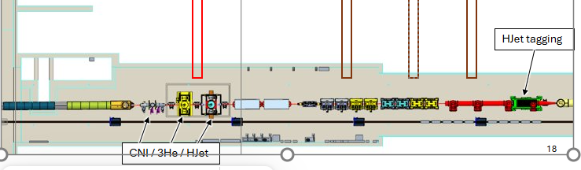
HSR Polarimeter Location: IR4
IR12 area used for polarimeters in RHIC can not be used in the HSR, because of a space conflict with 41 GeV switchyard and other space limitations
Appropriate location for hadron polarimetry was arranged in IR4 area
Unlike RHIC, in the HSR there are no magnets between p-C and Jet polarimeters!
To satisfy requirements of 3He polarization measurement, a dipole magnet is placed between Jet polarimeter and taggers

Slide 18
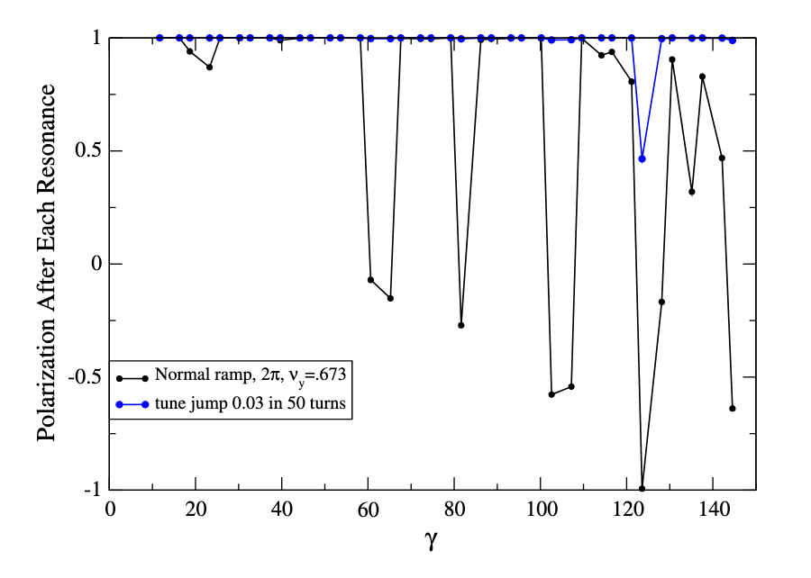
Polarized deuterons
 | p | d
m, GeV | 0.938 | 1.876
G | 1.79 | -0.143
E/u, GeV | 24-275 | 12-137
|Gγ | | 46.5-525.5 | 1.6-20.9
Polarized deuteron are not currently in the EIC scope, but there is a physics interest for using them.
The studies have been done which showed the feasibility of polarized d.
The imperfection resonances can be overcome by partial snakes on the base of the planned detector solenoid(s).
The intrinsic resonance can be overcome with modest tune jump.
At Gγ =3n (3, 6, 9, 12, 15, 18), longitudinal polarization can be reached at both 6 o’clock and 8 o’clock IRs. 22.5 GeV interval.
D polarization at acceleration with and without tune jumps
H.Huang

Slide 19
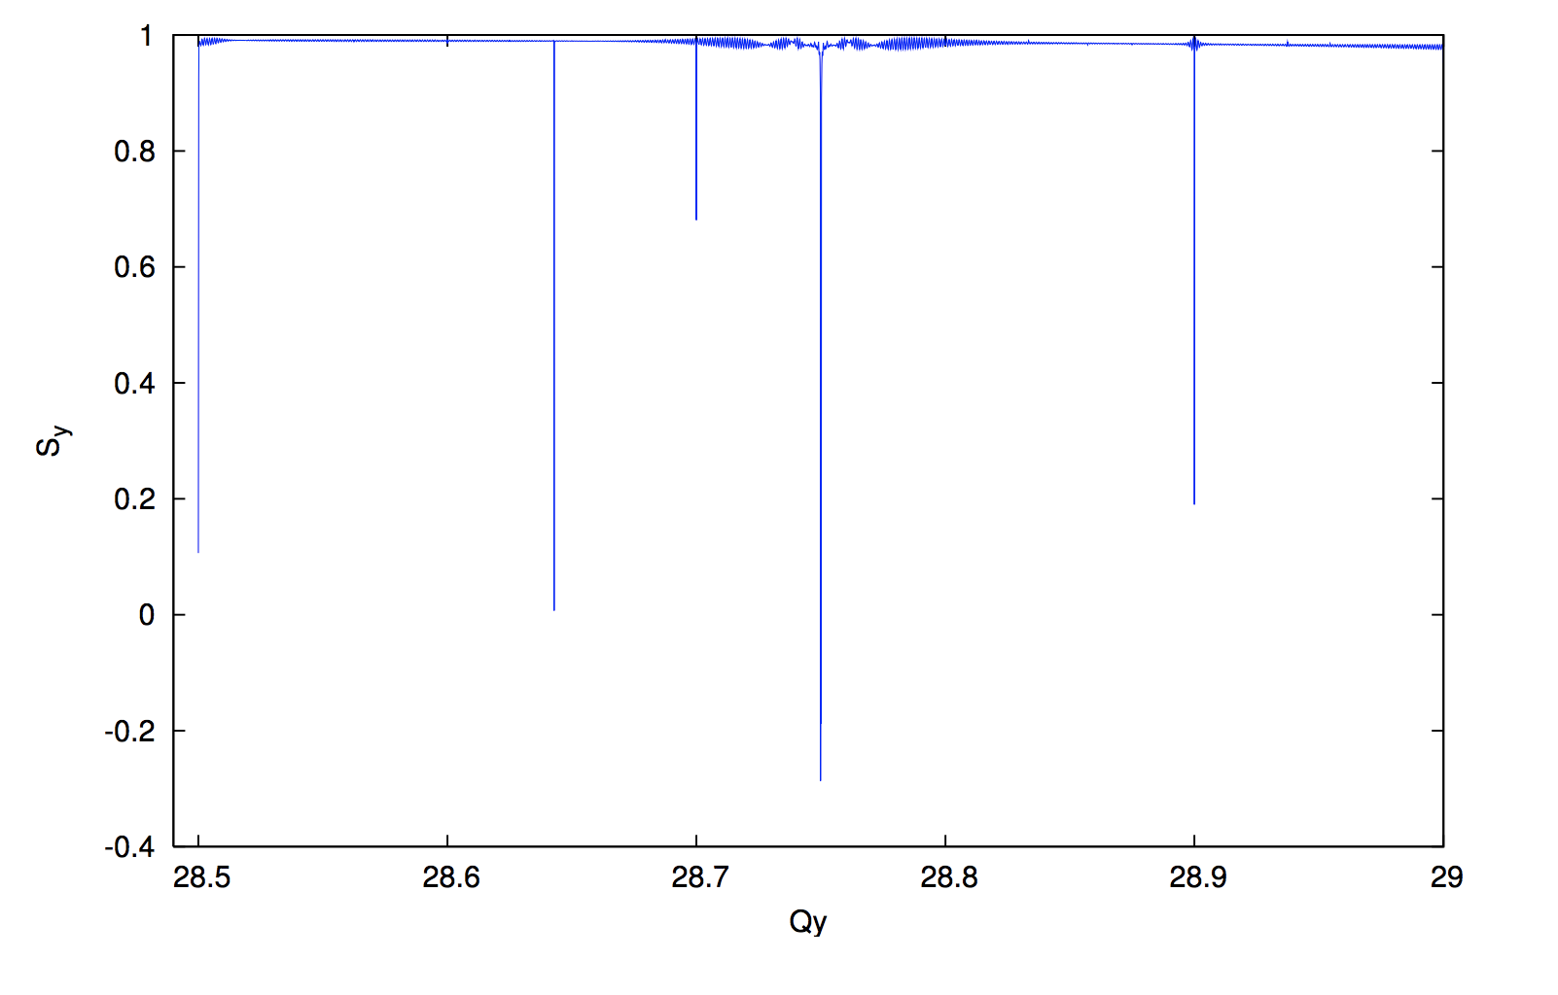
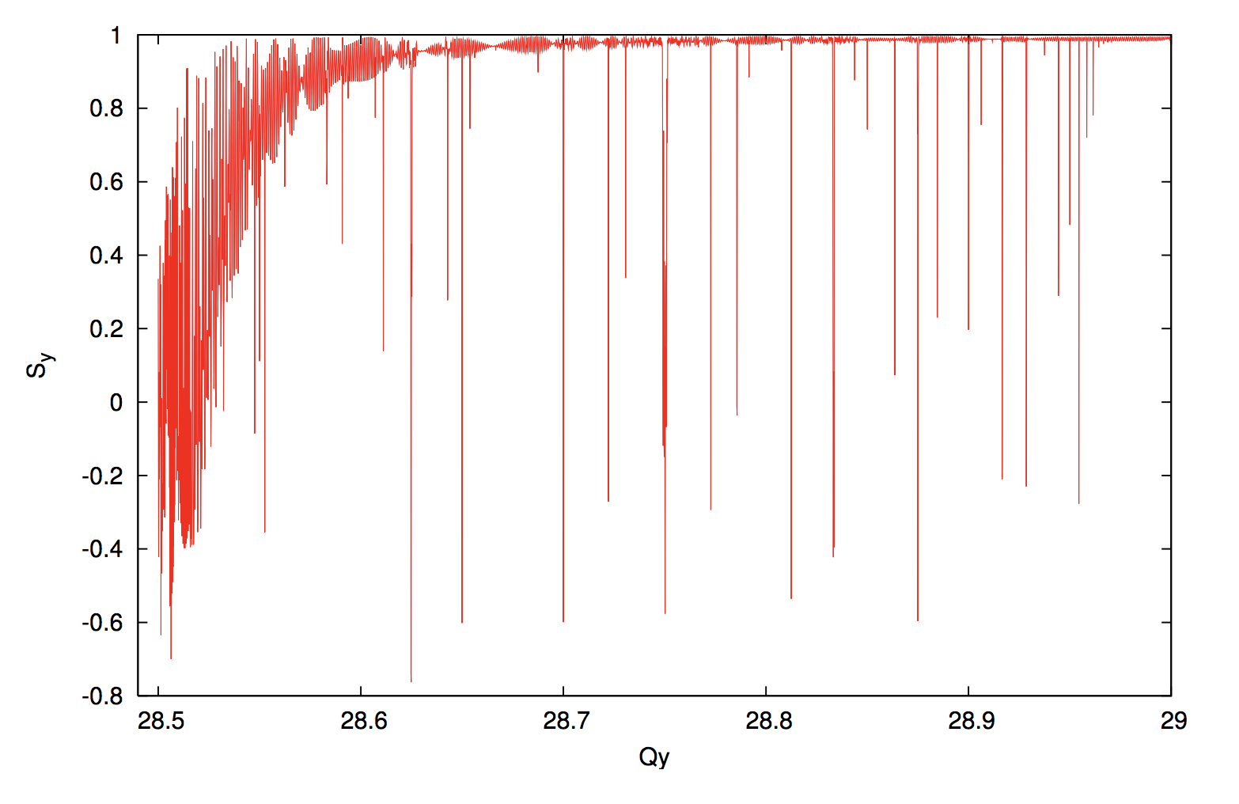
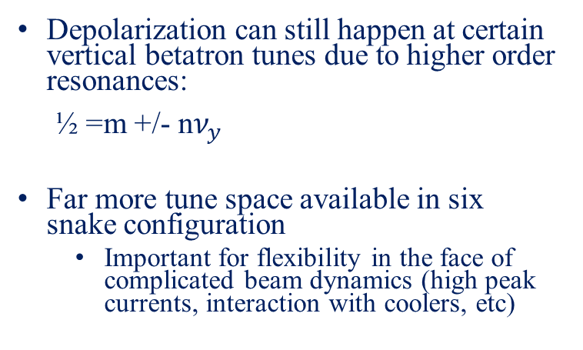
Snake Resonances in RHIC
Depolarization can still happen at certain vertical betatron tunes due to higher order resonances:
½ =m +/- n$ν_{y}$
Far more tune space available in six snake configuration
  Important for flexibility in the face of complicated beam dynamics (high peak currents, interaction with coolers, etc)
Experimental observation of
Snake Resonances in RHIC
RHIC with 2 Snakes
Snake resonance spectrum
EIC Hadron Ring with 6 Snakes
S_{y}
S_{y}
RHIC tune space
6-snakes
2-snakes
Q_{y}

Slide 20
Summary
Electron-Ion Collider will re-use existing RHIC injector chain, including ion sources.
EIC will take full advantage of existing tools and techniques used to preserve proton polarization in injectors and RHIC.
Additional snakes will be added to the EIC Hadron ring for improving p polarization and preserving He-3 polarization. Six snakes are enough, and we are exploring if four snakes are also possible.
Simulations have been performed to verify the design choices.

Slide 21
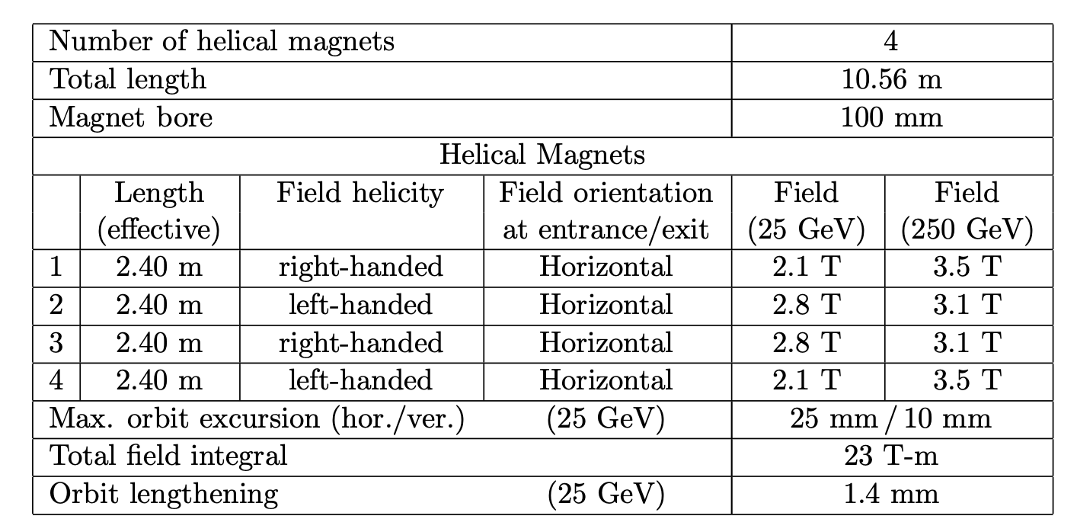
RHIS Spin Rotators
Spin rotator use helical dipole magnets.
Exactly, the same magnets as in the Snakes.
Maximum field is 4T.
But, unlike the Snakes, the orientation of the magnetic field in the center of the helical magnet is horizontal.
Main parameters of the spin rotators in RHIC

