Slide 1
ESR and RCS Design
Christoph Montag, BNL
March 19-20, 2026

Slide 2
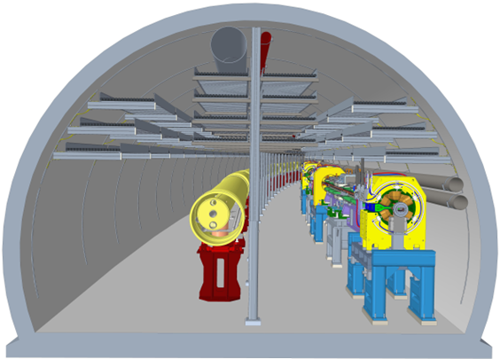
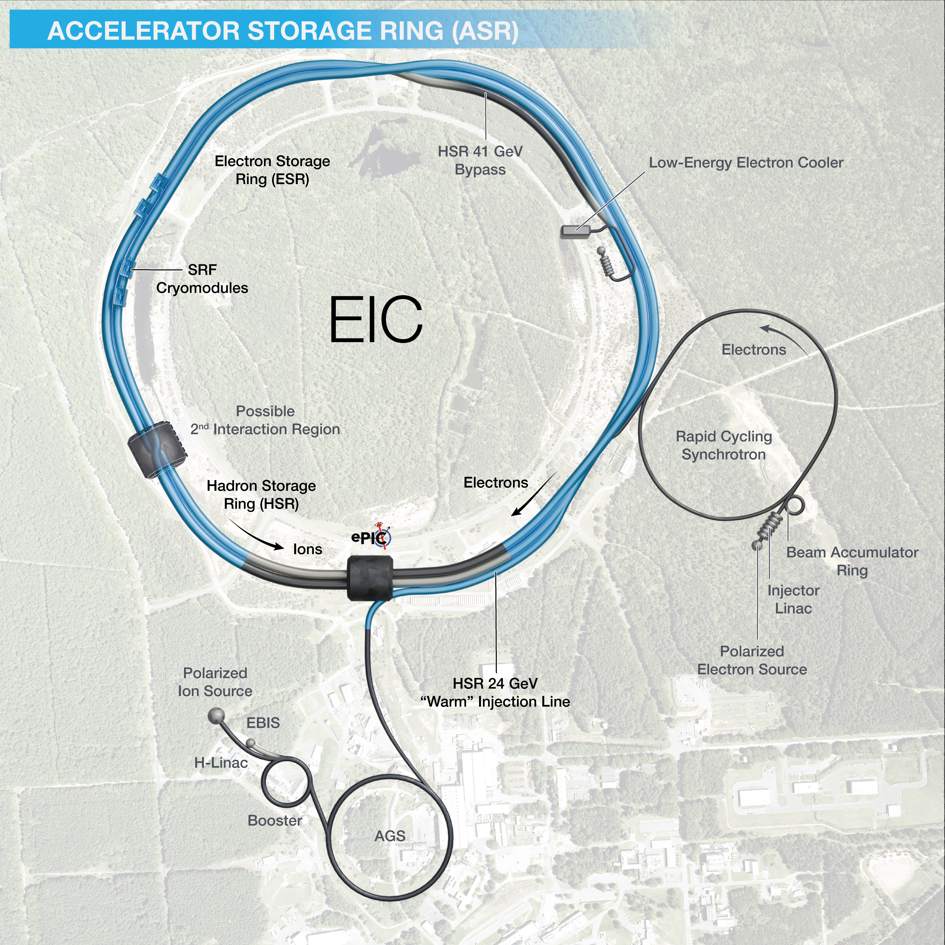
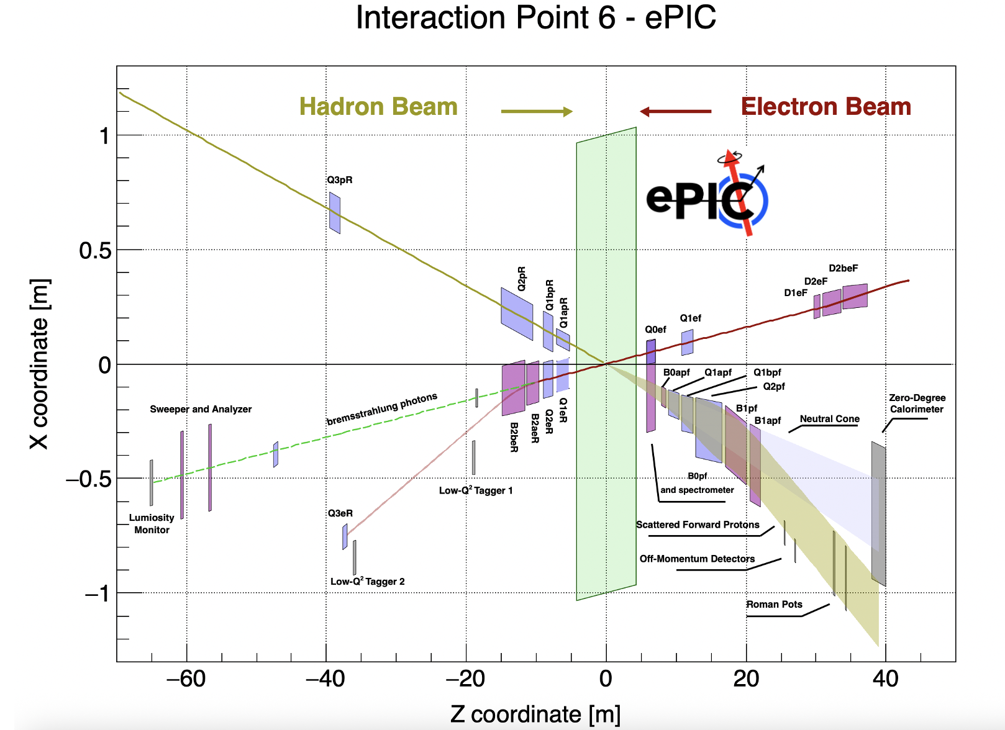
Electron Storage Ring (ESR)
Electron Storage Ring (ESR) consists of six FODO-cell arcs, and six straight sections (IRs)
Straight sections are used for:
RF cavities (IR10)
Cross-over with HSR (IR12)
Abort system (IR2)
Injection and cross-over
with HSR (IR4)
ePIC Detector (IR6)
Future second detector
(IR8)

Slide 3
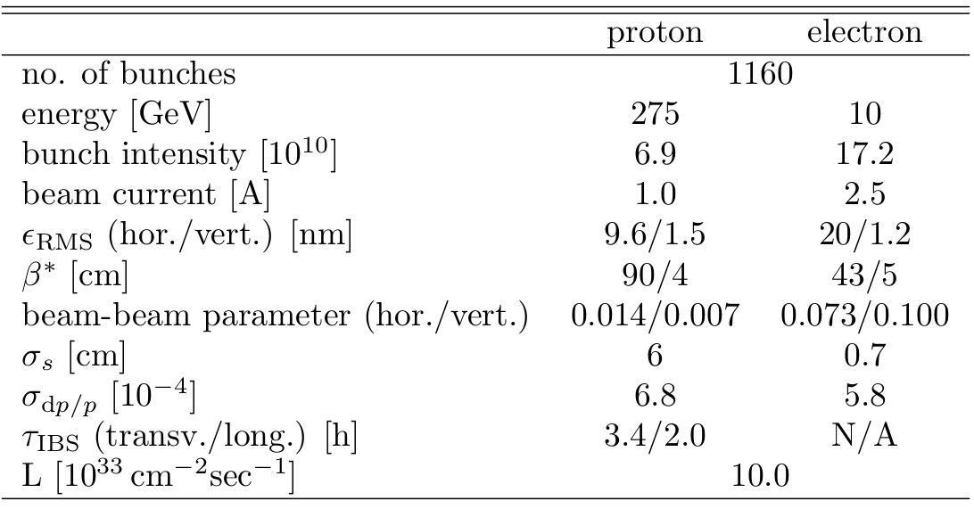
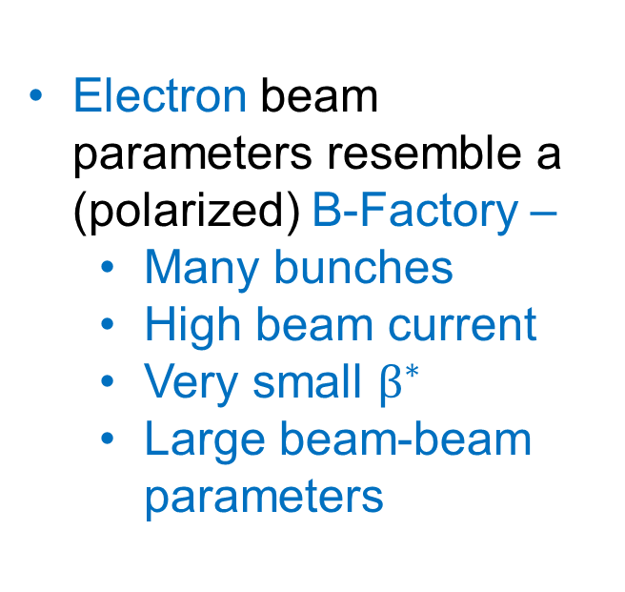
Parameters for Highest e-p Luminosity
Electron beam parameters resemble a (polarized) B-Factory –
Many bunches
High beam current
Very small $β^{∗}$
Large beam-beam parameters

Slide 4
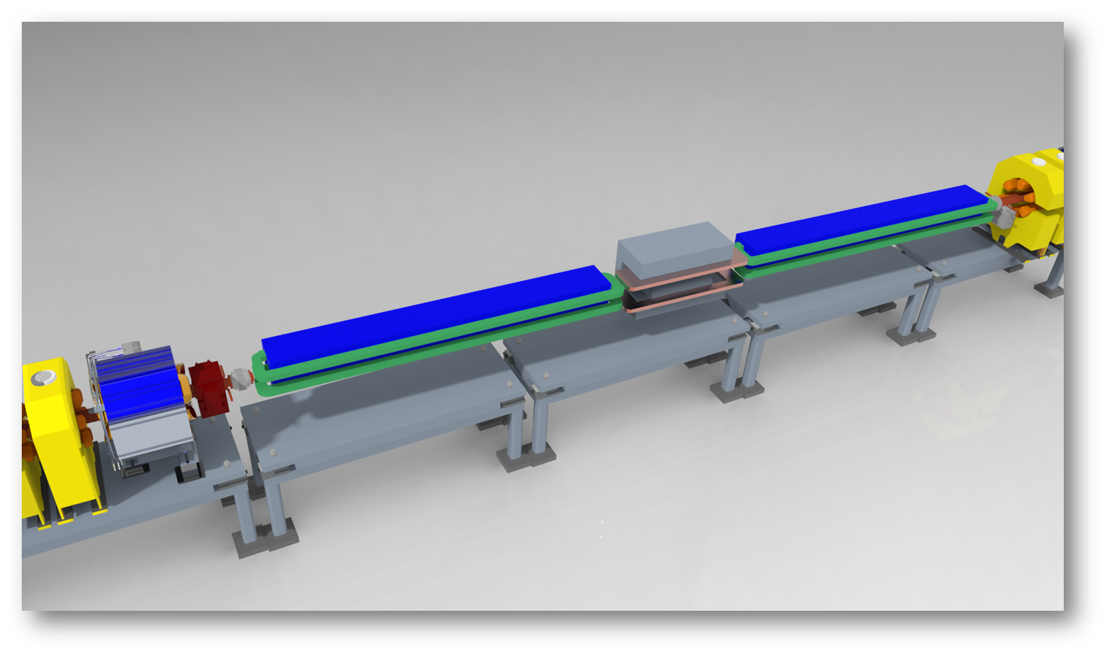
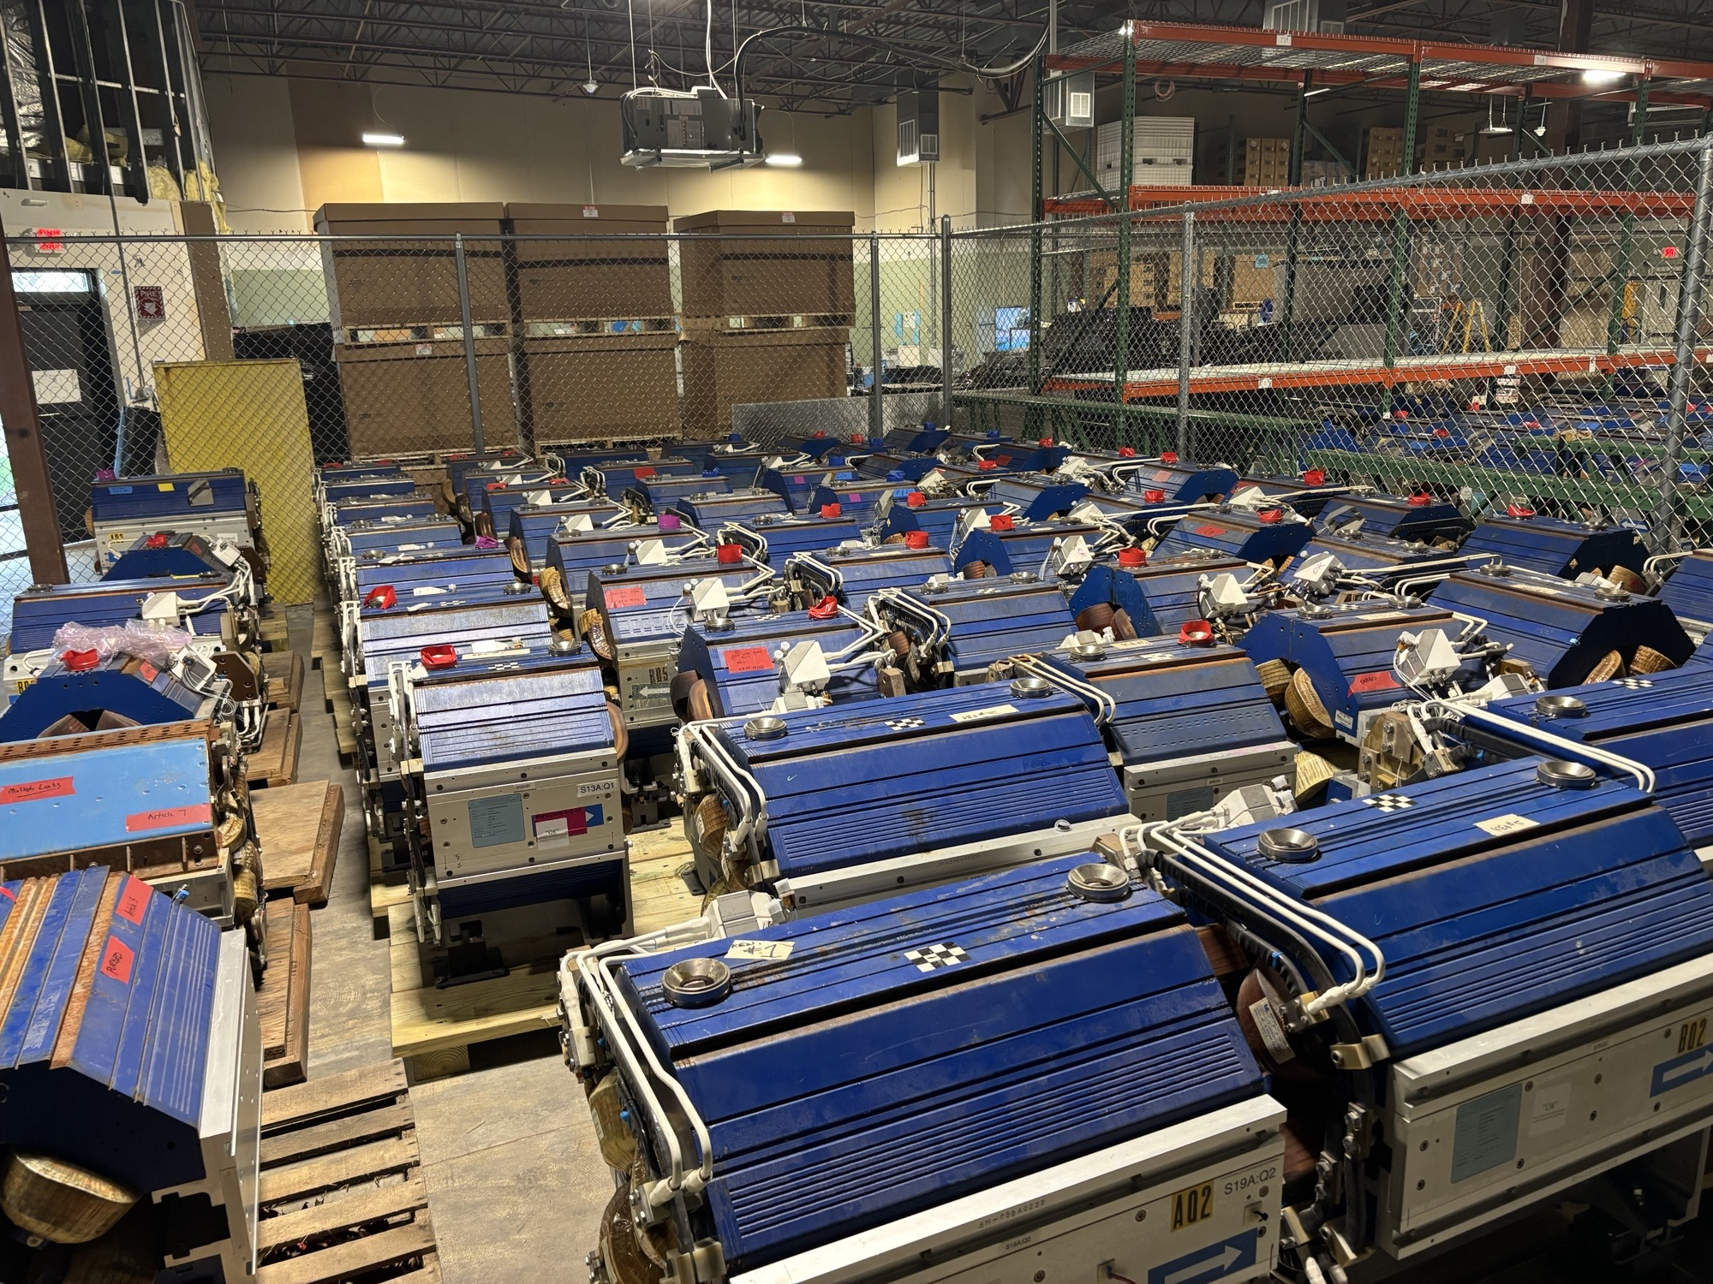
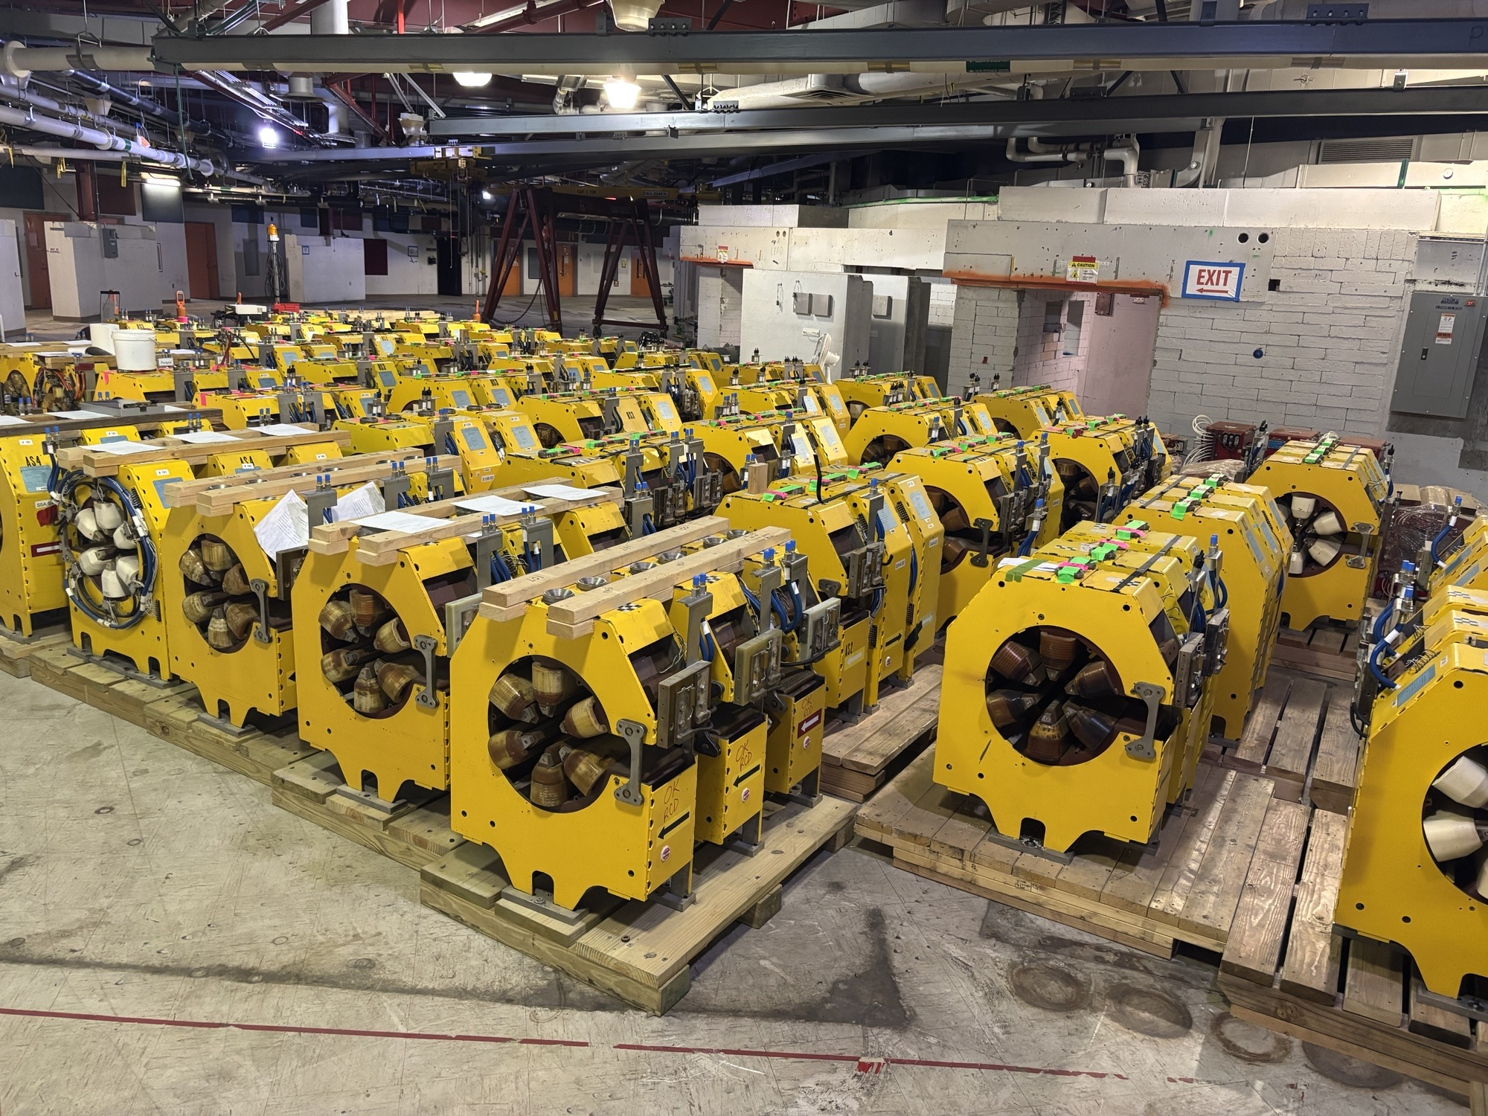
Magnets
Received 400 quadrupoles and 280 sextupoles from APS
Used TWICE the measured multipole errors in dynamic aperture tracking
Adopted these multipoles as field quality requirements for the small number of new magnets still needed
Dipole field quality requirements are based on field simulations with different mechanical/geometrical imperfections

Slide 5
Superconducting RF
ESR needs 10 MW RF power, and up to 61 MV for ultimate performance
ESR lattice provides drift spaces for 9 two-cavity SRF cryomodules in IR10
4 SRF cavities in 2 two-cavity cryomodules to be installed as part of ASR subproject, remaining six cryomodules for a total of 16 cavities in eight cryomodules as part of Project and Integrated Performance (IP) subproject
3.2 MW total power solid-state amplifiers to be installed as part of ASR subproject, with another 9.6 MW to be added as part of Project and Integrated Performance (IP) subproject

Slide 6
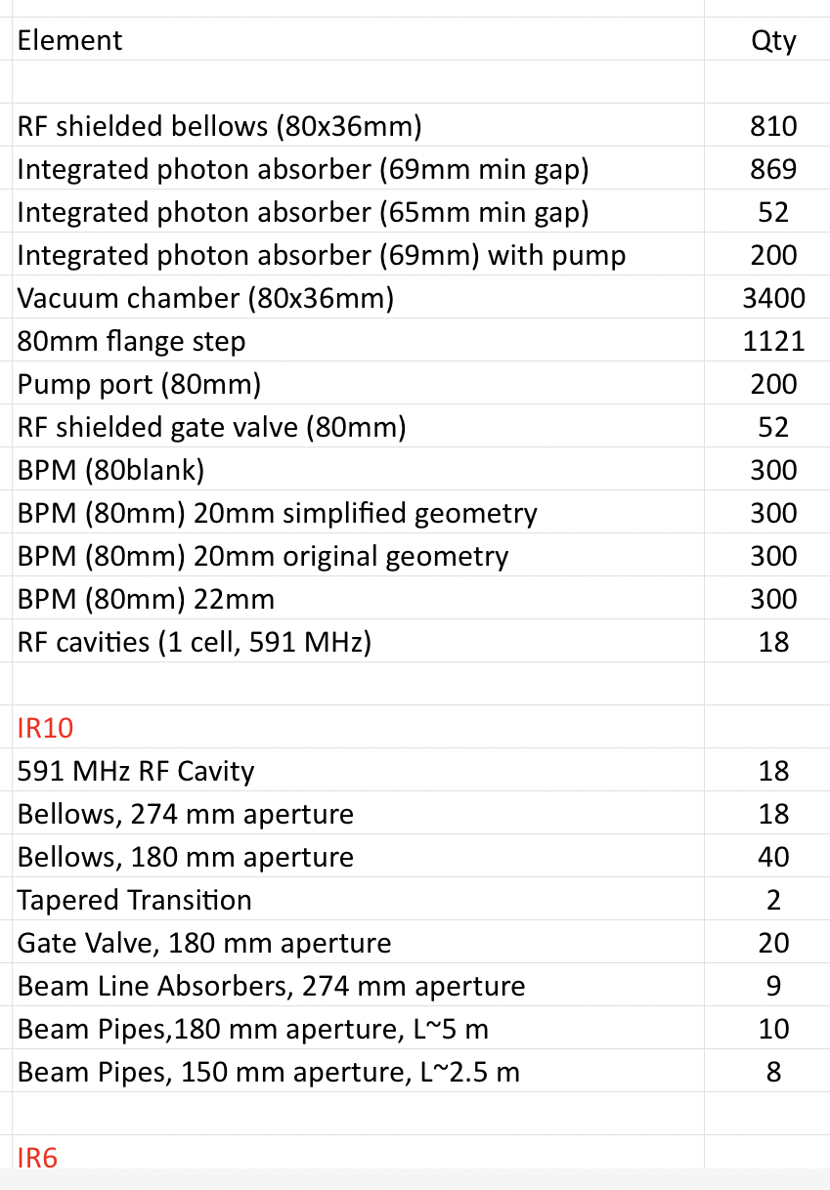
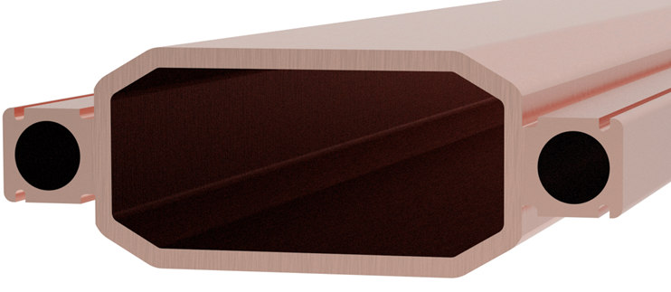
Vacuum System
80x36 mm octagonal cross section for 15 sigma (fully coupled) plus 10 mm horizontal, 5 mm vertical aperture
Copper vacuum chamber for better radiation shielding than aluminum
Water cooling channels to remove 10 MW of synchrotron radiation heat load
Additional shielding to protect magnet coils from hard photons
5 nTorr vacuum required for 10 h beam-gas lifetime, based on simulations
Impedance budget under development – 60% complete

Slide 7
Instrumentation
Dual plane BPMs to be installed at vertically focusing quadrupoles only, with provisions for retrofitting at horizontally focusing quads (BPM housing as part of vacuum chamber, but no buttons)
BPM requirements based on envisioned operating scenarios, from initial low intensity, single bunch beam threading to full intensity luminosity operations
Limited number of BPMs downstream of injection kickers with fitted with special electronics capable of monitoring orbit of refilled bunch among up to 1159 circulating bunches
Bunch-by-bunch transverse and longitudinal feedback system requirements based on collective effects studies
Synchrotron light monitors

Slide 8
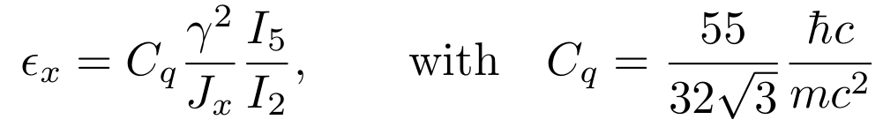
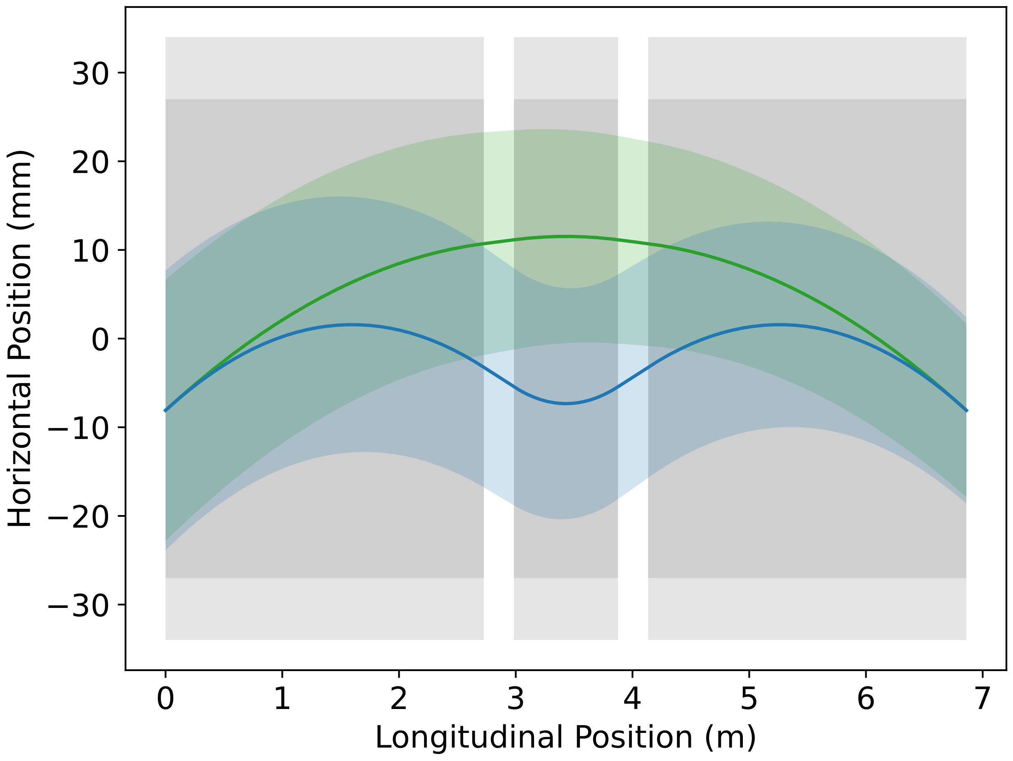
Emittance Control in the ESR
EIC needs nearly constant (20 to 24 nm) emittance from 5 to 18 GeV for optimum luminosity, but equilibrium emittance in an electron storage ring depends on beam energy:
Betatron phase advance μ per FODO cell is the “knob” to adjust the emittance
60 degrees at 10 GeV and 90 degrees at 18 GeV yield 20 nm at 10 GeV, 24 nm at 18 GeV
“Super-bends” (reverse bends) for emittance generation below 10 GeV – pole width accommodates the ~20 mm orbit variation
Rotating coil field measurements to be taken along different paths to reflect these orbit changes
Feed-down due to off-center orbits taken into account in dynamic aperture tracking

Slide 9
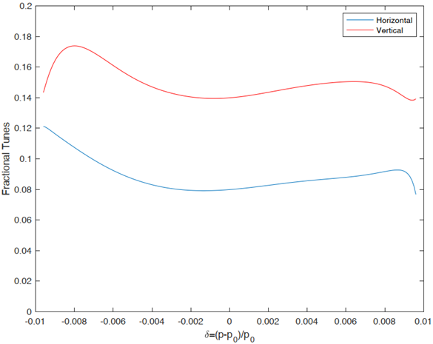
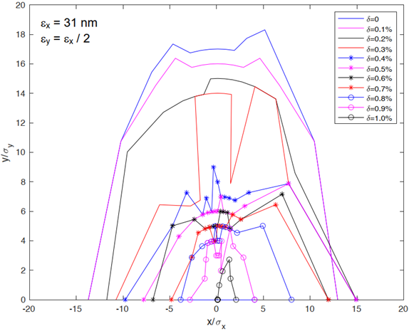
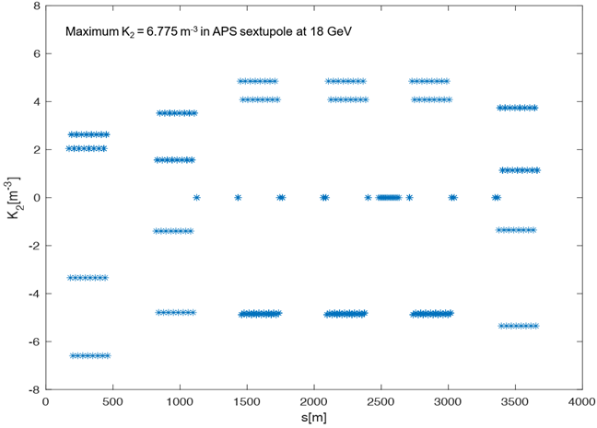
Dynamic Aperture in the ESR
ESR lattice has evolved over half a dozen iterations and is now under version control
Each lattice iteration was generated for three different energies (5, 10, and 18 GeV) and for 1 and 2 interaction regions
Dynamic aperture goal of 10σ was reached in every lattice iteration and configuration
Dynamic aperture optimization in final lattice version is in progress, expected to be final by 4/30/2026
Fractional tune vs δ (±1%)
DA for δ = 0 to 1%
Sextupole K-values

Slide 10
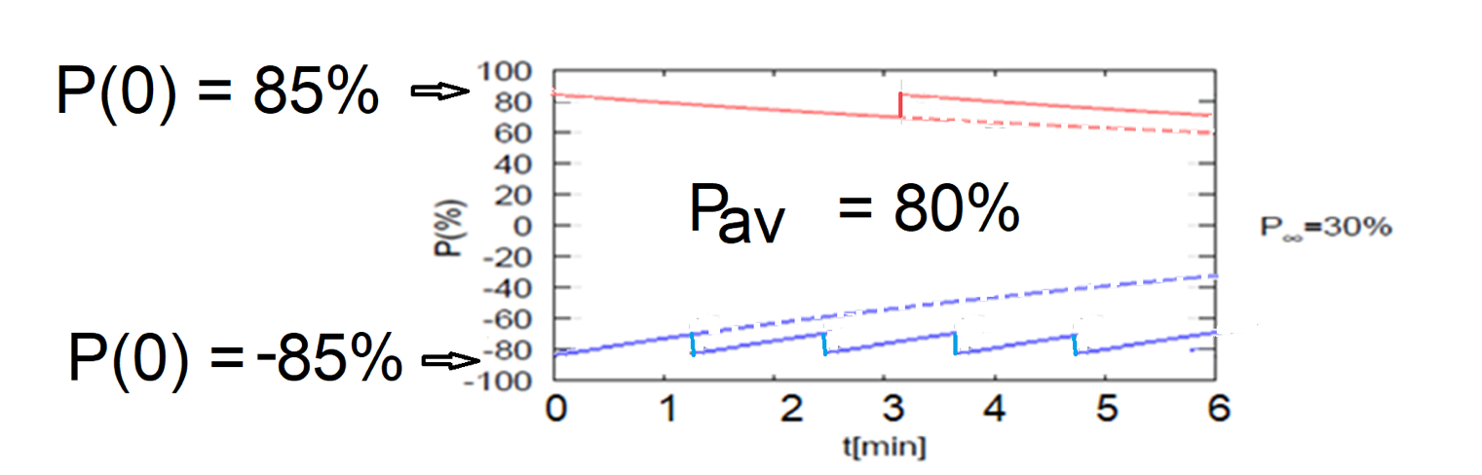
ESR Polarization
Frequent injection of bunches with high initial polarization of 85%
Initial polarization decays towards P∞
At 18 GeV, every bunch is replaced (on average) after 5 min with RCS cycling rate of 1Hz
Conceptual example, using conservative polarization lifetime and equilibrium polarization:
B P
B P
Refilled every 3.2 minutes
Refilled every 1.2 minutes
Re-injection
P_{av}=80%
P∞= 30%
(conservative)
P_{av}=80%
Re-injections

Slide 11
Polarization Optimization and Vertical Emittance Generation
ESR needs a relatively large vertical emittance – emittance ratio $ε_{y}/ε_{x}$=0.1
Large vertical emittance is generally detrimental to polarization performance
Developed two sets of vertical orbit bumps with “orthogonal” functions:
One set generates vertical dispersion but has very low impact on spin matching
Second set optimizes spin matching via harmonic bumps but has very low impact on vertical emittance
Bumps are known a priori using the design lattice, only unknown parameter is the bump amplitudes
Vertical emittance and spin matching can be optimized simultaneously by scanning individual bump amplitudes

Slide 12

Electron Bunch Replacement Requirements
Required replacement times per energy, based on polarization lifetime optimization in ESR, for 85% injected polarization from RCS and 70% time-averaged polarization in ESR:
Replacing one bunch per second easily meets these requirements – 20 minutes for 1160 bunches at 5 and 10 GeV, and 5 minutes for 290 bunches at 18 GeV

Slide 13
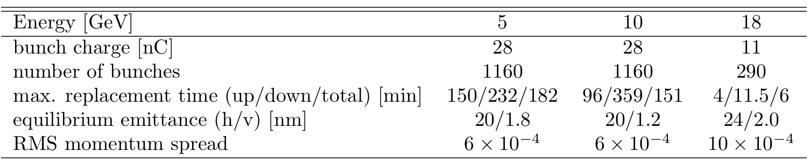
Electron Injector System
Requirements on the EIS as injector to the ESR:
Provide 28 nC per bunch, one bunch per second for continuous bunch replacement in the ESR
Accelerate beam to 5, 10, and 18 GeV
Provide bunches with emittances matched to ESR
Fill the entire ESR in less than 20 minutes
Preserve spin polarization during the ramp, using a dedicated, highly periodic lattice design
Requirements driven by ESR needs:
Continuous bunch replacement required at 18 GeV – one bunch per second

Slide 14
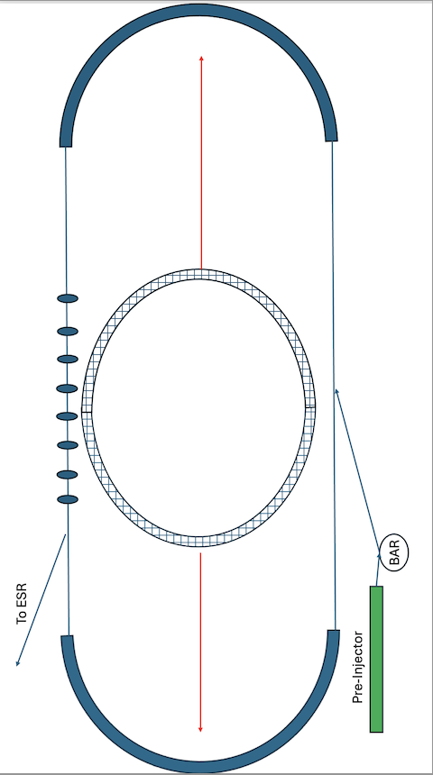
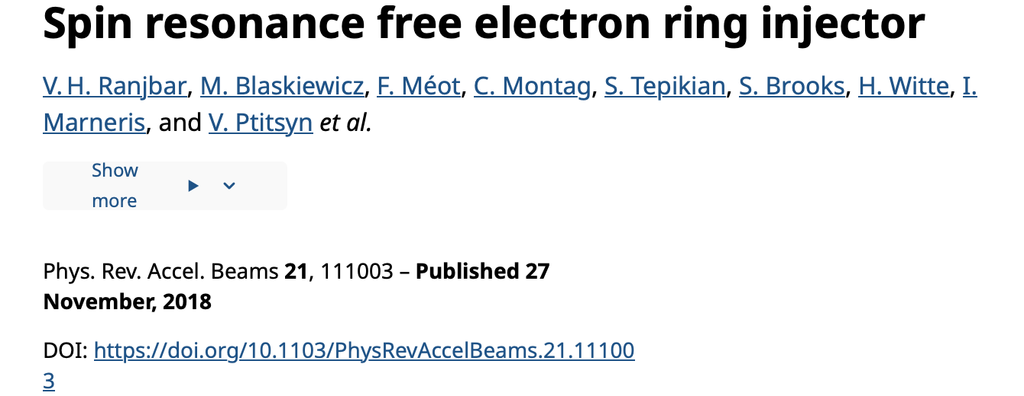
RCS Lattice Concept
Spin resonance condition: N*P ± Qy = Gγ
For acceleration to 18 GeV, Gγ < 41
Choose P = 160, Qy = 52.12; Qy & P – Qy > 41
Need straight sections for up to 134 MV of RF voltage and to accommodate injection and extraction.
These straights would normally spoil the high periodicity - periodicity “P” would be 2 in a racetrack layout, not 160
To restore high spin periodicity we realize the straight sections as identity matrices
14

Slide 15
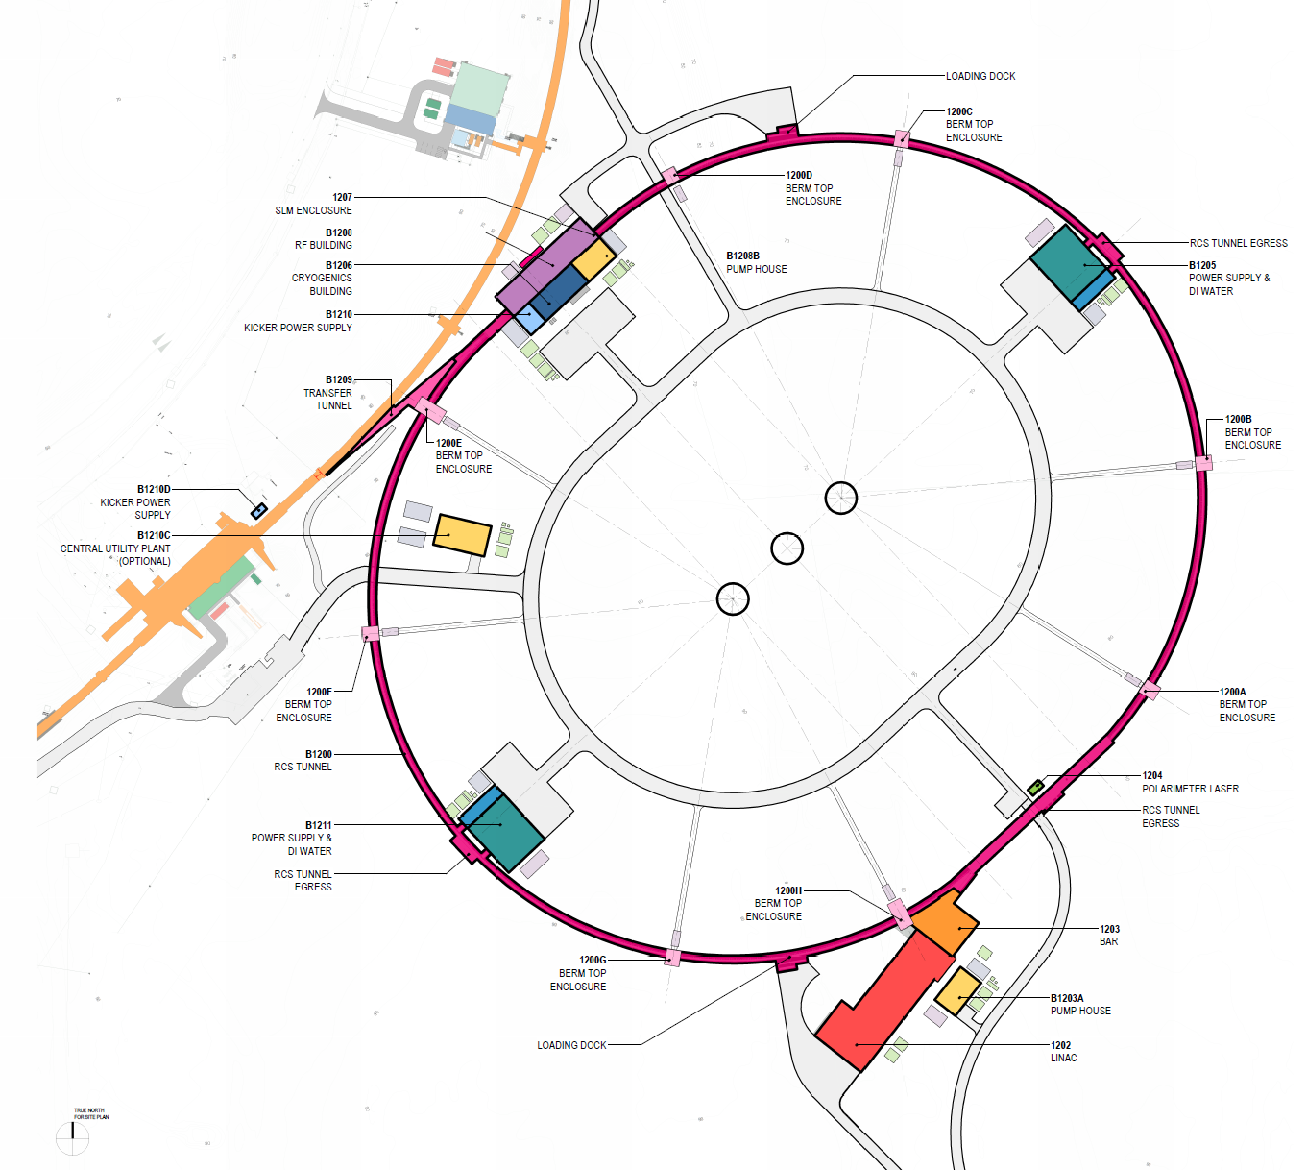
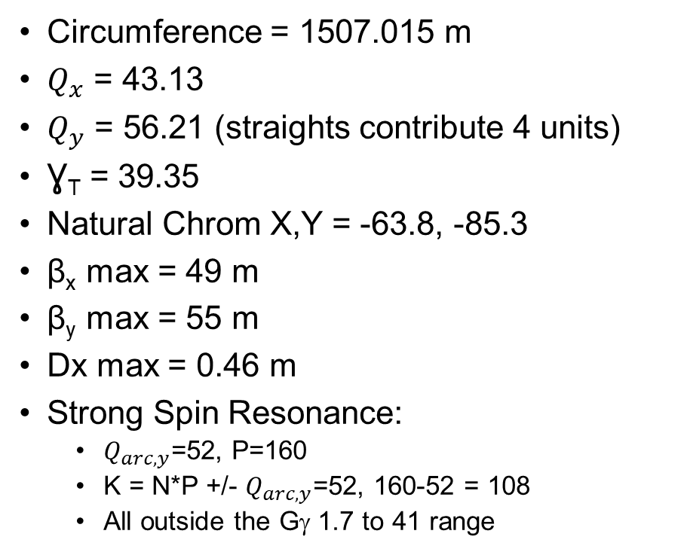
RCS Layout and Parameters
Circumference = 1507.015 m
$Q_{x}$ = 43.13
$Q_{y}$ = 56.21 (straights contribute 4 units)
Ɣ_{T} = 39.35
Natural Chrom X,Y = -63.8, -85.3
β_{x} max = 49 m
β_{y} max = 55 m
Dx max = 0.46 m
Strong Spin Resonance:
$Q_{arc, y}$=52, P=160
K = N*P +/- $Q_{arc, y}$=52, 160-52 = 108
All outside the Gγ 1.7 to 41 range
15

Slide 16
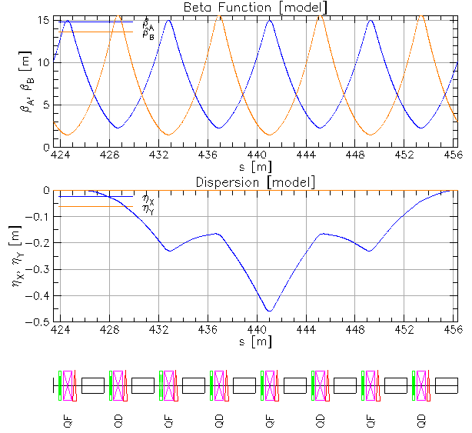
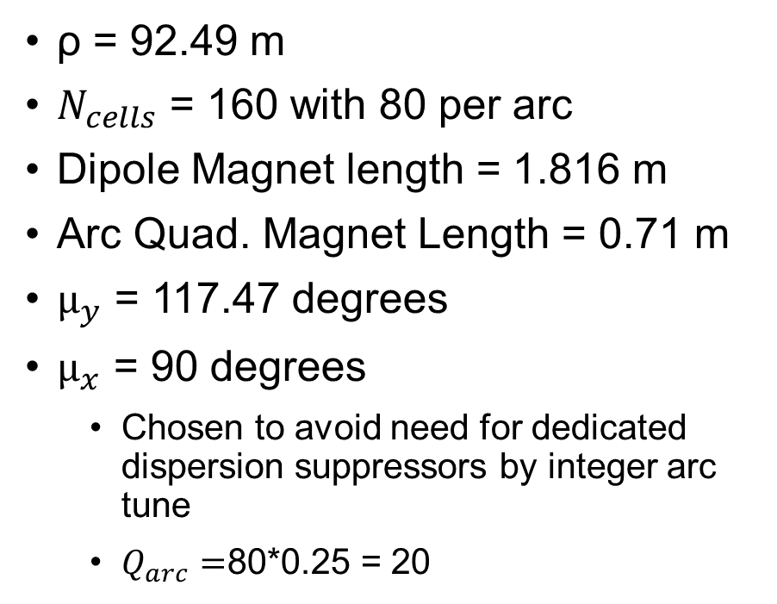
RCS Arc Cell Optics
ρ = 92.49 m
$N_{cells}$ = 160 with 80 per arc
Dipole Magnet length = 1.816 m
Arc Quad. Magnet Length = 0.71 m
$μ_{y}$ = 117.47 degrees
$μ_{x}$ = 90 degrees
Chosen to avoid need for dedicated dispersion suppressors by integer arc tune
$Q_{arc}=$80*0.25 = 20
16

Slide 17
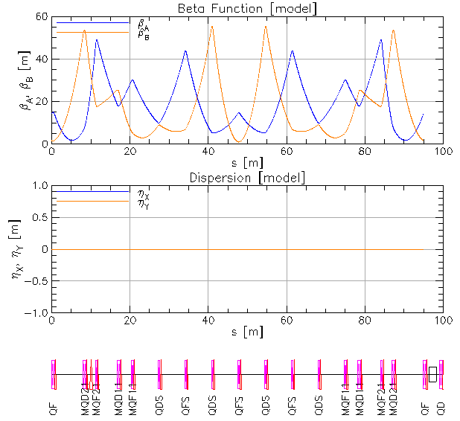
RCS Straight Section Optics
Dispersion kept to zero by using integer horizontal arc tune with the horizontal phase advance across the straights tuned to achieve the desired fractional tune
Each cryomodule needs 5 m and delivers 17 MV. To allow for correctors and BPMs we allow for 6.33 m between quadrupoles
18 GeV requires 8 cryomodules to achieve 134 MV.
To have space for this we use 4 FODO cells with 6.33 m drifts between quads in our straight sections.
We also need four additional “matching” quads at the entrance and exit of the straight section
The total length is 94.94 m
17

Slide 18
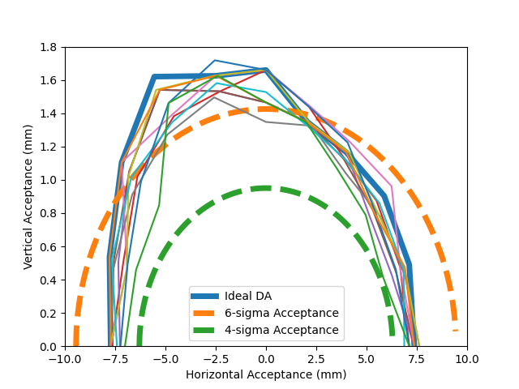
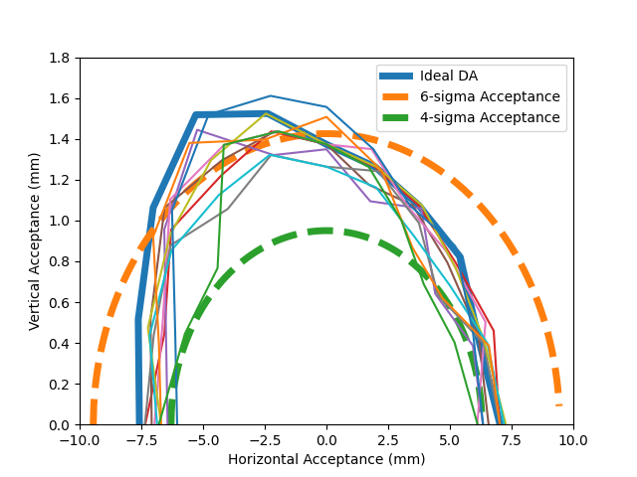
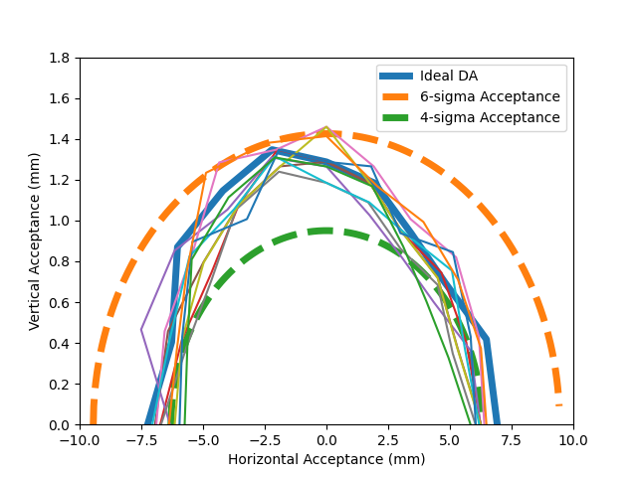
Dynamic Aperture in the RCS
0% dp/p
0.5% dp/p
1% dp/p
Dynamic aperture shown at injection, when emittances are largest
Below a few GeV, electrons behave like hadrons – no synchrotron radiation damping and quantum excitation
18

Slide 19
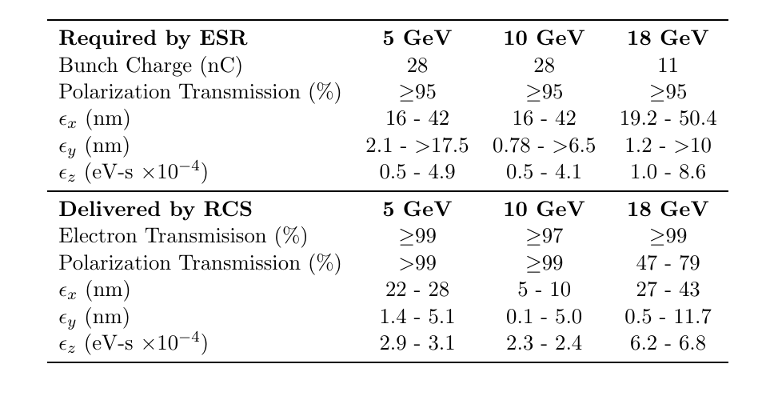
RCS Extraction Parameters and ESR Requirements
The lower bound of the ESR emittance acceptance is determined by the proton beam blowup in beam-beam simulations. The upper bound of the emittance acceptance is currently under active study
Parameters highlighted in red may require additional effort to match what is required by the ESR
Ranges of extraction parameters from the RCS for 10 seeds with realistic errors and corrections
19

Slide 20
Bunch Formation
Achieving the high bunch intensities required by the ESR necessitates accumulation in the injector chain
Radiation damping at RCS injection energy is too slow to provide one full-intensity bunch per second
Solution:
A dedicated Beam Accumulator Ring (BAR)

Slide 21
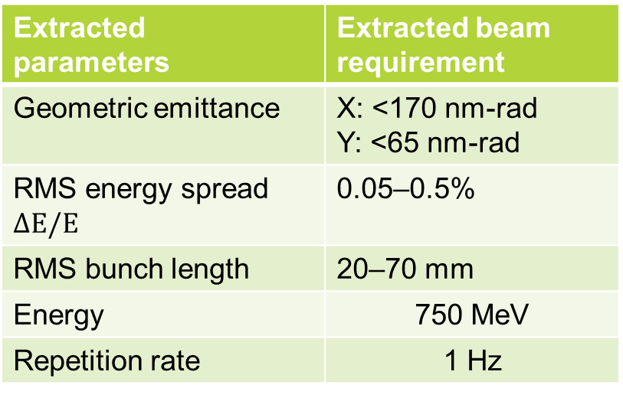
Beam Accumulator Ring BAR
Up to 30 bunches with 1.0 to 1.7 nC each from the LINAC must be injected into BAR:
The 28 nC bunches extracted from the BAR must meet the following requirements:
Injected parameters | Nominal at 1.1nC | Worst-case
Geometric emittance | X: 45 nm-rad Y: 30 nm-rad | X: 68 nm-rad Y: 68 nm-rad
RMS energy spread $ΔE/E$ | 0.45% | 0.5%
RMS bunch length | 0.7 mm | 0.95 mm
Energy | 750 MeV
Repetition rate | 30 Hz
RMS pulse-to-pulse energy jitter | 0.15%
Extracted parameters | Extracted beam requirement
Geometric emittance | X: <170 nm-rad Y: <65 nm-rad
RMS energy spread $ΔE/E$ | 0.05–0.5%
RMS bunch length | 20–70 mm
Energy | 750 MeV
Repetition rate | 1 Hz
Spin polarization must be preserved

Slide 22
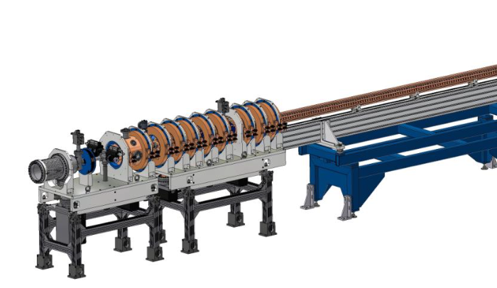
S-Band Injector LINAC
Conventional S-Band (2856 MHz) normal-conducting LINAC, 750 MeV
Front-end is 10 MeV L-Band (1.3 GHz) normal-conducting LINAC due to larger aperture

Slide 23
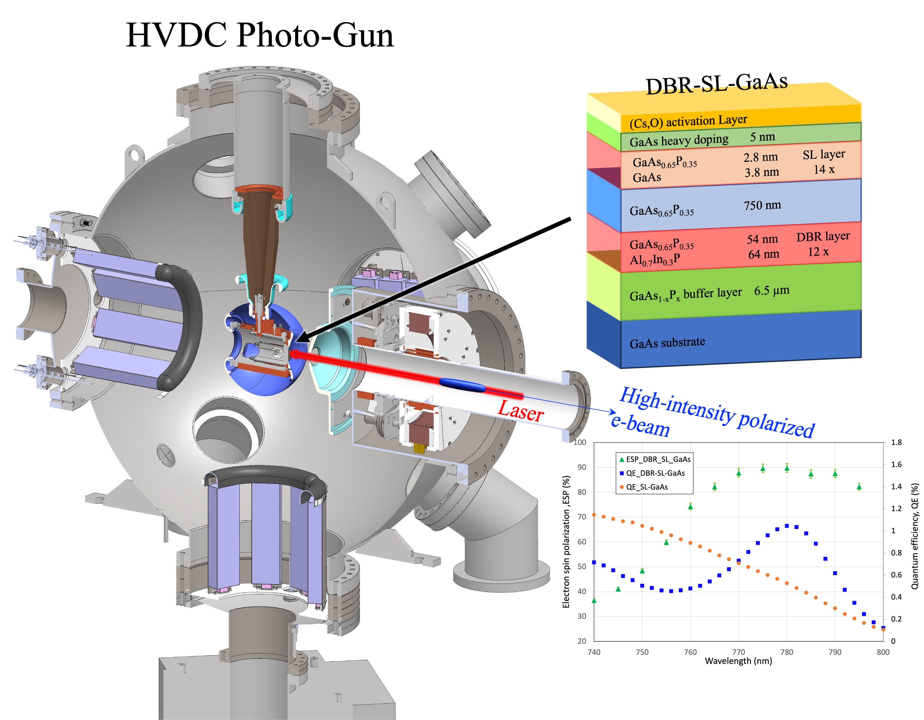
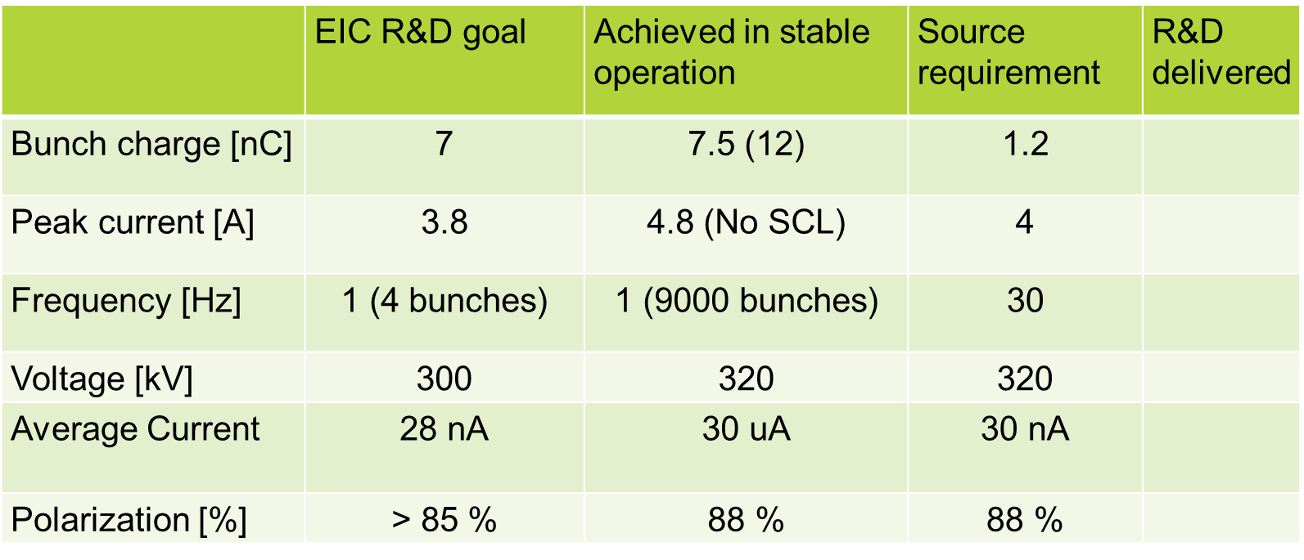
High Intensity Polarized HVDC Gun

Slide 24
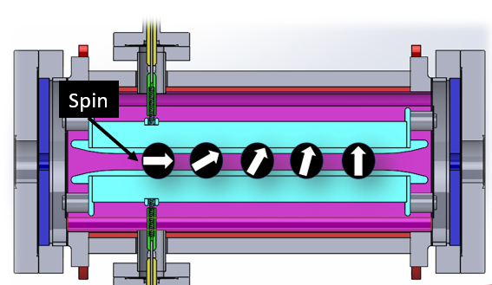


Spin Rotator using Wien filter
Polarized electron gun produces > 85% longitudinally polarized beam
Spins need to be vertical in BAR to preserve polarization
Wien filter as spin rotator:
High EIC gun beam energy requires long Wien filter
- need additional focusing
$$\frac{E_{y}}{B_{x}}=v_{z}$$
Θ = $\frac{eL}{m_{0}cβγ^{2}}B_{x}$
Approach:
Two Wien filters, each one rotates spin by 45 deg.
Place a quadrupole triplet in between the Wien filter to focus the beam
Double Wien filters

Slide 25
Summary
The EIC Electron Storage Ring (ESR) resembles a polarized B-factory with a large energy range
Polarization performance in the ESR is optimized using dedicated vertical orbit bumps
RCS is based on a highly periodic lattice to avoid depolarizing spin resonances during the entire energy ramp
Pre-injector chain consists of an existing polarized electron gun with >85% polarization, a 750 MeV LINAC, and a Beam Accumulator Ring (BAR)
Using frequent and continuous bunch replacement, time and ensemble average polarization in the ESR is expected to exceed 70%
Thank you!

