Slide 1
Hadron Storage Ring Systems
Chuyu Liu
Collider-Accelerator Department, BNL
EPIOS meeting
Mar 19 – 20, 2026
Stony Brook University/Online (https://indico.cfnssbu.physics.sunysb.edu/event/648/)

Slide 2
Outline
RHIC Facility Overview
EIC Hadron Storage Ring
Flat-beam
Radial Shift
Transition Crossing
EIC HSR Systems
Straight Sections
Injection System
RF
Hadron Cooling
Vacuum
Machine Protection
Summary

Slide 3
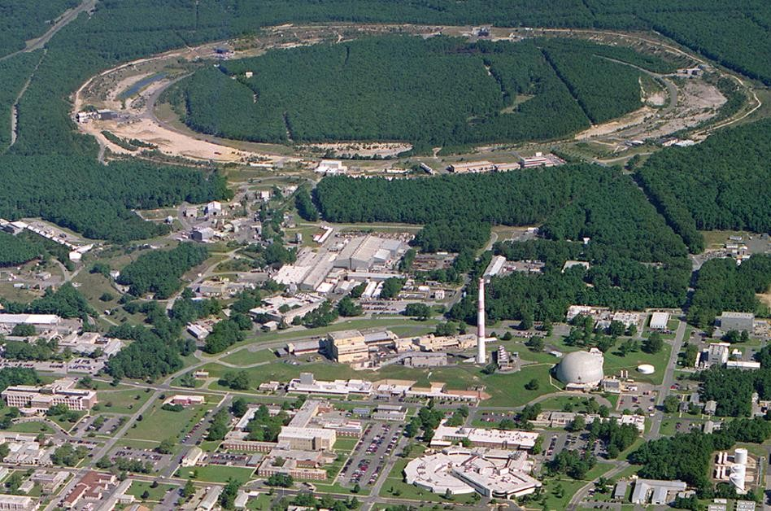
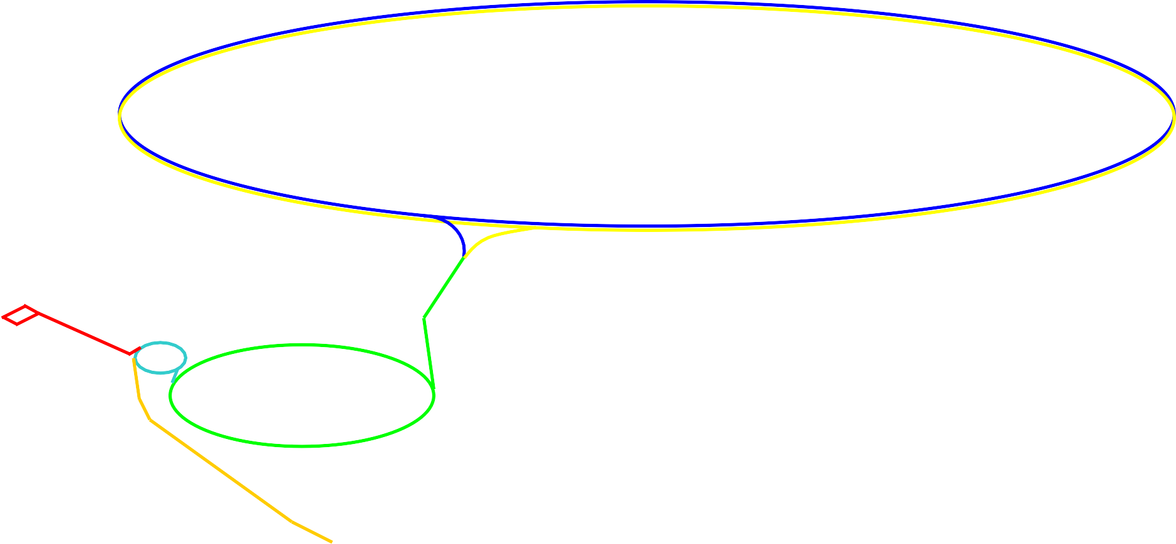

Aerial view of the RHIC facility
12:00 o’clock
RHIC
10:00 o’clock
2:00 o’clock
8:00 o’clock
6:00 o’clock
4:00 o’clock
LINAC
NSRL
^{EBIS}Booster
AGS
Tandem
Notes:
Several decades following Rutherford's landmark experiment, our understanding solidified, revealing that atoms are composed of nucleons and electrons. Furthermore, the discovery of quarks and gluons as the constituents of nucleons further expanded our knowledge. However, physicists sought to generate an abundant supply of quarks and gluons to comprehensively study their properties and interactions.

Slide 4
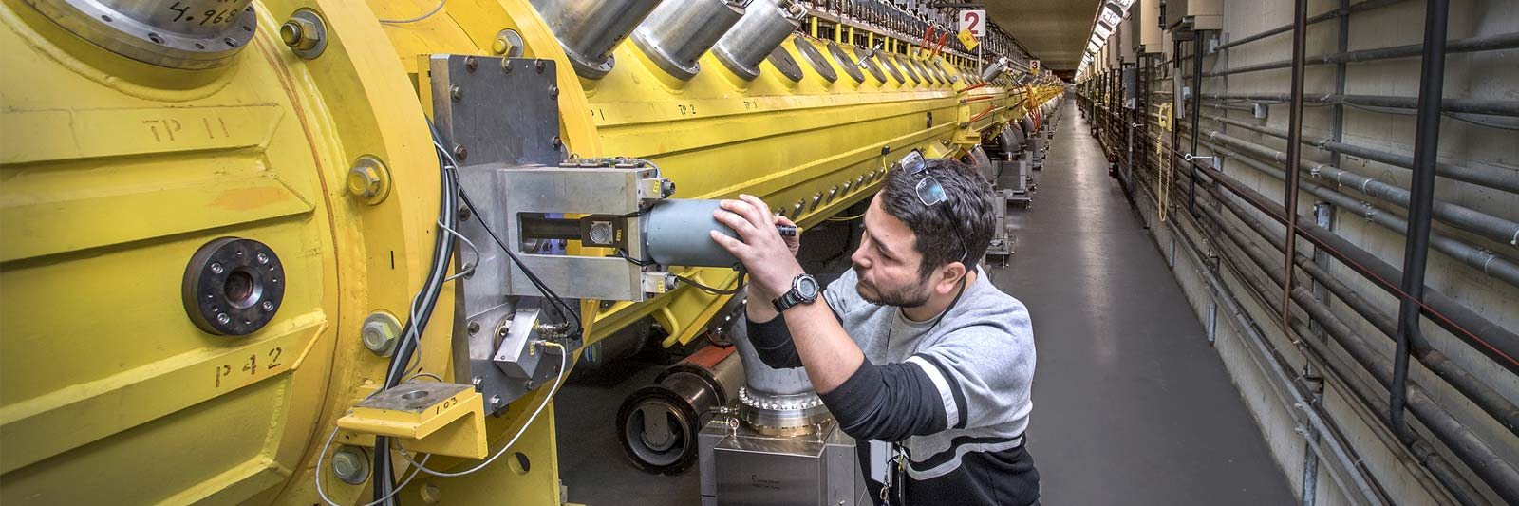
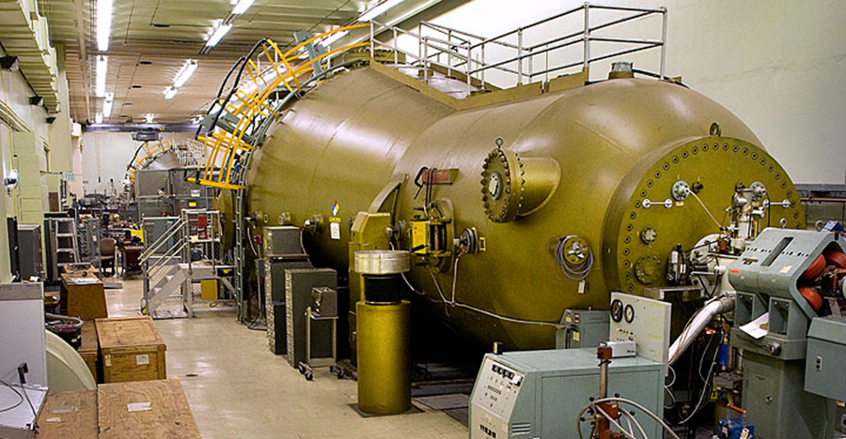
Hadron Pre-injector at BNL
Linac (1970) EBIS injector (2010) Tandem (1970)
Ion: H⁻, H^{-^} H-U H-U
E: 10 -200 MeV 2 MeV/u 14 MV(1+q)
I_{ave} : 200uA, ~150 nA ~10 μA
RR: 10 Hz 5 Hz dc/pulsed
User: BLIP, NSRL, NSRL, RHIC SEU, NSRL
RHIC RHIC,
Can serve all users simultaneously
Courtesy of Deepak Raparia

Slide 5

Requirements for Hadron Injectors
Parameter/Species | p | Unpolarized d | He | Au | Ag
Charge number Z | 1 | 1 | 2 | 79 | 47
Mass number A | 1 | 2 | 3 | 197 | 109
Injection energy [GeV] | 23.8 | 12.2 | 11.1 | 9.8 | 10.53
Beam rigidity [T∙m] | 79.3 | 81.2 | 55.3 | 81.2 | 81.1
Bunch intensity [10¹⁰] | 32 | 15 | 13 | 0.23 | 0.39
RMS normalized emittance, h/v [mm] | 2.5 | 1.5 | 1.5 | 1.5 | 1.5
RMS longitudinal emittance [10⁻³ eV∙s] | 42 | 42 | 42 | 42 | 42
Polarization [%] | 75 | - | 75 | - | -
Table 1 lists the beam species and their parameters expected to be needed in the first few years of the EIC physics program. All parameters are specified at AGS extraction. Most requirement parameters are driven by the EIC physics goals including polarization and luminosity. Others are consistent with what have been demonstrated by the HIC during RHIC operation.

Slide 6
Additional developments in the injectors
ANL (MEP Group), with University of Kentucky, is developing polarized Li-6 and Li-7 sources
Early-stage effort
Would expand available polarized species for EIC
Can be installed at EBIS
A promising option for polarized deuterons:
Use existing COSY polarized source at BNL Tandem
Ongoing development of polarized ³He in the Hadron Injector Complex

Slide 7
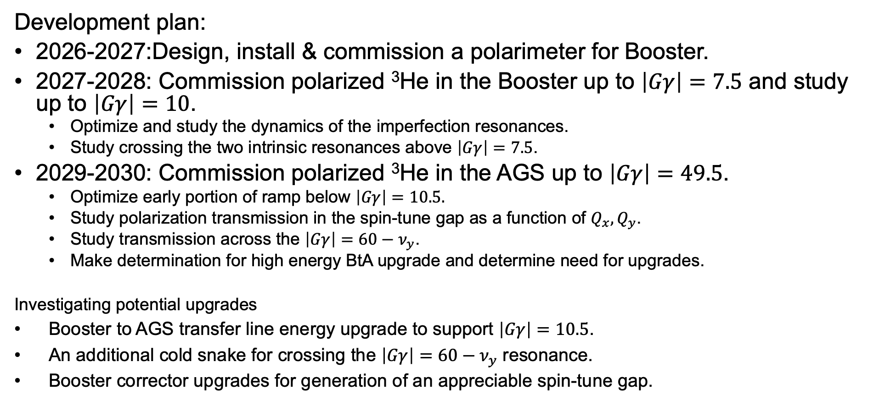
Polarized ³He at the Hadron Injector Complex
Development plan:
2026-2027:Design, install & commission a polarimeter for Booster.
2027-2028: Commission polarized ³He in the Booster up to $\left|Gγ\right|=7.5$ and study up to $\left|Gγ\right|=10$.
Optimize and study the dynamics of the imperfection resonances.
Study crossing the two intrinsic resonances above $\left|Gγ\right|=7.5$.
2029-2030: Commission polarized ³He in the AGS up to $\left|Gγ\right|=49.5$.
Optimize early portion of ramp below $\left|Gγ\right|=10.5.$
Study polarization transmission in the spin-tune gap as a function of $Q_{x},Q_{y}$.
Study transmission across the $\left|Gγ\right|=60−ν_{y}$.
Make determination for high energy BtA upgrade and determine need for upgrades.
Investigating potential upgrades
Booster to AGS transfer line energy upgrade to support $\left|Gγ\right|=10.5$.
An additional cold snake for crossing the $\left|Gγ\right|=60−ν_{y}$ resonance.
Booster corrector upgrades for generation of an appreciable spin-tune gap.
Courtesy of K. Hock

Slide 8
EIC Hadron Storage Ring

Slide 9
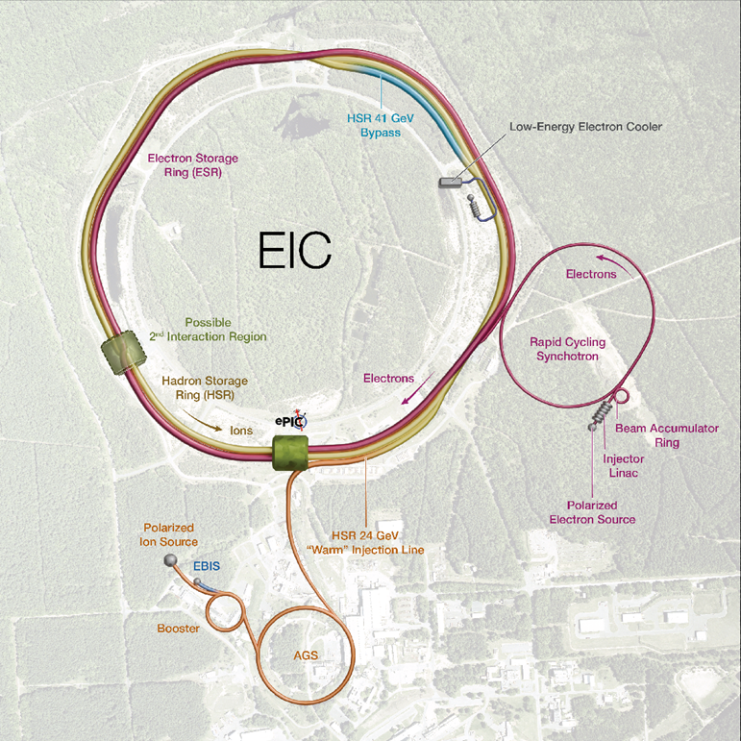
Electron-Ion Collider
Hadron Storage Ring (HSR) 10-275 GeV
Superconducting magnets (existing)
1160 bunches, 1A beam current (3x RHIC)
Flat beam (11:1 ratio)
Beam cooling
Electron Storage Ring (ESR) 5–18 GeV
large beam current, 2.5 A ➔ 9 MW S.R. power
S.C. RF cavities
Need to inject polarized bunches
Electron Rapid Cycling Synchrotron (RCS) 750 MeV- 18GeV
1 Hz
Spin transparent due to high periodicity
Electron Injector
Warm Linac, 30 Hz
Beam Accumulation Ring, 1 Hz

Slide 10
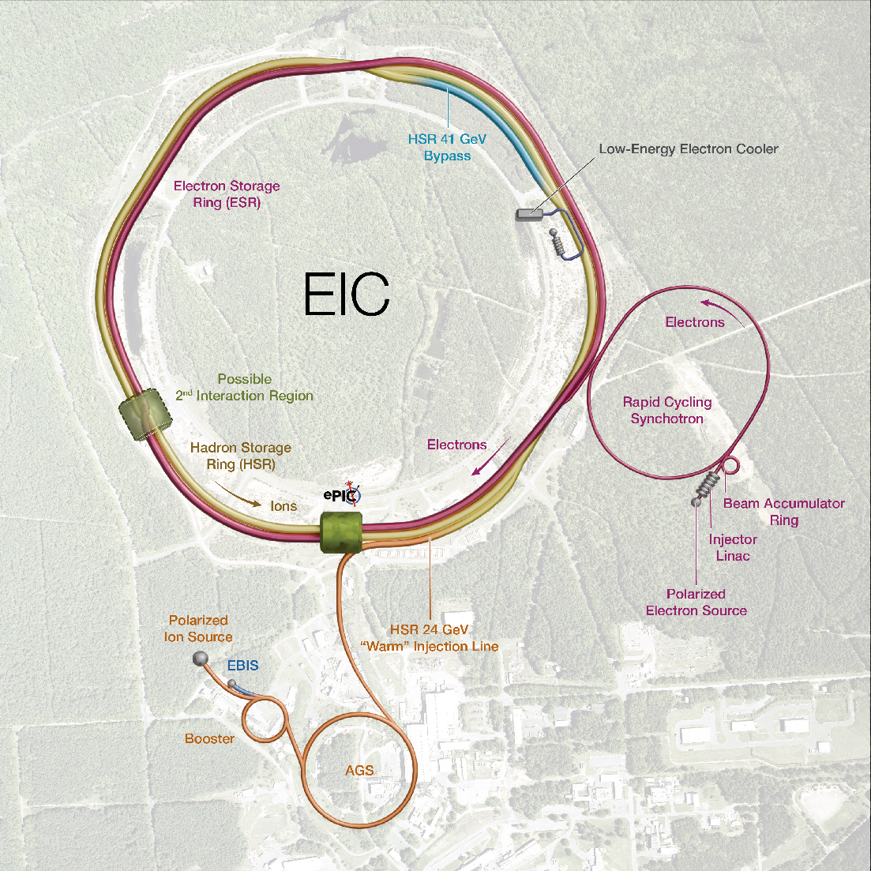
HSR Machine
Design is based on the existing RHIC Complex in BNL.
HSR will be composed of Yellow ring only and new IR6.
41 GeV bypass will be added between IR12 and IR2.
HSR warm injection line bring beams from AGS to HSR IR4, where the septum and injection kickers are located.
Low Energy Cooler is located at IR2.

Slide 11
HSR Machine (cont'd)
Key upgrades to achieve higher energy, higher current, high polarization, more bunches...
Hadron beams include:
Polarized protons
Polarized 3He ions
Unpolarized ion species up to Uranium
At injection, a fully configurable bunch-by-bunch spin pattern is available for experiments.
105 ns
RHIC:111 bunches all times
40ns
HSR: 290 bunches at injection
10ns
HSR: 1160 bunches at store

Slide 12
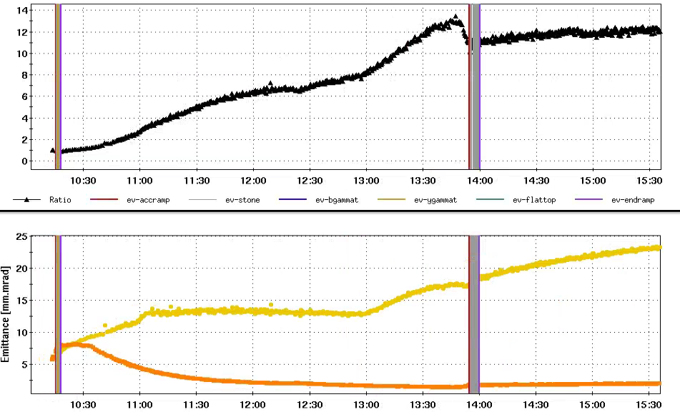
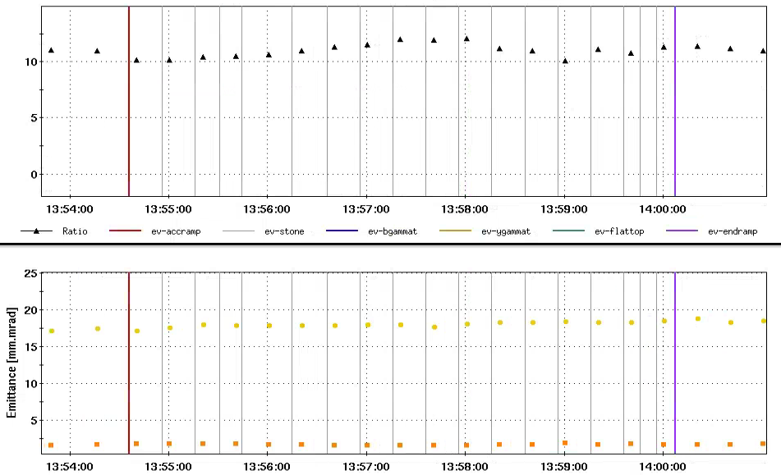
Flat Beam Acceleration Beam Experiment
Maximum transverse beam emittance ratio 13:1 was obtained with stochastic cooling at 31 GeV/nucleon
Transverse emittance ratio 11:1 was well maintained during acceleration from 31 GeV/nucleon to 100 GeV/nucleon
Flat beam was kept at 100 GeV with EIC/HSR tunes for ~2 hours, 11:1 emittance ratio was well maintained too
Emittance Ratio
Emittance Ratio
Emittance ratio
31 GeV
100GeV
Emittance ratio
Horizontal Emittance
Horizontal Emittance
Acceleration
Vertical Emittance
Vertical Emittance
Whole Fill
During Acceleration
12

Slide 13
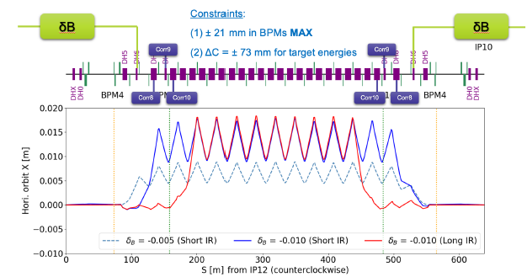
Radial Shift Implementation
To synchronize hadron-electron revolution frequencies the radial shift is employed in the hadron ring
Beam will be switched to one inner arc for 41 GeV operation.
Radial shift implementation in RHIC was successful – see G. Robert-Demolaize et al, https://doi.org/10.1016/j.nima.2024.170043
Radial shift implementation has been established in all IR sections, except IR6
Requires upgrade of several dipole corrector power supplies in IR straights, as well as adding shunt PSs for D6 dipole magnets. The D6 have leads available (not used in RHIC).
20 mm
100 GeV
store
275 GeV

Slide 14
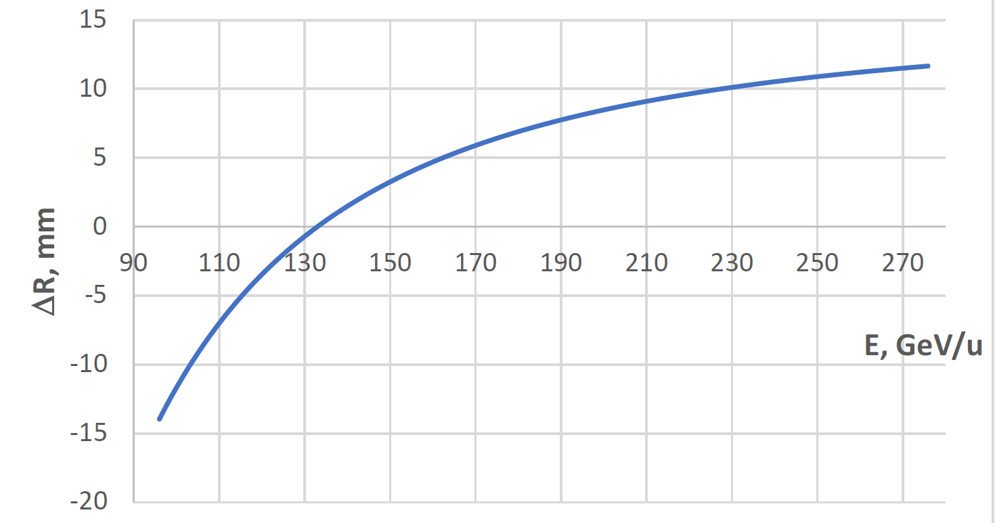

Beam Energy and Average Orbit Radius in the HSR
20 mm
130 GeV
100 GeV
store
275 GeV
70 mm $∅$ beam pipe
Since the electron revolution frequency is fixed, the hadron orbit must be adjusted with energy to keep the collisions in sync.
Courtesy of V. Ptitsyn

Slide 15
Transition crossing beam study
Purpose Study transition crossing in the EIC HSR by reducing the number of active jump quadrupoles during the transition.
Goal Achieve stable transition crossing with minimal emittance growth and beam loss using fewer quadrupoles.
Results
Initial attempts showed issues due to tune feedback oscillations
With tune feedback off, transition crossing was successful
No emittance blowup at 1.5×10⁹ per bunch (111 bunches)
In a second session, all goals were achieved within 8 ramps
Conclusion
Results suggest fewer jump quadrupoles may be feasible
However, due to different HSR optics and layout, all 48 quadrupoles are still required

Slide 16
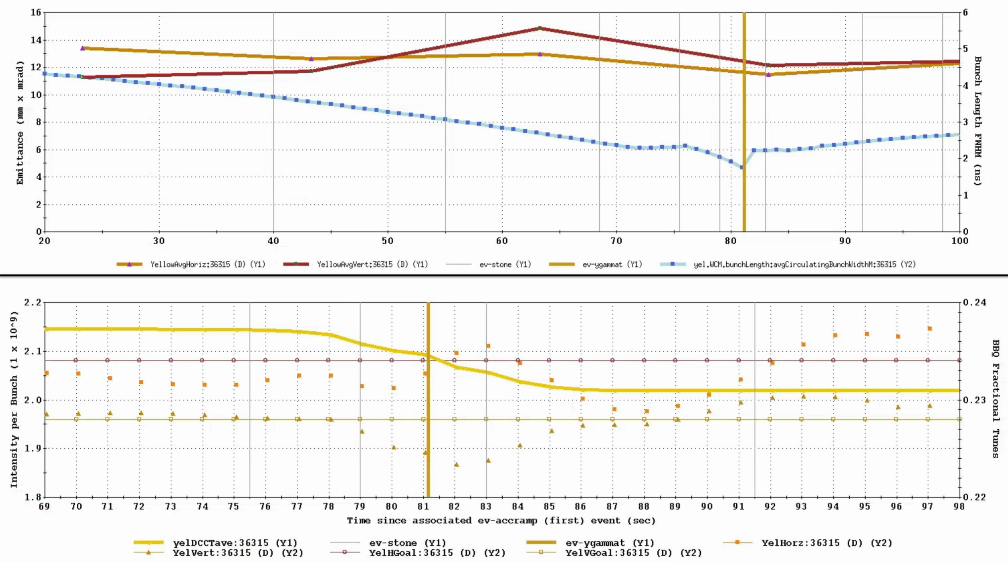
Beam study observations
111 bunches, 2.2 x10⁹ at injection
Without feedback
No significant beam loss (~6%)
No emittance blowup
No clear chromatic effects
Losses are tunable
Tune
Chromaticity
Courtesy of H. Lovelace

Slide 17
EIC HSR Systems

Slide 18
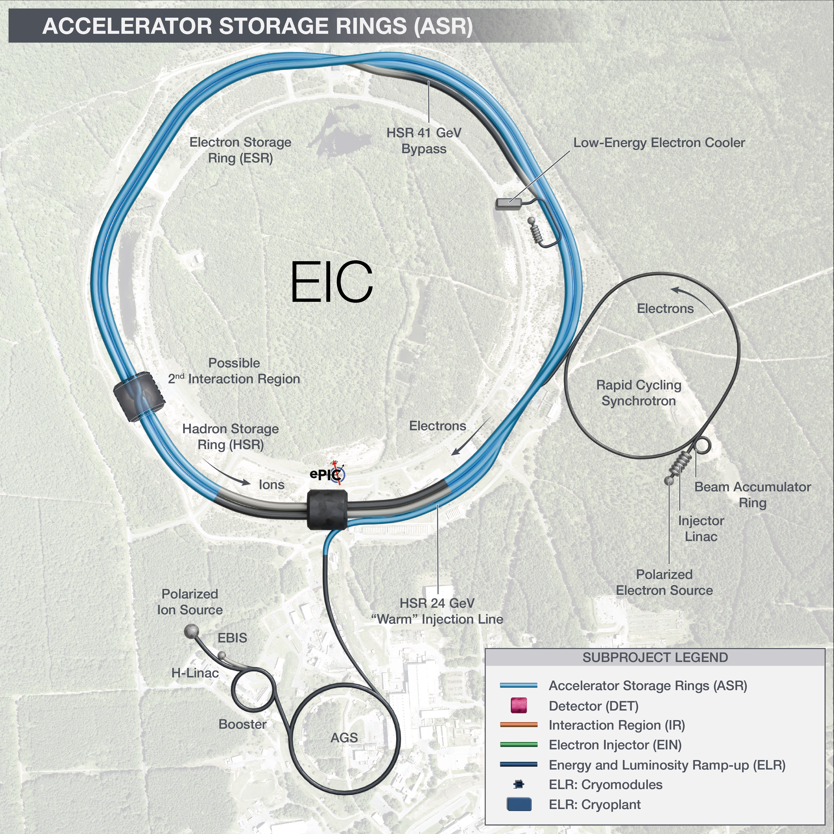
HSR Straight Section Modifications
Q3
Q2
Q1
D0
DX
RHIC
DX
D0
Q1
Q2
Q3
IR12 triplets
Q3
Q2
Q1
D0
D0
Q1
Q2
Q3
IR10 triplets
IR2 triplets
Q3
Q2
Q1
NC Dipoles
HSR
NC Dipoles
Q1
Q2
Q3
IR4 triplets
Reconfigure Yellow into HSR:
Replace DX and D0 magnets with NC dipoles
Redesign the warm to cold transition
In IR10 and IR4, remove the Blue triplet and repackage Yellow triplet into smaller cryostat to provide more space in those areas
IR8 triplets
18

Slide 19
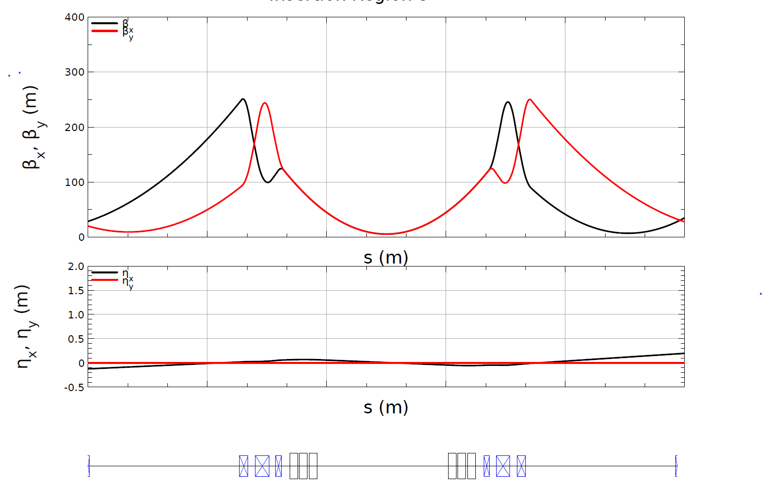
Lattice Design of Straight Sections
Beam sizes in the triplets are among the largest in the HSR.
Aperture is more of a concern at injection energy due to adiabatic damping.
The horizontal half aperture > 7*sigma_x, and the vertical half aperture > 6*sigma_y.
The lattice design informs the aperture design, and the aperture design, in turn, provides feedback to the lattice design — it’s a two-way process.
Lattice design of a typical IR, including IR8, 10, 12, 2

Slide 20
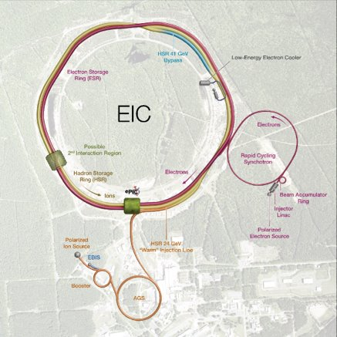
HSR injection system
Injection system requires fast kickers due to reduced bunch spacing
Bunch spacing: 105 ns → 40.5 ns
Stripline kickers selected
Injection located at IR4 due to space constraints

Slide 21
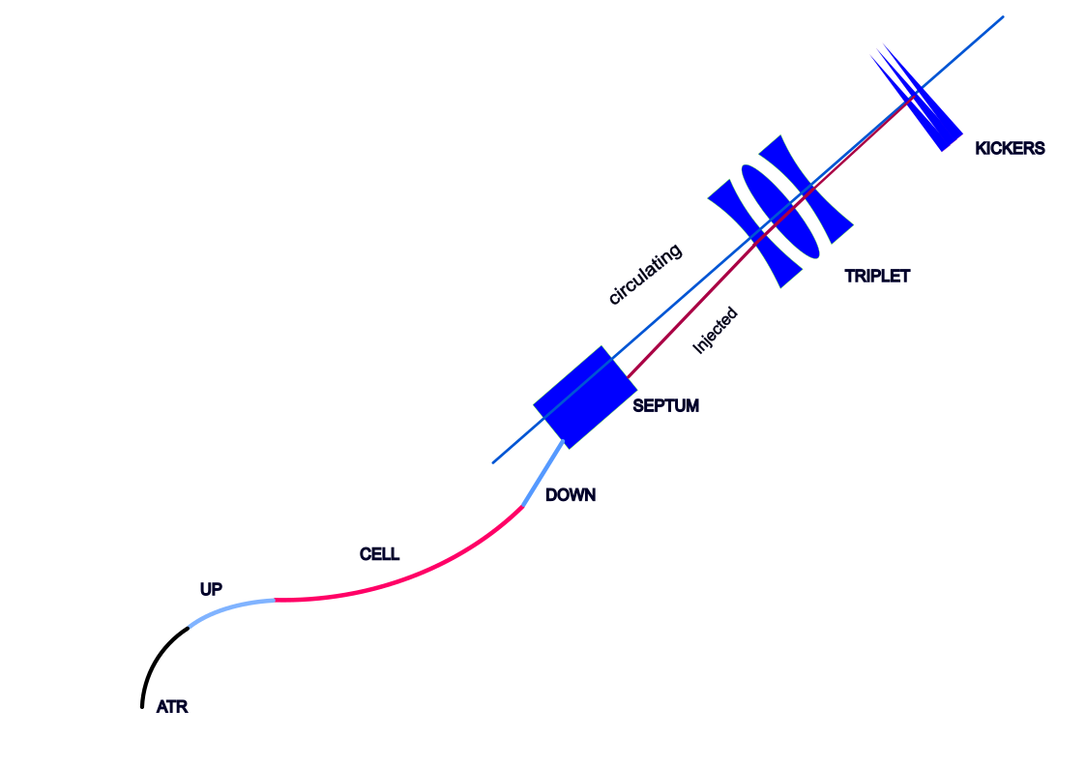
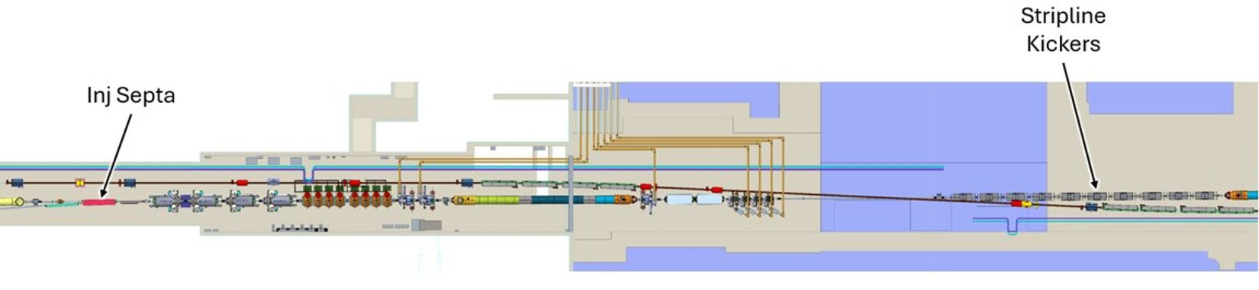
HSR injection system (cont’d)
Three main components:
Warm transfer line (upstream match → periodic cells → downstream match)
Septa: 2 DC + 1 AC (induction)
19–20 stripline kicker modules
Key parameters:
DC septum width: 14 mm
AC septum width: 4 mm
Kicker requirement:
Provide sufficient separation between injected and circulating beams
Avoid beam scraping
Required kick angle: 0.7 mrad

Slide 22
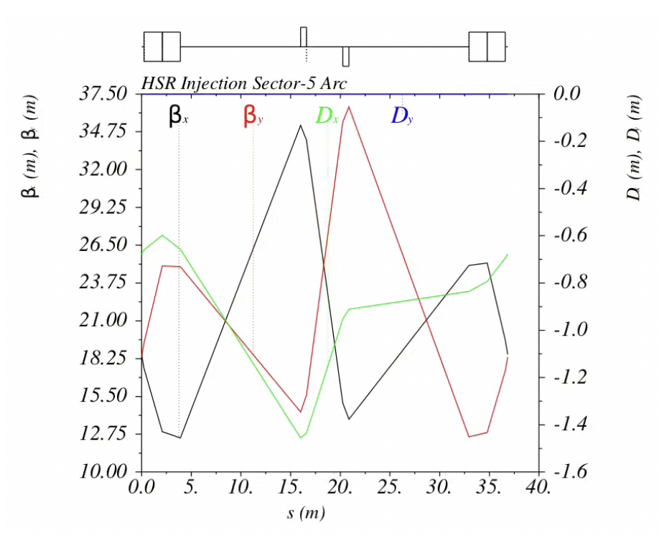
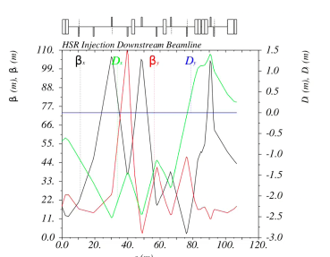
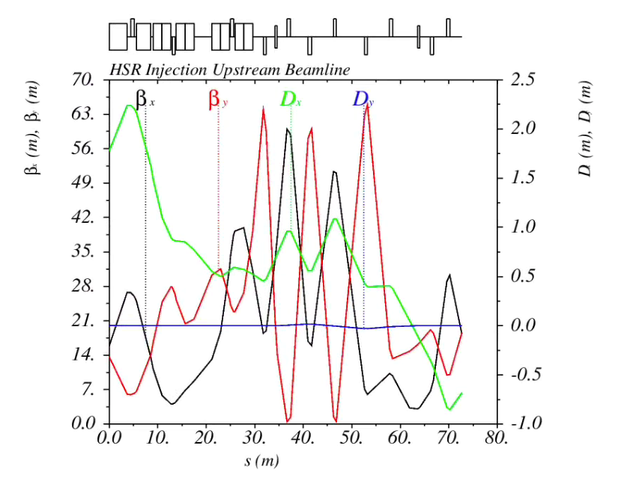
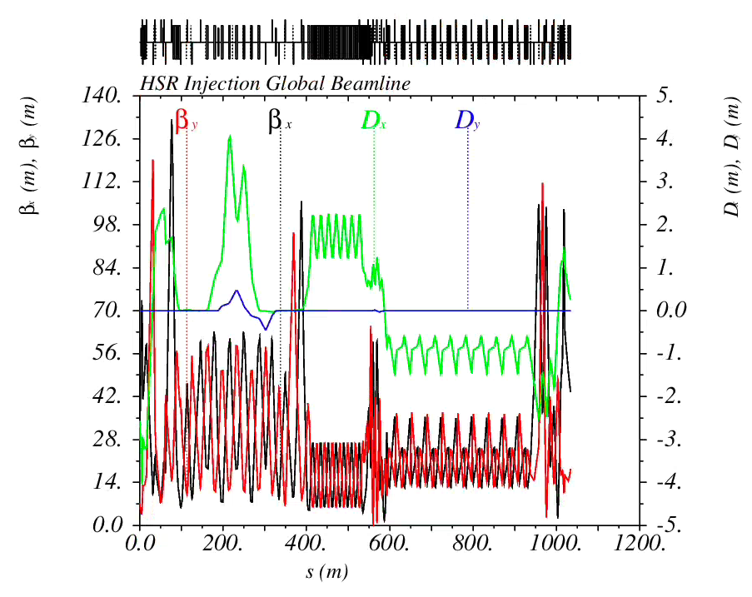
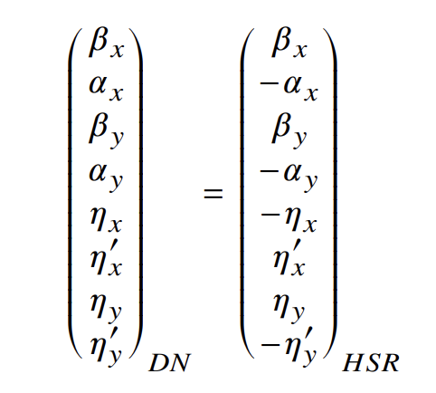
HSR Transfer Line
Upstream
Periodic Cells
Downstream
New warm transfer line extends the existing ATR line to IR4
Reuses combined-function magnets from the RHIC Blue transfer line
New quadrupoles (APS design can be used)
Matching:
AGS to HSR transfer line

Slide 23
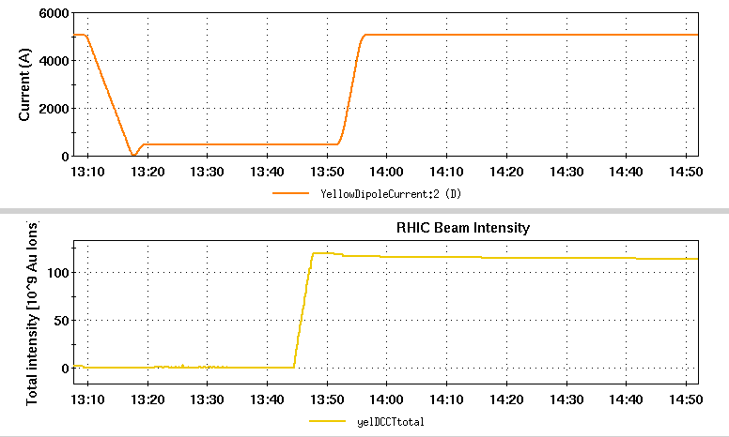
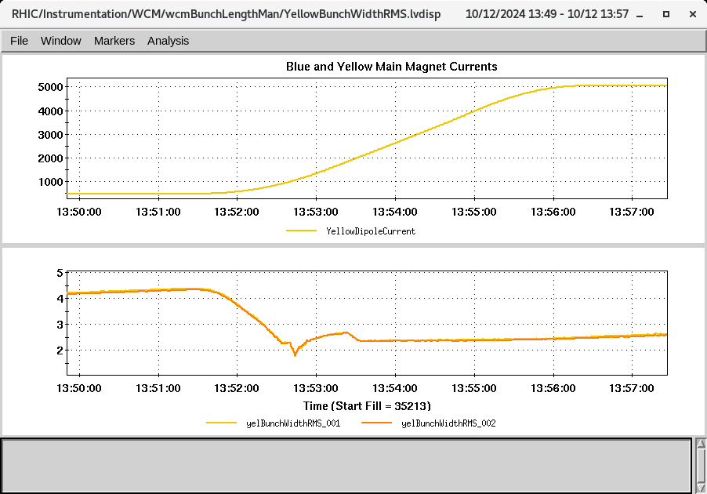
The Life Cycle of Hadron Beam
Current (A)
ramp
Bunch split
Bunch compression
Radial shift
Crab cavity on
tuning
store
44 nC
Bunch length (ns)
5 nC
injection
Au transition crossing
Bunch profile evolution

Slide 24
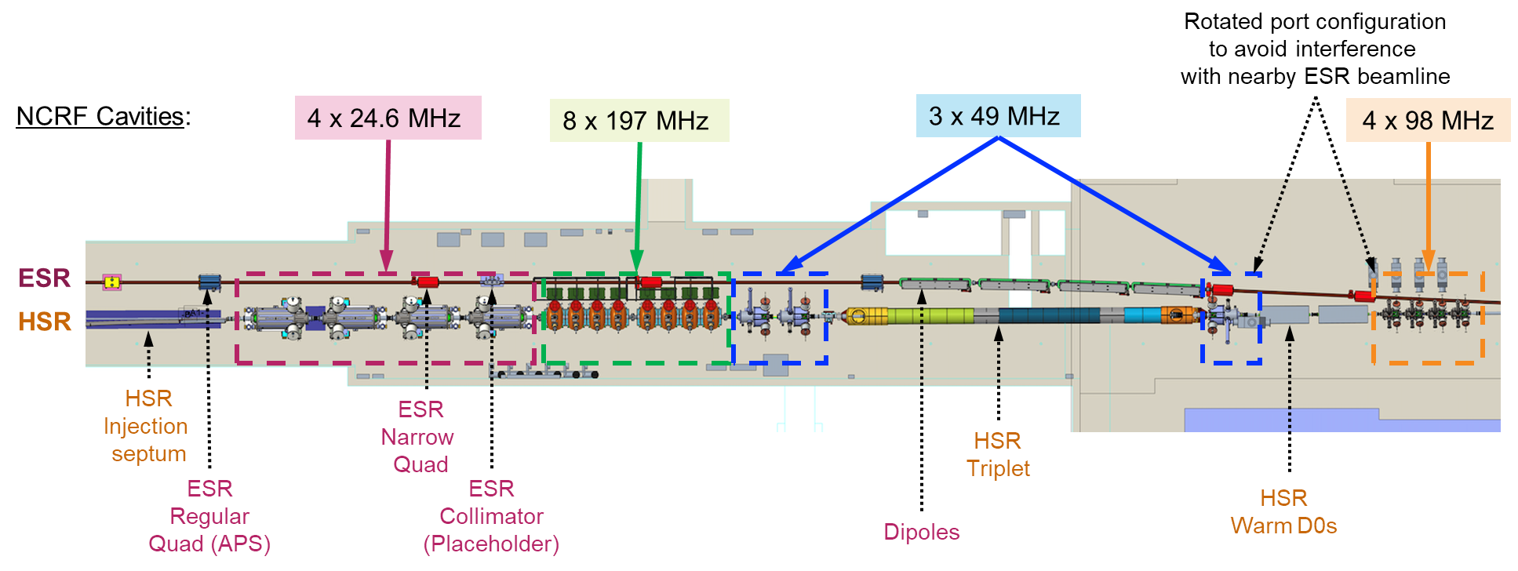
ASR NCRF Systems
4x 24.6 MHz NCRF Cavities
Capture and acceleration, repurpose from RHIC 28 MHz cavities
3x 49 MHz NCRF Cavities
290 to 580 Bunch splitting, new cavities
4x 98 MHz NCRF Cavities
580 to 1160 Bunch splitting, new cavities
8x 197 MHz NCRF Cavities
Bunch compression (together with 591 MHz SRF cavities), repurpose from RHIC 197 MHz cavities
Courtesy of Binping Xiao

Slide 25
Hadron Cooling in the EIC
Protons and ions will be precooled at 24 GeV using Electron Cooling.
Heavy ions at collision energies will be cooled using Stochastic Cooling.
Currently, no hadron cooling of proton is implemented at collision energies. However, it may be added in the future to increase the EIC average luminosity during store.

Slide 26
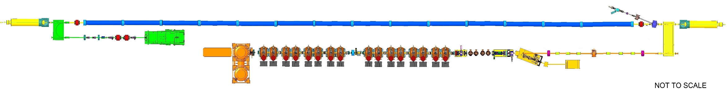
Low-Energy Cooler (LEC) for the EIC
RF diagnostics line with Deflecting cavity
180°Dipole
(U-turn)
LEReC Cooling Solenoids
180° Dipole
Spectrometer
Mu-metal shielding
Quad
cooling
RF diagnostic
hadron
hadron
hadron
e⁻
HSR
e⁻
HSR
e⁻
extraction
transport
injection
Injector test
SC Quad
PM
Cathode transport
PM
PM
Solenoids
Laser
197 MHz
130 kW Beam Dump
Extraction line
930 kW Beam Dump
4x 591 MHz
NCRF correction Cavities
Not to scale
DC Gun
400kV
Injector/linac
Test line
24MHz
RF cavity
16x 197 MHz
NCRF LINAC
The LEC is scaled up version of LEReC (which operated 2019-2025):
more RF cavities, longer cooling section, higher beam current.
Courtesy of Alexei Fedotov

Slide 27
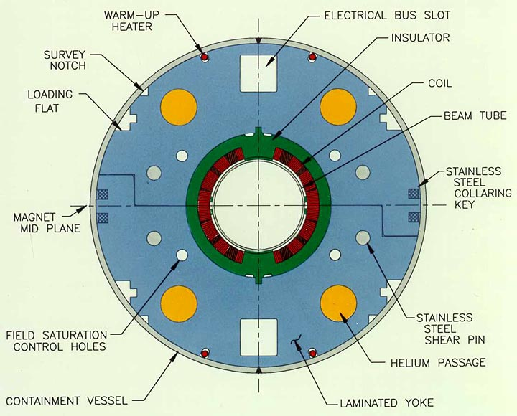
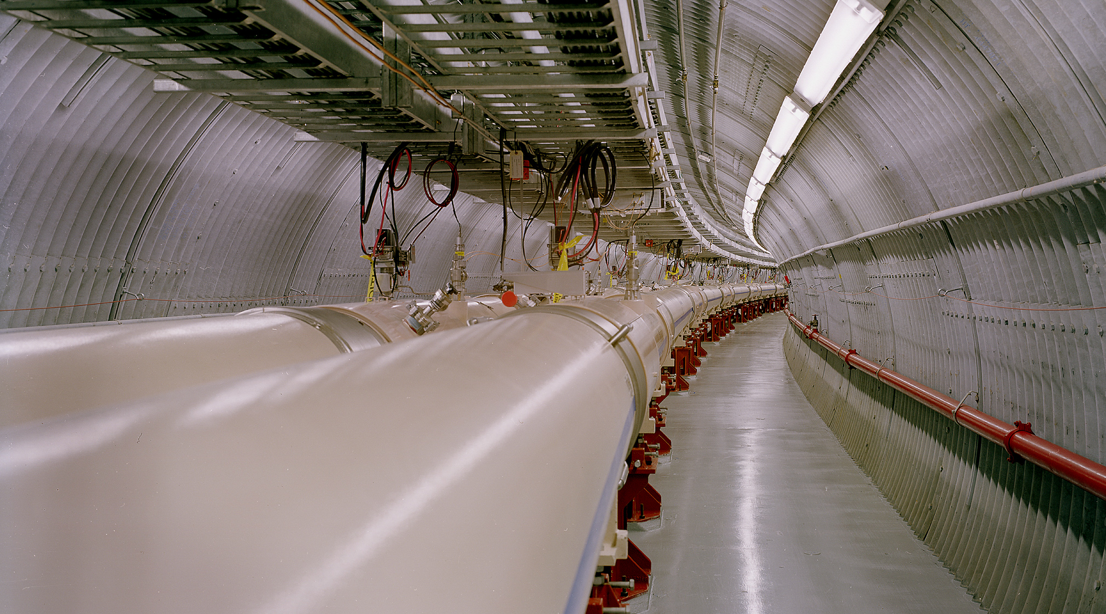
HSR Existing Vacuum System
Existing cold bore beam pipes are stainless steel
High surface resistance -> Excessive resistive wall heating
High secondary electron yield (SEY) -> Electron cloud formation
Aggressive new parameters required for EIC
High stored current (.72 A vs .27 A)
Reduced bunch length (60 cm vs 600 cm)
Short bunch spacing (10 ns vs 108 ns)
High bunch charge (1.2x10¹¹ ppb)

Slide 28
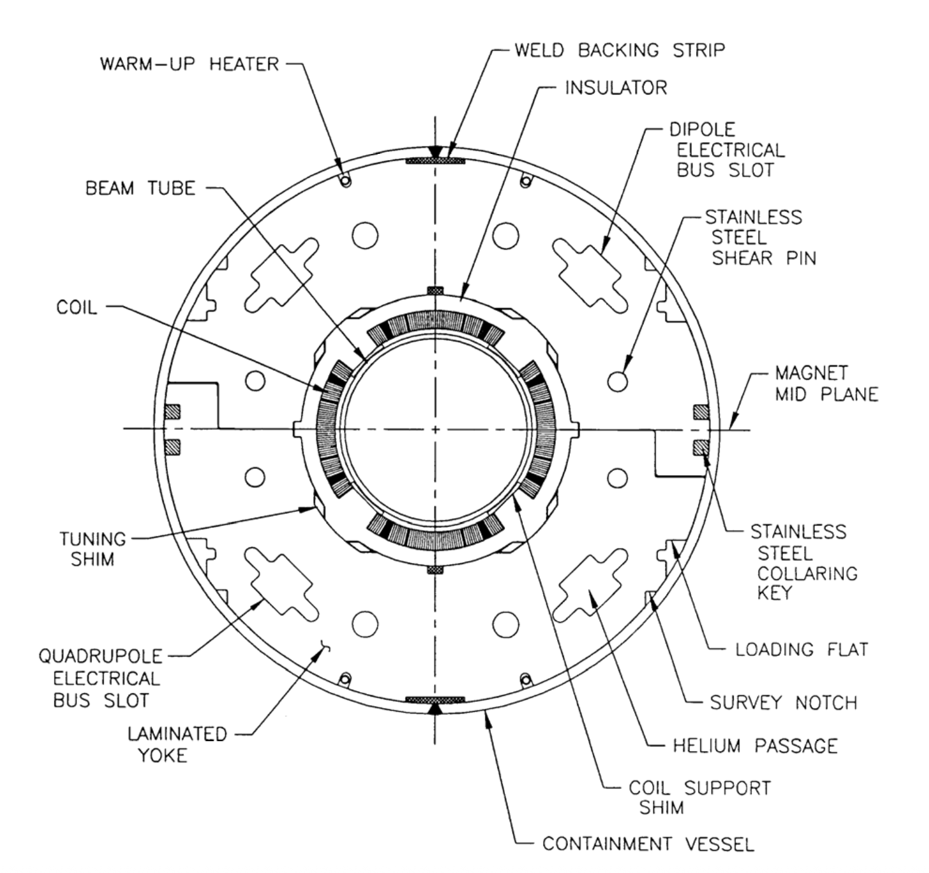
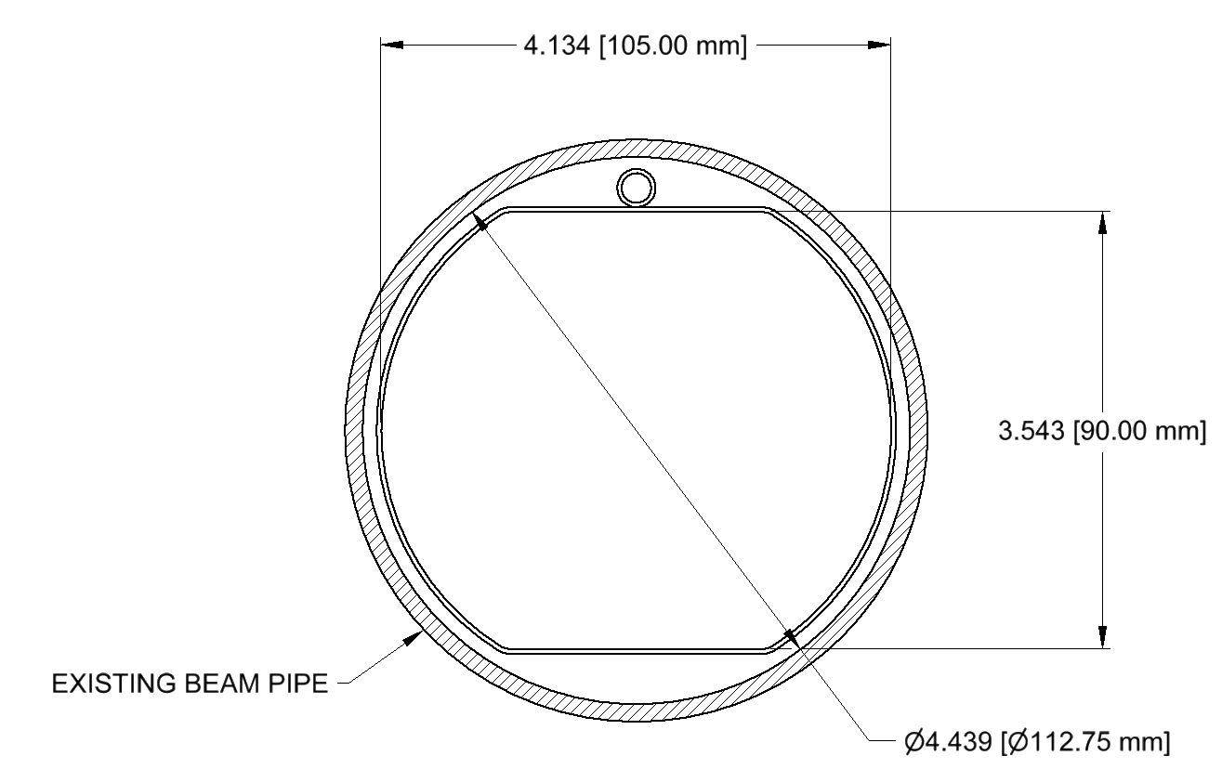
Resistive wall
Resistive Wall Heating and Mitigation
Proton beam induces ~2.5 W/m heat load on existing stainless-steel beam pipe
RHIC triplets have limited cooling capacity, reducing thermal margin
This increases the risk of magnet quench
Solution
Install a beam screen with high-conductivity surface
Use high-RRR (≥50) copper to reduce resistive heating
112.75 mm
Beampipe
w Beam Screen
Stainless-steel
beam pipe

Slide 29
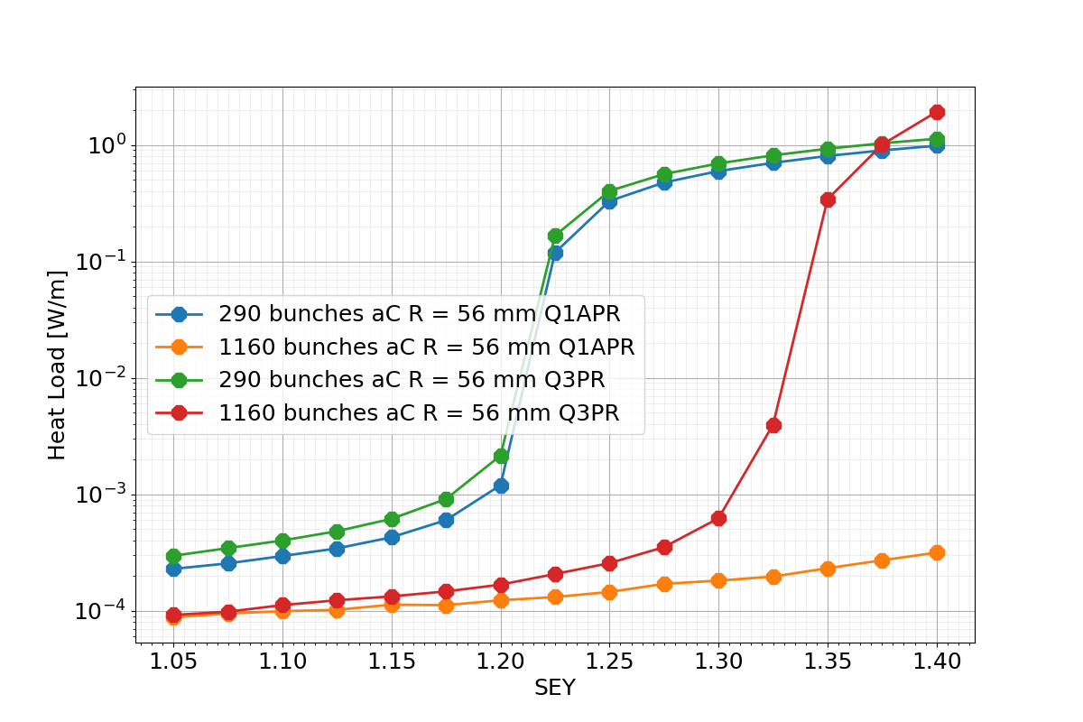
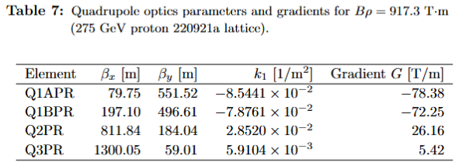
Electron cloud predictions
Electron cloud simulations (PyECLOUD) show buildup when SEY ≥ 1.20.
Amorphous carbon has low SEY by default and does not require activation or conditioning, unlike NEG or TiN.
[Xiaofeng Gu]

Slide 30
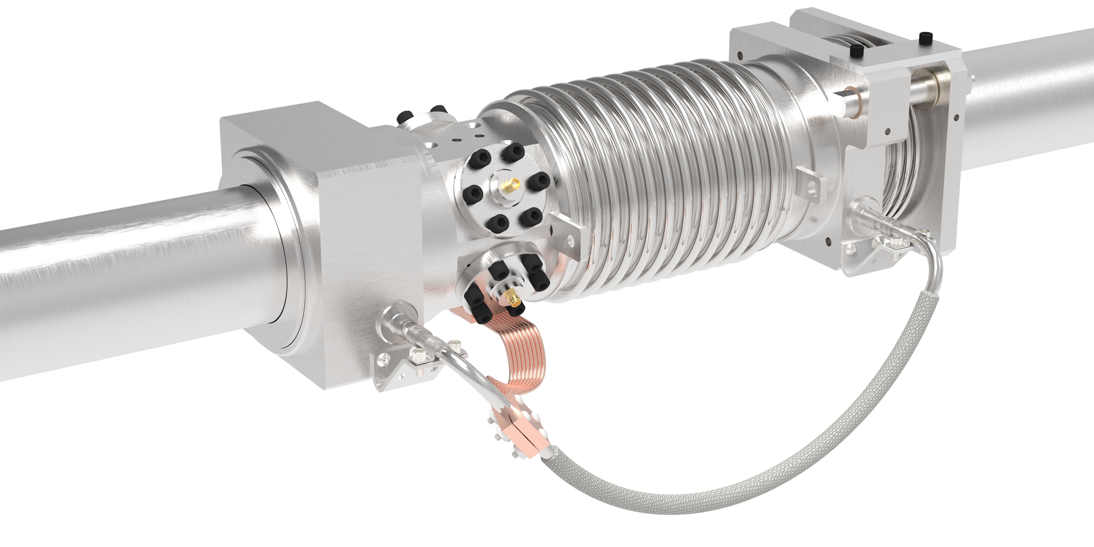
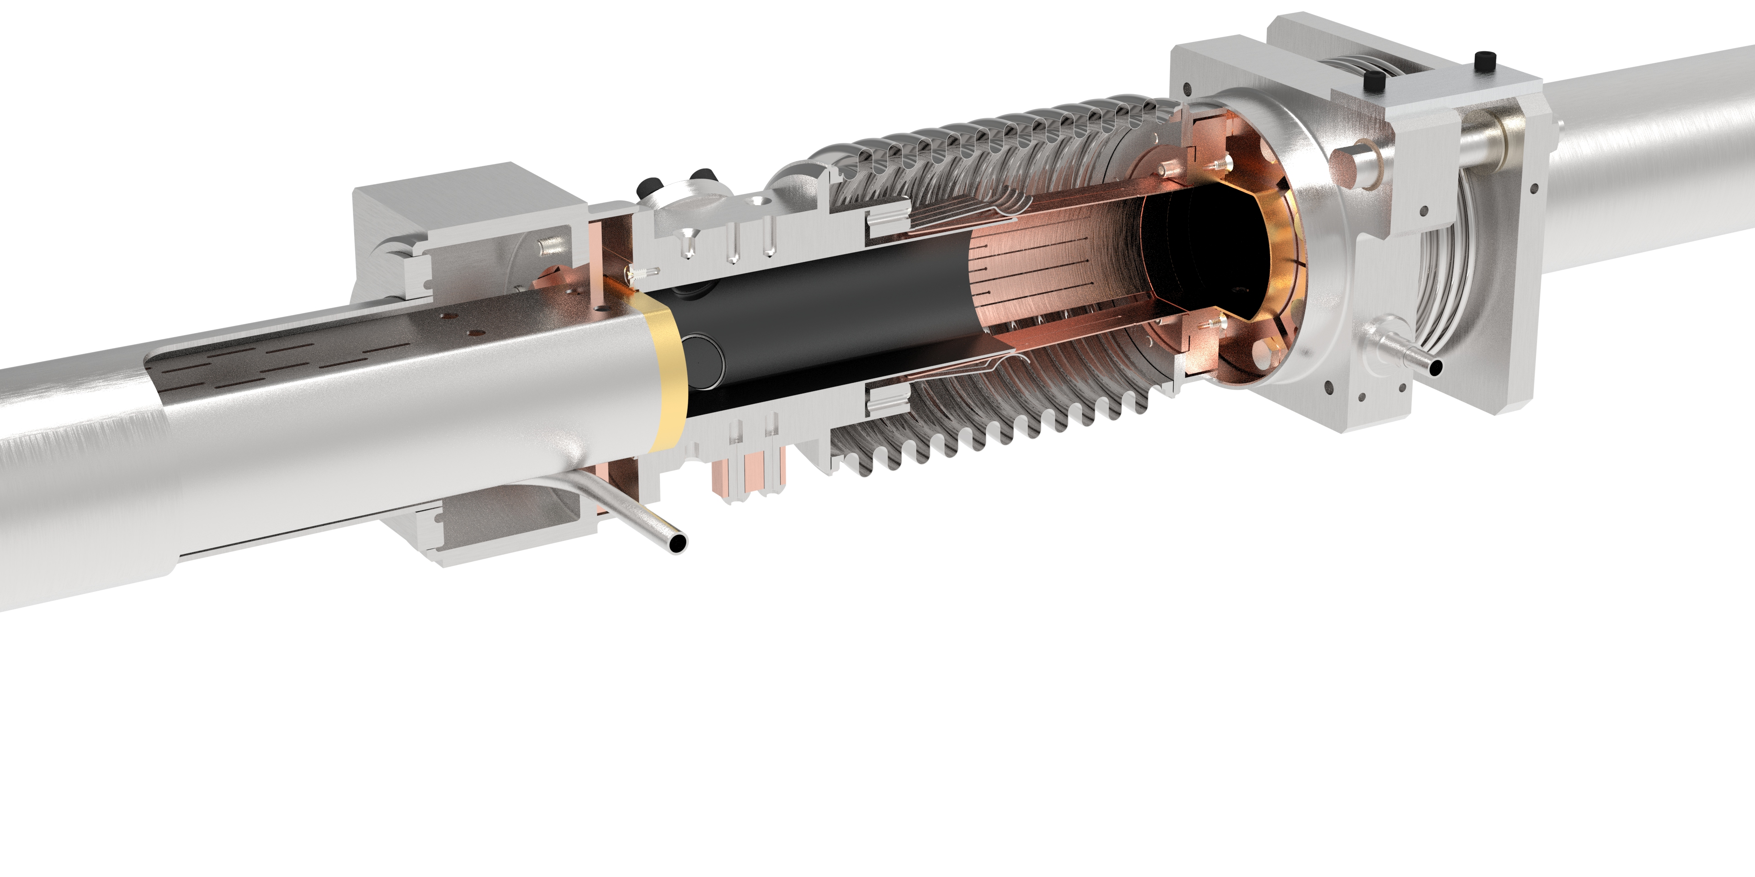
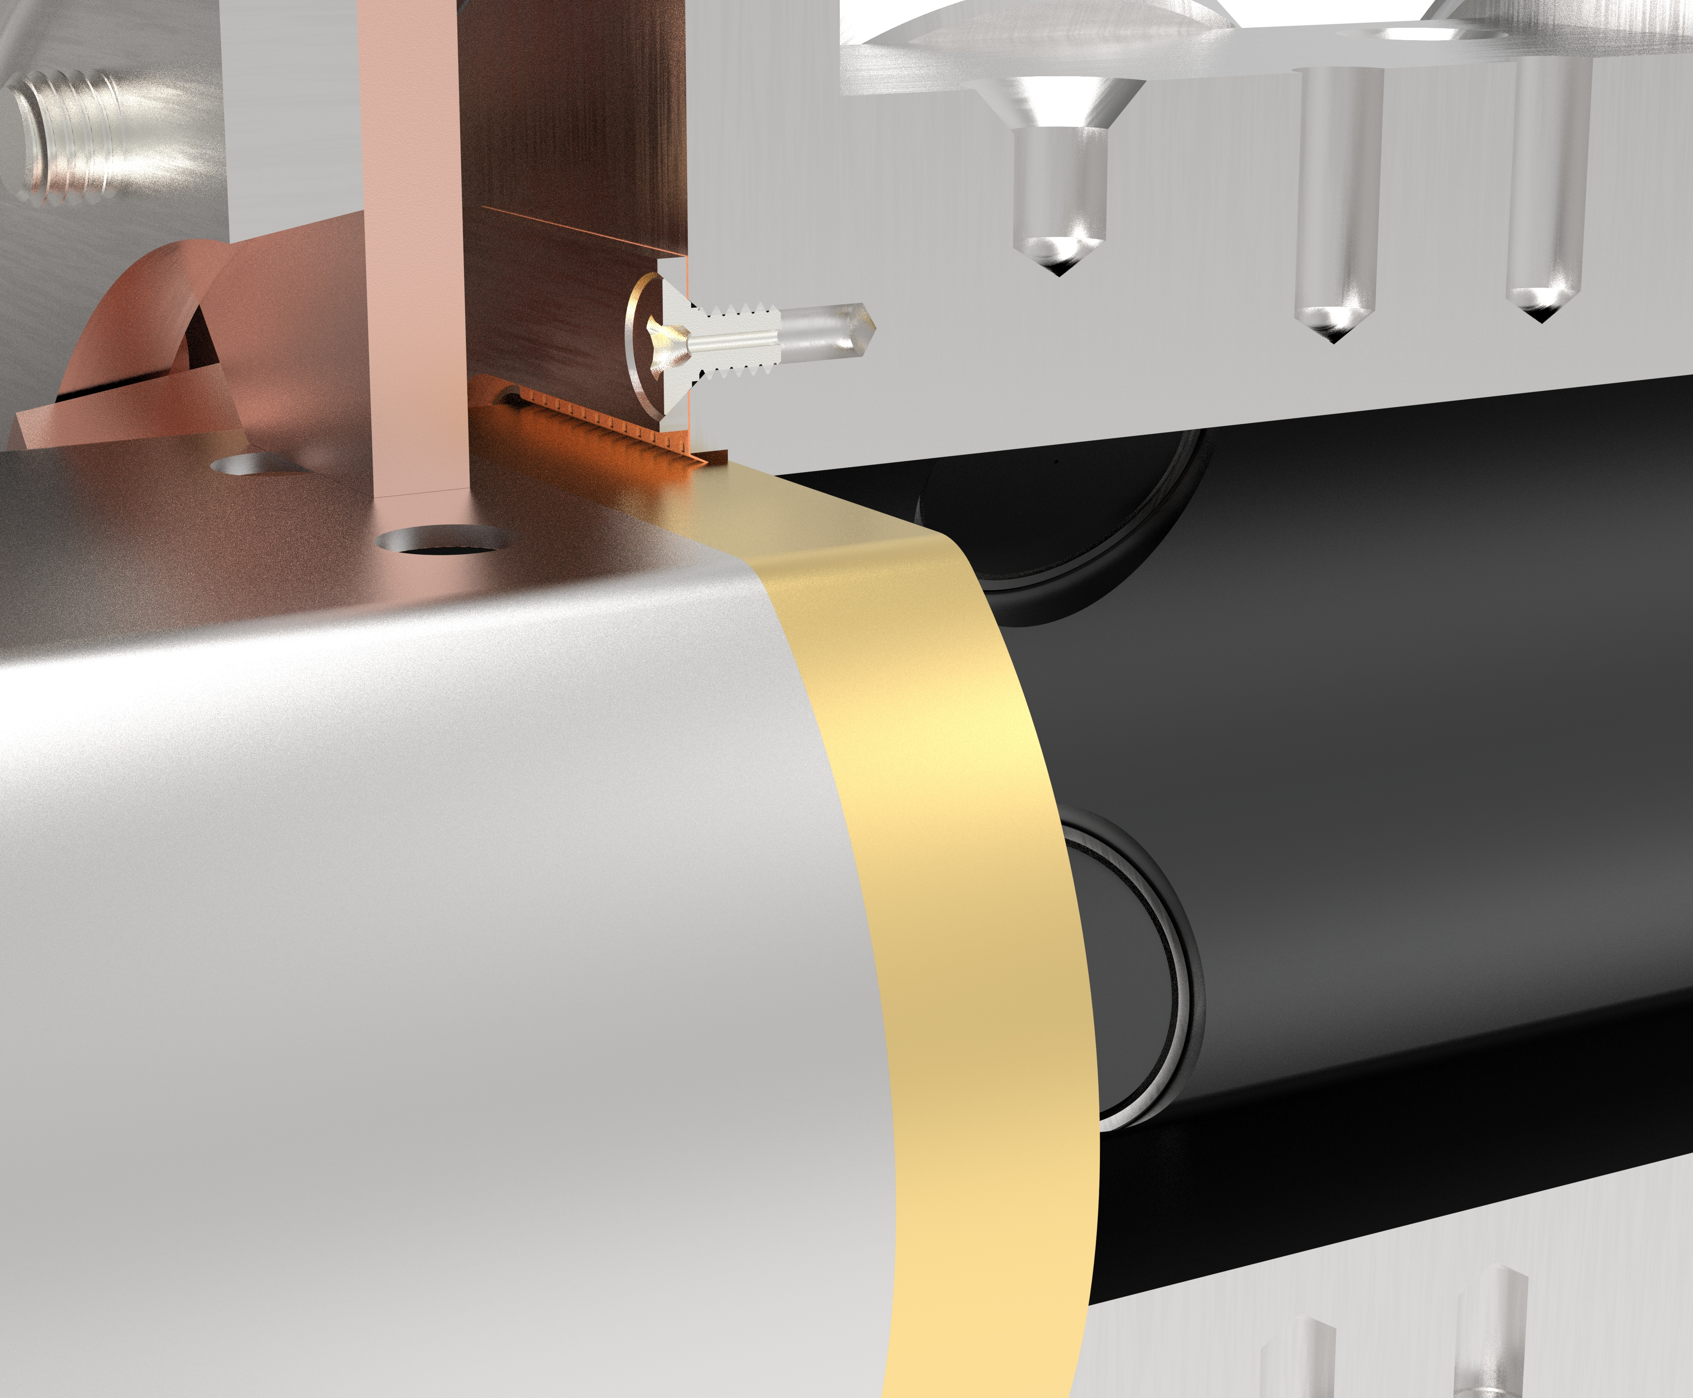
Magnet Interconnect Assembly
Anti-rotation extraction flange
Interconnect module
Flexible RF bridge
Spring ring
Fixed extraction flange
Existing magnet cold bore
Pumping slots
Existing magnet cold bore
Extraction bushing
Gold plated contact ring
Beam position monitor
Extraction bushing
Thermal strap
Helium jumper line
Strain relief bracket
Courtesy of Charlie Hetzel

Slide 31
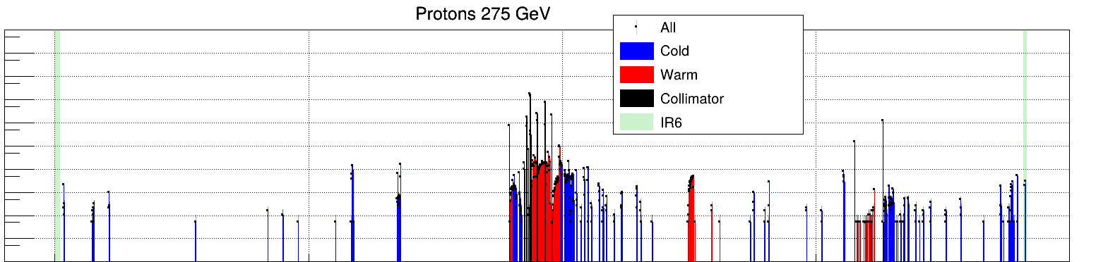
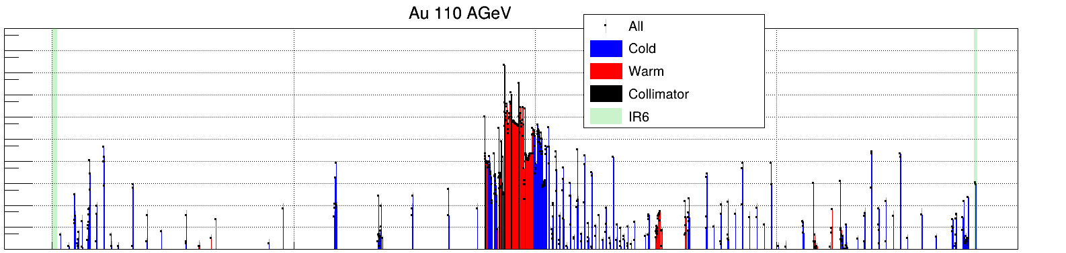
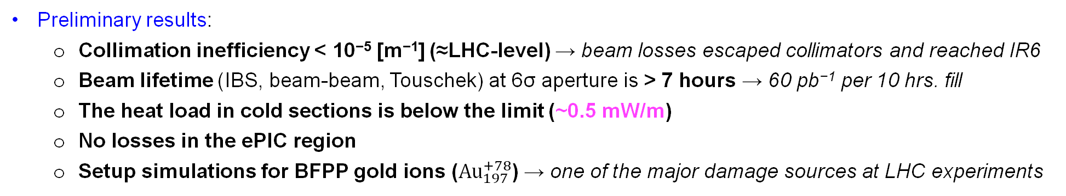
HSR Collimation & Losses
IR6-FWD
IR4
IR2
IR12
IR10
IR8
IR6-BWD
Tool: Xsuite
Method: Annular halo for betatron and RF sweep for momentum collimation (CERN-like)
Setup: One primary with two secondary betatron per plane + one primary with two secondary momentum
→ 9 collimators in IR12
+ 2 vertical tertiary collimators in IR8
10⁴
10²
Proton 275 GeV
1
Power [W/m]
10⁻²
10⁻⁴
10⁻⁶
HSR
10⁴
10²
Au ions 110 AGeV
1
Power [W/m]
10⁻²
10⁻⁴
10⁻⁶
0
1000
2000
3000
4000
Preliminary results:
Collimation inefficiency < 10⁻⁵ [m⁻¹] (≈LHC-level) → beam losses escaped collimators and reached IR6
Beam lifetime (IBS, beam-beam, Touschek) at 6σ aperture is > 7 hours → 60 pb⁻¹ per 10 hrs. fill
The heat load in cold sections is below the limit (~0.5 mW/m)
No losses in the ePIC region
Setup simulations for BFPP gold ions (${Au}_{197}^{+78}$) → one of the major damage sources at LHC experiments
S [m]
Courtesy of Andrii Natochii

Slide 32
HSR Collimators in IR12
Secondary mom. H-coll.
Secondary mom. H-coll.
Primary mom. H-coll.
Secondary H-coll.
Secondary H-coll.
Primary H-coll.
ESR
Secondary V-coll.
Secondary V-coll.
Primary V-coll.
HSR
End Cold Section
End Cold Section
Courtesy of Andrii Natochii

Slide 33
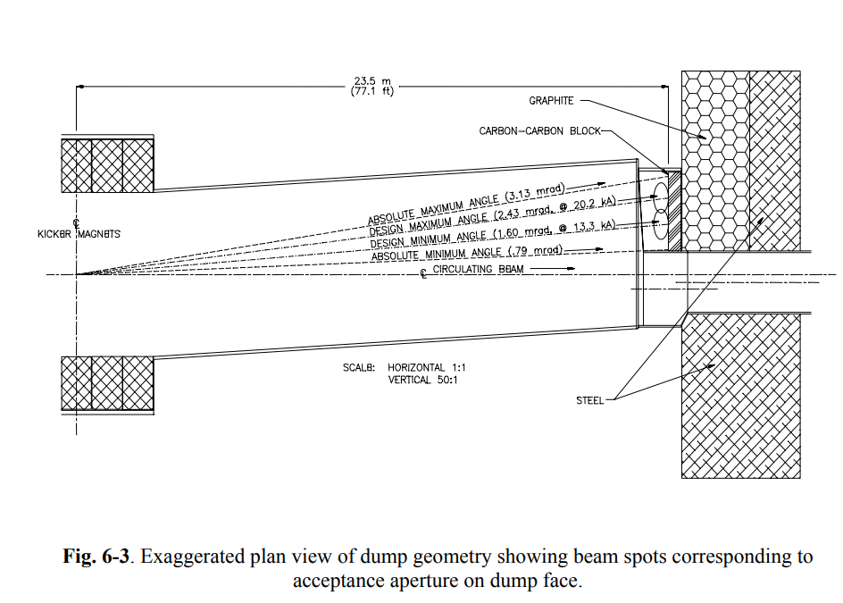
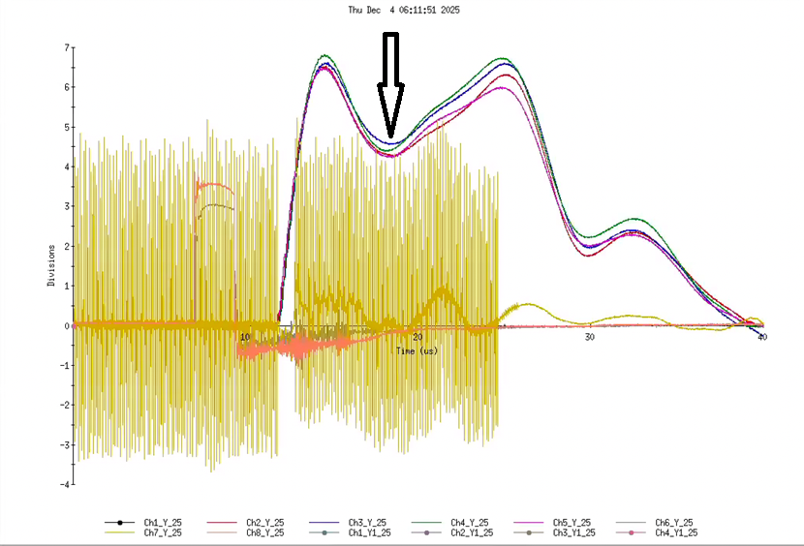
RHIC/HSR dump kickers parameters
Courtesy of A. Drees
From RHIC Configuration Manual
Courtesy of E. Skordis

Slide 34
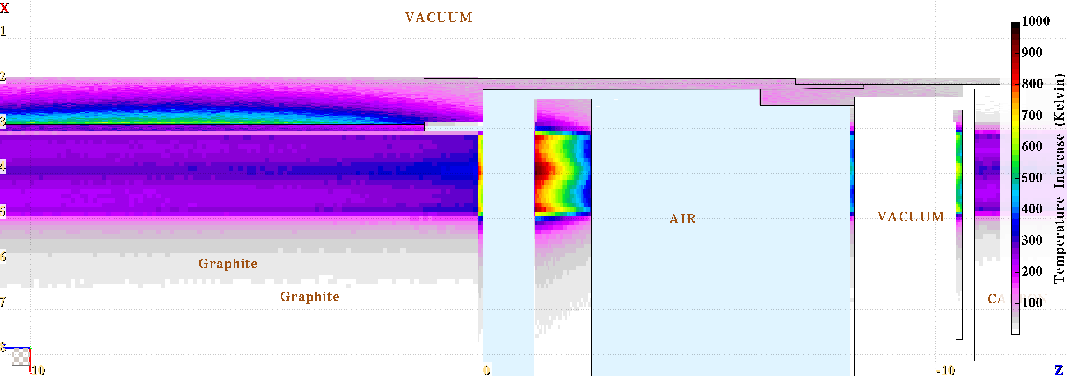
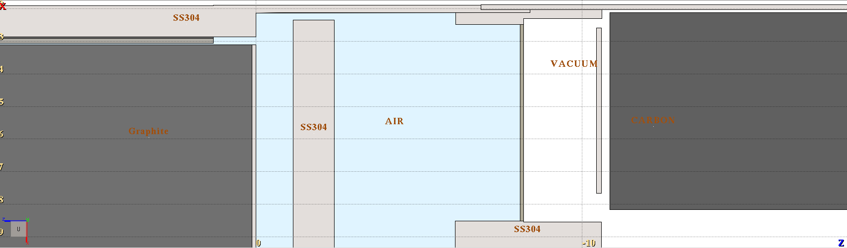
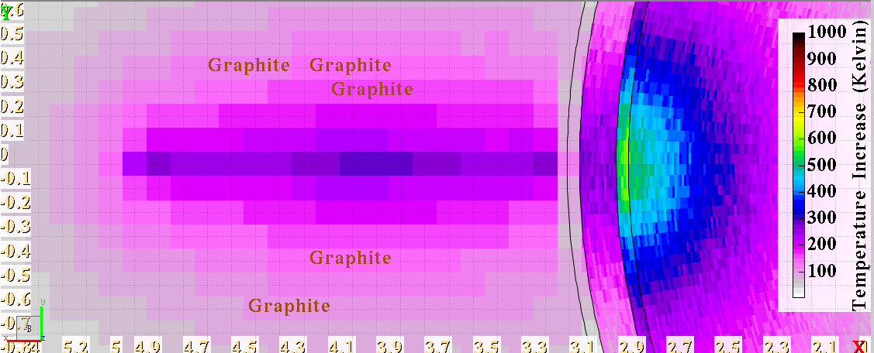
HSR Proton beam dump temperatures 4/5 kickers
Circulating Beam
Dumped Beam
Titanium window to surpass 600 Celsius (1.2kJ/cm3 peak)
Stainless Steel
Graphite
Titanium Window
Carbon Carbon

Slide 35
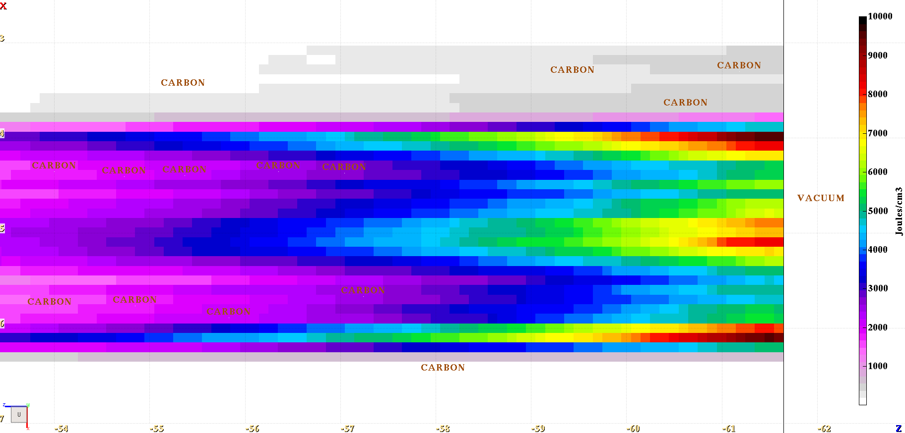
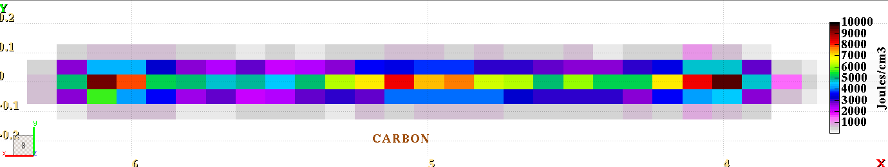
HSR Gold Ion beam dump Energy dens. 5/5 kickers
Circulating Beam
Dumped Beam

Slide 36
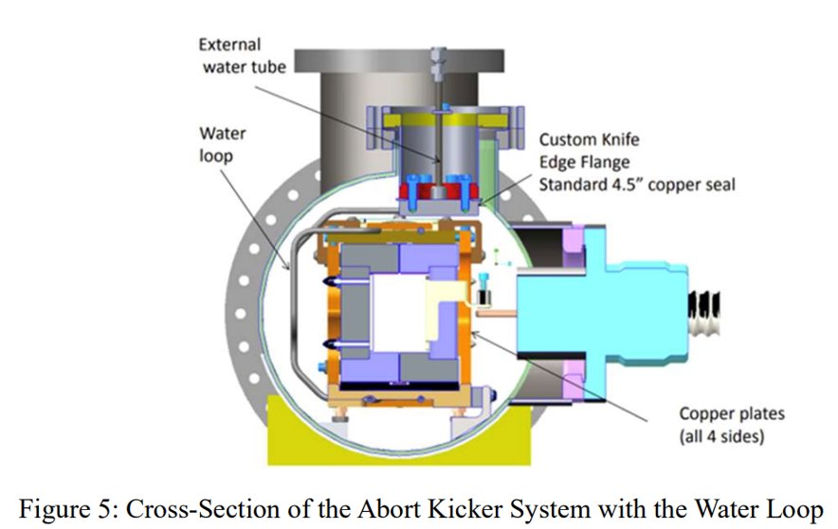
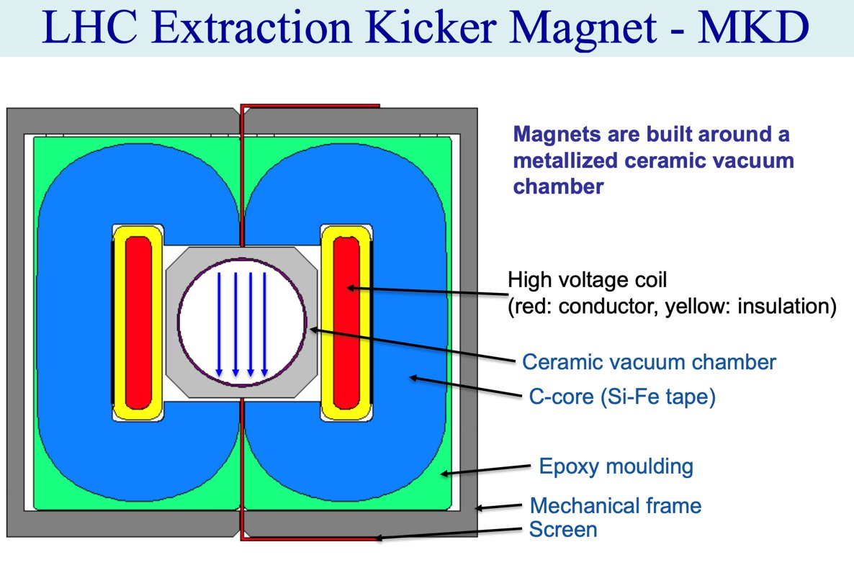
Upgrades to the HSR abort system
Issue #1: kicker pre-fire, potential damage of machine and detector components. Solution: change from Thyratron tube to solid state switches
Issue #2: coupling impedance due to in-vacuum kicker magnet. Solution: redesign kicker magnets with coated ceramic beam pipe.
Issue #3: overheating of beam dump due to flat beam. Solution: add a vertical kicker magnet to disperse flat beam.
LHC MKD as a model

Slide 37
Summary
Injector complex will be ready to support operations Ensures reliable beam delivery for commissioning and physics
Built on RHIC with targeted upgrades Including but not limited to the injection, RF, straight sections, vacuum, and machine protection systems
Key performance features validated Flat-beam acceleration, radial shift, and transition crossing with missing quads demonstrated in RHIC
On track toward CD-2 Steady progress within the ASR subproject

Slide 38
Additional slides

Slide 39
Energy and average orbit radius for different ion species at RHIC maximum beam rigidity (833 T*m)
3He
p
Zr
d
Au
U
Ru
Cu

Slide 40
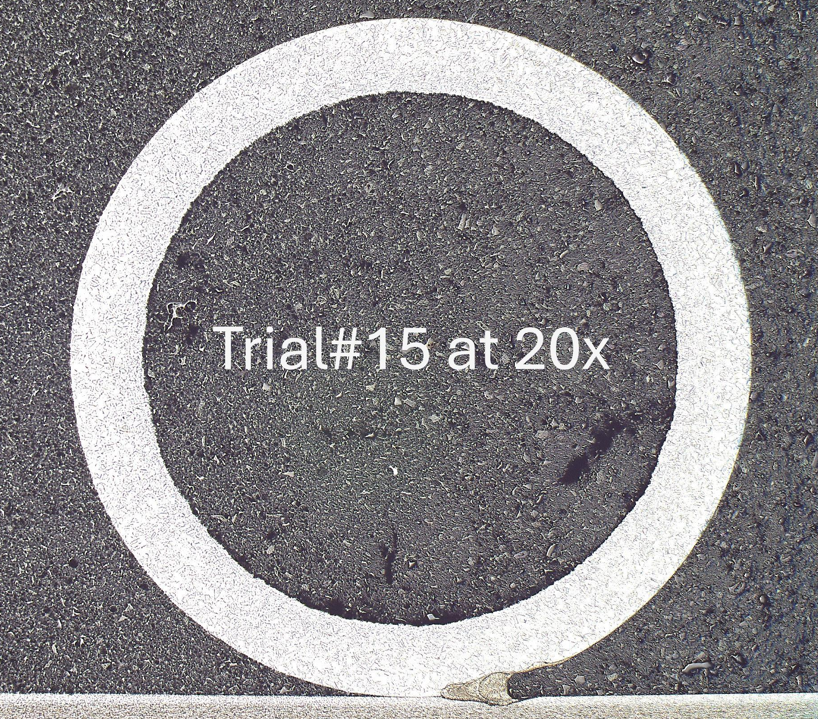
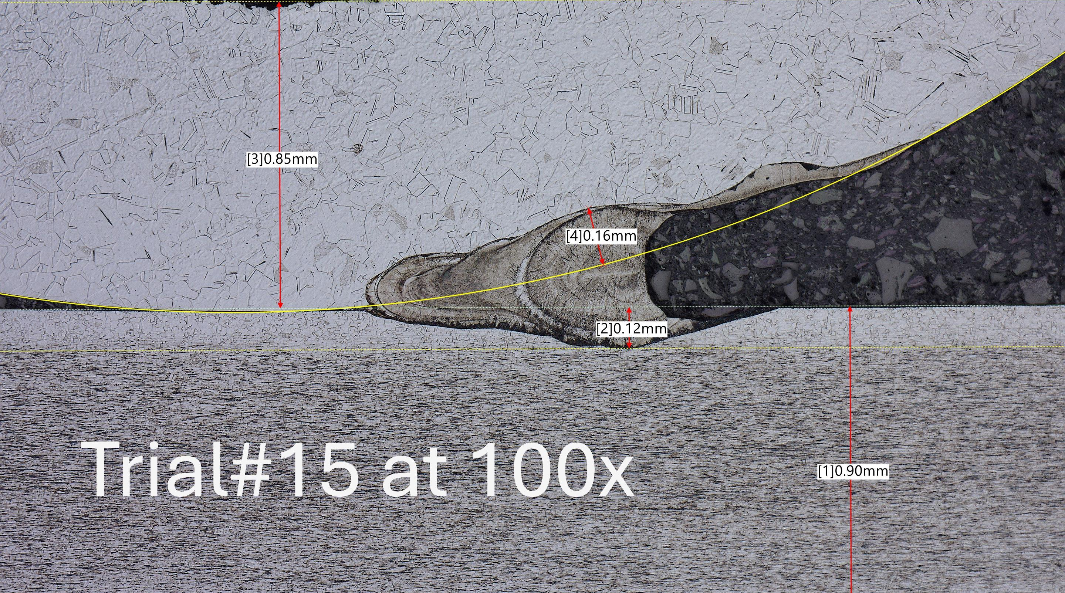
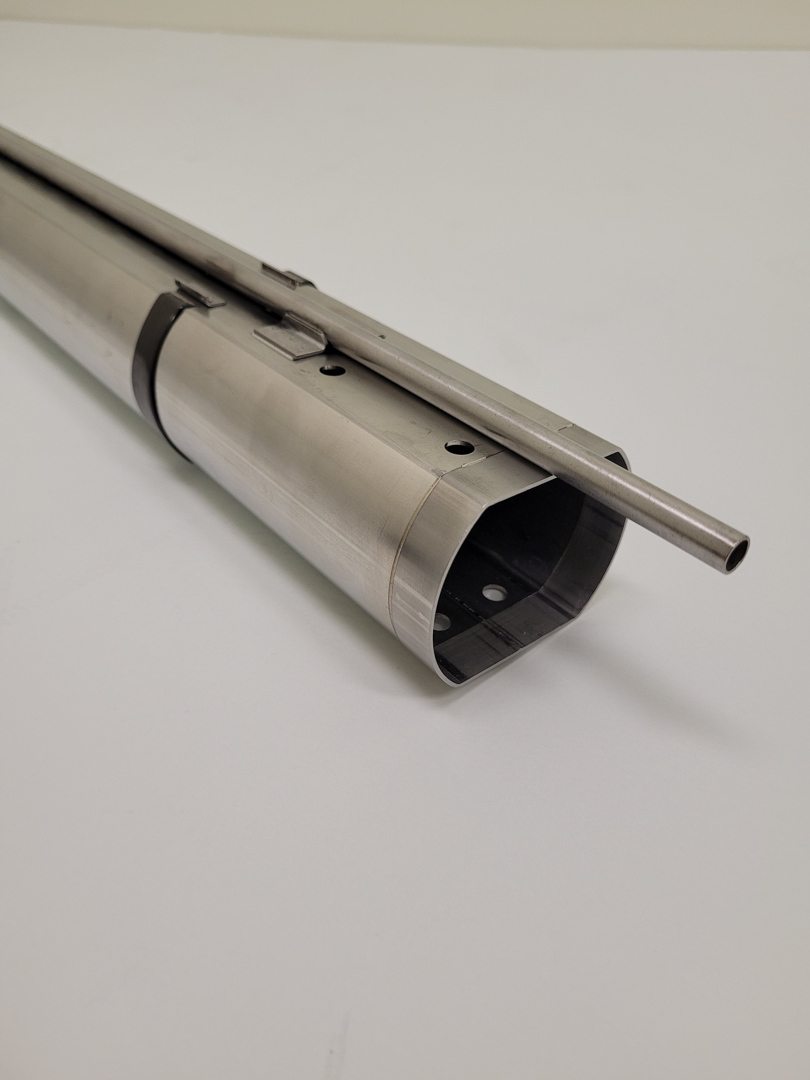


Beam Screens
Design based on the LHC beam screen
Copper cladded stainless steel
P506 stainless, C10100 OFE copper
Operating temperature: 4.5-10K
Single cooling tube (no synchrotron radiation)
Beam facing surfaces require aC coating
Cooling tube laser welded
Cooling tube support
Cooling tube (8mm)
Beam screen guide
Copper cladded SS
Courtesy of Charlie Hetzel
Beam screen prototype

Slide 41




aC Coating
Proof of principle coating system
Cycle time meets production requirements
Clean tent area for production complete (40x100’ [12.2x30.5m])
Full length (36’ [11m]) engineering validation system completed
Preparing for first coating run
Ultrasonic cleaning equipment (36’ [11m]) commissioned
Cleaning facility
Graphite target inside beam screen
Coating Facility
POP horizontal coating system

Slide 42
Proposal for EIC Science Program in the First Years
Year - 1
Year - 2
Year - 3
Year - 4
Year - 5
Start EIC Science
New Capability:
Commission electron polarization in parallel
Collider:
10 GeV electrons on 115 GeV/u heavy ion beams (Ag or Nb)
+Long. electron polarization
New Capability:
Commission proton polarization in parallel
Collider (base goal):
10 GeV long. polarized electrons on 130 GeV/u Deuterium
Collider (stretch goal):
Last weeks: 10 GeV long. polarized electrons and 130 GeV polarized protons
+Long. electron polarization
+ Proton polarization
New Capability:
Commission hadron spin rotators
Collider (base goal):
10 GeV long. polarized electrons on 130 GeV transverse-polarized protons
Collider (stretch goal):
Last weeks switch to longitudinal proton polarization
+ Long. electron polarization
+ Proton polarization
+ Hadron spin rotators
New Capability:
Commission hadron accelerator to operate with off-center orbits
Collider (base goal):
10 GeV long. polarized electrons on 100 GeV Au
Collider (stretch goal):
10 GeV long. polarized electrons on 250 GeV transverse and longitudinal polarized protons
+ Long. electron polarization
+ Proton polarization
+ Hadron spin rotators
+ Hadron beams with off-center orbits
Collider (base goal):
10 GeV long. polarized electrons on 100 GeV Au
Collider (stretch goal):
10 GeV long. polarized electrons on 166 GeV transverse and longitudinal polarized He-3
Time to construct the ELR subproject

