Slide 1
Spin in Storage Rings
EPIOS
Eiad Hamwi
March 19-20, 2026

Slide 2
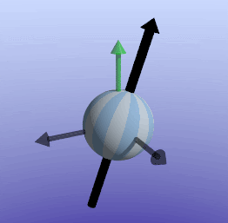
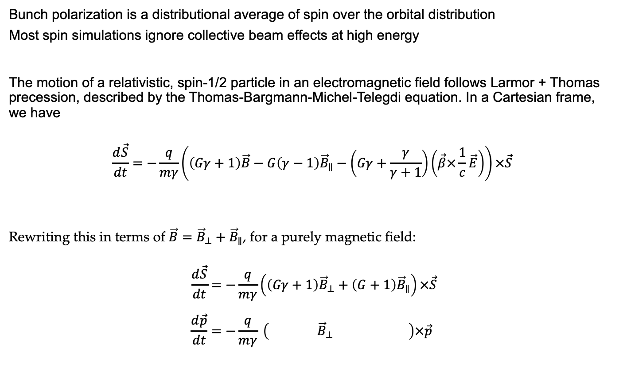
Spin Polarization
Bunch polarization is a distributional average of spin over the orbital distribution
Most spin simulations ignore collective beam effects at high energy
The motion of a relativistic, spin-1/2 particle in an electromagnetic field follows Larmor + Thomas precession, described by the Thomas-Bargmann-Michel-Telegdi equation. In a Cartesian frame, we have
$$\frac{d\vec{S}}{dt}=−\frac{q}{mγ}\left(\left(Gγ+1\right)\vec{B}−G\left(γ−1\right){\vec{B}}_{∥}−\left(Gγ+\frac{γ}{γ+1}\right)\left(\vec{β}×\frac{1}{c}\vec{E}\right)\right)×\vec{S}$$
Rewriting this in terms of $\vec{B}={\vec{B}}_{⊥}+{\vec{B}}_{∥}$, for a purely magnetic field:
$$\frac{d\vec{S}}{dt}=−\frac{q}{mγ}\left(\left(Gγ+1\right){\vec{B}}_{⊥}+\left(G+1\right){\vec{B}}_{∥}\right)×\vec{S} \\ \frac{d\vec{p}}{dt}=−\frac{q}{mγ} \left( {\vec{B}}_{⊥} \right)×\vec{p}$$
EPIOS 2026
Eiad Hamwi

Slide 3

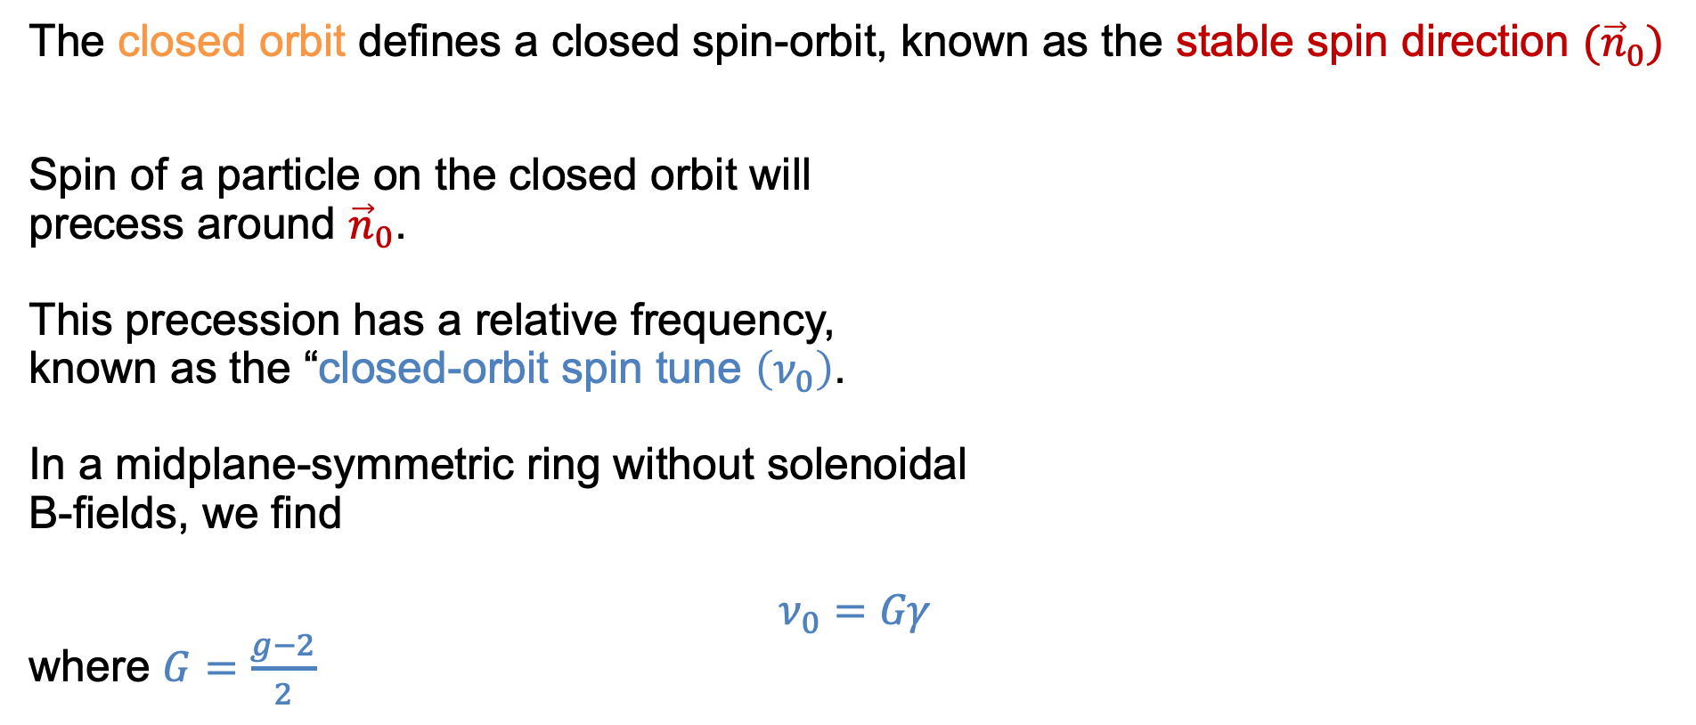
Closed Spin-Orbit (Stable Spin Direction)
The closed orbit defines a closed spin-orbit, known as the stable spin direction ${(\vec{n}}_{0})$
Spin of a particle on the closed orbit will precess around ${\vec{n}}_{0}$. This precession has a relative frequency, known as the “closed-orbit spin tune $\left(ν_{0}\right)$. In a midplane-symmetric ring without solenoidal B-fields, we find $$ν_{0}=Gγ$$ where $G=\frac{g−2}{2}$
$\left[\vec{m},\vec{l},{\vec{n}}_{0}\right]$
EPIOS 2026
Eiad Hamwi

Slide 4



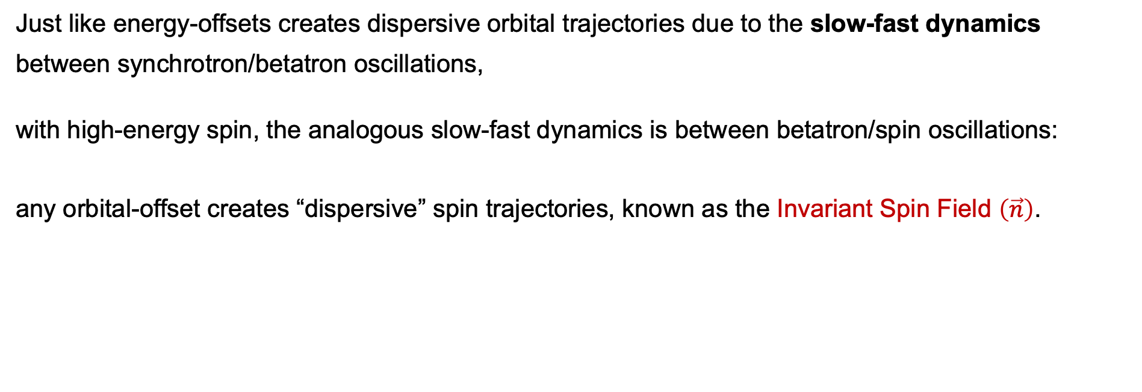



“Dispersive” Spin-Orbit (Invariant Spin Field)
Just like energy-offsets creates dispersive orbital trajectories due to the slow-fast dynamics
between synchrotron/betatron oscillations,
with high-energy spin, the analogous slow-fast dynamics is between betatron/spin oscillations:
any orbital-offset creates “dispersive” spin trajectories, known as the Invariant Spin Field $\left(\vec{n}\right)$.
$$p_{x}$$
$$p_{y}$$
$\vec{n}$
$$x$$
${\vec{n}}_{0}$
$$y$$
EPIOS 2026
Eiad Hamwi

Slide 5
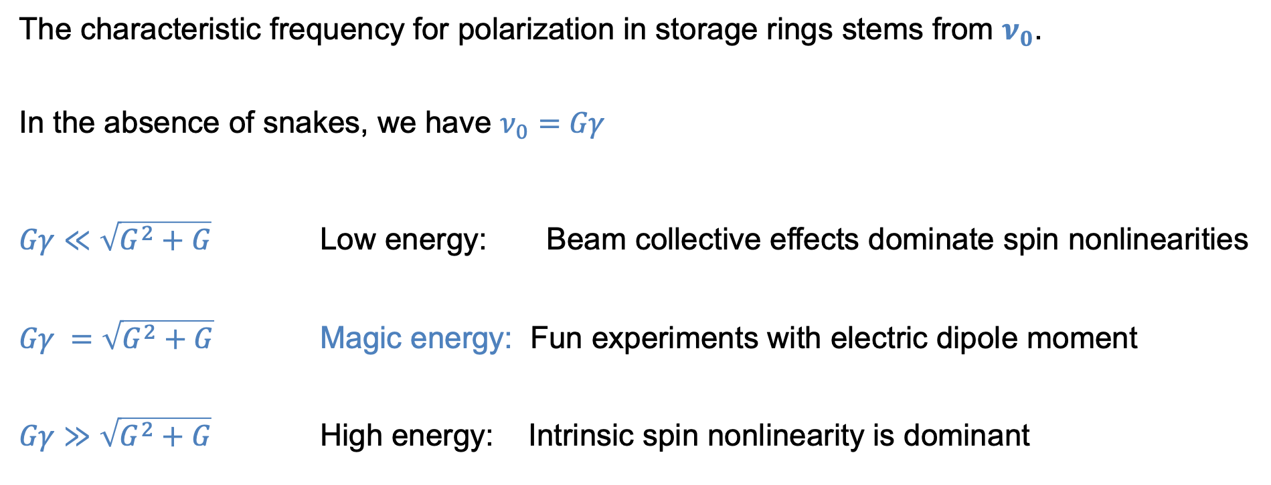
Spin-Orbit Regimes in Storage Rings
The characteristic frequency for polarization in storage rings stems from $ν_{0}$.
In the absence of snakes, we have $ν_{0}=Gγ$
$Gγ≪\sqrt{G^{2}+G}$ Low energy: Beam collective effects dominate spin nonlinearities
$Gγ =\sqrt{G^{2}+G}$ Magic energy: Fun experiments with electric dipole moment
$Gγ≫\sqrt{G^{2}+G}$ High energy: Intrinsic spin nonlinearity is dominant
EPIOS 2026
Eiad Hamwi

Slide 6
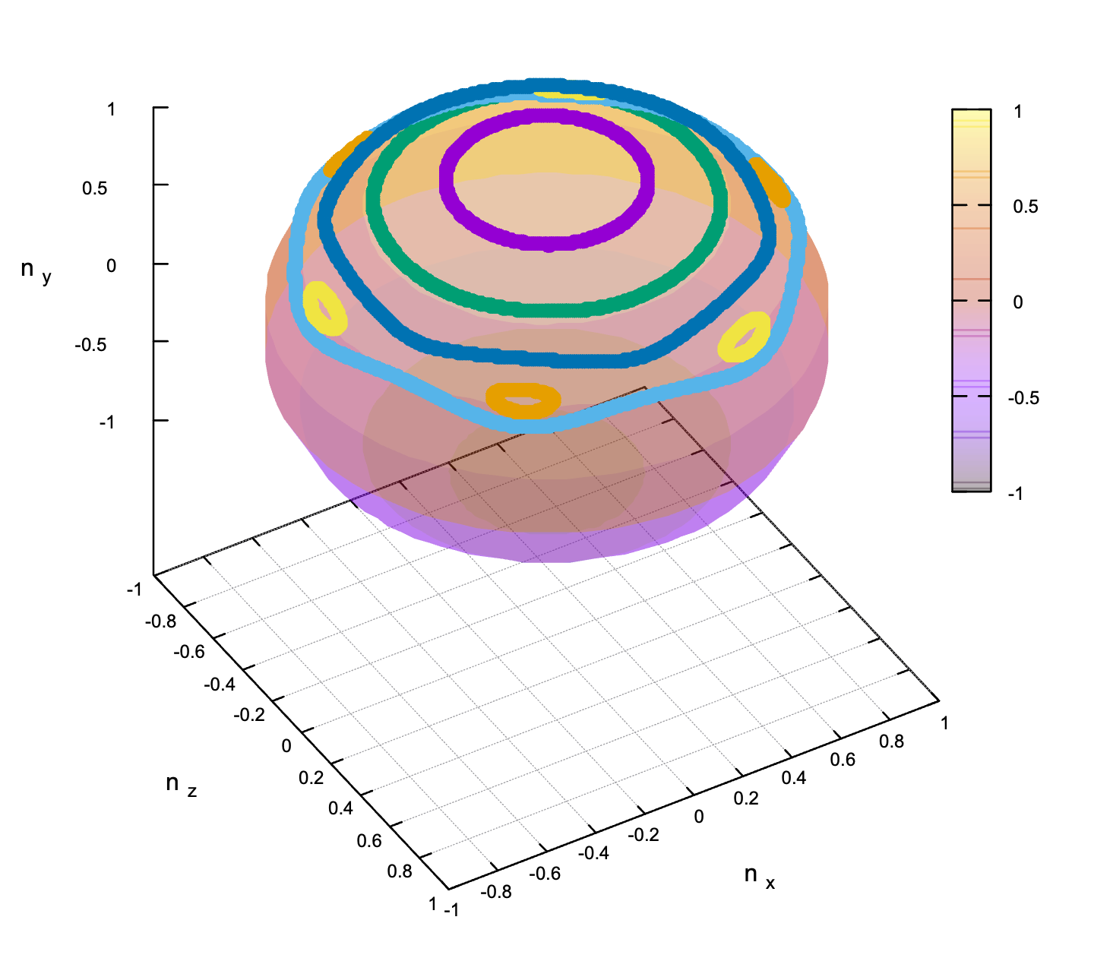
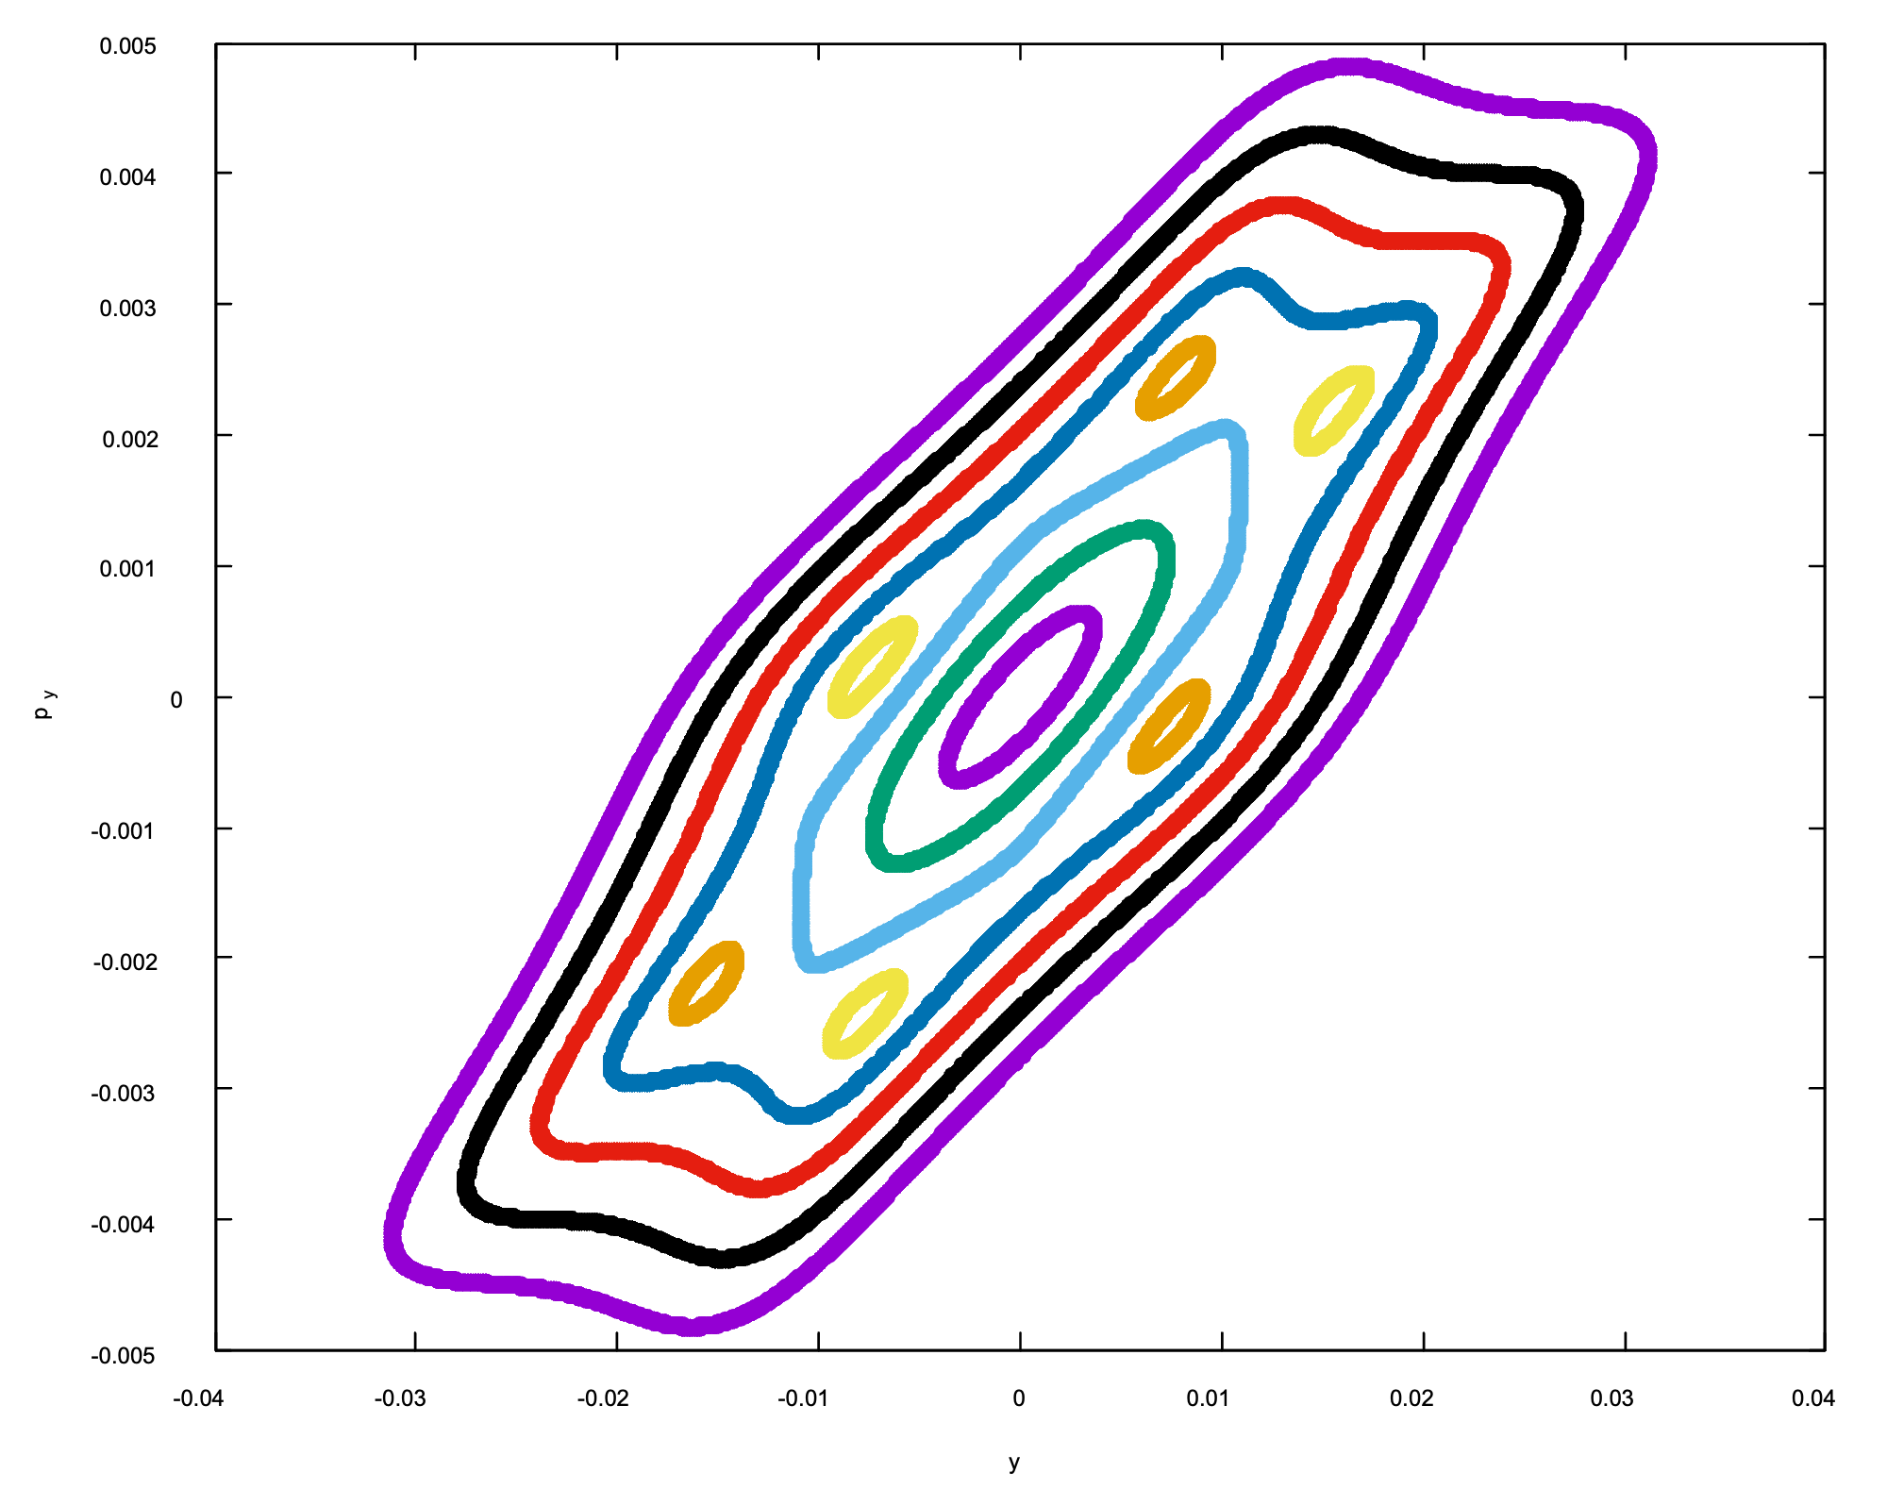
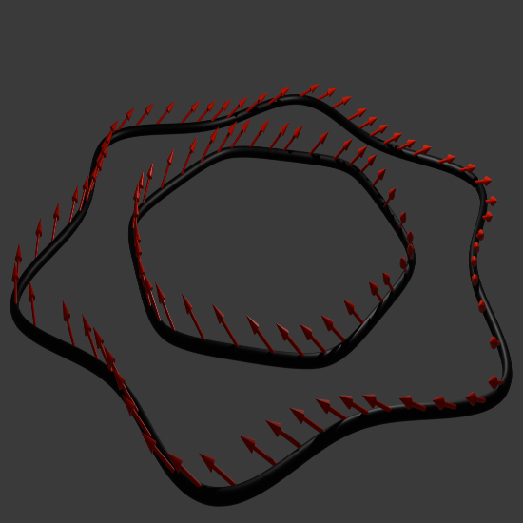

Resonances
Commensurable frequencies in multi-frequency systems (synch, rev, beta, etc…) can generate resonant artifacts
Orbital resonances deform tori Spin resonances deform $\vec{n}$ Combined image:
Fibered, Invariant Spin-Orbit Frame
Invariant Orbital Tori
Invariant Spin Fields
EPIOS 2026
Eiad Hamwi

Slide 7
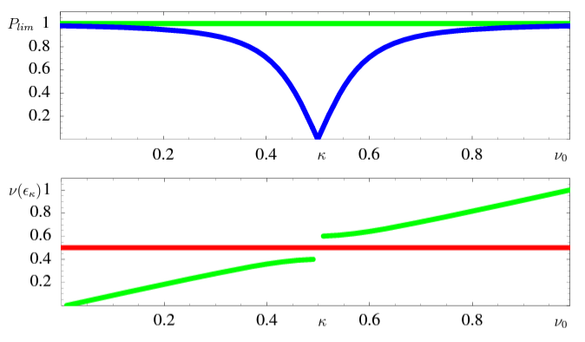
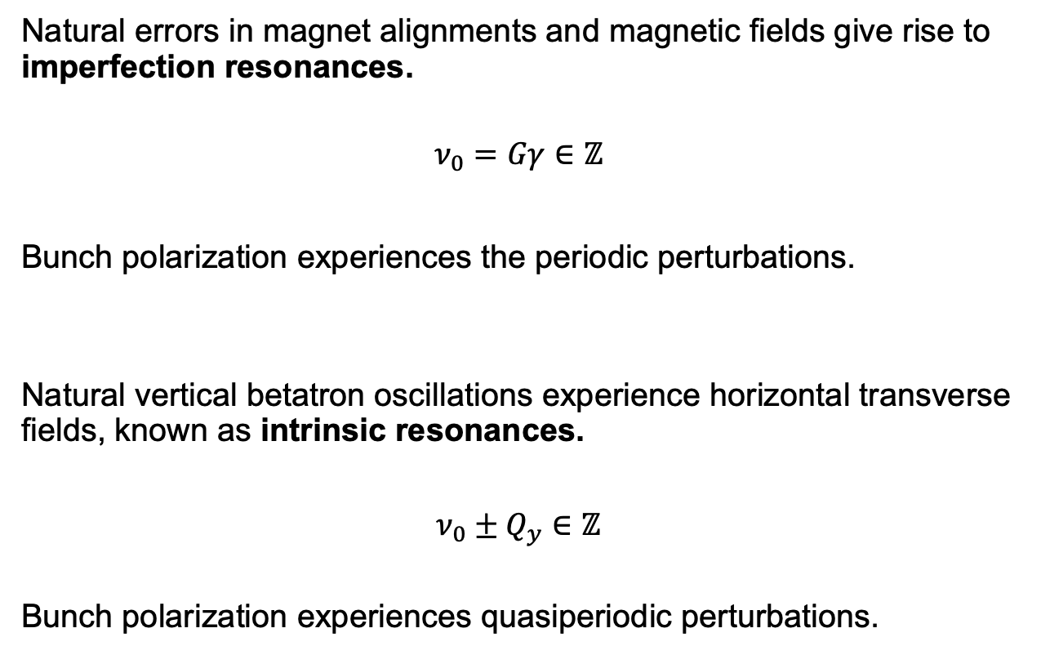
Low-order Resonances
Natural errors in magnet alignments and magnetic fields give rise to imperfection resonances.
$$ν_{0}=Gγ∈ℤ$$
Bunch polarization experiences the periodic perturbations.
Natural vertical betatron oscillations experience horizontal transverse fields, known as intrinsic resonances.
$$ν_{0}±Q_{y}∈ℤ$$
Bunch polarization experiences quasiperiodic perturbations.
Credit: G. H. Hoffstaetter
EPIOS 2026
Eiad Hamwi

Slide 8
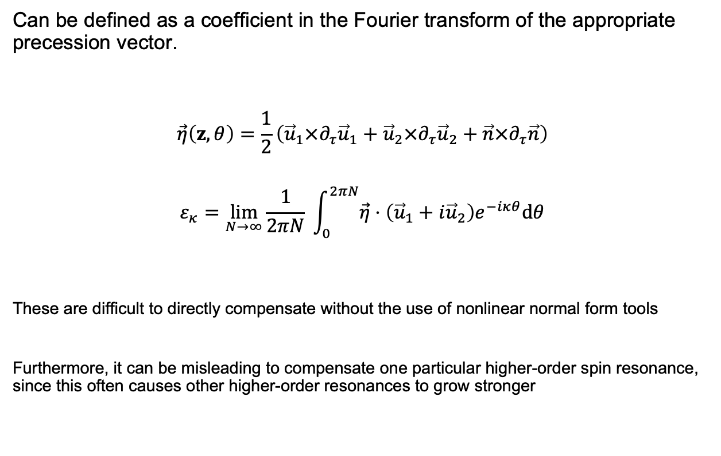
High-order Resonances
Can be defined as a coefficient in the Fourier transform of the appropriate precession vector.
$$\vec{η}\left(z,θ\right)=\frac{1}{2}\left({\vec{u}}_{1}×∂_{τ}{\vec{u}}_{1}+{\vec{u}}_{2}×∂_{τ}{\vec{u}}_{2}+\vec{n}×∂_{τ}\vec{n}\right)$$
$$ε_{κ}=\lim_{N→∞}{\frac{1}{2πN} }\int_{0}^{2πN}{\vec{η}⋅\left({\vec{u}}_{1}+i{\vec{u}}_{2}\right)e^{−iκθ}dθ}$$
These are difficult to directly compensate without the use of nonlinear normal form tools
Furthermore, it can be misleading to compensate one particular higher-order spin resonance, since this often causes other higher-order resonances to grow stronger
EPIOS 2026
Eiad Hamwi

Slide 9
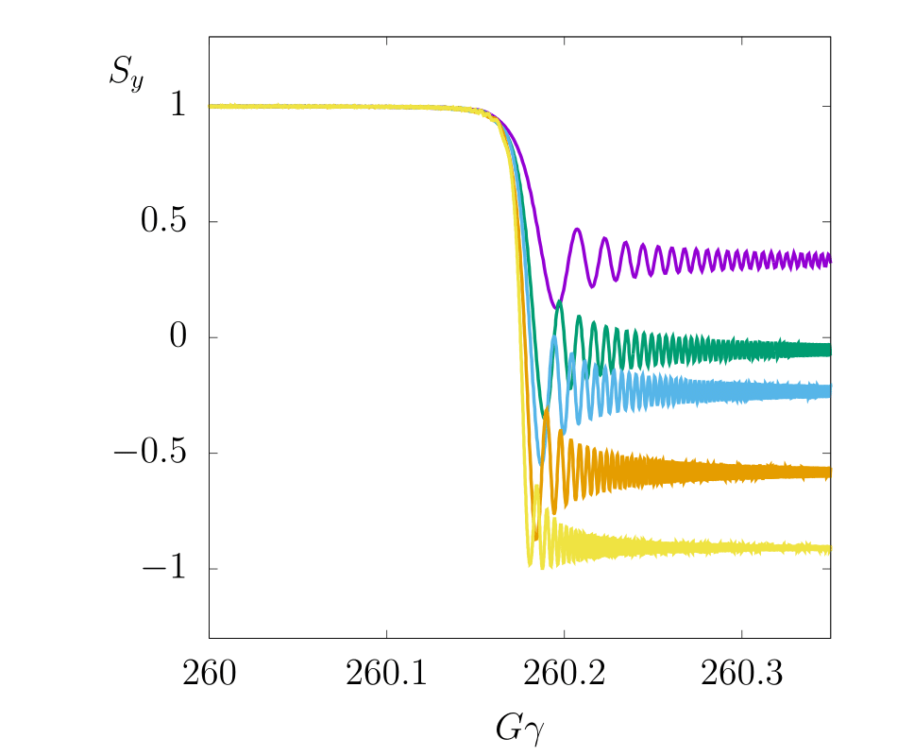
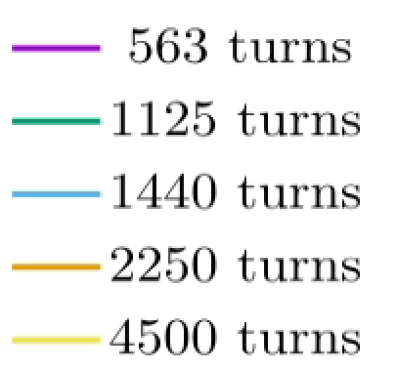


Polarization Loss
The primary mechanism for loss of polarization is due to non-adiabaticity, similarly to emittance
This occurs due to sharp changes of $\left(ν,\vec{n}\right)$ with energy near spin resonances
$$\left[Q_{y}\right]=0.18$$
EPIOS 2026
Eiad Hamwi

Slide 10
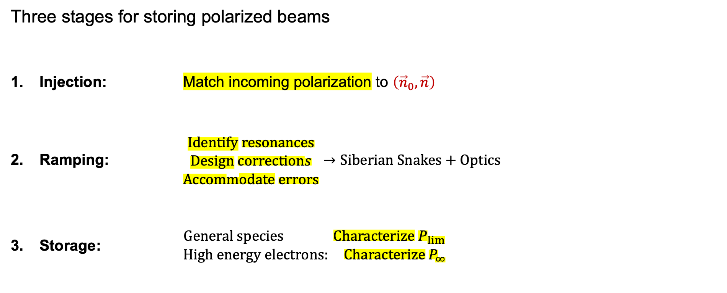
Controlling Spin-Orbit in Synchrotrons
Three stages for storing polarized beams
Injection: Match incoming polarization to $\left({\vec{n}}_{0},\vec{n}\right)$
Ramping: $\begin{matrix}Identify resonances \\ Design corrections \\ Accommodate errors\end{matrix}→Siberian Snakes+Optics$
Storage: $\begin{matrix}General species Characterize P_{lim} \\ High energy electrons: Characterize P_{∞}\end{matrix}$
EPIOS 2026
Eiad Hamwi

Slide 11

Siberian Snakes
These specialized helical dipole magnets can be appropriately placed to geometrically cancel the energy-dependence of closed-orbit spin tune $ν_{0}$ $⟶$ avoid resonance conditions
EPIOS 2026
Eiad Hamwi

Slide 12
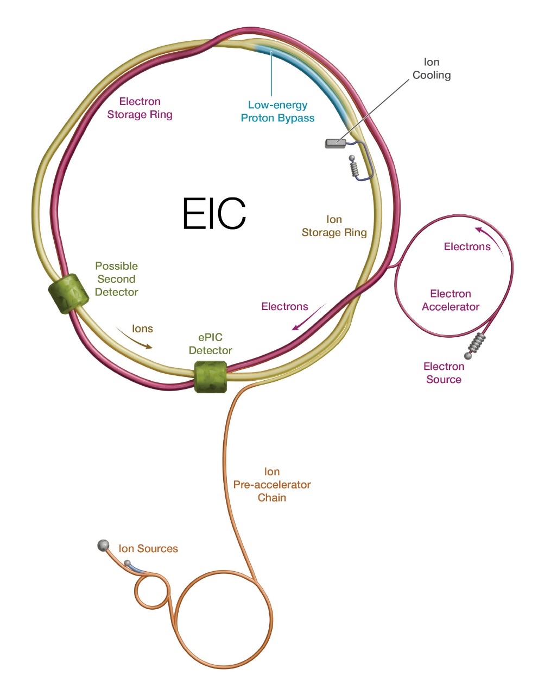


BNL’s Hadron Synchrotrons
Polarization needs to survive multiple hand-offs and ramps
OPPIS/EBIS $↓$
Booster $↓$
AGS $↓$
HSR
EBIS
OPPIS
AGS
Booster
EPIOS 2026
Eiad Hamwi

Slide 13
Booster & AGS
These are subtle machines, specifically the AGS
See Haixin’s talk earlier
Low-energy modeling is under active-development
See Vincent’s work
Collective effects such as space charge likely dominate beam nonlinearities
Requires deeper modeling for accurate beam dynamics characterization
We are working to leverage ML tools (BO, MPC, RL) for continuous active characterization and control of beam uncertainties, i.e. digital twins.
See Kevin’s talk tomorrow
EPIOS 2026
Eiad Hamwi

Slide 14
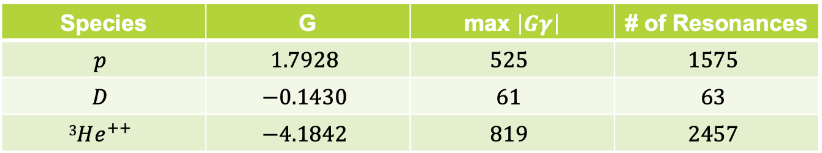

Hadron Storage Ring
Spectrum of leading-order resonances is species-dependent:
It is clear that $3He^{++}$ will need the most careful treatment. We focus on this now:
Species | G | max $\left|Gγ\right|$ | # of Resonances
$$p$$ | $$1.7928$$ | $$525$$ | $$1575$$
$$D$$ | $$−0.1430$$ | $$61$$ | $$63$$
$$3He^{++}$$ | $$−4.1842$$ | $$819$$ | $$2457$$
+ Difficulty
 | 1-IP Injection | 1-IP Store | 2-IP Store
Pre-cooled Helions |  | ✔ | ✔
Un-cooled Helions | ✔
+ Difficulty
EPIOS 2026
Eiad Hamwi

Slide 15
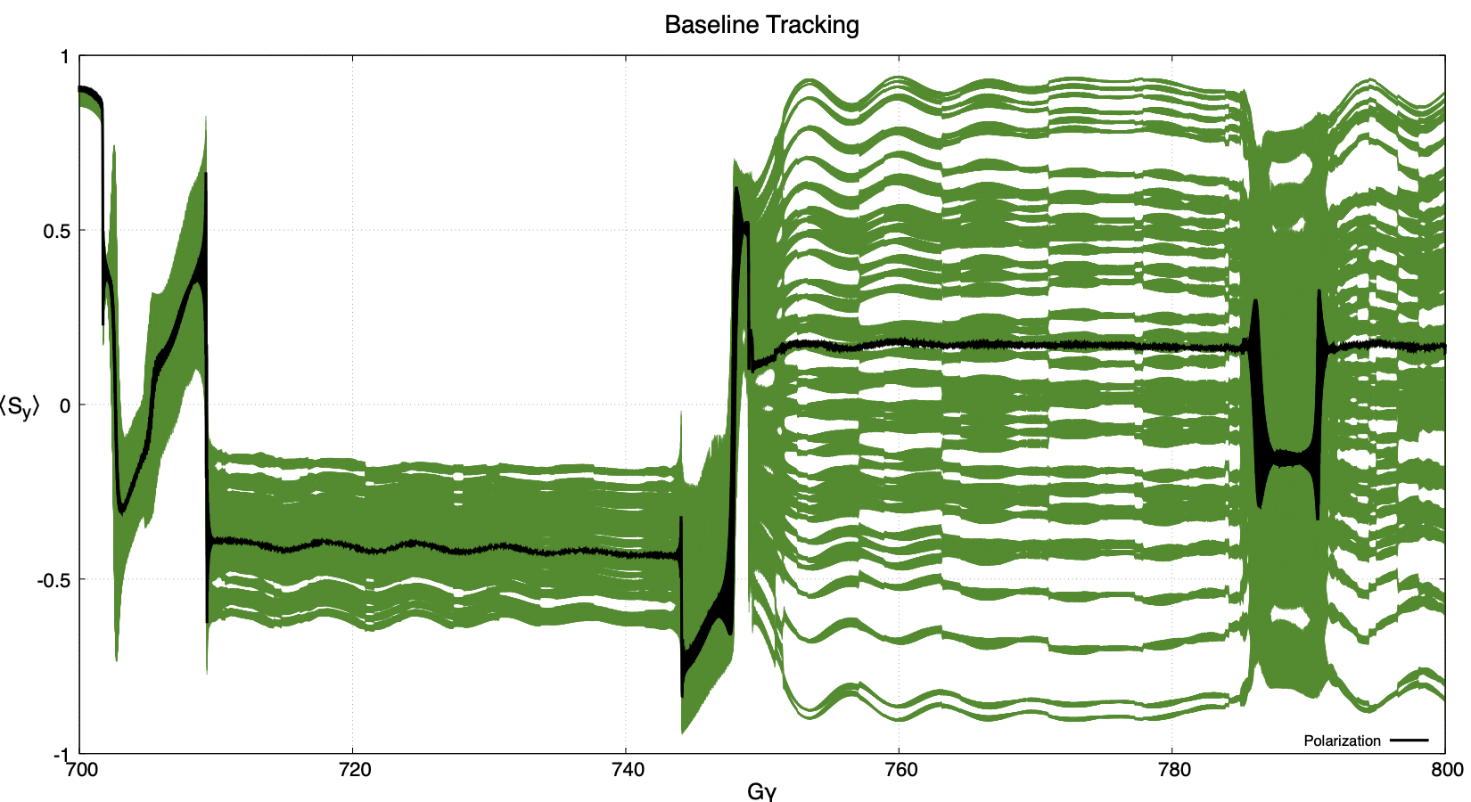

Hadron Storage Ring
“Un-cooled” $3He^{++}$ will really struggle at high energy with a simple-minded choice for snakes
Large-amplitude beam:
EPIOS 2026
Eiad Hamwi

Slide 16
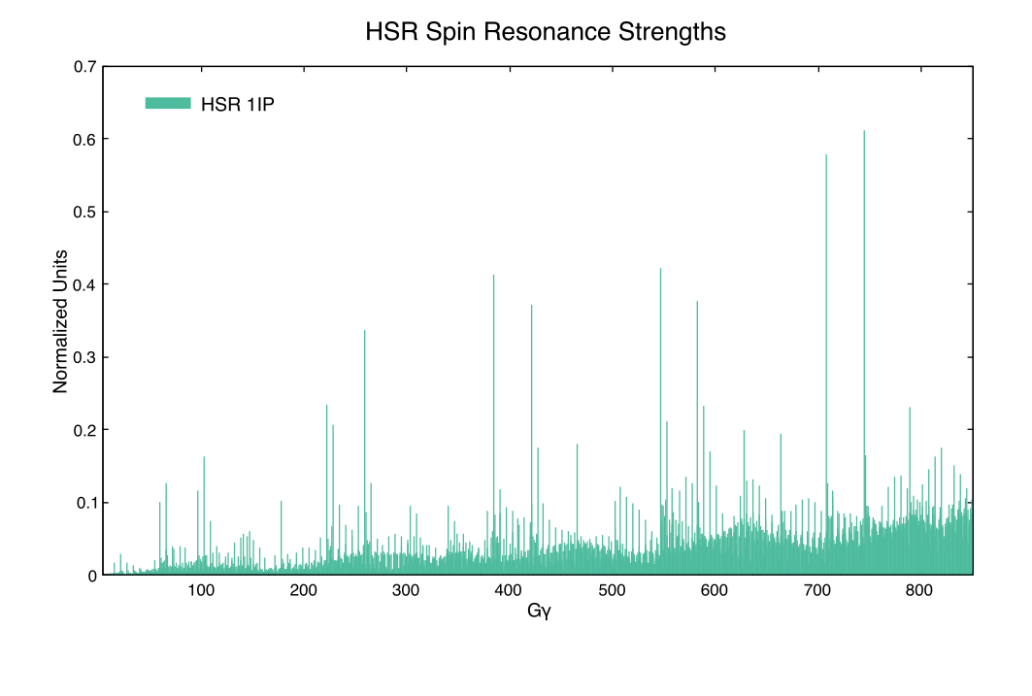
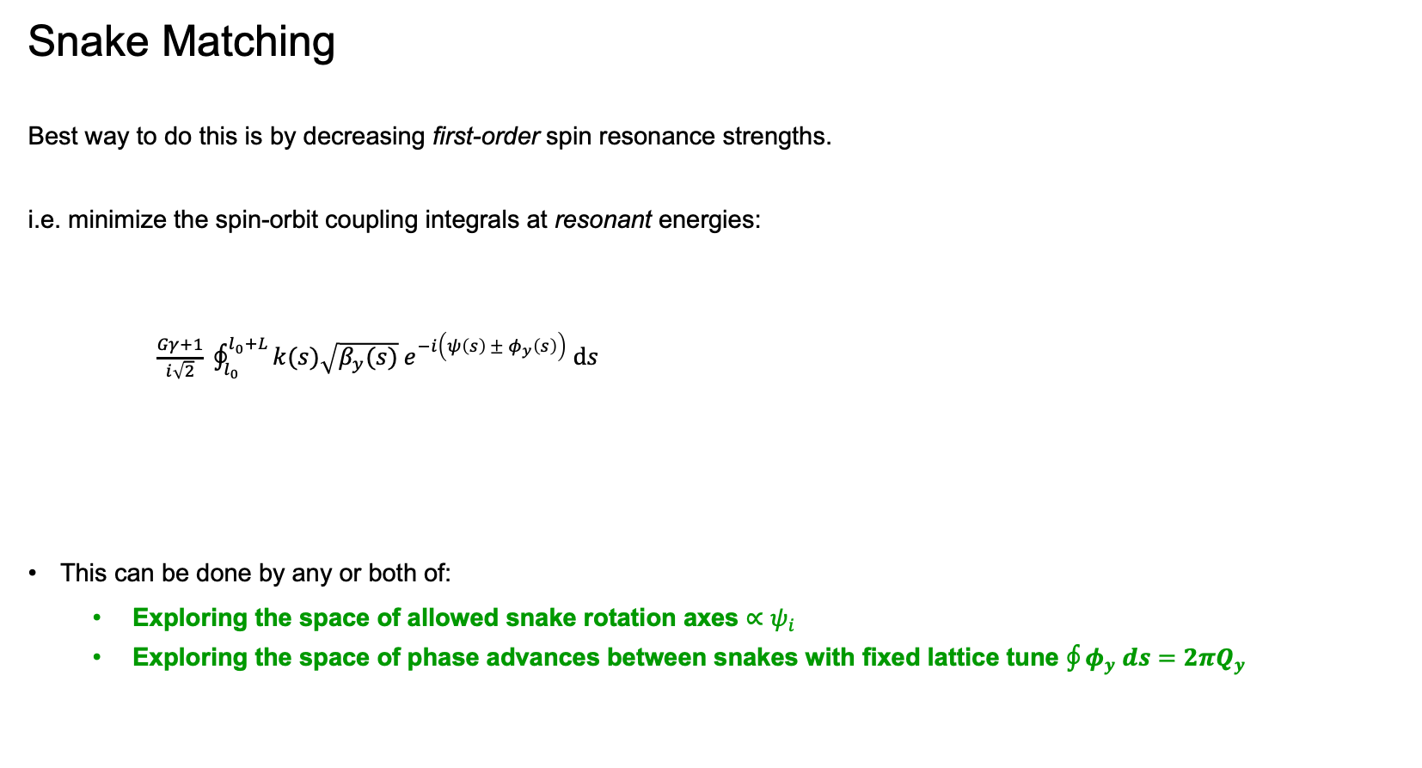
Hadron Storage Ring
Snake Matching
Best way to do this is by decreasing first-order spin resonance strengths.
i.e. minimize the spin-orbit coupling integrals at resonant energies:
$\frac{Gγ+1}{i\sqrt{2}} \oint_{l_{0}}^{l_{0}+L}{k(s)\sqrt{β_{y}(s)} e^{−i\left(ψ\left(s\right) ± φ_{y}\left(s\right)\right)} ds}$
This can be done by any or both of:
Exploring the space of allowed snake rotation axes $∝ψ_{i}$
Exploring the space of phase advances between snakes with fixed lattice tune $\oint{φ_{y} ds}=2πQ_{y}$
EPIOS 2026
Eiad Hamwi

Slide 17
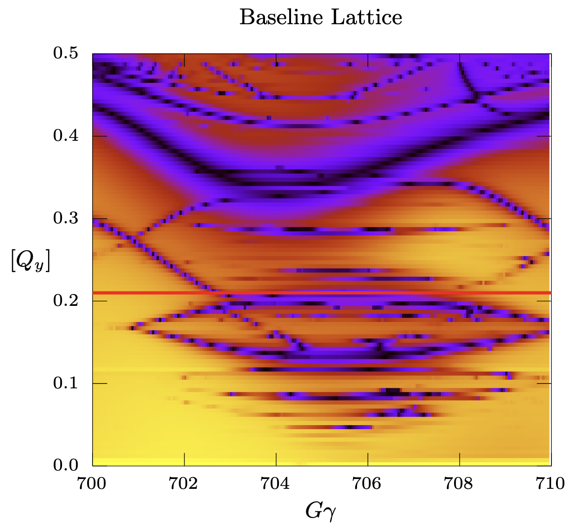
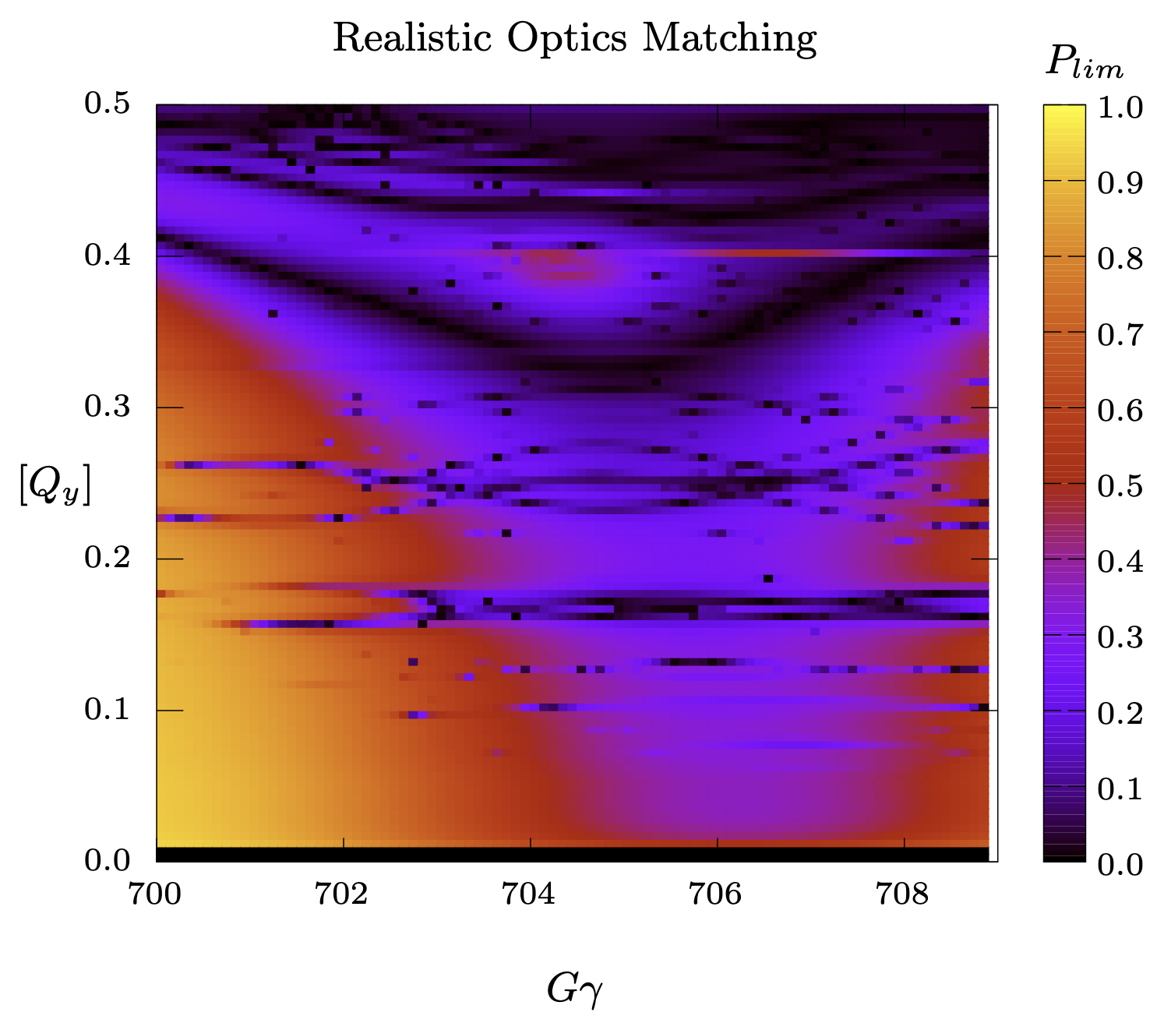

Hadron Storage Ring
Zoom in on one resonant region
Perform tune scan of $P_{lim⁡}$
Identify high-order “doublets”
Optimize “width” of resonant doublets
EPIOS 2026
Eiad Hamwi

Slide 18
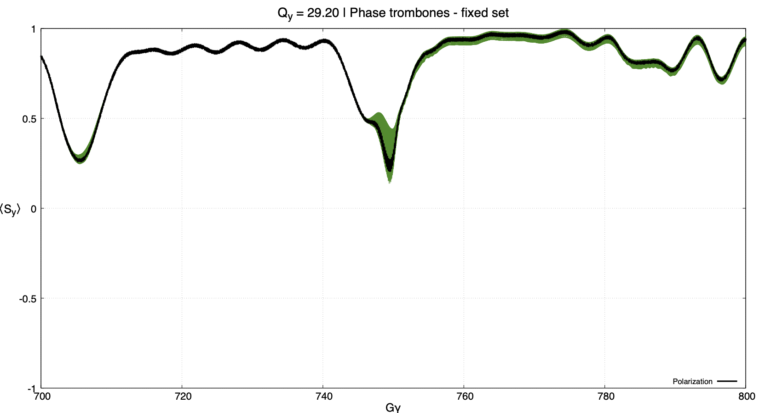
Hadron Storage Ring
After optimizing per-arc phase-advance:
EPIOS 2026
Eiad Hamwi

Slide 19
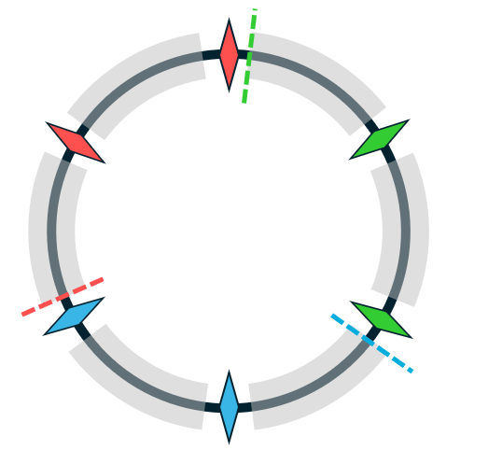
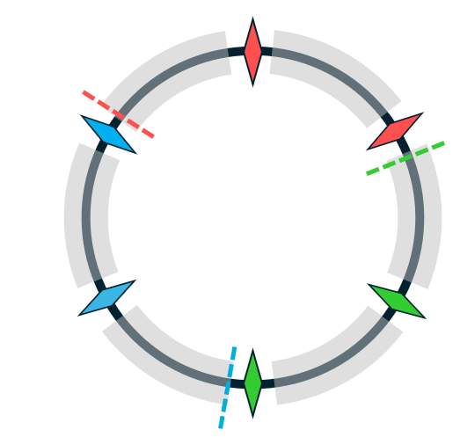

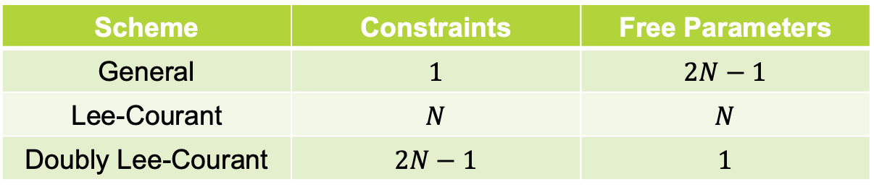
Hadron Storage Ring
$2N$ snakes offer strong degrees of freedom for polarization control
Doubly Lee-Courant
I hypothesized stronger performance from stronger symmetry
Only works for odd number of pairs of snakes
Scheme | Constraints | Free Parameters
General | $$1$$ | $$2N−1$$
Lee-Courant | $$N$$ | $$N$$
Doubly Lee-Courant | $$2N−1$$ | $$1$$
EPIOS 2026
Eiad Hamwi

Slide 20
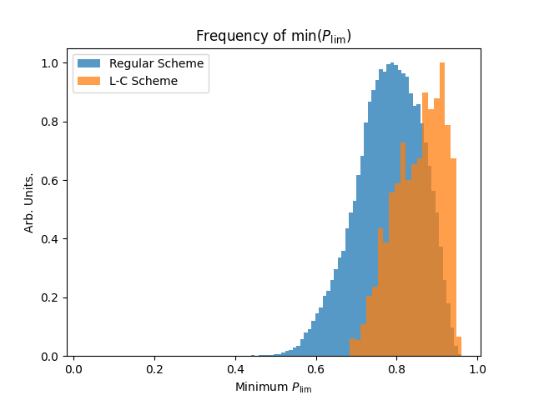
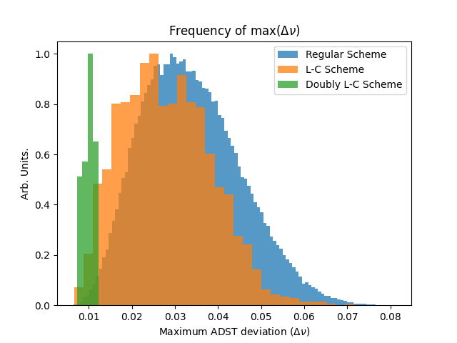
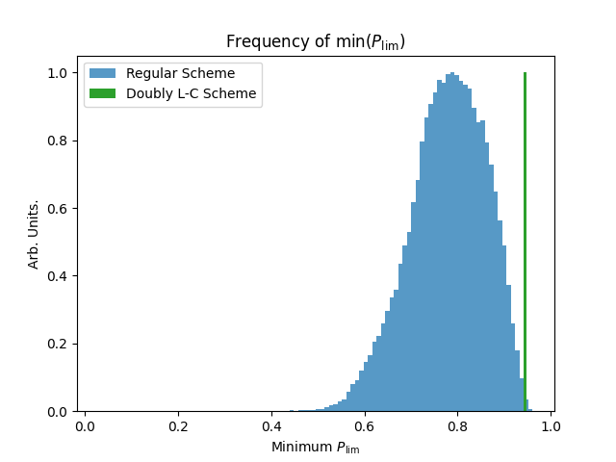
Hadron Storage Ring
“Doubly Lee-Courant” snake schemes
EPIOS 2026
Eiad Hamwi

Slide 21
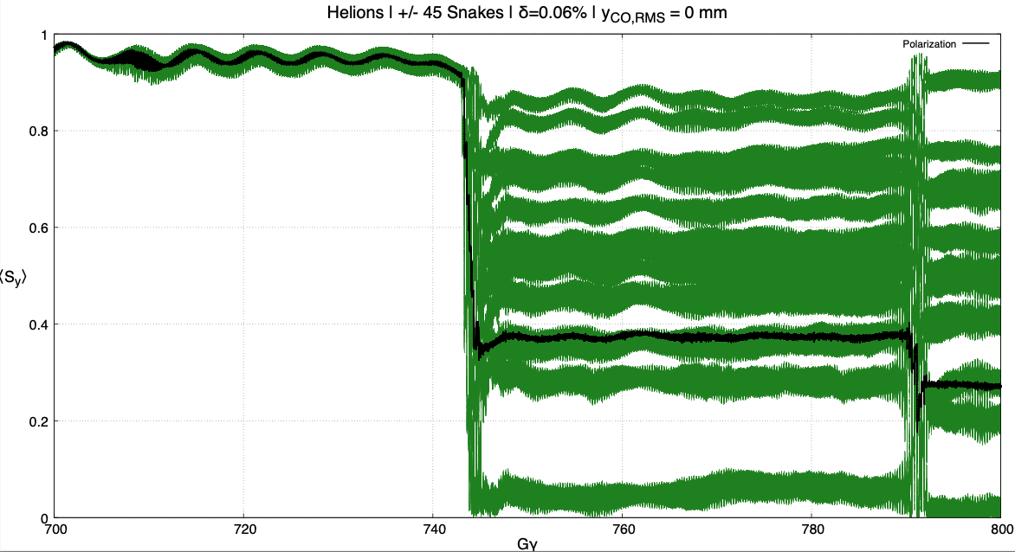


Hadron Storage Ring
Polarization transmission enhancement for large-amplitude pre-cooled bunch in high-energy optics lattice
All particles: $\left(J_{x}, J_{y}, \frac{dp}{p}\right)=(5.2 μm, 1.4 μm, 0.06\%)$
Old snakes $({45}^{∘}{−45}^{∘} {45}^{∘}{−45}^{∘} {45}^{∘} {−45}^{∘})$
EPIOS 2026
Eiad Hamwi

Slide 22
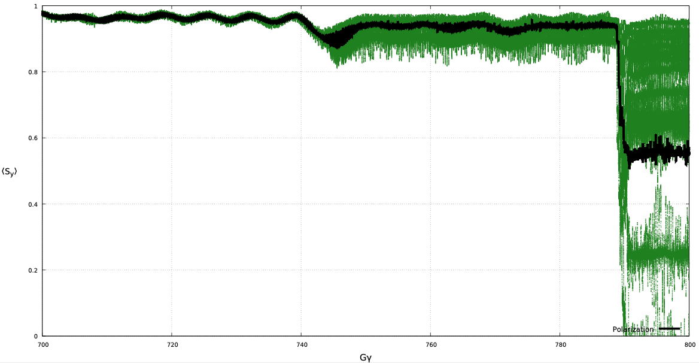
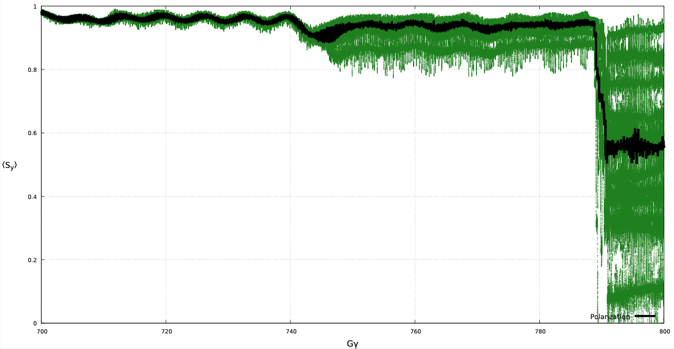
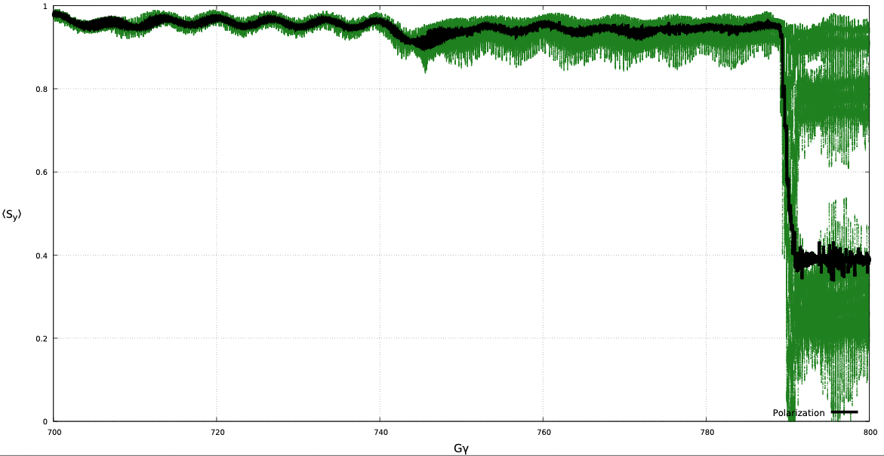
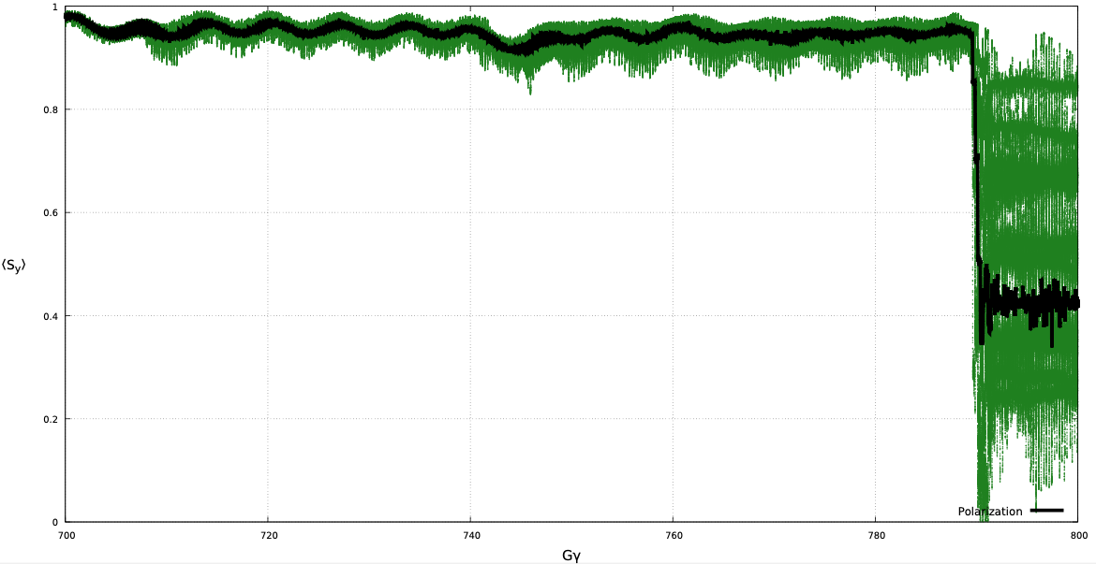
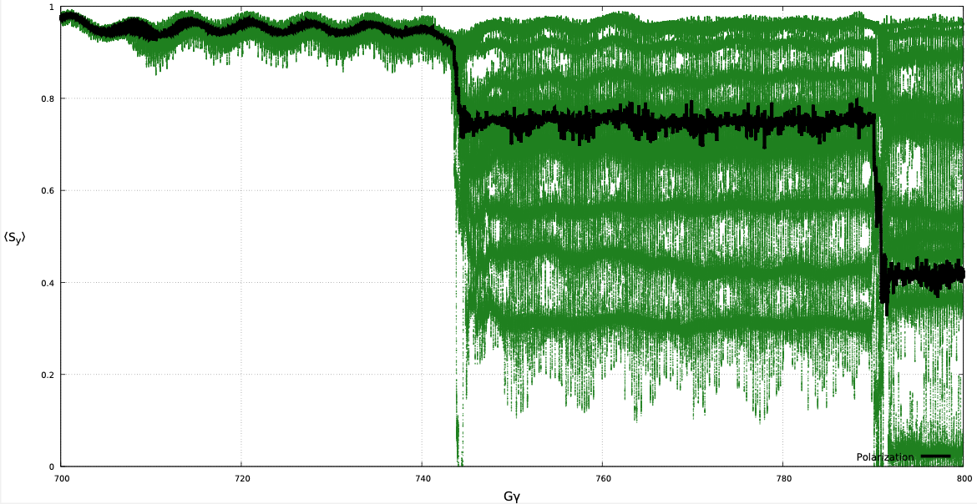
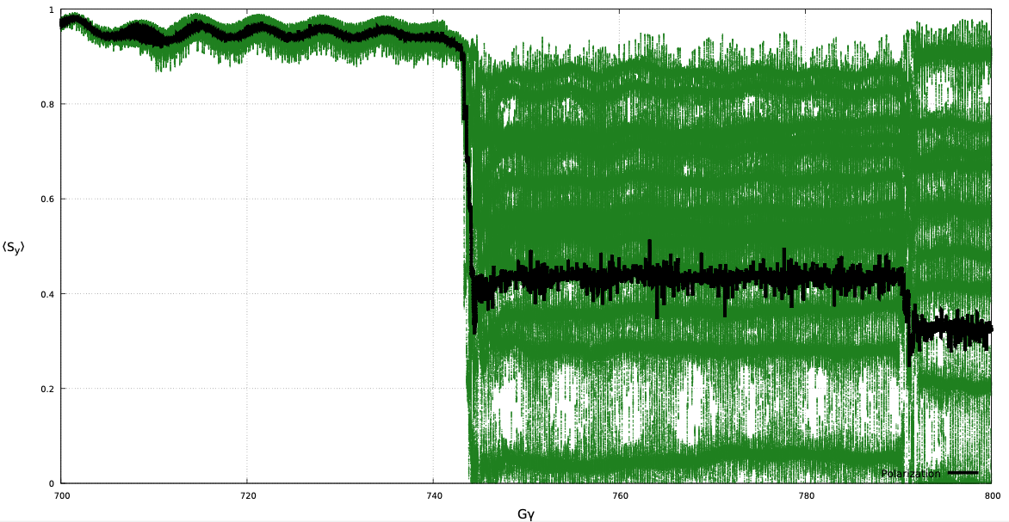
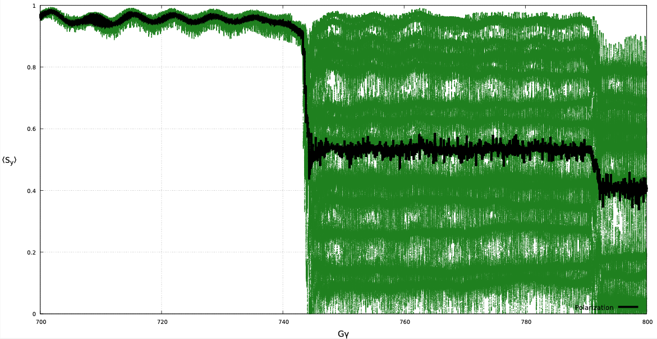
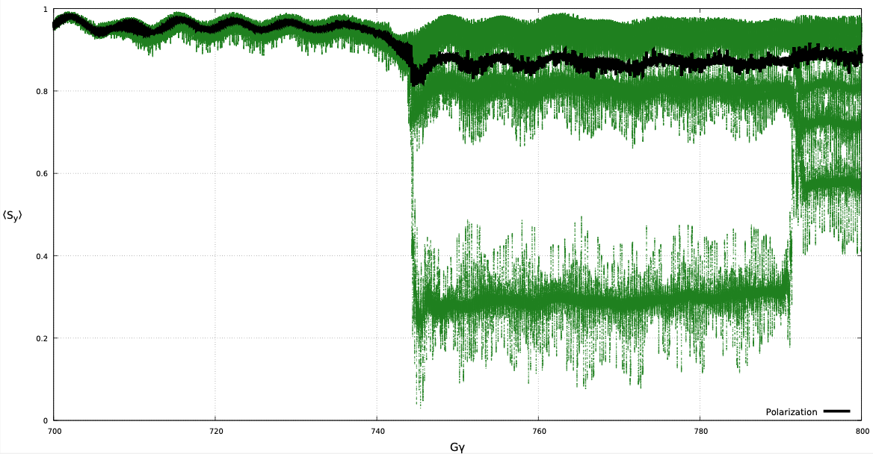
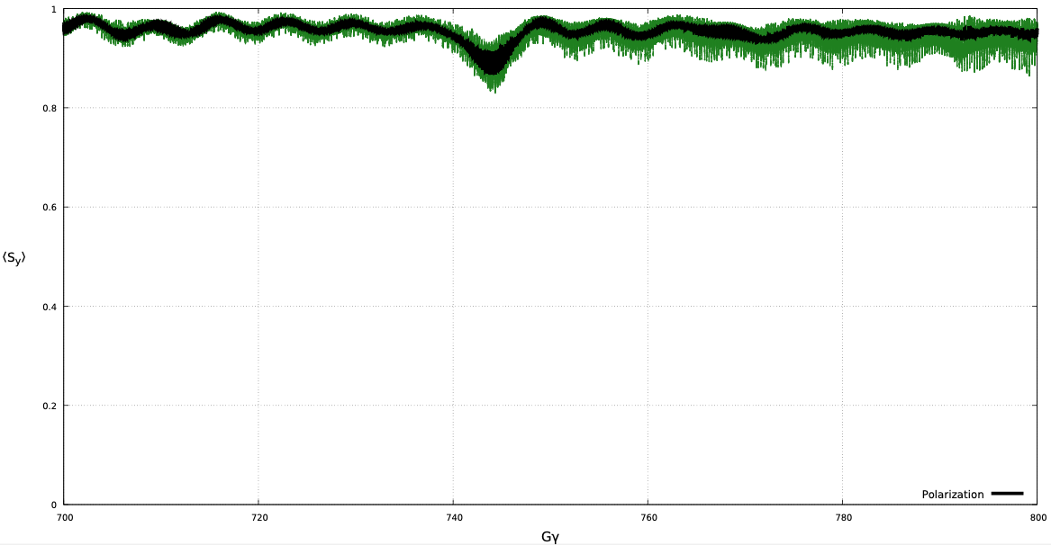
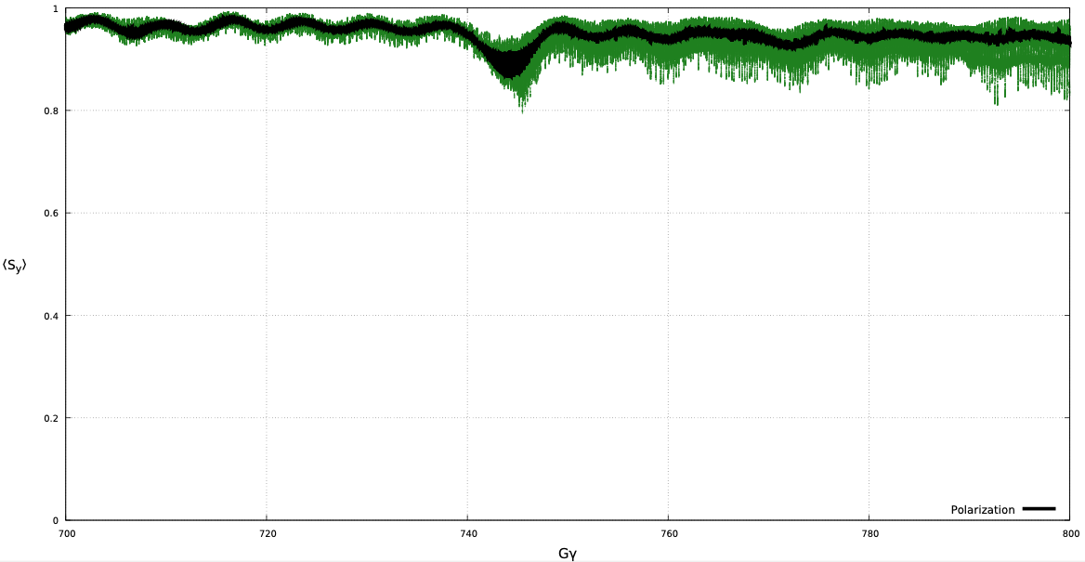
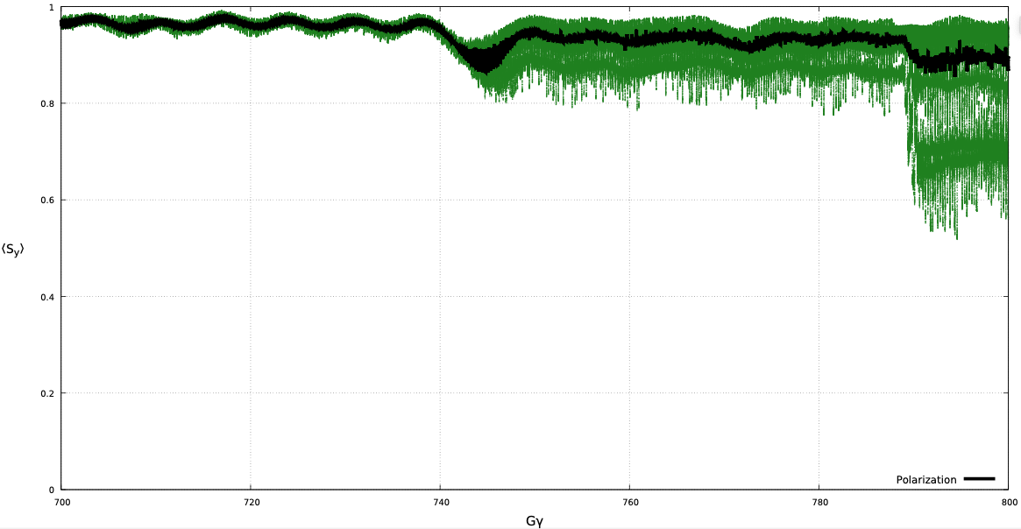
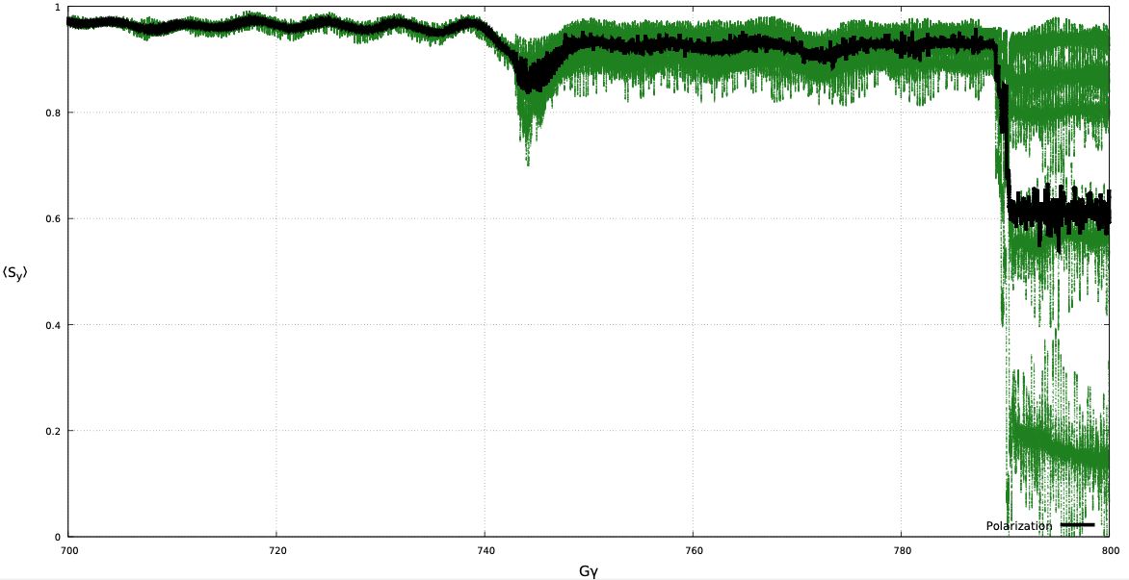













Hadron Storage Ring
$${−75}^{∘}$$
$${−60}^{∘}$$
$${−45}^{∘}$$
$${−30}^{∘}$$
$${−15}^{∘}$$
$$0^{∘}$$
$${15}^{∘}$$
$${30}^{∘}$$
$${45}^{∘}$$
$${60}^{∘}$$
$${75}^{∘}$$
$${90}^{∘}$$
$$ψ_{0}$$
EPIOS 2026
Eiad Hamwi

Slide 23

Hadron Storage Ring
After optimization of DLC axis:
New snakes $(90^{∘} 0^{∘} 90^{∘} 0^{∘} 90^{∘} 0^{∘})$
EPIOS 2026
Eiad Hamwi

Slide 24


Hadron Storage Ring
Protons $\left(100−160 GeV\right)$ with only four snakes, no misalignments:
Preliminary results with same lattice/beam
Note I used $$σ_{δ}=7⋅{10}^{−4}$$
Realistic value is
$$σ_{δ}=9⋅{10}^{−5}$$
EPIOS 2026
Eiad Hamwi

Slide 25
Summary
Mathematical theory and simulation tools are well-developed for optimizing spin polarization transmission in synchrotron storage rings
Six snakes offer maximum polarization survival and offer a unique geometric cancellation factor that is ideal for the HSR-symmetry
Proton polarization survival seems troubling with only four snakes
EPIOS 2026
Eiad Hamwi

Slide 26
Thank you! Questions?
EPIOS 2026
Eiad Hamwi

Slide 27
Invariant Tensor-Polarization Field
Spin-1 nuclei such as deuterons carry not only a rank-1 vector polarization, but also a rank-2 traceless tensor polarization.
The key point is that both vector and tensor components obeys the standard T-BMT precession. The tensor polarization evolve merely according to the rank-2 representation of the same transport equation.
Polarization loss is derived from the same resonance conditions but is quadratic in vector polarization loss.
EPIOS 2026
Eiad Hamwi

