Slide 1
EIC Software Town Hall & Fun4All Basics
TK Hemmick

Slide 2
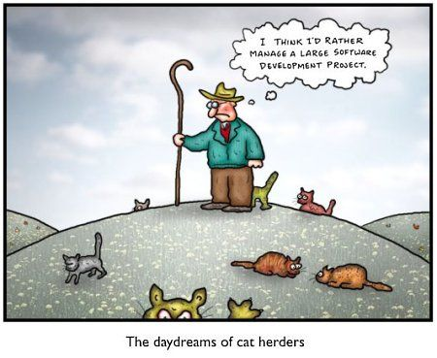
Why a Town Hall?
All large experiments build computing infrastructures.
These are typically built in advance by a team of brilliant professionals with specific visions for the goals.
Success is eventually measured by productivity of the collaboration:
Rapid development of new analysis code.
Intrinsically low maintenance for the core team.
Intrinsically low maintenance for the users.
Avoids pitfalls that can lead to wrong results or retractions.
The “cat herding” analogy is apropos:
Success is from understanding the cat, not understanding “herding”
EIC “cats” have been raised in varied environments.
Today is about hearing from the cats.
To herd the cats, the cats must be heard.
Don’t be offended when I state the obvious.
I’m just a cat, not a critic.

Slide 3

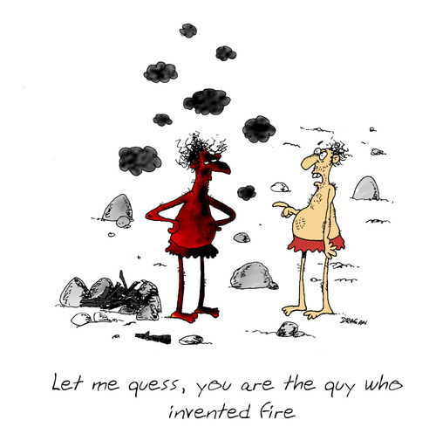
A Remark about my Opinions
This cat has opinions
Some of them are likely wrong.
All of them are:
Deeply considered
Evidence based
Evolving from personal experience of very successful and very unsuccessful paradigms applied to large collaborations.
I promise to:
Not be a fanboy of any particular existing code.
Not be a critic of any particular existing code.
Not hold back on which principles I consider productive or counter-productive.
Avoid “Not Invented Here”.
Try to define the likes of one of our cats.

Slide 4

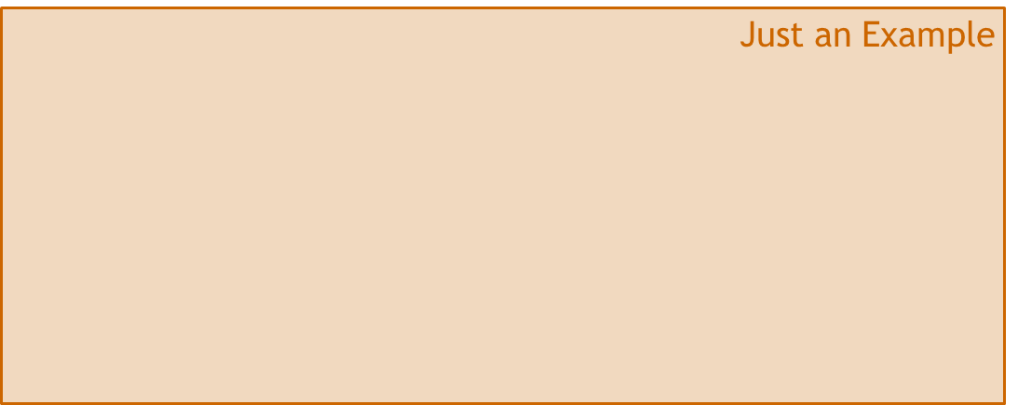
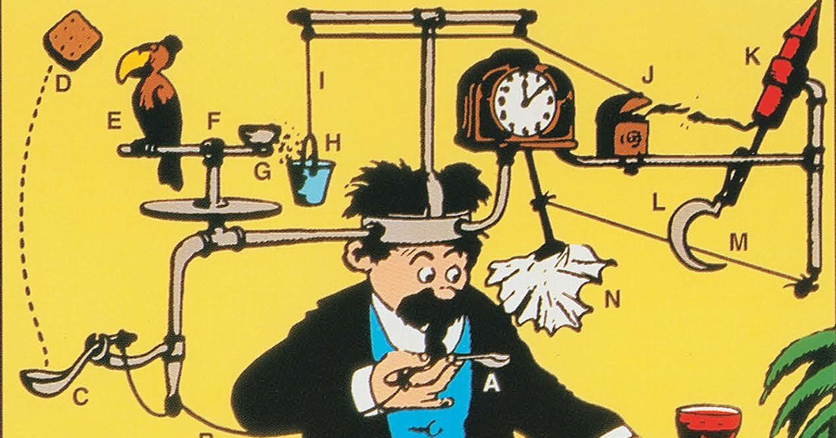

Presentation Format
Examples are the classic way to illustrate and clarify a point.
Examples are often mistaken for edicts.
Warning Label Strategy:
An Example Implementation
A general principle

Slide 5

Social Engineering vs. “Dumb It Down”
To my experience, a rapid development and low maintenance code base is not the result of a “dumb it down” campaign to make the user interface easier to understand.
Rather, rapid development and low maintenance is achieved by understanding the social engineering aspects of the code base and finding ways to adapt to the patterns of physicist developers.
Physicists as a user base are among the worst:
Smart
Hard working
Egotistical
Favor results over elegance.
Favor results over maintenance.
Not always experienced in code development.
In my opinion, they must be isolated from one another to limit their ability to do damage to themselves and their colleagues.

Slide 6

Isolation-1
No file should require editing by more than one user:
Ordinary users never change a line in the core code.
Users never change lines in each others code.
The only 100% effective rule enforcer is the compiler.
A module base class can effectively isolate each user’s code:
The five basic calls (FBC) to make a module:
At the beginning of the analysis.
Each time a new run number begins.
Each time a new event is present in memory.
Each time a run ends.
At the very end of the analysis.
The user can ONLY see data if they inherit this interface.
The core code knows ZERO about the details or existence of ANY modules; the core code knows only the base class for modules.

Slide 7
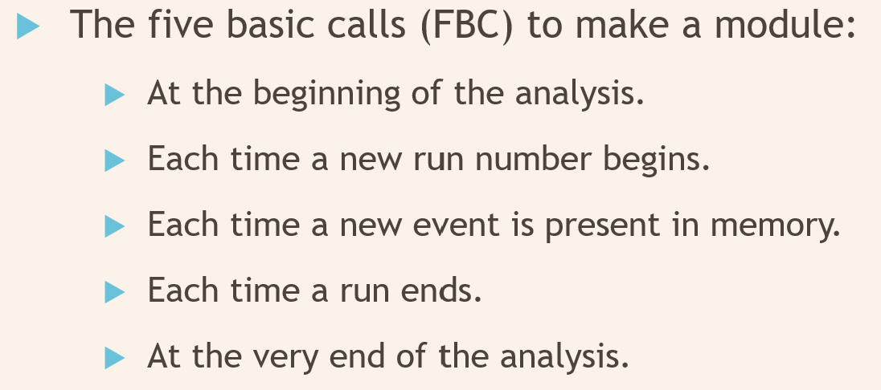
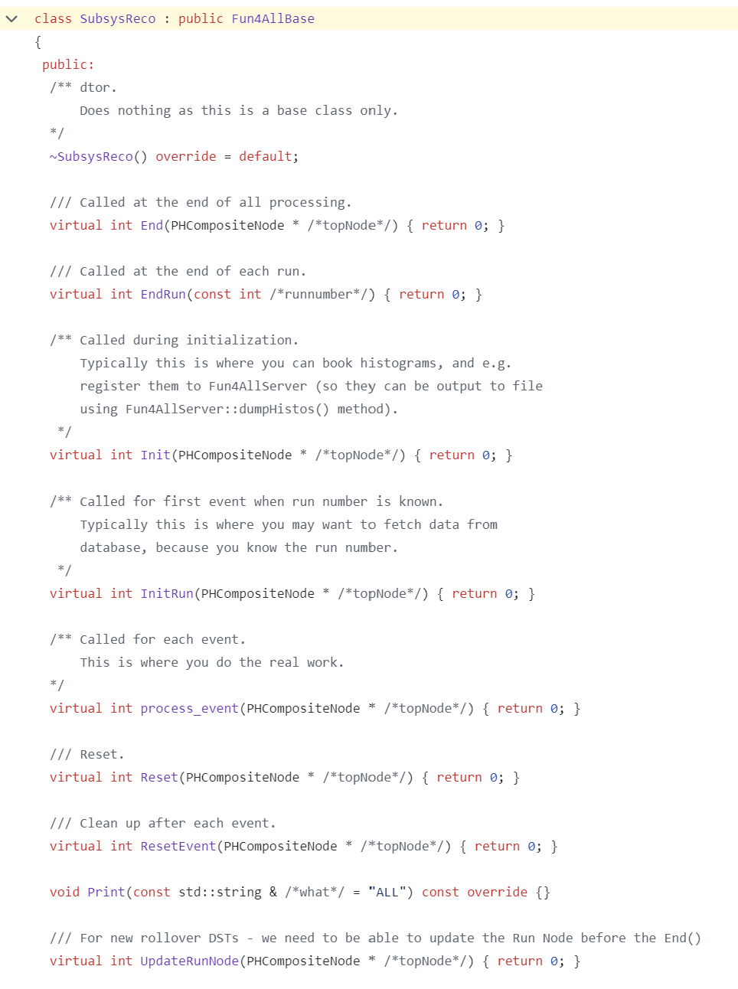
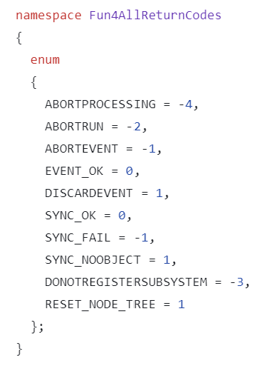
Isolation-1 Implementation!
1
2
3
5
4
4
5
Notice that you can play with the module execution using return codes.
Meh code:
TpcReco *tpc = new TpcReco();
tpc->Something_Only_Tpcs_Do(WTF);
se->registerSubsystem( tpc );
Good Code (Polymorphism):
SubsysReco *tpc = new TpcReco();
se->registerSubsystem( tpc );
Best Code (IMO):
se->registerSubsystem( new TpcReco() );
1
2
3
3a

Slide 8
Isolation-2
Common code base
Un-adulterated root
blah.so
blah.so
User working in isolation
plain root distribution
blah.so
blah.so
$LD_LIBRARY_PATH
blah.so
OneModule.so
blah.so
blah.so
blah.so
blah.so
Encouragement by example that one or few modules:
Reside in a particular directory.
Make their own *.so
Load shared objects at run time.
Assists dramatically the rapid development goal
I only recompile a tiny bit of the code.
I load main library for everything except my local development lib.
Development cycle is fast:
Edit/compile/try/repeat
My personal ideal is that root remains “as distributed” and ALL the experiment code base is loaded at runtime.
Works robustly with 100s of users coding simultaneously, so long as their contribution is fully isolated.

Slide 9

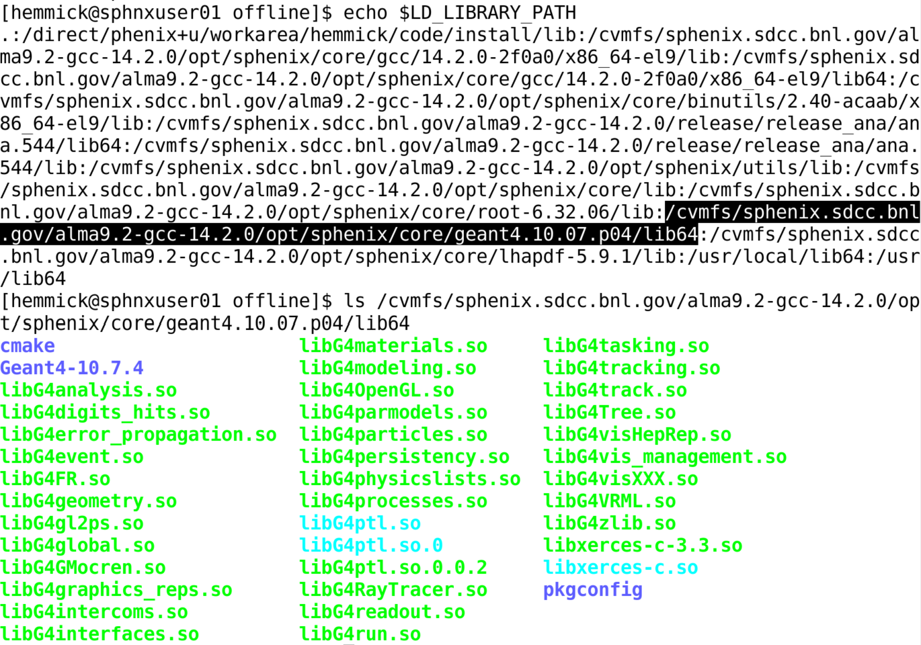
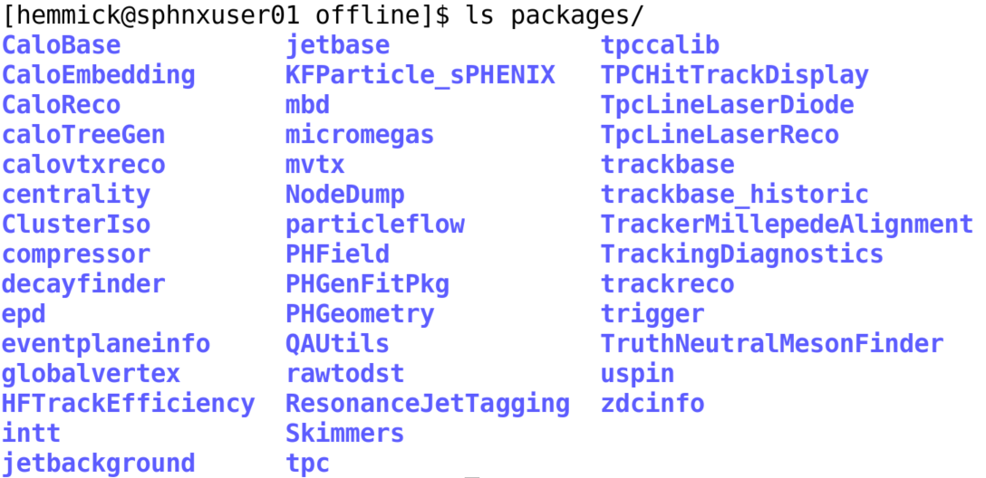
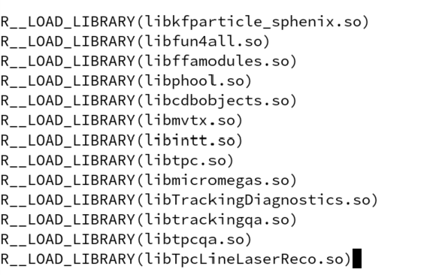
Isolation-2 Implementation!
$LD_LIBRARY_PATH is List of directories to find libraries
Beautiful
Pretty
WTF
Nominally:
Each of the bottom directories makes one *.so
Each directory kind of belongs to “one subsystem”.
Rule of Thumb:
Only the compiler is effective at enforcing standards.
One such directory full of Blah.so
Adding Blah.so to root

Slide 10
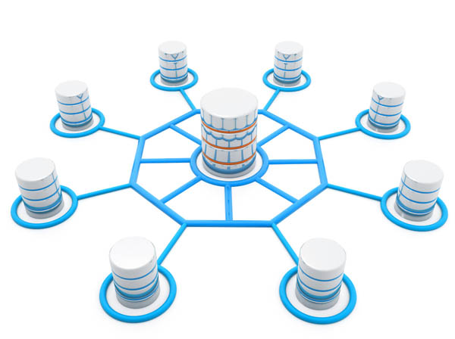
Resources Available to User Code
Zeroeth Approximation:
Each FBC code serves to find data (raw and processed by other FBCs).
Each FBC code might produce data for subsequent FBC codes.
An elegant solution (IMO)
A “repository-like” space (i.e. available memory) is provided.
Instantiated FBCs should “find” or “attach” to the same repository.
I personally like singletons for this kind of operation:
Repository *repo = Repository::instance();
Note that this is different from fun4all (where server owns repository).
This is the style I have used in all my test beam analysis framework efforts.
Whatevs…
SEVERAL CONCEPTS HERE!!!
Singleton Factory
Linked List
Polymorphism

Slide 11
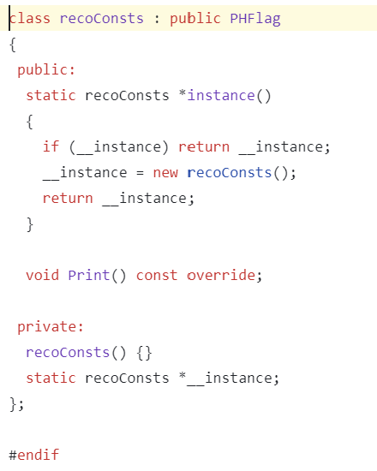

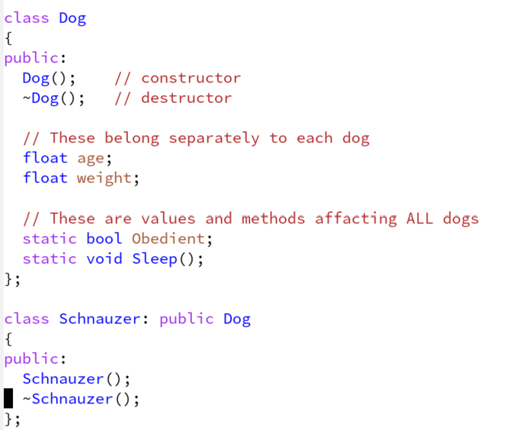
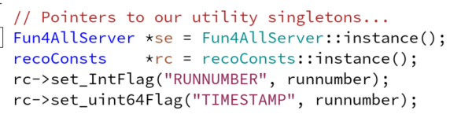
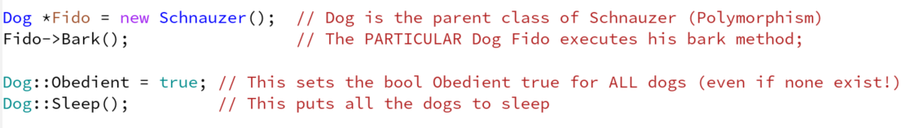
Singleton Factory
Fun4AllServer
“Framework” pointer
Used to “find” data.
recoConsts:
Parameter passer
WTF?!? The constructor is private!
The ONLY public thing is a method.
If none make “the one”.
Return a pointer to “the one”
Schnauzer is a type of dog.
As a dog it has its own age and weight
All dogs share the value Obedient
All dogs share the method Sleep
Even if there are no dogs!

Slide 12
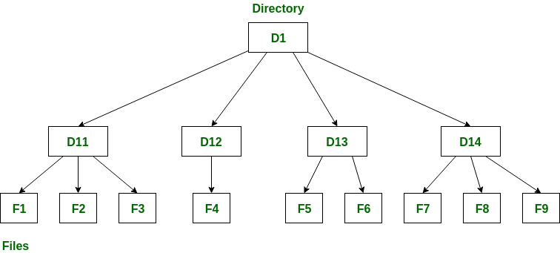
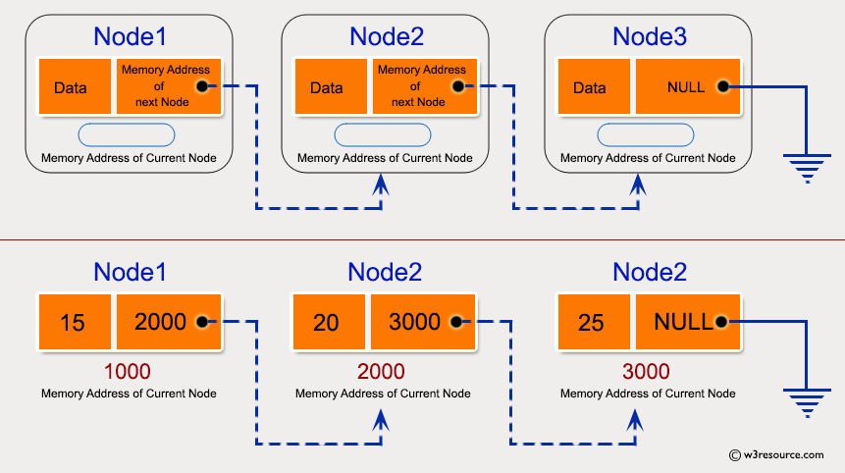
The “Repository” implemented as a Linked List Tree
A 1-Dimensional Linked List
Familiar way to organize data on disk
“Directory” → PHCompositeNode
“File” → PHDataNode (or) “File” → PHIODataNode
PHDataNode shall not be placed in output.
PHIODataNode may be placed in output (if you want)
How to code “directory” that grows as needed?
Make all entities inherit from a common base class.
Implement a “Linked List” architecture.
In the simple example a Node contains
An INT (which is its data)
A pointer (to the next item)
A PHCompositeNode has:
A name (string, try to be unique for sanity)
A list of pointers to other nodes.
A PHDataNode has:
A name
A pointer to a single PHObject (base class!)
The object is most often a container!

Slide 13
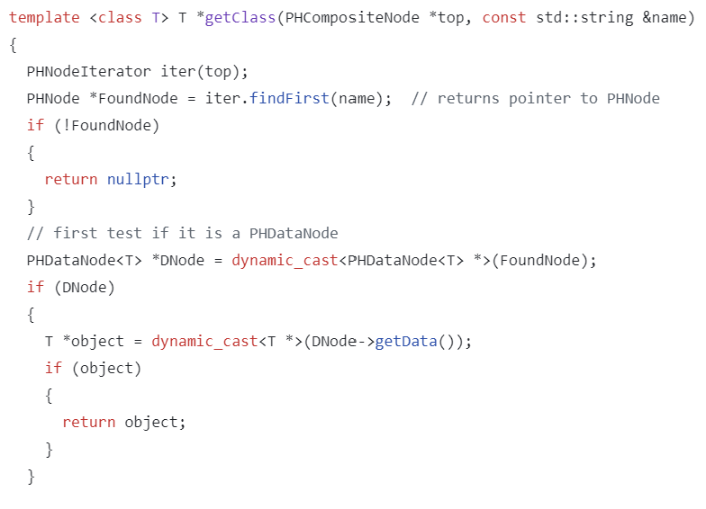
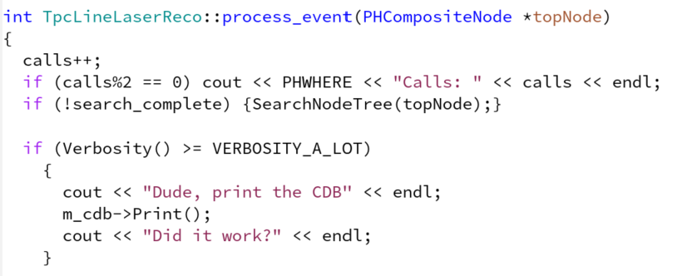
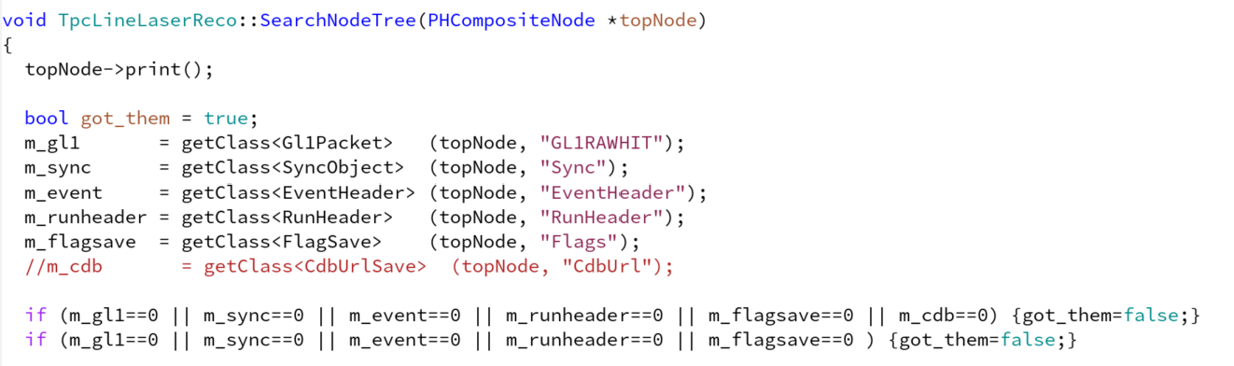
How to find “stuff” already in the Node Tree
Fun4All calls me each event
The node tree is passed as an argument
1
2
3
Nodes don’t move, so I find them once.
3
1
2
getClass is a template class:
Searches in tree
For a node named
Casts the result into type
1
2
3

Slide 14
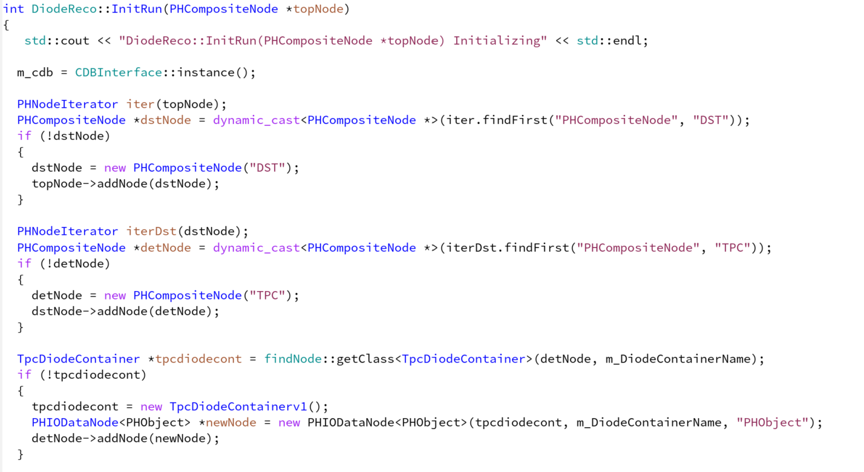
How to put “stuff” into the Node Tree
NOTE:
Versioning is mentioned here.
This is a high-level concept.
We’ll deal with that on a later slide.
1
2
3
4
5
6
7
8
1-2 Find the DIRECTORY “DST” in topNode (if not found make it).
3-4 Find the DIRECTORY “TPC” in DST (if not found make it).
5,6,7,8 Find the DATA “TpcDiodeContainer” in TPC
If not found made a “v1” version of the container.
Make a PHIODataNode that has the diode container as its “contents”
Add this node to the TPC directory on the Node Tree.

Slide 15

“Repository” Comments
Fun4all contains a “node tree”:
Linked list of containers inheriting from a common class…accessed by “name”.
Examples of elegant and horrible containers existed (discussed next).
Containers have streamers!
Any and all containers in a repository can stream to/from a file.
Your code does not know history of data…merely its existence in memory.
“Industrial strength”
Frodo (offline package for my RICH R&D)
Frodo is just a small repository of containers.
Frodo does not control the event loop.
Quick & dirty, but very effective.
Details of repository are irrelevant.
Relevant features include:
Vital part of the isolation paradigm.
Code insensitive to how the repository was filled (live or fetched from disk)
Adding streamers to container base class permanently solves io problems.

Slide 16

Schema Evolution
Experiments evolve over time (upgrades etc).
The data file contents evolve over time.
Can code written in 2021 run on every datafile recorded since 2000?
Sure, if you installed a robust schema evolution mechanism into your container classes!
PHENIX: Every nightly rebuild checks code efficacy on example raw data files from every run.
BUT(!!!) the original containers grew into ugly code.
PHENIX:
Each of the MANY container classes scheme evolved following the paradigm of the commercial company “Objectivity”.
The most popular containers evolved through “too many” versions (dozens in one case).
sPHENIX:
Simplified universal container class.
A few users required “tough love” to give up on their desire to proliferate containers.
Probably saves years of effort, but clever cats CAN still probably gum up the works.

Slide 17

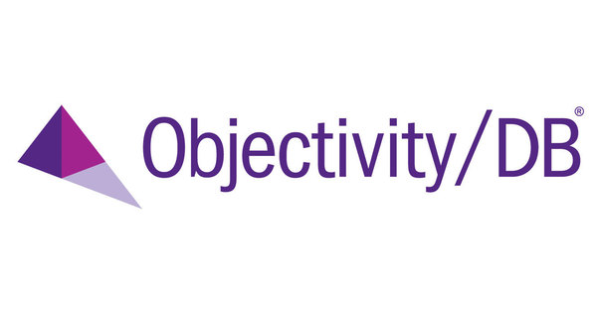
sPHENIX Schema Evolution
Ewww…
Nobody likes this until AFTER it saves your analysis.
Question #1: Wouldn’t it be nice to save OBJECTS into files? (members and methods)
Question #2: What if the newer objects in the files differ from the older ones:
PHENIX stored central arm tracks in files (aka CNT).
Originally there was no TOF-WEST so the tracks could not offer that info.
Later there was TOF-WEST and so the info MUST be offered on the tracks.
How can one code read both files???
Answer: Solved by “Objectivity” company (design copied by PHENIX)
Make a non-versioned “base class” that contains every value over history.
Implement the base class to return an error message for EVERY field: “That information is not found in this version”
Make derived classes:
v1 overrides the error message with data for every field it has.
v2 overrides the error message with data for every field it has.
End user retrieves data as BASE CLASS:
Values for real stuff.
Error messages for missing stuff.
Created As Versioned Class
Found by Base Class

Slide 18
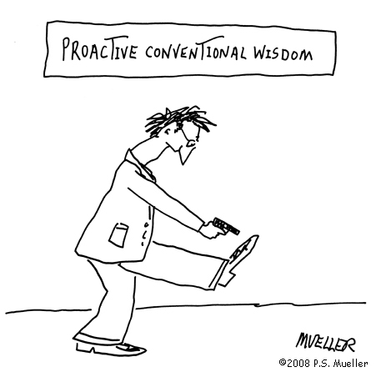
Random Comments
Capitalization Conventions are a good thing.
Not encouraged or enforced in PHENIX.
You spend a LOT of time reading the header files of your colleagues.
Taxi rules help code validity and archiving.
petaBytes of data don’t fit on disk at RCF.
Staging data is a major consideration:
Taxi riders collected along with requests for necessary subset of data.
Data staged via “live resource availability” (ordered tape access; available local drives)
Jobs send to the data rather than data sent to the jobs.
Every taxi rider must present valgrind validation of their code to ride on the taxi and the code must be in the archive (not your private directory).
Recalibration is applied to data passes by default.
Some calibrations can only be applied at reconstruction.
Many calibrations can be “tweaked” after reconstruction.
“MasterRecalibrator” collects the best–known fixes and requires effort to turn off
Can be a useful place for “service work”.

Slide 19
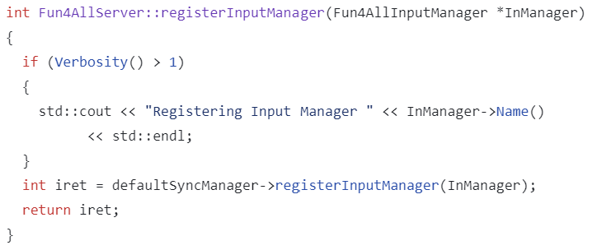
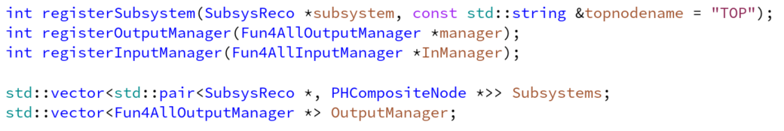
Fun4All Overview
Input Must Be “Synchronized”
Selected Lines from Fun4AllServer
Fun4All is a Singleton Factory (there can be only one) with main tasks:
It should read SYNCHRONIZED input data to the Node Tree from one or many sources.
It should hand the Node to tree to one of many SubsysReco modules.
It should stream data out from the Node Tree to one or many output files.
Your analysis macro does this:
Makes and registers a list of InputManagers to get the data you need.
Makes and registers a list of analysis modules (standard and personal!)
Makes and registers a list of OutputManagers.
Note: Output managers have abilities to be TUNED to your needs.

Slide 20
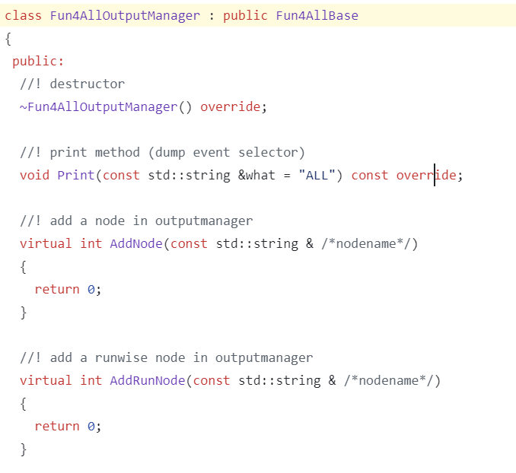
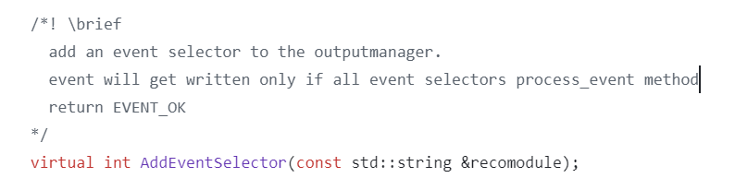
Advanced use of an Output Manager
Add an Event-by-Event PHIODataNode to the list
Add a Run-by-Run PHIODataNode to the list
Add a SubsysReco name (your module) to decide if the output shall be written.
This will allow one to make a filtered file.
This is in response to Mariia: “If we gave a macro to get Laser Flash events I’m sure they would run it.”

Slide 21
How to filter the laser flash events
Write a SubsysReco that:
Makes a SECOND copy of the TpcRawData container in the node tree.
Under a new name!!
During process_event() this one should:
Loop over the original raw data.
Copy the hit to the output container IF it matches the laser timing window.
Write a SubsysReco that:
Looks at the existing output deciding if this is a laser event.
Returns YES to the output manager if it is, NO if it is not.
Test and make analysis request.

Slide 22

Summary
Isolation
By design, no two physicists need edit the same file.
Base class (FBC) for module decouples people’s efforts.
Rapid development cycle
Loading code by shared object isolates and accelerates development
Context Independence
Well written “repository” with streaming-capable container classes.
Eliminates efforts for future io development.
Code reuse in different environments (monitoring, calibration, reconstruction, analysis)
Freedom for reconstruction/analysis cycles (no fixed epoch to permanent storage implied).
Schema Evolution
DO NOT(!!!) copy the PHENIX schema-evolved container classes.
DO take a serious look at the sPHENIX universal container classes.
Best practices:
Naming conventions, code validation, recalibration unification.

Slide 23
Fun4All Basics

