Slide 1
Neural Compression for sPHENIX TPC Data
By Yi Huang, Yihui Ren, Shinjae Yoo, Jin Huang
Speaker: Yi Huang
MENU2026 at Stony Brook University
10/26/2026

Slide 2
The sPHENIX Experiment

Slide 3
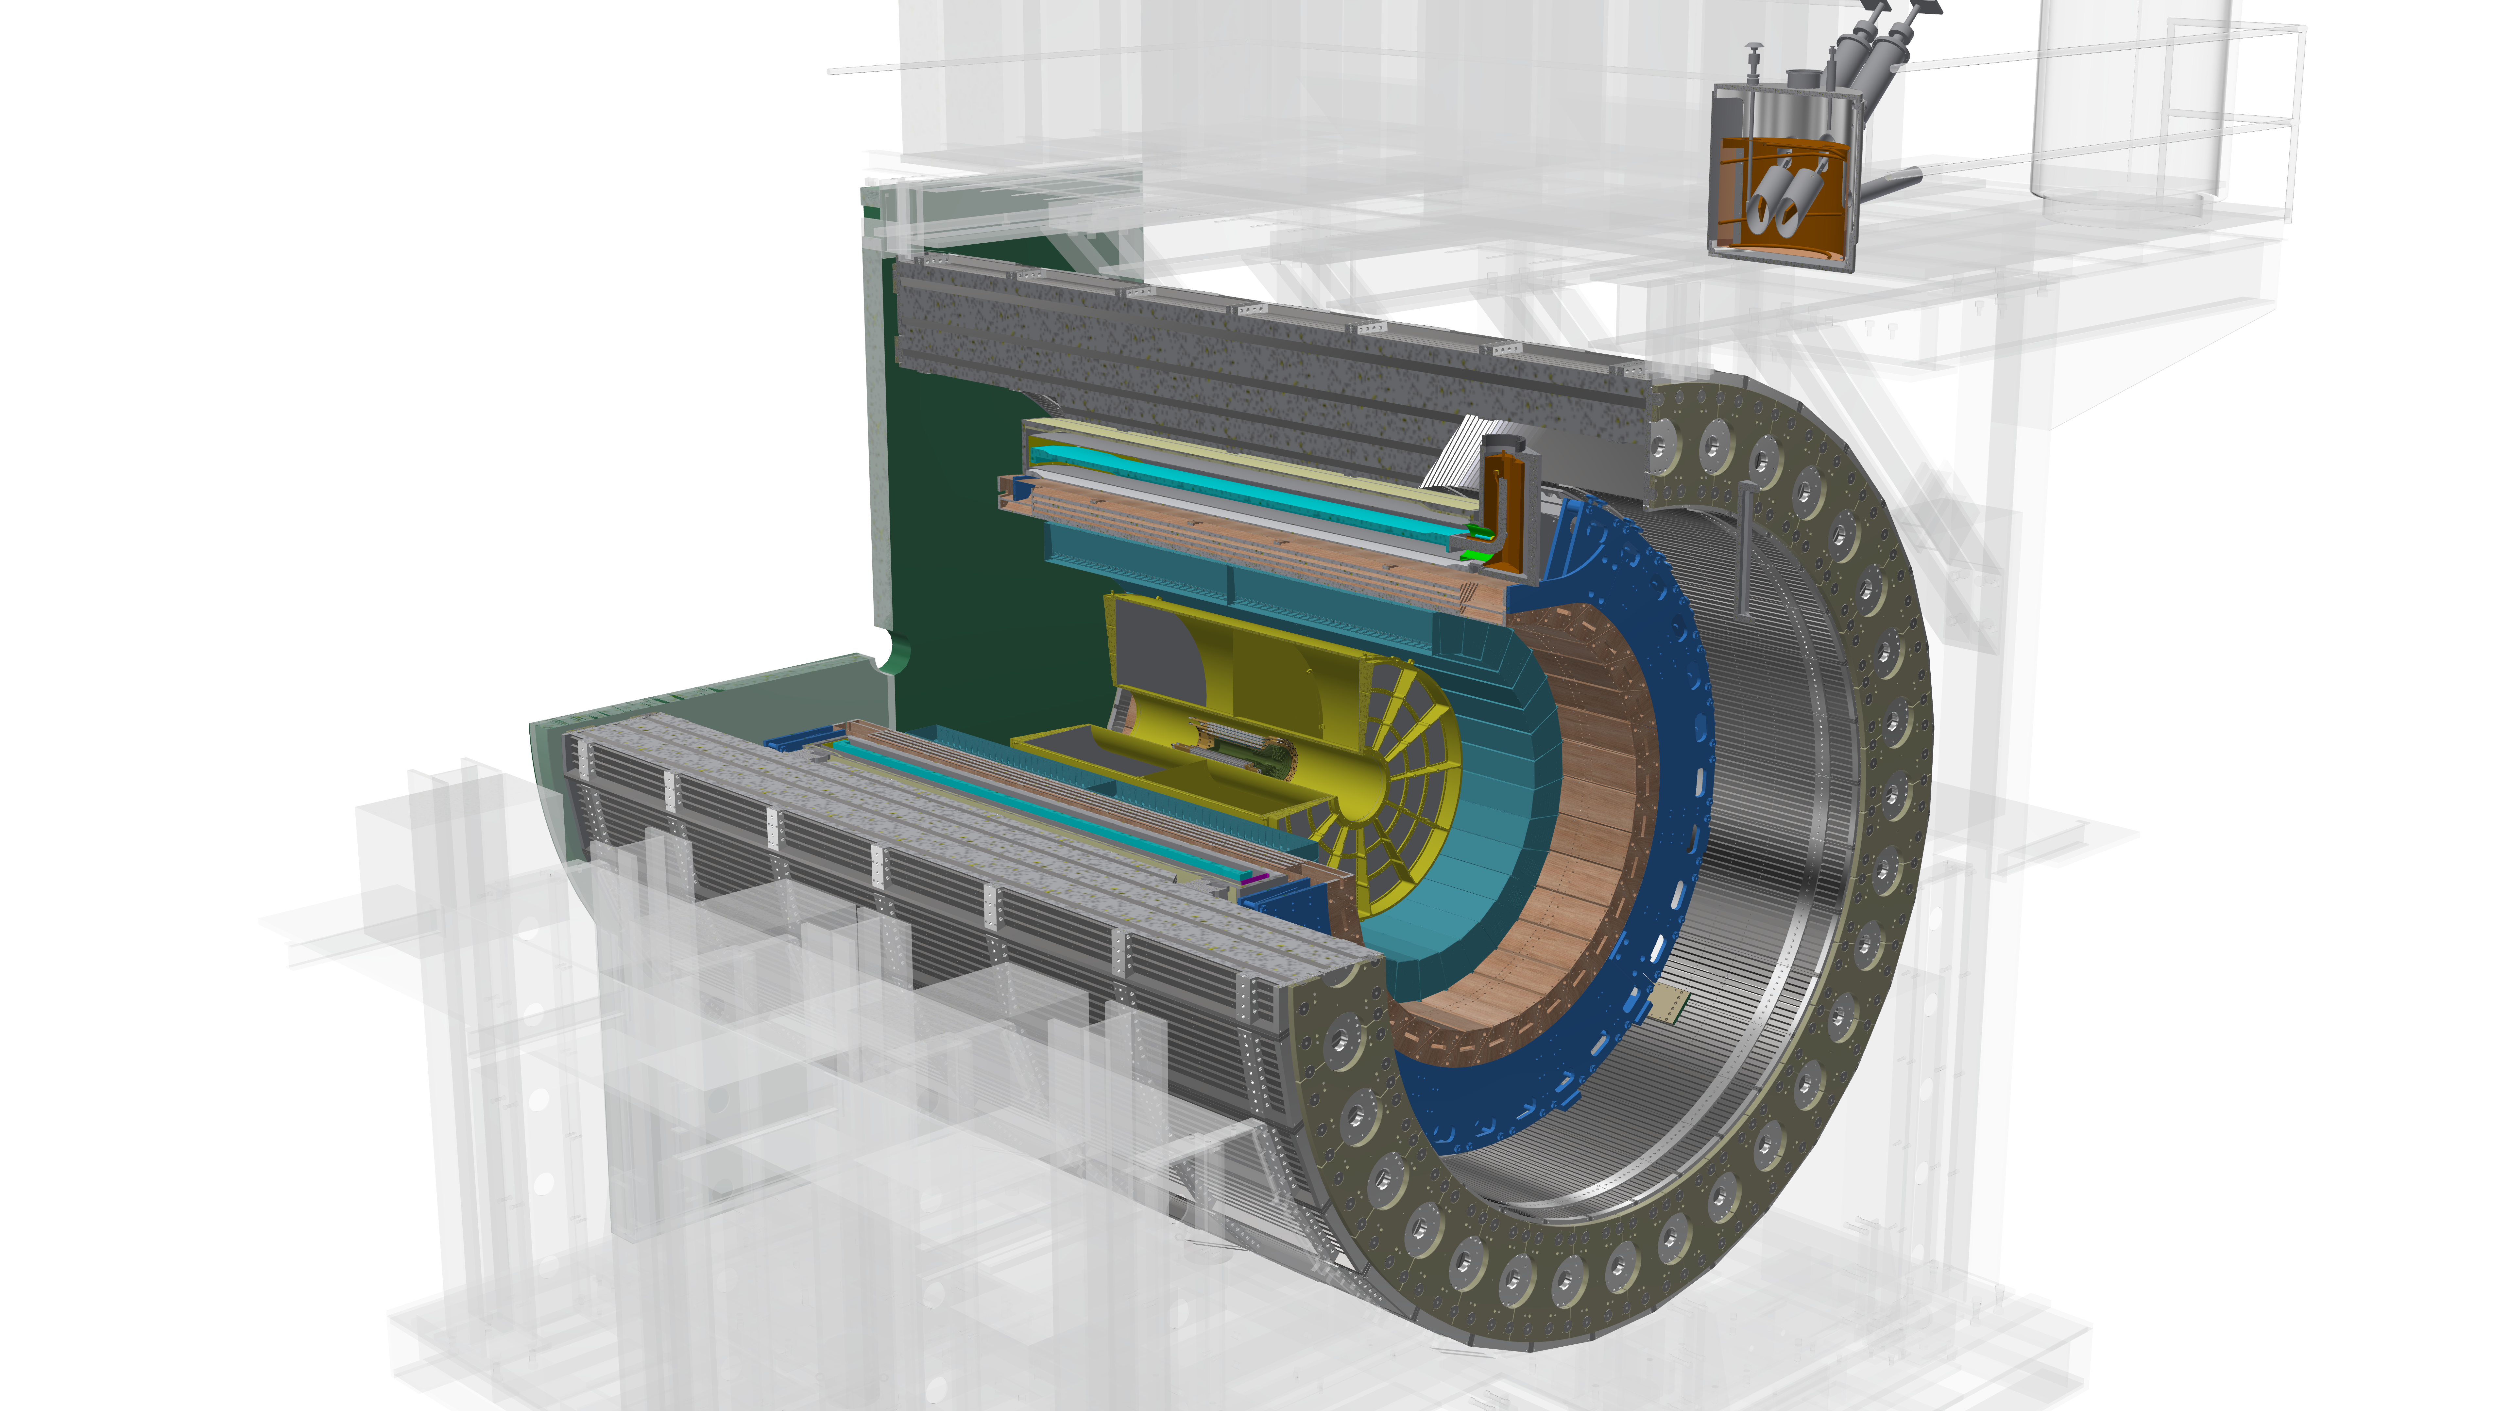
Detector model at sPHENIX
Calorimeters
Silicon Trackers
Time-projection Chamber
Notes:
sPHENIX is composed of 9 detectors at the Relativistic Heavy Ion Collider at BNL. From inside out, are the silicon trackers, the Time-projection Chamber which is the subject of our study and the calorimeters. Time-projection chamber is the major tracking device at sPHENIX and dominate the data volume.

Slide 4

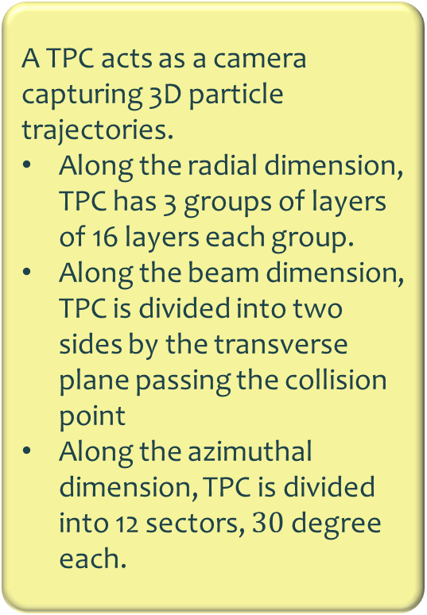
Time projection Chamber (TPC)
A TPC acts as a camera capturing 3D particle trajectories.
Along the radial dimension, TPC has 3 groups of layers of 16 layers each group.
Along the beam dimension, TPC is divided into two sides by the transverse plane passing the collision point
Along the azimuthal dimension, TPC is divided into 12 sectors, $30$ degree each.
Notes:
Time projection chamber produce tracking data at extremely high data rate and we cannot save all the data produced to the permanent storage for future study. The currently solution is to use a trigger system to select collision most valuable events and discard the remaining. However, as we move gradually to streaming data intake, we want to see whether we develop fast compression algorithm based on deep neural network to make saving all data possible.

Slide 5
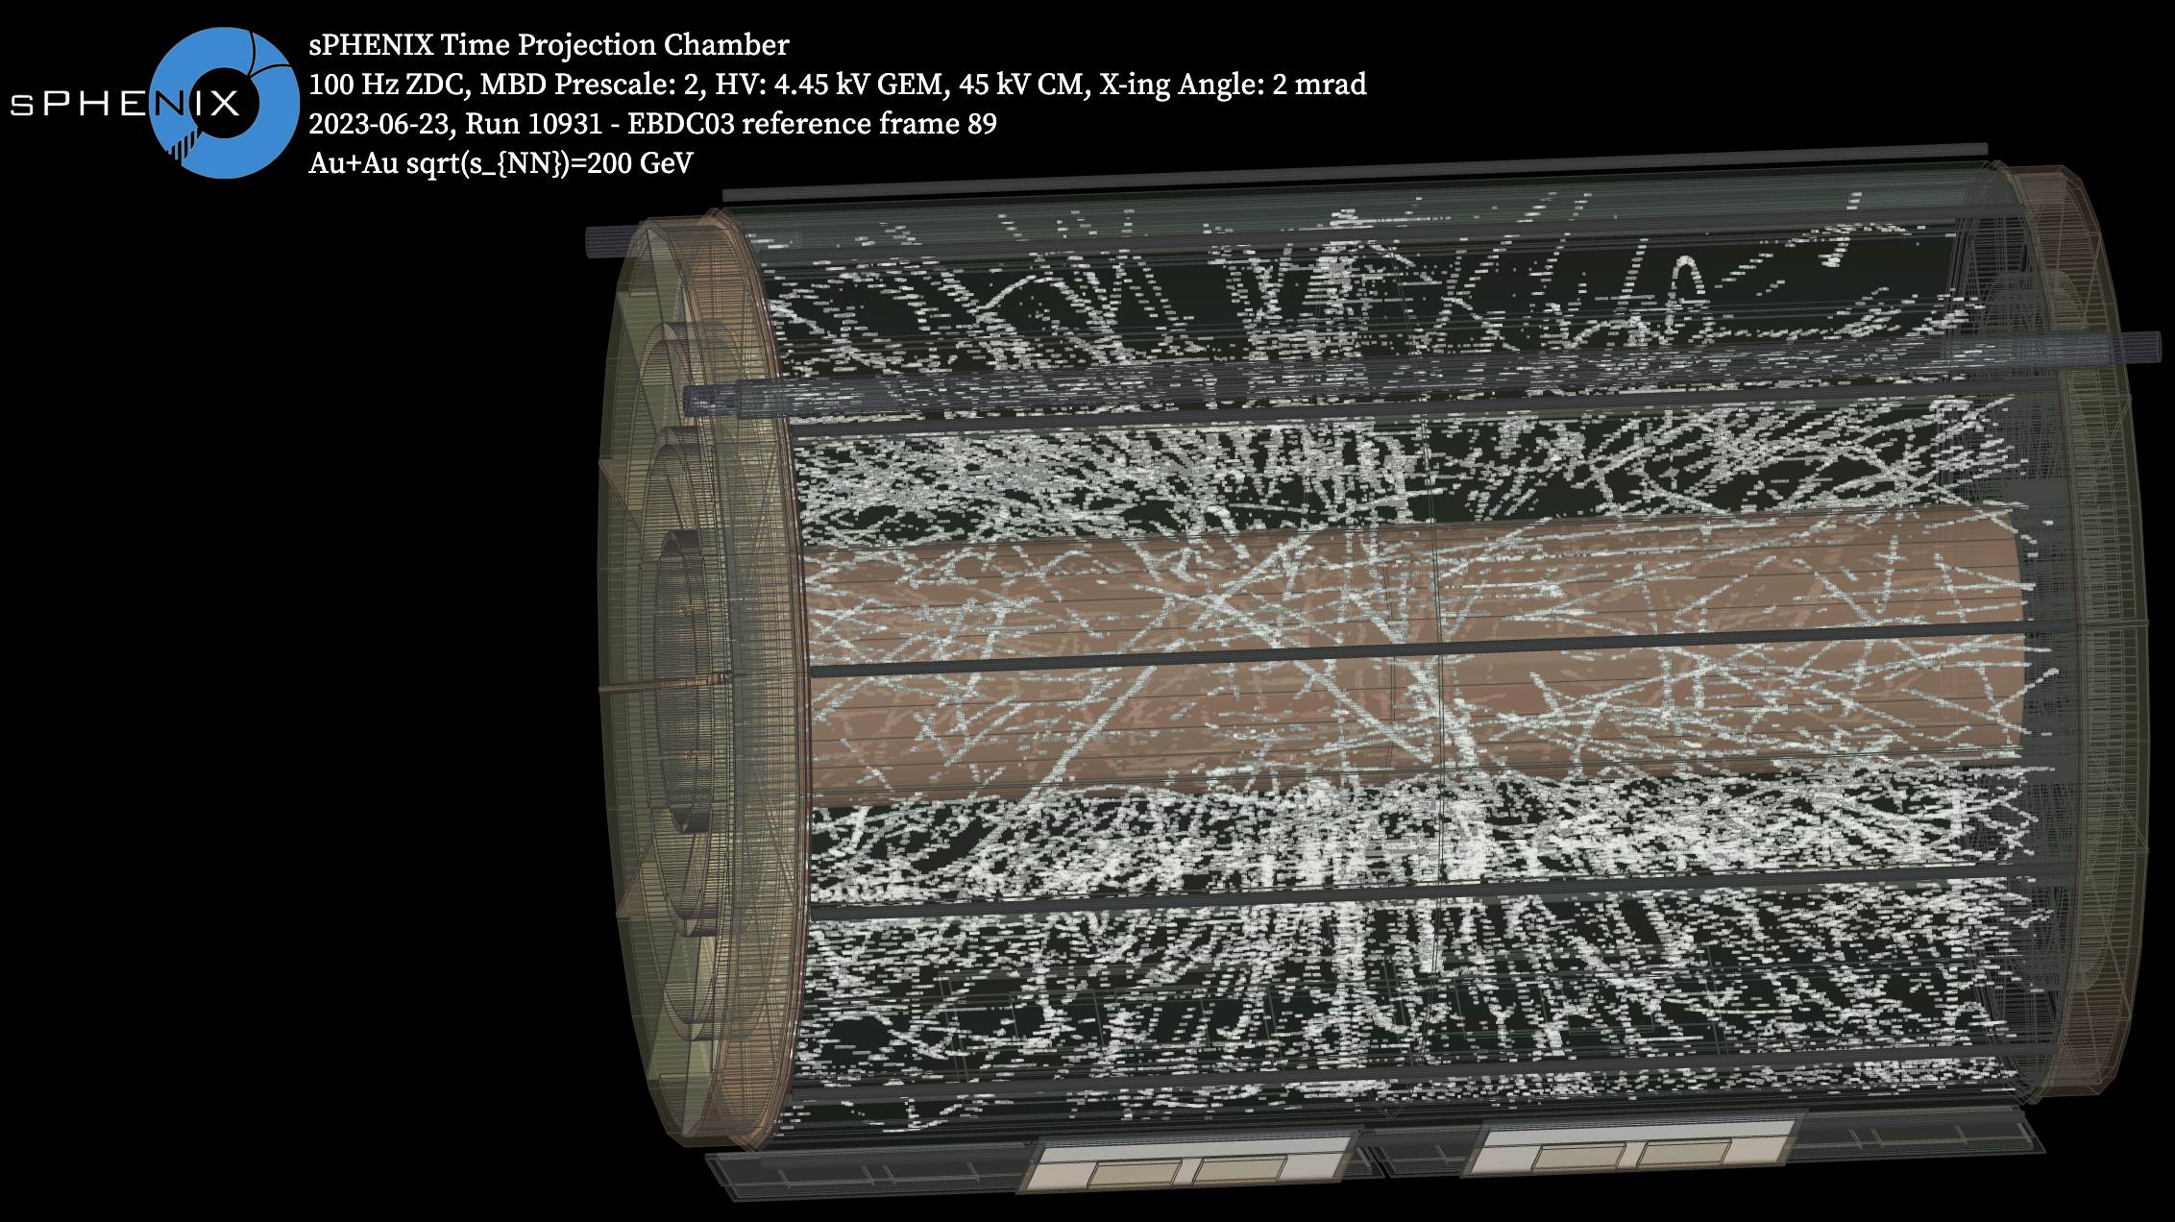

Slide 6
TPC Data
The challenge of sparse data

Slide 7
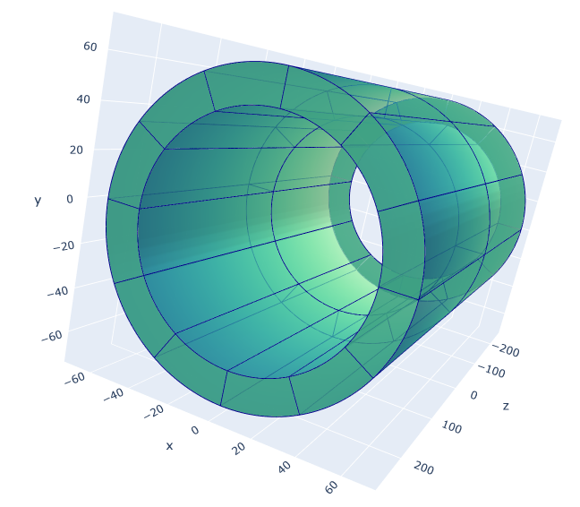
In this study, we are going to focus on the outer layer group:
16 layers along the radial direction
2304 columns of sensor nodes along the azimuth direction
498 rows along the beam direction
Subdivided into 24 TPC wedges of shape (16, 192, 249)

Slide 8
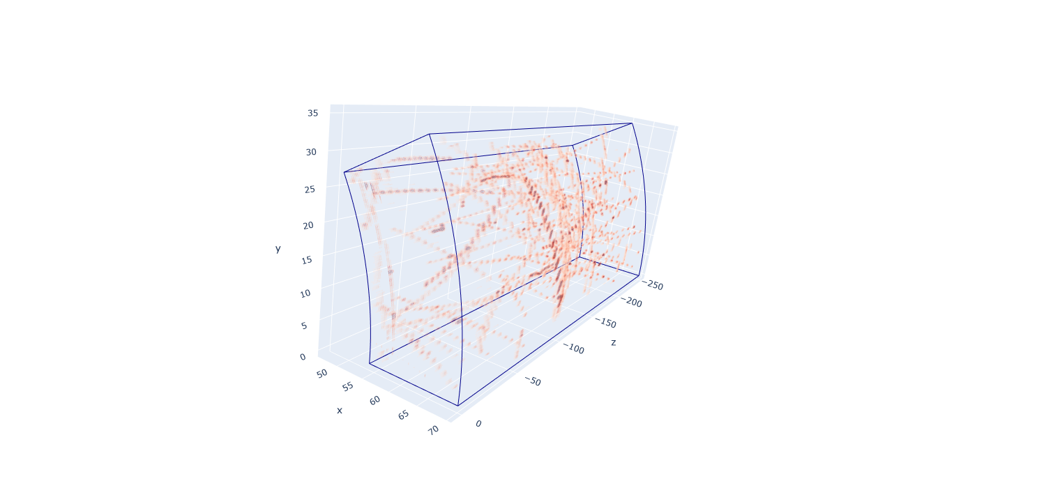
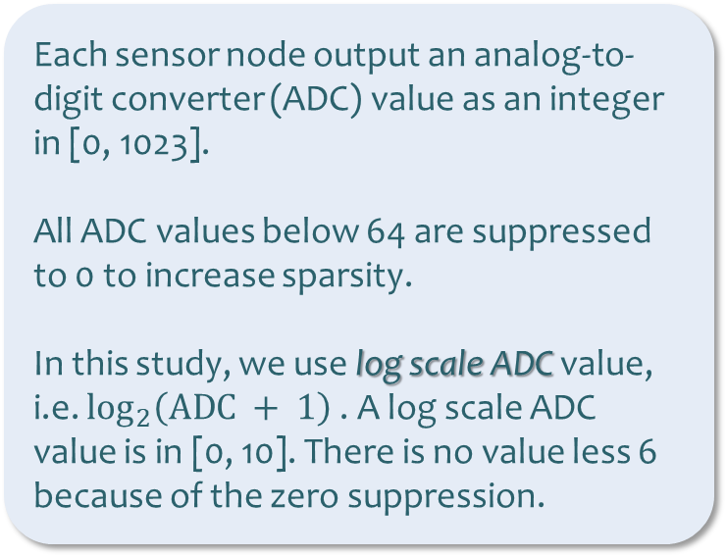
TPC wedges of shape (16, 192, 249)
Input to the neural compression algorithm
Each sensor node output an analog-to-digit converter (ADC) value as an integer in [0, 1023].
All ADC values below 64 are suppressed to 0 to increase sparsity.
In this study, we use log scale ADC value, i.e. $\log_{2}\left(\text{ADC} + 1\right)$. A log scale ADC value is in [0, 10]. There is no value less 6 because of the zero suppression.
Fig. Log scale ADC value in a TPC wedge

Slide 9
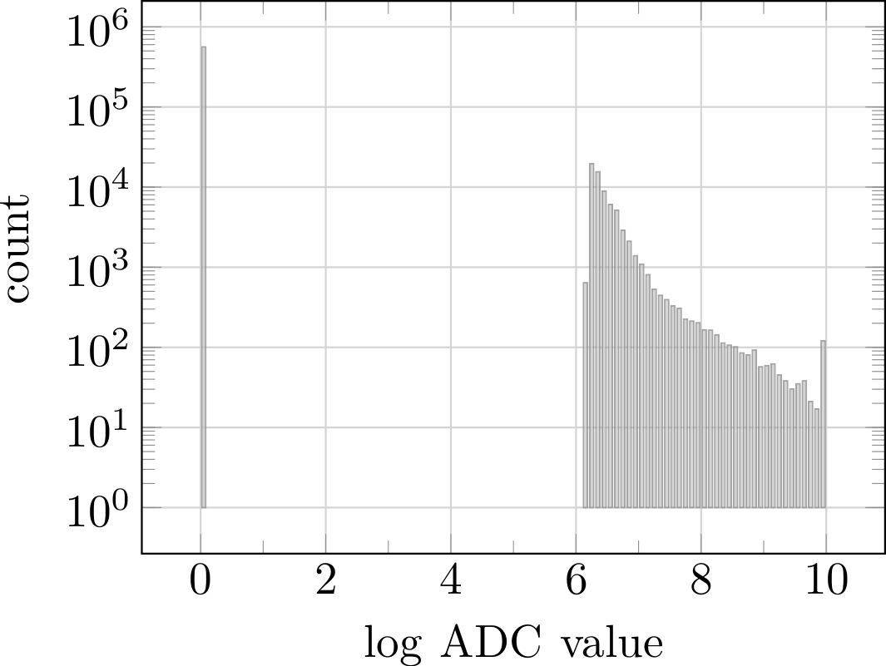

Discontinuous, bi-modal distribution
A much more NN friendly distribution

Slide 10
Neural Compression, stage 1
Design neural compressor for discontinuous distribution

Slide 11
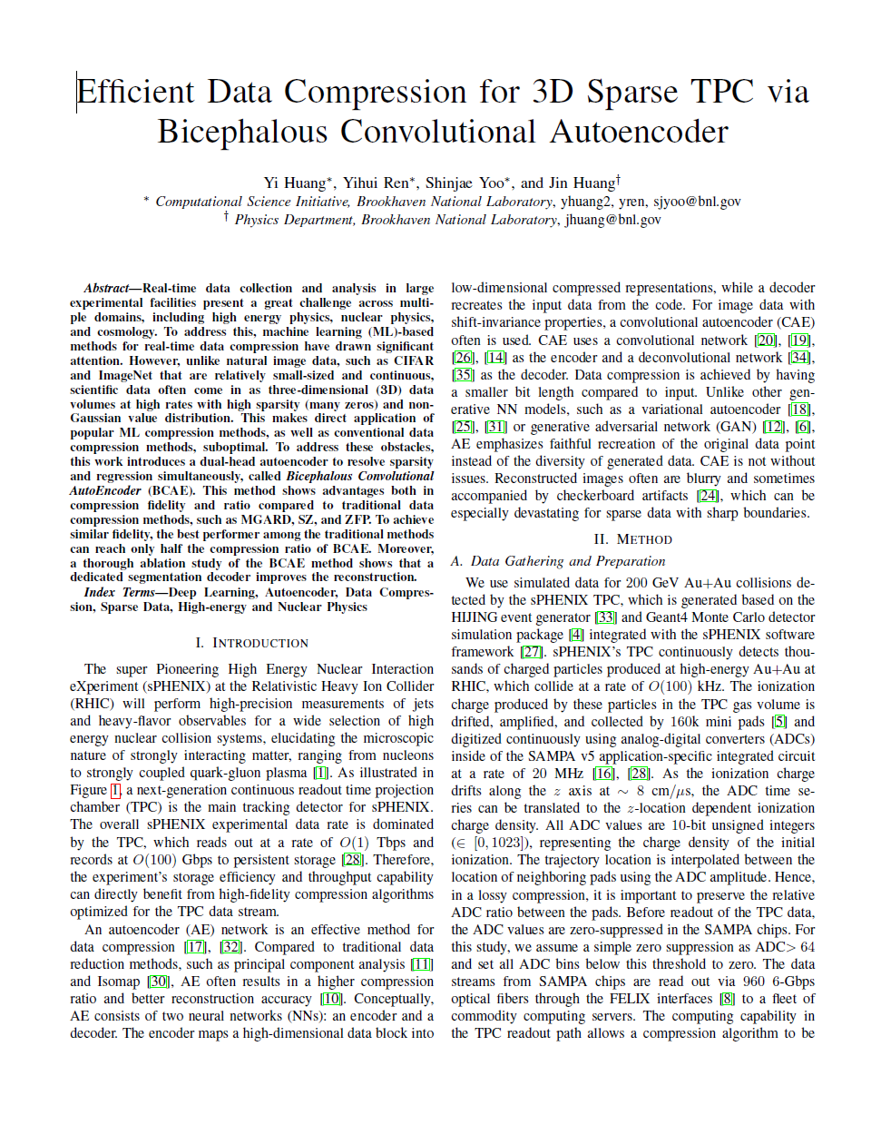
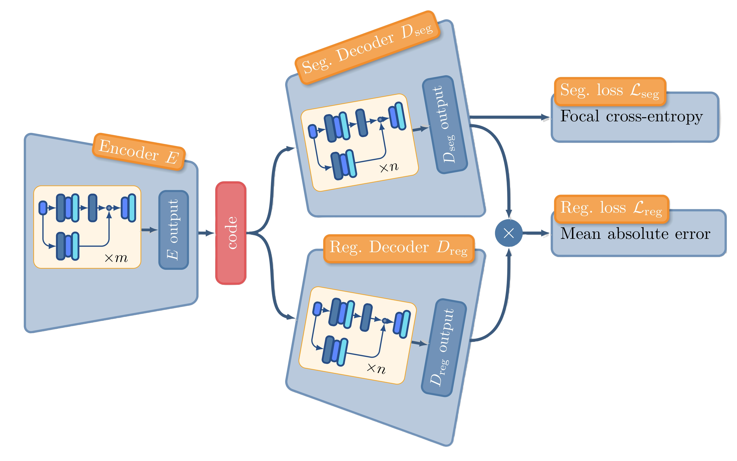
BCAE
https://arxiv.org/pdf/2111.05423.pdf

Slide 12
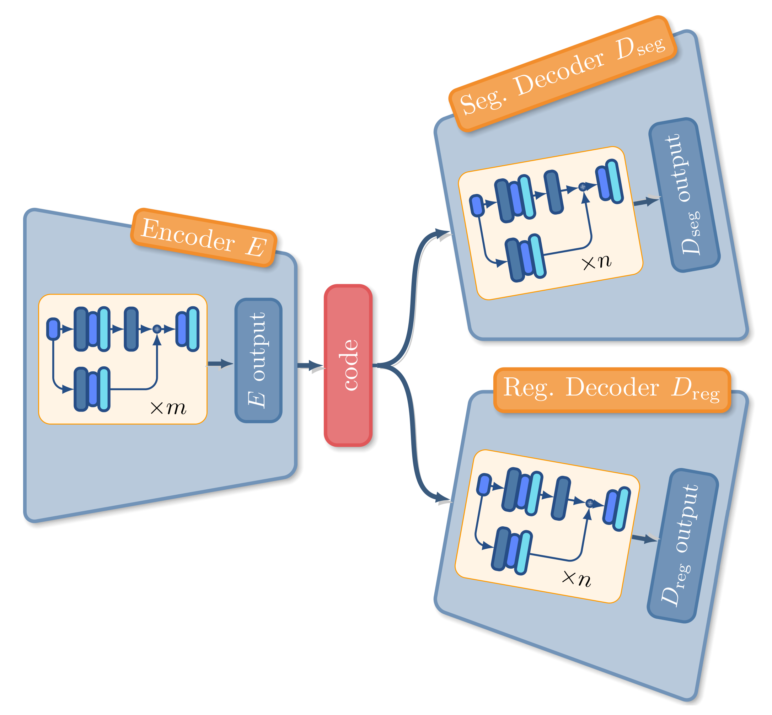
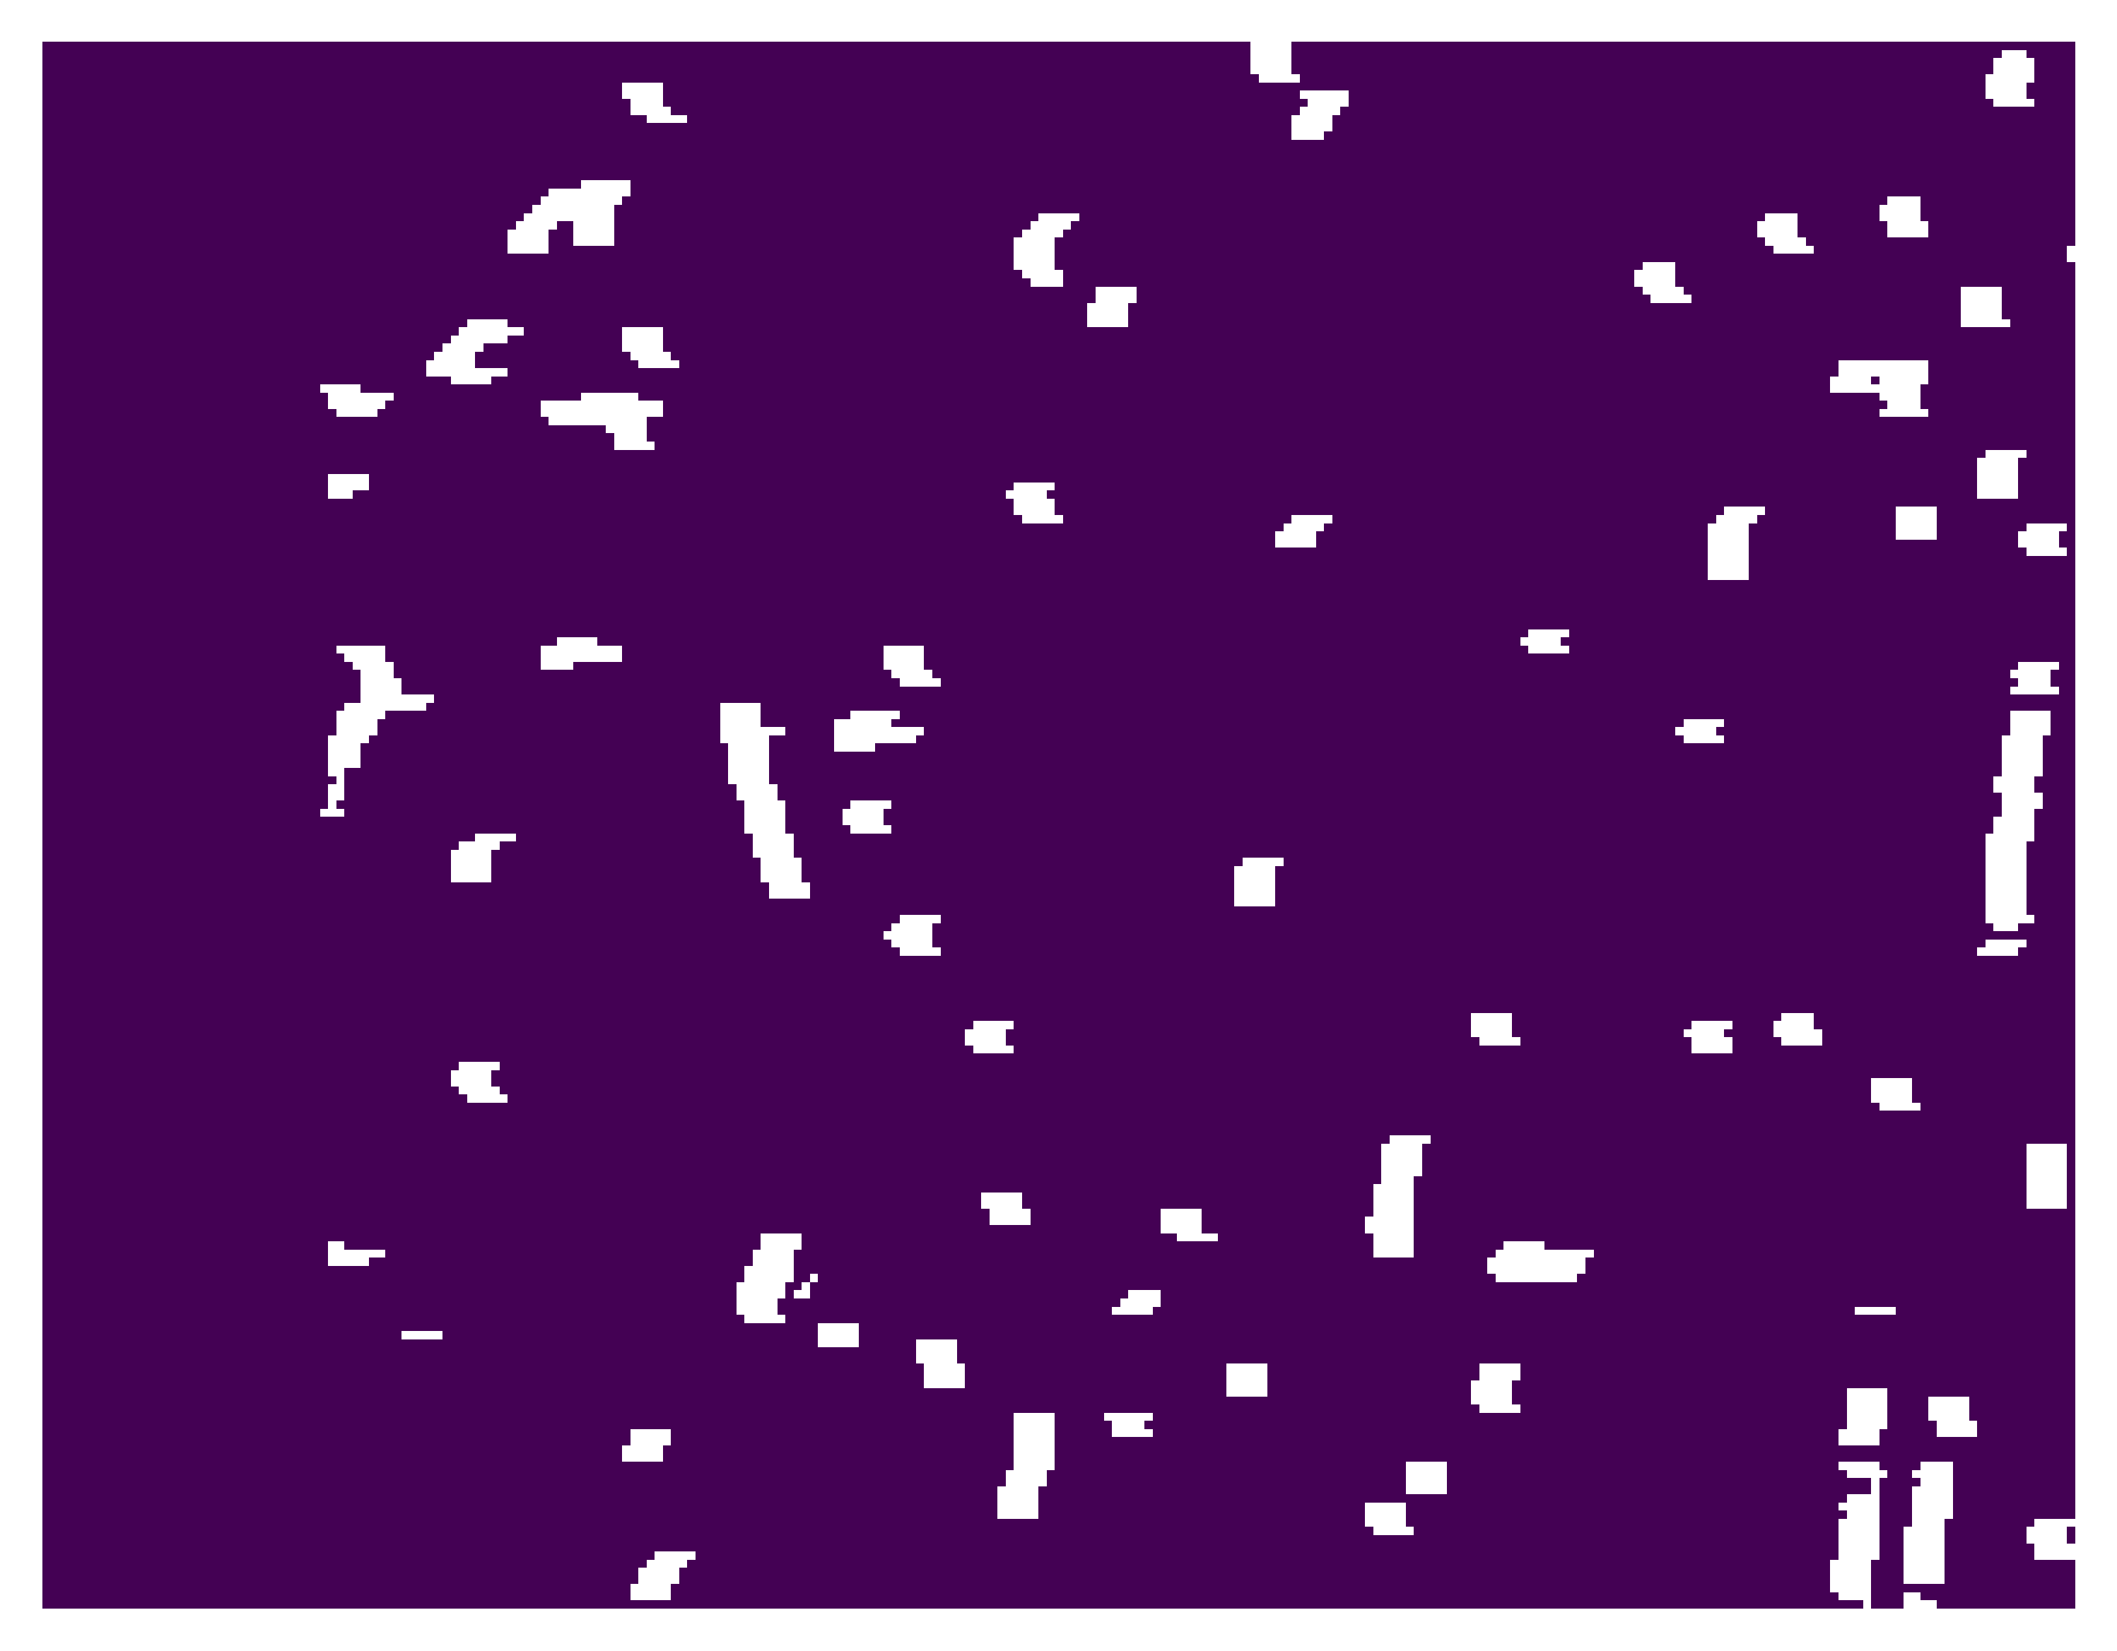
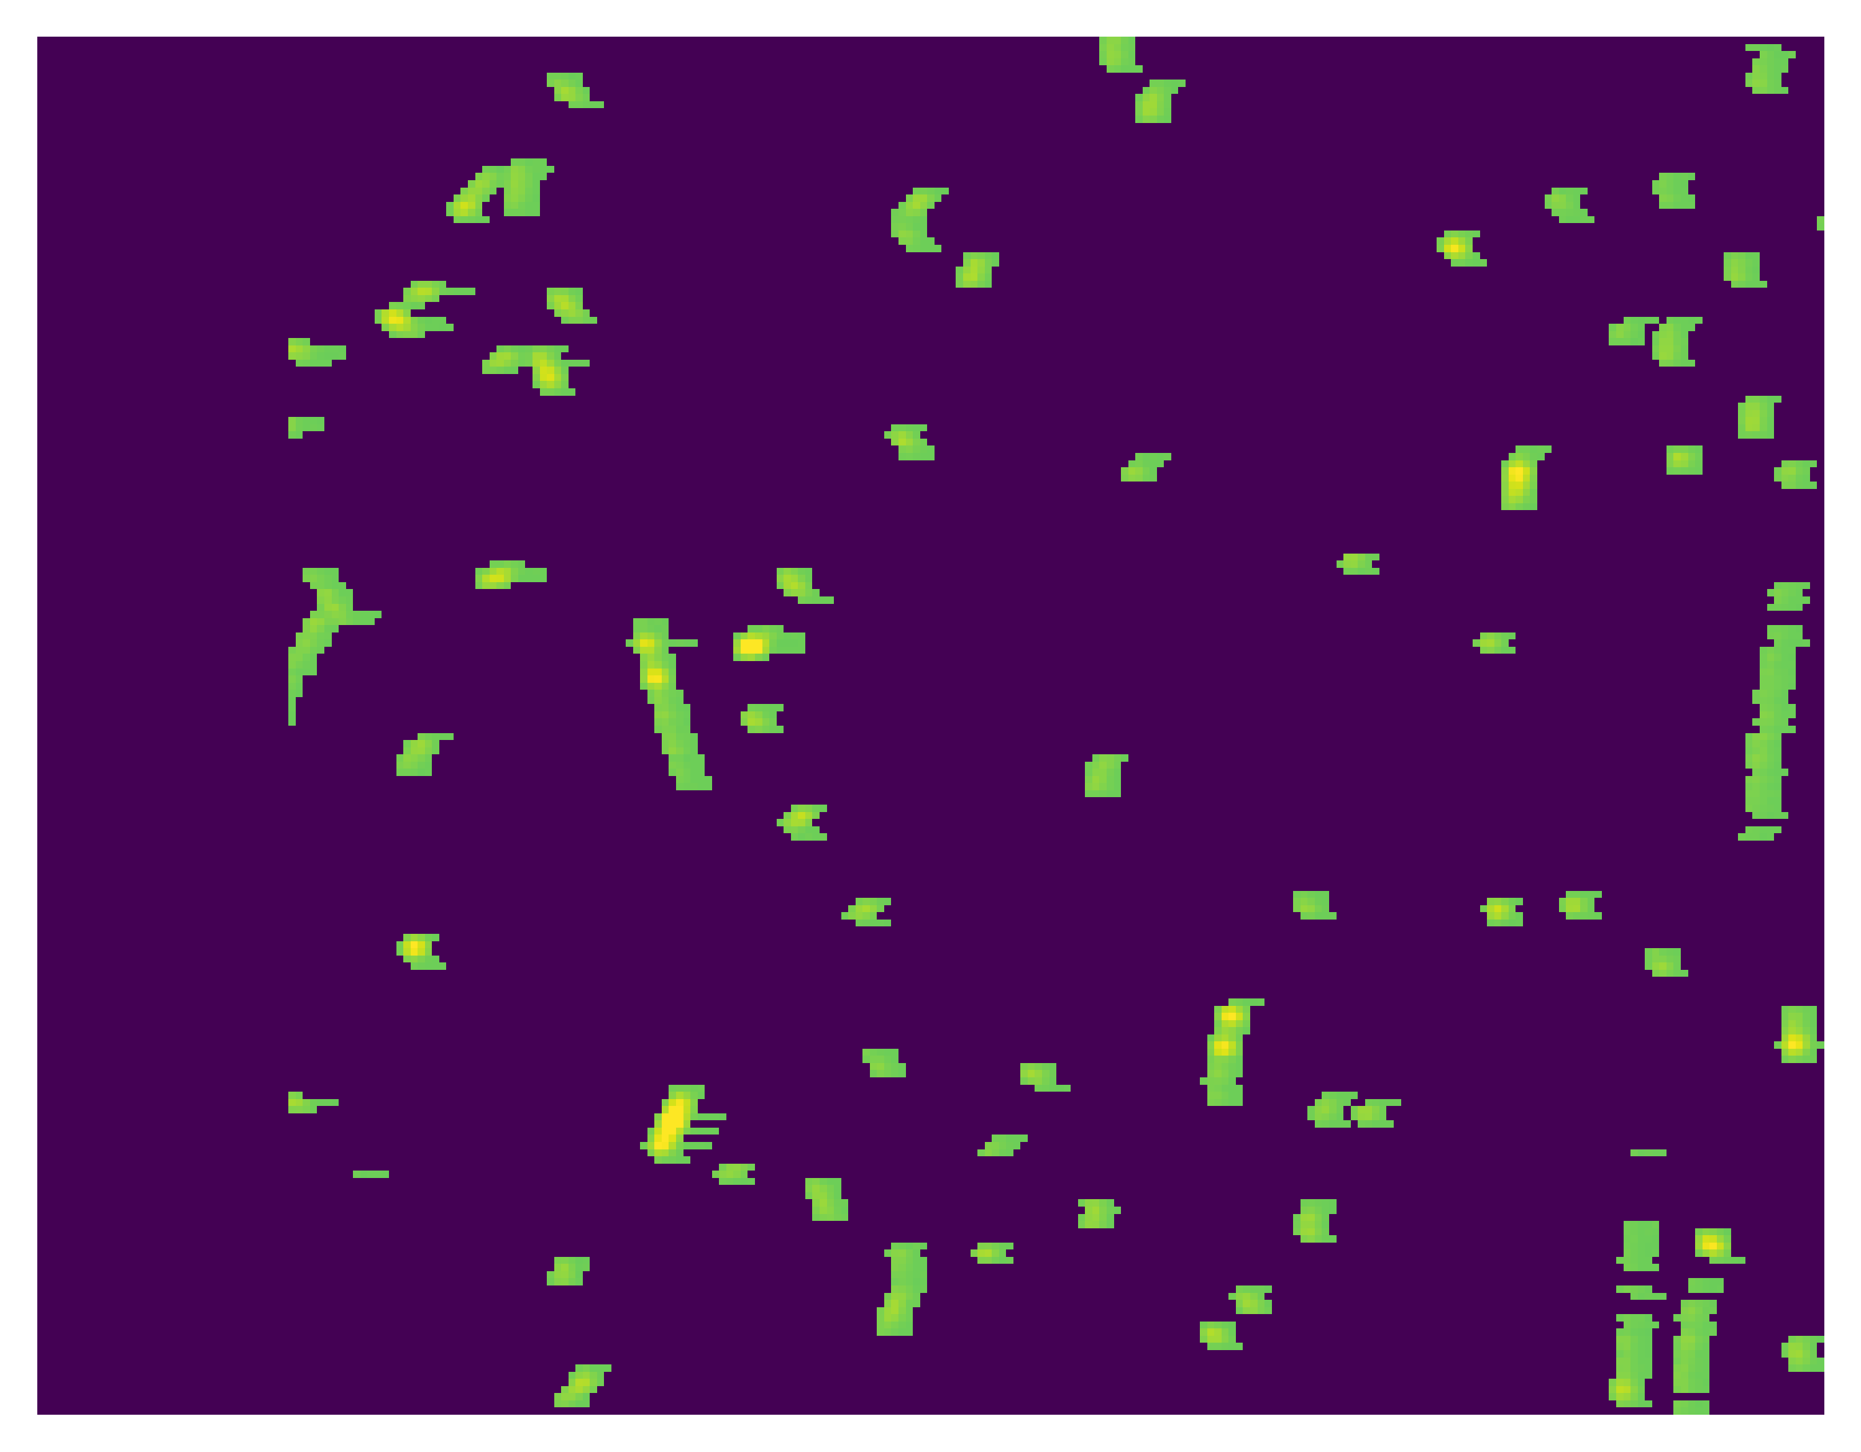

Segmentation output (mask)
input
Regression output
Permanent storage

Slide 13
Segmentation output (mask)
input
Regression output
Permanent storage

Slide 14


Regression output $×$ mask
input
Regression loss

Slide 15
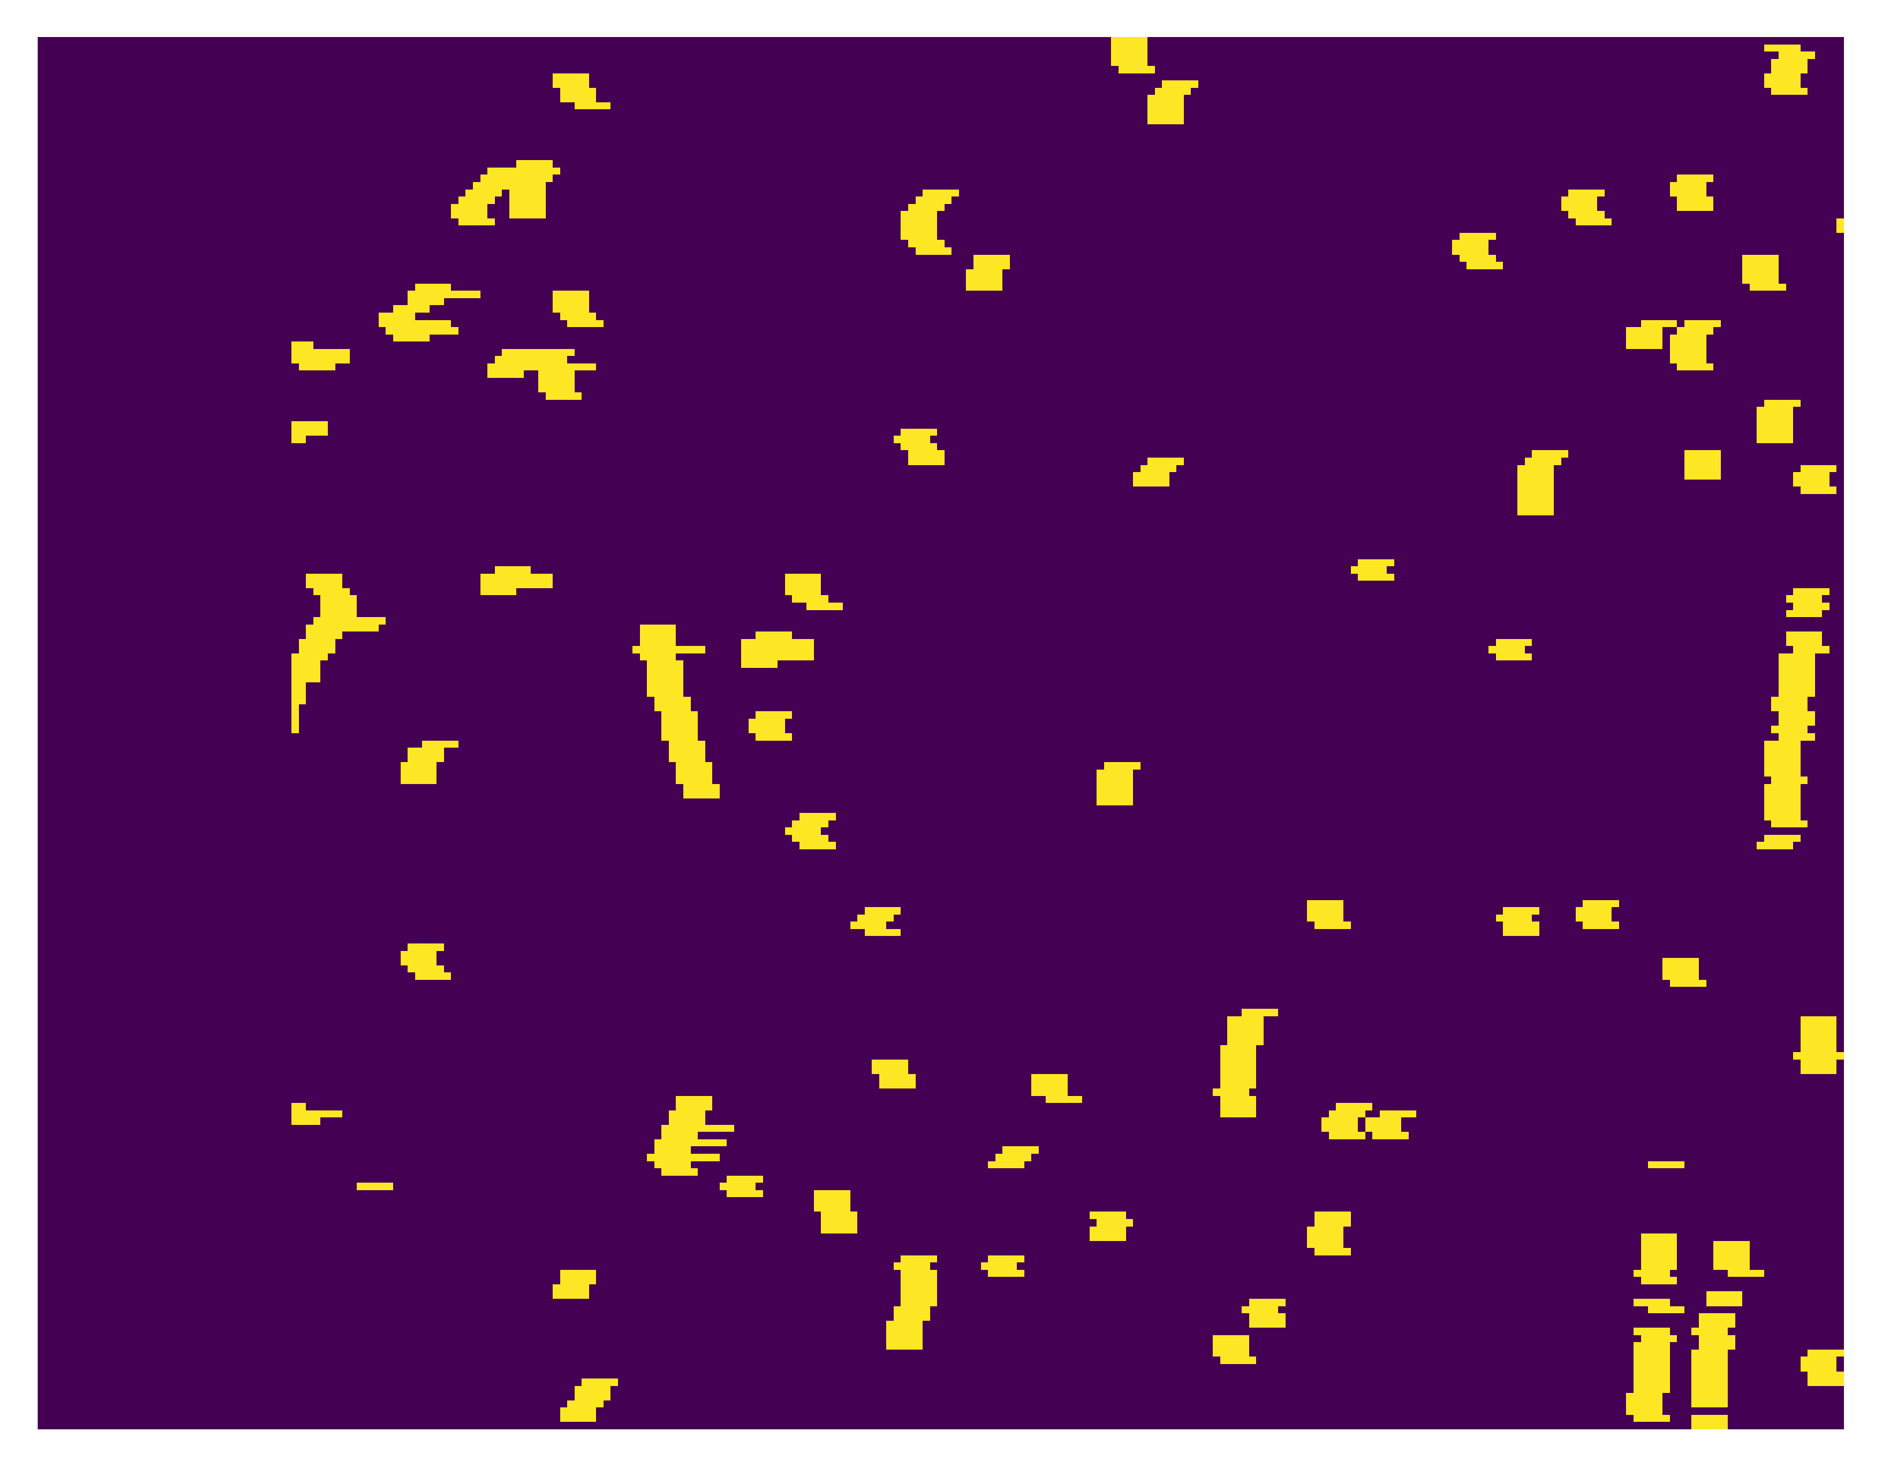

mask
Classification ground truth (input $>0$)
Classification loss

Slide 16
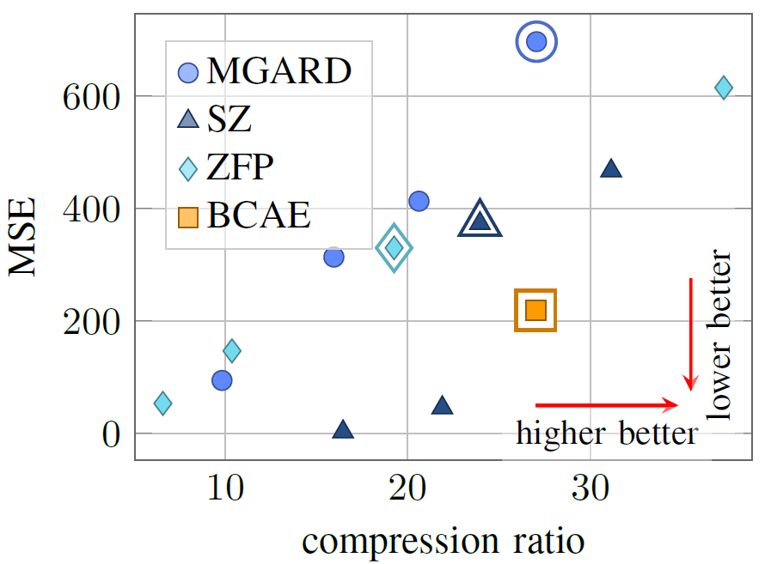
Performance of BCAE comparing to off-the-shelf lossy compression algorithms

Slide 17
Neural Compression, stage 2
Aiming for higher throughput

Slide 18
Use 2D Convolution to make BCAE Faster
The TPC wedge data has shape (16, 192, 249).
Comparing to the azimuth and horizontal direction, the radial dimension is thin.
We can treat the radial dimension as the feature dimension and use 2D convolutions
16 layers

Slide 19
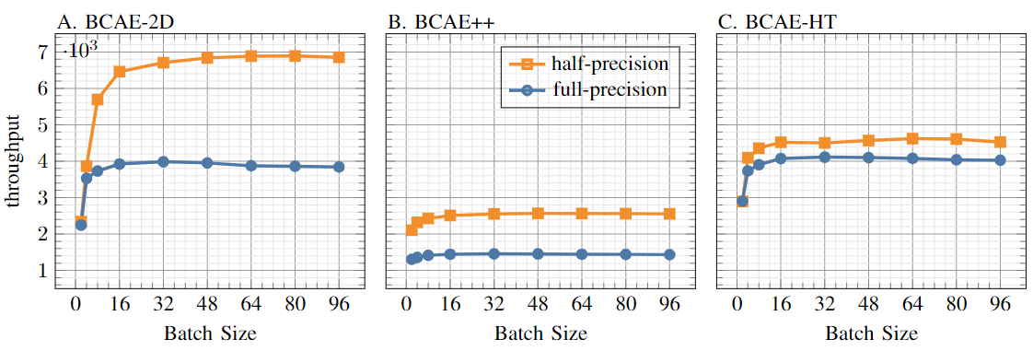
Throughput comparison two computing modes
Stage one throughput
Throughput (num of TPC wedges process per second) evaluated on a NVIDIA 6000 ADA chip
It is not always the case, but for this application, reducing the floating-point precision from full to half does not affect performance in any significant way.

Slide 20
Throughput comparison two computing modes
Stage two throughput
Throughput (num of TPC wedges process per second) evaluated on a NVIDIA 6000 ADA chip
It is not always the case, but for this application, reducing the floating-point precision from full to half does not affect performance in any significant way.

Slide 21
Throughput comparison two computing modes
A variation of 3D stage-1 model that runs faster
Throughput (num of TPC wedges process per second) evaluated on a NVIDIA 6000 ADA chip
It is not always the case, but for this application, reducing the floating-point precision from full to half does not affect performance in any significant way.

Slide 22
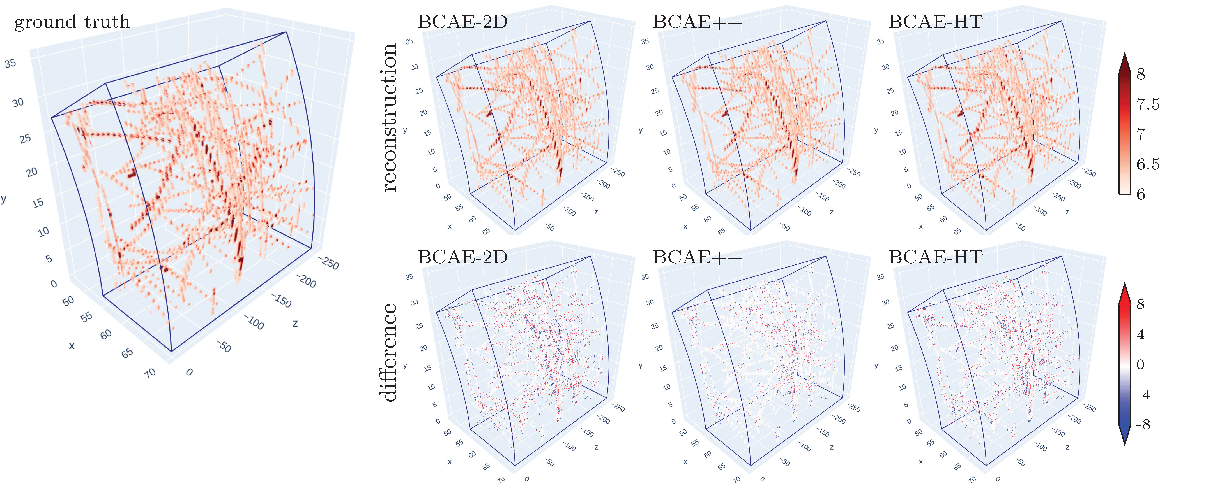
Performance comparison
Stage two performance

Slide 23
Neural Compression, stage 3
Can sparsity be a bless?

Slide 24
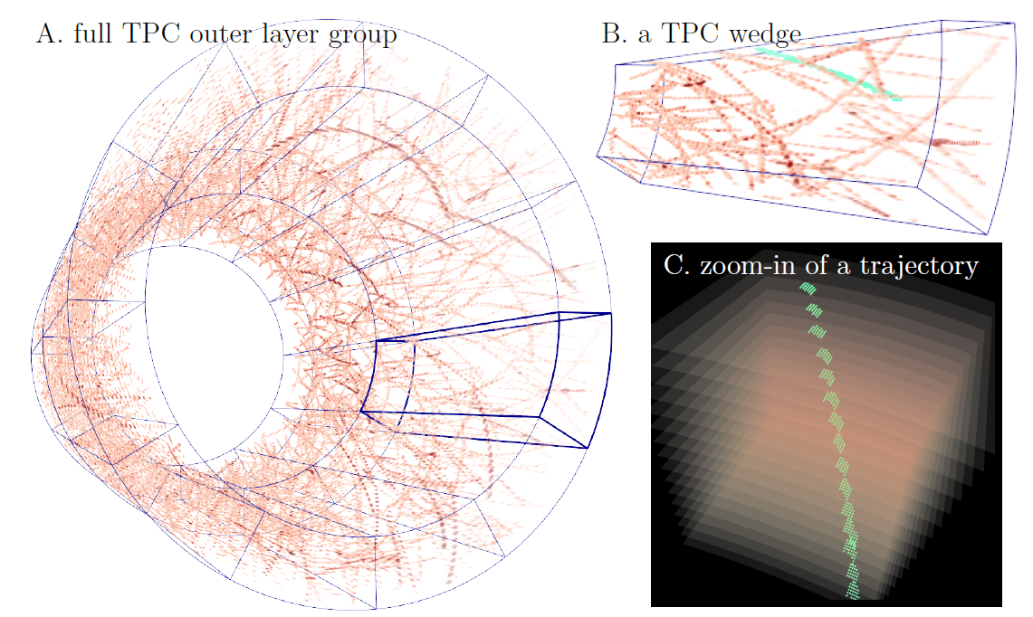

Slide 26
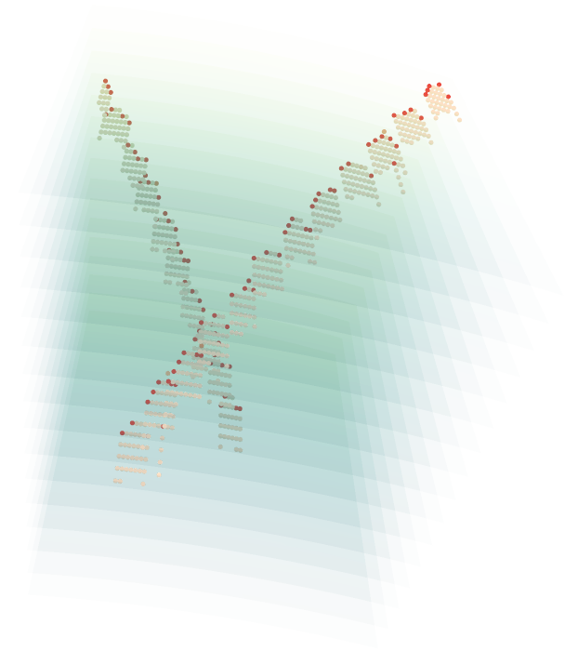
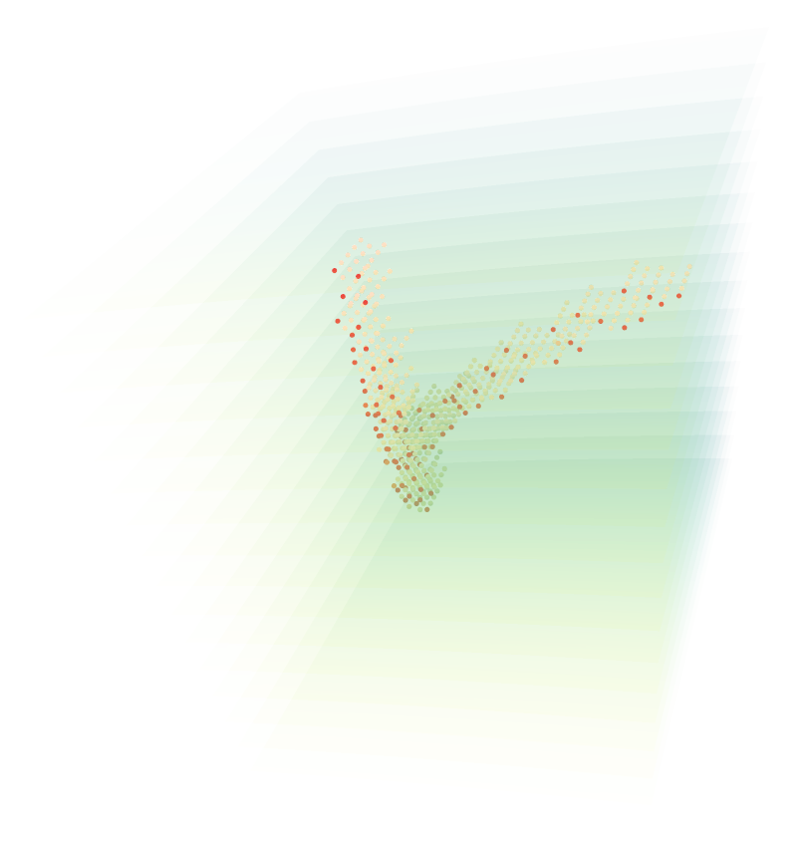
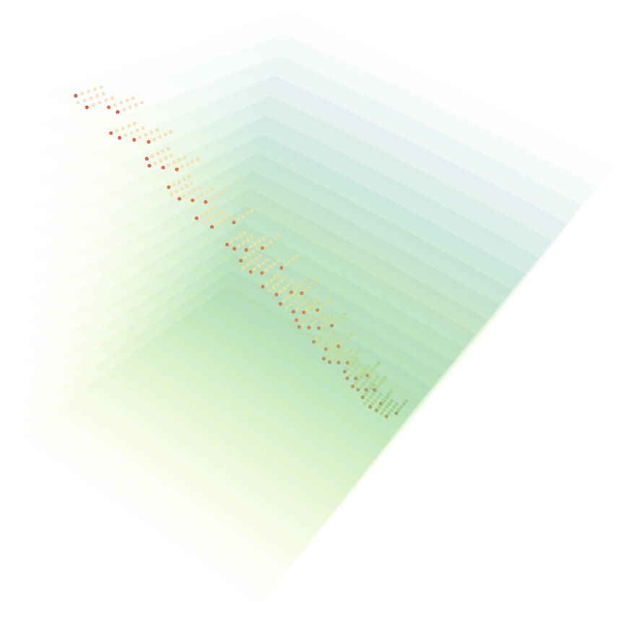
Locate the most valuable signals

Slide 27
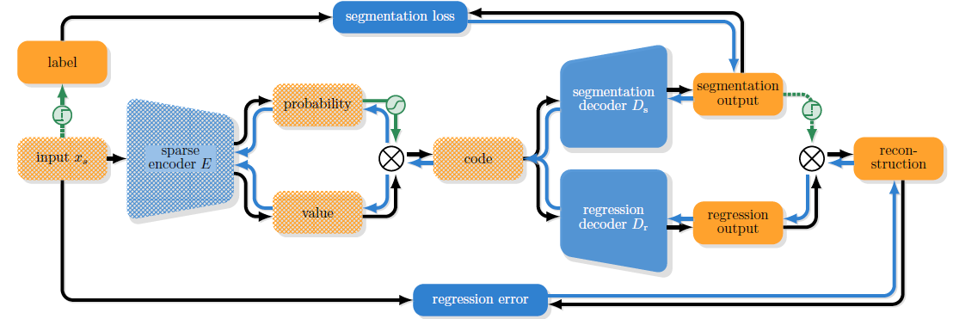
BCAE-VS
Variable ratio Compression for Sparse input
Sparse
Convolution

Slide 28

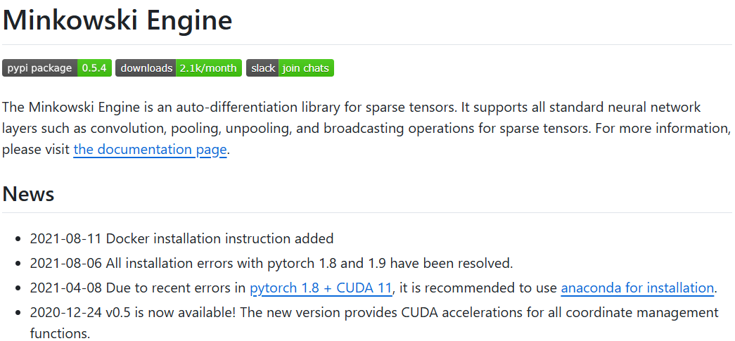

Sparse Convolution Engines

Slide 29
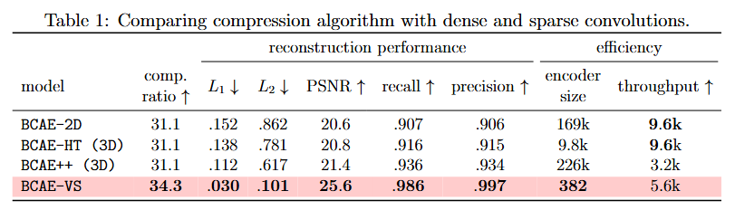
Performance Comparison
Stage-2
Stage-1
The new sparse convolution engine will be faster!
Old sparse convolution engine,
insufficient hardware support

Slide 30
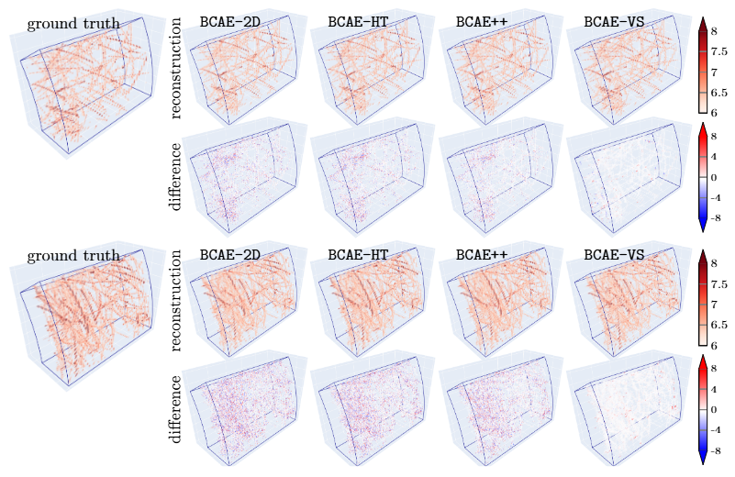
Performance Comparison

Slide 31
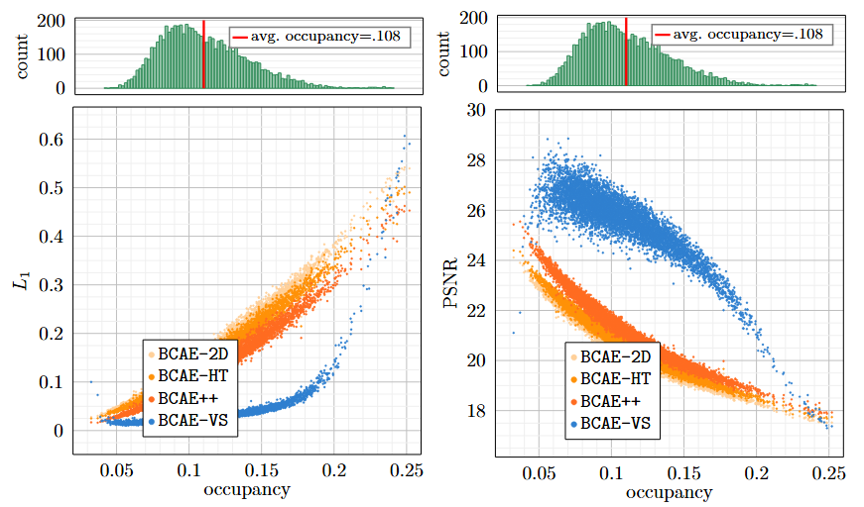
Reconstruction Accuracy—regression

Slide 32
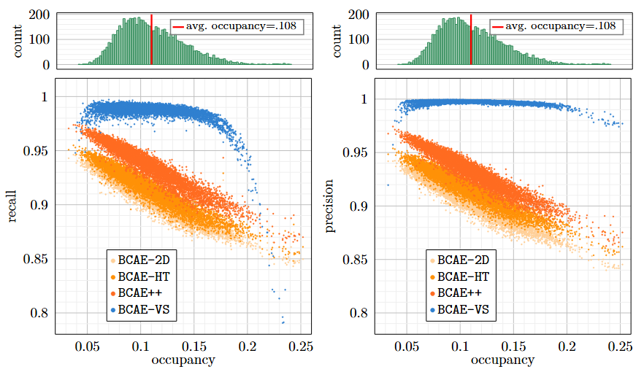
Reconstruction Accuracy—classification

Slide 33
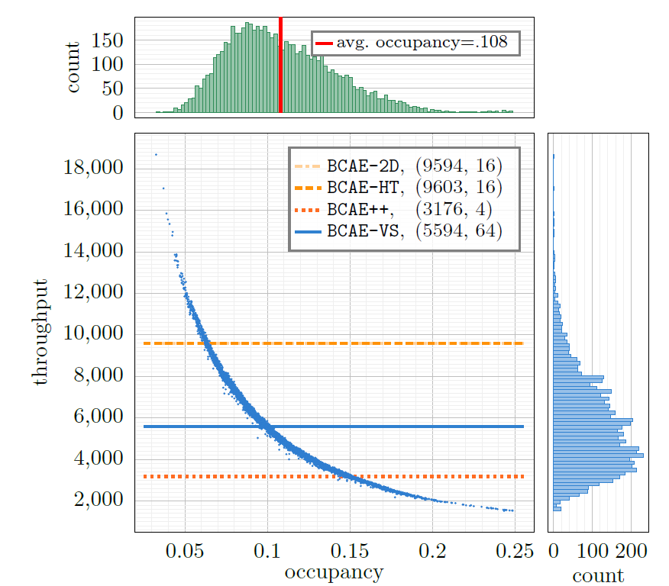
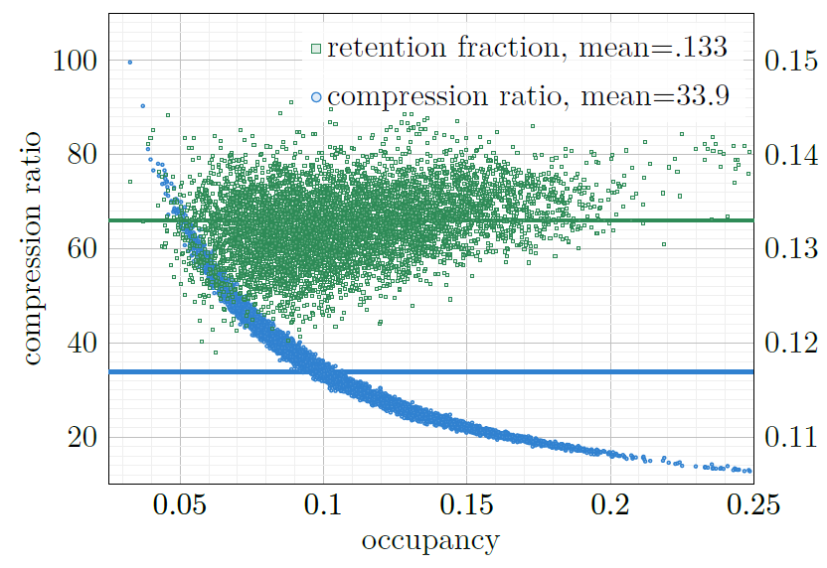
Variable compression ratio and Throughput
as function of sparsity

Slide 34
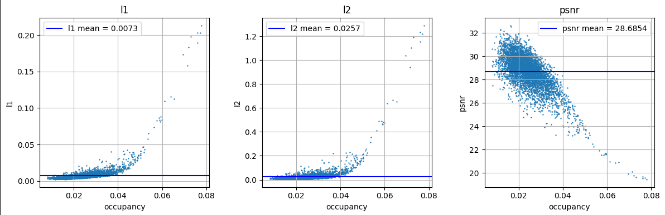
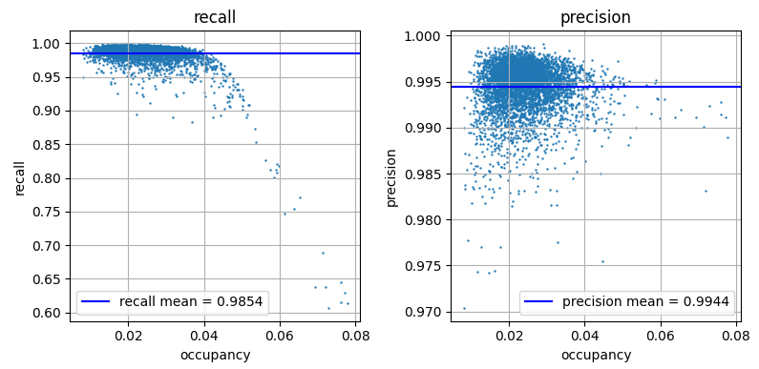
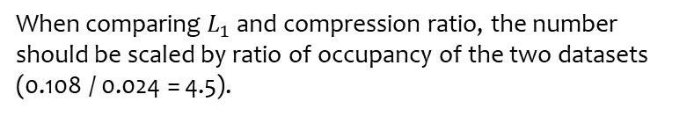
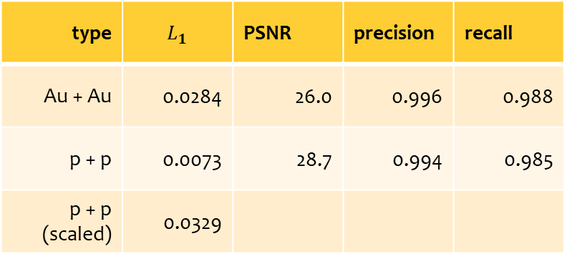
Newest Result of BCAE-VS on proton-proton Collision
type | $$L_{1}$$ | PSNR | precision | recall
Au + Au | 0.0284 | 26.0 | 0.996 | 0.988
p + p | 0.0073 | 28.7 | 0.994 | 0.985
p + p (scaled) | 0.0329
type | Retention ratio | occupancy | Compression ratio
Au + Au | 0.133 | 0.108 | 34
p + p | 0.109 | 0.024 | 185
p + p (scaled) |  |  | 152
When comparing $L_{1}$ and compression ratio, the number should be scaled by ratio of occupancy of the two datasets (0.108 / 0.024 = 4.5).

Slide 35
Thank you!

