Slide 1
PHGarfield 0.9
T.K. Hemmick

Slide 2
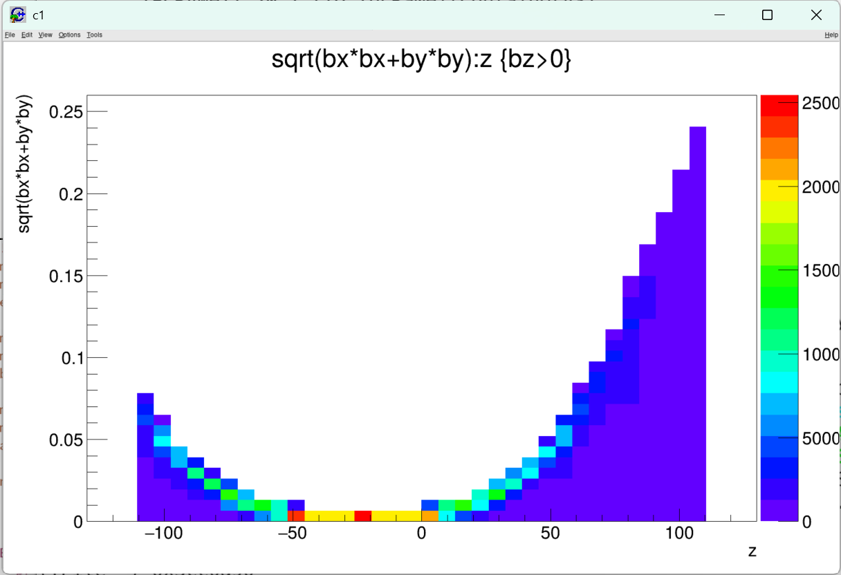
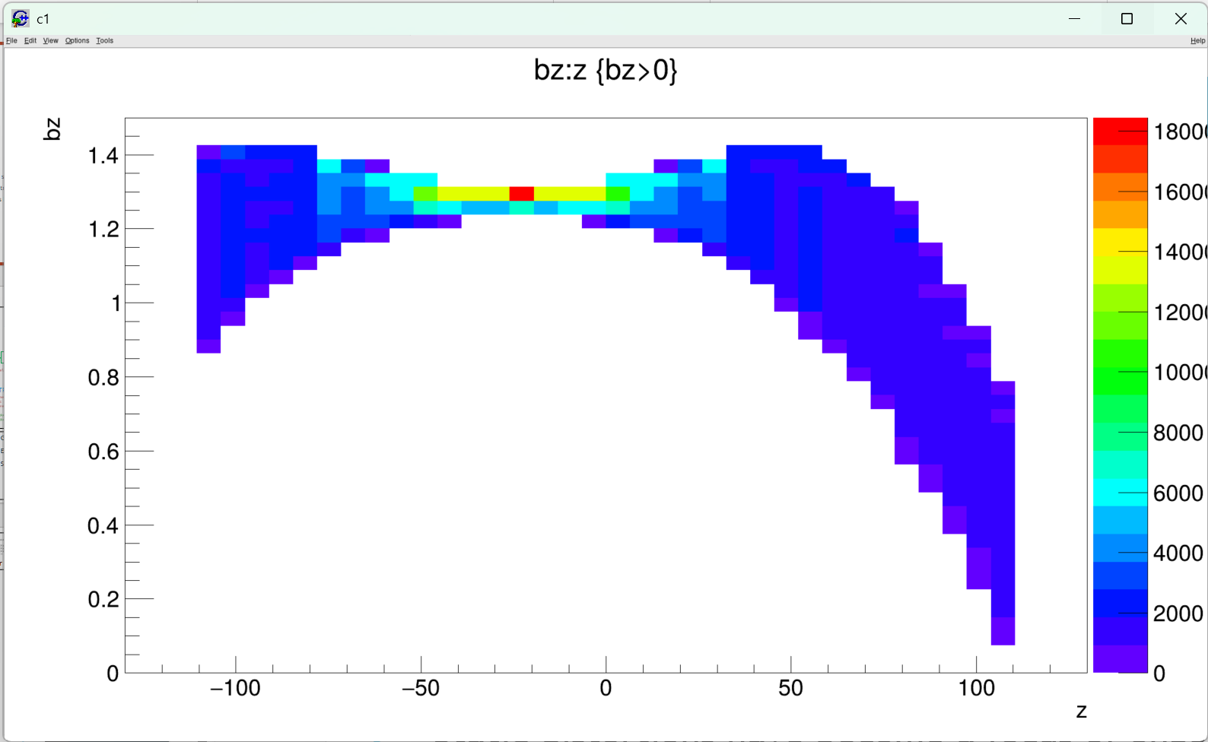
Basic concept behind PHGarfield
Are we really off by 200 mm?
Static distortions have become a focus of ongoing tracking studies.
Indications from Mariia have shown that distortions N/S are not the same.
Historical reconstruction of the field survey shows a strong asymmetry (maybe)
Current work on the RDCA (do the track circles hit the origin) shows N/S asymmetry.
Concept:
  Embed Garfield into sPHENIX libraries to use it as a field tool.
  Start with pad locations and follow “reverse field lines” toward CM.
  Straightforward distortions come from following the line backwards!

Slide 3
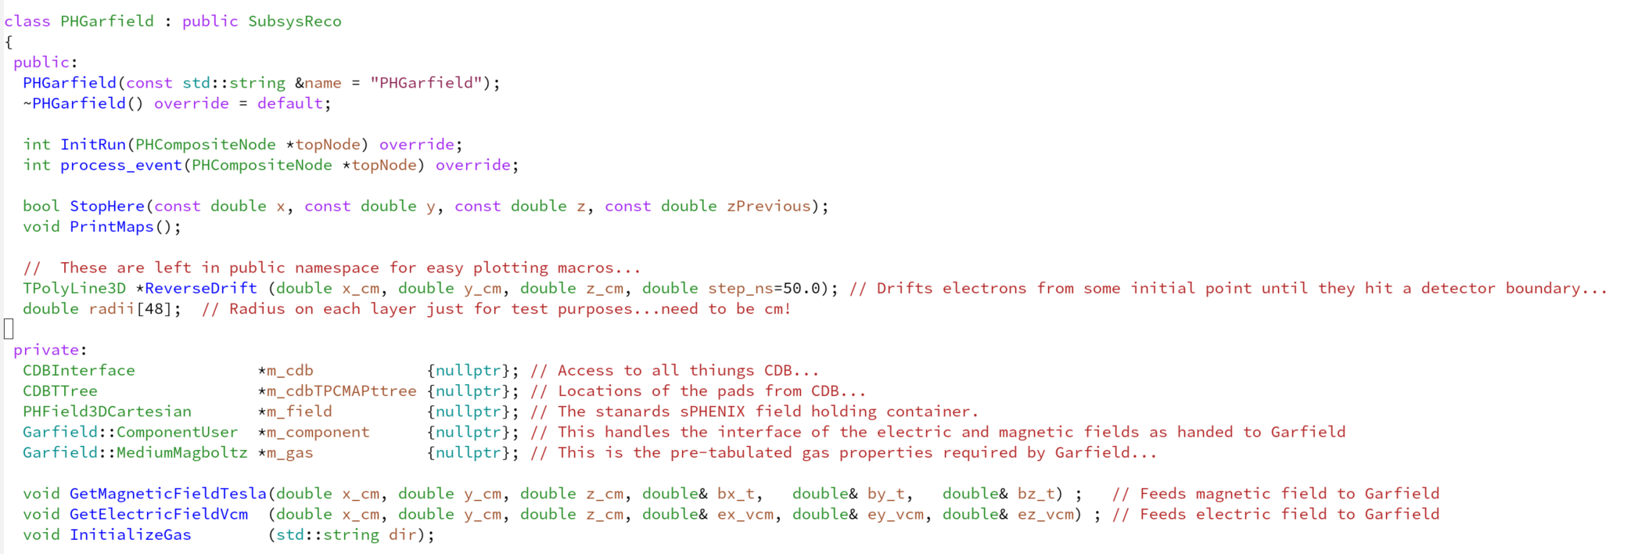
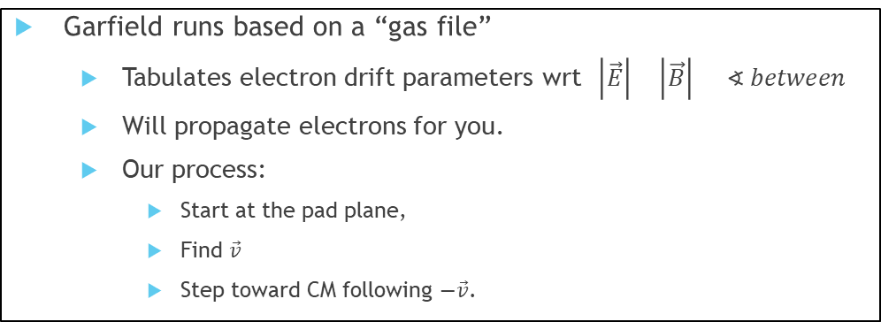
PHGarfield
Graphics!
sPHENIX
B-field
TPC Pad Locations
Garfield
Garfield
Garfield runs based on a “gas file”
  Tabulates electron drift parameters wrt $\left|\vec{E}\right| \left|\vec{B}\right| ∢ between$
  Will propagate electrons for you.
  Our process:
    Start at the pad plane,
    Find $\vec{v}$
    Step toward CM following $−\vec{v}$.
Gas file calculation is SLOOOWWW…
Electron drift if FAST!
Strategy:
  Pre-calculate the full grid of gas files.
  Read the gas files in and use them for fast tracking.

Slide 4
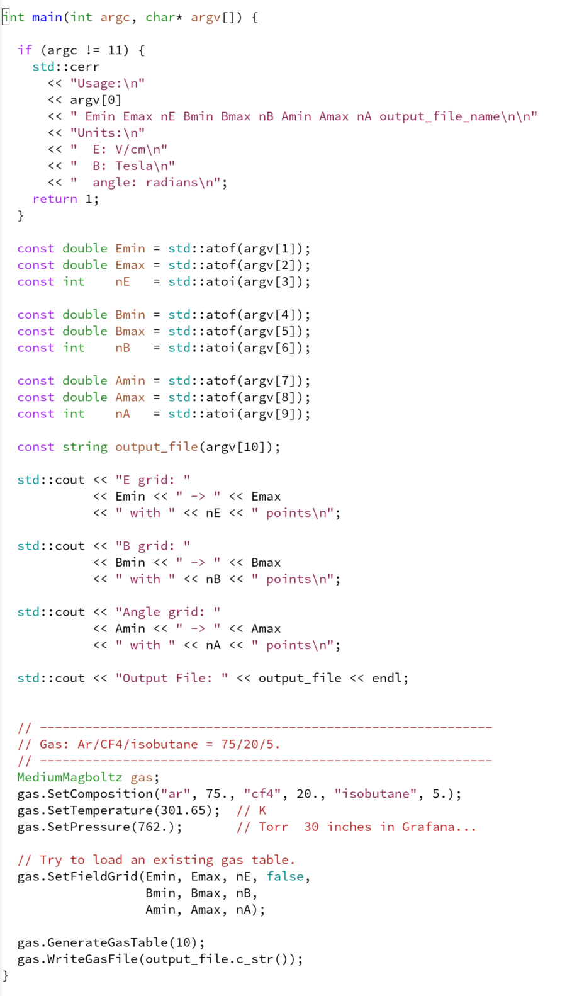
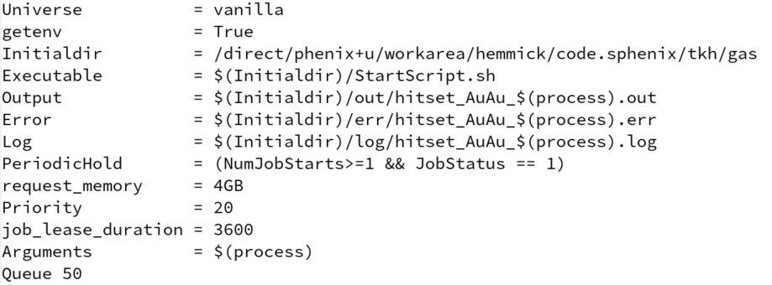
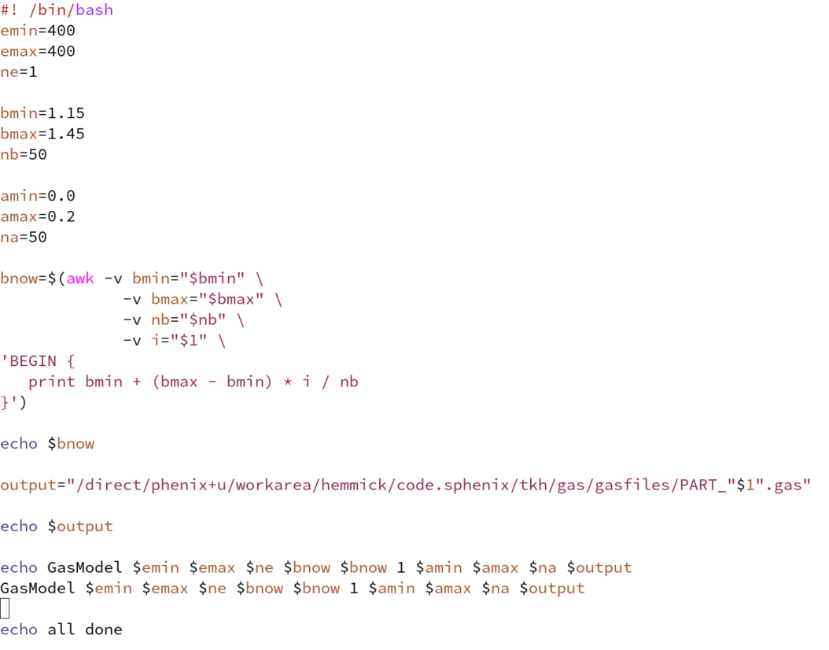
GasModel.cc
Compiles to an executable.
Send many jobs to the condor queue:
  Current map:
    1x E; 50x B; 50x Angle
    Send to 50 condor queues
    6 hours per job (we easily can go much finer)
Condor Job File
Grid specs for a single job
Launcher Script
Calculate Grid

Slide 5
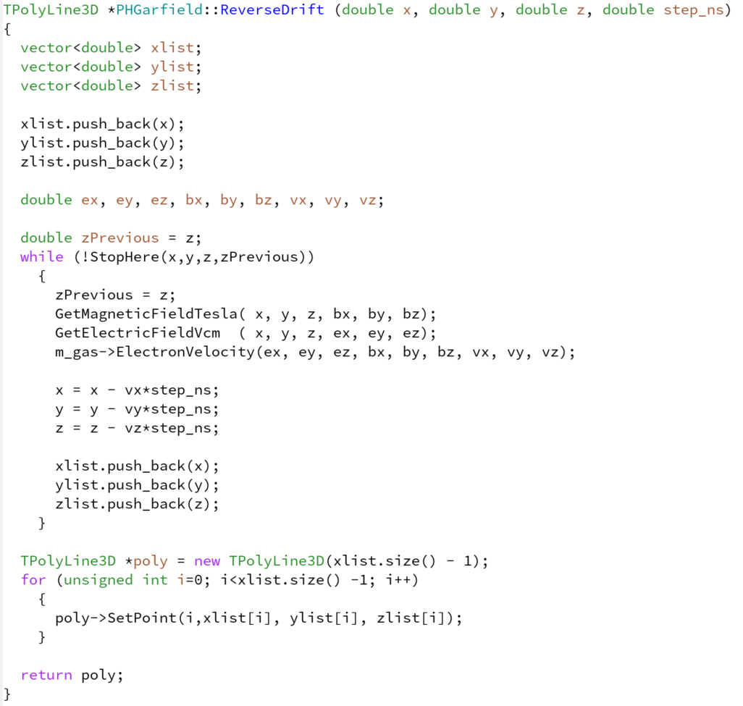
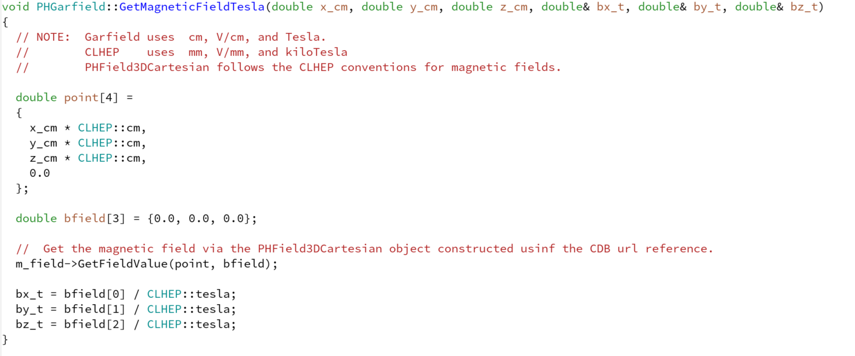
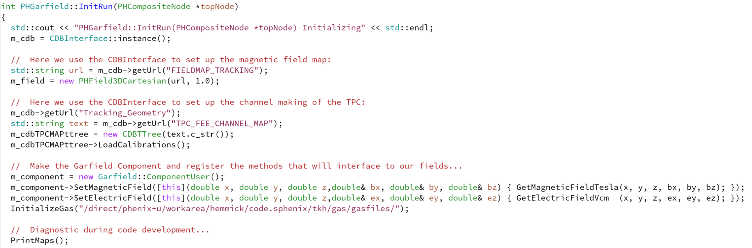
PHGarfield
Units are something of an issue:
  CLHEP: mm, V/mm, kiloTesla; Garfield: cm, V/cm, Tesla

Slide 6
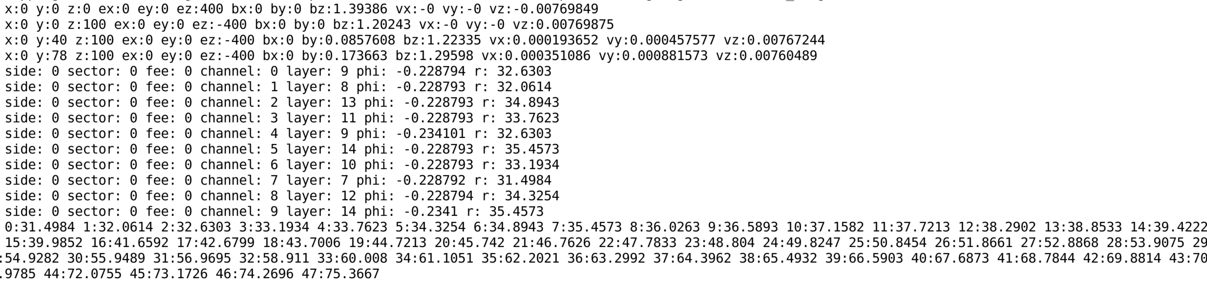
Spot Checks
E-field, B-field, Drift Velocity
Pad Locations
All this looks great, so let’s visualize the static distortions!

Slide 7
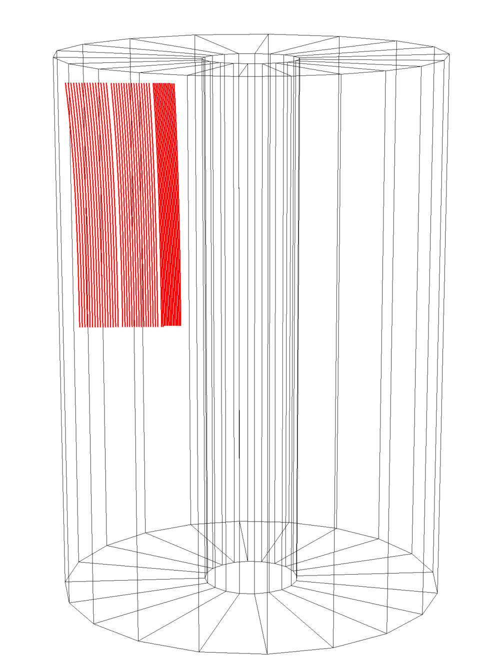
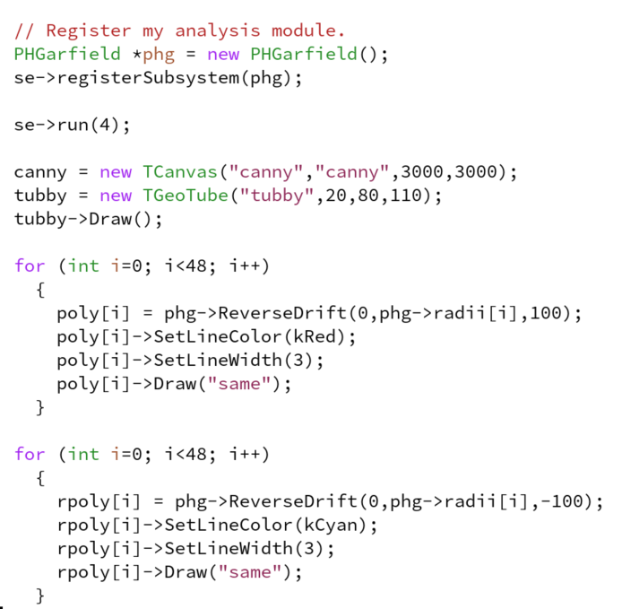
North
South
Dramatic radial shift!
NOTE: The cylinder is to guide the eye and is bigger then the TPC.

Slide 8
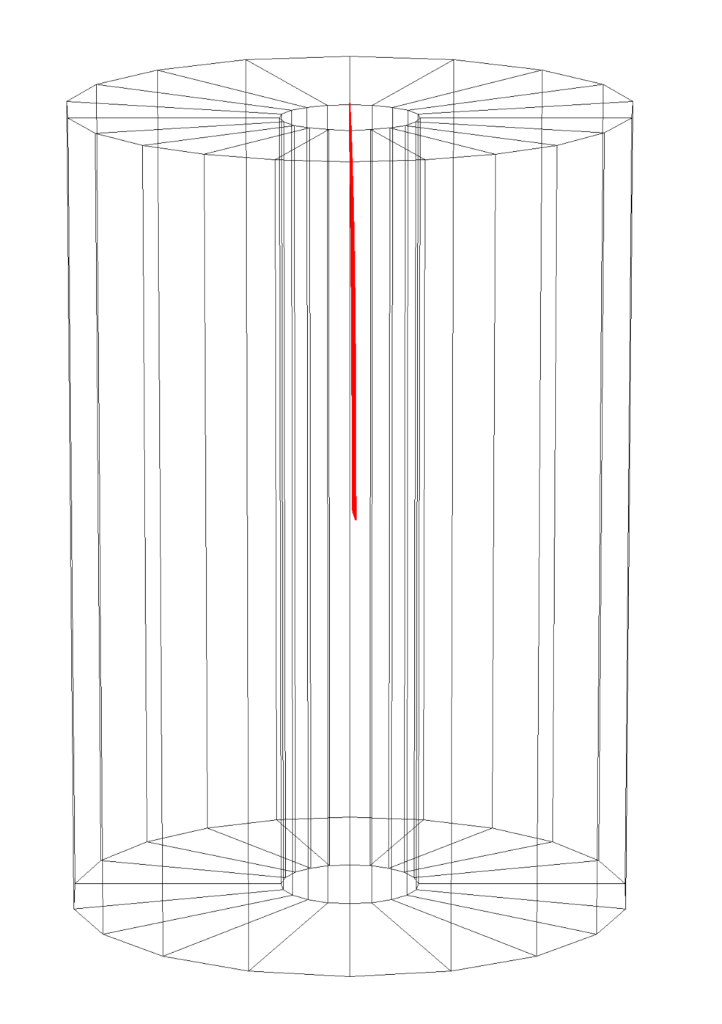
North
South

Slide 9
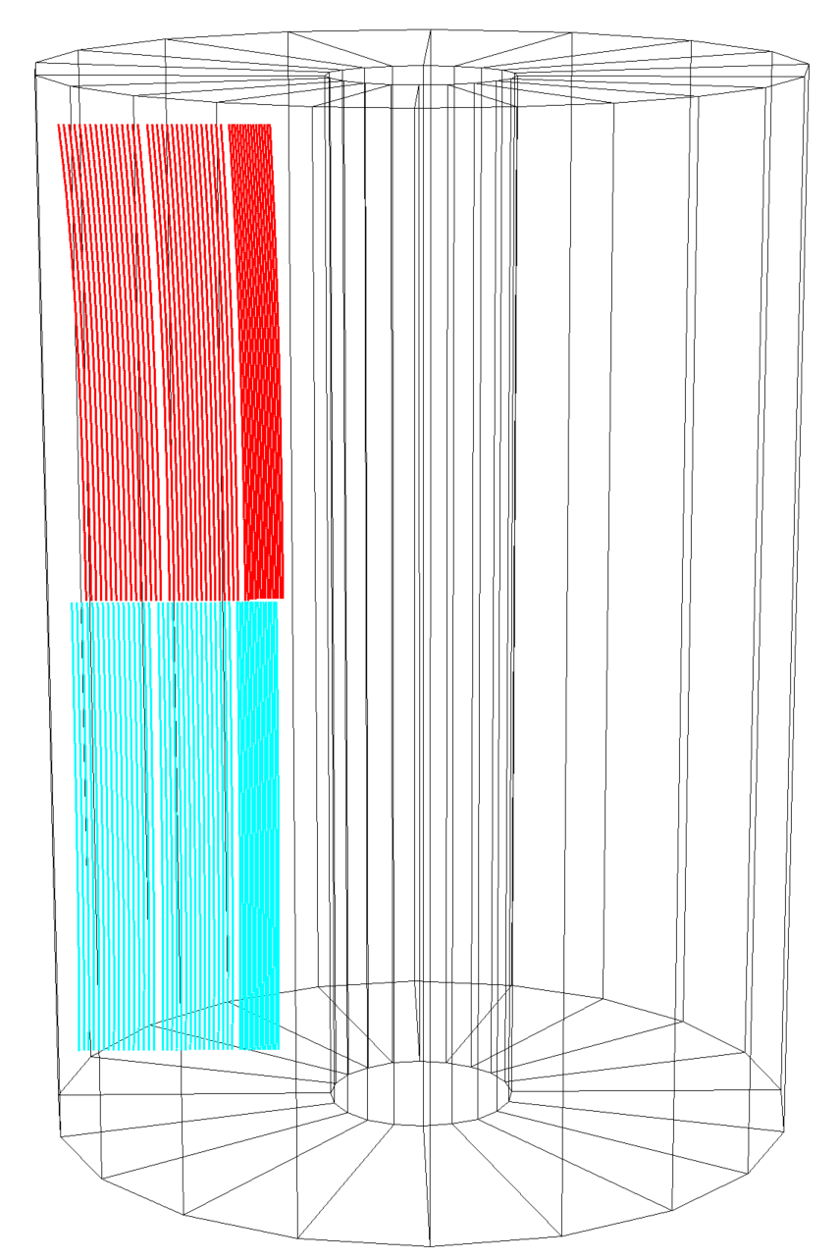
North
Dramatically different radial shifts!
South

Slide 10
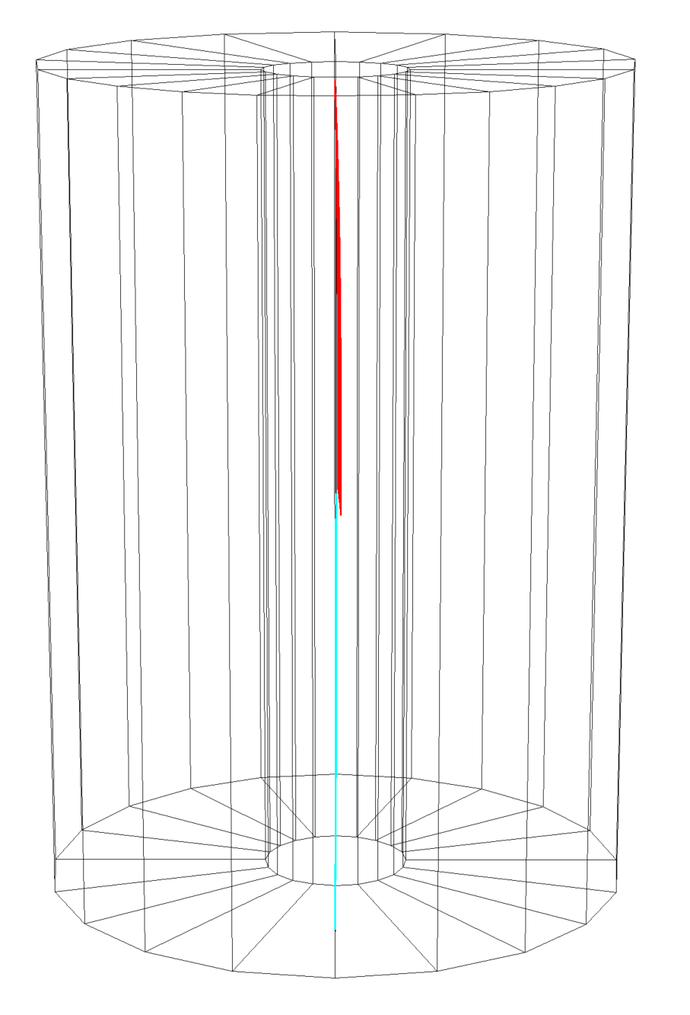
North
South

Slide 11
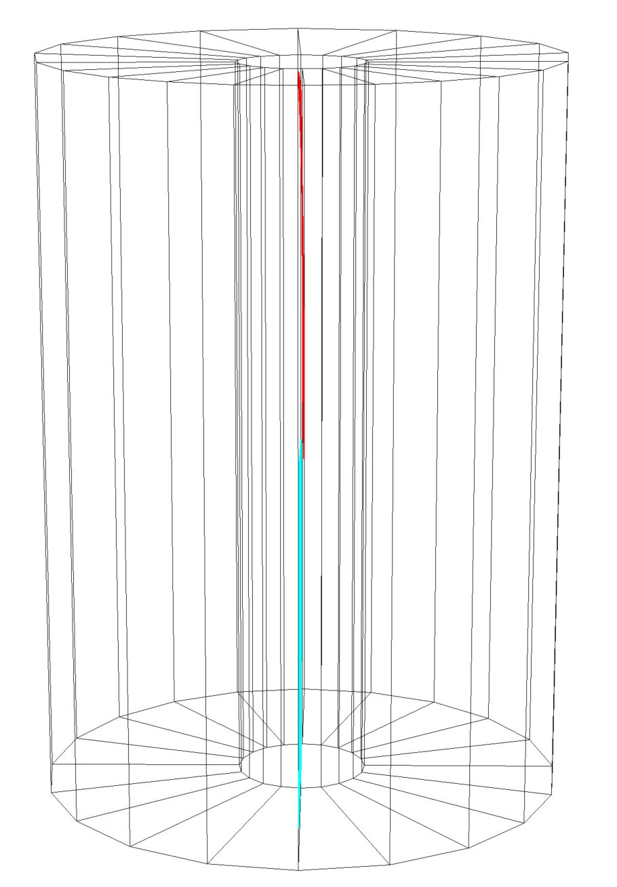
North
South

Slide 12
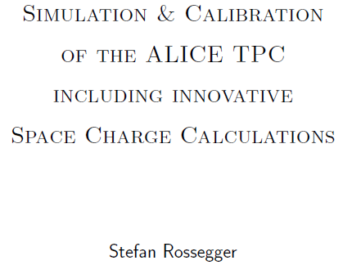
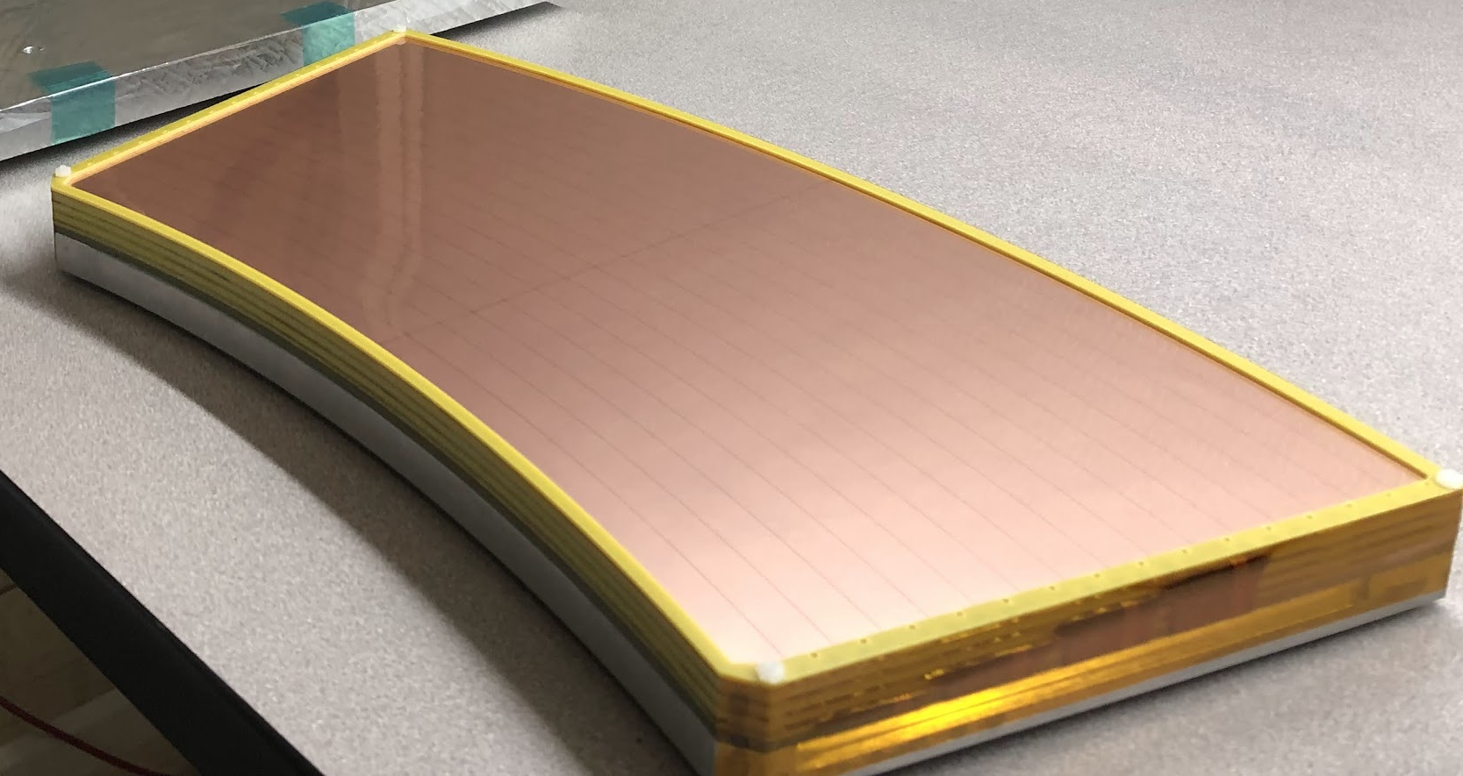
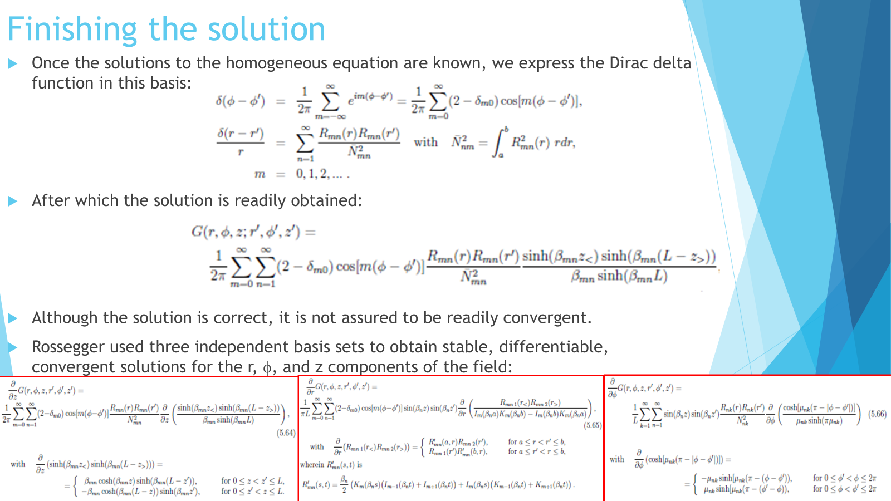
What else can we do?
Modules make a “pillar” of IBF
Dead Stripes cut “holes” in the pillars
Space charge creates an E-field and can also go in Garfield!
Ross has the “Rossiger” machinery to go from a detailed S.C. to E-field.
The basic concept is this:
  Corrections are “correct” when the RDCA distributions are zero & flat.
  We can devise “amplifiable” contributions:
    Scale SC field up or down by a multiplicative factor.
    Scale Drift Velocity up or down by a multiplicative factor.
    We’ve got to right when the RDCA shows that a helix fit hits the beam spot.
NOTE: Gain variations lead to pillar-by-pillar distortions.
Are these correlated with Mariia’s observation that the module edge distortions are not all the same?

Slide 13
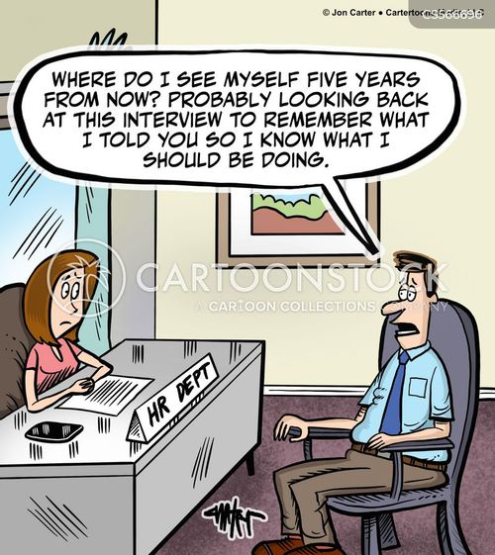
Other things
CDB needs an update.
Presently it only allows for ideal module placement.
It needs to have survey data
  And ideal…
  And real…
The future of the PolyLines:
  My preference is that we USE THEM as drift alleys and be done with it.
  It is also possible to form “Distortion Maps” from these.
    Distortion map = difference between naïve and true.
    But if we TUNE the naïve is the calculation still OK?
    If we align detectors with uncorrected data is it still OK?
    Is it all circular thinking?????

