Slide 1

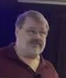
TPC Local Calibrations:
New Distortion Handling
Credit
Speaker

Slide 2
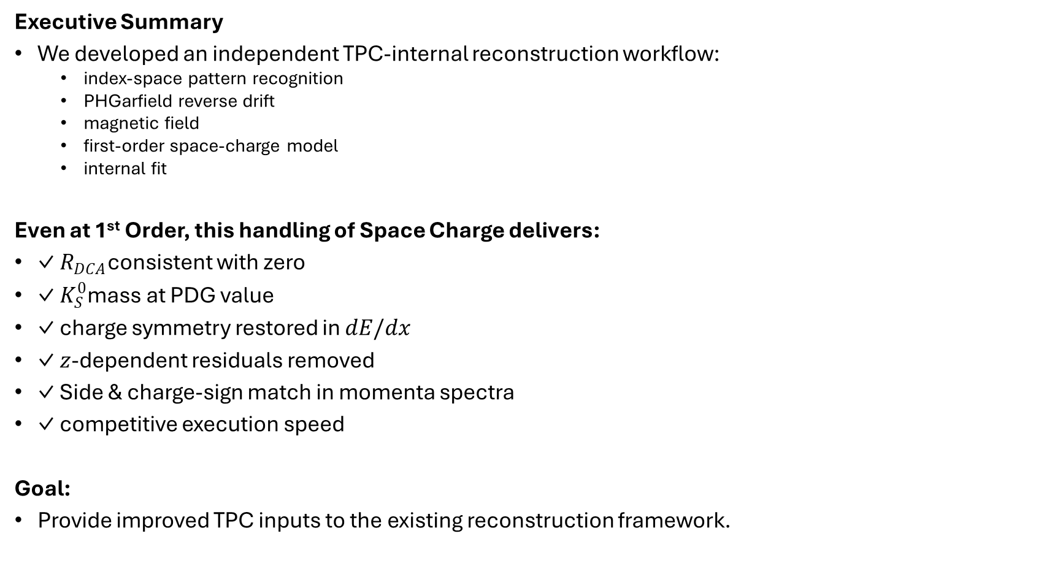
Executive Summary
Executive Summary
We developed an independent TPC-internal reconstruction workflow:
  index-space pattern recognition
  PHGarfield reverse drift
  magnetic field
  first-order space-charge model
  internal fit
Even at 1st Order, this handling of Space Charge delivers:
✓ $R_{DCA}$consistent with zero
✓ $K_{S}^{0}$mass at PDG value
✓ charge symmetry restored in $dE/dx$
✓ $z$-dependent residuals removed
✓ Side & charge-sign match in momenta spectra
✓ competitive execution speed
Goal:
Provide improved TPC inputs to the existing reconstruction framework.

Slide 3


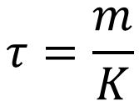
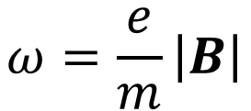
Distortions vs Alignments
$$τ=\frac{m}{K}$$
$$ω=\frac{e}{m}\left|B\right|$$
The TPC is our only detector that suffers significantly from distortions:
  Gas properties ➔ Known Physics (Garfield)
  Magnetic field ➔ Measured by CERN.
  Electric Field ➔ Space charge, Field Cage mechanics, magnetic materials…
Garfield handles these correctly physics as long as you know them
Space charge is the trickiest, but it can be handled by PHGarfield.

Slide 4
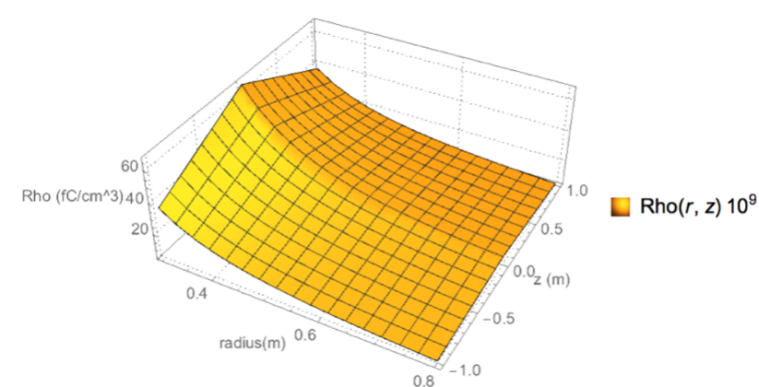
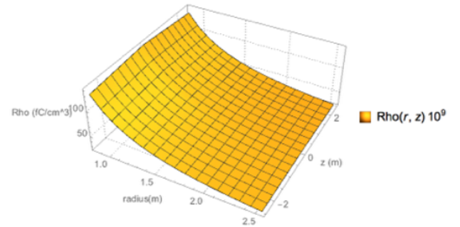
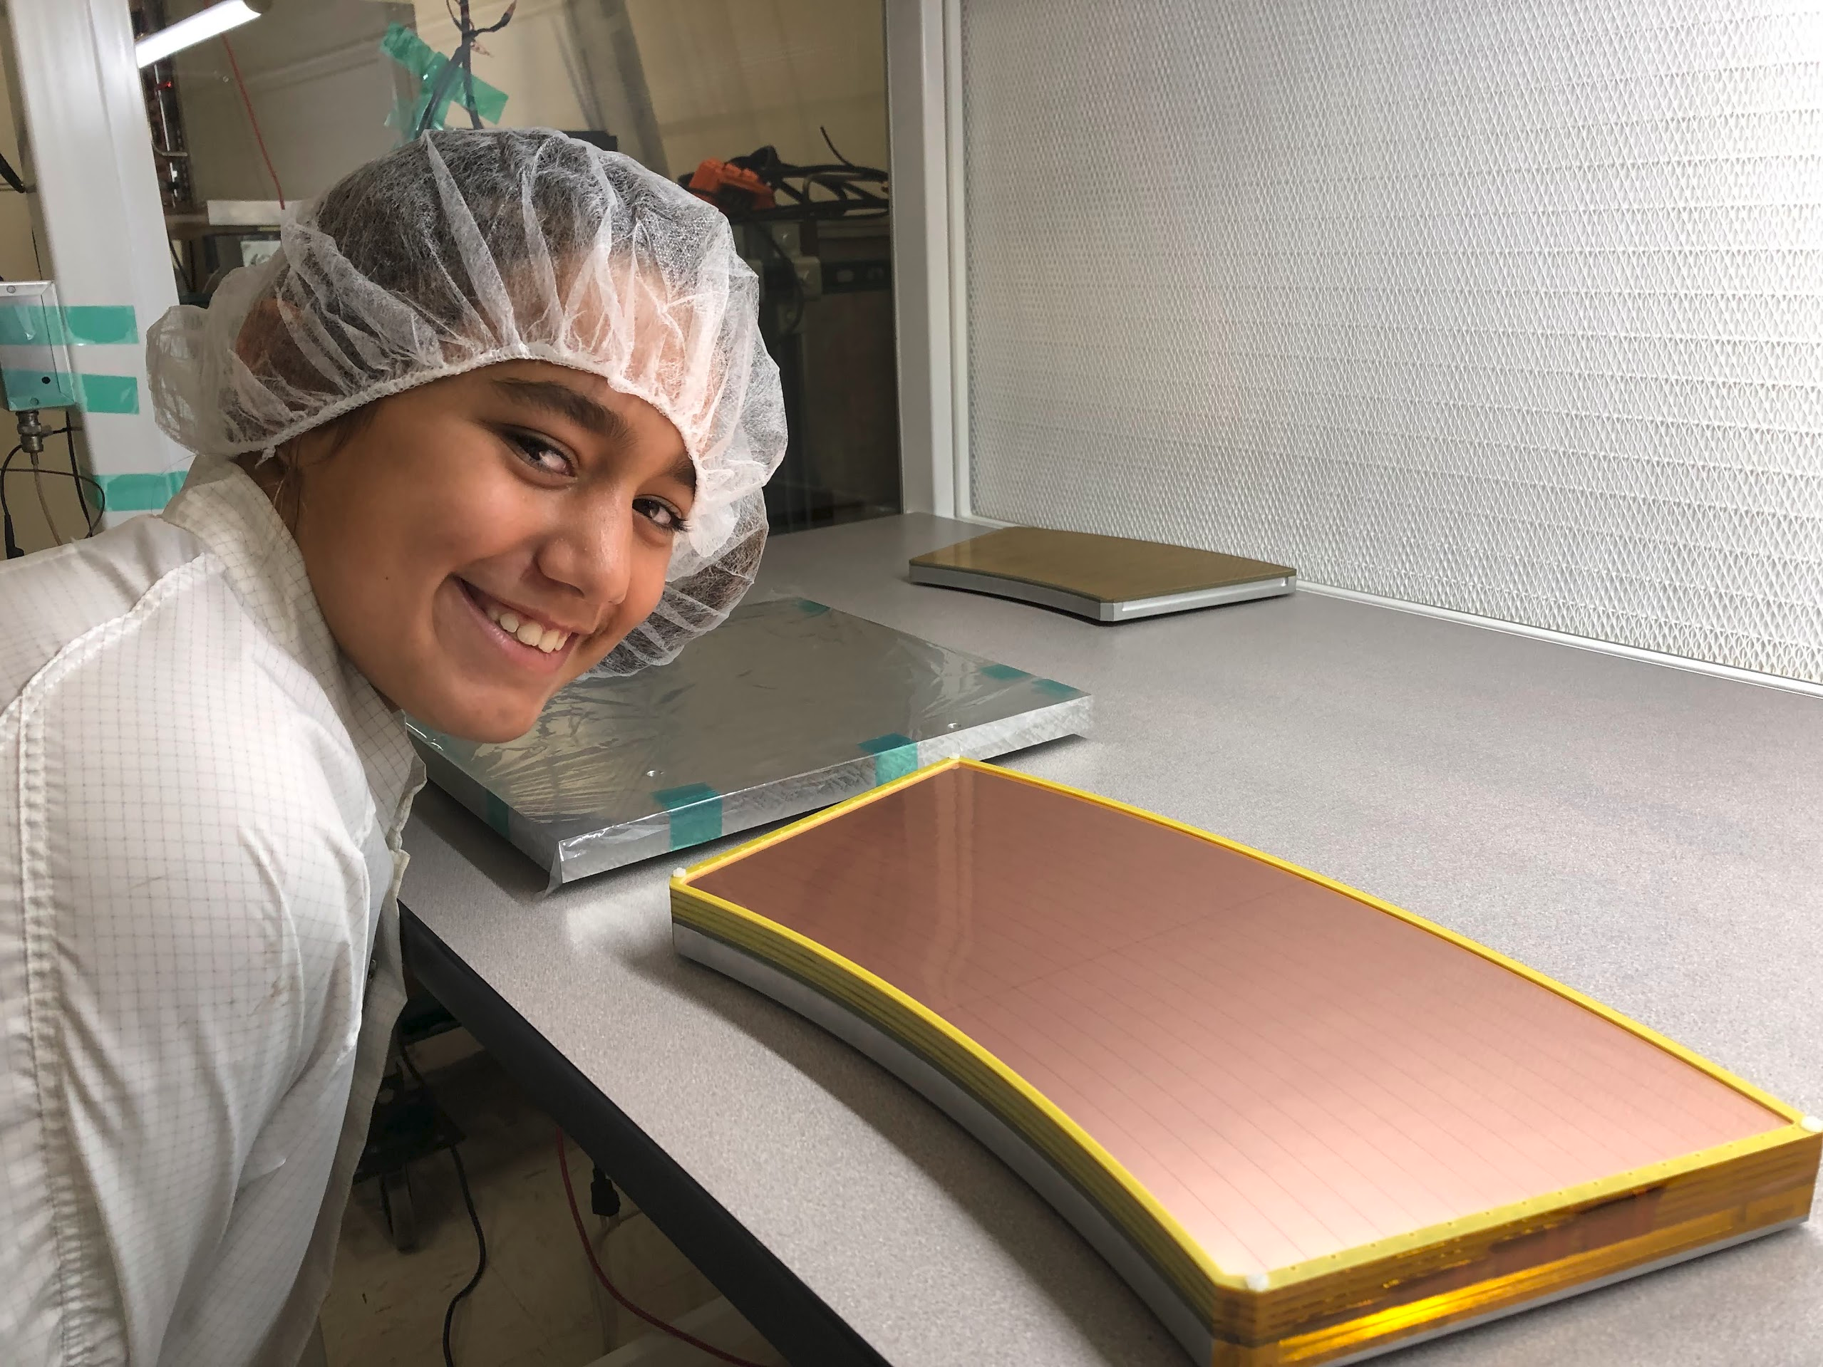
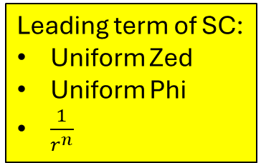
Principle Aspects of Space Charge
Primary
All
Leading term of SC:
Uniform Zed
Uniform Phi
$\frac{1}{r^{n}}$
A smooth underlying shape with finite-statistical fluctuations.
Two sources with different underlying shapes:
  Primary ionization (~5%):
    Zed-dependent density (high @ CM, low @ GEMs)
    R-dependent Density…”smooth” falloff at increasing R.
    ~Uniform in Phi.
  Ion Backflow (~95%)
    Flat in Zed & Phi
    Falls off with R.
    “Lumpy” (stripes have gaps, some are dead, may have substructure)
Stripes of charge

Slide 5
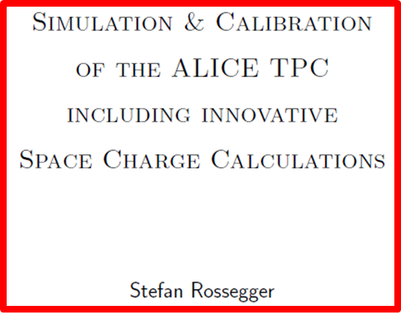
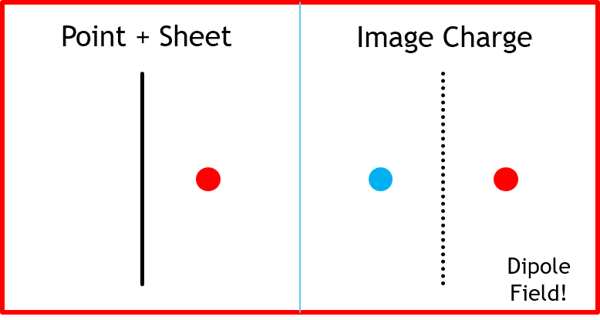
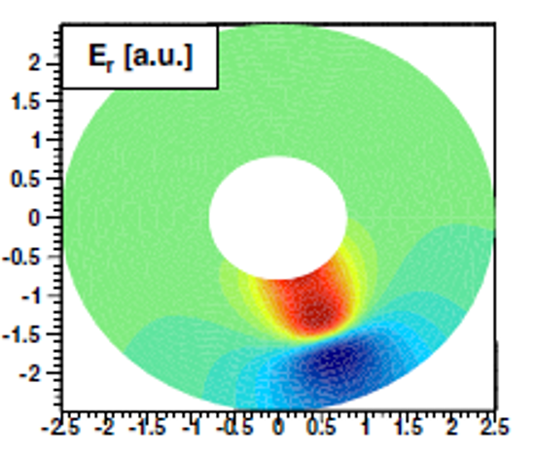
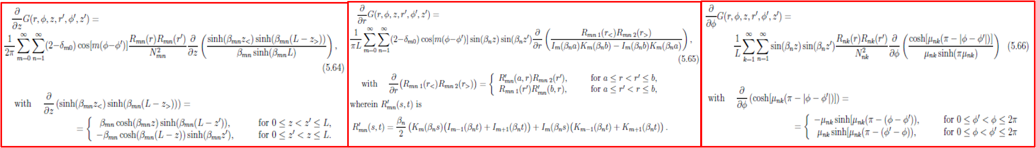
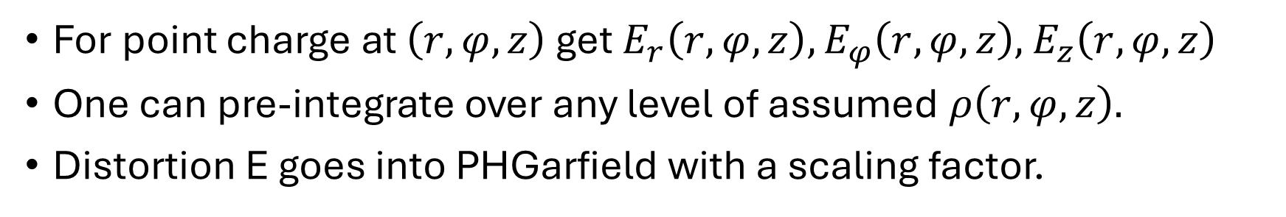
Space Charge is not in Free Space
Conductors Distort Field
Point Charge with TPC Boundary Conditions
For point charge at $\left(r, φ, z\right)$ get $E_{r}\left(r, φ, z\right),E_{φ}\left(r, φ, z\right),$ $E_{z}\left(r, φ, z\right)$
One can pre-integrate over any level of assumed $ρ\left(r, φ, z\right).$
Distortion E goes into PHGarfield with a scaling factor.

Slide 6
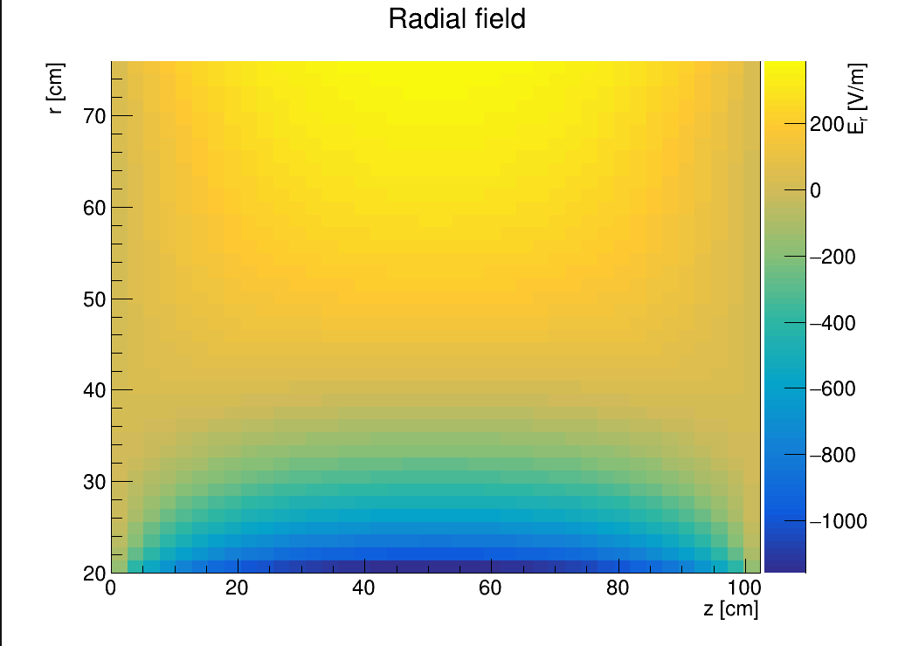
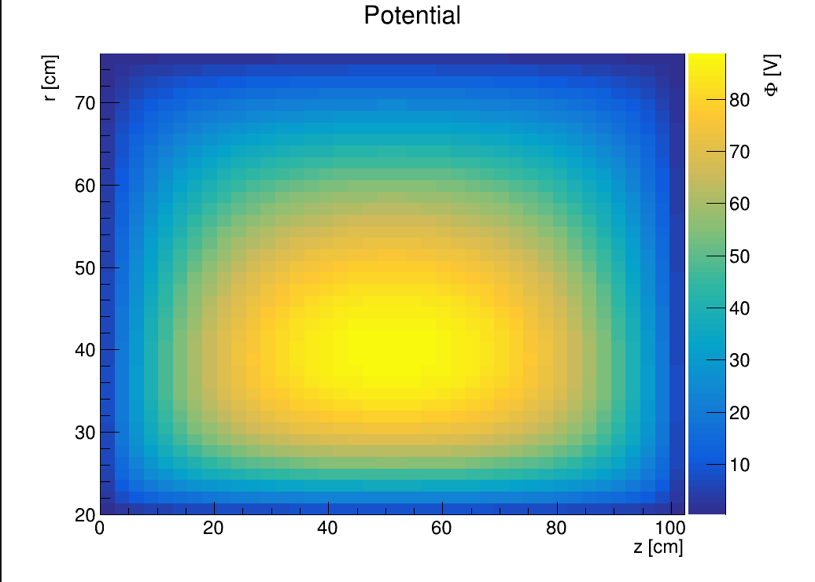
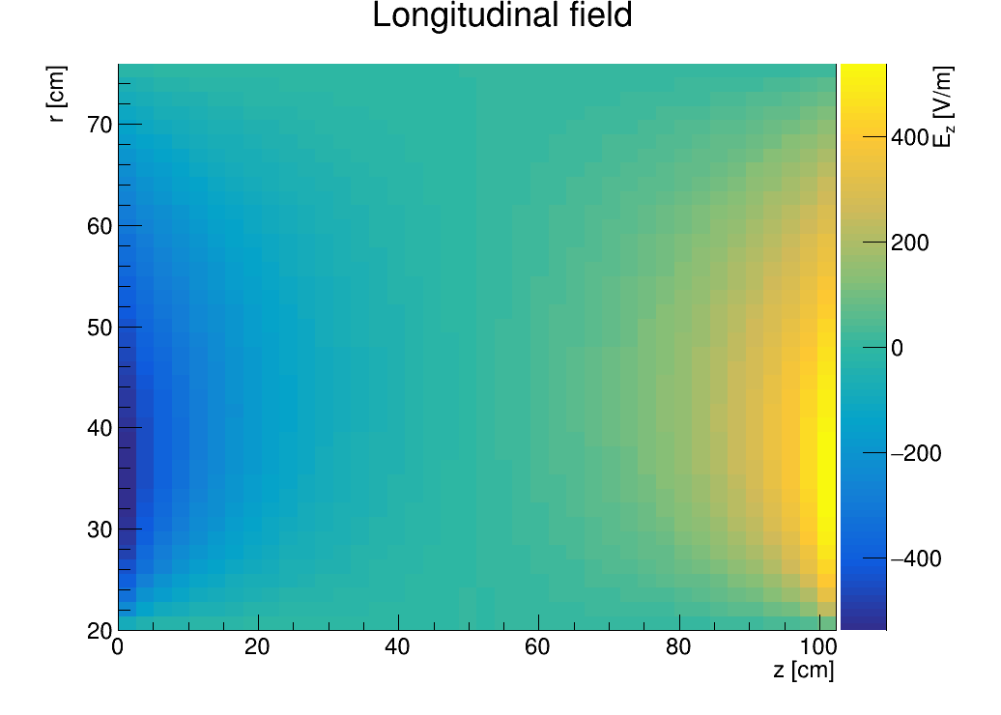
SC Electric field
This field is then normalized in South and North side to correspond the SC in a particular run
These pictures show coefficient south =1, coefficient north=1

Slide 7
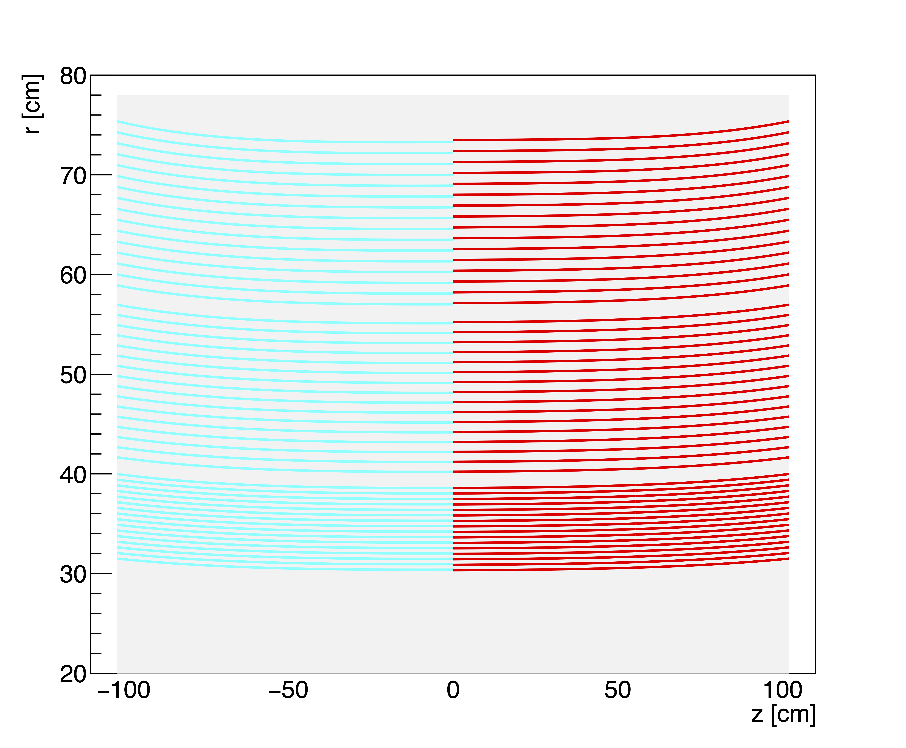
PHGarfield
Polylines
Magnetic field map
No SC Electric field

Slide 8

Polylines
SC Electric field
For p+p
Coefficients
Soth 1.0 North 1.6

Slide 9

Polylines
SC Electric field
For O+O
Coefficients
Soth 5.4 North 5.8

Slide 10

Polylines
Exaggerated example
Coefficients
South 10 North 10

Slide 11
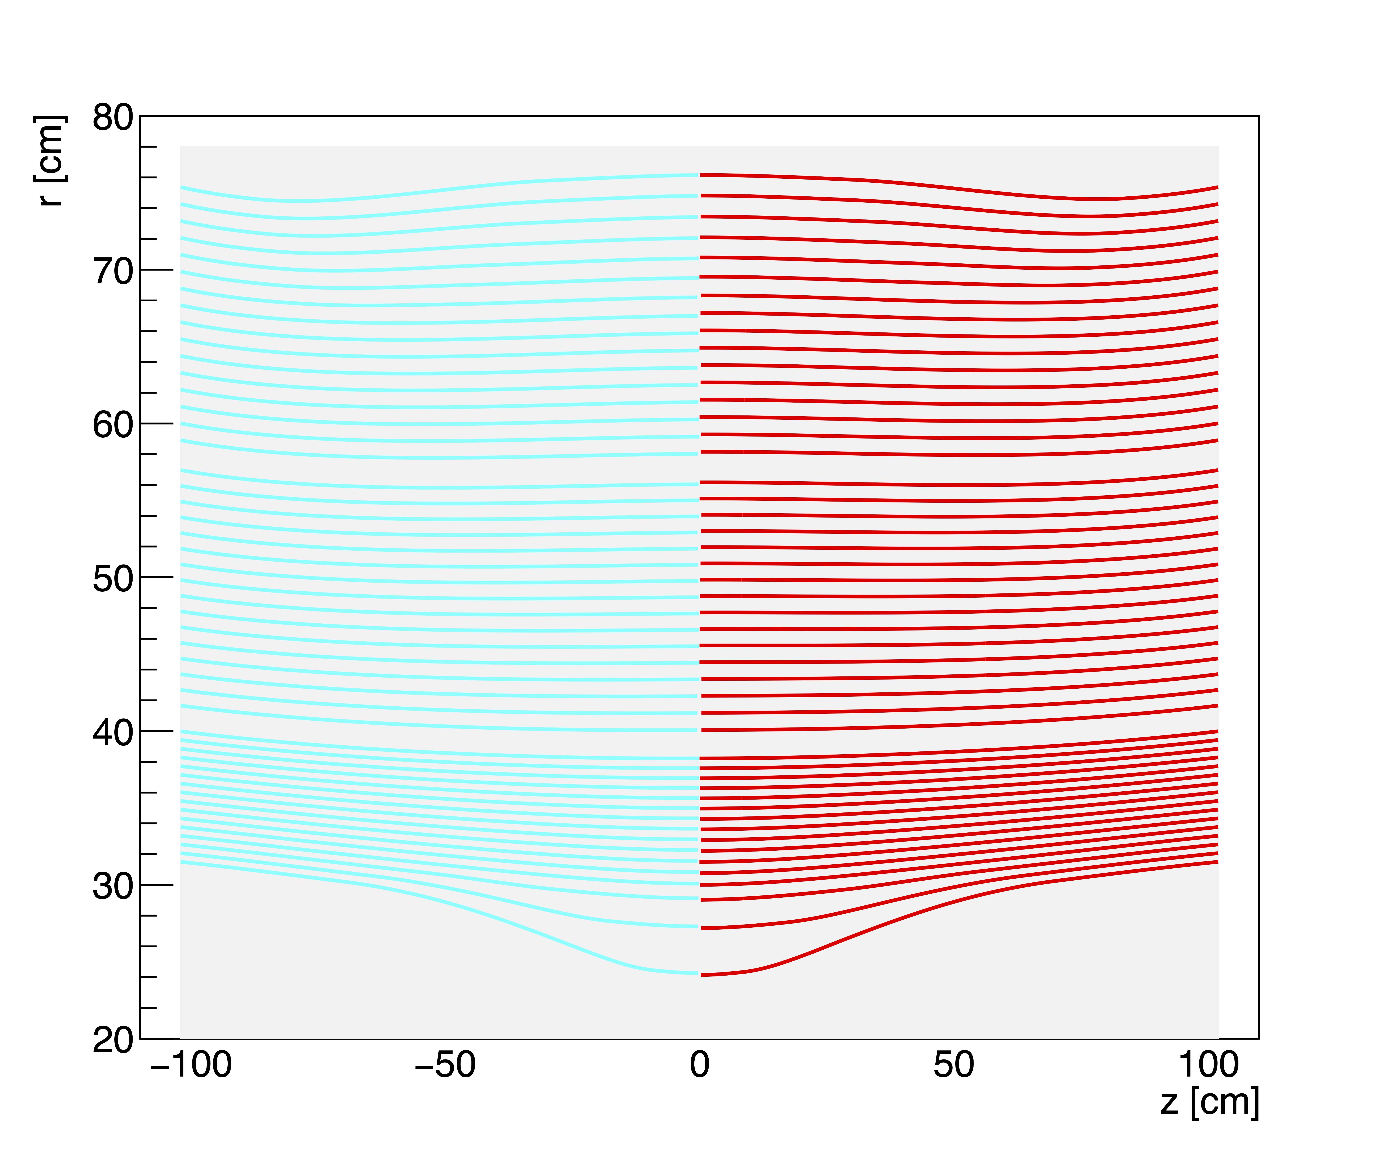
Polylines
Exaggerated example
Coefficients
South 20 North 20

Slide 12
How to apply this information:
Result now has a drift velocity that is:
  Not simply directed along Zed.
  Not a constant.
  Both radial (E from SC) and azimuthal (ExB) components.
The firing of a pad follows the Polyline backwards in time to place the charge into a 3D location within the TPC volume.
Desired:
  Comment these in three-space without snapping to ACTs
    Uncorrected distortions can be huge and make non-physical trajectories.
    Trajectories can appear non-physical when the SC correction is wrong.
    Need a “loose” algorithm that connects the hits to allow us to scan over too high and too low SC corrections to deduce experimentally the size of the distortion.
  Level of SC determined without bias toward “good tracks” “Matched tracks” …
  Corrected trajectory for each TPC-only track can return precision info to ACTs

Slide 13
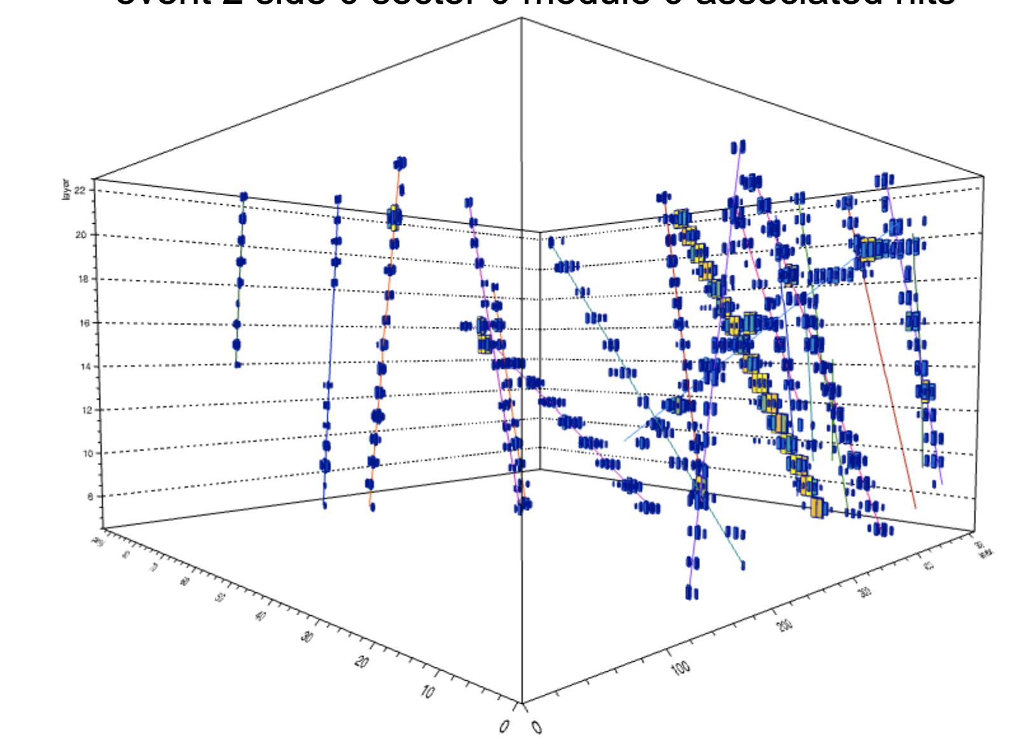
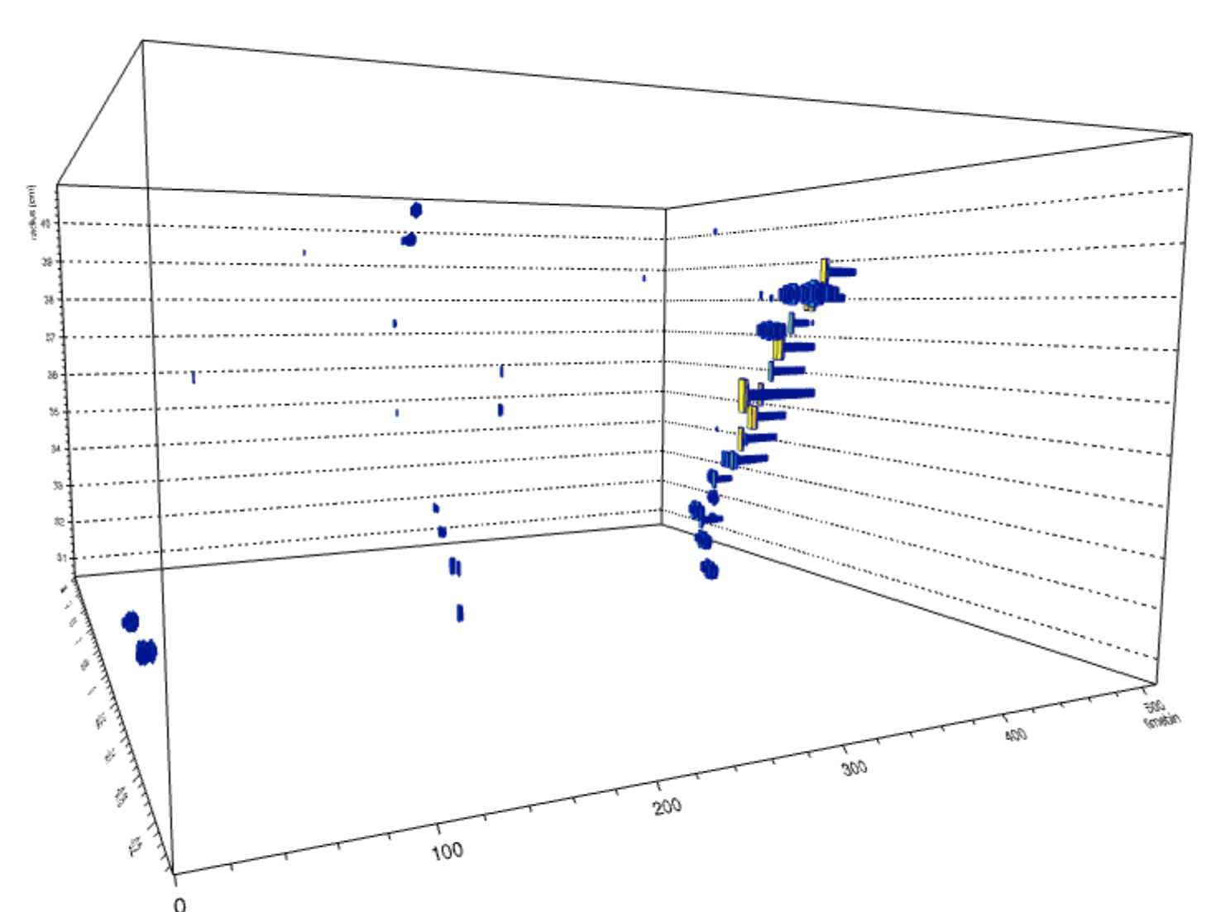
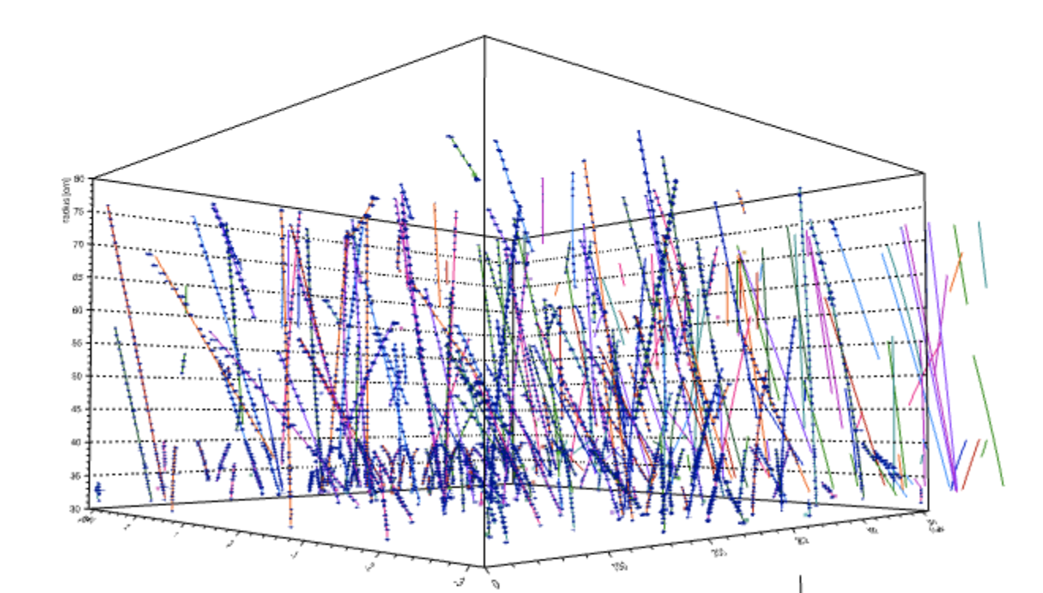
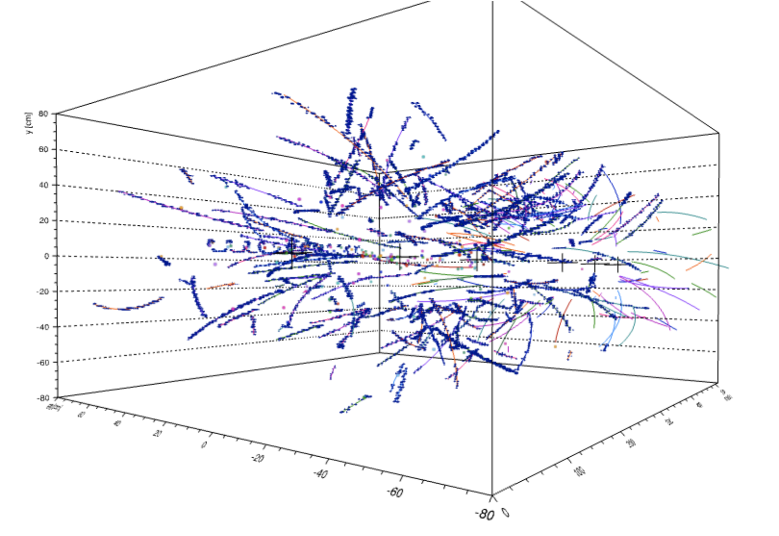
TPC-only Algorithm overview
Not assigned to any track
Assigned to module track
Tpc_ModuleTracks
( pad phi, layer radius, time bin)
( x, y, time bin)
TPC_AssembledTracks
TPC_PolyTracks
E and B polylines
Hits
Physics space
x,y,z
Hits
hardware coordinates
Final clusters
x,y,z
Reverse drift from pad plane
We will comment on algorithm performance at the end.

Slide 14
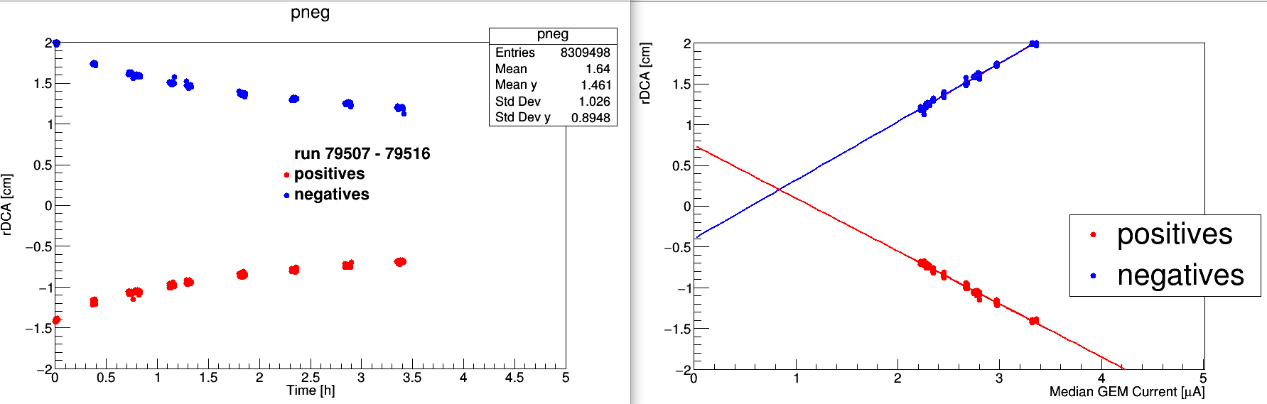
Overview of the Process.
Test scenario:
Use the 1st order space charge.
  Can be upgraded.
Solve TPC-only tracking with varying Space charge with a convergence criterion of “good R_{DCA}”
Look at physical variables to see if there is improvement.
The figure on the left has been used to say that R_{DCA} errors are not primarily from space charge since the effect seems to be leveling off with time.
We believe that this interpretation is premature since beam intensity does not fall linearly with time.
The figure on the right shows that when plotted vs beam load, the R_{DCA} error does vary linearly with load.

Slide 15
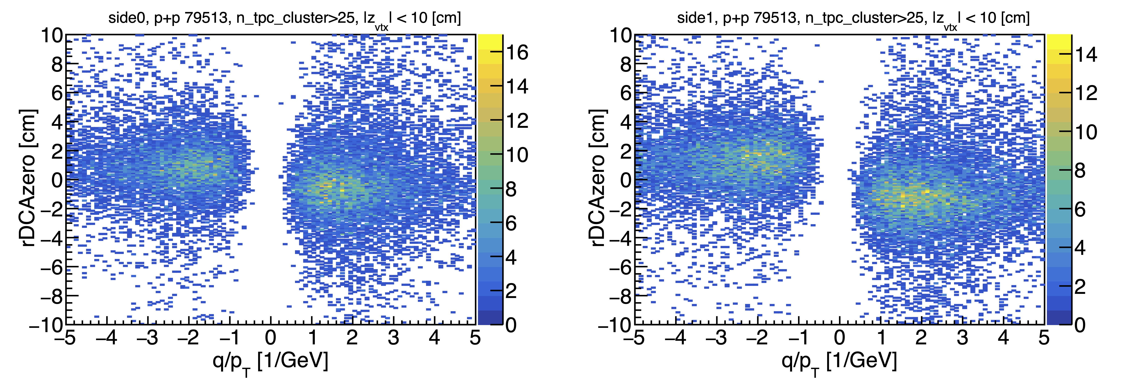
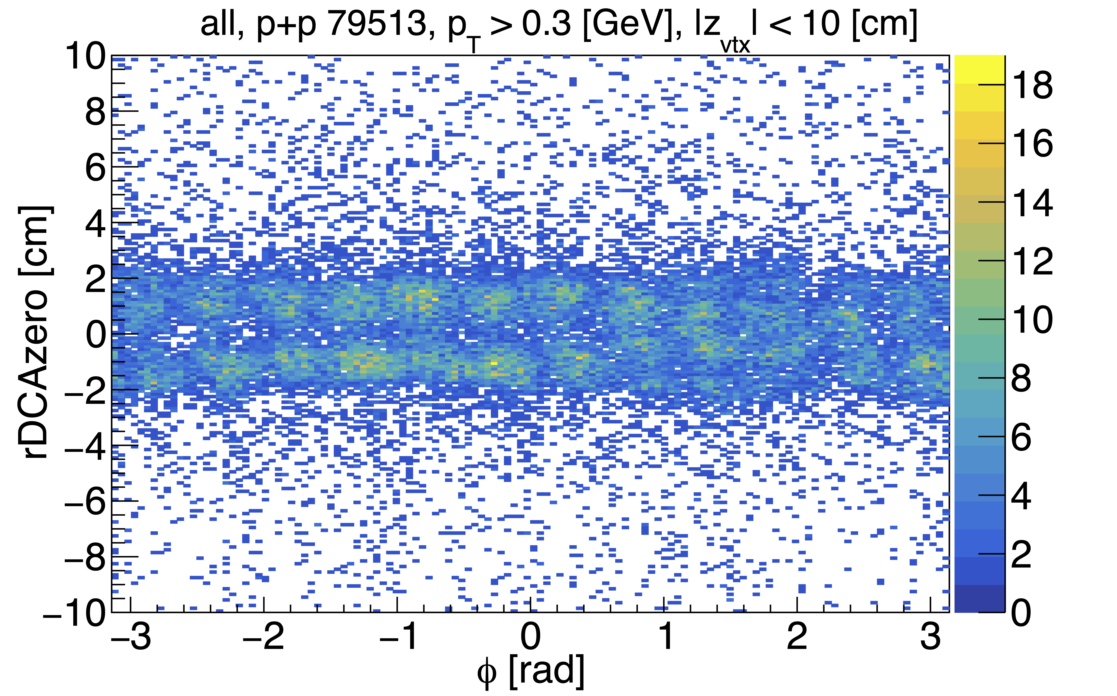
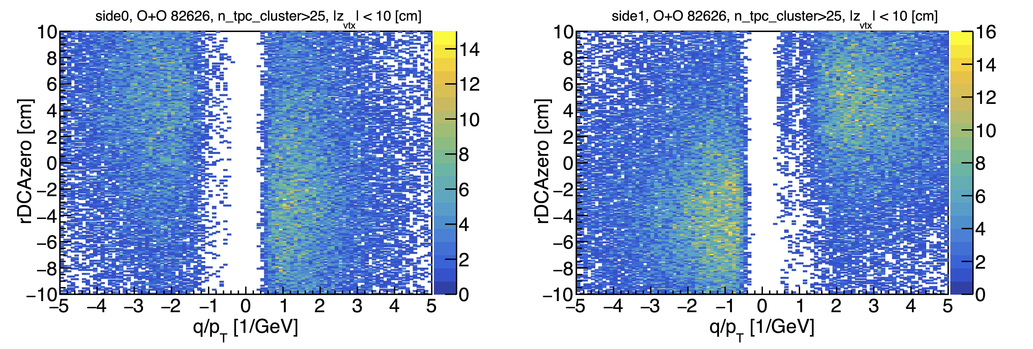
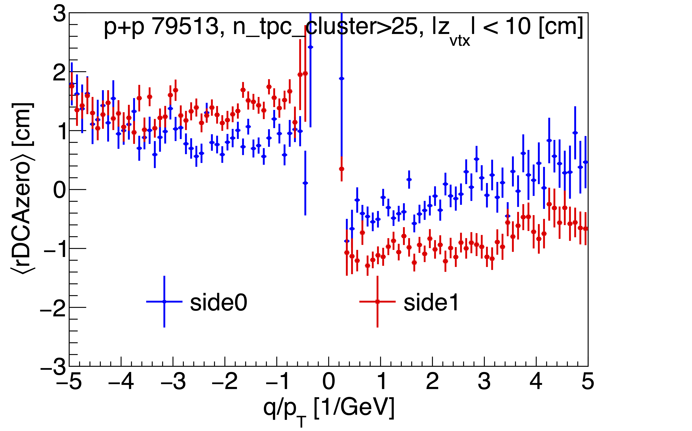
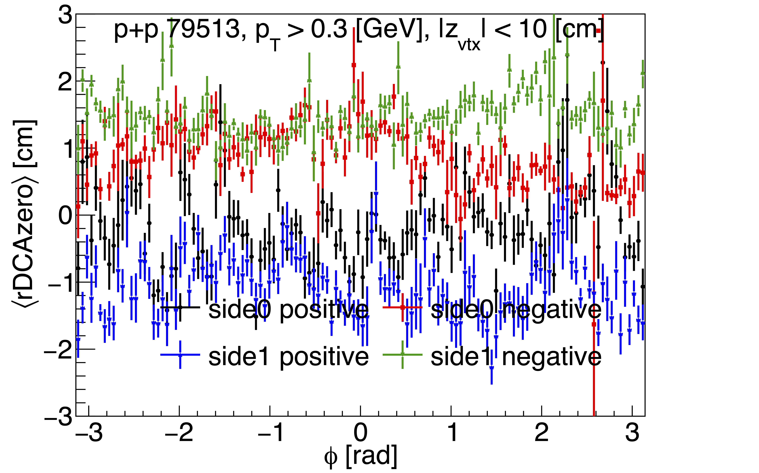
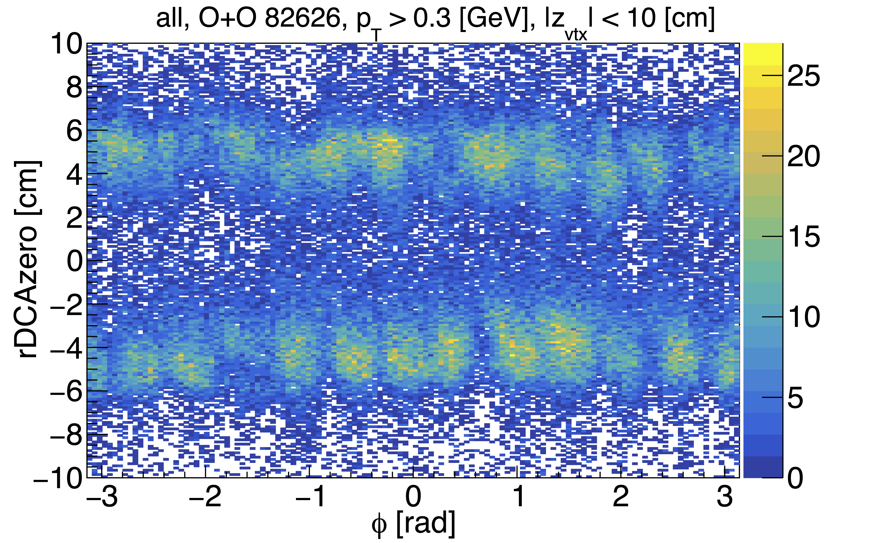
With only magnetic field. Before SC 1st order SC
O+O
p+p
Mean values for such distributions don’t even make a lot of sense

Slide 16
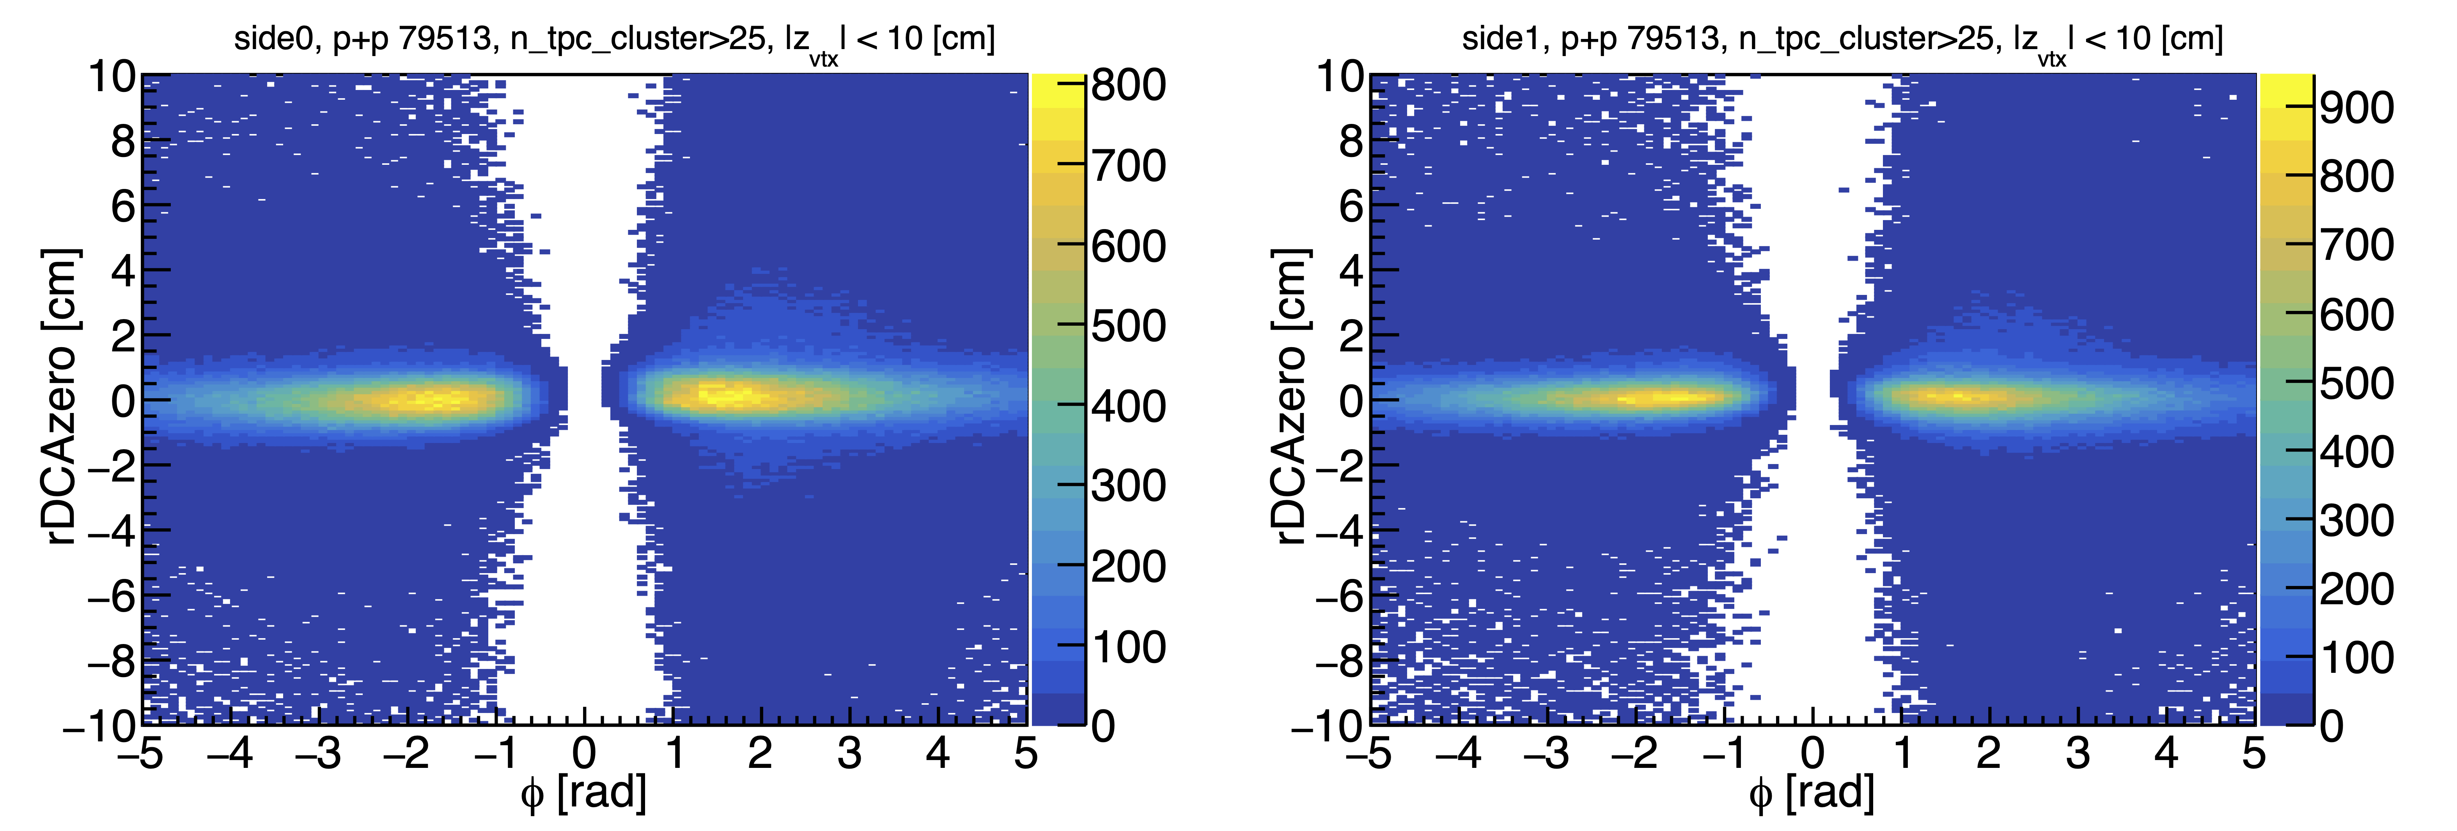
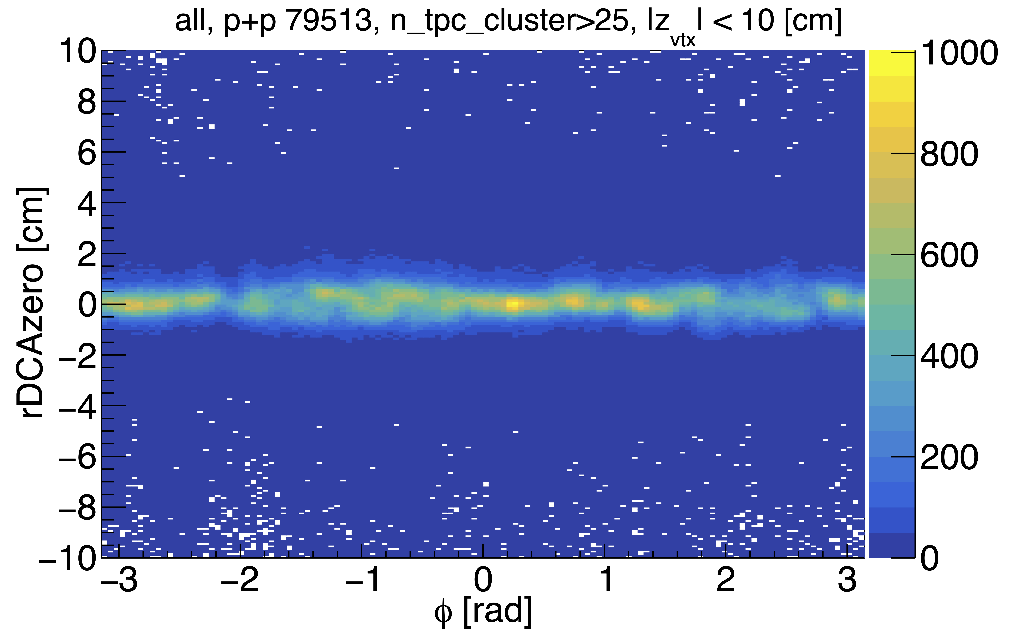
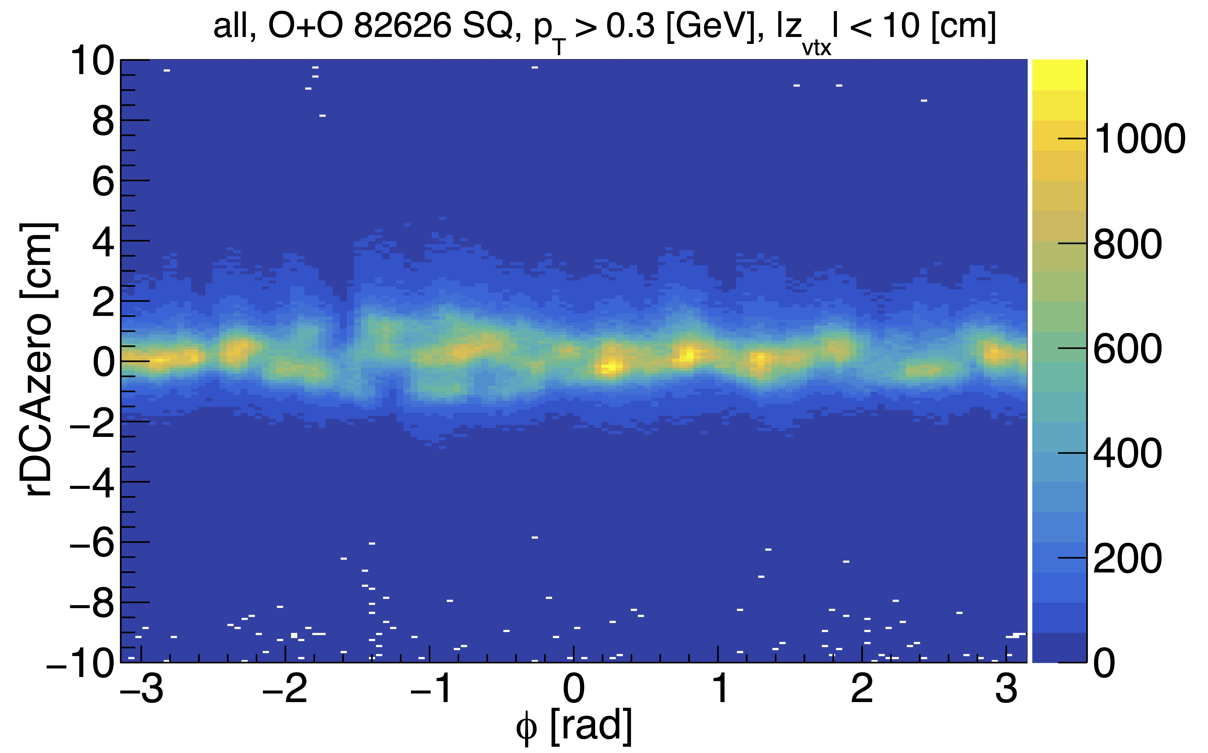
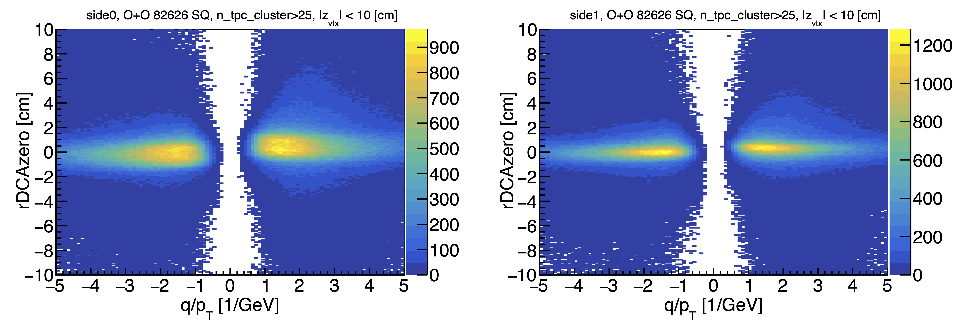
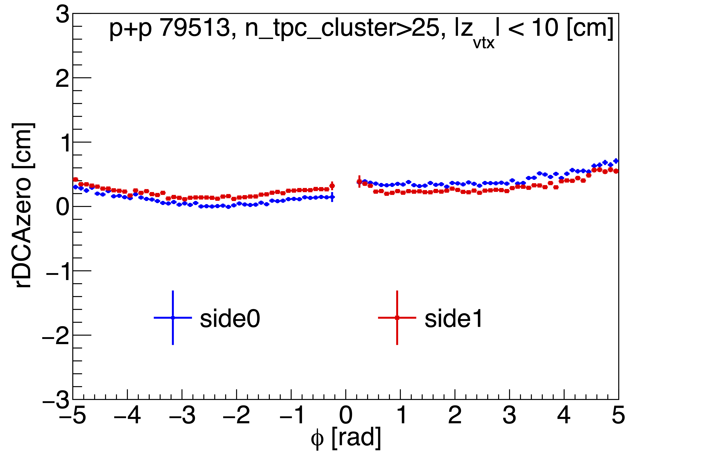
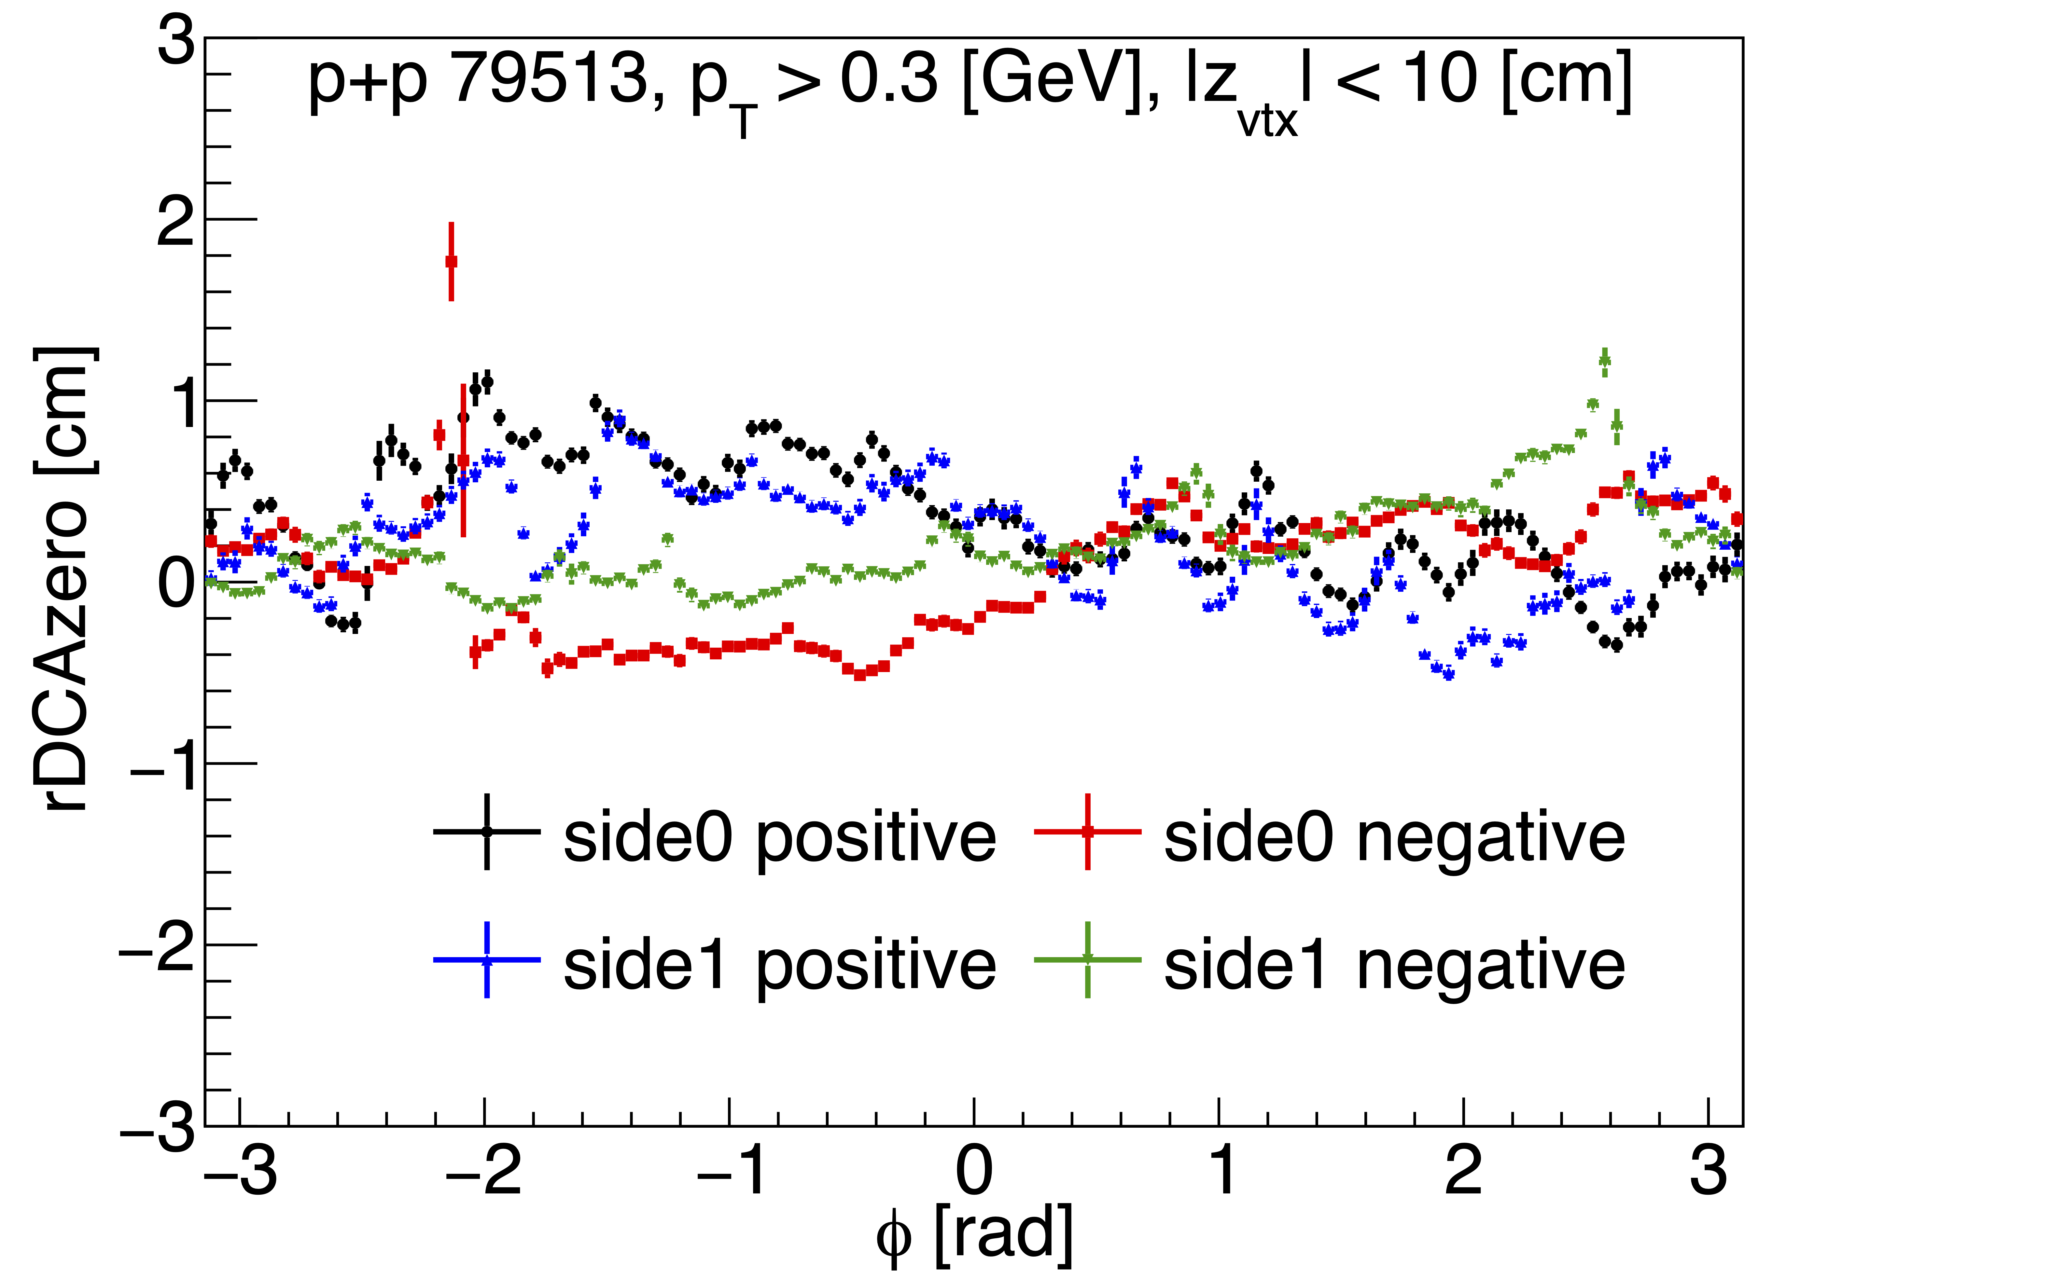
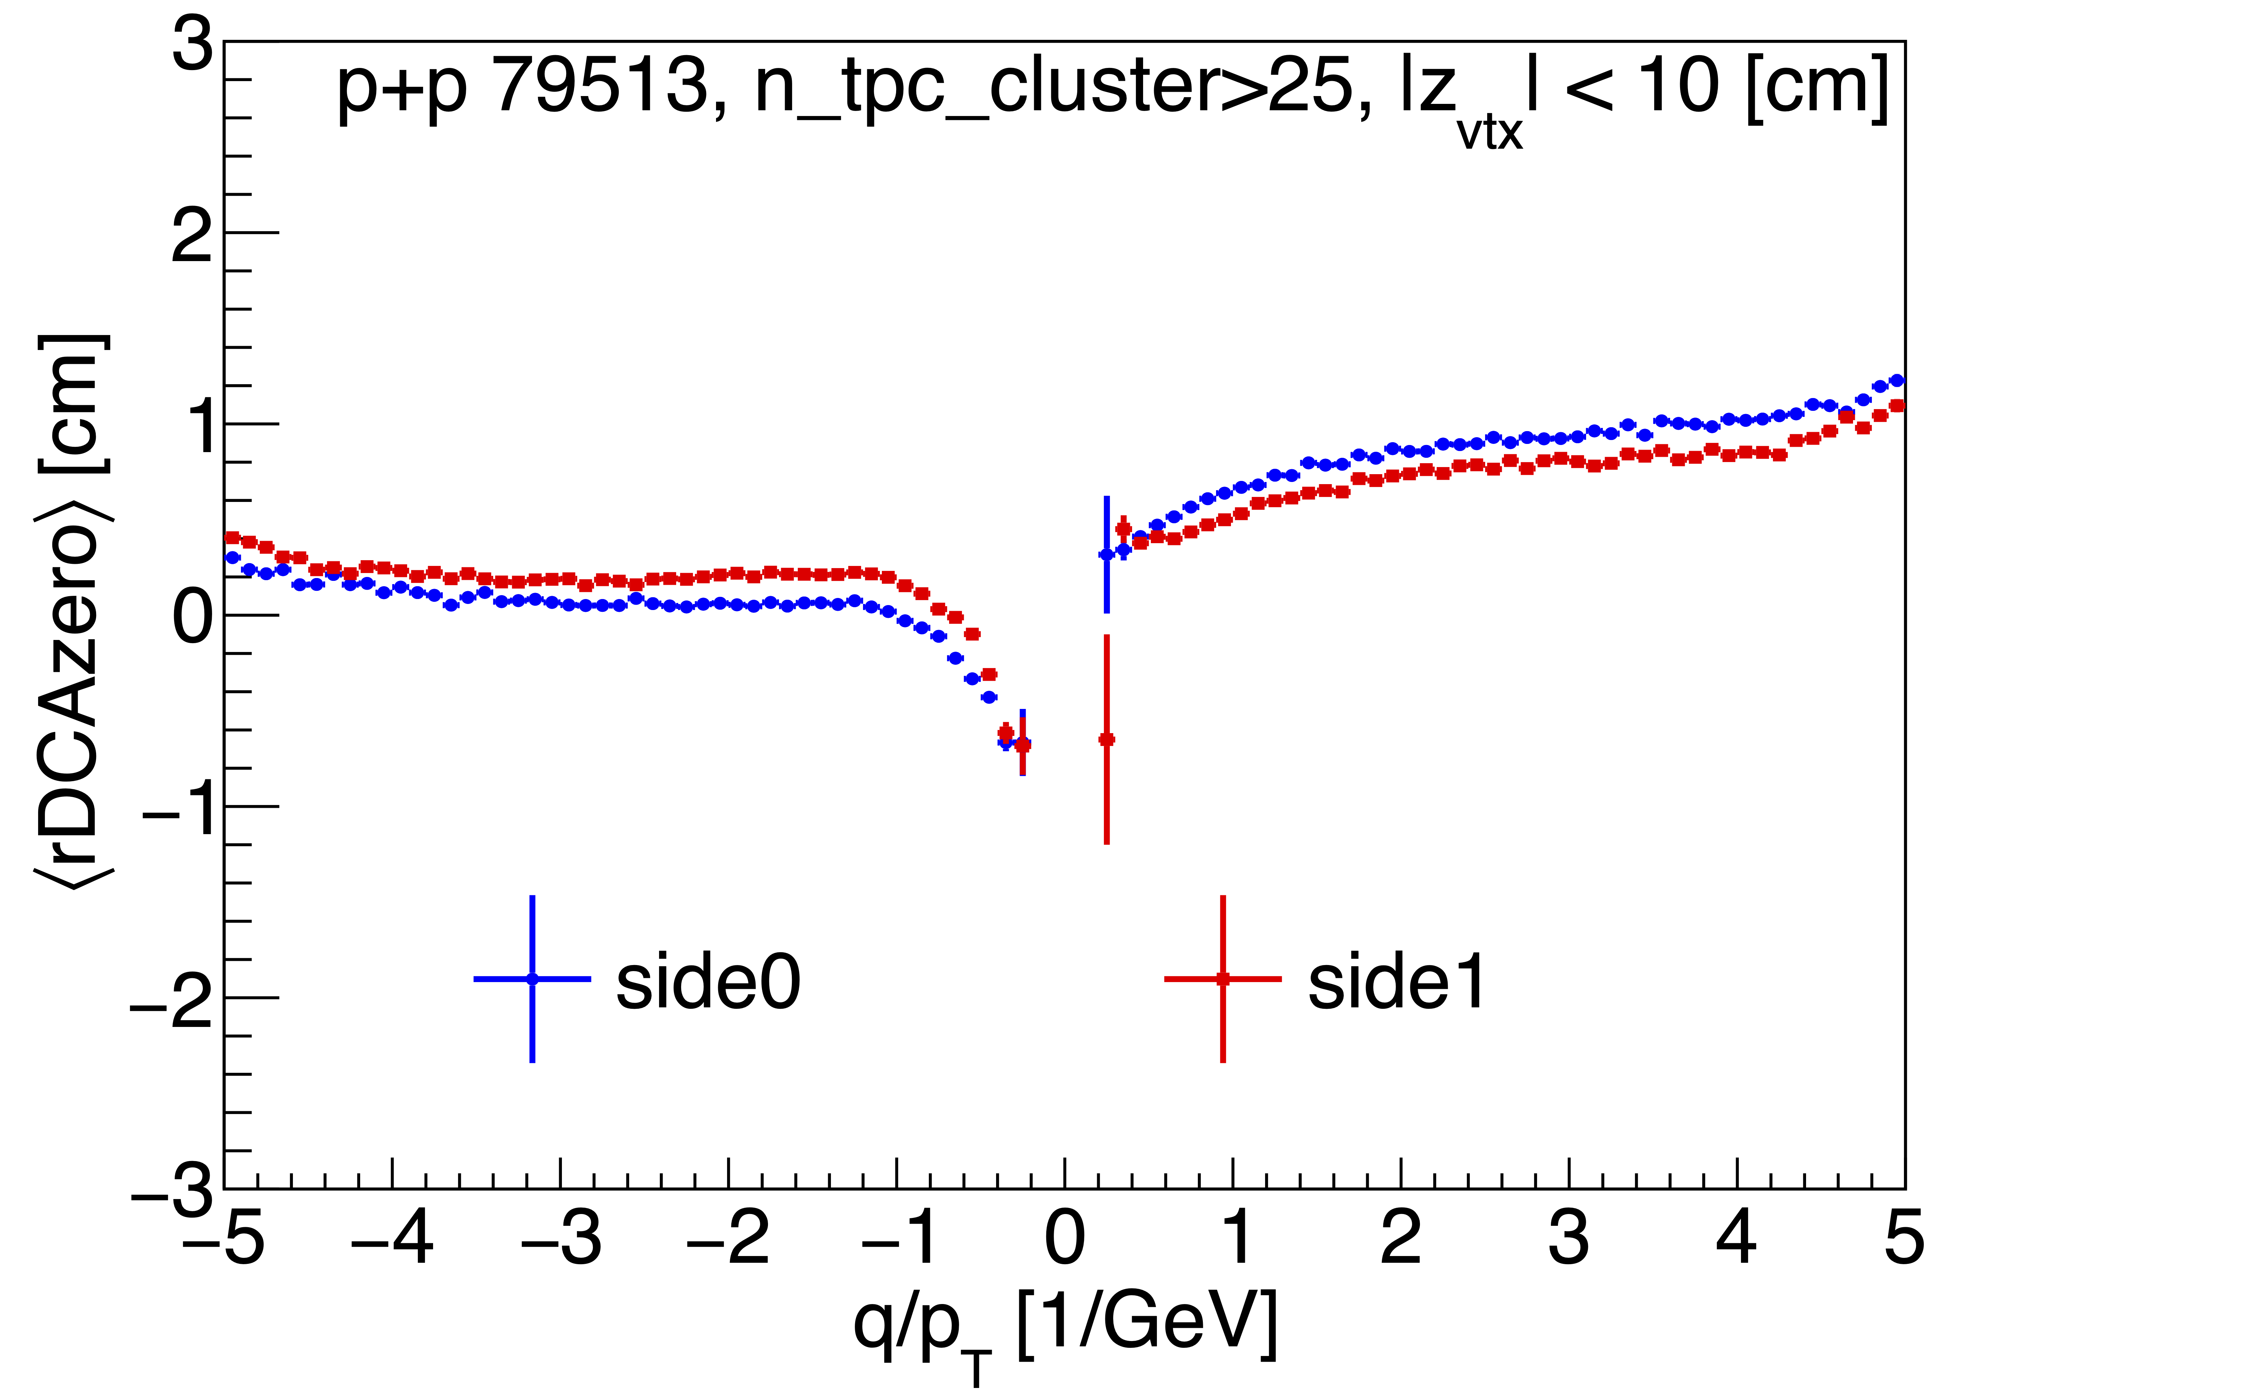
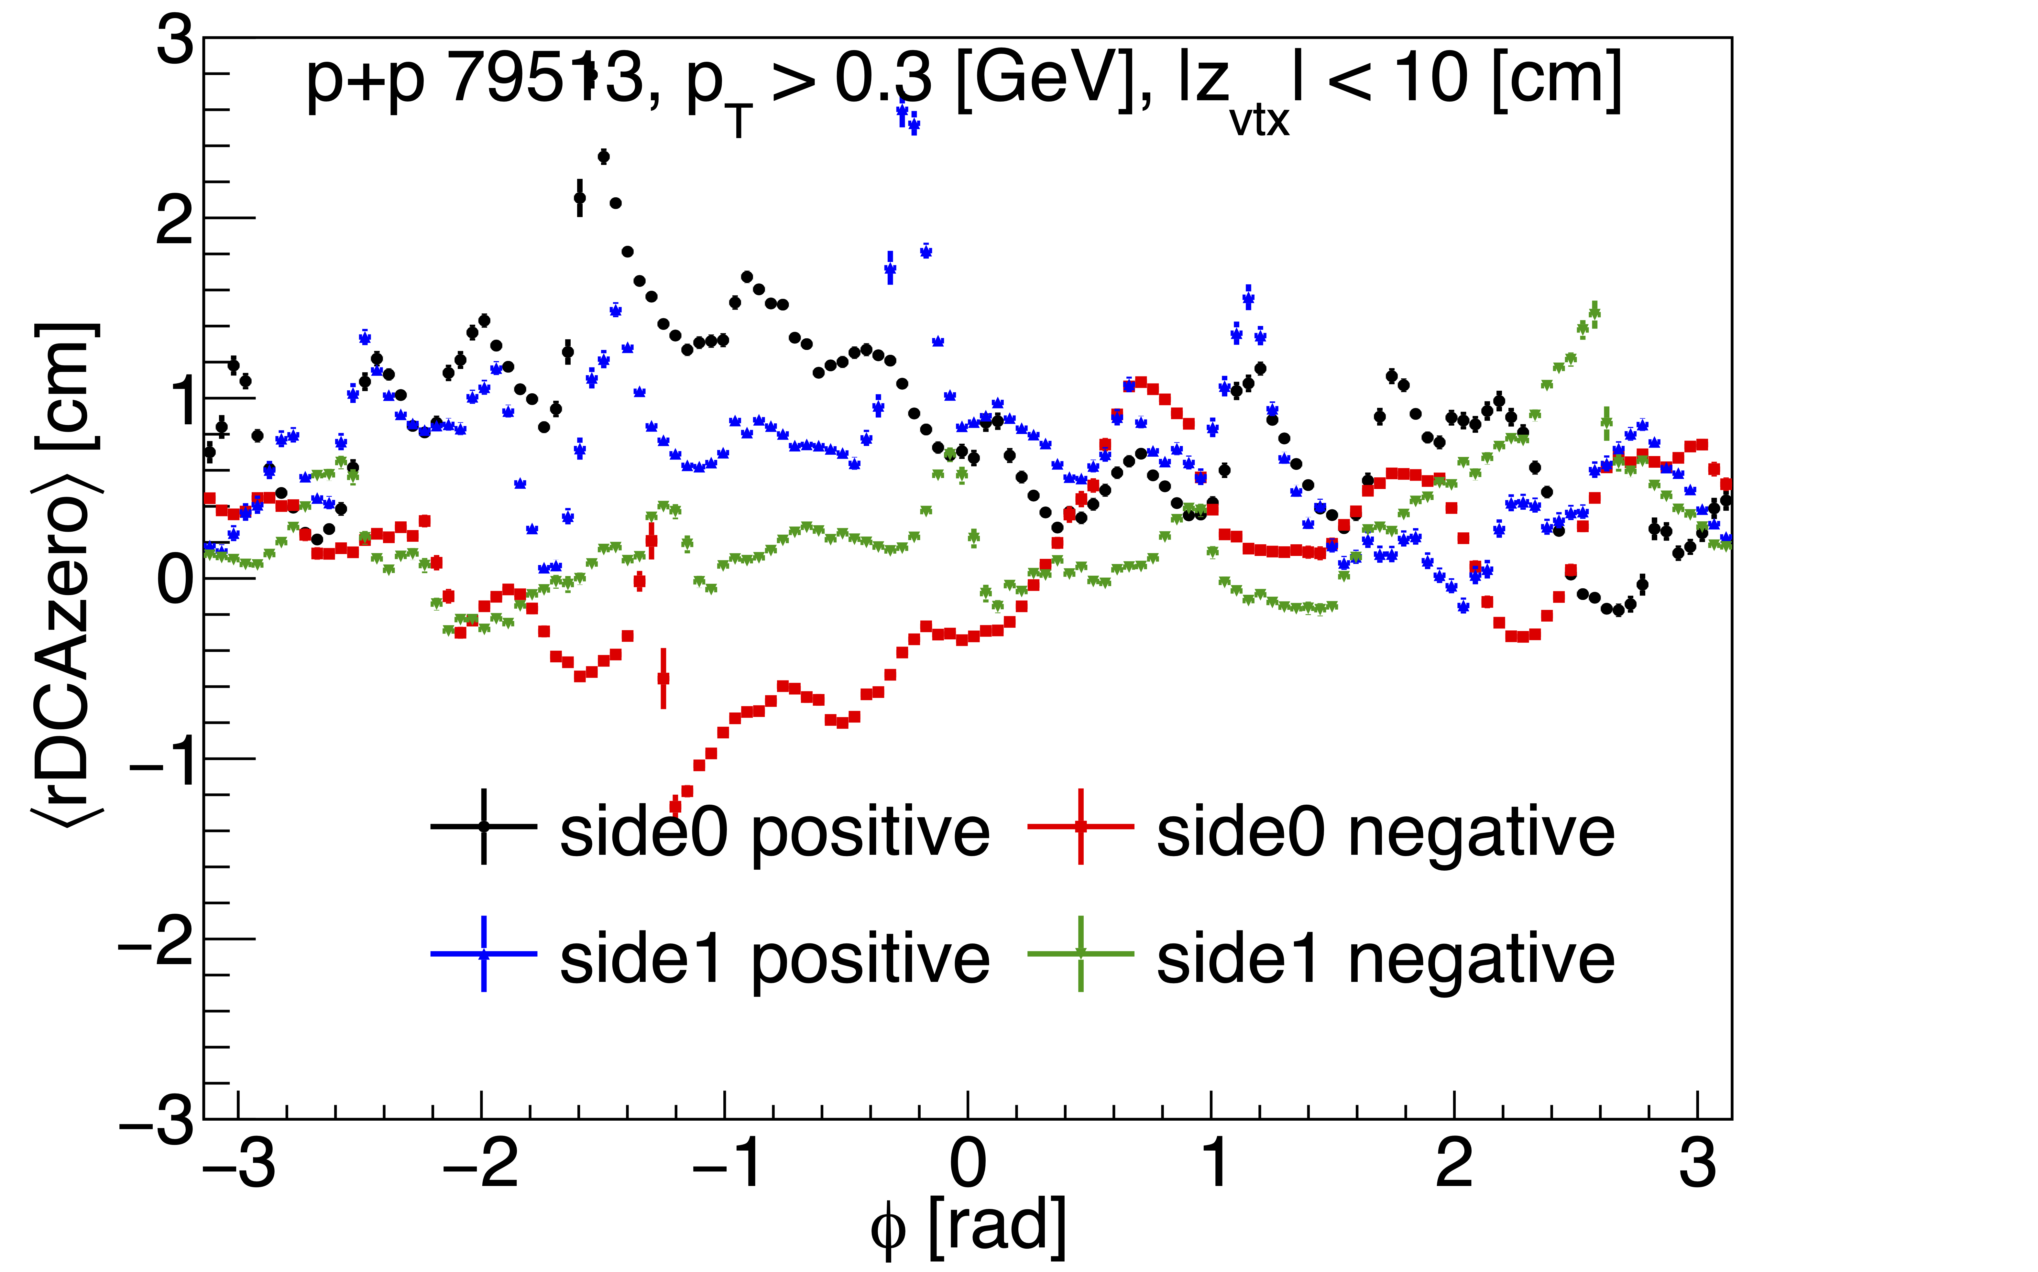
After SC 1st order correction
Demonstrates reasonable “tuning”
O+O
p+p

Slide 17
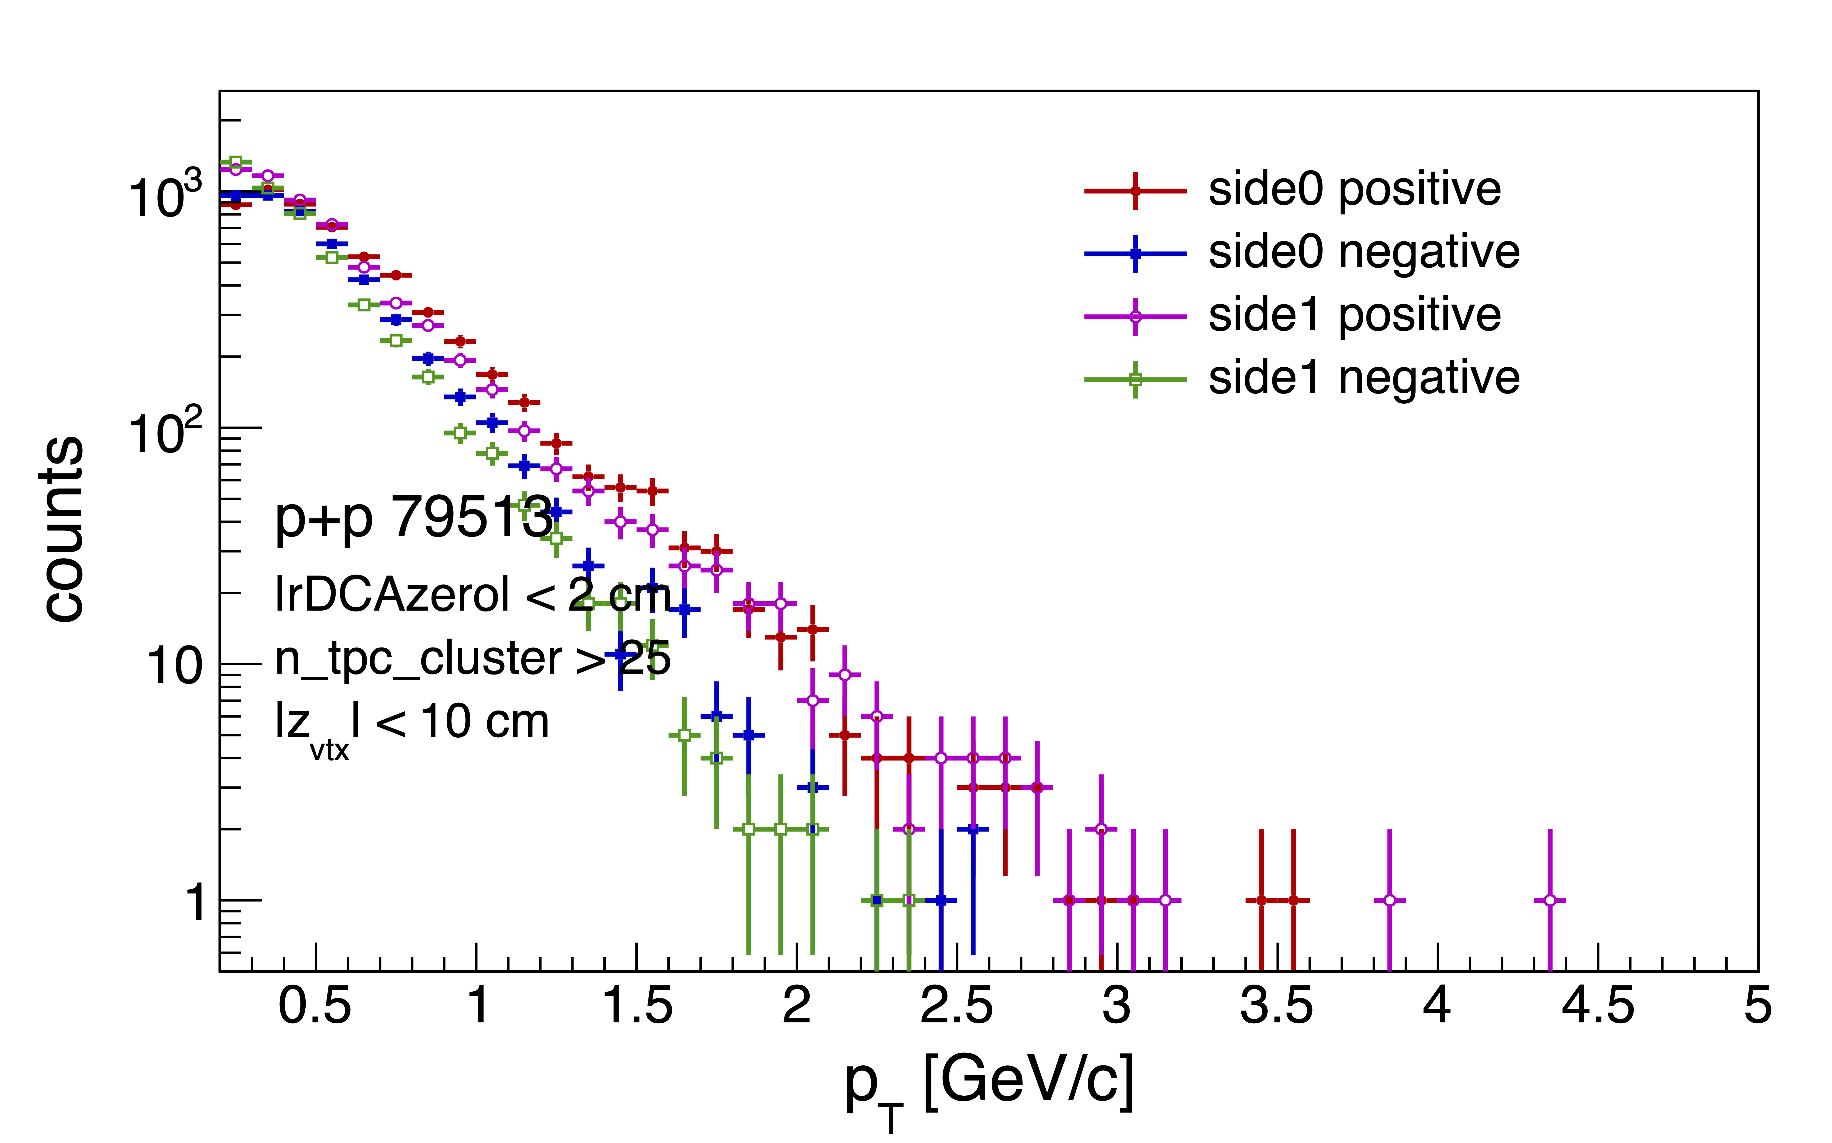
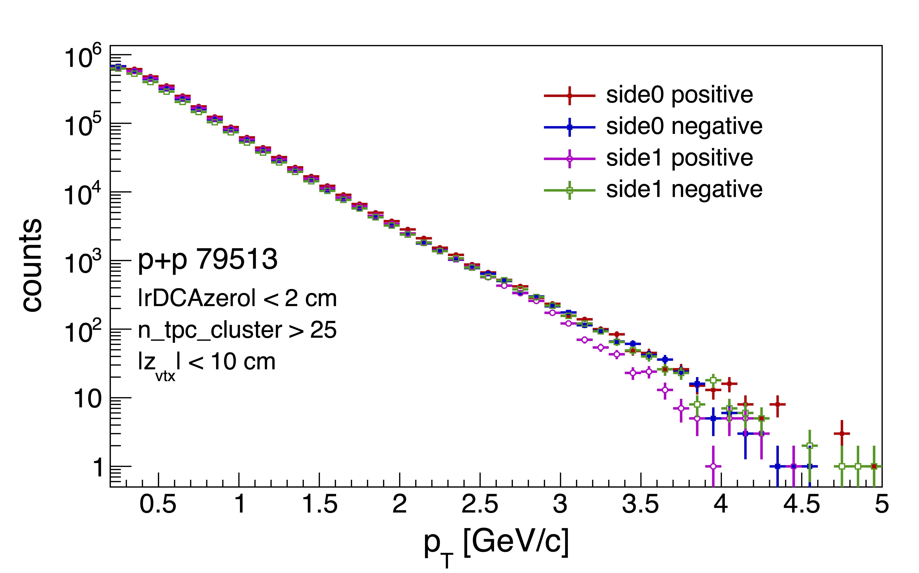
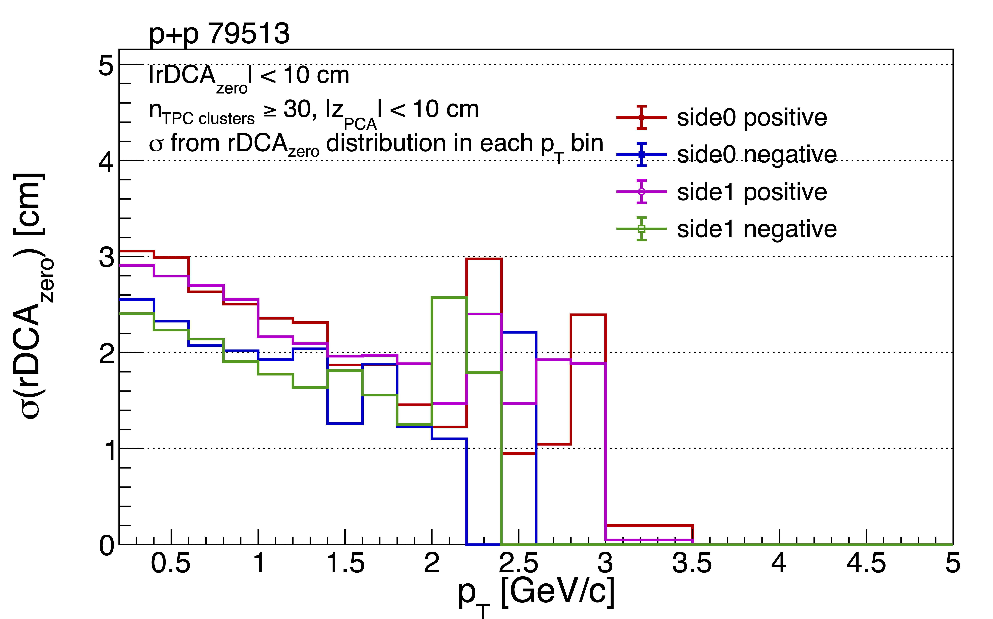
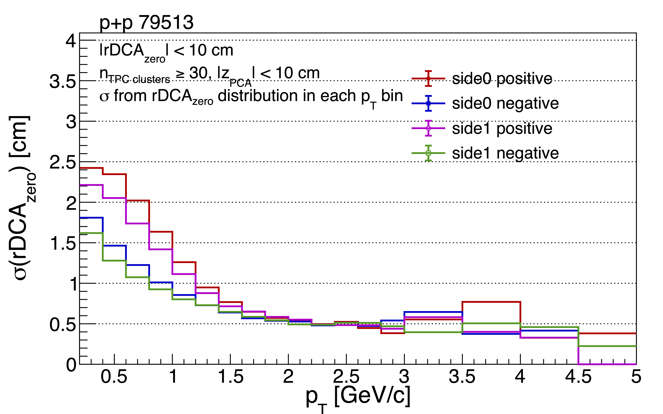
Momentum Spectra & DCA Before and after
p+p Before
p+p After
Non-physical
Differences
Excellent
Agreement
Larger
Smaller

Slide 18
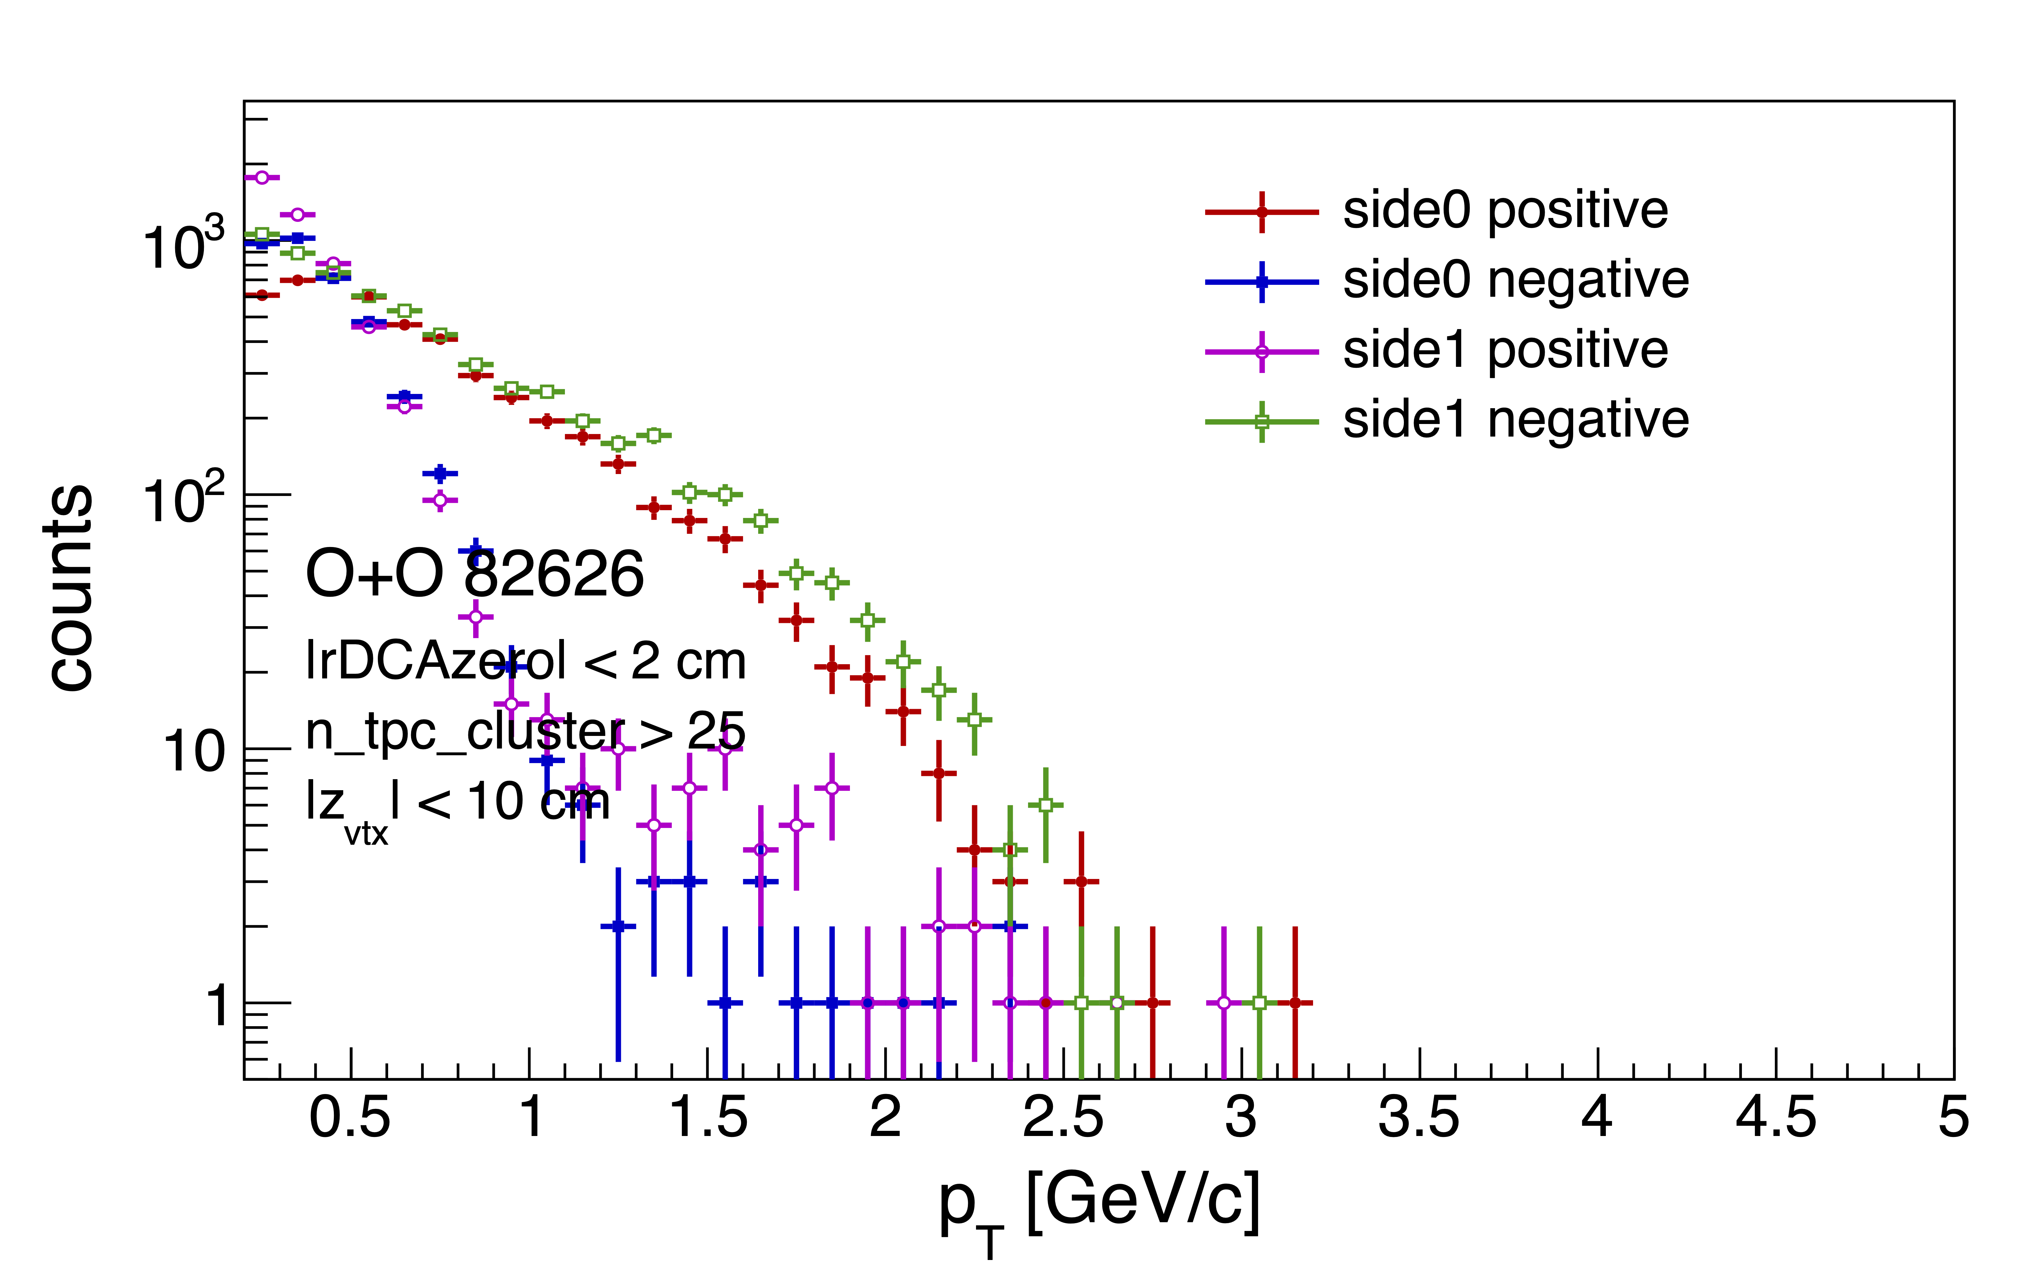
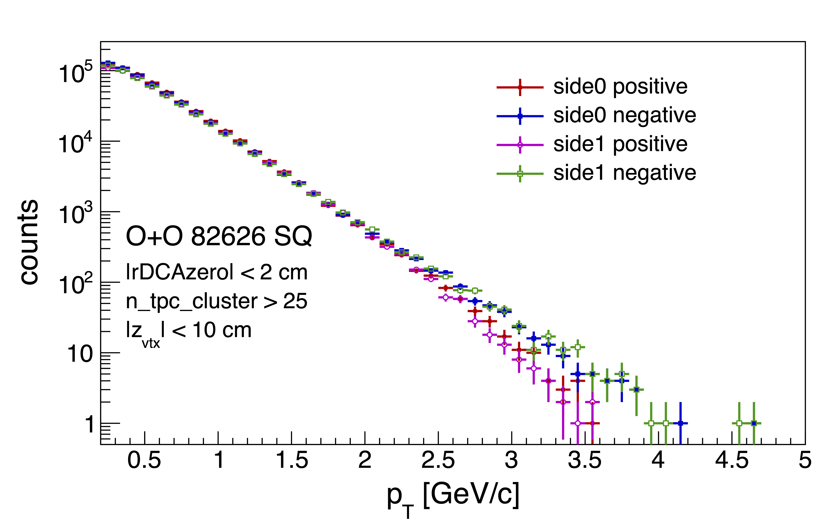
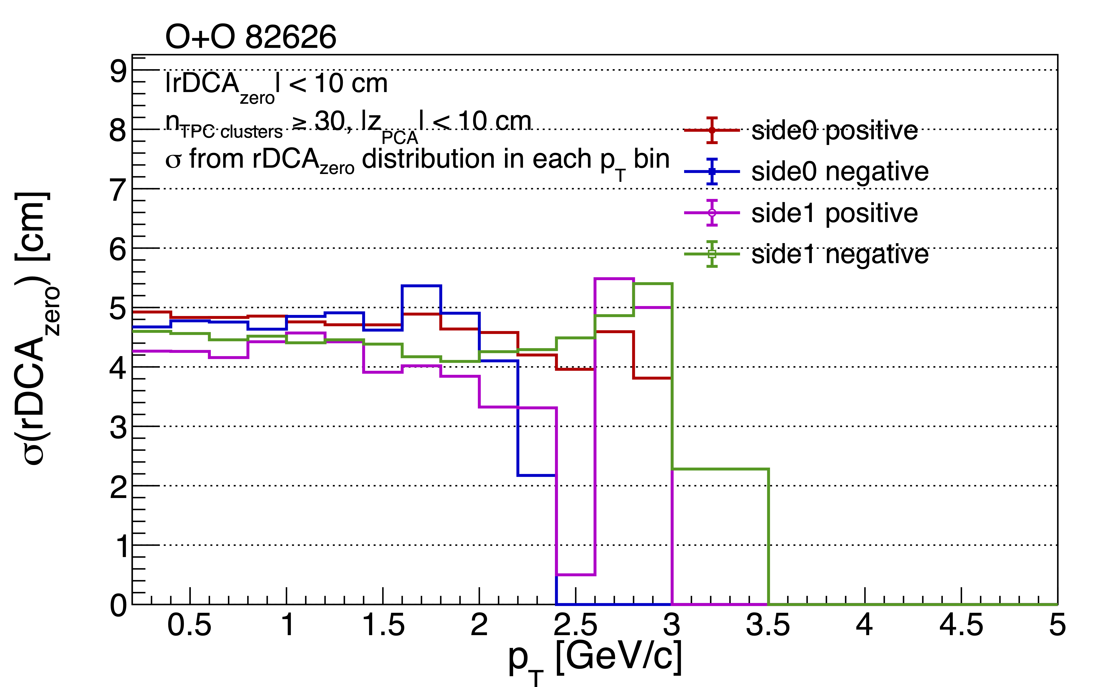
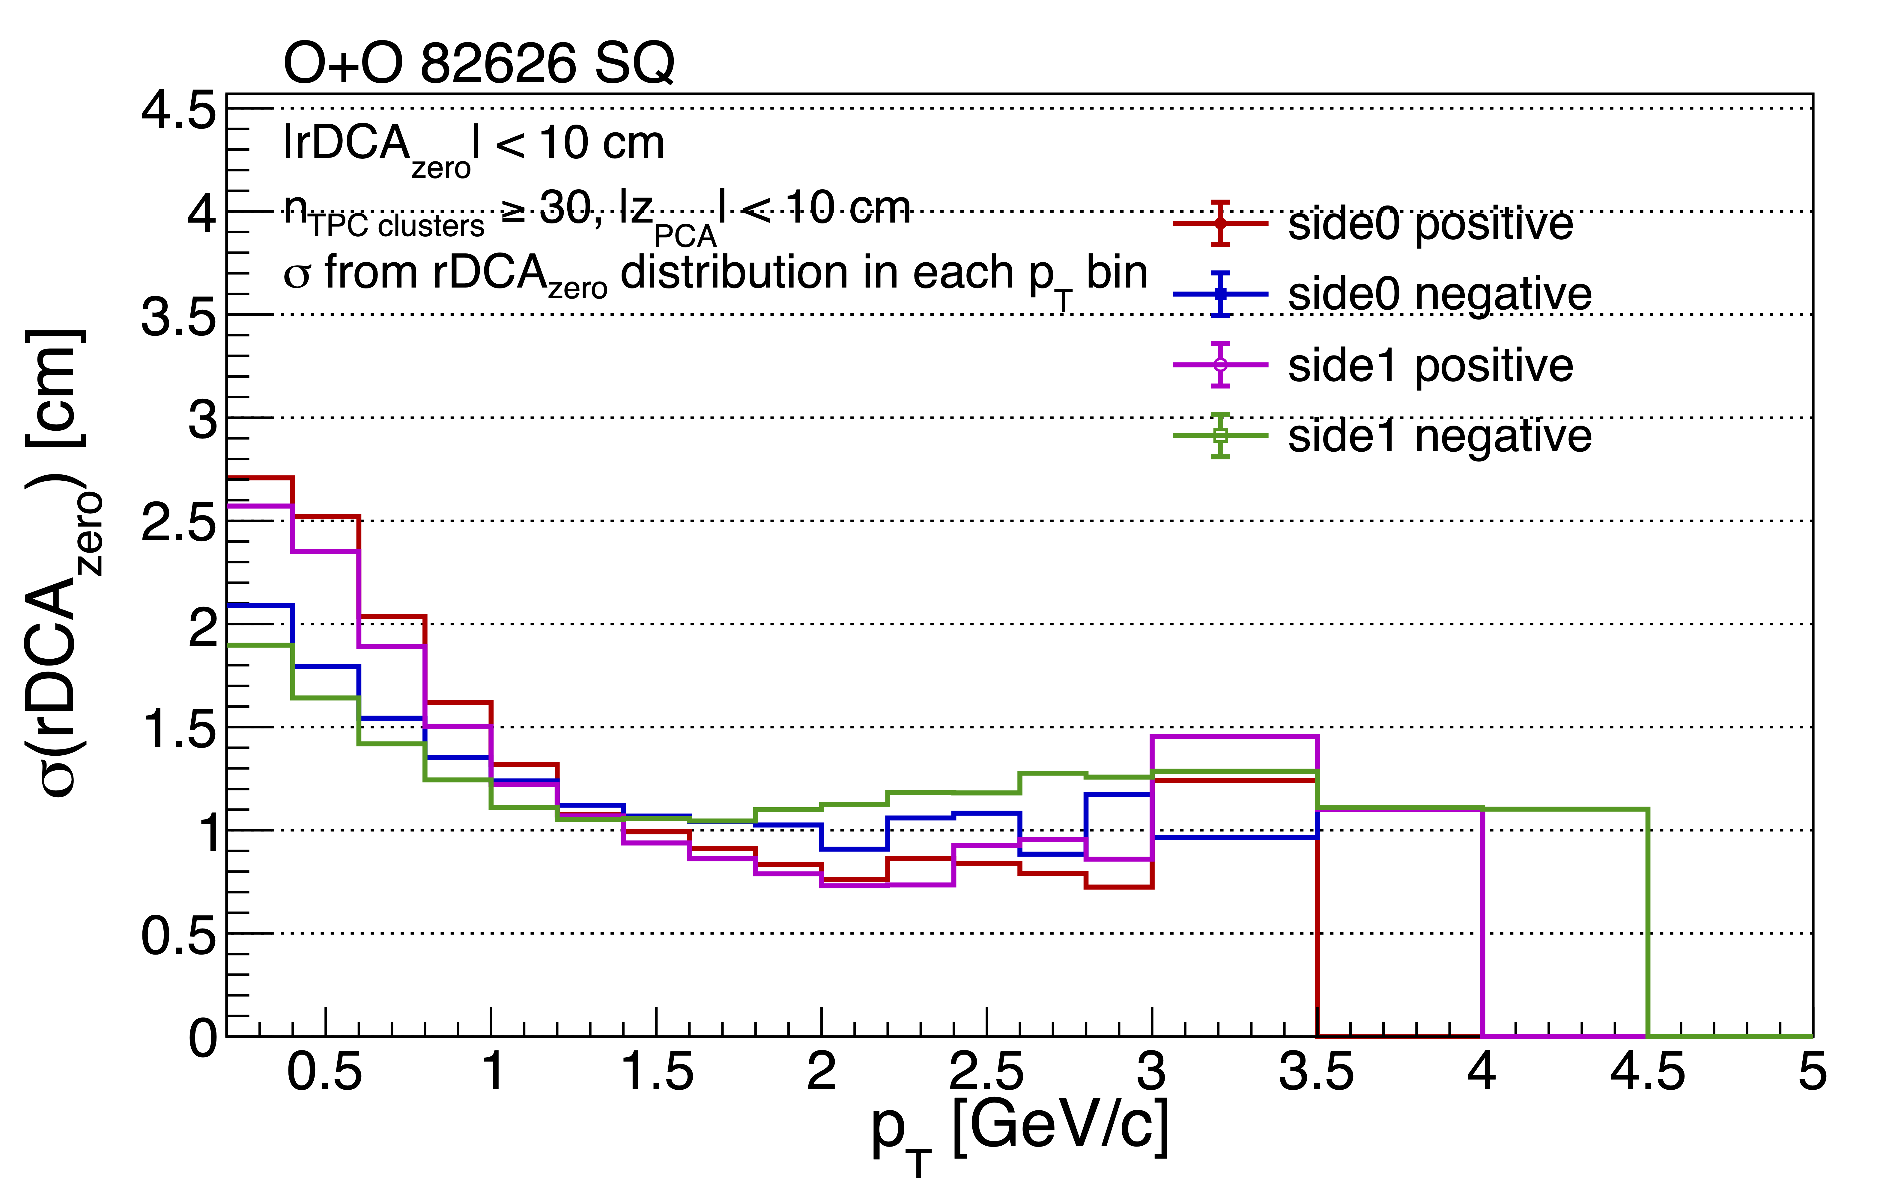
Before and after - rDCA
O+O Before
O+O After
Non-physical
Differences
Excellent
Agreement
Larger
Smaller

Slide 19
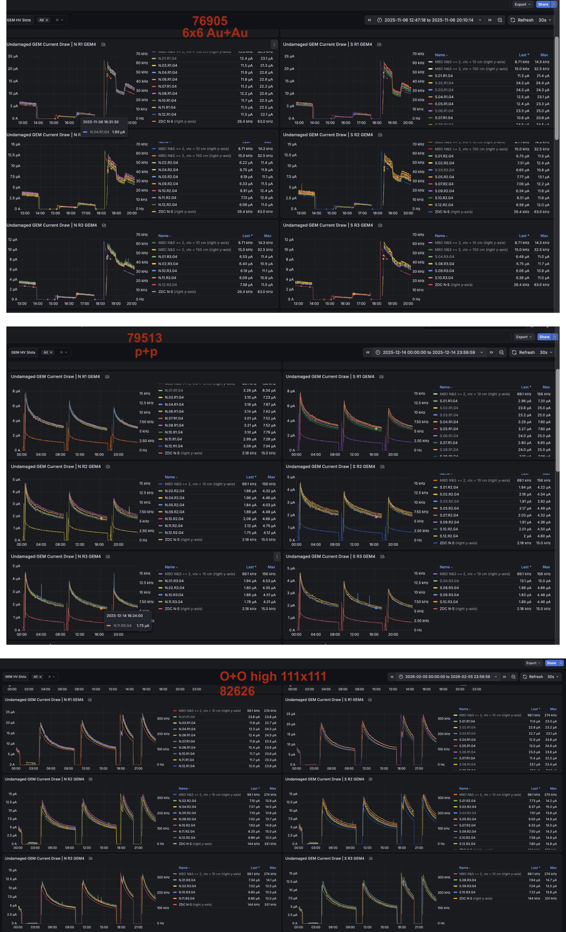
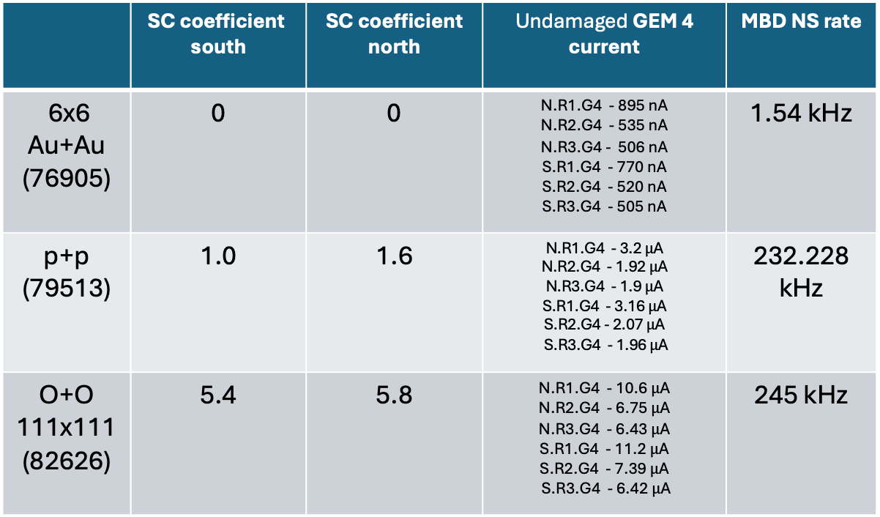
Electric field for Space charge coefficients
 | SC coefficient south | SC coefficient north | Undamaged GEM 4 current | MBD NS rate
6x6 Au+Au (76905) | 0 | 0 | N.R1.G4 - 895 nA N.R2.G4 - 535 nA N.R3.G4 - 506 nA S.R1.G4 - 770 nA S.R2.G4 - 520 nA S.R3.G4 - 505 nA | 1.54 kHz
p+p (79513) | 1.0 | 1.6 | N.R1.G4 - 3.2 $μ$A N.R2.G4 - 1.92 $μ$A N.R3.G4 - 1.9 $μ$A S.R1.G4 - 3.16 $μ$A S.R2.G4 - 2.07 $μ$A S.R3.G4 - 1.96 $μ$A | 232.228 kHz
O+O 111x111 (82626) | 5.4 | 5.8 | N.R1.G4 - 10.6 $μ$A N.R2.G4 - 6.75 $μ$A N.R3.G4 - 6.43 $μ$A S.R1.G4 - 11.2 $μ$A S.R2.G4 - 7.39 $μ$A S.R3.G4 - 6.42 $μ$A | 245 kHz
One of the smallest load runs
One of the largest load runs
NOTE: “Normal” S.C. density estimated by AI for this run.

Slide 20
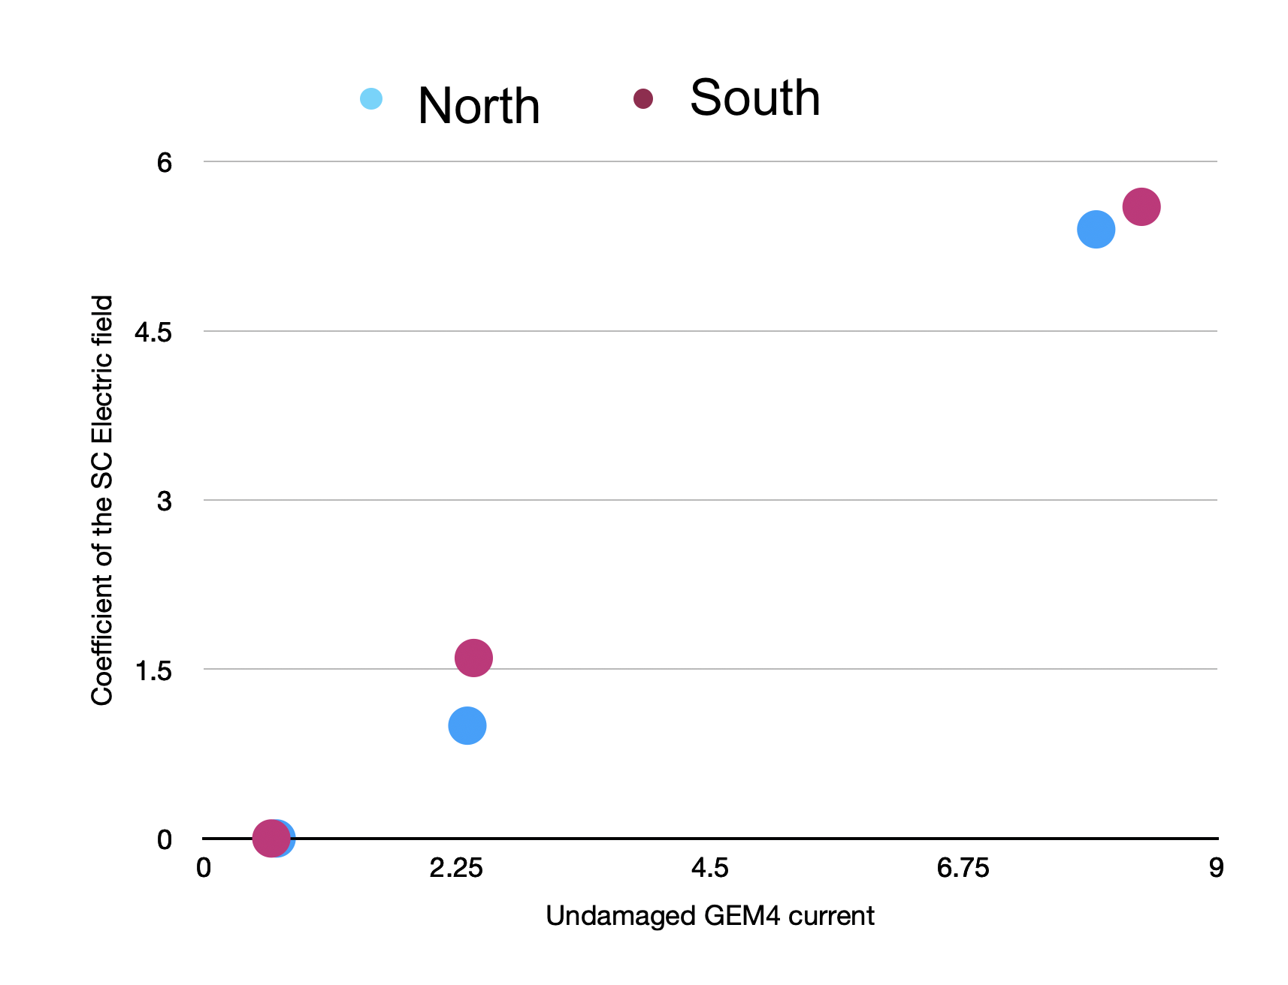
Electric field for Space charge coefficients
 | SC coefficient south | SC coefficient north | Undamaged GEM 4 current | MBD NS rate
6x6 Au+Au (76905) | 0 | 0 | N.R1.G4 - 895 nA N.R2.G4 - 535 nA N.R3.G4 - 506 nA S.R1.G4 - 770 nA S.R2.G4 - 520 nA S.R3.G4 - 505 nA | 1.54 kHz
p+p (79513) | 1.0 | 1.6 | N.R1.G4 - 3.2 $μ$A N.R2.G4 - 1.92 $μ$A N.R3.G4 - 1.9 $μ$A S.R1.G4 - 3.16 $μ$A S.R2.G4 - 2.07 $μ$A S.R3.G4 - 1.96 $μ$A | 232.228 kHz
O+O 111x111 (82626) | 5.4 | 5.8 | N.R1.G4 - 10.6 $μ$A N.R2.G4 - 6.75 $μ$A N.R3.G4 - 6.43 $μ$A S.R1.G4 - 11.2 $μ$A S.R2.G4 - 7.39 $μ$A S.R3.G4 - 6.42 $μ$A | 245 kHz
One of the smallest load runs
One of the largest load runs

Slide 21
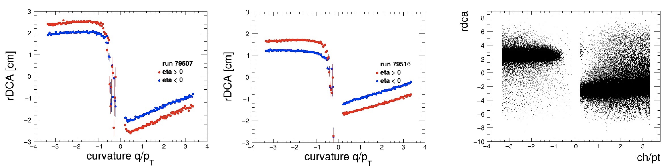
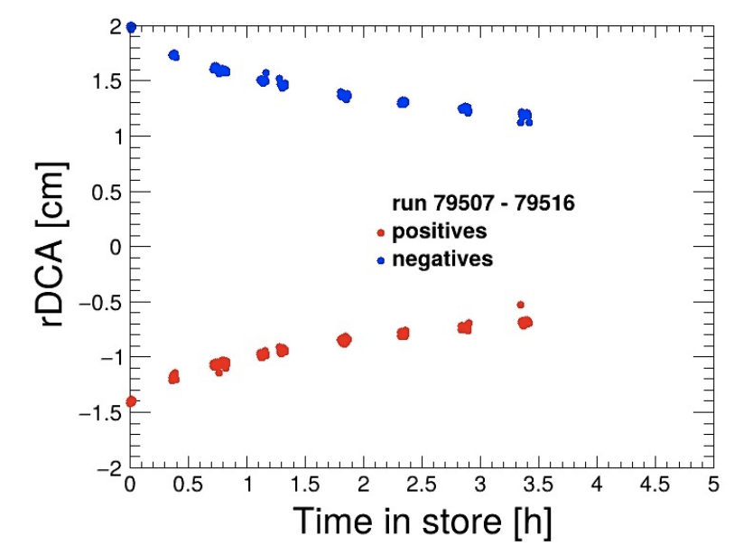

rDCA vs $q/p_{T}$
Standard tracking
TPC SA tracking

Slide 22




rDCA vs $φ$

Slide 23






$rΔφ$ Residuals
Cluster $φ$ vs $Layer$
Standard tracking: All distortion corrections
Standard tracking: No distortion corrections
TPC SA tracking: Magnetic field + Electric field

Slide 24







$Δz$ Residuals
Cluster $φ$ vs $z_{signed}$
Standard tracking: All distortion corrections
Standard tracking: No distortion corrections
TPC SA tracking: Magnetic field + Electric field

Slide 25




$rΔφ$ Residuals divided by side and charge
Standard tracking: All distortion corrections
Standard tracking: No distortion corrections
charge>0
Charge<0
South side 0
TPC SA tracking: Magnetic field + Electric field
North side 1

Slide 26




$Δz$ Residuals
Divided by side
Standard tracking: All distortion corrections
South side 0
North side 1
Standard tracking: No distortion corrections
South side 0
North side 1
TPC SA tracking: Magnetic field + Electric field
South side 0
North side 1

Slide 27





$dE/dx$
(no gain corrections)
79516
79513
p+p run 79513
O+O run 82626
Integrated over phi

Slide 28


$dE/dx$ charge assymetry
Within one sector

Slide 29





$π+K$ combined spectra using dE/dx PID
Standard tracking
TPC SA tracking

Slide 30






$K_{S}^{0}$ reconstruction
~At
PDG Mass
LF PPG16
https://sphenix-invenio.sdcc.bnl.gov/records/jx2cm-11v07
NOTE: Without Silicon Vertexing, there is increased combinatorial
Different versions
Below PDG Mass
25k minbias p+p 79516 run
(only ~ zero crossing)

Slide 31




$K_{S}^{0}$ reconstruction
LF PPG16
https://sphenix-invenio.sdcc.bnl.gov/records/jx2cm-11v07
Different versions
25k minbias p+p 79516 run
(only ~ zero crossing)

Slide 32





$K_{S}^{0}$ reconstruction Au+Au and O+O
with loose and tighter cuts

Slide 33



Event Displays
Internal TPC Tracks are a small bit more numerous reflecting the “loose criterion” necessary for this analysis.
6x6 Au+Au $pcaz<20$ cm
Standard tracking
TPC SA tracking
$$N_{ch}=358$$
$$N_{ch}=450$$

Slide 34

Track double counting check
No evidence of double-counting.

Slide 35
Request(s)
A pull request is ready and we would appreciate review by the tracking experts.
We would like for Mariia to present this analysis (these slides or slightly modified) at the local detector calibration meeting tomorrow.
  Since it is “TPC Internal” is seems appropriate.
We would like to develop the smooth interface plan to couple this workflow into the standard tracking.
  This will require a pre-pass to calibrate the space charge factor(s).
  This will require that these results transfer information to ACTs smoothly.
  This will require advice from you and other experts.
We would like to continue this development beyond first order to see how much of the distortion issue can be handled in this manner.
  Ross is presently working on a “sum over ARCs” style approach.
  Existing Digital Current work will meld smoothly into this effort.
  We anticipate that other things (like Bade’s work on TPOT) will benefit immediately.

Slide 36
Integration with Standard Tracking
The deliverable of the TPC SA tracking is TPC track or TPC seed
Knowing trajectories this output can be connected with other subsystems
We currently consider various options:
  ACTS states – intersections of the TPC track with ideal ACTS surfaces – 48 states
  ACTS point and vector – treat TPC track as a seed , provide point and vector of the seed at inner field cage and outer field cage + several additional points in-between, to keep it as a seed
  Whatever folks more familiar with ACTs think is best.

Slide 37
Conclusions
An independent TPC-internal reconstruction workflow has been demonstrated.
Multiple independent physics observables improve simultaneously.
First-order space charge already explains much of the observed behavior.
We believe the TPC should provide higher-level objects (tracks or seeds) to the global reconstruction.
We look forward to working with the tracking experts to determine the optimal ACTS interface.
"Our objective is not to replace the existing reconstruction, but to strengthen it by moving detector-specific tracking into the detector, where the relevant transport physics naturally resides."

Slide 38
Speed p+p
TPC SA Tracking
Next step – working on code efficiency
-------------------------------------- ** --------------------------------------
Tpc_ModuleTrackReco_TOP: per event time (ms): 270.625
-------------------------------------- ** --------------------------------------
Tpc_AssembledTrackReco_TOP: per event time (ms): 364.996
-------------------------------------- ** --------------------------------------
Tpc_PolyClusterizer_TOP: per event time (ms): 14402.7
-------------------------------------- ** --------------------------------------
Tpc_PolyTrackReco_TOP: per event time (ms): 0.971917
-------------------------------------- ** --------------------------------------
Tpc_PolyTrackVertexer_TOP: per event time (ms): 0.139726
-------------------------------------- ** --------------------------------------
Known inefficiency, easy to improve, expected improvement ~10 times

Slide 39
Speed p+p
Standard Tracking
-------------------------------------- ** --------------------------------------
PHActsTrkFitter_TOP: per event time (ms): 936.499
-------------------------------------- ** --------------------------------------
PHCASeeding_TOP: per event time (ms): 80.4181
-------------------------------------- ** --------------------------------------
PHSimpleKFProp_TOP: per event time (ms): 818.815
-------------------------------------- ** --------------------------------------
PHSimpleVertexFinder_TOP: per event time (ms): 0.401757
-------------------------------------- ** --------------------------------------
PHTpcDeltaZCorrection_TOP: per event time (ms): 27.0994
-------------------------------------- ** --------------------------------------
PrelimDistortionCorrection_TOP: per event time (ms): 113.907
-------------------------------------- ** --------------------------------------
TpcClusterizer_TOP: per event time (ms): 48.5728

Slide 40
Speed Au+Au 6x6 1mrad
TPC SA Tracking
-------------------------------------- ** --------------------------------------
Tpc_ModuleTrackReco_TOP: per event time (ms): 1507.57
-------------------------------------- ** --------------------------------------
Tpc_AssembledTrackReco_TOP: per event time (ms): 1989.08
-------------------------------------- ** --------------------------------------
Tpc_PolyClusterizer_TOP: per event time (ms): 29938.8
-------------------------------------- ** --------------------------------------
Tpc_PolyTrackReco_TOP: per event time (ms): 12.2172
-------------------------------------- ** --------------------------------------
Tpc_PolyTrackVertexer_TOP: per event time (ms): 1.54954
-------------------------------------- ** --------------------------------------

Slide 41
Speed O+O 111x111
TPC SA Tracking
-------------------------------------- ** --------------------------------------
Tpc_ModuleTrackReco_TOP: per event time (ms): 1695.11
-------------------------------------- ** --------------------------------------
Tpc_AssembledTrackReco_TOP: per event time (ms): 1989.08
-------------------------------------- ** --------------------------------------
Tpc_PolyClusterizer_TOP: per event time (ms): 35009.7
-------------------------------------- ** --------------------------------------
Tpc_PolyTrackReco_TOP: per event time (ms): 10.3582
-------------------------------------- ** --------------------------------------
Tpc_PolyTrackVertexer_TOP: per event time (ms): 1.65706
-------------------------------------- ** --------------------------------------

Slide 42

Recognition
Chenxi Ma – extensive work on Fitting procedure and $K_{S}^{0}$ reconstruction
Yuri Mitrankov – SC Electric field tuning, $K_{S}^{0}$ reconstruction, and plots
Chenliang Jin - $π+K$ combined spectra
Luke Legnoski – $dE/dx$ plots and gain normalization (not implemented yet)

Slide 43
Backup

Slide 44


Arementeros-Podolanski plot
Maybe will do with like sign bg subtracktion if there will be enough time…
Kshort and lambda bands are seen with TPC SA
Conversions appear at 0

Slide 45





Slide 46




Slide 47



SC Electric field. Additional plots
Rossegger Green function and kernels

Slide 48

dEdx O+O
Au+Au run 76905 (6x6, 1mrad)

Slide 49








$K_{S}^{0}$ reconstruction cuts

Slide 50







$K_{S}^{0}$ reconstruction cuts

Slide 51


Store 79506 - 79516. $MBD NS$ Start - 348.314 kHz, End - 196.586 kHz
Run 79513. $MBD NS$ 232.228 kHz

Slide 52
AI usage disclosure
Codex was used

